Slide 1

Flavor Planet App Development
Techconsulting

Slide 2
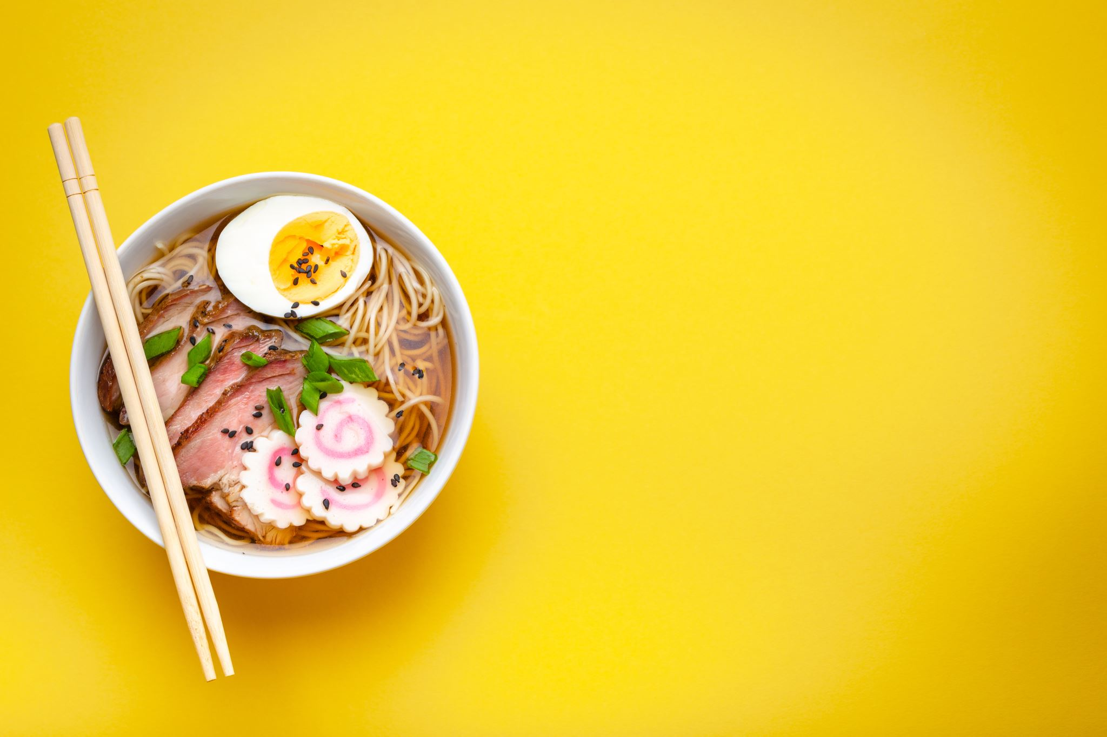
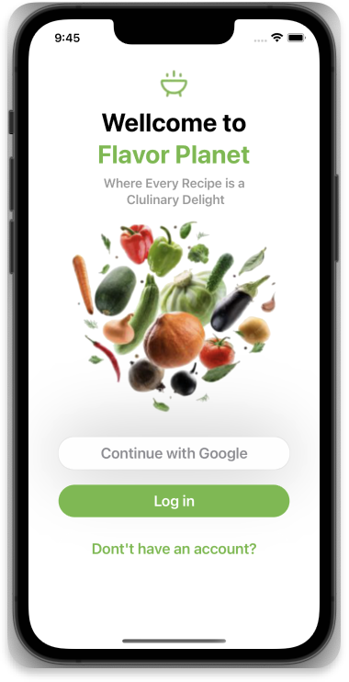
Introduction
App designed to explore recipes based on categories like:
Beef
Vegan
Pasta
etc.

Slide 3
Product Overview
Offers seamless recipe search and exploration.
Inspired by a user-friendly UI design.
Strategic Objectives
Enhance user engagement through recipe discovery.
Provide a user-friendly interface for easy navigation.
Consider monetization through premium features.

Slide 4
Key Elements
Architecture: MVVM-C for maintainability
Frameworks: Combine, SwiftUI, CoreData, KingFisher.
Design Patterns: Observer, Singleton, Async Await.

Slide 5
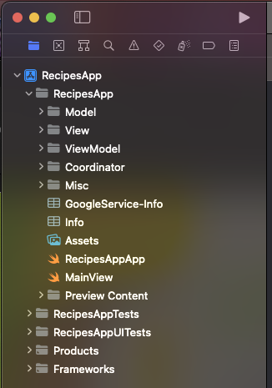
Architecture
Utilizes MVVM-C architecture for maintainable code.

Slide 6
Design Patterns
Singleton
Builder
Observer
Coordinator

Slide 7
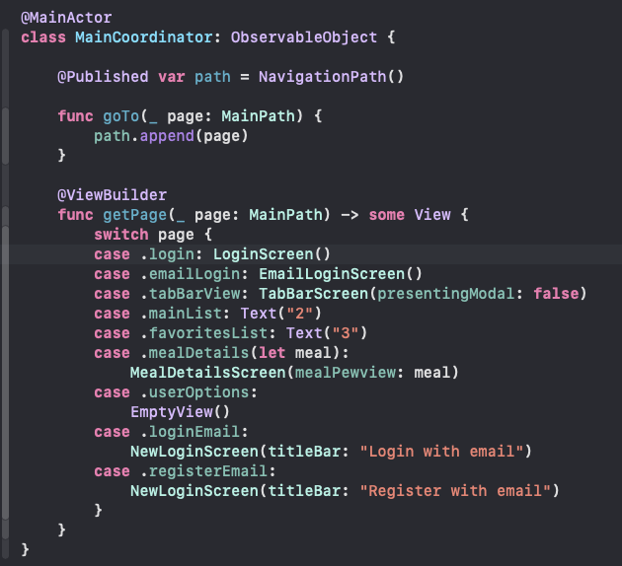
Coordinator
To enhance modularity and navigation.

Slide 8
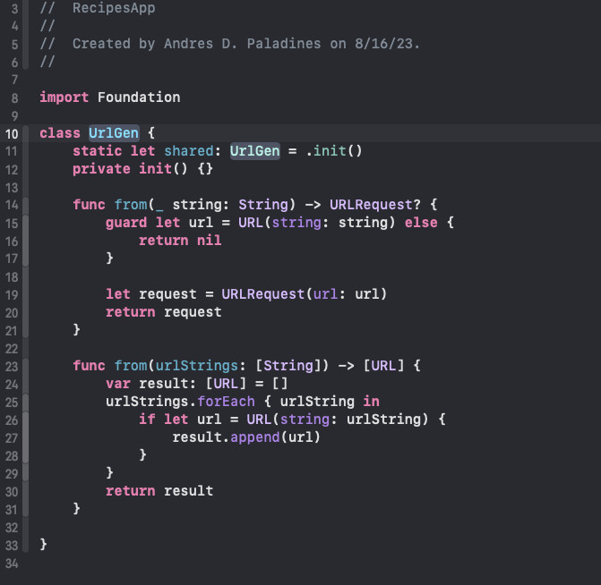
Singleton
Utilizes MVVM-C architecture for maintainable code.

Slide 9
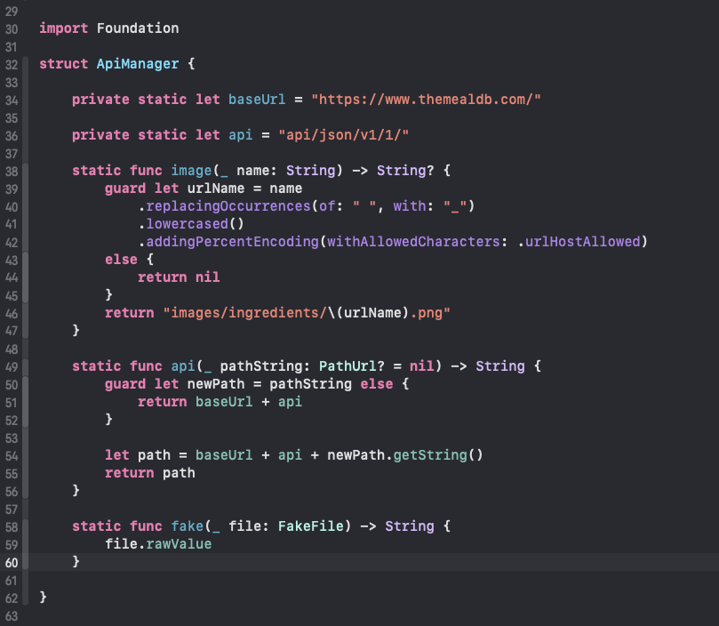
Builder
To generate appropriate URLs.

Slide 10
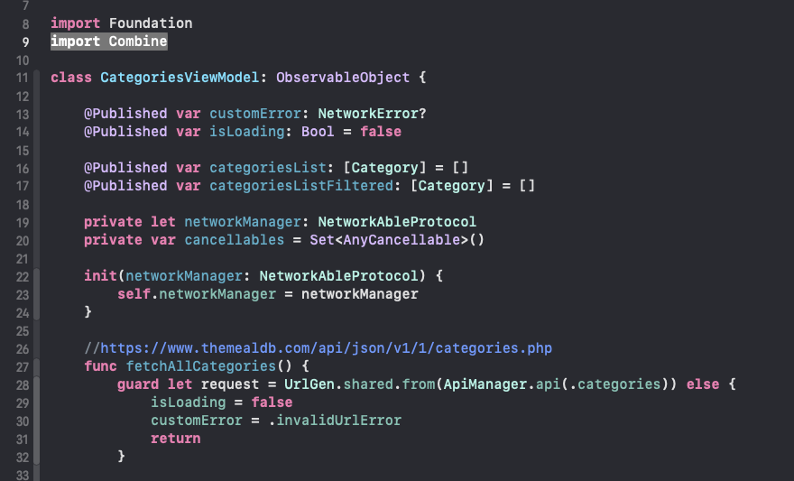
Observer
Used with combine and Observable Objects.

Slide 11
App Presentation

Slide 12
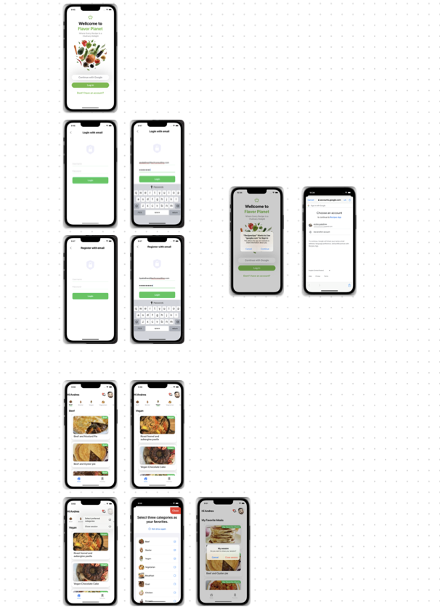
Screens

Slide 13
Login Options Screen
Screen to go to:
Register with email.
Login with email.
Login with Gmail

Slide 14
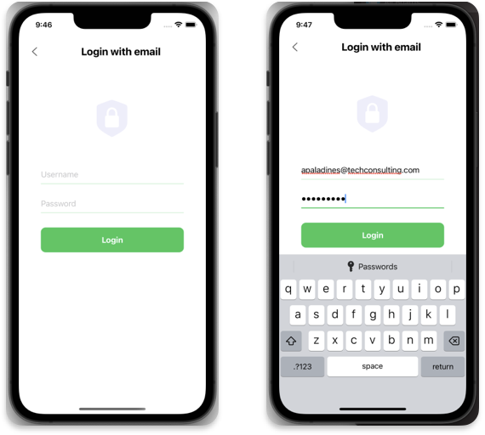
Login with email

Slide 15
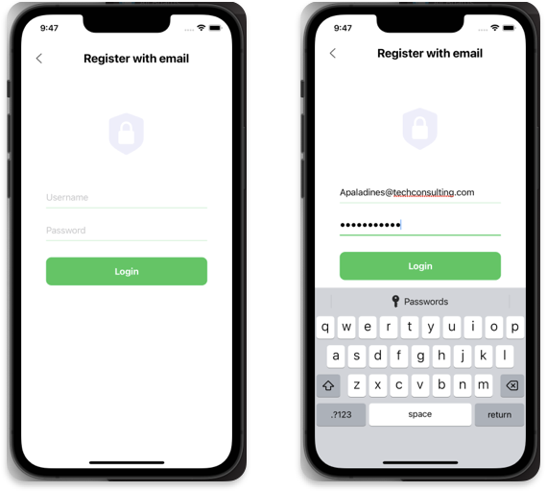
Register with email

Slide 16
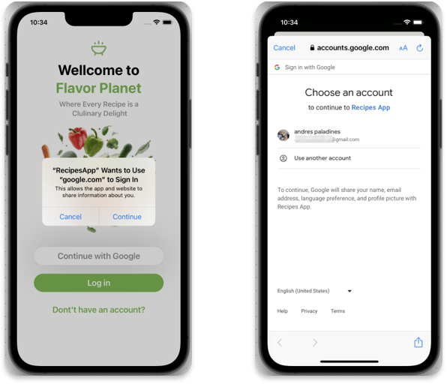
Login with Gmail

Slide 17
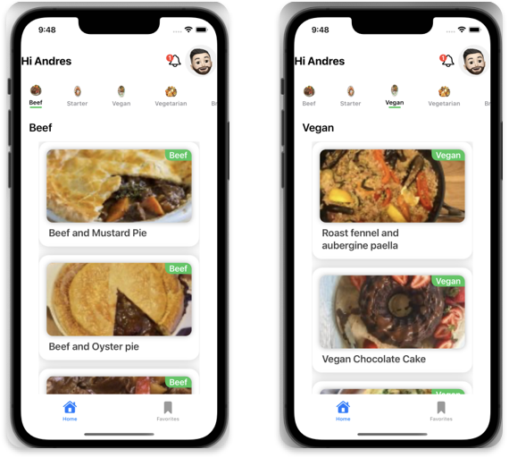
Main List Screen

Slide 18
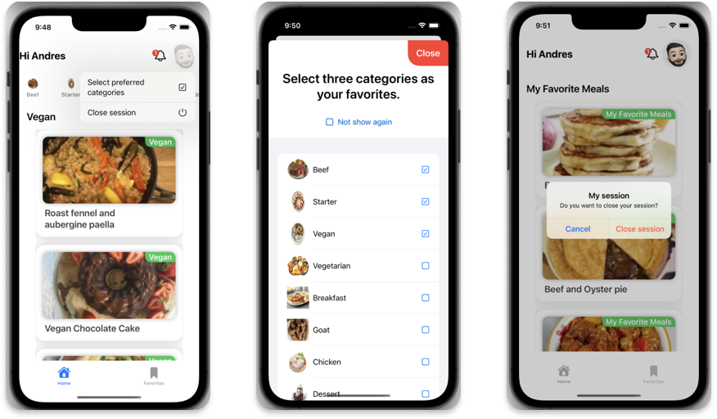
Main List Screen Options

Slide 19
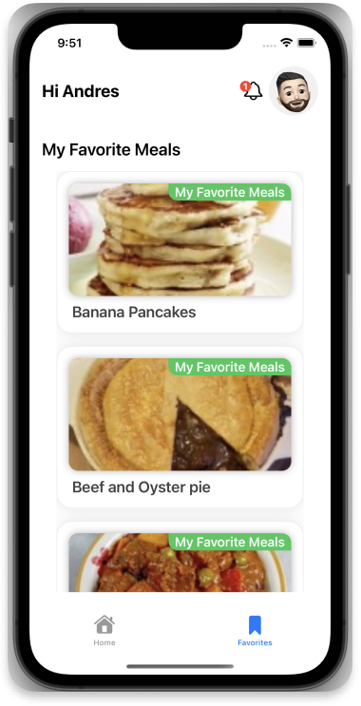
Favorites List Screen

Slide 20
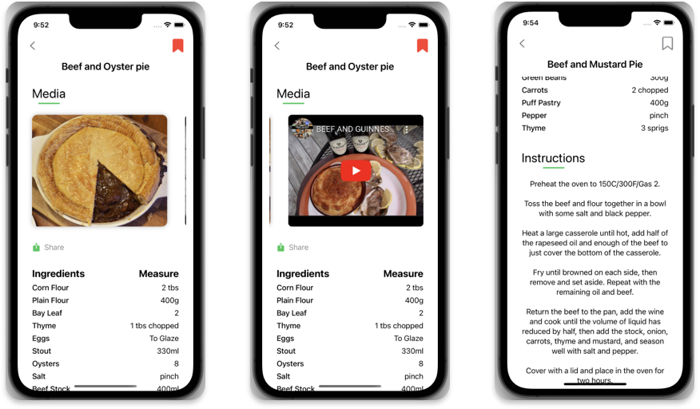
Meal Details Screen

Slide 21
Thanks

