Slide 1

Flavor Planet App Development
Techconsulting

Slide 2

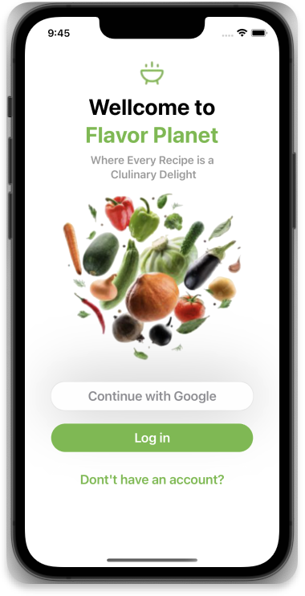
Introduction
Recipe app with:
Gmail login
email/password registration and login.
App designed to explore recipes based on categories like:
Beef
Vegan
Pasta
etc.

Slide 3
Product Overview
Offers seamless recipe search and exploration.
Features Gmail login and email/password registration.
Inspired by a user-friendly UI design.
Utilizes MVVM-C architecture for maintainable code.
Strategic Objectives
Enhance user engagement through recipe discovery.
Provide a user-friendly interface for easy navigation.
Consider monetization through premium features.

Slide 4
Key Elements
Architecture: MVVM-C for maintainability
Frameworks: Combine, SwiftUI, CoreData, KingFisher.
Design Patterns: Observer, Singleton, Async Await.

Slide 5
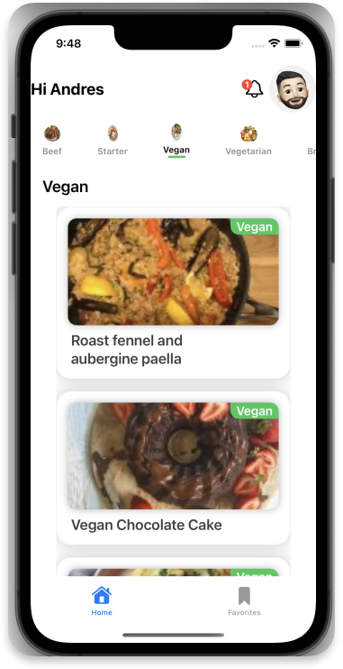
App Presentation

