Slide 1
TRANSFORMING LEARNING INTO AMAZING E-LEARNING EXPERIENCE

Slide 2
TEAM DETAILS
NAME | SEMESTER | ENROLLMENT NO. | NAME OF INSTITUTE
Abhishek Pipaliya | 6th | 18SOEIT11025 | RK University
Rutika Sorthiya | 6th | 18SOECE11059 | RK University
Darshan Vyas | 6th | 19SOEIT13004 | RK University
Vasu Mathukiya | 6th | 19SOEIT13801 | RK University

Slide 3

PROBLEM STATEMENT
How do you motivate students to embrace social learning and upgrade their knowledge?
Enabling employees to generate social learning content that delivers value for students.
Most commonly problem now days, How to attract the students for amazing e-learning?

Slide 4
Synchronous E-learning
Synchronous e-learning involves online studies through chat and videoconferencing. This kind of learning tool is real-time.
There is real interaction with other people
In this case, the courses are self-paced and can be completed at the convenience of the student.
The benefits of synchronous learning
Interaction between participants.
Exchange of knowledge and experience between participants.
Real-time feedback for the instructor.
Training happens on a fixed schedule.

Slide 5
Asynchronous E-Learning
Asynchronous e-learning refers to the opposite .The instructor, the learner, and other participants are not engaged in the learning process at the same time.
There is no real-time interaction with other people
The benefits of asynchronous learning
Participants can learn in their own time and schedule
Less work for trainers and faculty
Automated tasks reduce repetitive work such as giving online classes and grading exams

Slide 6
Advantages of E-learning
Online Learning Accommodates Everyone’s Needs
The online method of learning is best suited for everyone. This digital revolution has led to remarkable changes in how the content is accessed, consumed, discussed, and shared.
Online educational courses can be taken up by office goers and housewives too, at the time that suits them. Depending on their availability and comfort, many people choose to learn at weekends or evenings.
Lectures Can Be Taken Any Number Of Times
Unlike classroom teaching, with online learning you can access the content an unlimited number of times.
This is especially required at the time of revision when preparing for an exam.

Slide 7
Reduced Costs
e-Learning is cost effective as compared to traditional forms of learning. The reason for this price reduction is because learning through this mode happens quickly and easily.
A lot of training time is reduced with respect to trainers, travel, course materials, and accommodation.
This cost effectiveness also helps in enhancing the profitability of an organization.
Environmental Effects
Considering the present times, e-learning is an effective way to prevent a burden on the environment.
Traditional learning methods involve lots of paperwork. E-learning is a paperless form of learning that helps protect the environment.
A study revealed that the e-learning approach took up 90% less power and generated 85% fewer carbon emissions as compared to the traditional learning approach
Effectiveness
It results in improved scores on certifications, tests, or other types of evaluation.
Higher number of students who achieve ‘pass’ or mastery’ level.
Enhanced ability to learn and implement the new processes or knowledge at the workplace.
Help in retaining information for a longer time.

Slide 8
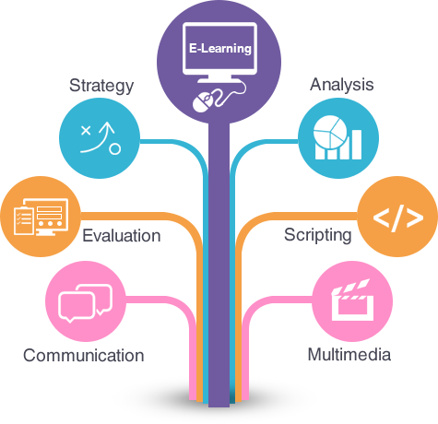

Slide 9
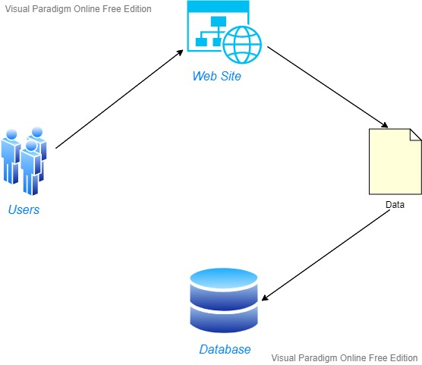
Overview of website

Slide 10
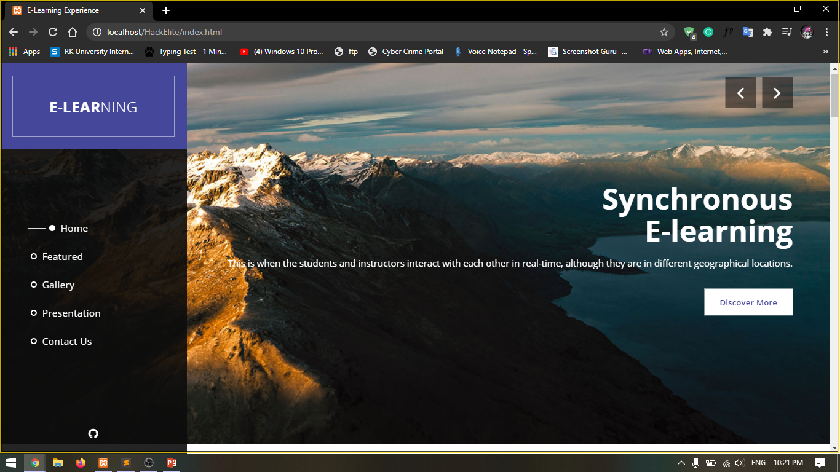

Slide 11
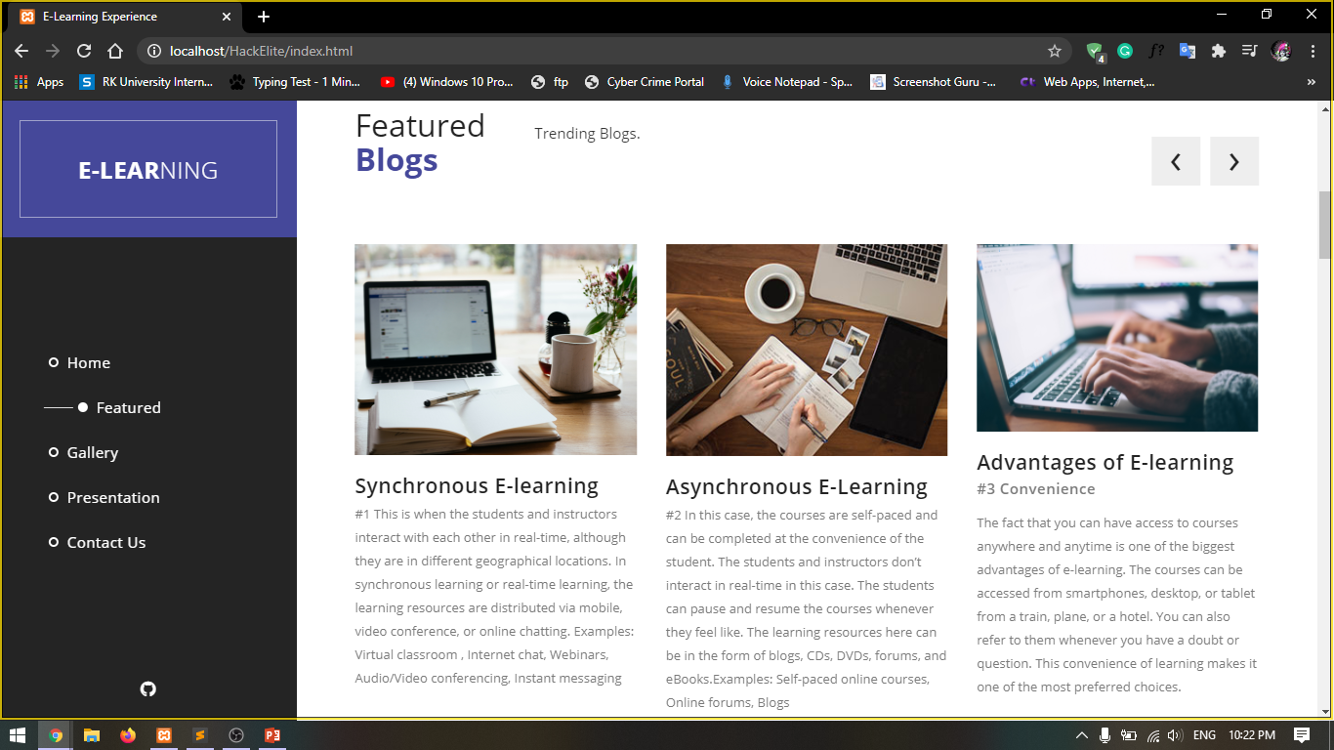

Slide 12
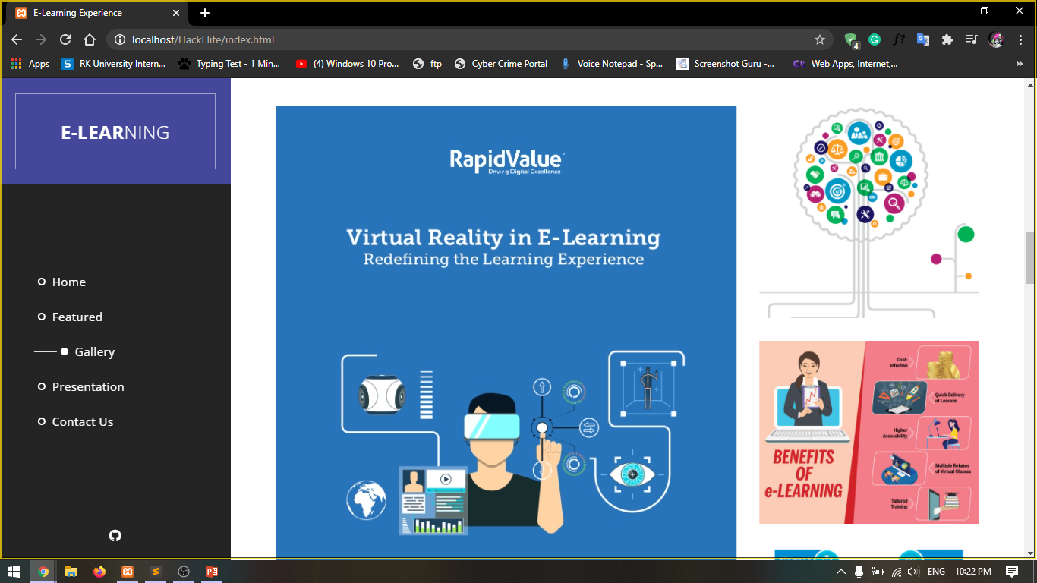

Slide 13


