Slide 1
2023-24 Data Overview
(Q2 - H1) NEW DELHI

Slide 2
Domestic Sales Performance
Q2 (July-Sept)
Category | 2018-19 | 2019-20 | 2020-21 | 2021-22 | 2022-23 | 2023-24 | CAGR %
Passenger Vehicle | 871 | 621 | 726 | 741 | 1,026 | 1,074 | 4.3%
Commercial Vehicle | 257 | 167 | 134 | 166 | 232 | 248 | -0.7%
Three-Wheeler | 193 | 181 | 47 | 71 | 120 | 195 | 0.3%
Two-Wheeler | 5,891 | 4,683 | 4,691 | 4,136 | 4,674 | 4,598 | -4.8%
H1 (Apr-Sept)
Category | 2018-19 | 2019-20 | 2020-21 | 2021-22 | 2022-23 | 2023-24 | CAGR %
Passenger Vehicle | 1,744 | 1,333 | 880 | 1,388 | 1,937 | 2,070 | 3.5%
Commercial Vehicle | 487 | 375 | 165 | 272 | 456 | 465 | -0.9%
Three-Wheeler | 354 | 331 | 59 | 95 | 197 | 340 | -0.8%
Two-Wheeler | 11,568 | 9,696 | 5,985 | 6,550 | 8,398 | 8,739 | -5.5%

Slide 3
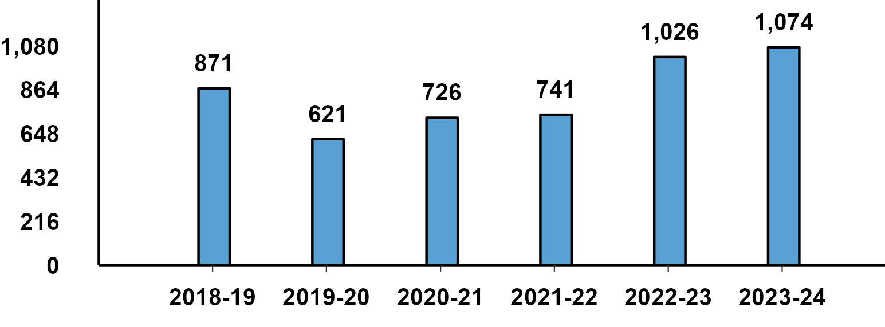
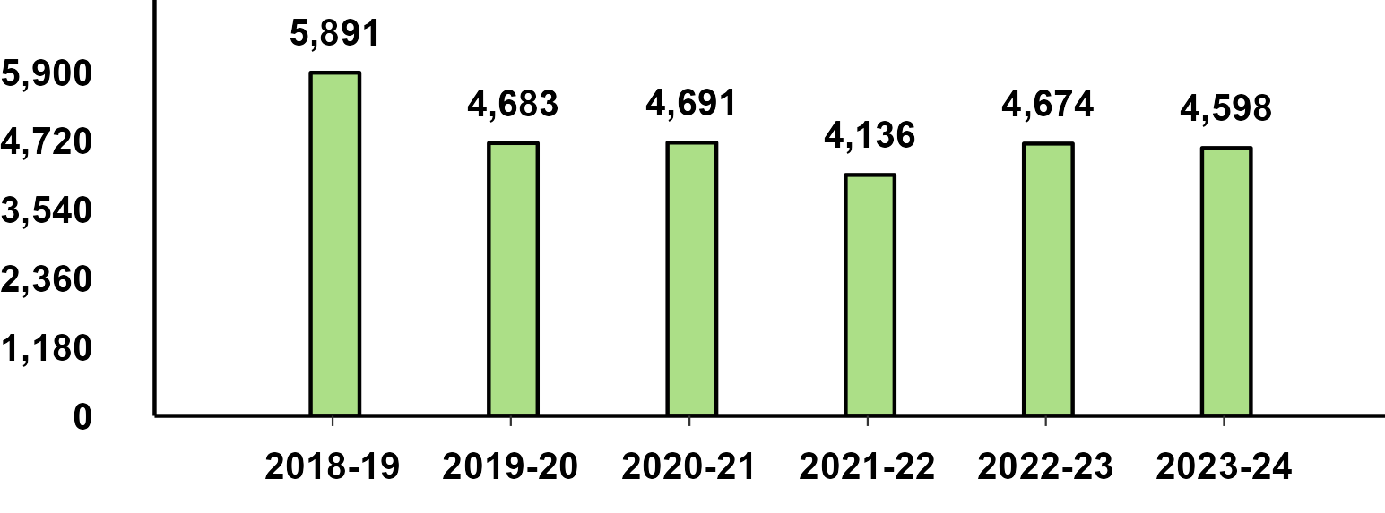
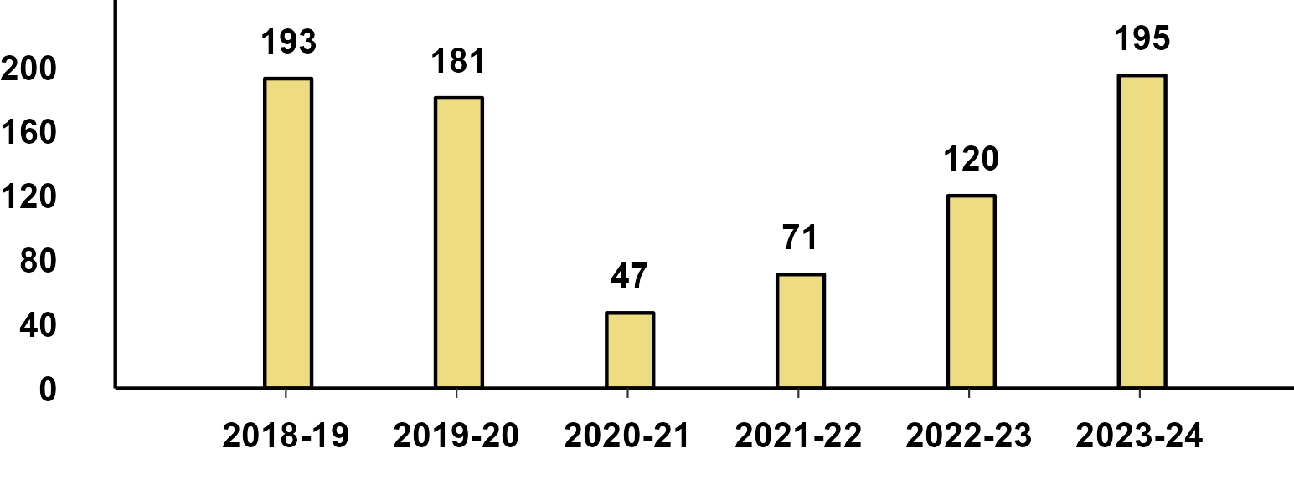
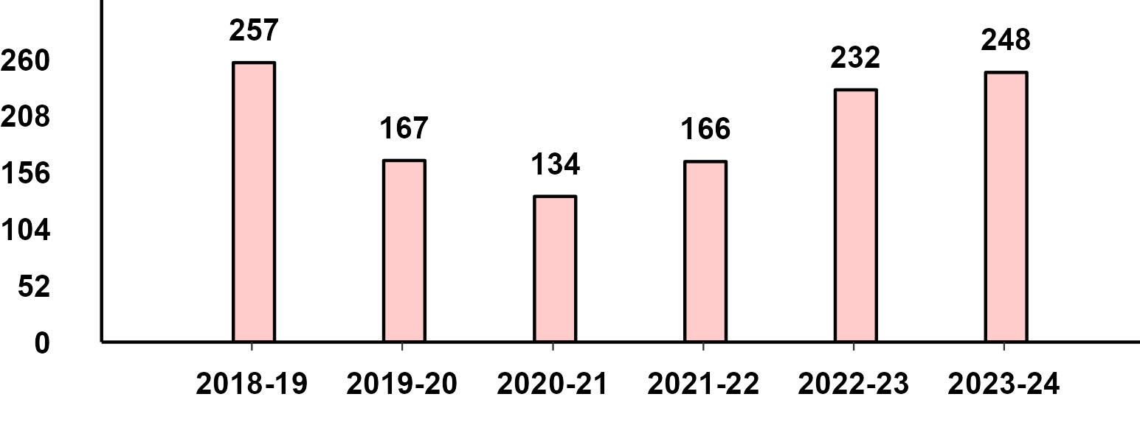
Domestic Sales - Q2(Jul-Sept) Performance
Passenger Vehicle - Q2 Performance
Two-Wheeler - Q2 Performance
Three-Wheeler - Q2 Performance
Commercial Vehicle - Q2 Performance

Slide 4
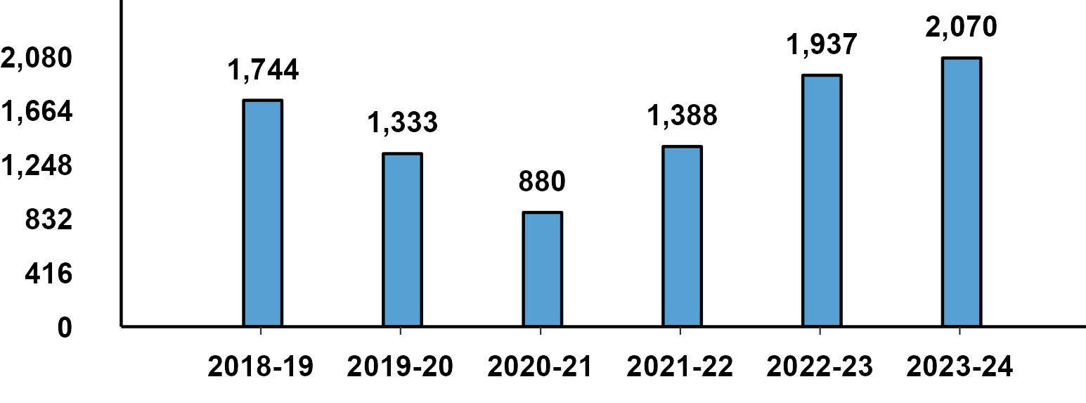
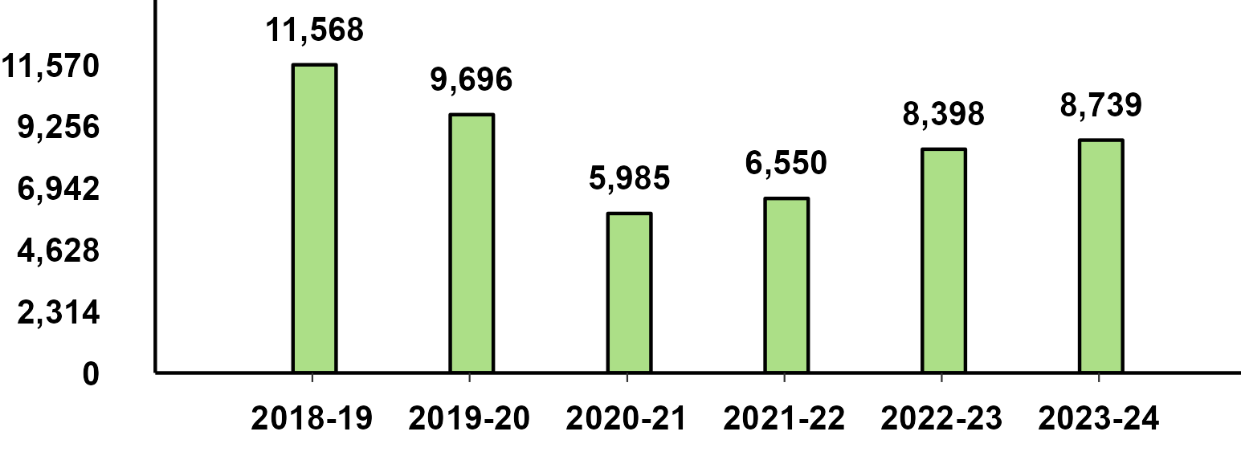
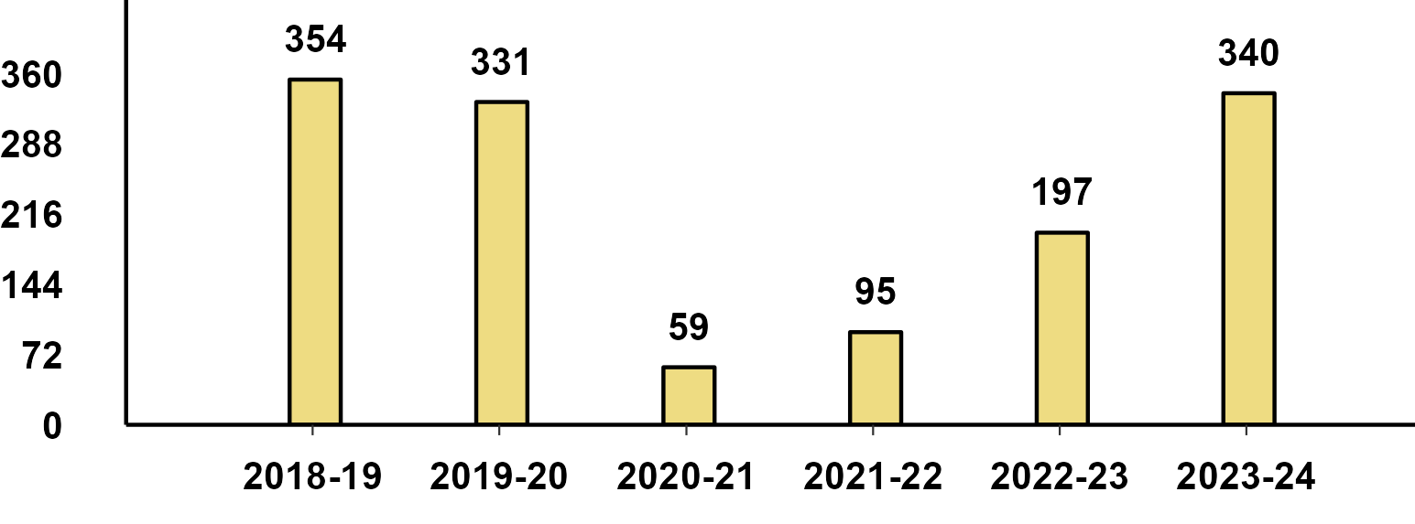
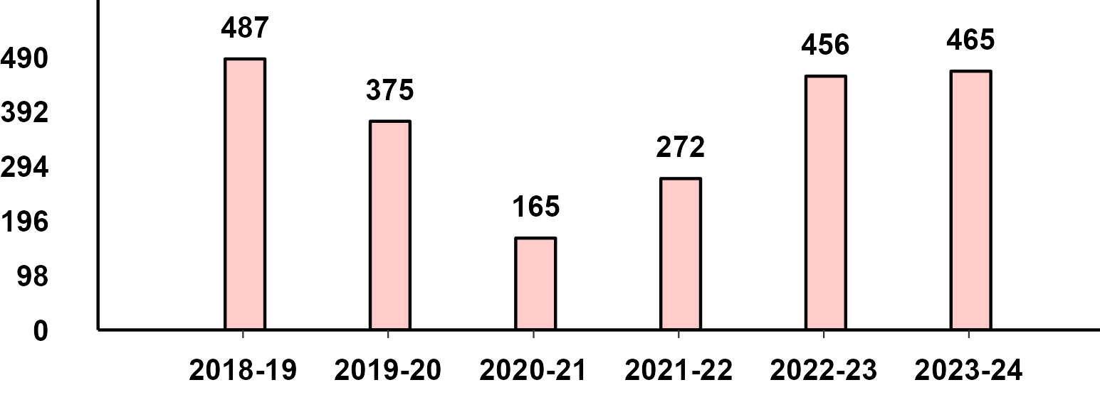
Domestic Sales - H1(Apr-Sept) Performance
Passenger Vehicle - H1 Performance
Two-Wheeler - H1 Performance
Three-Wheeler - H1 Performance
Commercial Vehicle - H1 Performance

Slide 5
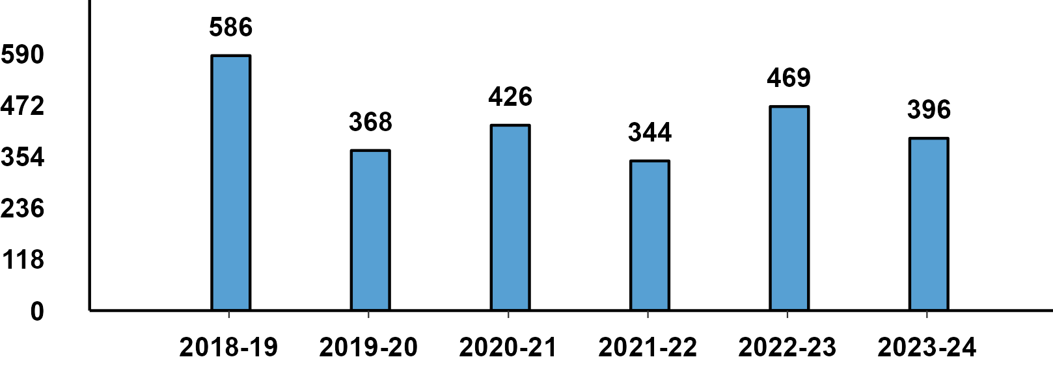
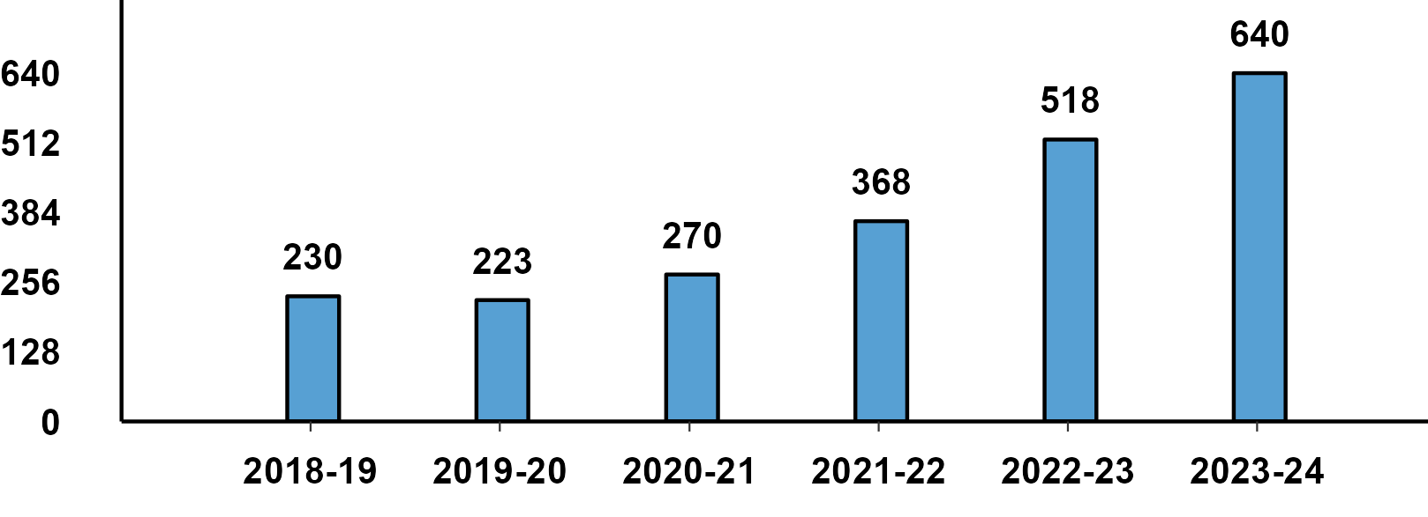
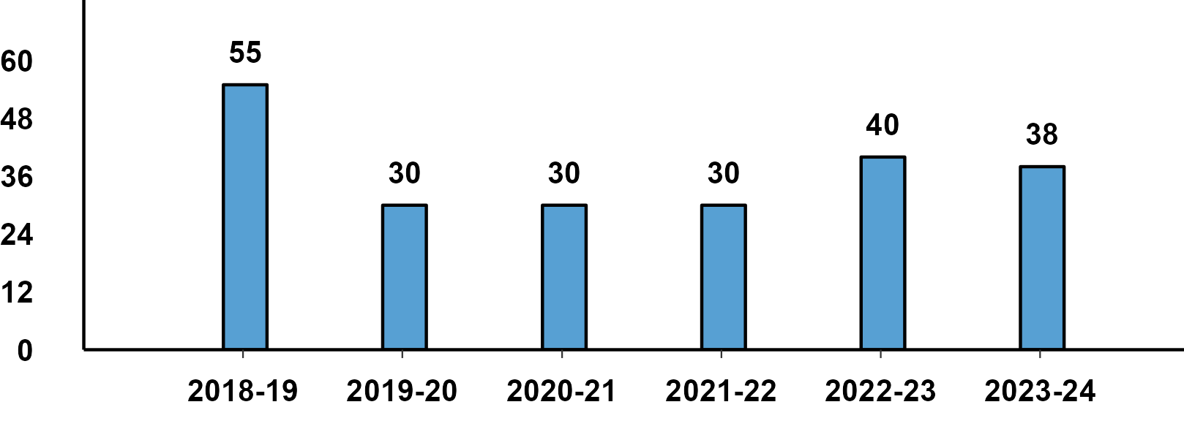
Passenger Vehicle: Sub-Category - Q2 Performance
PVs - Passenger Cars - Q2 Domestic Sales
PVs - Utility Vehicles - Q2 Domestic Sales
PVs - Vans - Q2 Domestic Sales

Slide 6
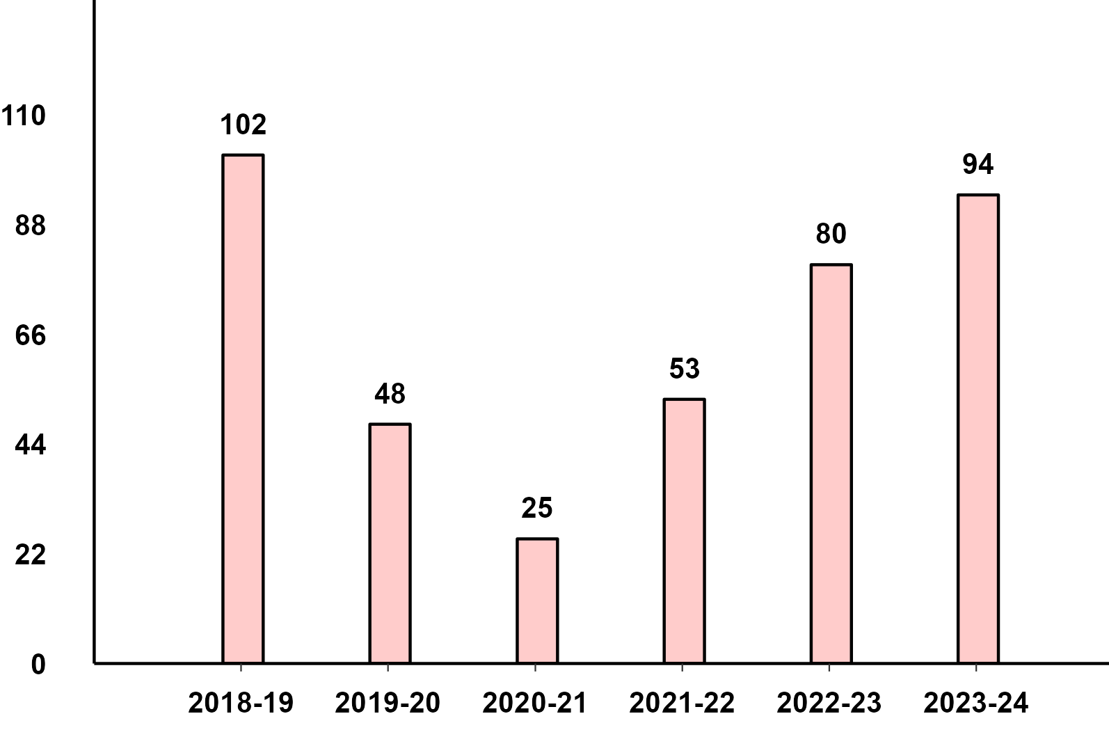
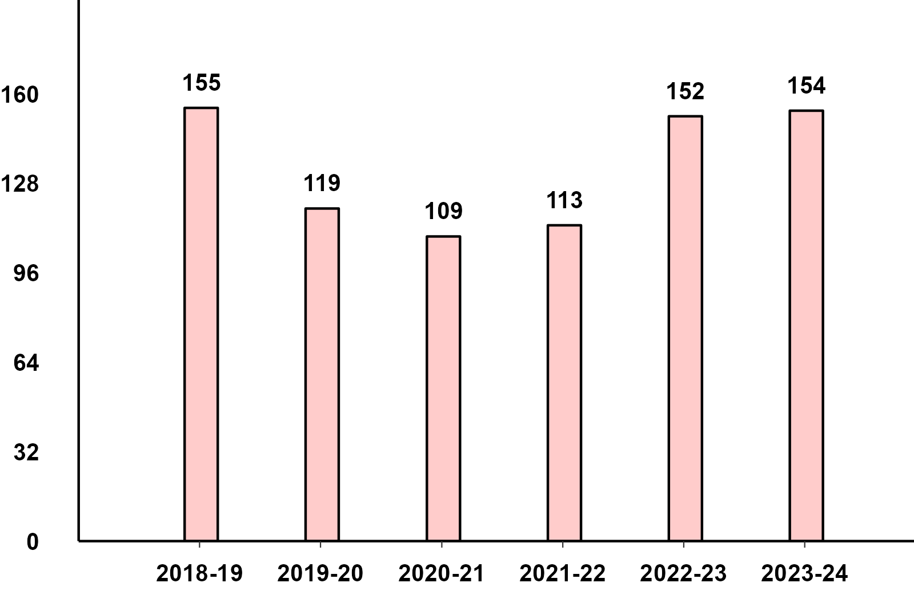
Commercial Vehicles: Sub-Category - Q2 Performance
M&HCV - Q2 Domestic Sales
LCV - Q2 Domestic Sales

Slide 7
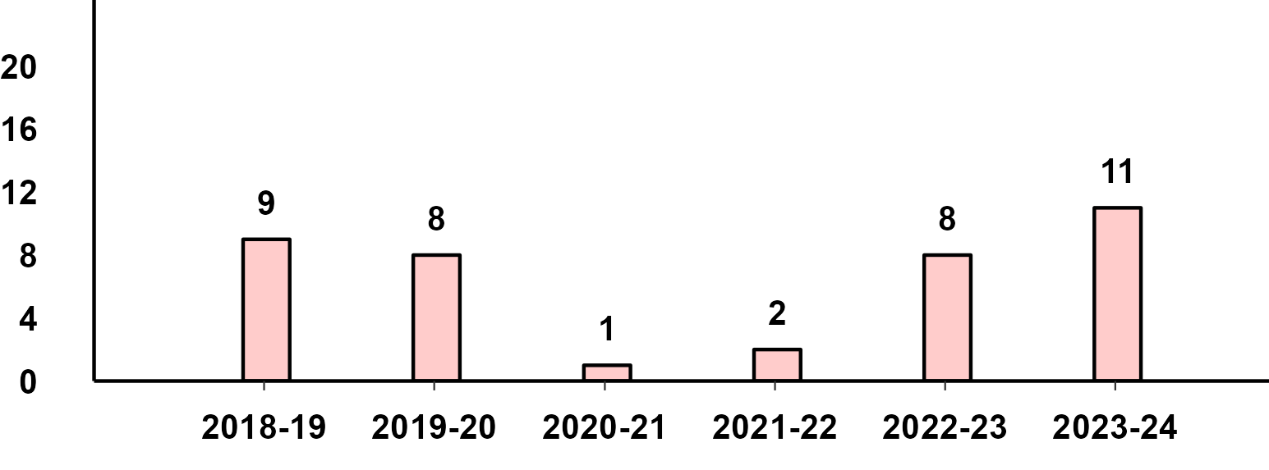
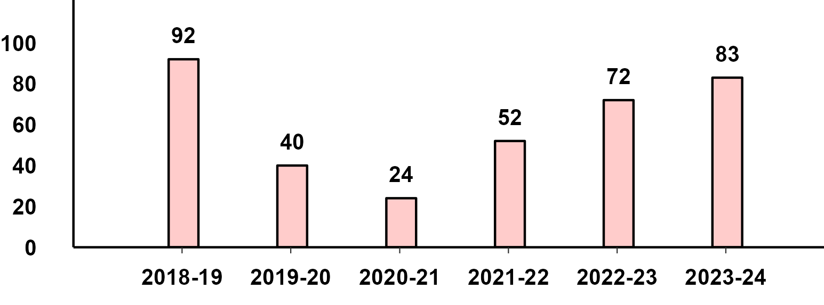
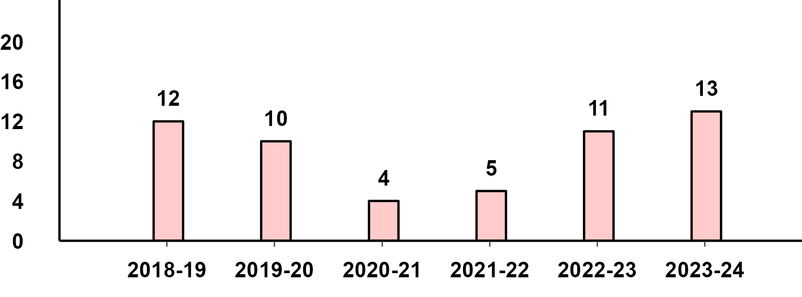
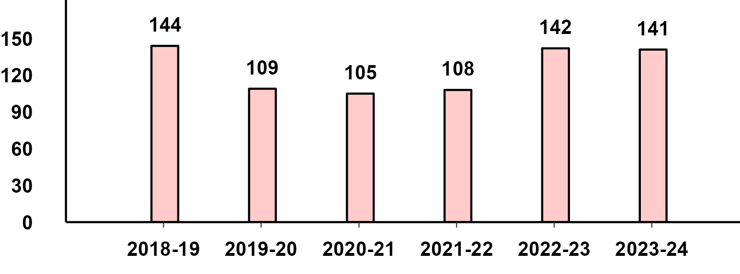
Commercial Vehicles- Passengers & Goods - Q2 Performance
M&HCV Passenger - Q2 Domestic Sales
M&HCV Goods - Q2 Domestic Sales
LCV Passenger - Q2 Domestic Sales
LCV Goods - Q2 Domestic Sales

Slide 8
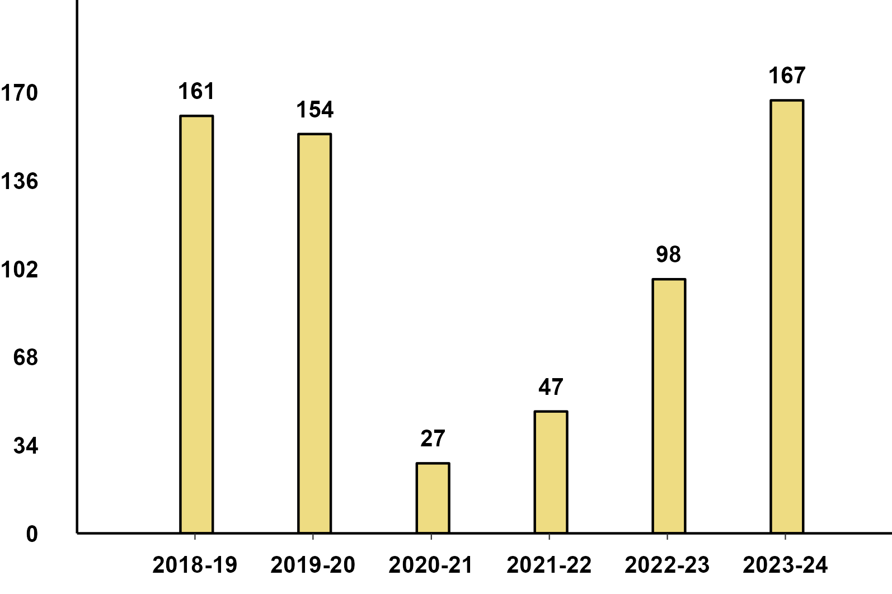
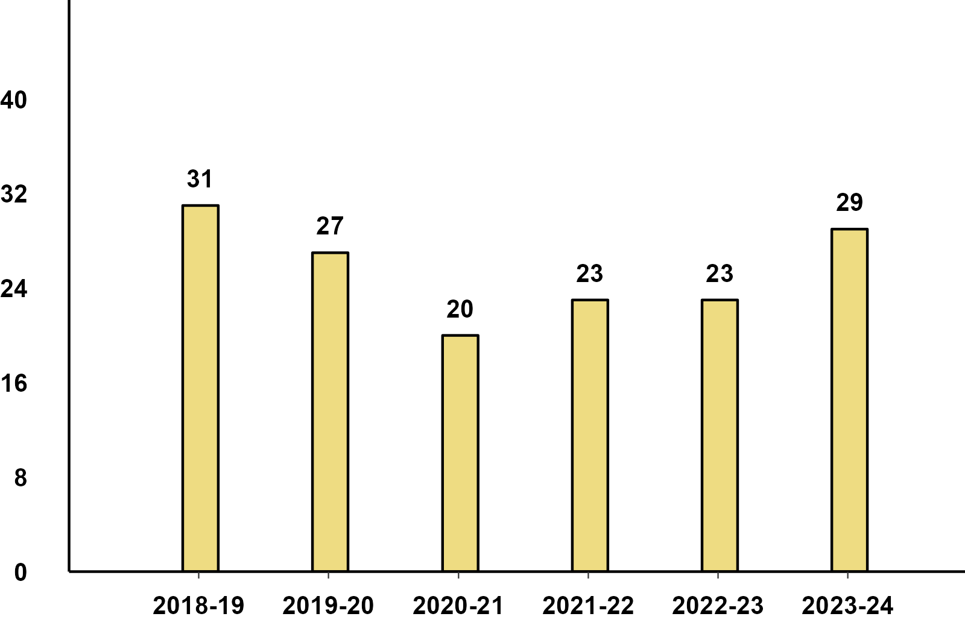
Three-Wheelers - Passenger & Goods - Q2 Performance
Three-Wheeler - Passenger - Q2 Domestic Sales
Three-Wheeler - Goods - Q2 Domestic Sales

Slide 9
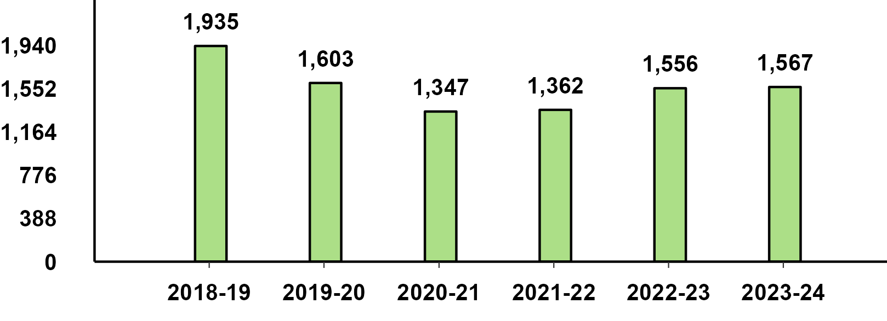
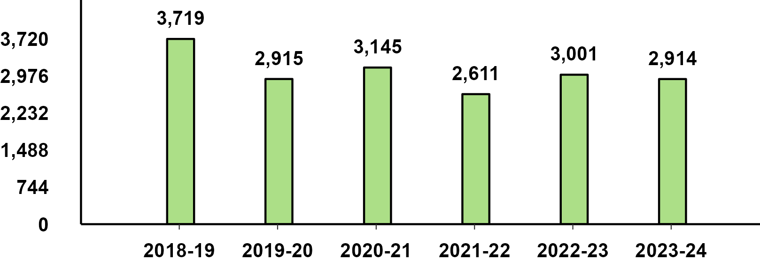
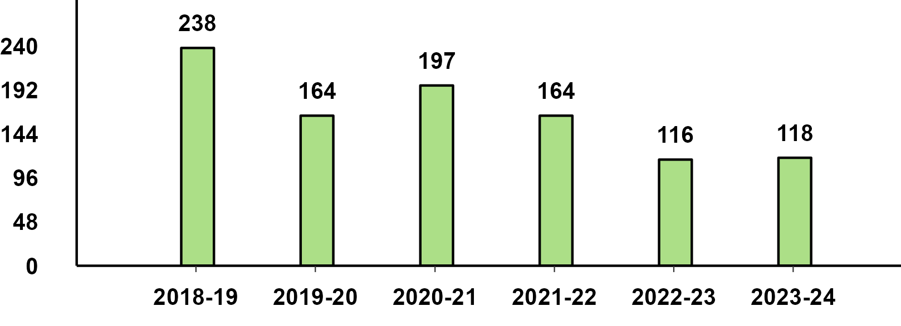
Two-Wheelers Sub-Category - Q2 Performance
Two-Wheeler - Scooters - Q2 Performance
Two-Wheeler - Motorcycles - Q2 Performance
Two-Wheeler - Mopeds - Q2 Performance

Slide 10
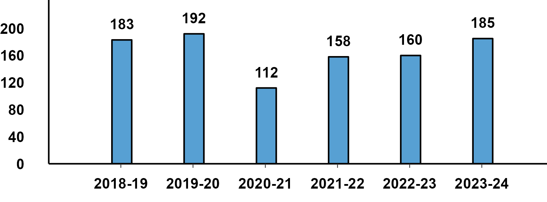
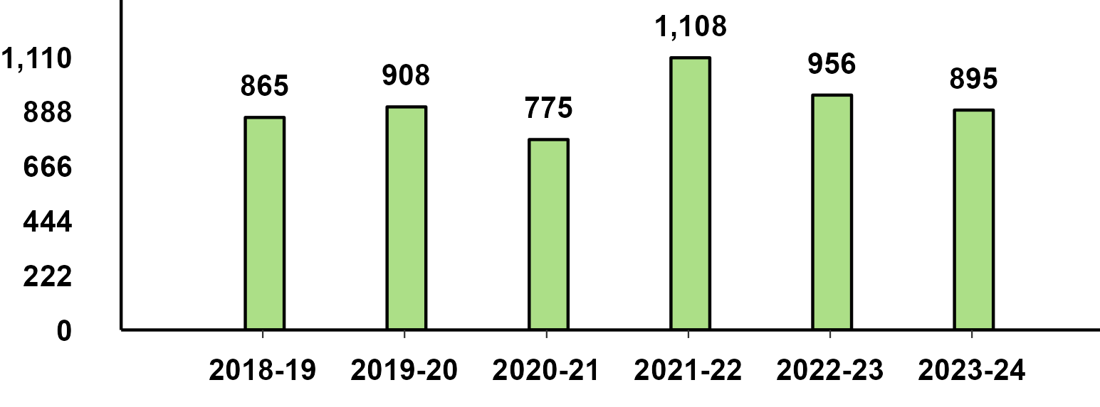
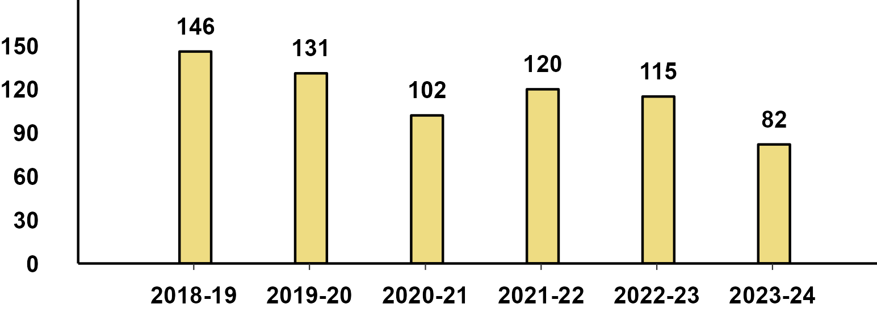
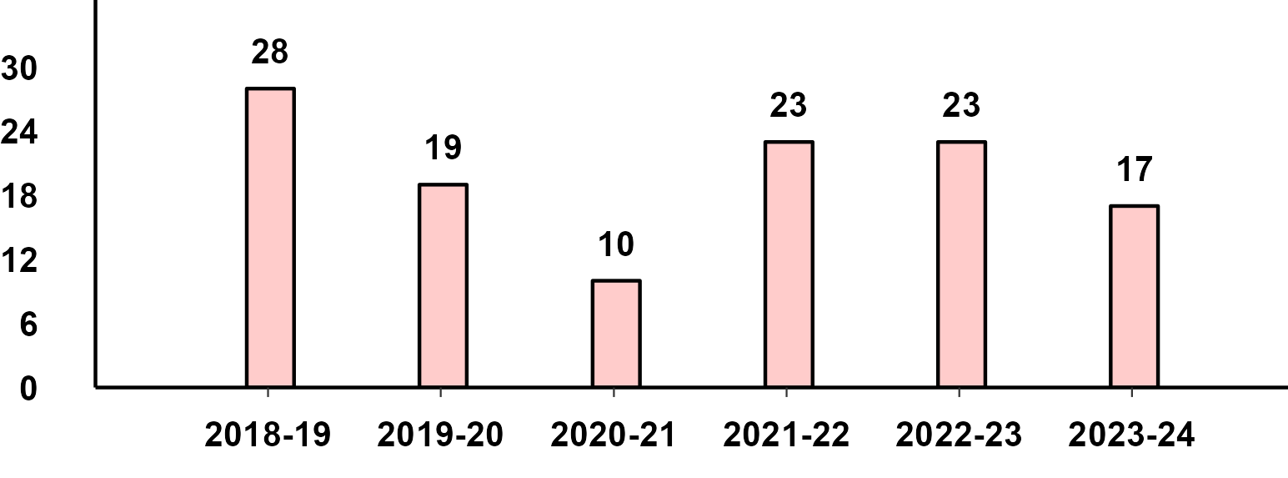
Q2 Export Performance
Passenger Vehicle Exports (Q2)
Two-Wheeler Exports (Q2)
Three-Wheeler Exports (Q2)
Commercial Vehicle Exports (Q2)

Slide 11
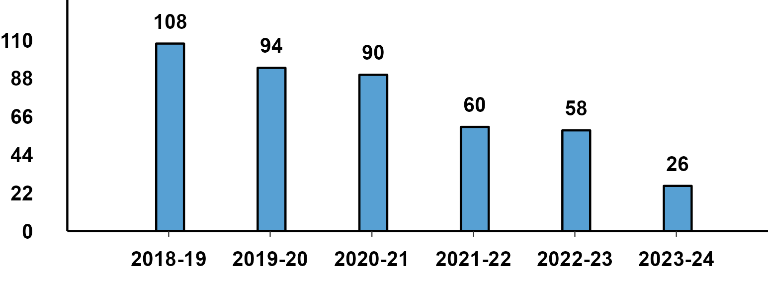
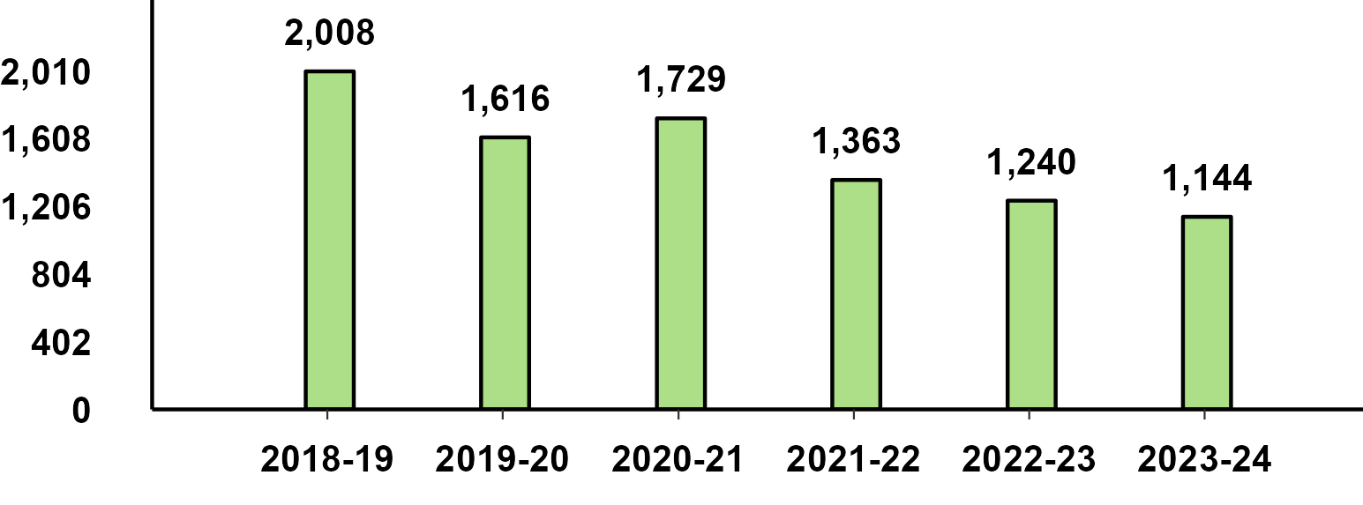
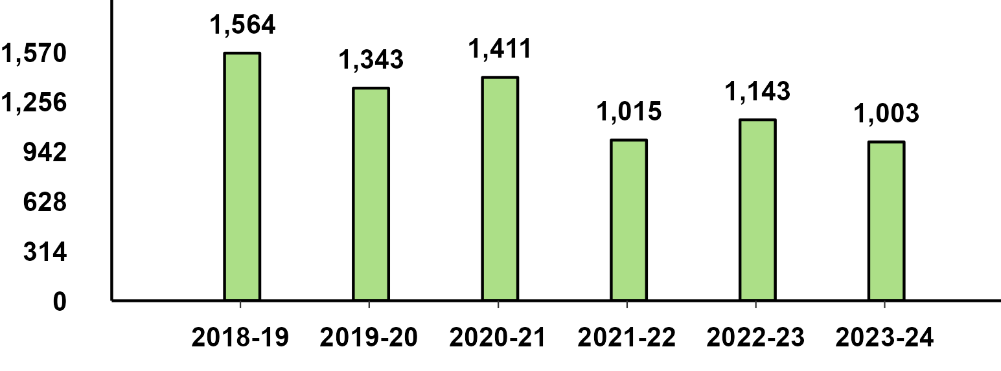
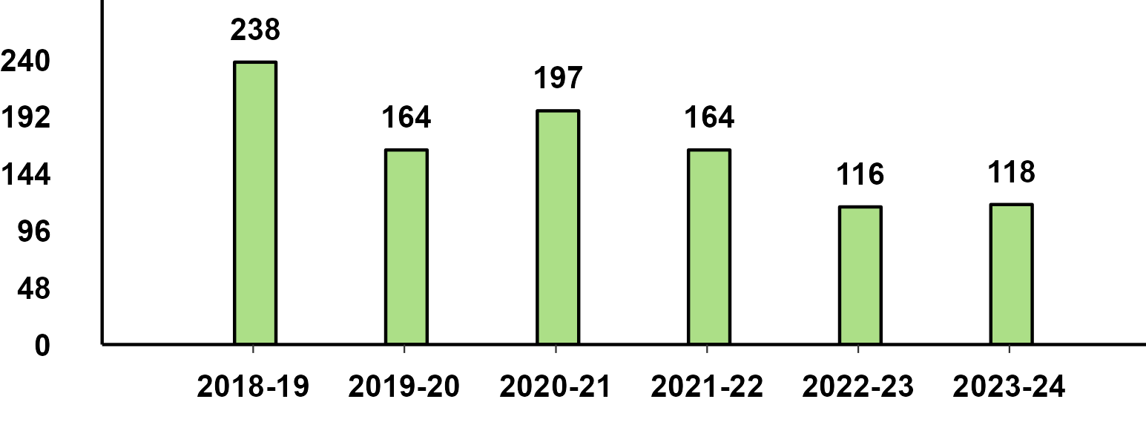
Challenges With Entry Level
Mini/Micro Cars (Less than 3.6 mm) - Q2
Motorcycles upto 110 cc - Q2
Scooters upto 125 cc - Q2
Mopeds - Q2

Slide 12
THANK YOU

Slide 13
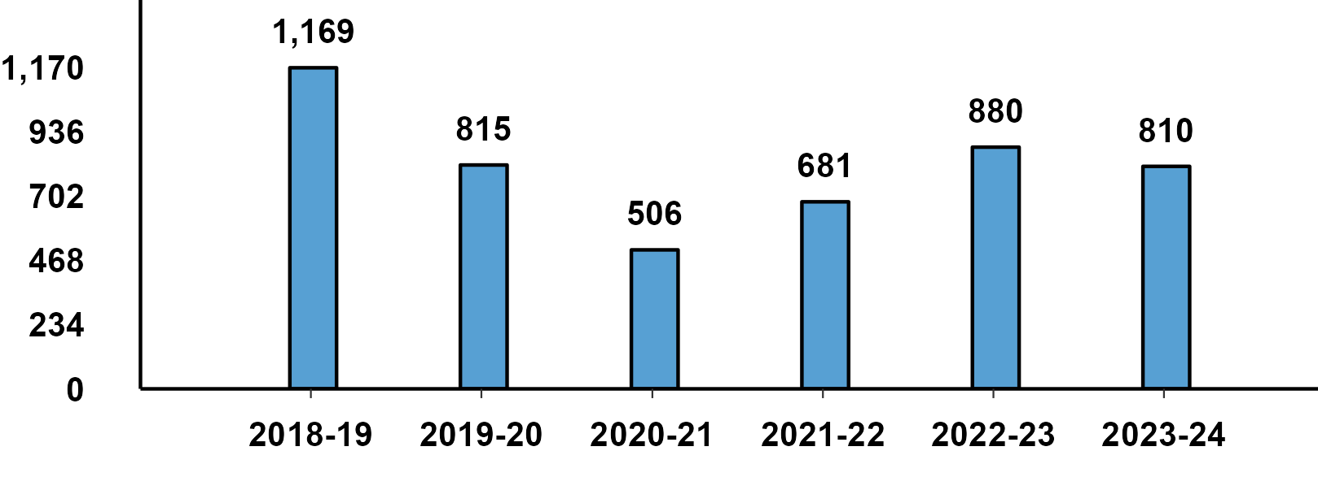
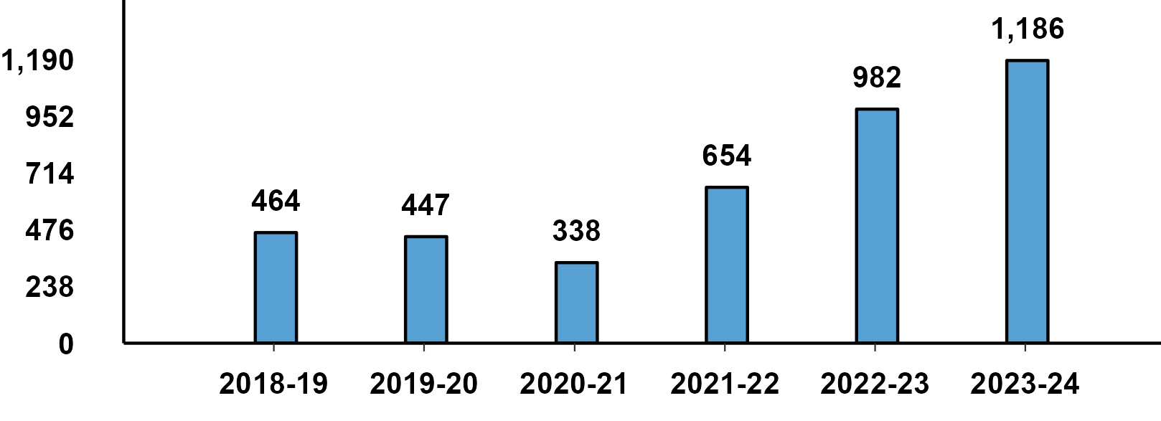
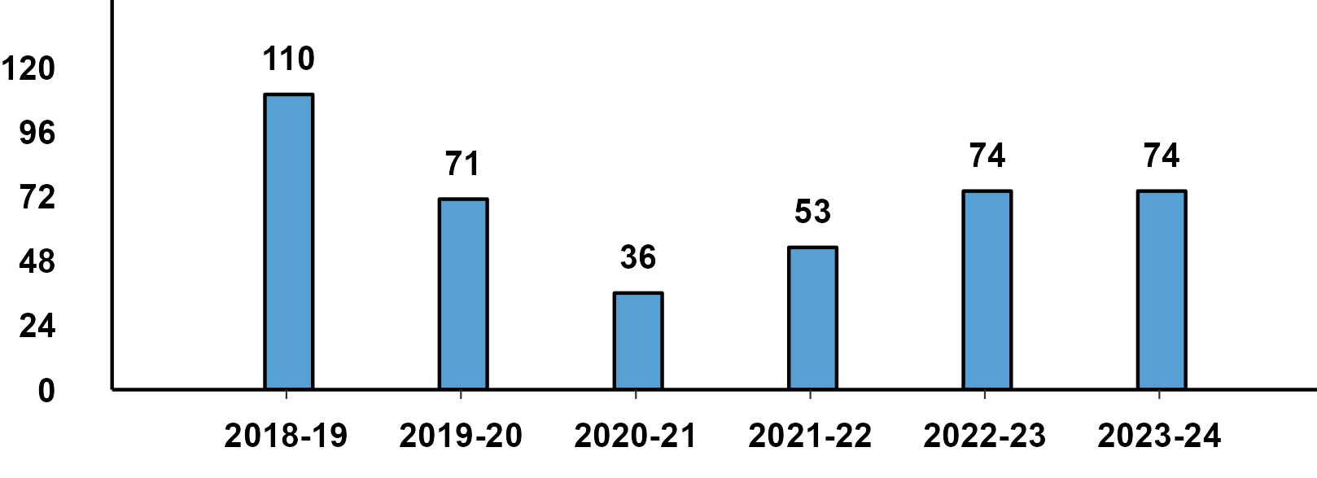
Passenger Vehicle: Sub-Category - H1 Performance
PVs - Passenger Cars - H1 Domestic Sales
PVs - Utility Vehicles - H1 Domestic Sales
PVs - Vans - H1 Domestic Sales

Slide 14
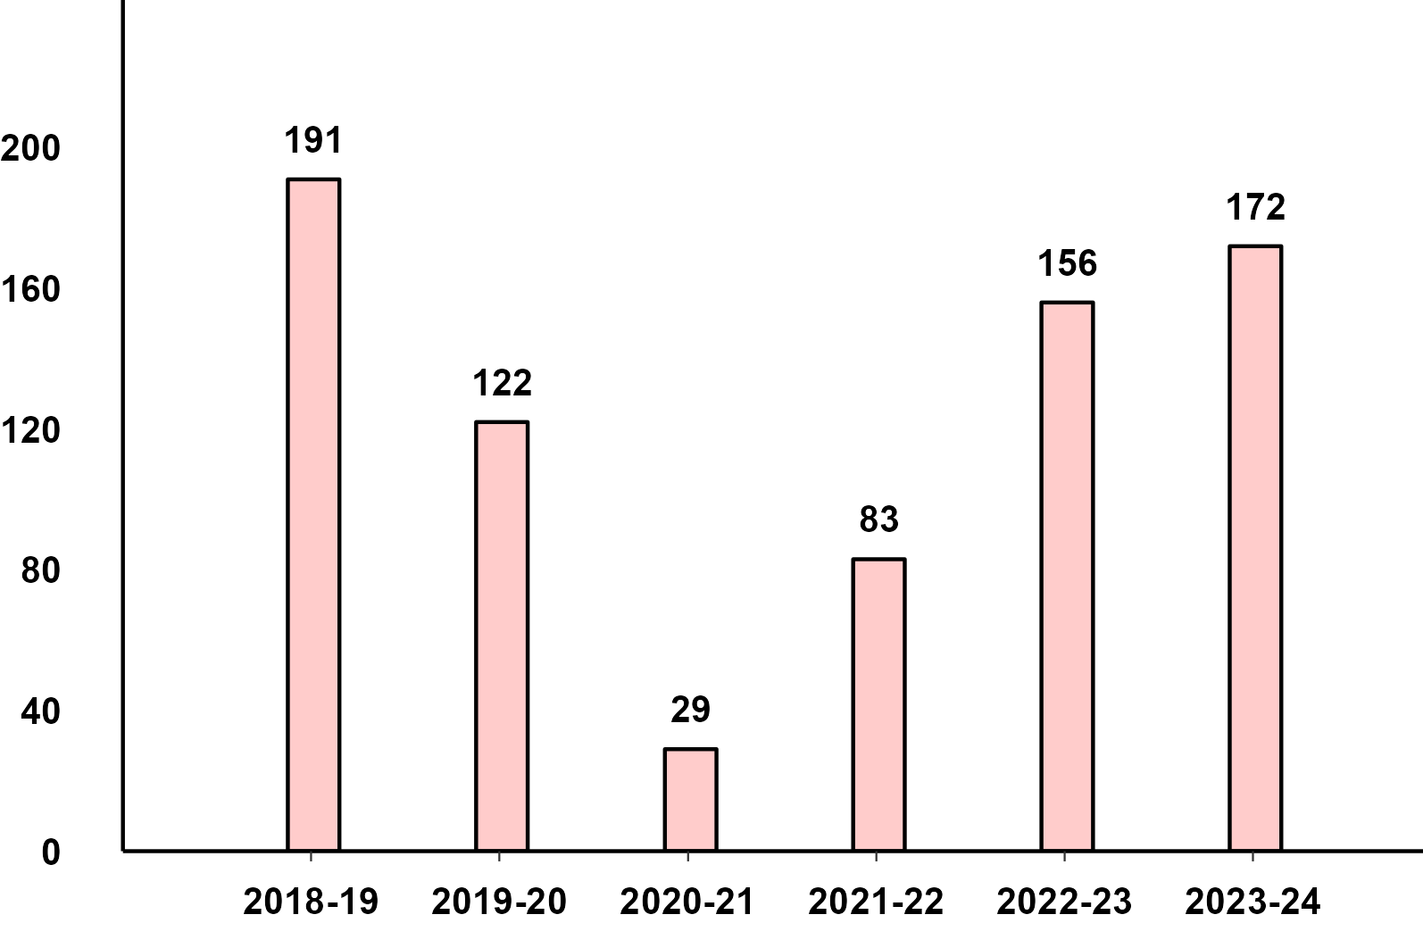
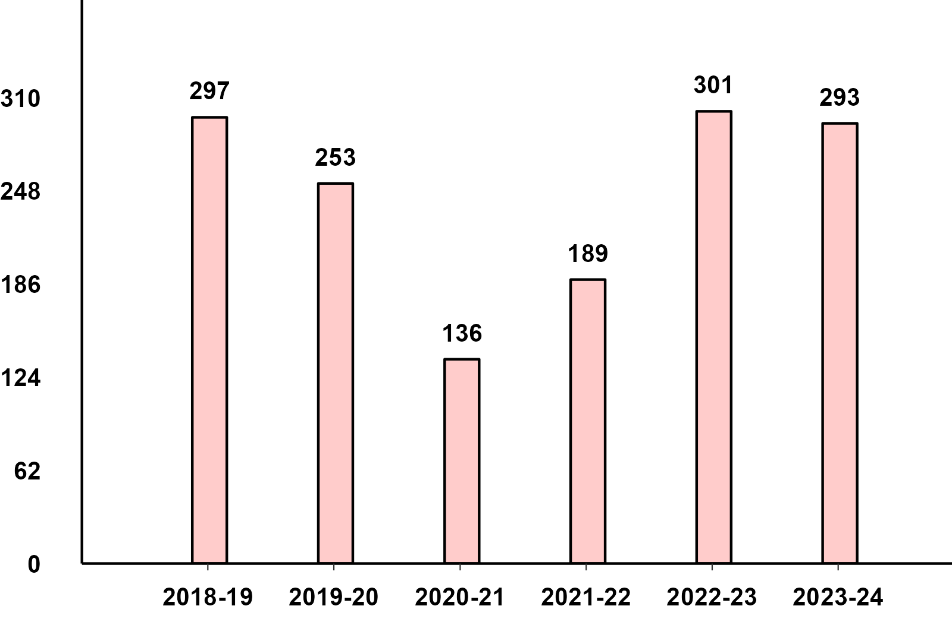
Commercial Vehicles: Sub-Category - H1 Performance
M&HCV - H1 Domestic Sales
LCV - H1 Domestic Sales

