Slide 1
2023-24 Data Overview
(Q3 - CY) NEW DELHI

Slide 2
Domestic Sales Performance
Q3 (Oct-Dec)
Category | 2018-19 | 2019-20 | 2020-21 | 2021-22 | 2022-23 | CAGR %
Passenger Vehicle | 789 | 785 | 898 | 761 | 935 | 3.5%
Commercial Vehicle | 236 | 195 | 193 | 195 | 227 | -0.8%
Three Wheeler | 167 | 177 | 73 | 83 | 139 | -3.6%
Two Wheeler | 4,958 | 4,218 | 4,782 | 3,630 | 3,859 | -4.9%
CY (Jan-Dec)
Category | CY - 19 | CY - 20 | CY - 21 | CY - 22 | CAGR %
Passenger Vehicle | 2,962 | 2,433 | 3,082 | 3,792 | 5.1%
Commercial Vehicle | 855 | 505 | 677 | 933 | 1.8%
Three Wheeler | 687 | 263 | 265 | 419 | -9.4%
Two Wheeler | 18,567 | 14,270 | 14,534 | 15,647 | -3.4%
Cumulative - Nov '23
Category | 2018-19 | 2019-20 | 2020-21 | 2021-22 | 2022-23 | 2023-24 | CAGR %
Passenger Vehicle | 2,295 | 1,858 | 1,456 | 1,830 | 2,504 | 2,700 | 3.3%
Three Wheeler | 477 | 453 | 110 | 150 | 296 | 476 | 0.0%
Two Wheeler | 15,268 | 12,864 | 9,639 | 9,164 | 11,213 | 12,259 | -4.3%

Slide 3
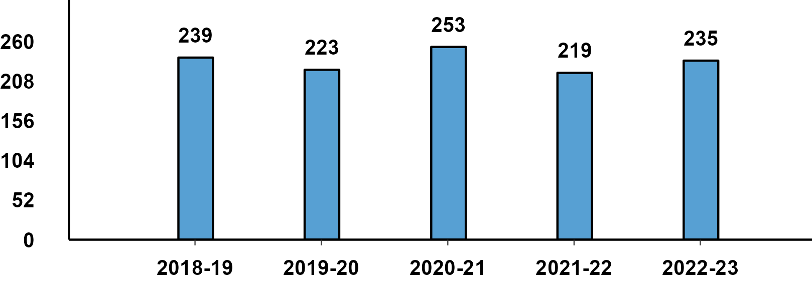
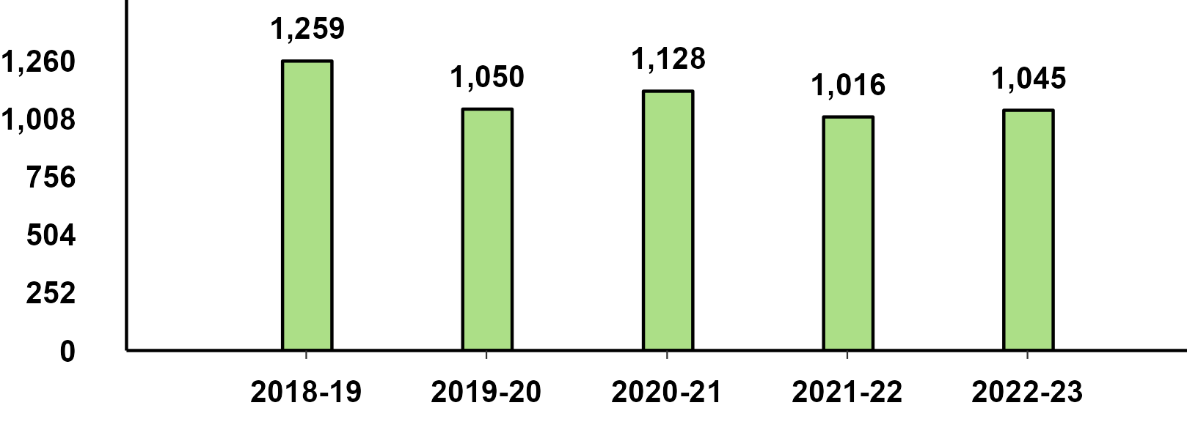
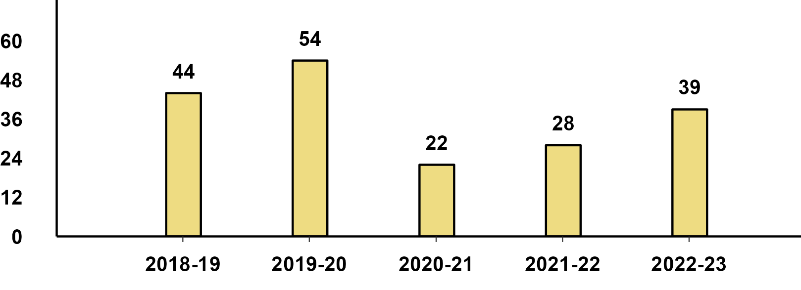
Domestic Sales - December Performance
Passenger Vehicle - December Performance
Two-Wheeler - December Performance
Three-Wheeler - December Performance

Slide 4
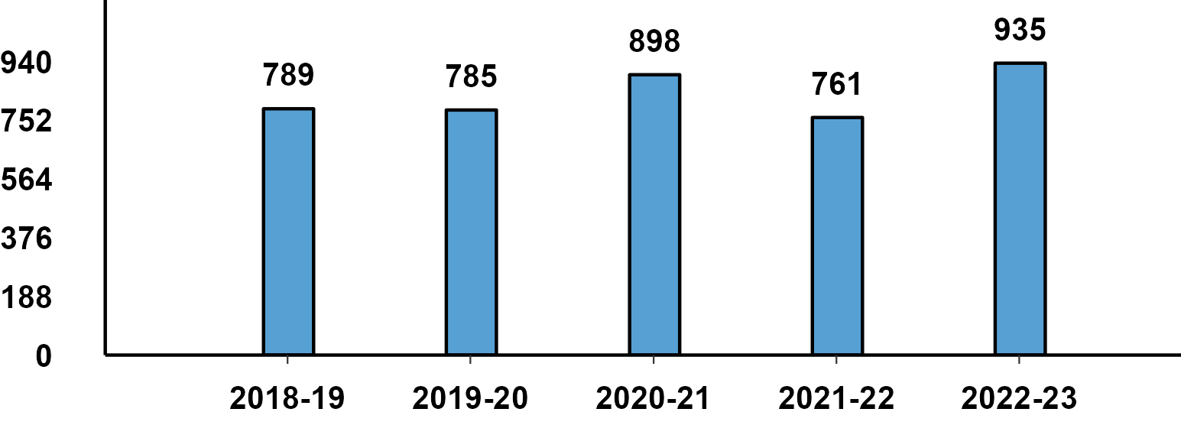
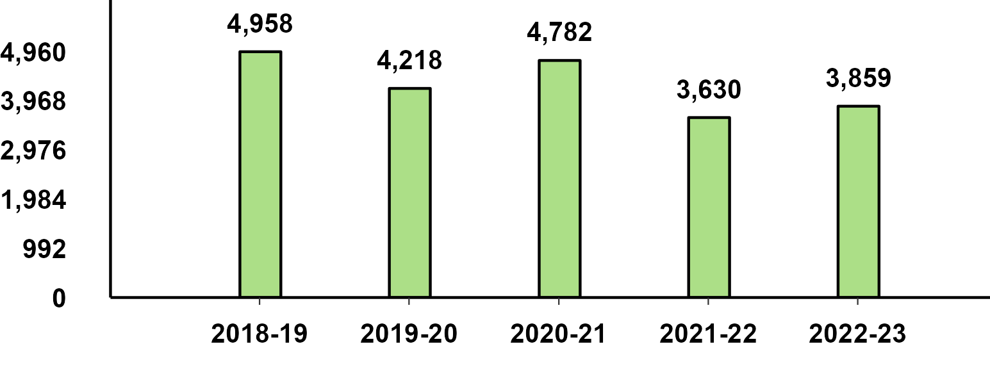
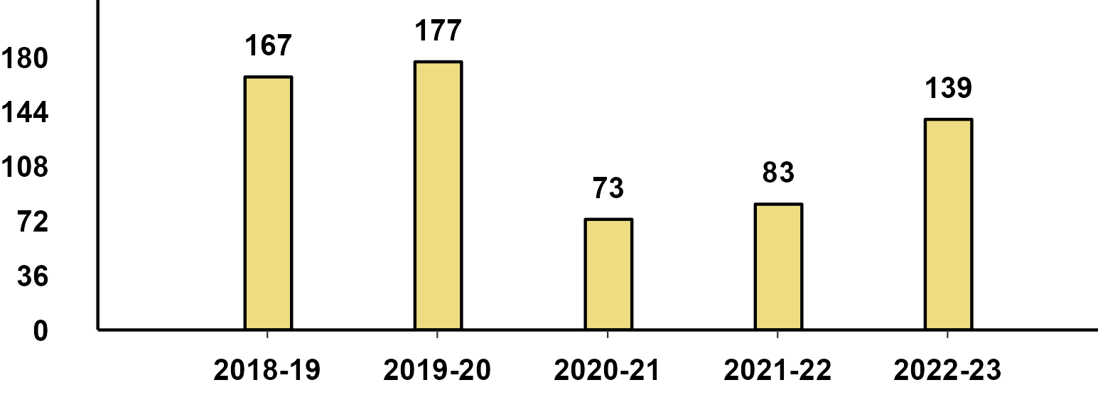
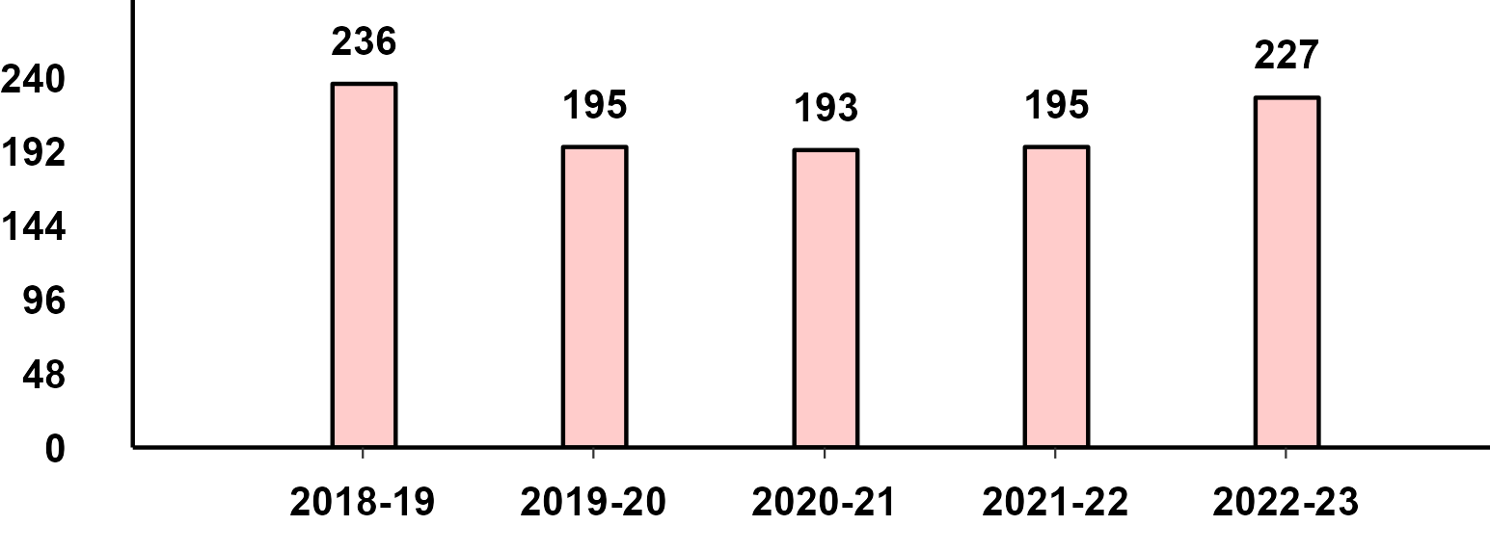
Domestic Sales - Q3(Oct-Dec) Performance
Passenger Vehicle - Q3 Performance
Two-Wheeler - Q3 Performance
Three-Wheeler - Q3 Performance
Commercial Vehicle - Q3 Performance

Slide 5



Monthly Domestic Sales Cumulative - Nov '23
Passenger Vehicle
Two Wheeler
Three Wheeler

Slide 6
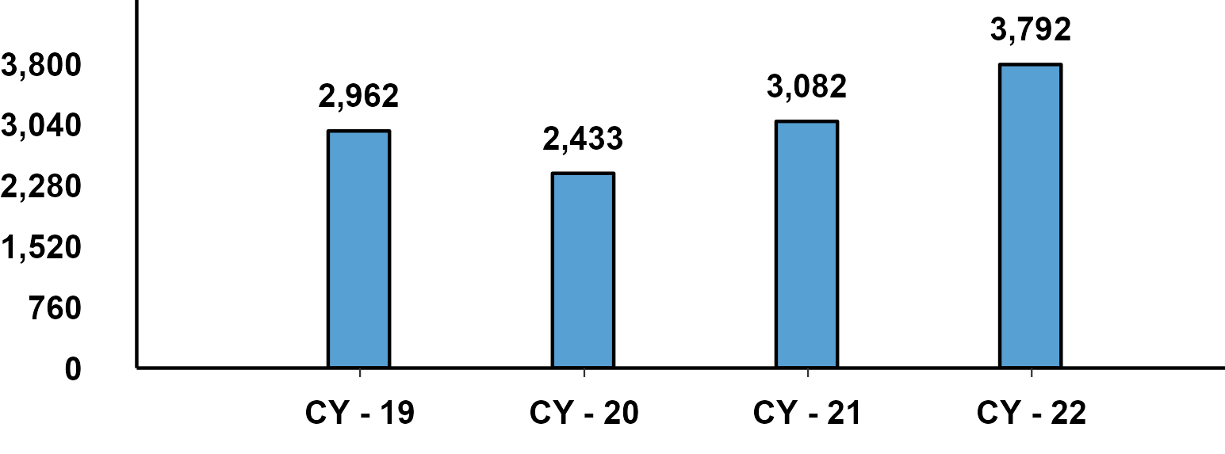
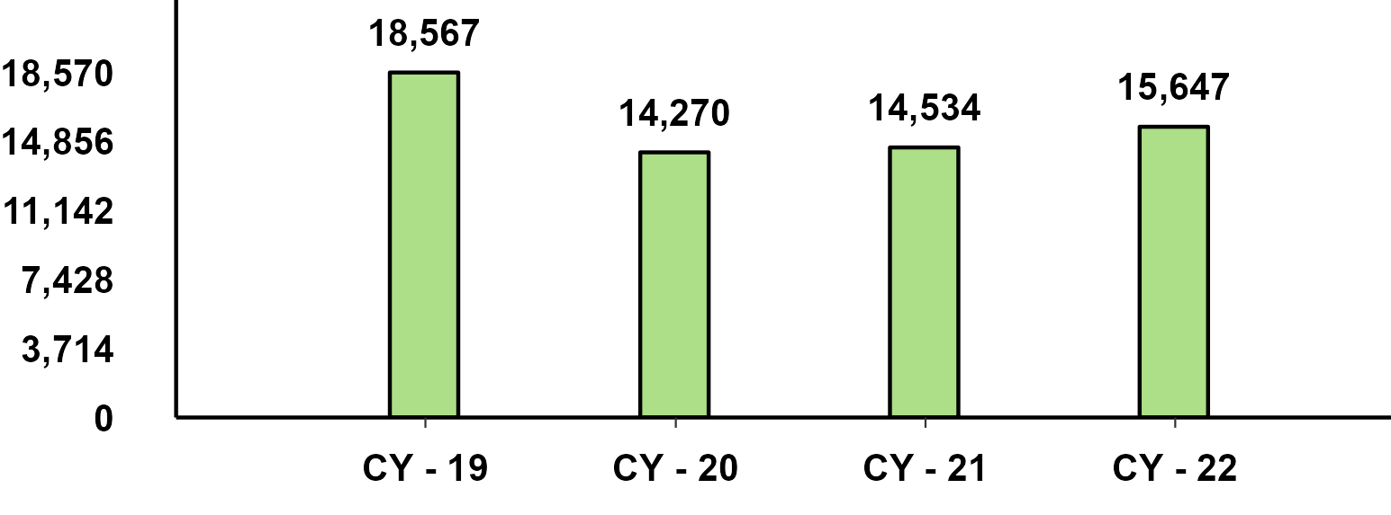
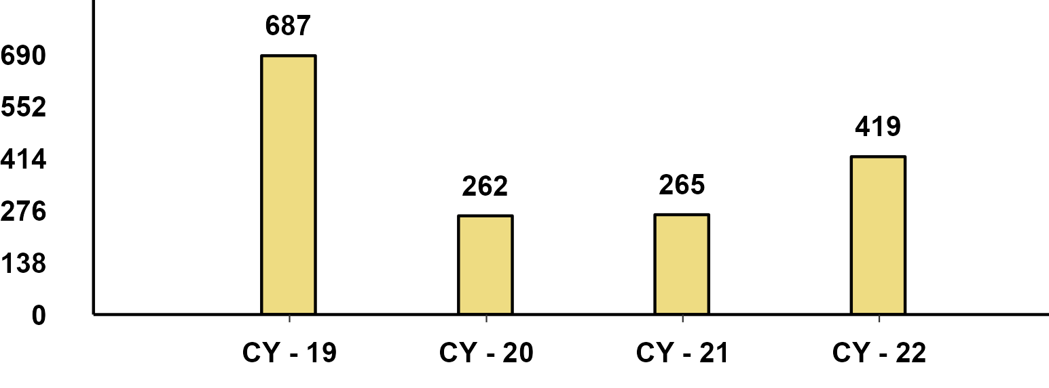
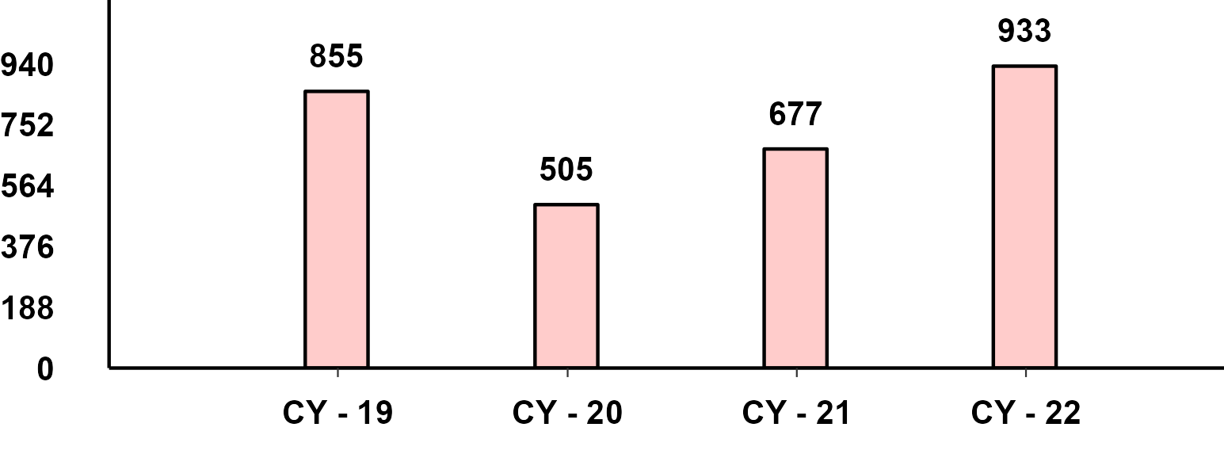
Domestic Sales - CY(Jan-Dec) Performance
Passenger Vehicle - CY Performance
Two Wheeler - CY Performance
Three Wheeler - CY Performance
Commercial Vehicle - CY Performance

Slide 7
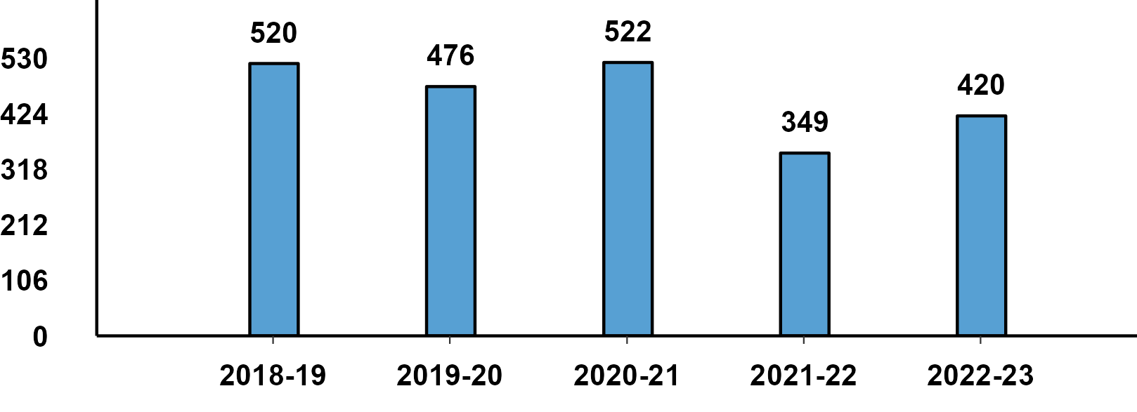
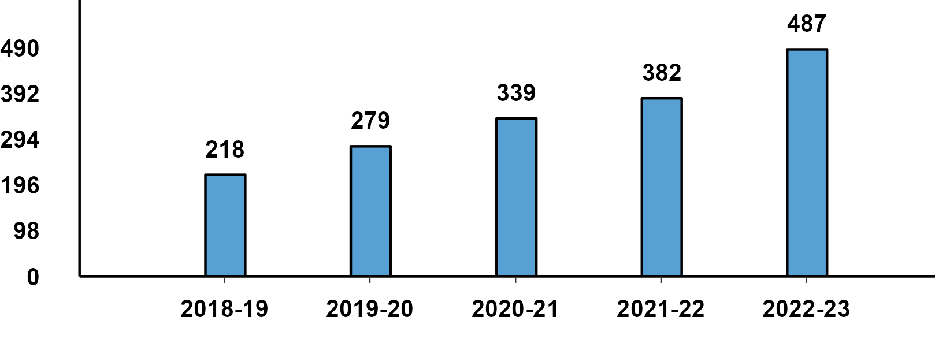
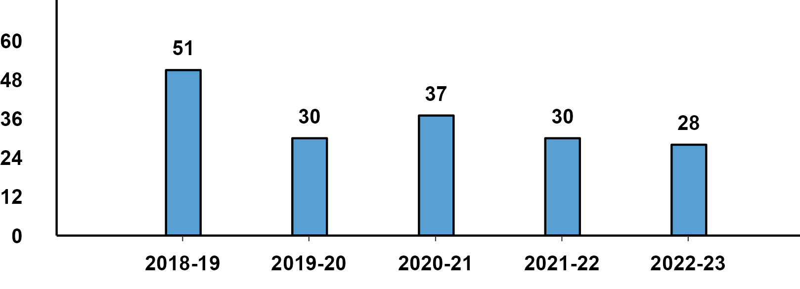
Passenger Vehicle: Sub-Category - Q3 Performance
PVs - Passenger Cars - Q3 Domestic Sales
PVs - Utility Vehicles - Q3 Domestic Sales
PVs - Vans - Q3 Domestic Sales

Slide 8
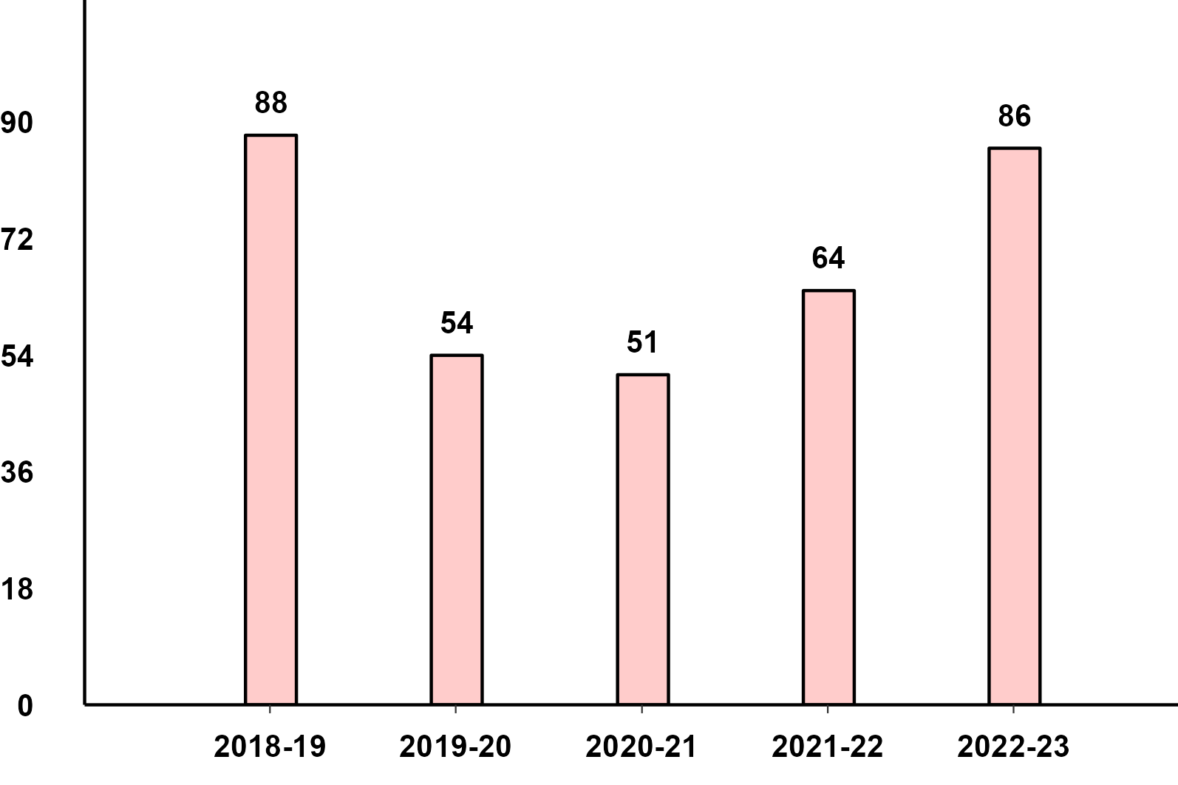
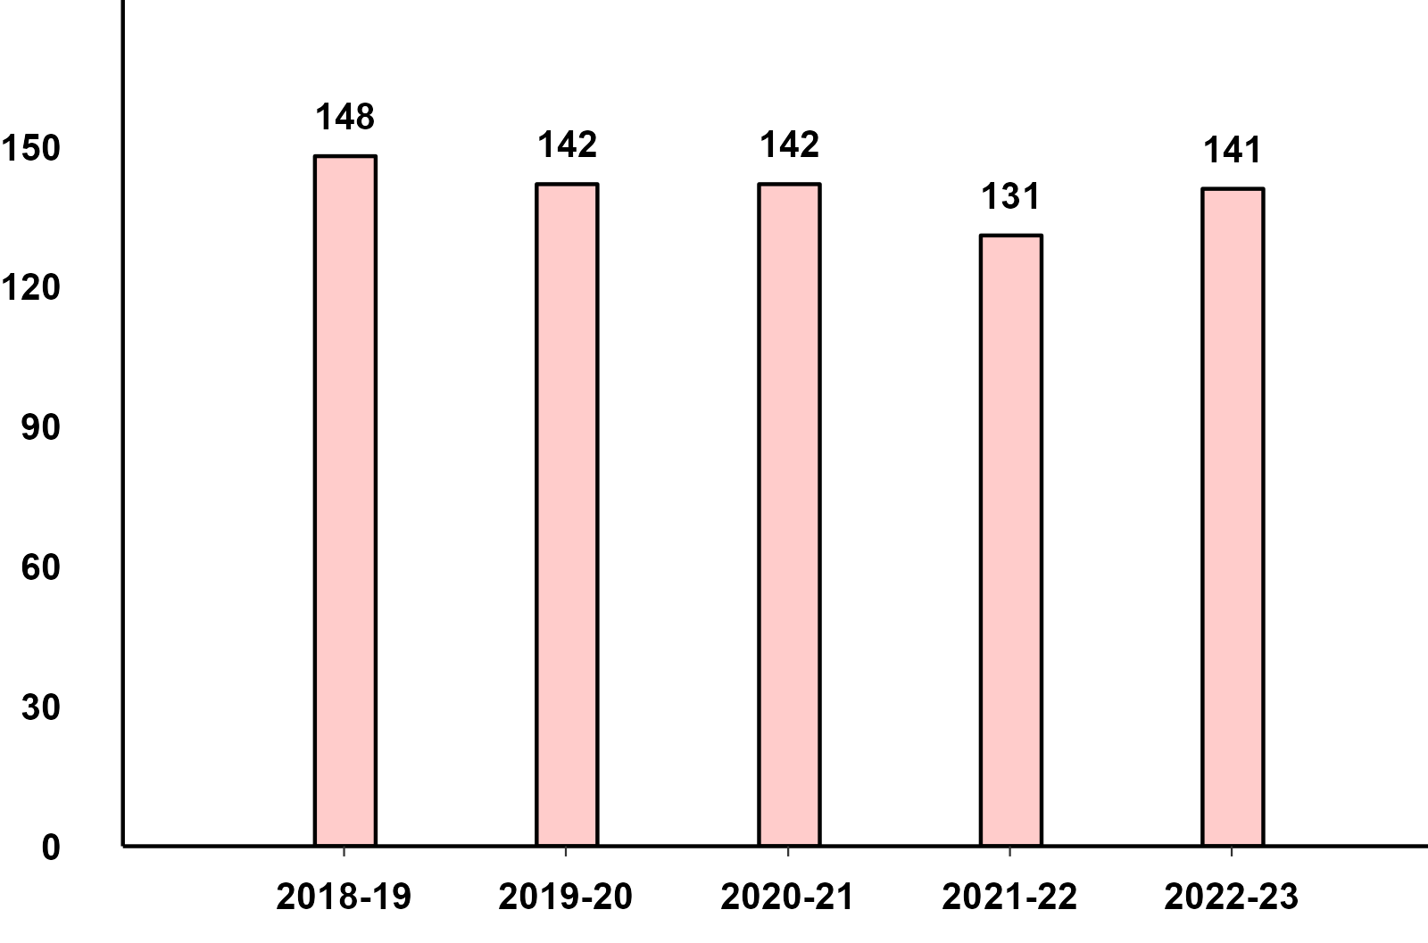
Commercial Vehicles: Sub-Category - Q3 Performance
M&HCV - Q3 Domestic Sales
LCV - Q3 Domestic Sales

Slide 9
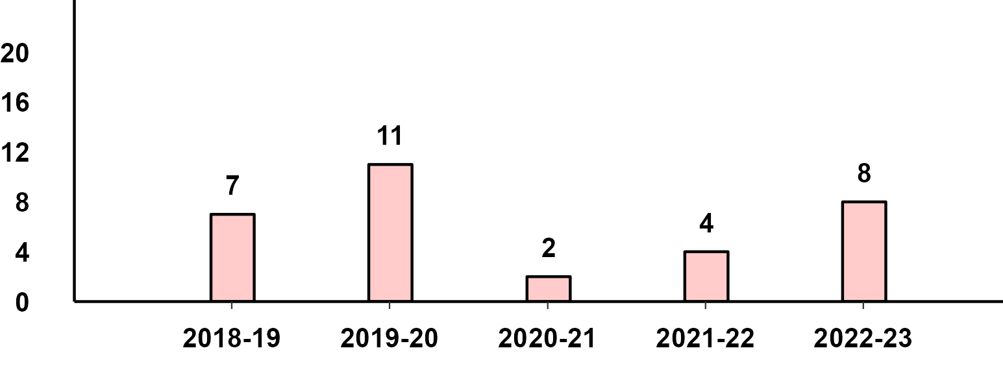
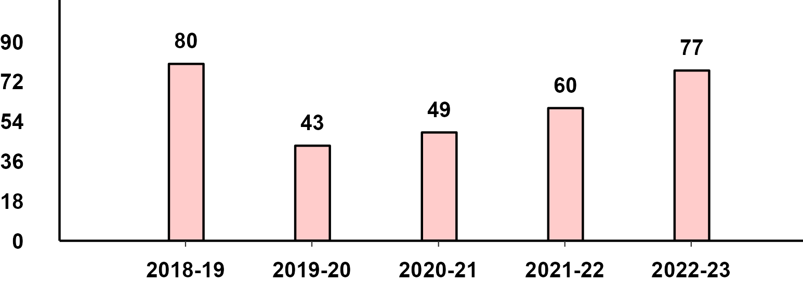
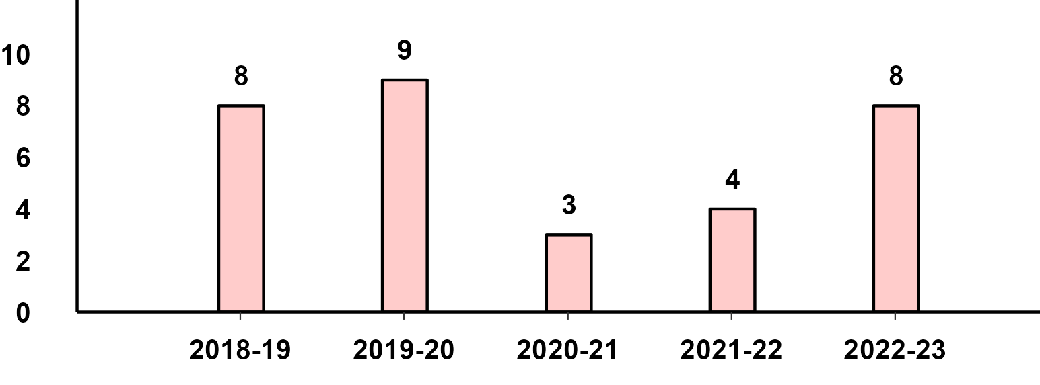
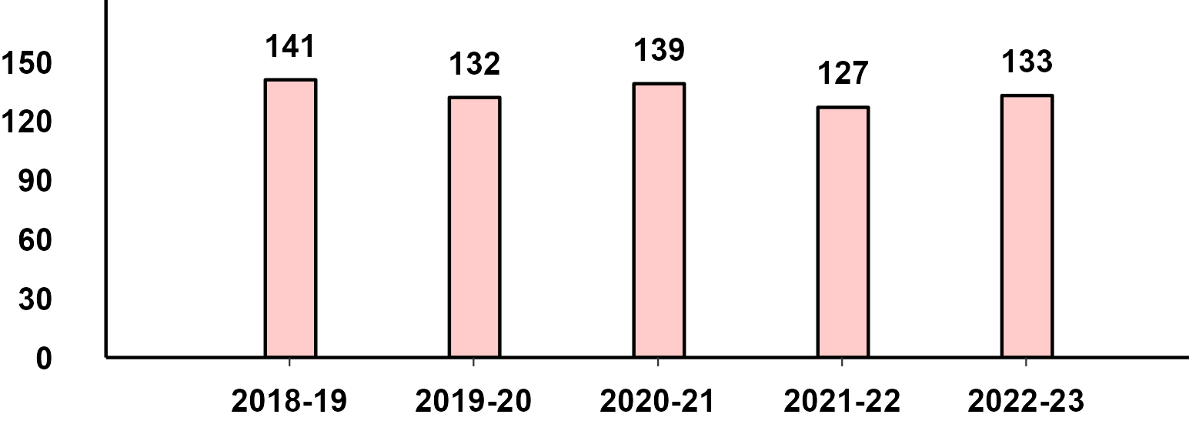
Commercial Vehicles- Passengers & Goods - Q3 Performance
M&HCV Passenger - Q2 Domestic Sales
M&HCV Goods - Q2 Domestic Sales
LCV Passenger - Q2 Domestic Sales
LCV Goods - Q2 Domestic Sales

Slide 10
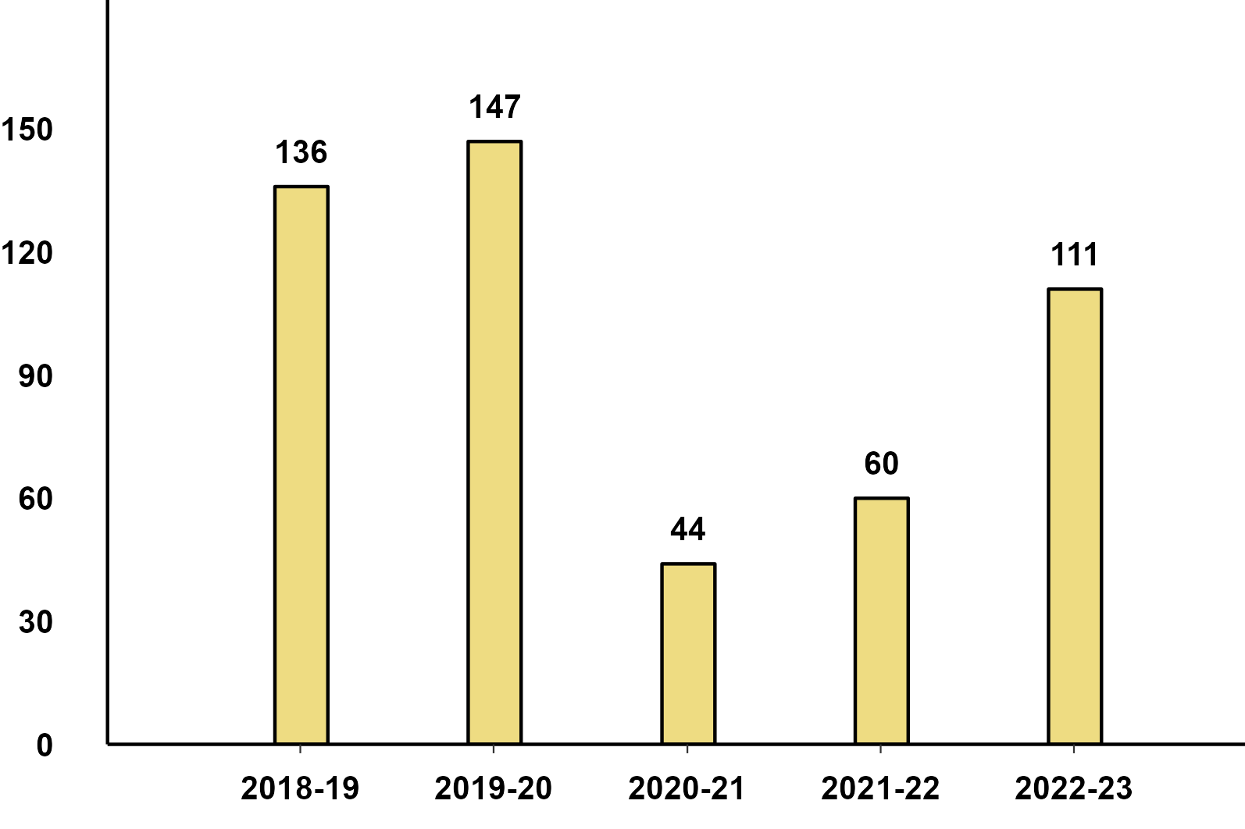
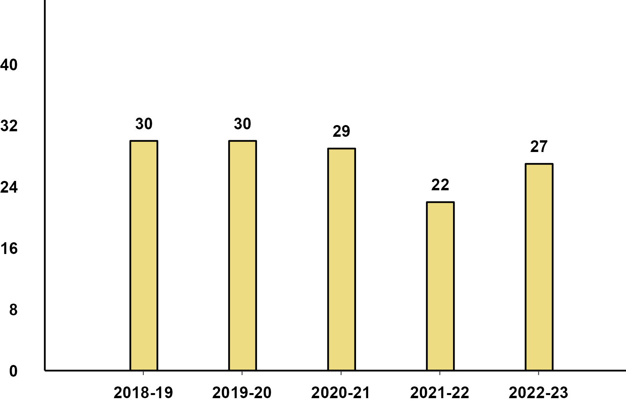
Three Wheelers - Passenger & Goods - Q3 Performance
Three Wheeler - Passenger - Q3 Domestic Sales
Three Wheeler - Goods - Q3 Domestic Sales

Slide 11
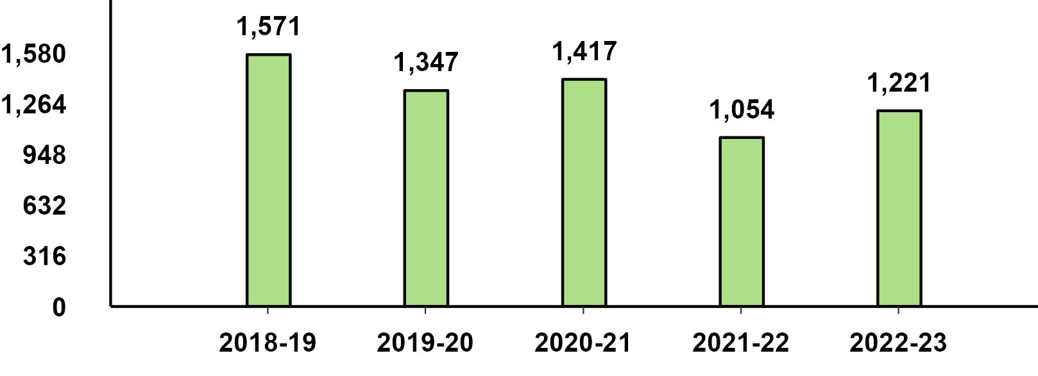
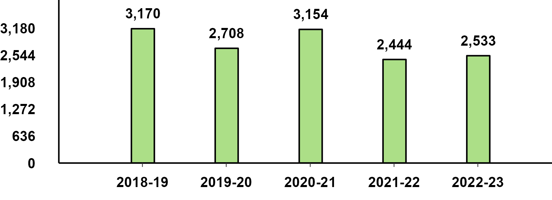
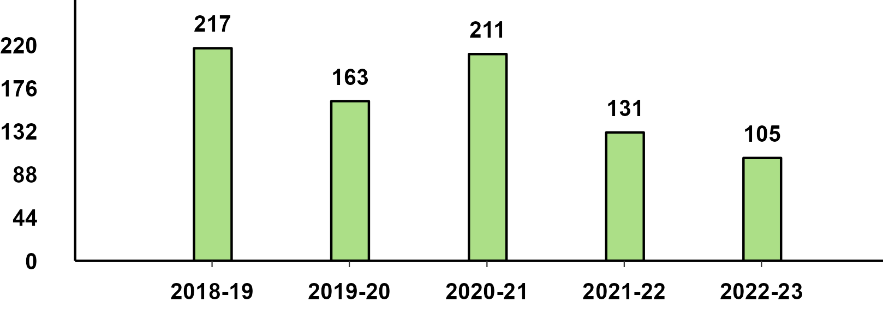
Two Wheelers Sub-Category - Q3 Performance
Two Wheeler - Scooters - Q3 Performance
Two Wheeler - Motorcycles - Q3 Performance
Two Wheeler - Mopeds - Q3 Performance

Slide 12
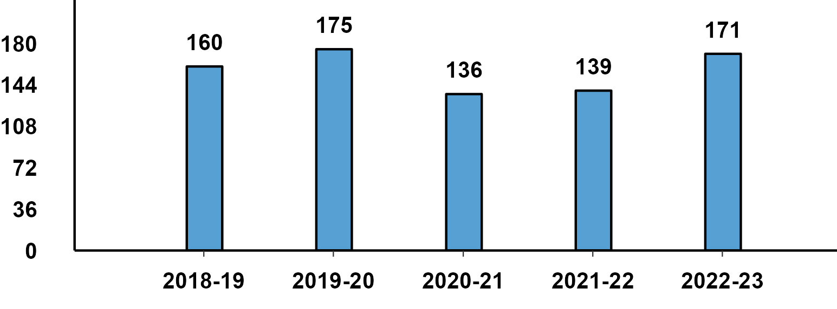
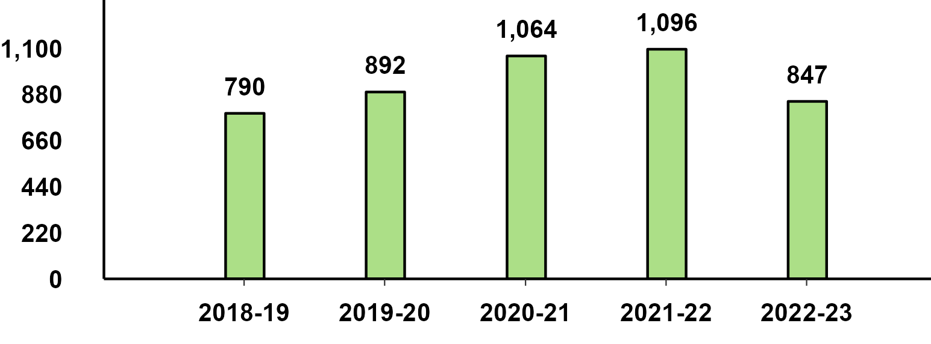
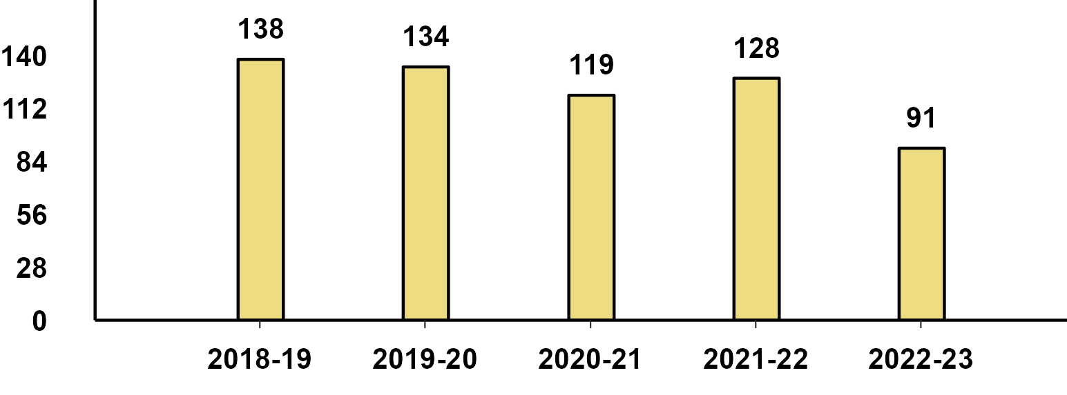
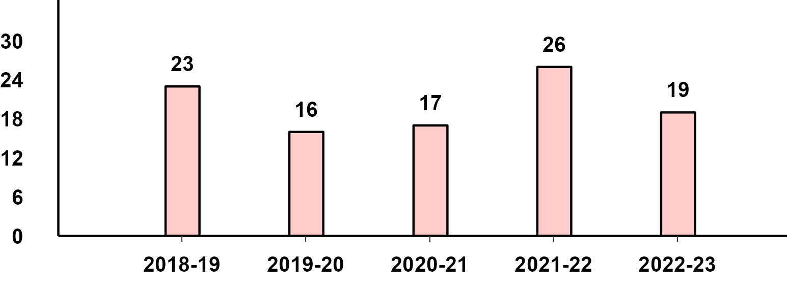
Q3 Export Performance
Passenger Vehicle Exports (Q3)
Two-Wheeler Exports (Q3)
Three-Wheeler Exports (Q3)
Commercial Vehicle Exports (Q3)

Slide 13
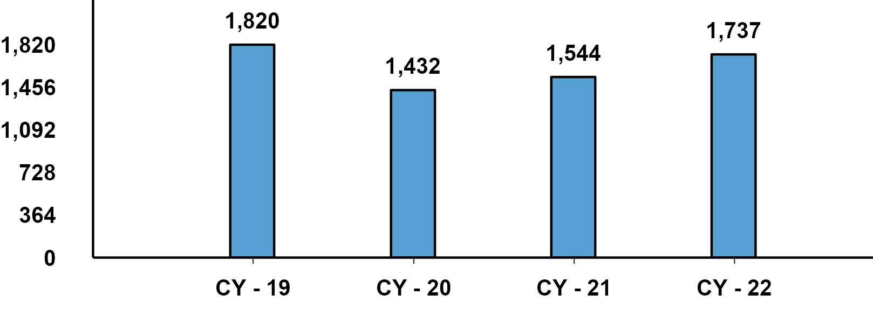
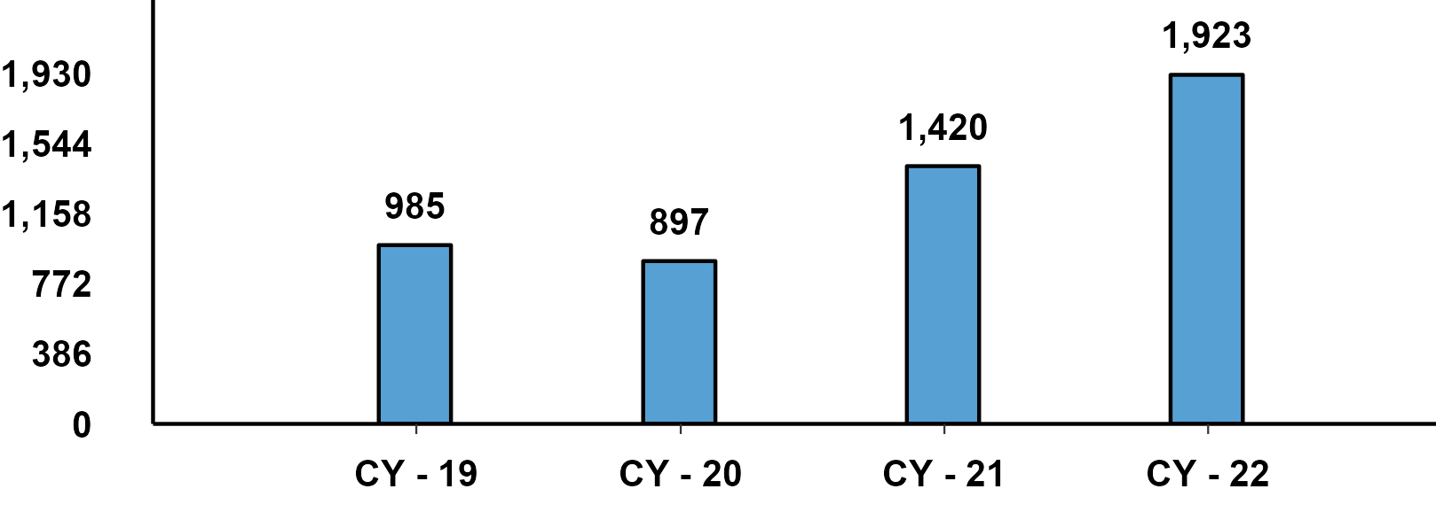
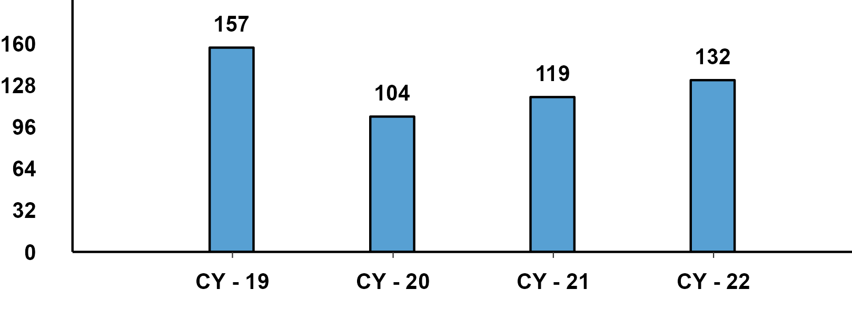
Passenger Vehicle: Sub-Category - CY(Jan-Dec) Performance
PVs - Passenger Cars - CY Domestic Sales
PVs - Utility Vehicles - CY Domestic Sales
PVs - Vans - CY Domestic Sales

Slide 14
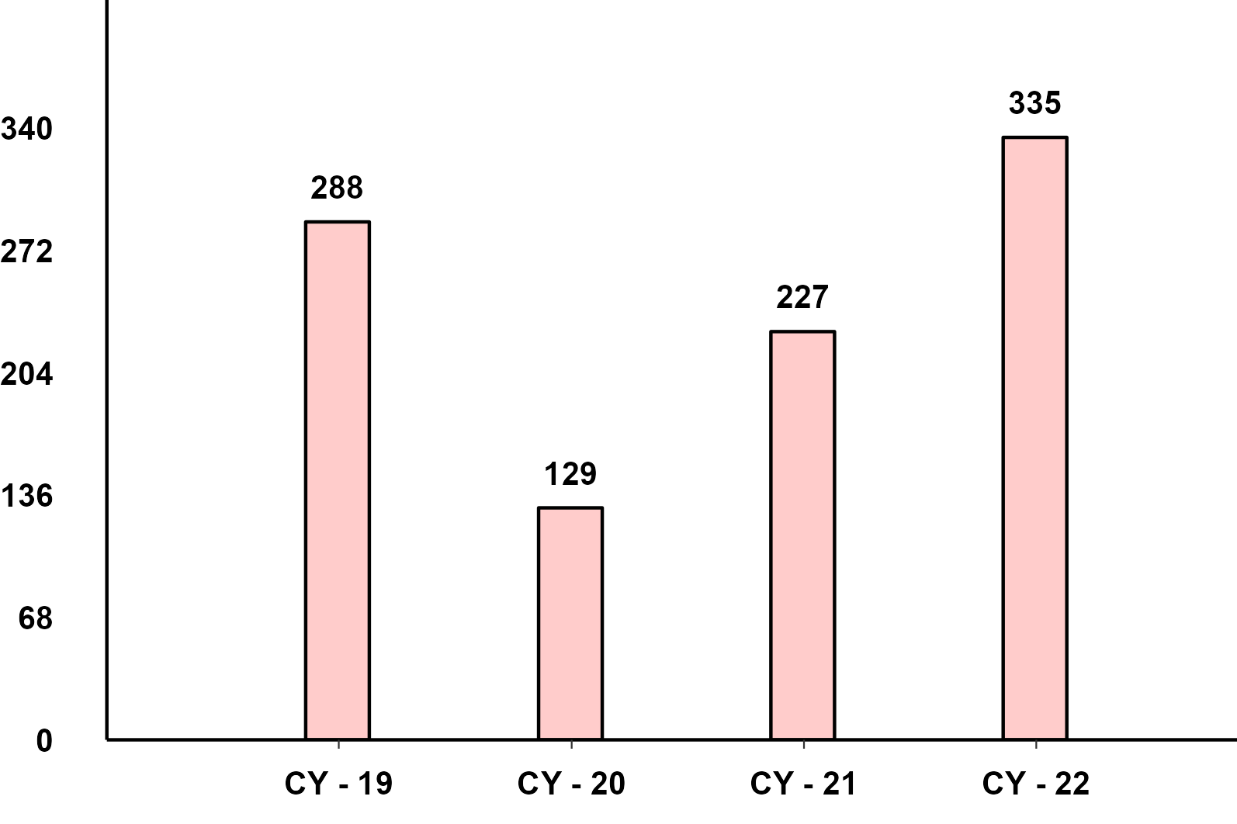
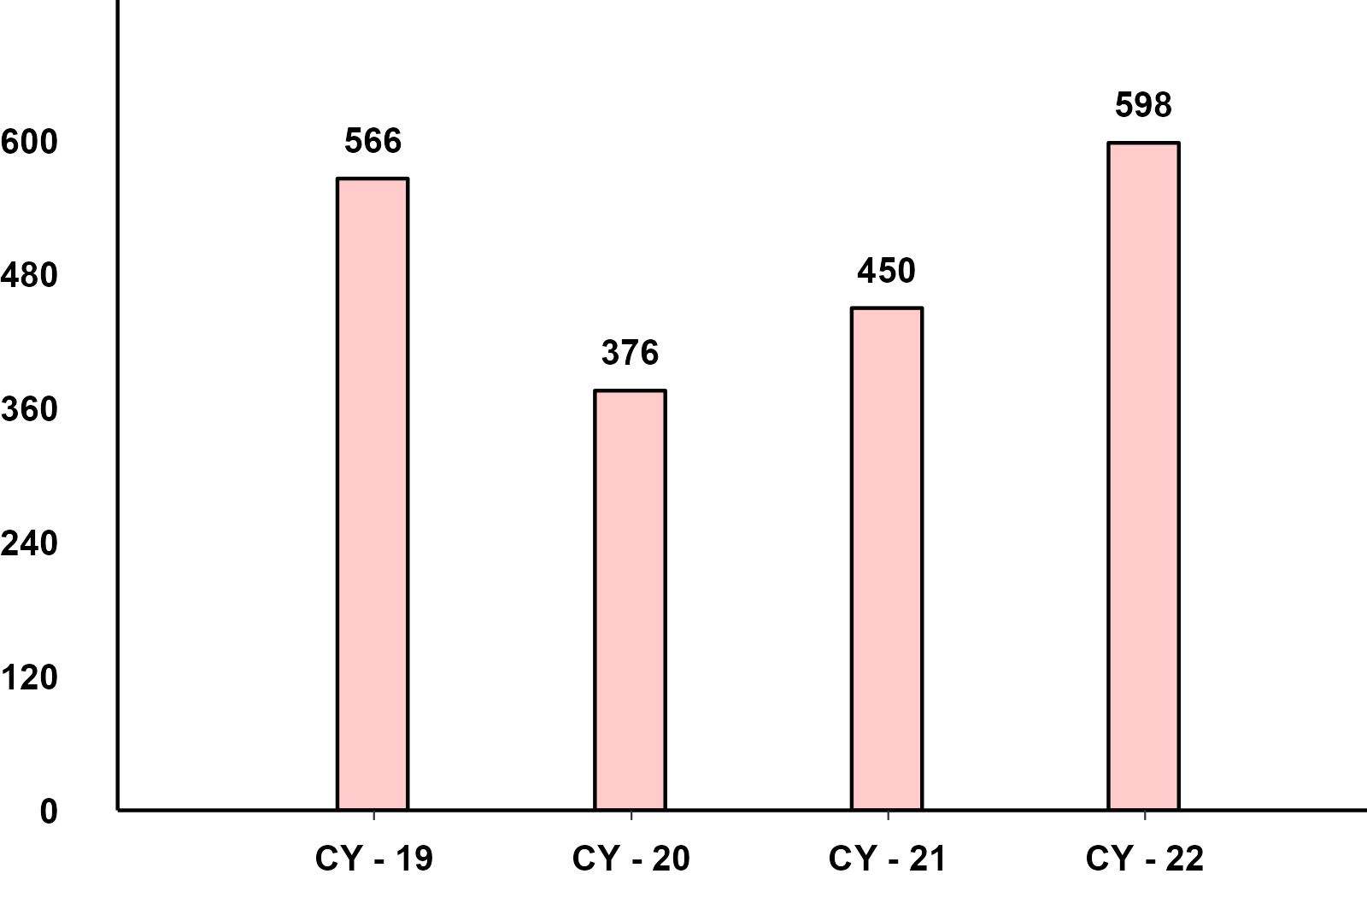
Commercial Vehicles: Sub-Category - CY(Jan-Dec) Performance
M&HCV - CY Domestic Sales
LCV - CY Domestic Sales

Slide 15
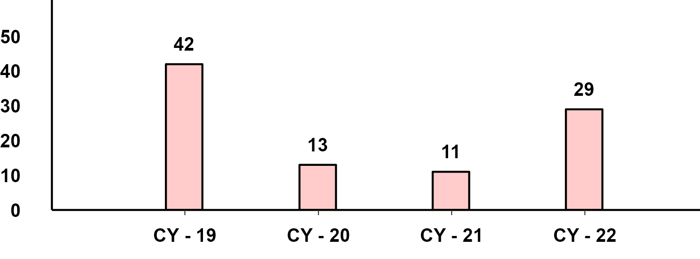
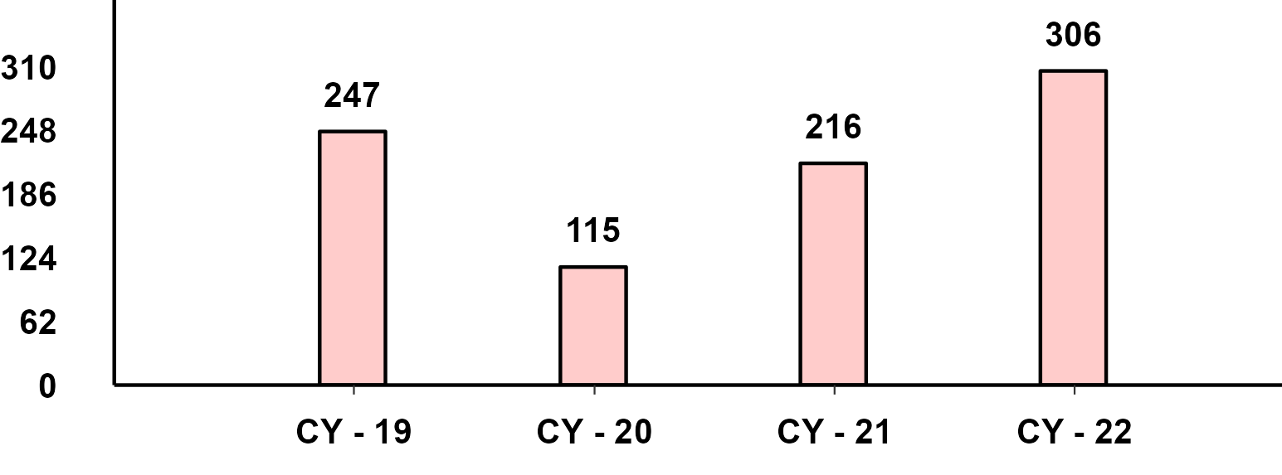
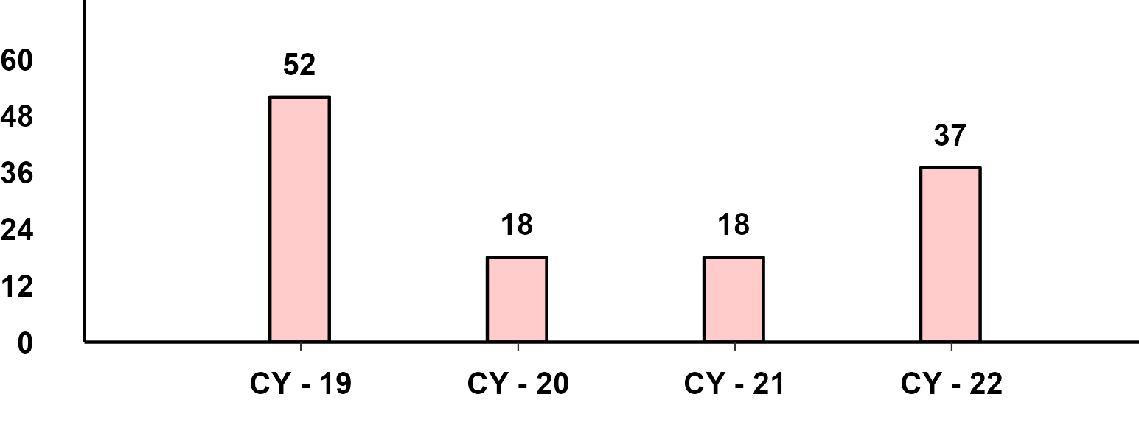
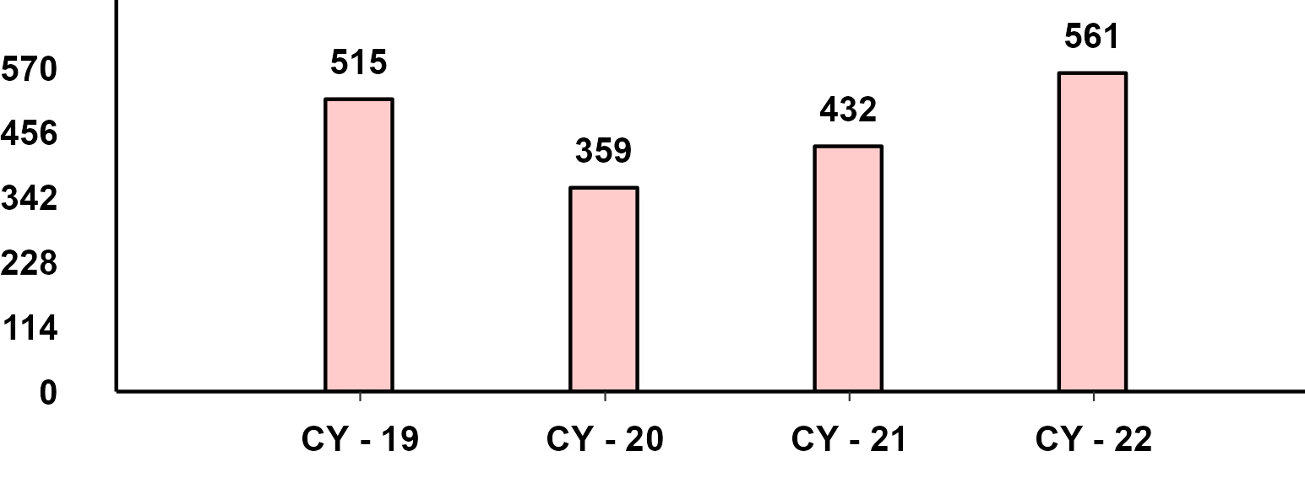
Commercial Vehicles- Passengers & Goods - CY(Jan-Dec) Performance
M&HCV Passenger - CY Domestic Sales
M&HCV Goods - CY Domestic Sales
LCV Passenger - CY Domestic Sales
LCV Goods - CY Domestic Sales

Slide 16
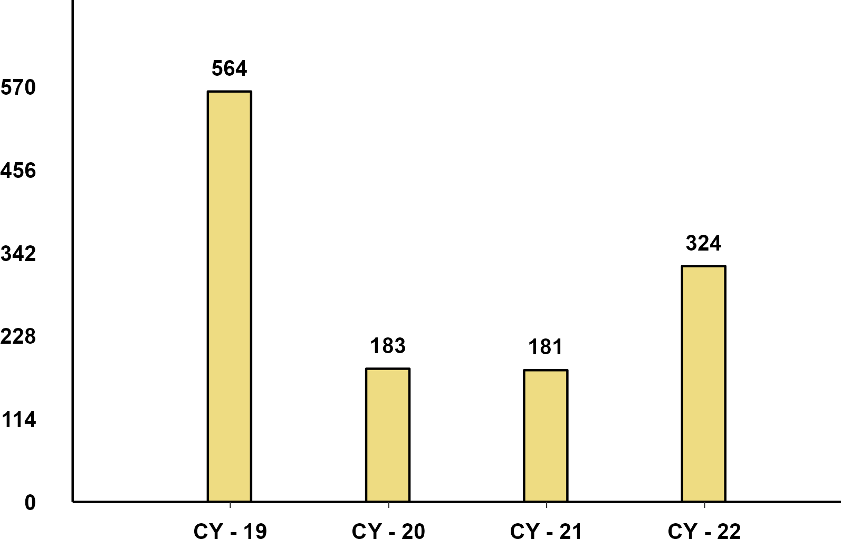
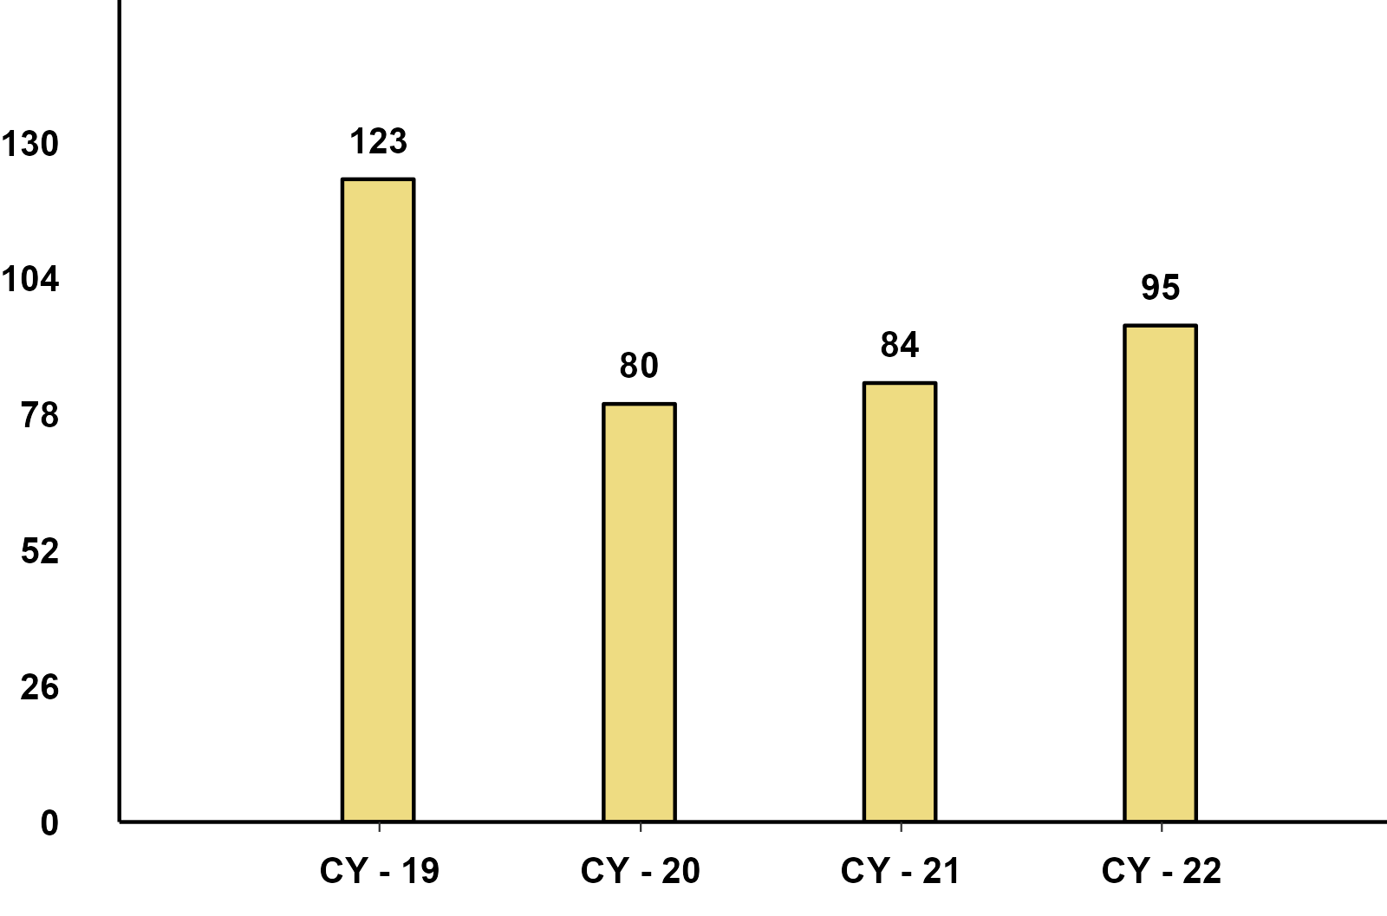
Three Wheelers - Passenger & Goods - CY(Jan-Dec) Performance
Three Wheeler - Passenger - CY Domestic Sales
Three Wheeler - Goods - CY Domestic Sales

Slide 17
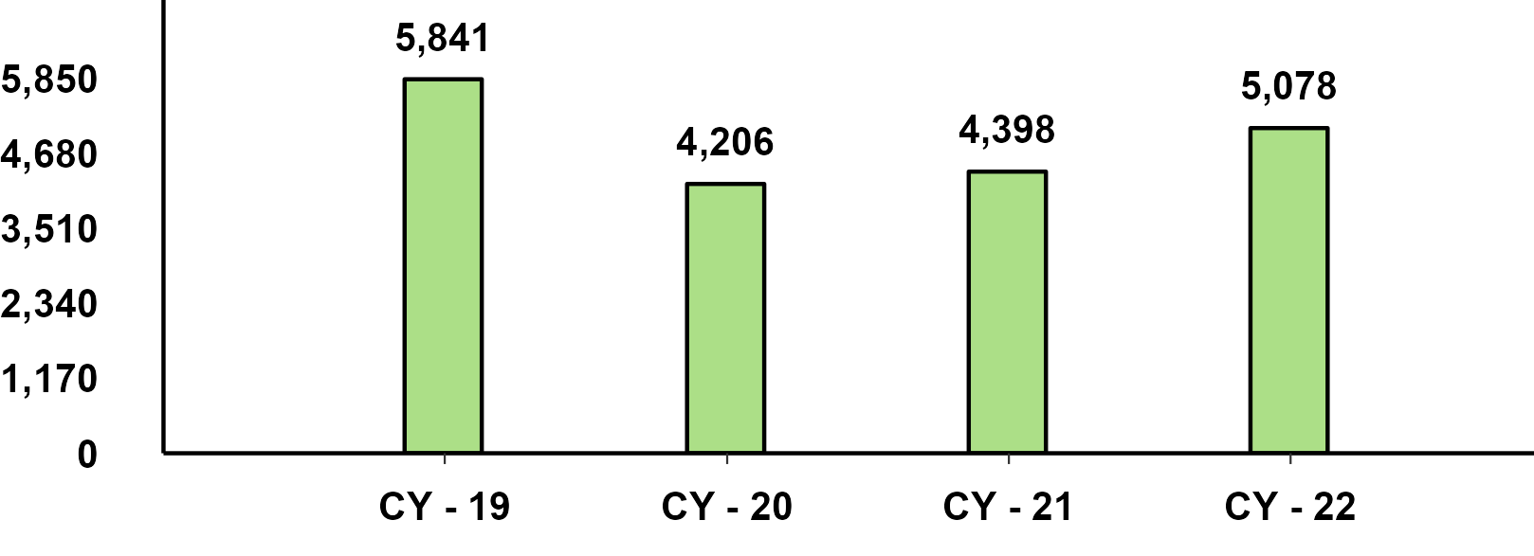

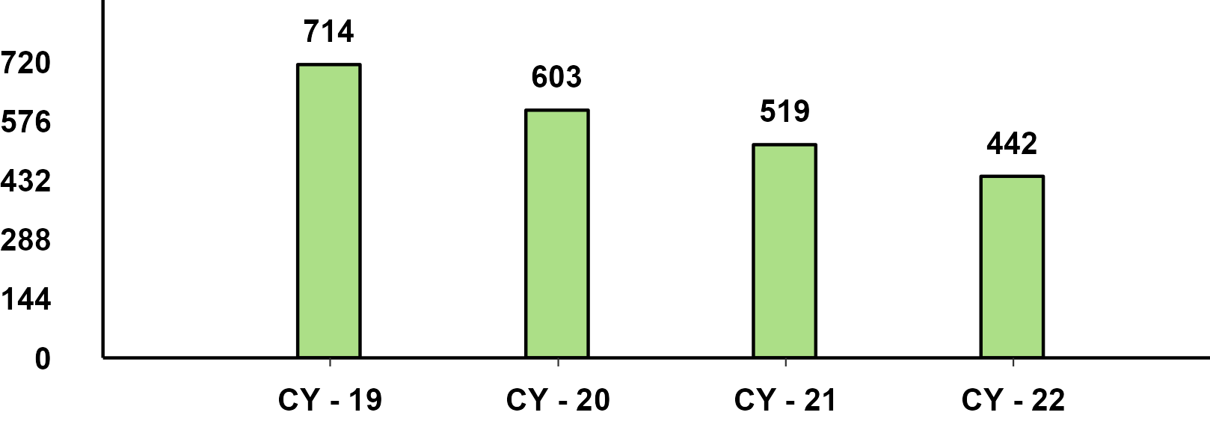
Two Wheelers Sub-Category - CY(Jan-Dec) Performance
Two Wheeler - Scooters - CY Performance
Two Wheeler - Motorcycles - CY Performance
Two Wheeler - Mopeds - CY Performance

Slide 18
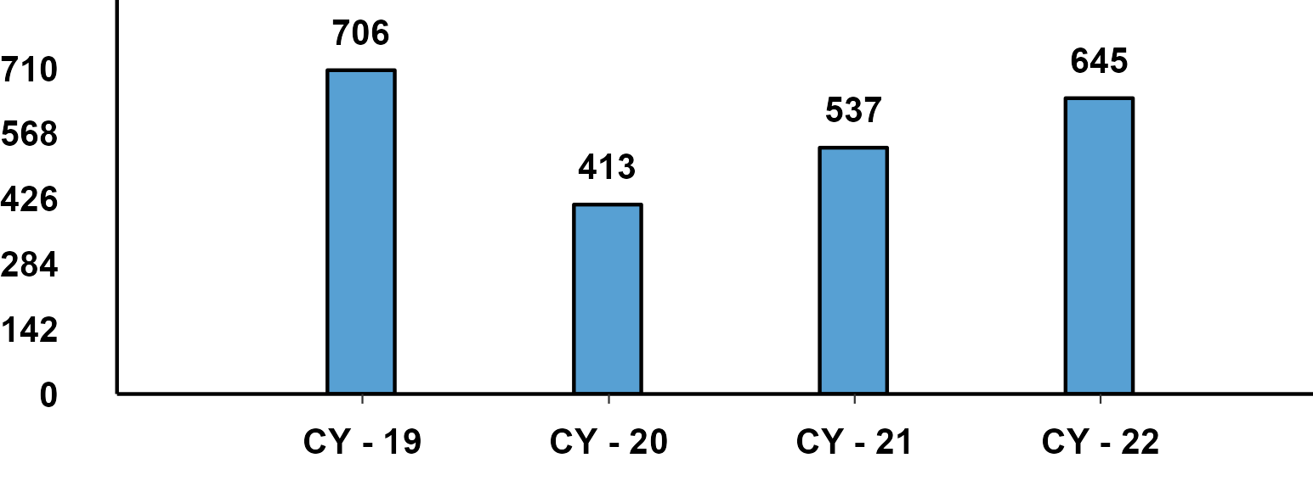
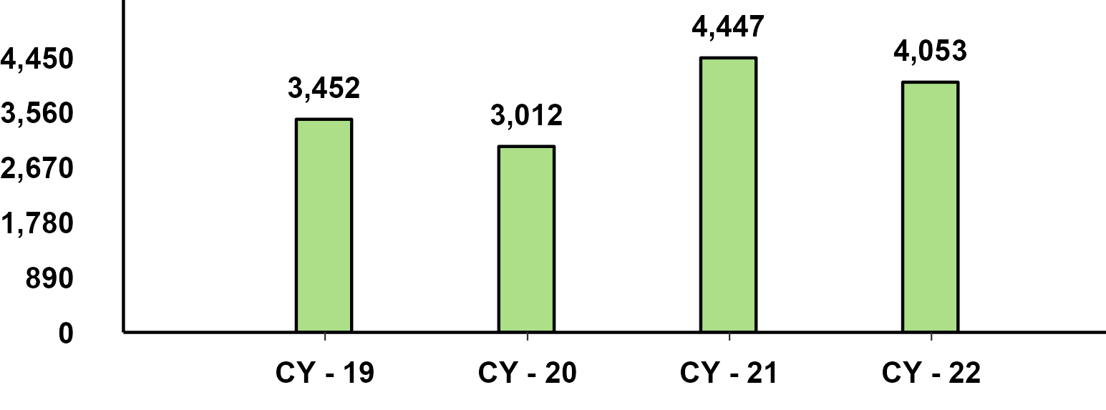
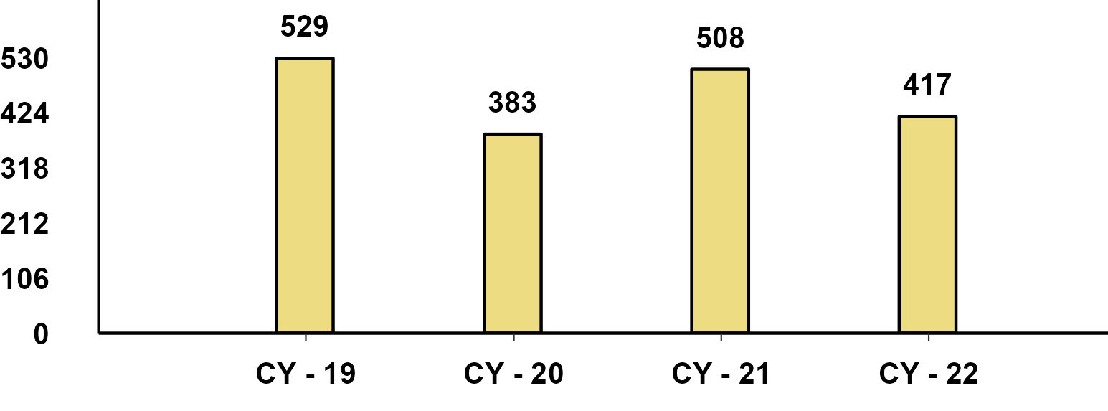
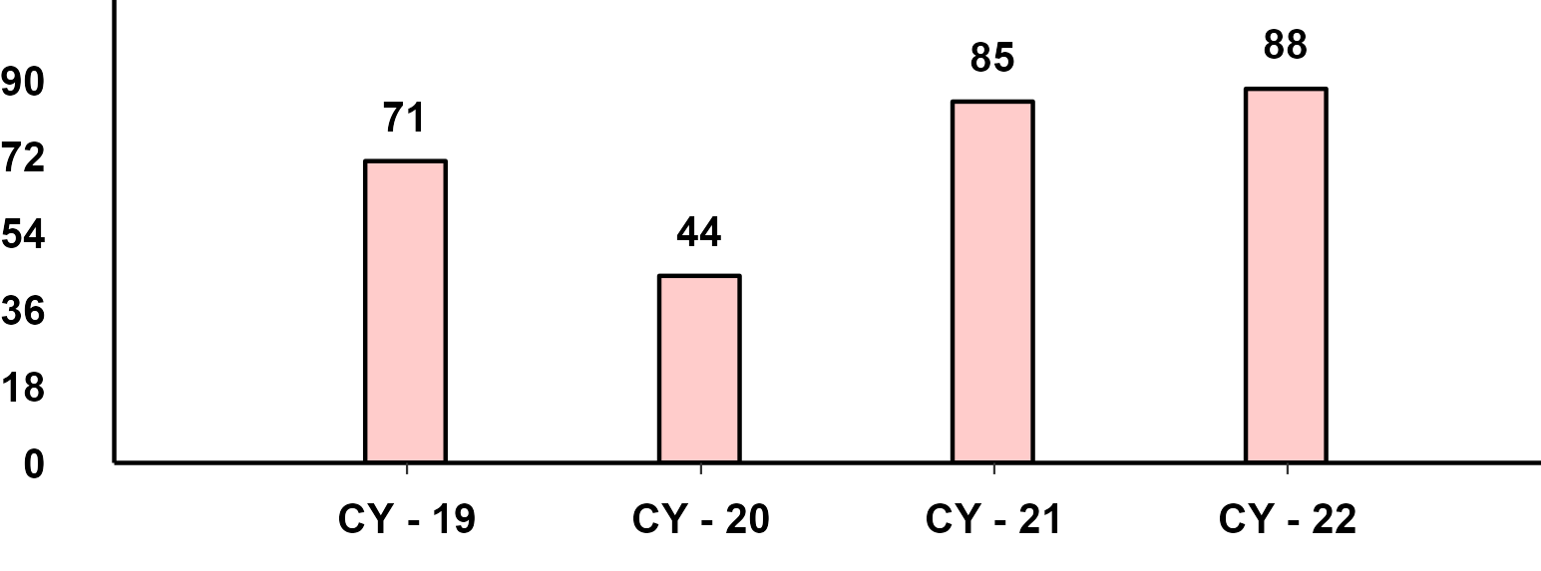
CY(Jan-Dec) Export Performance
Passenger Vehicle Exports (CY)
Two-Wheeler Exports (CY)
Three-Wheeler Exports (CY)
Commercial Vehicle Exports (CY)

