Slide 1
2023-24 Data Overview
(Q4 - FY) NEW DELHI

Slide 2
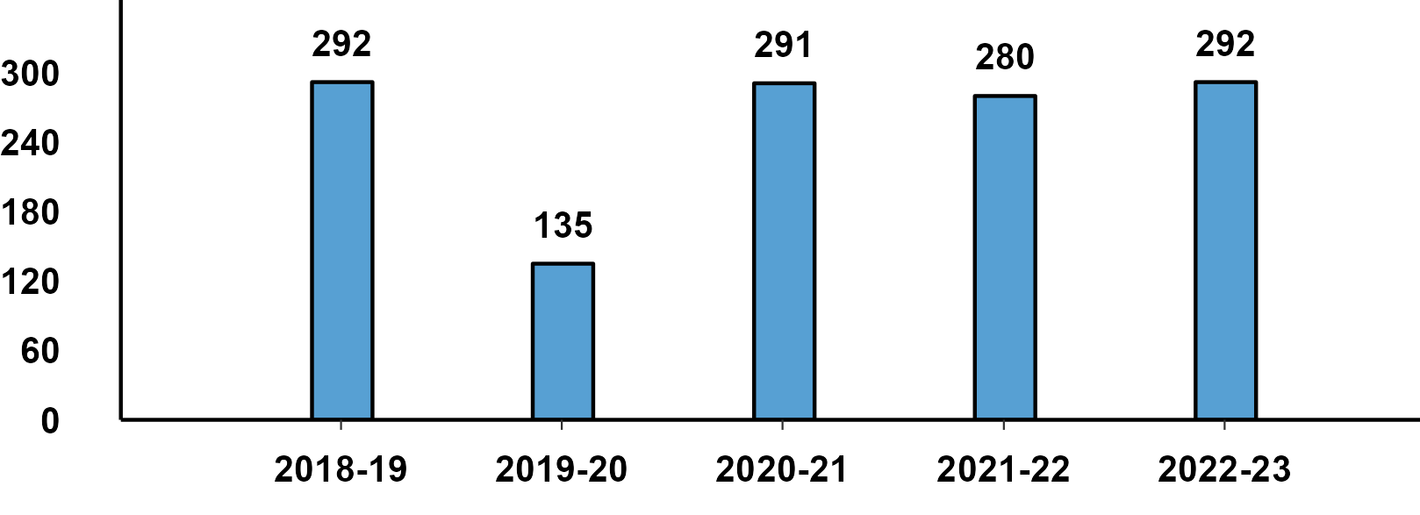
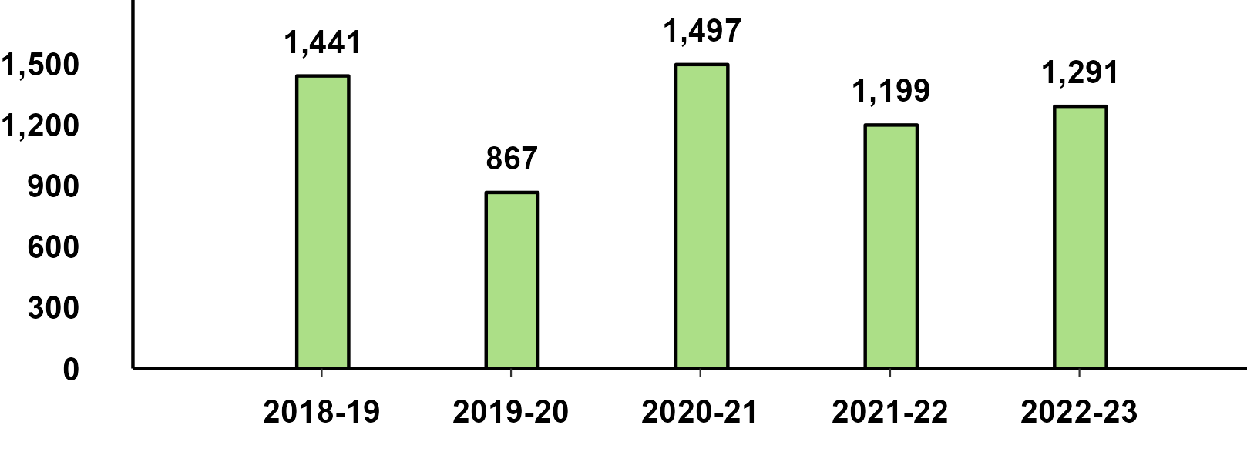
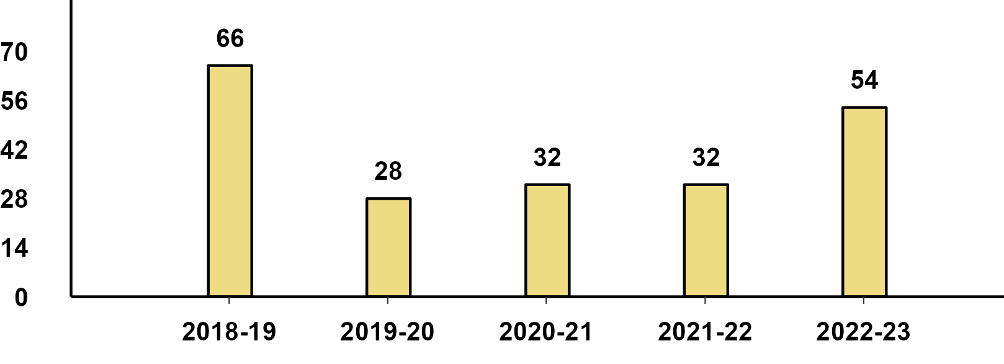
Domestic Sales - March Performance
Passenger Vehicle - March Performance
Two-Wheeler - March Performance
Three-Wheeler - March Performance

Slide 3
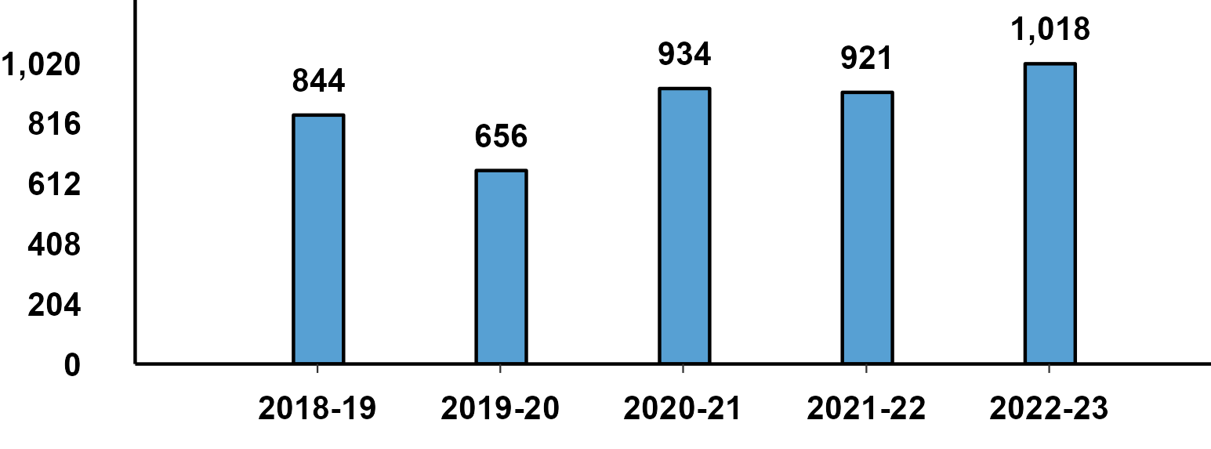
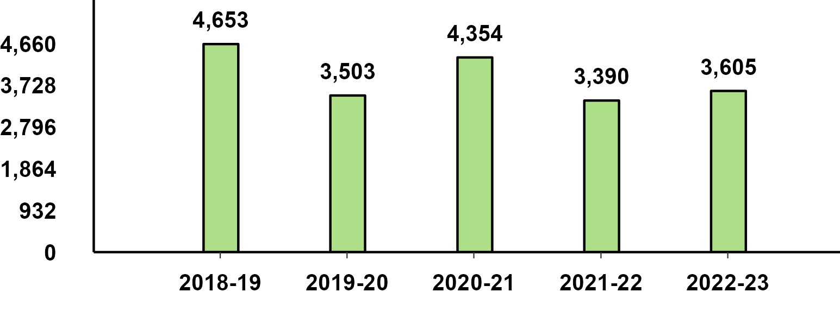
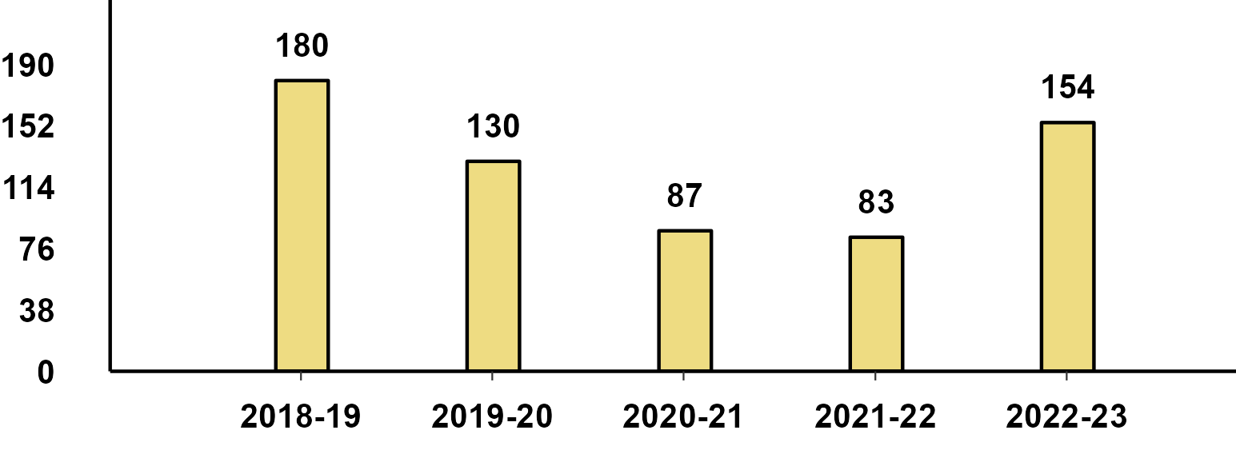
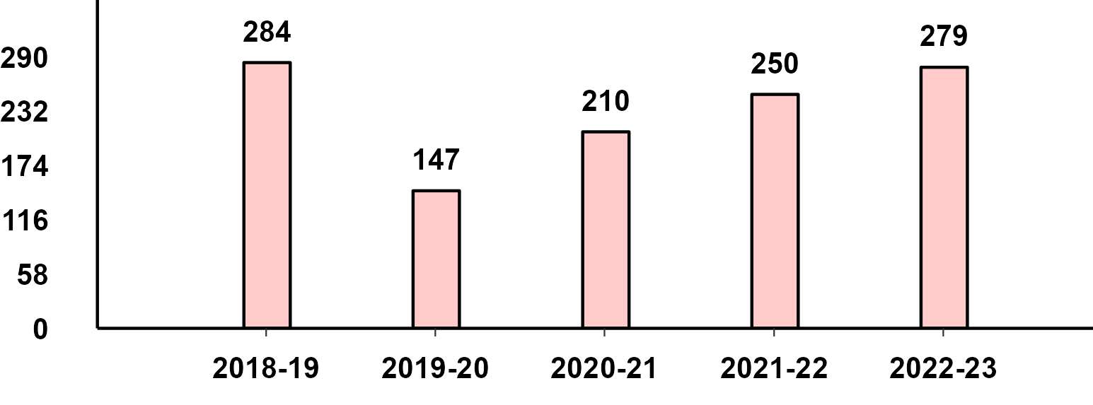
Domestic Sales - Q4(Jan-Mar) Performance
Passenger Vehicle - Q4 Performance
Two-Wheeler - Q4 Performance
Three-Wheeler - Q4 Performance
Commercial Vehicle - Q4 Performance

Slide 4
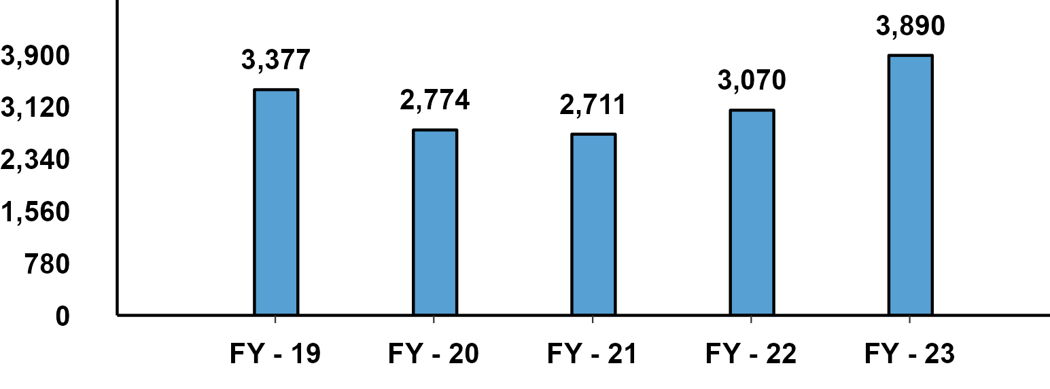
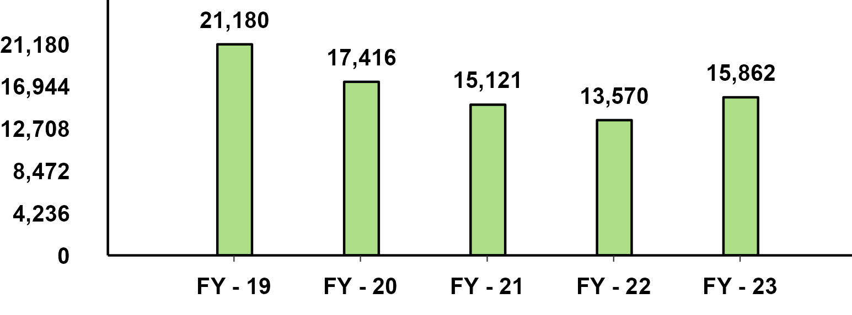
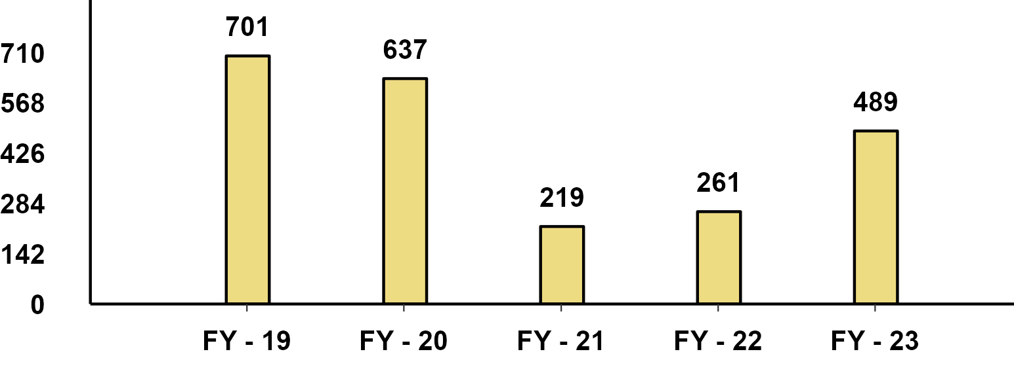
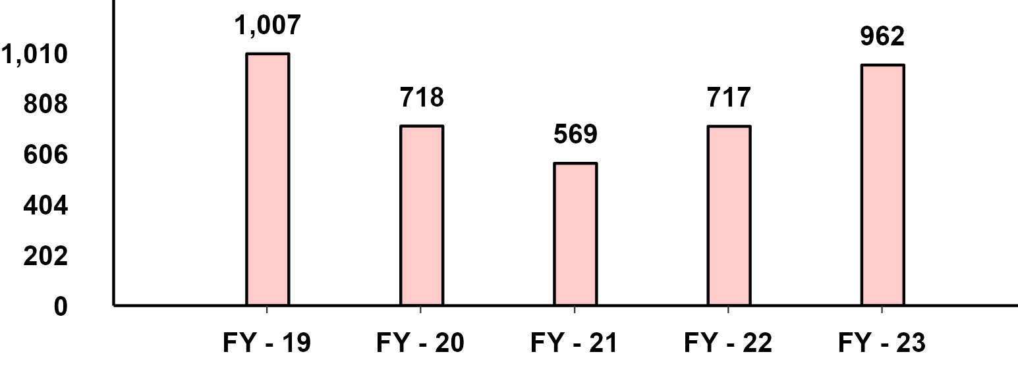
Domestic Sales - FY(Apr-Mar) Performance
Passenger Vehicle - FY Performance
Two-Wheeler - FY Performance
Three-Wheeler - FY Performance
Commercial Vehicle - FY Performance

Slide 5
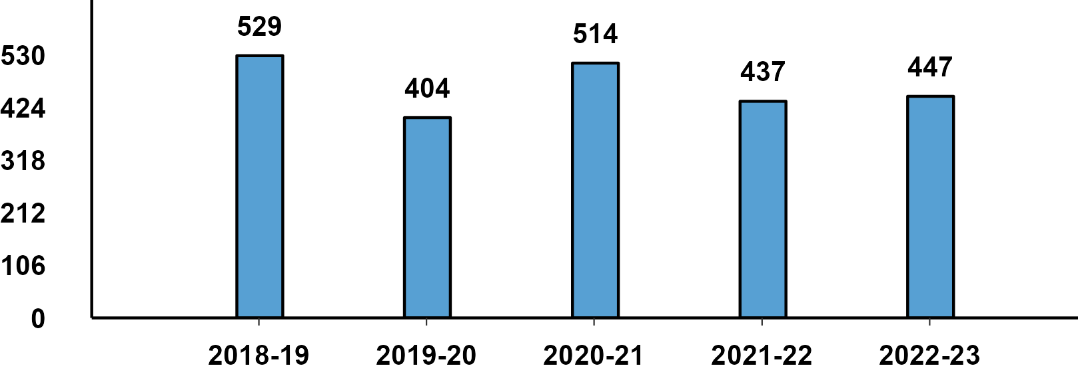
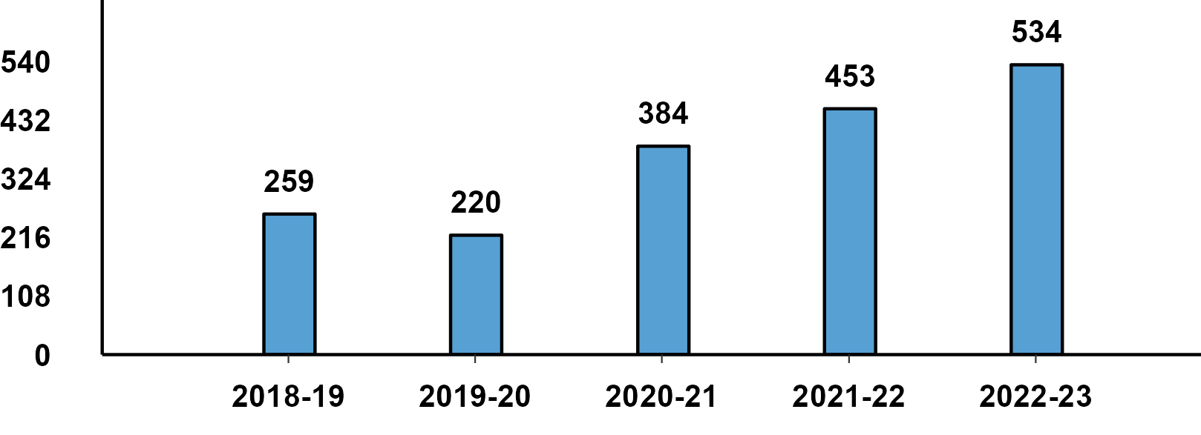
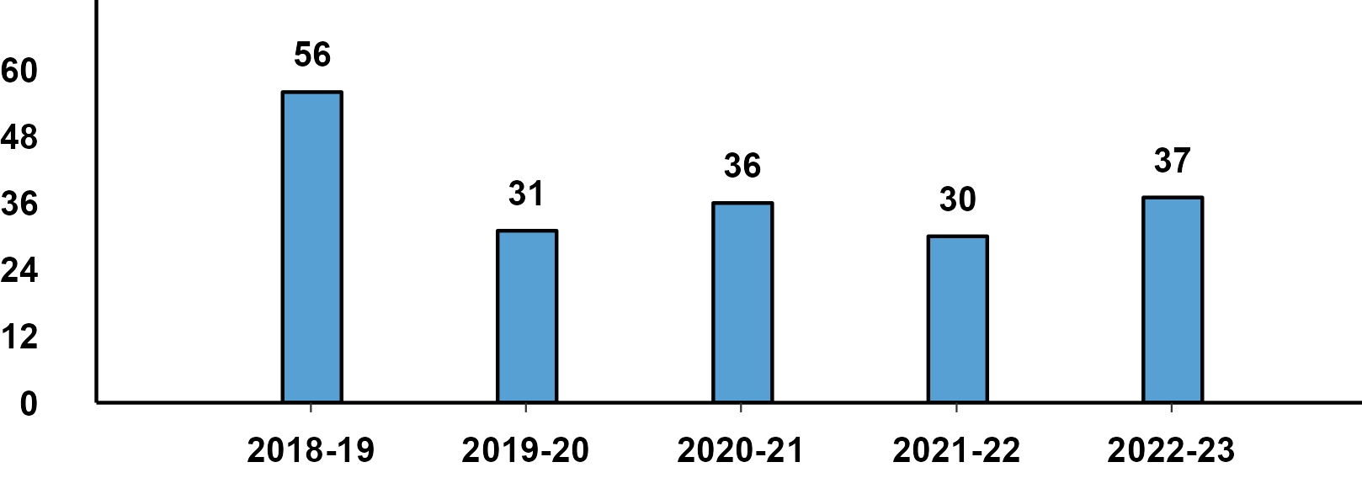
Passenger Vehicle: Sub-Category - Q4 Performance
PVs - Passenger Cars - Q4 Domestic Sales
PVs - Utility Vehicles - Q4 Domestic Sales
PVs - Vans - Q4 Domestic Sales

Slide 6
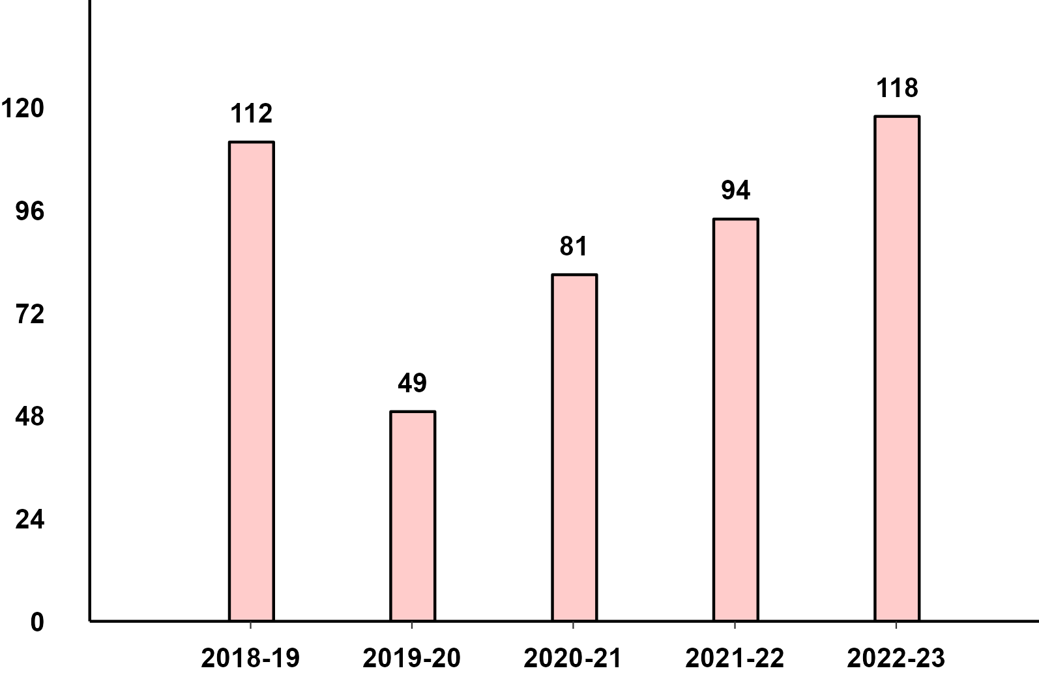
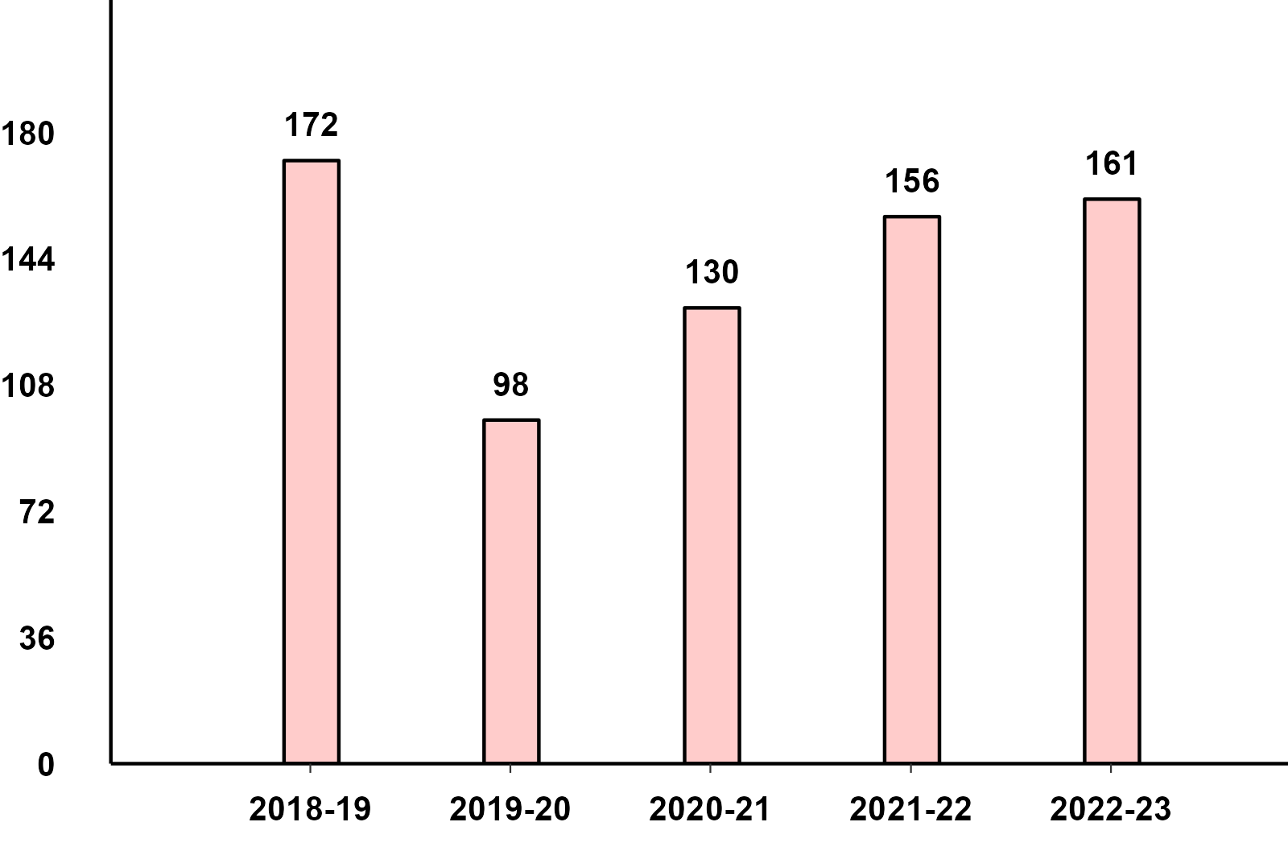
Commercial Vehicles: Sub-Category - Q4 Performance
M&HCV - Q4 Domestic Sales
LCV - Q4 Domestic Sales

Slide 7
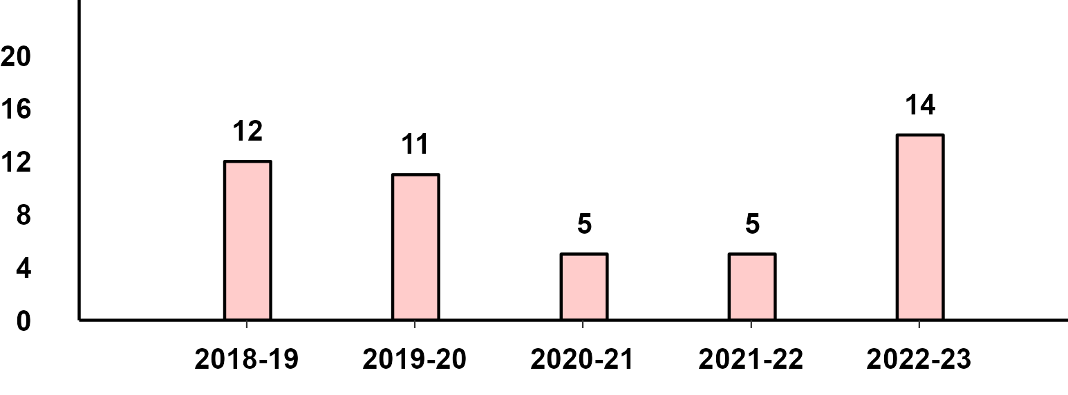
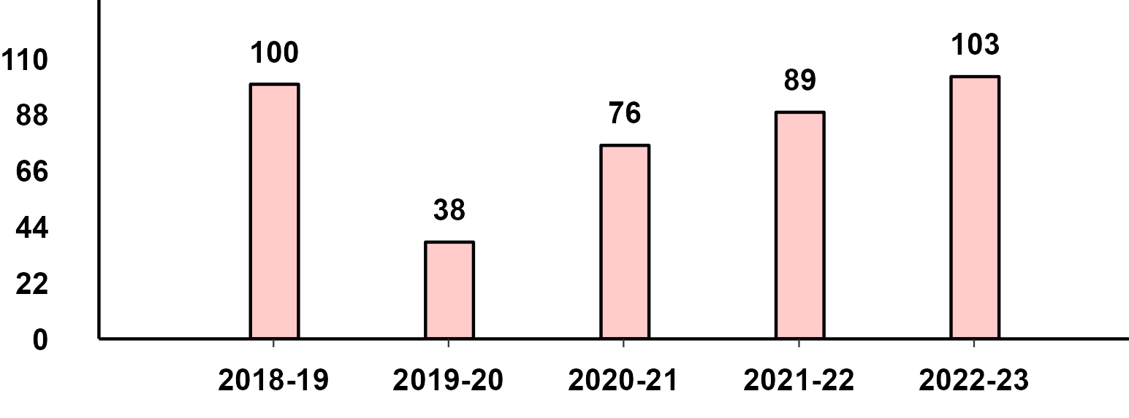
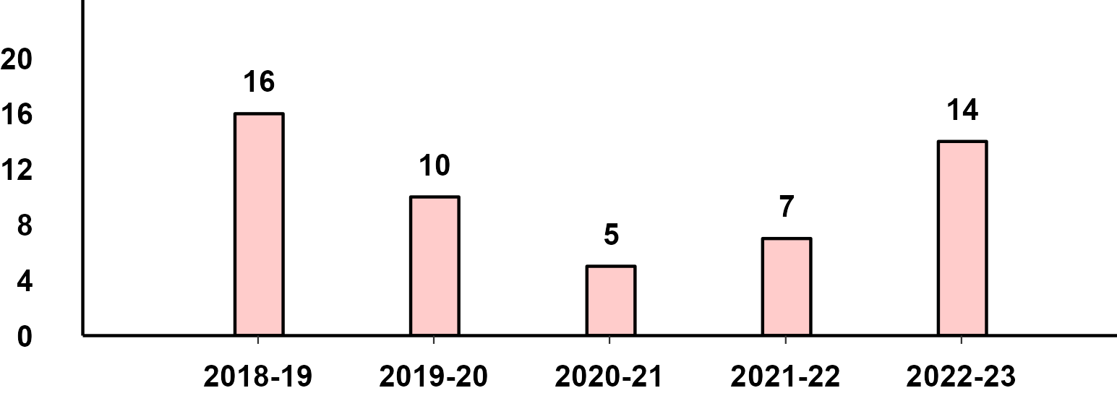
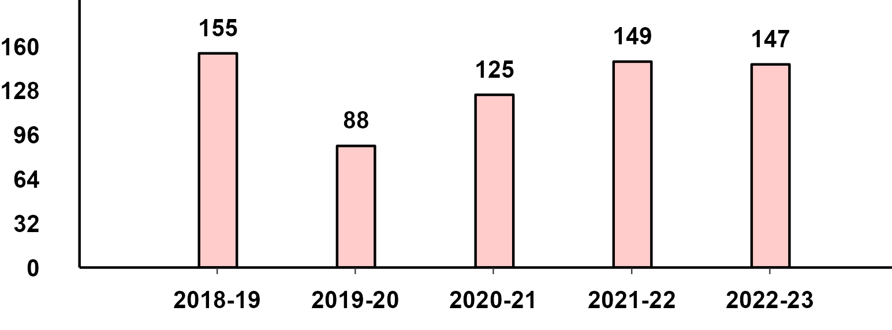
Commercial Vehicles- Passengers & Goods - Q4 Performance
M&HCV Passenger - Q4 Domestic Sales
M&HCV Goods - Q4 Domestic Sales
LCV Passenger - Q4 Domestic Sales
LCV Goods - Q4 Domestic Sales

Slide 8
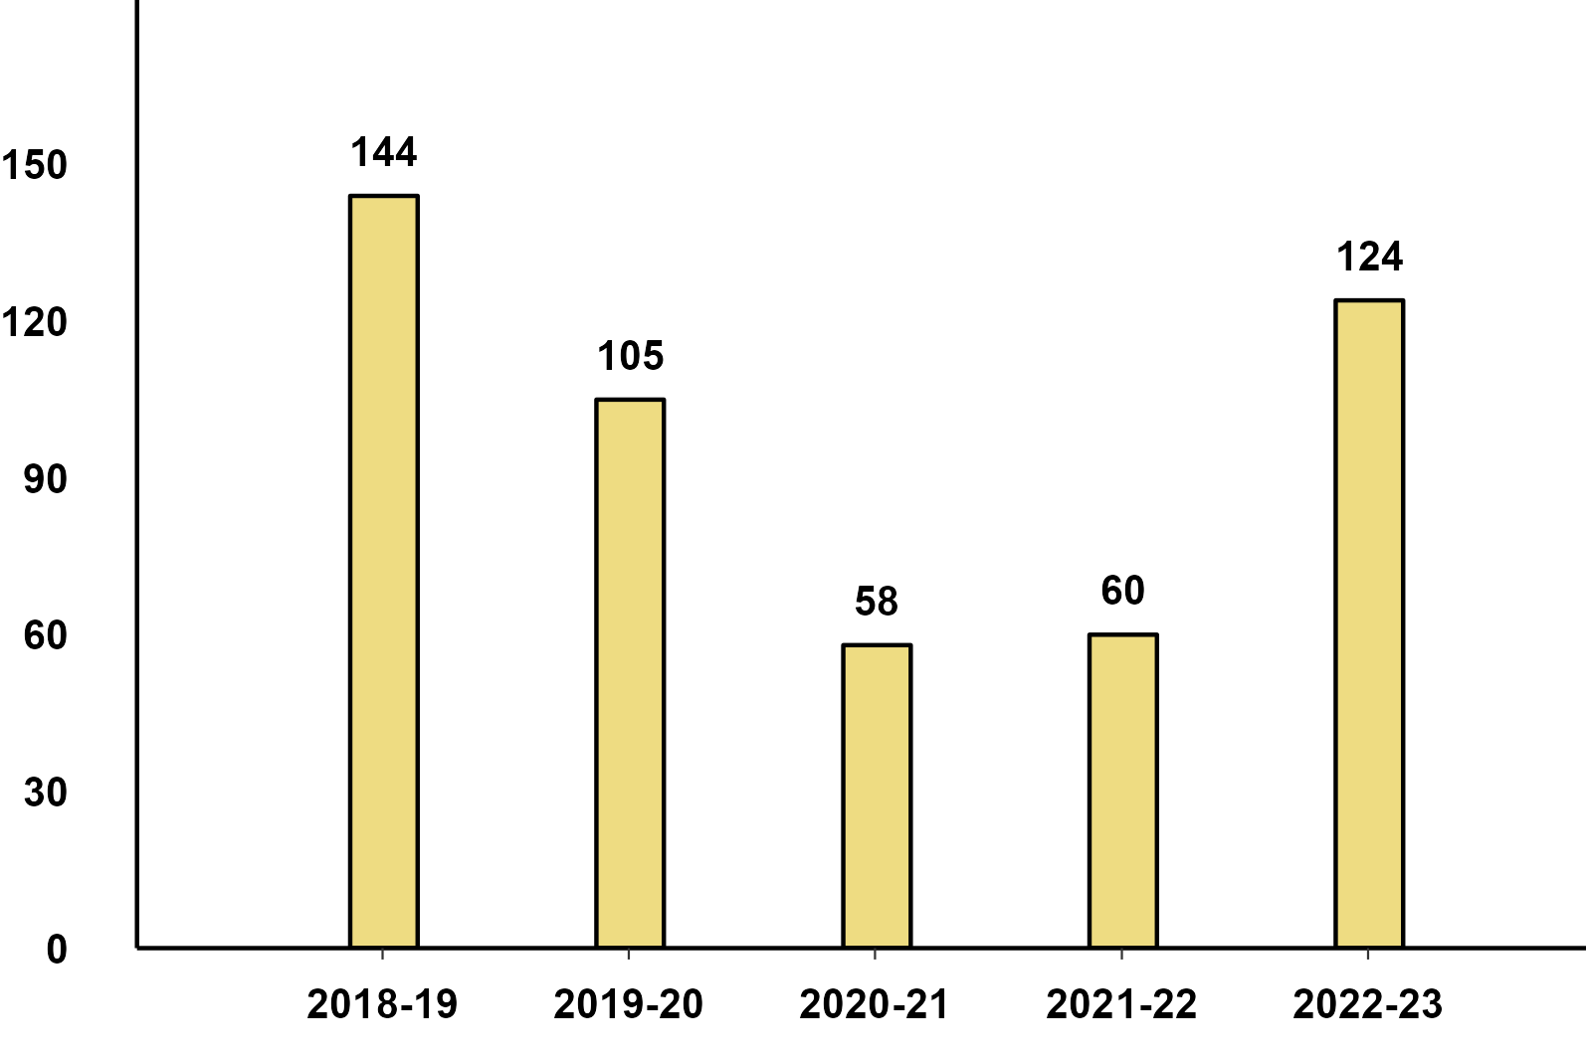
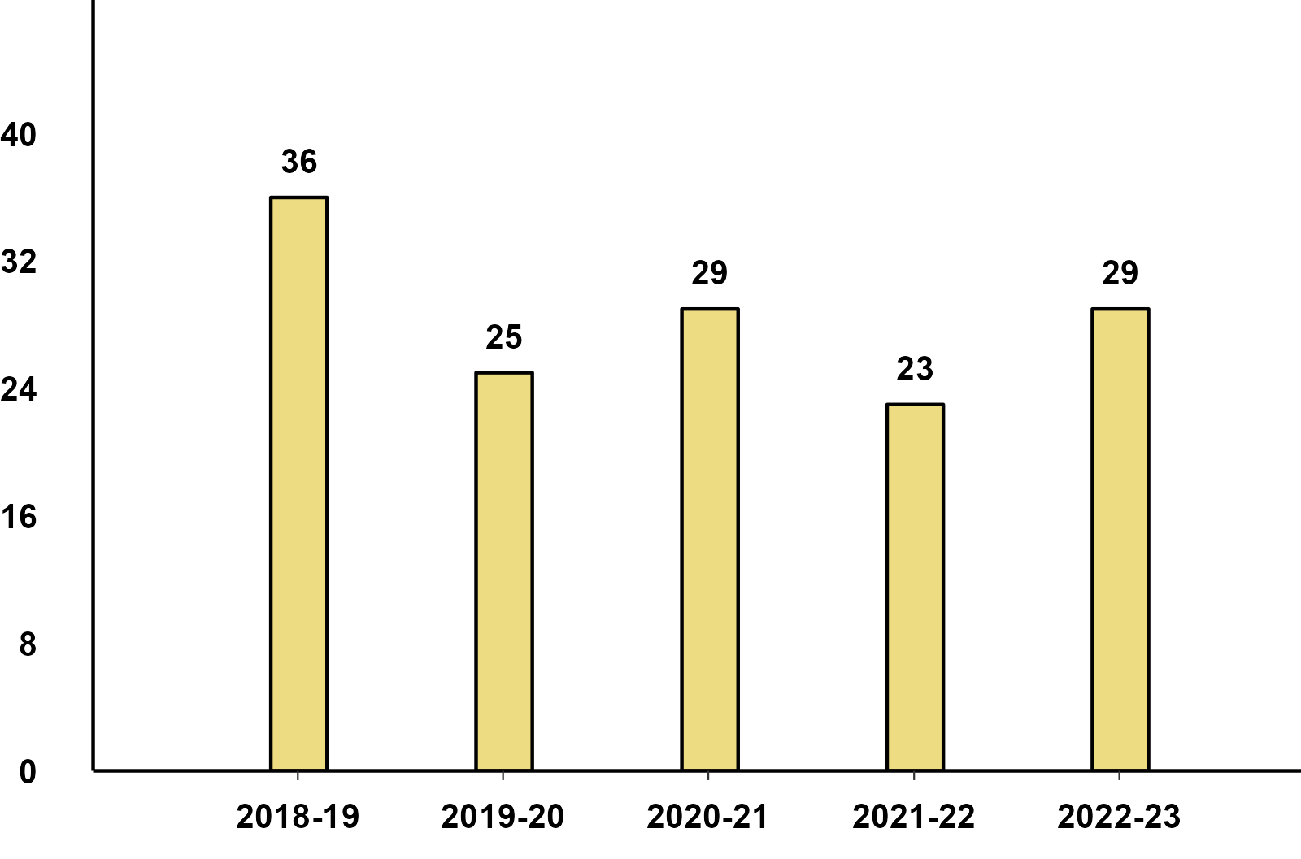
Three Wheelers - Passenger & Goods - Q4 Performance
Three-Wheeler - Passenger - Q4 Domestic Sales
Three-Wheeler - Goods - Q4 Domestic Sales

Slide 9
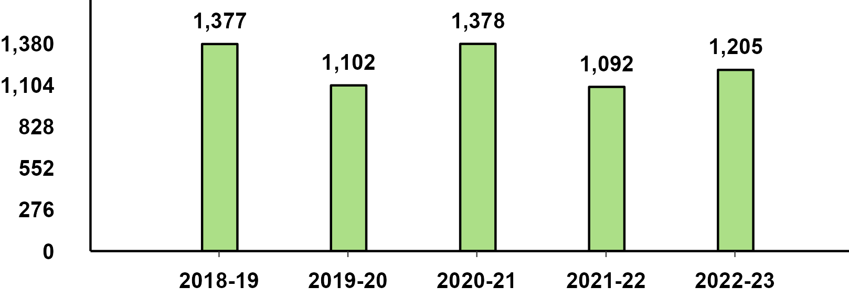
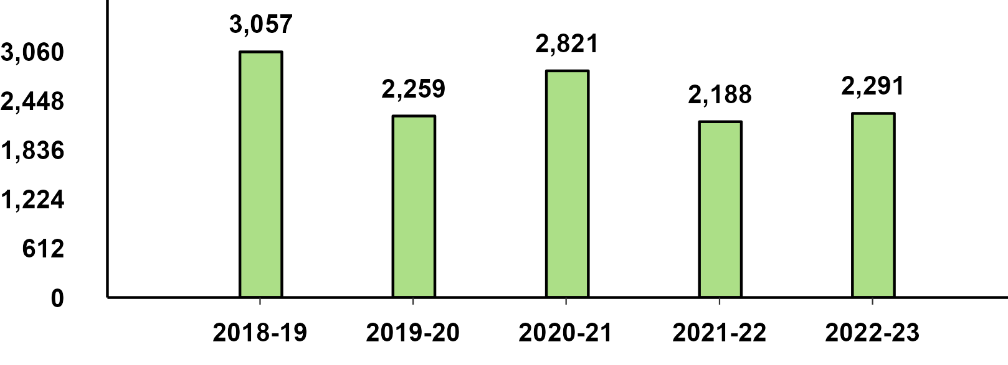
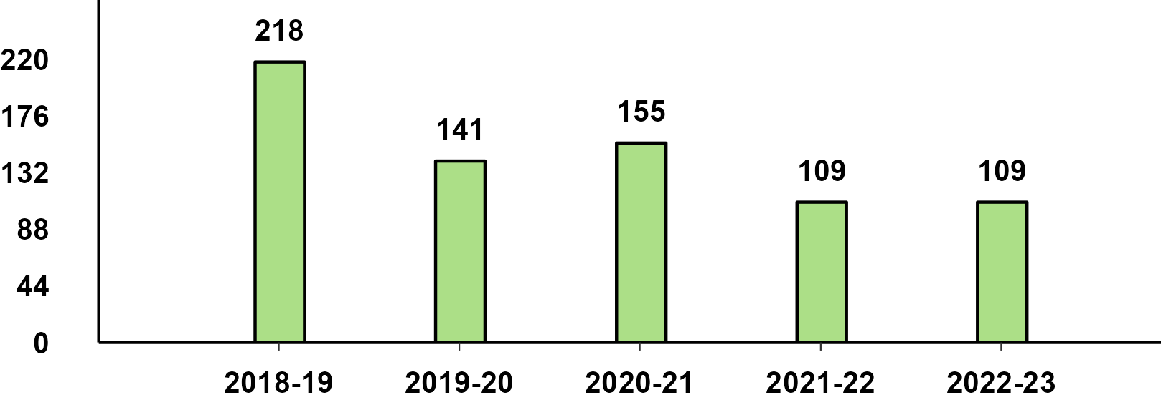
Two Wheelers Sub-Category - Q4 Performance
Two-Wheeler - Scooters - Q4 Performance
Two-Wheeler - Motorcycles - Q4 Performance
Two-Wheeler - Mopeds - Q4 Performance

Slide 10
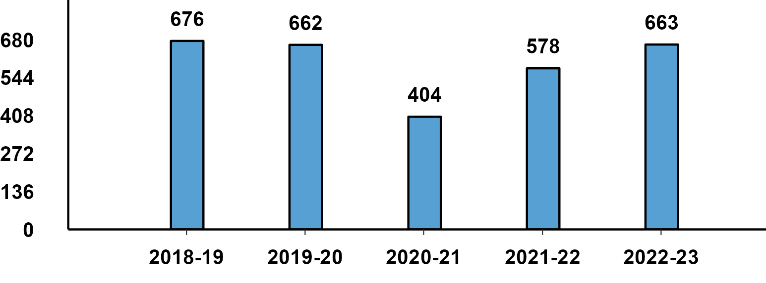
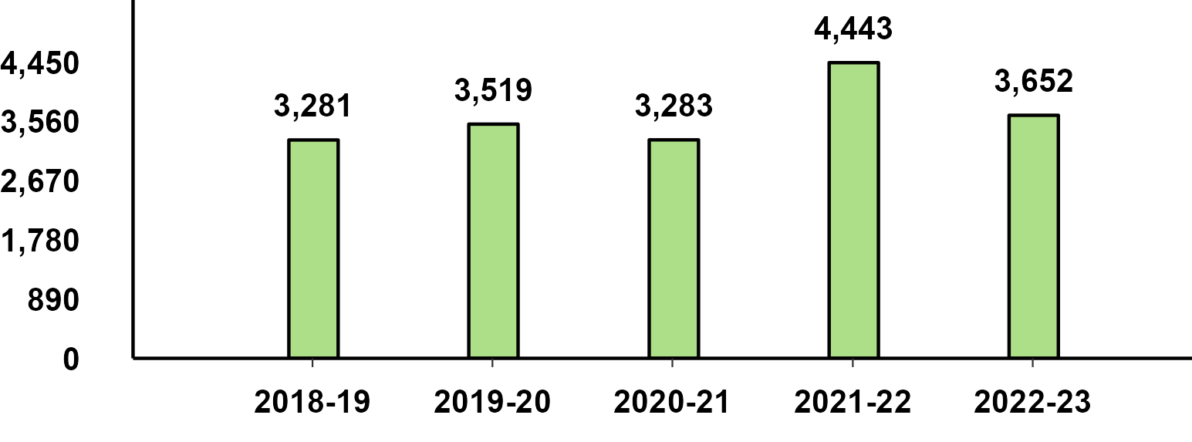
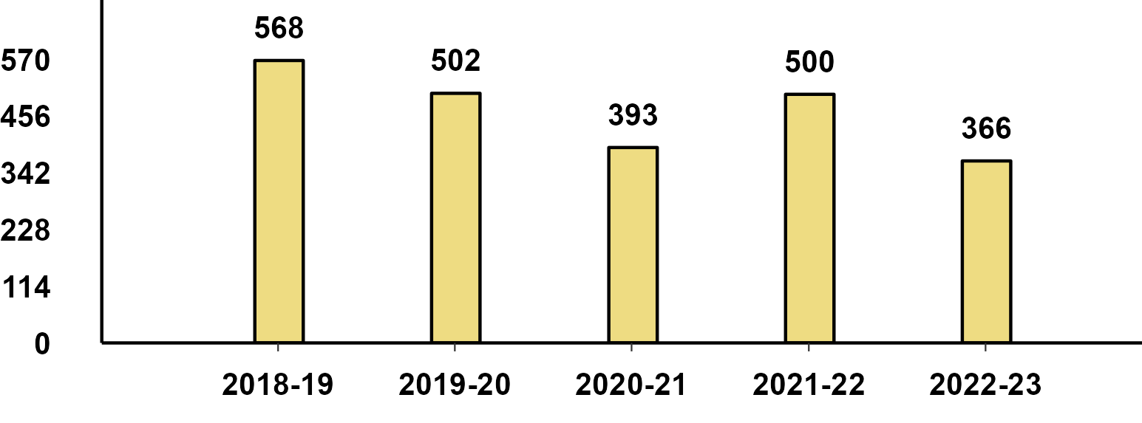
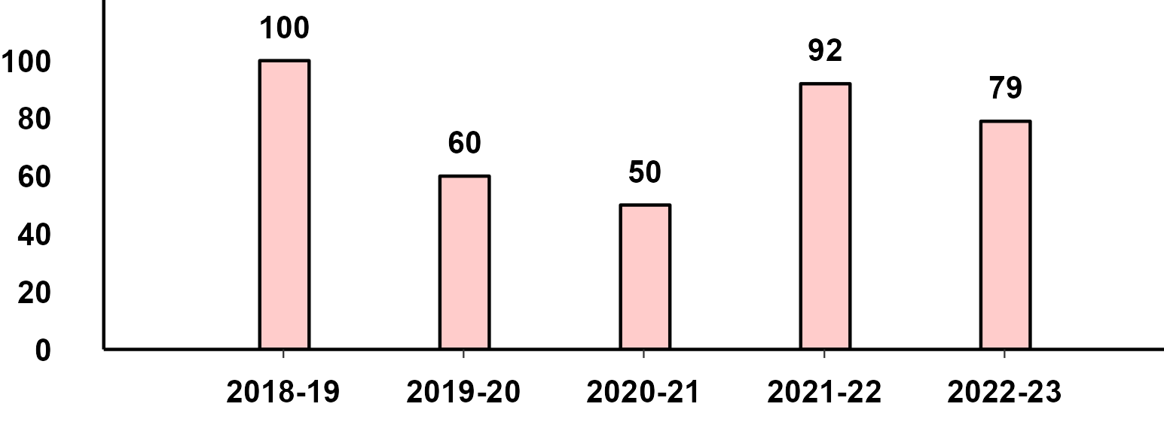
Q4 Export Performance
Passenger Vehicle Exports (Q4)
Two-Wheeler Exports (Q4)
Three-Wheeler Exports (Q4)
Commercial Vehicle Exports (Q4)

Slide 11
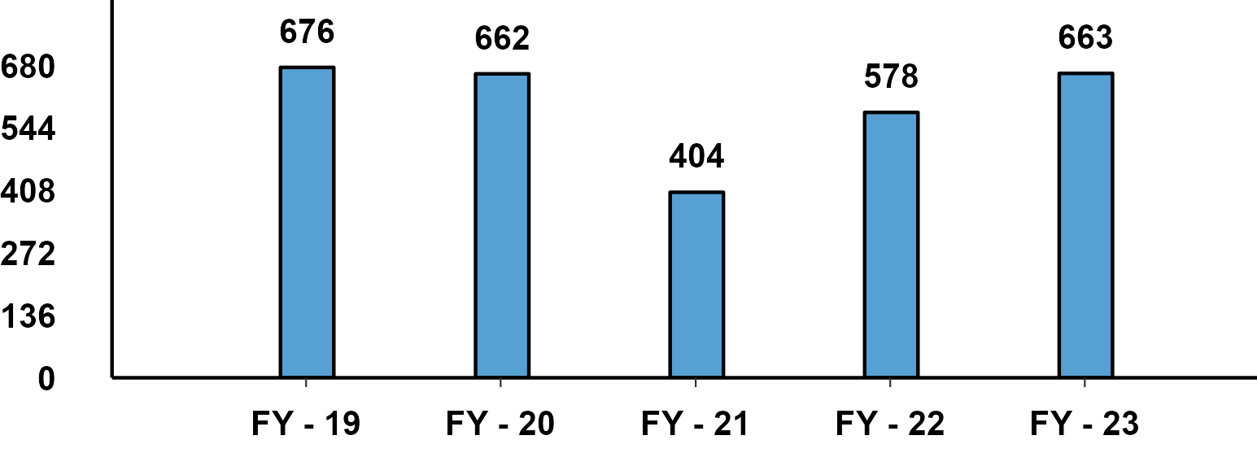
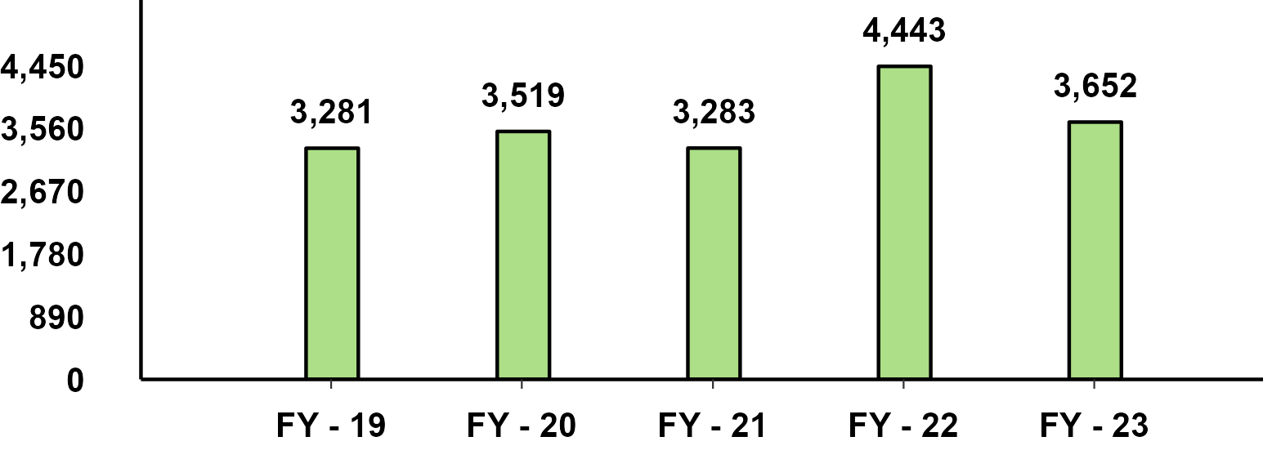
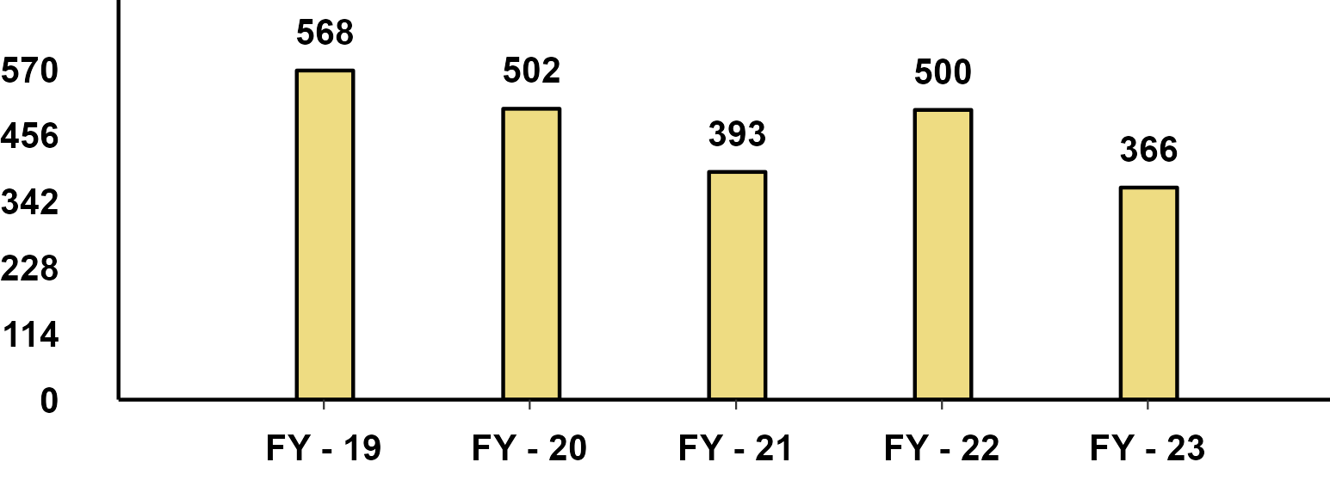
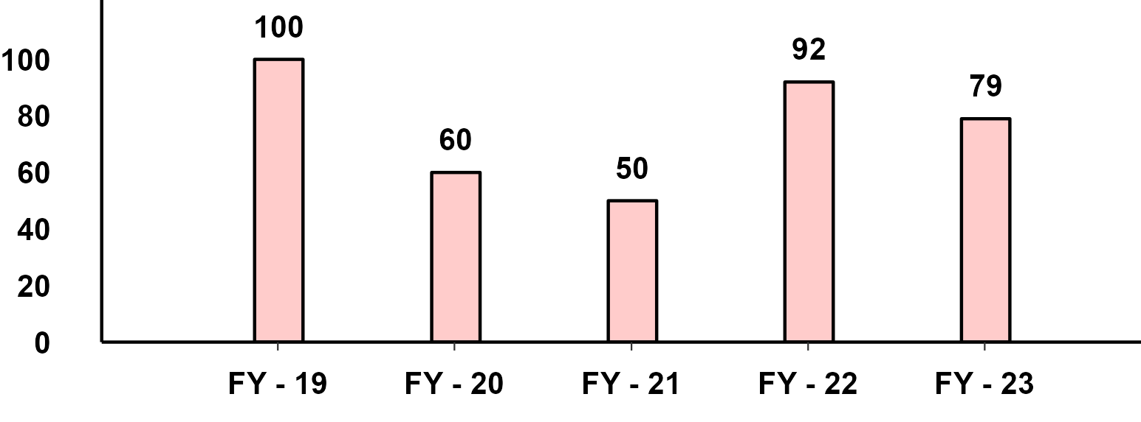
FY(Apr-Mar) Export Performance
Passenger Vehicle - FY Performance
Two-Wheeler - FY Performance
Three-Wheeler - FY Performance
Commercial Vehicle - FY Performance

