Slide 1
CPI and IIP
ENDOWMENT INVESTMENT
August 20, 2024

Slide 2
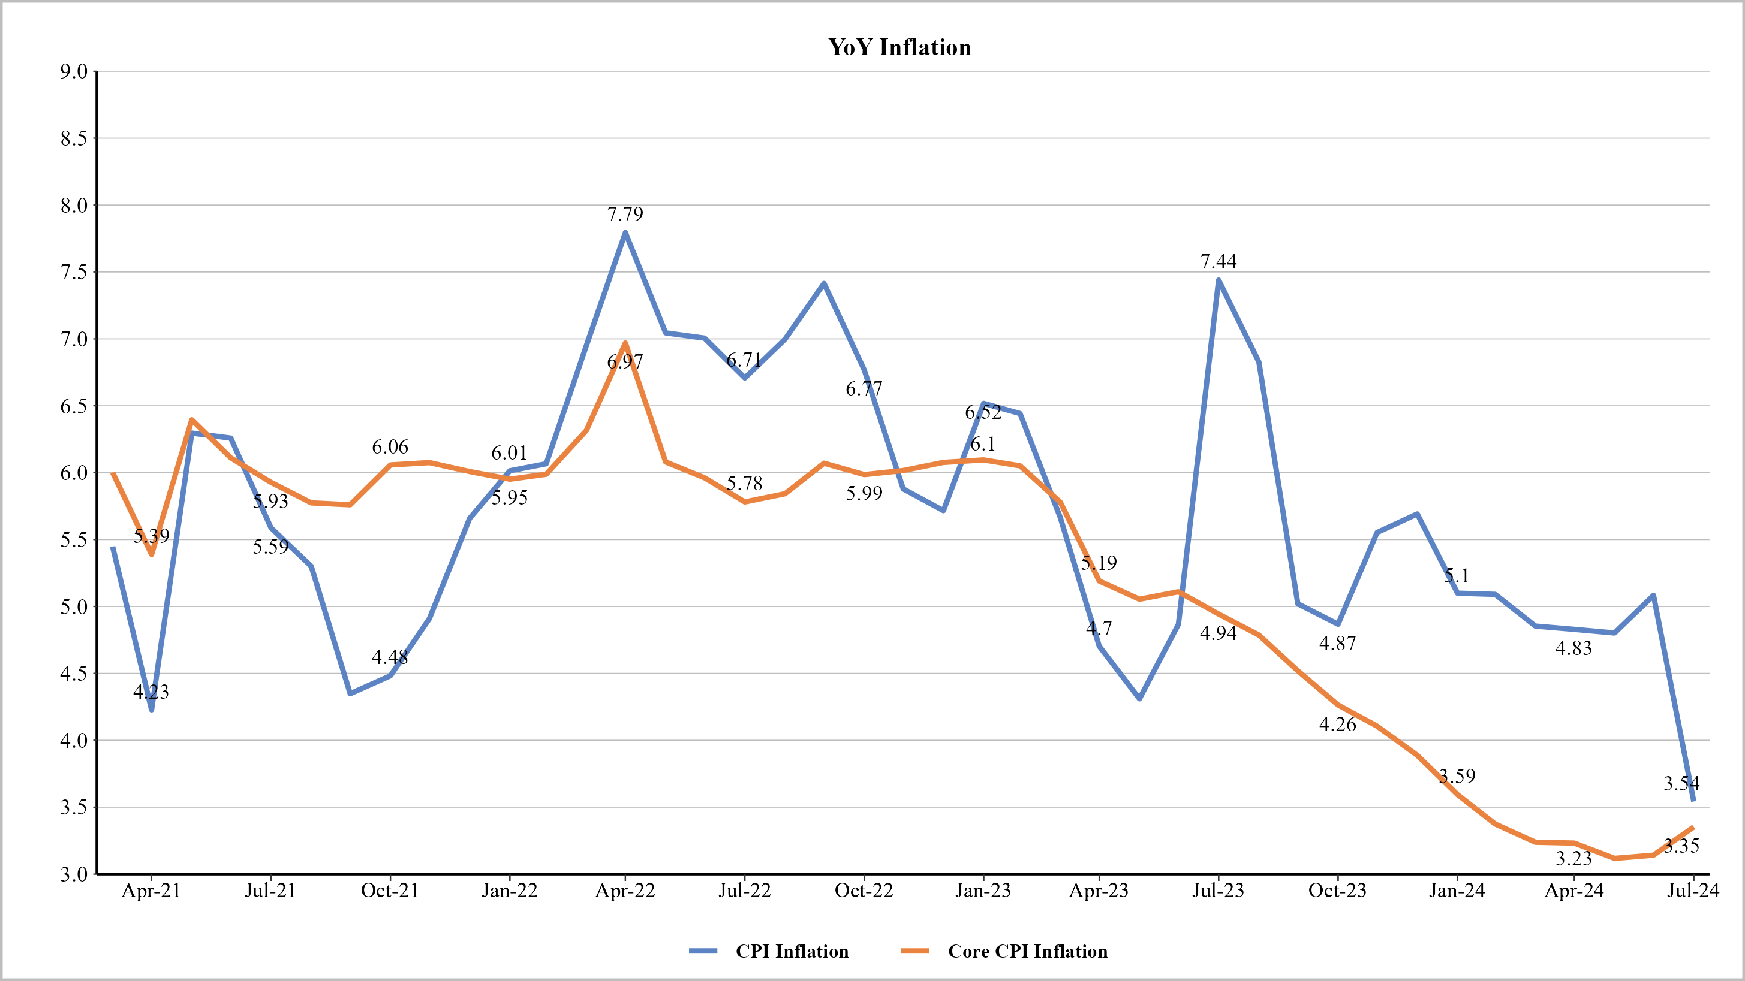
CPI Inflation vs. Core CPI Inflation
Source: Thurro, MoSPI

Slide 3
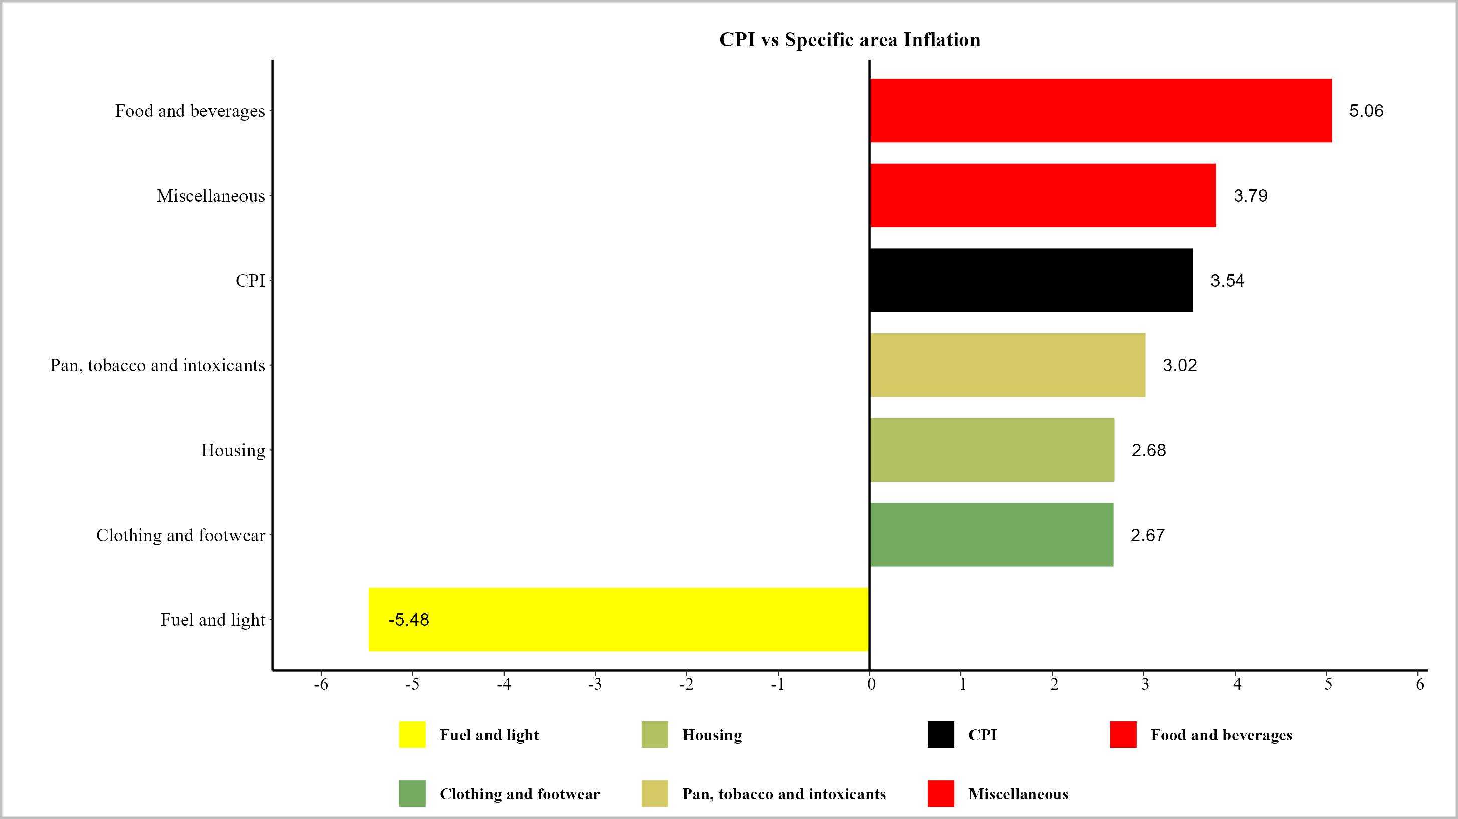
CPI Components Inflation for July '24
Source: Thurro, MoSPI

Slide 4
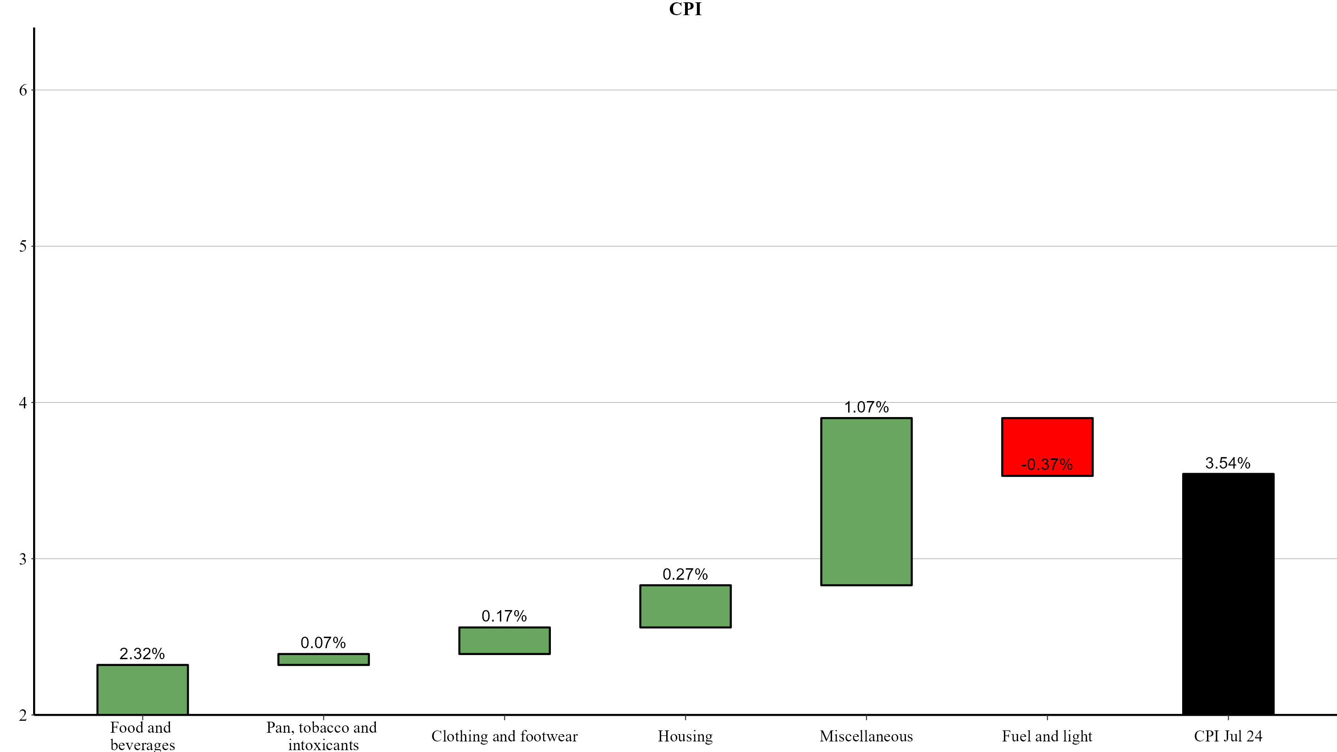
CPI Inflation Attributes Analysis (Jul ' 23 to Jul ' 24)
Source: Thurro, MoSPI

Slide 5
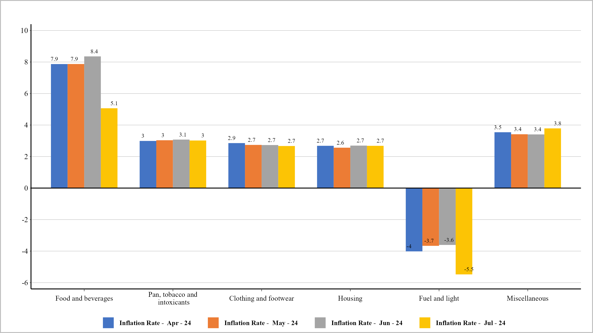
CPI Components
Source: Thurro, MoSPI

Slide 6
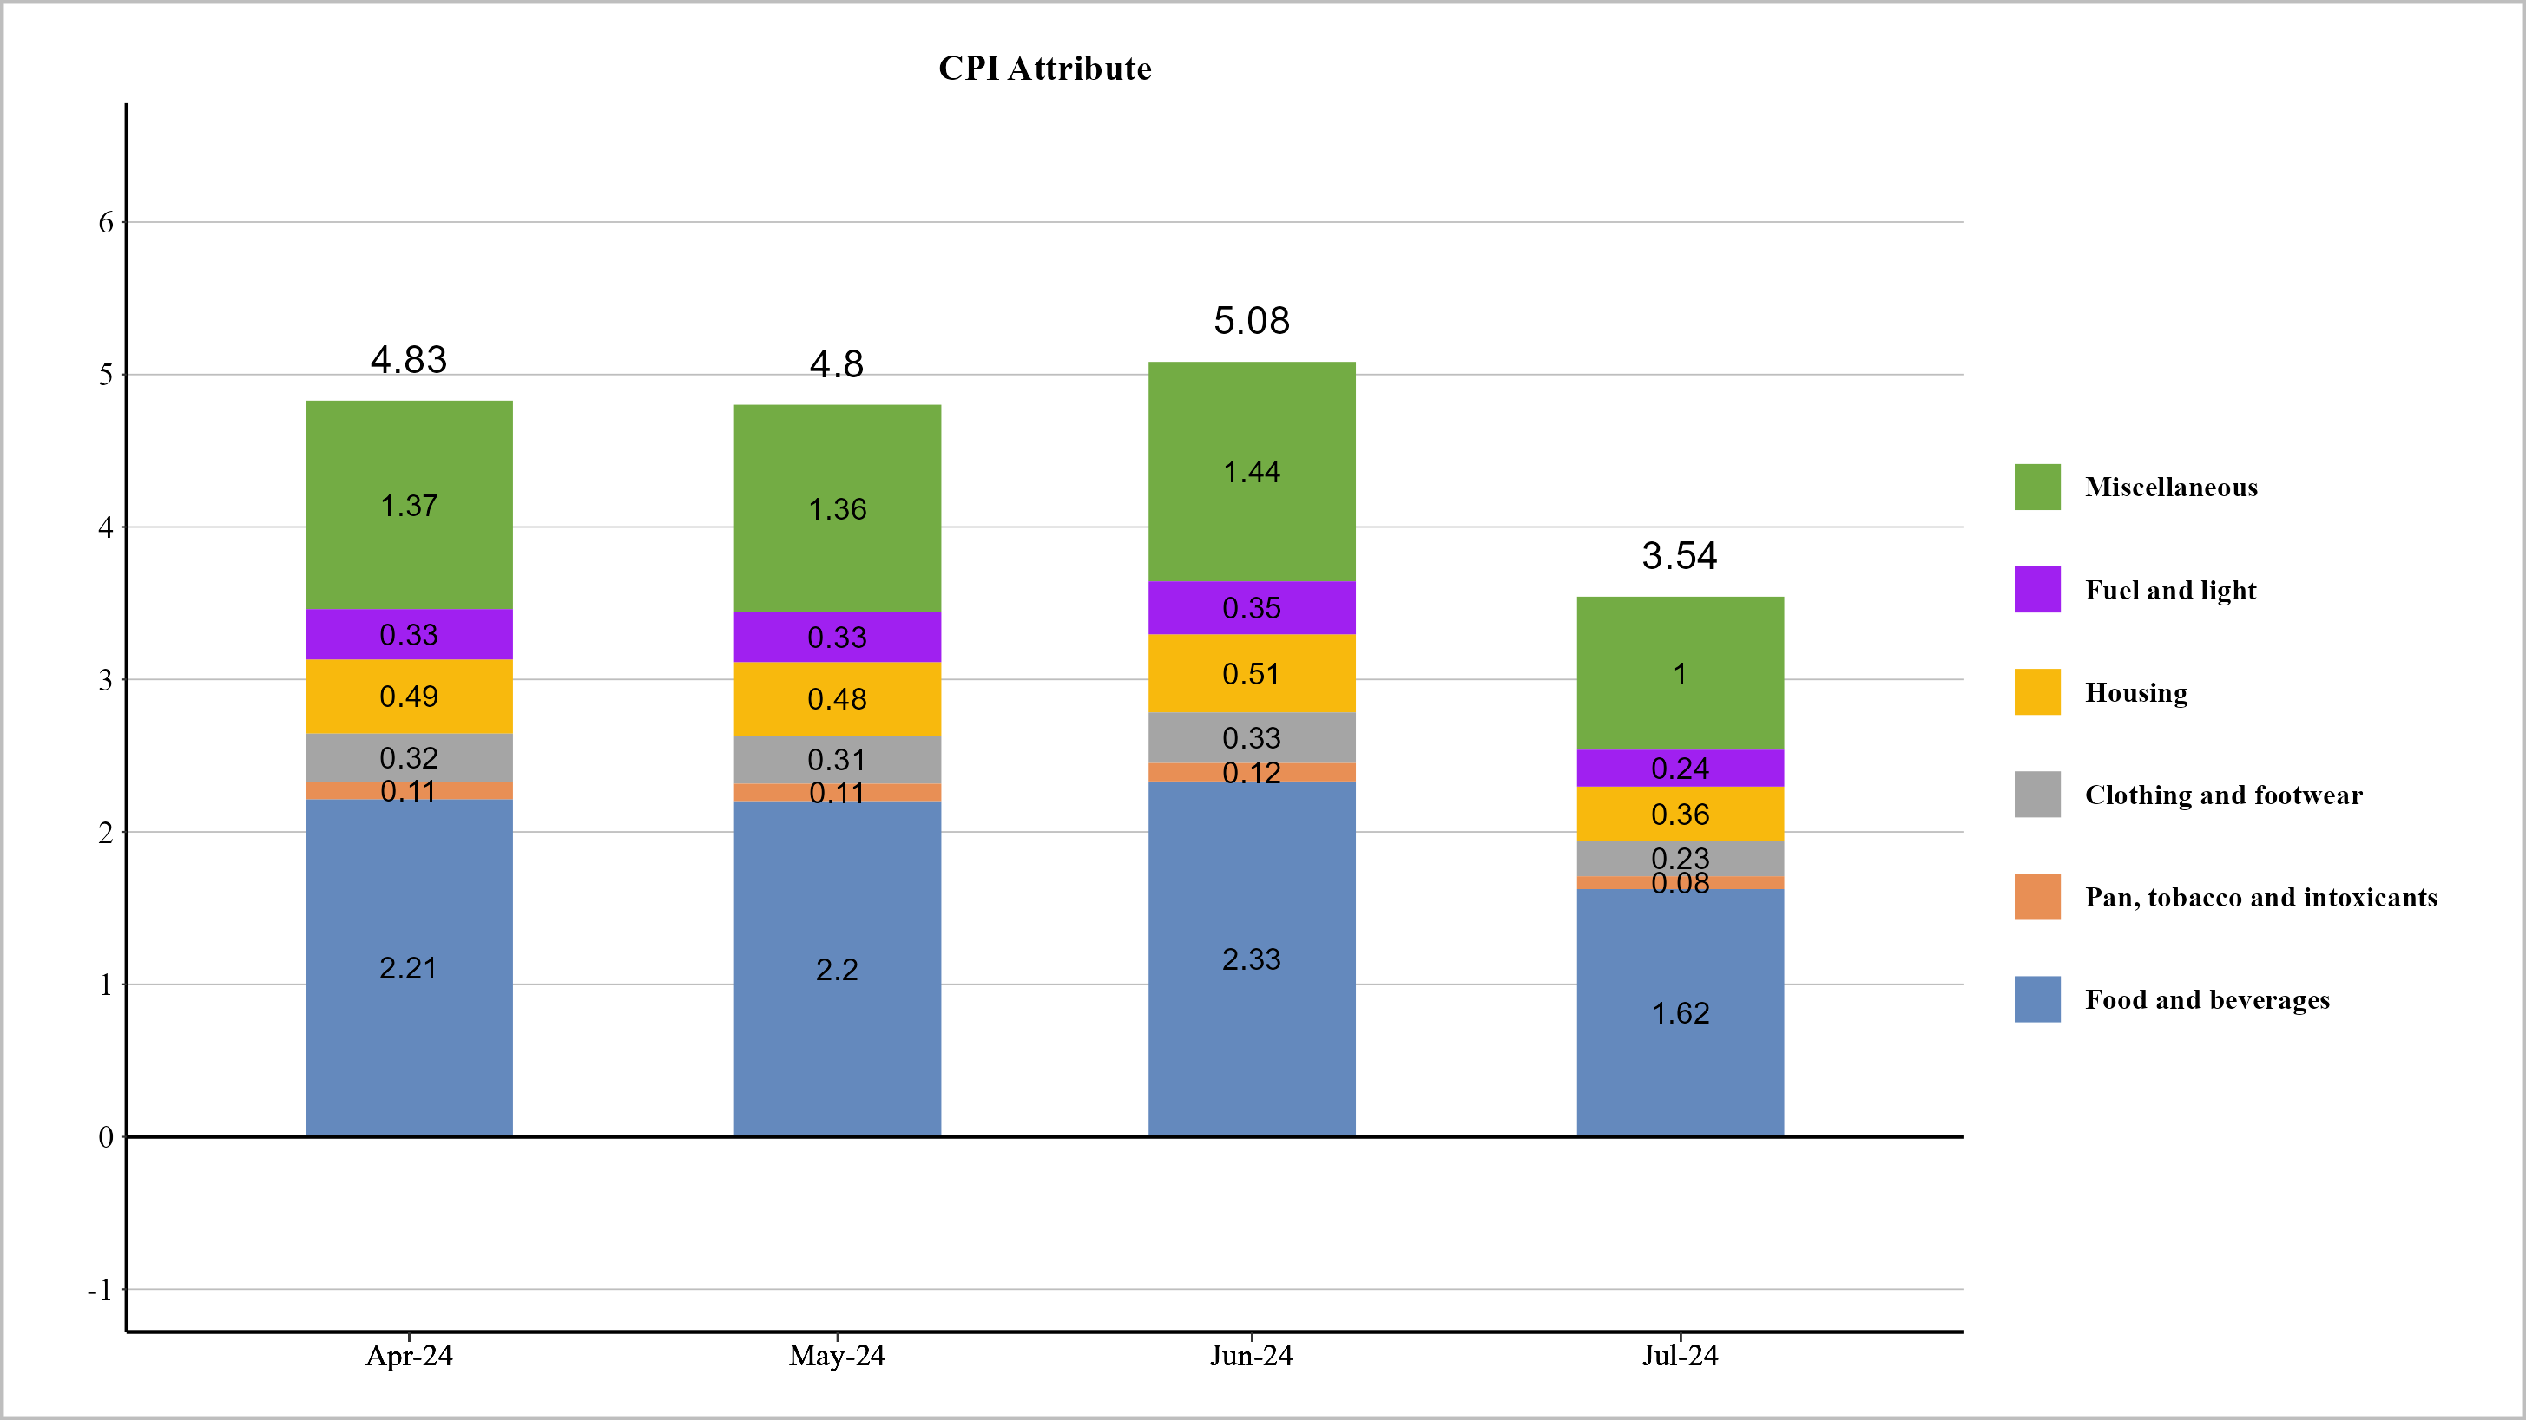
CPI Attribute
Source: Thurro, MoSPI

Slide 7
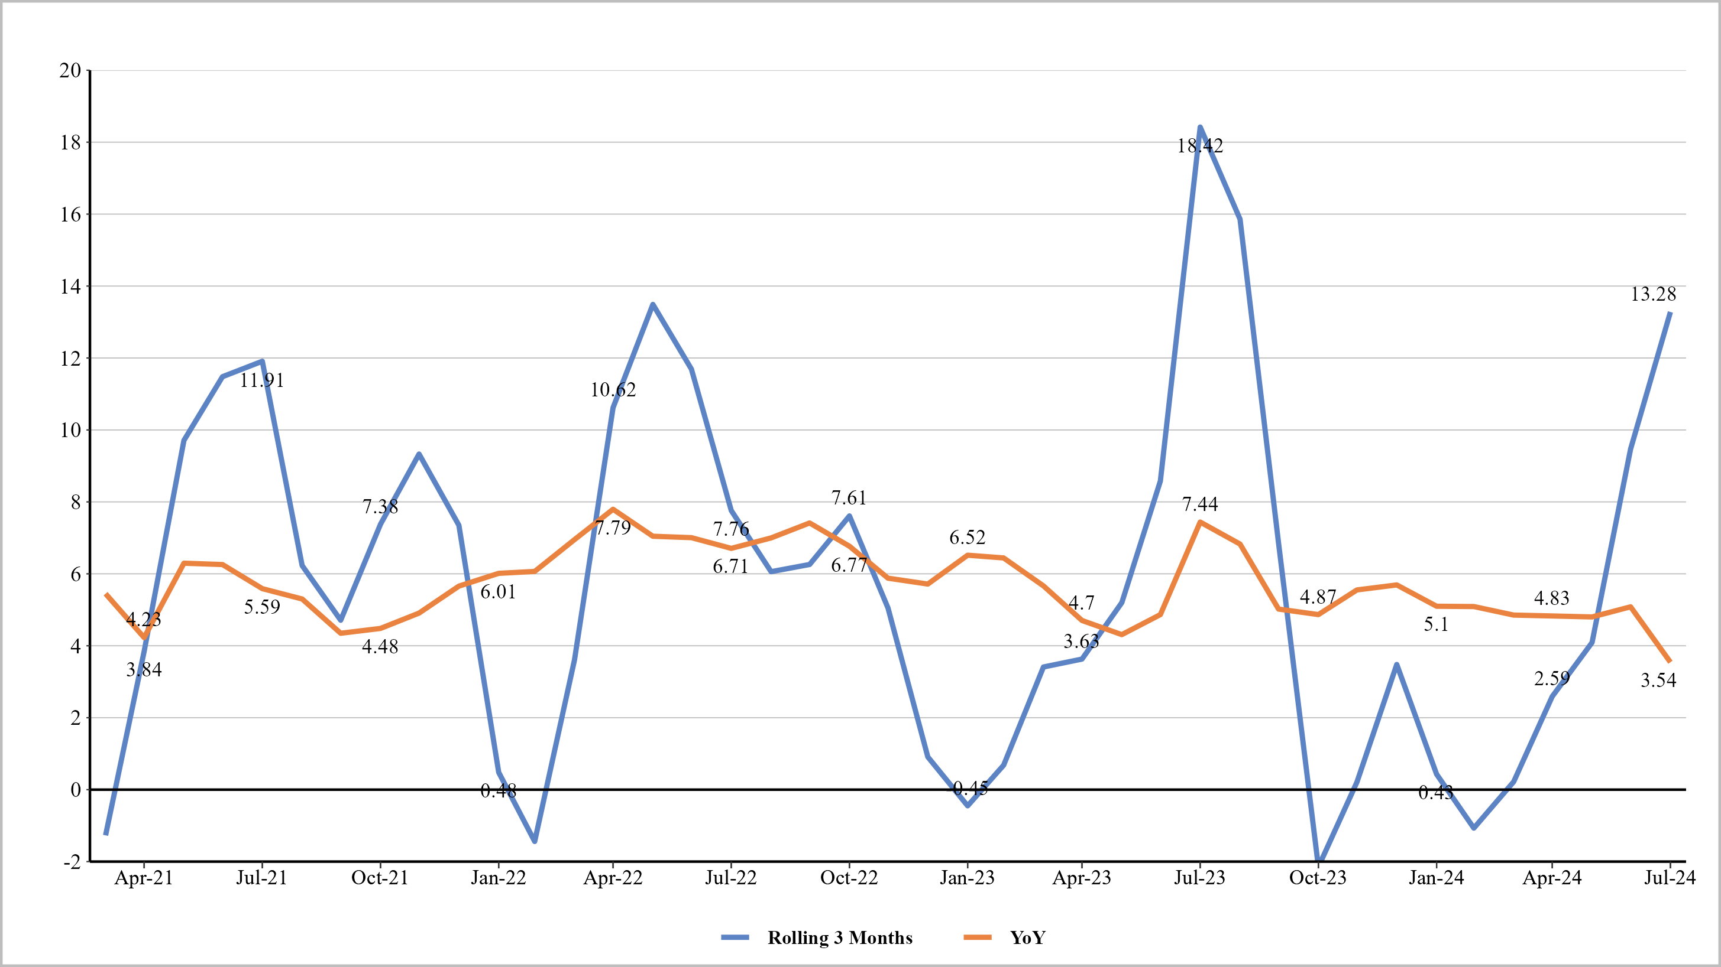
CPI YoY vs. Rolling 3 Months
Source: Thurro, MoSPI

Slide 8
CPI Inflation & Attributes
CPI Inflation
Description | Weight | Jul 23 | Aug 23 | Sep 23 | Oct 23 | Nov 23 | Dec 23 | Jan 24 | Feb 24 | Mar 24 | Apr 24 | May 24 | Jun 24 | Jul 24
CPI Inflation |  | 7.44 | 6.83 | 5.02 | 4.87 | 5.55 | 5.69 | 5.10 | 5.09 | 4.85 | 4.83 | 4.80 | 5.08 | 3.54
Food and beverages | 45.86 | 10.57 | 9.19 | 6.30 | 6.29 | 8.02 | 8.70 | 7.58 | 7.76 | 7.74 | 7.87 | 7.87 | 8.36 | 5.06
Housing | 10.07 | 4.47 | 4.38 | 3.95 | 3.80 | 3.55 | 3.63 | 3.20 | 2.88 | 2.71 | 2.68 | 2.56 | 2.69 | 2.68
Fuel and light | 6.84 | 3.67 | 4.31 | -0.11 | -0.39 | -0.77 | -0.99 | -0.60 | -0.77 | -3.35 | -4.02 | -3.67 | -3.61 | -5.48
Clothing and footwear | 6.53 | 5.64 | 5.15 | 4.56 | 4.31 | 3.90 | 3.61 | 3.37 | 3.14 | 2.97 | 2.85 | 2.74 | 2.73 | 2.67
Pan, tobacco and intoxicants | 2.38 | 3.85 | 4.10 | 3.88 | 3.87 | 3.81 | 3.65 | 3.28 | 3.12 | 3.11 | 2.99 | 3.03 | 3.08 | 3.02
Miscellaneous | 28.32 | 5.05 | 4.91 | 4.77 | 4.46 | 4.38 | 4.07 | 3.82 | 3.63 | 3.50 | 3.54 | 3.41 | 3.41 | 3.79
CPI Inflation Attributes
Description | Weight | Jul 23 | Aug 23 | Sep 23 | Oct 23 | Nov 23 | Dec 23 | Jan 24 | Feb 24 | Mar 24 | Apr 24 | May 24 | Jun 24 | Jul 24
CPI Inflation Attribute |  | 7.44 | 6.83 | 5.02 | 4.87 | 5.55 | 5.69 | 5.10 | 5.09 | 4.85 | 4.83 | 4.80 | 5.08 | 3.54
Food and beverages | 45.86 | 3.41 | 3.13 | 2.30 | 2.23 | 2.55 | 2.61 | 2.34 | 2.33 | 2.23 | 2.21 | 2.20 | 2.33 | 1.62
Housing | 10.07 | 0.75 | 0.69 | 0.51 | 0.49 | 0.56 | 0.57 | 0.51 | 0.51 | 0.49 | 0.49 | 0.48 | 0.51 | 0.36
Fuel and light | 6.84 | 0.51 | 0.47 | 0.34 | 0.33 | 0.38 | 0.39 | 0.35 | 0.35 | 0.33 | 0.33 | 0.33 | 0.35 | 0.24
Clothing and footwear | 6.53 | 0.49 | 0.45 | 0.33 | 0.32 | 0.36 | 0.37 | 0.33 | 0.33 | 0.32 | 0.32 | 0.31 | 0.33 | 0.23
Pan, tobacco and intoxicants | 2.38 | 0.18 | 0.16 | 0.12 | 0.12 | 0.13 | 0.14 | 0.12 | 0.12 | 0.12 | 0.11 | 0.11 | 0.12 | 0.08
Miscellaneous | 28.32 | 2.11 | 1.93 | 1.42 | 1.38 | 1.57 | 1.61 | 1.44 | 1.44 | 1.37 | 1.37 | 1.36 | 1.44 | 1.00
Note 1 (Top Table) : Dark Green - Light Green < 5 < Yellow - Red
Note 2 (Bottom Table) : Dark Green - Light Green < July '23 Value < Yellow - Red
Source: Thurro, MoSPI

Slide 9
Food and Beverages Inflation
Description | Weight | Jul 23 | Aug 23 | Sep 23 | Oct 23 | Nov 23 | Dec 23 | Jan 24 | Feb 24 | Mar 24 | Apr 24 | May 24 | Jun 24 | Jul 24
Food and beverages | 45.86 | 10.57 | 9.19 | 6.30 | 6.29 | 8.02 | 8.70 | 7.58 | 7.76 | 7.74 | 7.87 | 7.87 | 8.36 | 5.06
Cereals and products | 9.67 | 13.04 | 11.85 | 10.95 | 10.71 | 10.27 | 9.93 | 7.83 | 7.65 | 8.37 | 8.63 | 8.69 | 8.75 | 8.14
Milk and products | 6.61 | 8.34 | 7.79 | 6.95 | 6.44 | 5.75 | 5.07 | 4.64 | 3.86 | 3.38 | 2.97 | 2.62 | 3.00 | 2.99
Vegetables | 6.04 | 37.40 | 26.08 | 3.44 | 2.80 | 17.70 | 27.64 | 27.10 | 30.25 | 28.34 | 27.80 | 27.39 | 29.32 | 6.83
Prepared meals, snacks, sweets etc. | 5.55 | 5.45 | 5.31 | 4.96 | 4.73 | 4.22 | 4.10 | 3.97 | 3.75 | 3.58 | 3.46 | 3.35 | 3.44 | 3.48
Meat and fish | 3.61 | 2.25 | 3.68 | 4.06 | 3.27 | 2.20 | 1.10 | 1.19 | 5.16 | 6.40 | 8.22 | 7.28 | 5.39 | 5.97
Oils and fats | 3.56 | -16.80 | -15.33 | -14.04 | -13.73 | -15.09 | -14.96 | -14.96 | -13.97 | -11.72 | -9.43 | -6.71 | -2.68 | -1.17
Fruits | 2.89 | 3.10 | 3.99 | 7.30 | 9.34 | 11.01 | 11.08 | 8.59 | 4.83 | 3.01 | 5.22 | 6.68 | 7.15 | 3.84
Spices | 2.50 | 21.68 | 23.19 | 23.11 | 22.71 | 21.50 | 19.69 | 16.31 | 13.51 | 11.40 | 7.75 | 4.27 | 2.06 | -1.43
Pulses and products | 2.38 | 13.33 | 13.04 | 16.32 | 18.85 | 20.29 | 20.73 | 19.54 | 18.90 | 17.77 | 16.84 | 17.14 | 16.07 | 14.77
Sugar and Confectionery | 1.36 | 3.75 | 3.80 | 4.61 | 5.50 | 6.55 | 7.22 | 7.43 | 7.48 | 7.25 | 6.02 | 5.70 | 5.83 | 5.22
Non-alcoholic beverages | 1.26 | 3.62 | 3.67 | 3.54 | 3.53 | 3.58 | 3.33 | 3.33 | 3.03 | 2.84 | 2.60 | 2.42 | 2.36 | 2.29
Egg | 0.43 | 3.82 | 4.31 | 6.48 | 9.30 | 5.90 | 4.36 | 5.55 | 10.69 | 10.33 | 7.13 | 7.68 | 4.10 | 6.76
Note : Dark Green - Light Green < 5 < Yellow - Red
Source: Thurro, MoSPI

Slide 10
Food and Beverages Attributes
Description | Weight | Jul 23 | Aug 23 | Sep 23 | Oct 23 | Nov 23 | Dec 23 | Jan 24 | Feb 24 | Mar 24 | Apr 24 | May 24 | Jun 24 | Jul 24
Food and beverages | 45.86 | 10.57 | 9.19 | 6.30 | 6.29 | 8.02 | 8.70 | 7.58 | 7.76 | 7.74 | 7.87 | 7.87 | 8.36 | 5.06
Cereals and products | 9.67 | 2.23 | 1.94 | 1.33 | 1.33 | 1.69 | 1.83 | 1.60 | 1.64 | 1.63 | 1.66 | 1.66 | 1.76 | 1.07
Milk and products | 6.61 | 1.52 | 1.32 | 0.91 | 0.91 | 1.16 | 1.25 | 1.09 | 1.12 | 1.12 | 1.13 | 1.13 | 1.20 | 0.73
Vegetables | 6.04 | 1.39 | 1.21 | 0.83 | 0.83 | 1.06 | 1.15 | 1.00 | 1.02 | 1.02 | 1.04 | 1.04 | 1.10 | 0.67
Prepared meals, snacks, sweets etc. | 5.55 | 1.28 | 1.11 | 0.76 | 0.76 | 0.97 | 1.05 | 0.92 | 0.94 | 0.94 | 0.95 | 0.95 | 1.01 | 0.61
Meat and fish | 3.61 | 0.83 | 0.72 | 0.50 | 0.50 | 0.63 | 0.68 | 0.60 | 0.61 | 0.61 | 0.62 | 0.62 | 0.66 | 0.40
Oils and fats | 3.56 | 0.82 | 0.71 | 0.49 | 0.49 | 0.62 | 0.68 | 0.59 | 0.60 | 0.60 | 0.61 | 0.61 | 0.65 | 0.39
Fruits | 2.89 | 0.67 | 0.58 | 0.40 | 0.40 | 0.51 | 0.55 | 0.48 | 0.49 | 0.49 | 0.50 | 0.50 | 0.53 | 0.32
Spices | 2.50 | 0.58 | 0.50 | 0.34 | 0.34 | 0.44 | 0.47 | 0.41 | 0.42 | 0.42 | 0.43 | 0.43 | 0.46 | 0.28
Pulses and products | 2.38 | 0.55 | 0.48 | 0.33 | 0.33 | 0.42 | 0.45 | 0.39 | 0.40 | 0.40 | 0.41 | 0.41 | 0.43 | 0.26
Sugar and Confectionery | 1.36 | 0.31 | 0.27 | 0.19 | 0.19 | 0.24 | 0.26 | 0.22 | 0.23 | 0.23 | 0.23 | 0.23 | 0.25 | 0.15
Non-alcoholic beverages | 1.26 | 0.29 | 0.25 | 0.17 | 0.17 | 0.22 | 0.24 | 0.21 | 0.21 | 0.21 | 0.22 | 0.22 | 0.23 | 0.14
Egg | 0.43 | 0.10 | 0.09 | 0.06 | 0.06 | 0.08 | 0.08 | 0.07 | 0.07 | 0.07 | 0.07 | 0.07 | 0.08 | 0.05
Note : Dark Green - Light Green < July '23 Value < Yellow - Red
Source: Thurro, MoSPI

Slide 11
CPI Inflation Ex Food & Beverages - Components
Description | Weight | Jul 23 | Aug 23 | Sep 23 | Oct 23 | Nov 23 | Dec 23 | Jan 24 | Feb 24 | Mar 24 | Apr 24 | May 24 | Jun 24 | Jul 24
Housing | 10.07 | 4.47 | 4.38 | 3.95 | 3.80 | 3.55 | 3.63 | 3.20 | 2.88 | 2.71 | 2.68 | 2.56 | 2.69 | 2.68
Fuel and light | 6.84 | 3.67 | 4.31 | -0.11 | -0.39 | -0.77 | -0.99 | -0.60 | -0.77 | -3.35 | -4.02 | -3.67 | -3.61 | -5.48
Clothing and footwear | 6.53 | 5.64 | 5.15 | 4.56 | 4.31 | 3.90 | 3.61 | 3.37 | 3.14 | 2.97 | 2.85 | 2.74 | 2.73 | 2.67
Clothing | 5.58 | 5.66 | 5.24 | 4.64 | 4.45 | 4.04 | 3.75 | 3.46 | 3.18 | 3.12 | 2.89 | 2.83 | 2.77 | 2.76
Footwear | 0.95 | 5.49 | 4.81 | 4.07 | 3.59 | 3.29 | 3.05 | 2.87 | 2.64 | 2.57 | 2.40 | 2.17 | 2.05 | 1.99
Pan, tobacco and intoxicants | 2.38 | 3.85 | 4.10 | 3.88 | 3.87 | 3.81 | 3.65 | 3.28 | 3.12 | 3.11 | 2.99 | 3.03 | 3.08 | 3.02
Miscellaneous | 28.32 | 5.05 | 4.91 | 4.77 | 4.46 | 4.38 | 4.07 | 3.82 | 3.63 | 3.50 | 3.54 | 3.41 | 3.41 | 3.79
Transport and communication | 8.59 | 2.48 | 2.47 | 2.28 | 1.96 | 2.09 | 1.96 | 1.96 | 1.83 | 1.52 | 1.09 | 0.97 | 0.97 | 2.48
Health | 5.89 | 6.19 | 6.17 | 5.91 | 5.88 | 5.51 | 5.08 | 4.88 | 4.53 | 4.28 | 4.27 | 4.20 | 4.13 | 4.06
Education | 4.46 | 5.54 | 5.46 | 5.26 | 5.07 | 5.01 | 4.82 | 4.93 | 4.75 | 4.69 | 4.20 | 4.07 | 3.57 | 3.43
Personal care and effects | 3.89 | 8.90 | 8.12 | 8.54 | 7.84 | 7.83 | 7.28 | 5.88 | 5.23 | 6.02 | 7.45 | 7.67 | 8.23 | 8.44
Household goods and services | 3.80 | 5.20 | 4.81 | 4.31 | 3.93 | 3.50 | 3.37 | 3.07 | 2.82 | 2.70 | 2.75 | 2.51 | 2.39 | 2.33
Recreation and amusement | 1.68 | 3.73 | 3.59 | 3.40 | 3.27 | 3.15 | 3.08 | 2.89 | 2.71 | 2.76 | 2.64 | 2.57 | 2.33 | 2.20
Note : Dark Green - Light Green < 5 < Yellow - Red
Source: Thurro, MoSPI

Slide 12
CPI Inflation Ex Food & Beverages - Attributes
Description | Weight | Jul 23 | Aug 23 | Sep 23 | Oct 23 | Nov 23 | Dec 23 | Jan 24 | Feb 24 | Mar 24 | Apr 24 | May 24 | Jun 24 | Jul 24
Housing | 10.07 | 4.47 | 4.38 | 3.95 | 3.80 | 3.55 | 3.63 | 3.20 | 2.88 | 2.71 | 2.68 | 2.56 | 2.69 | 2.68
Fuel and light | 6.84 | 3.67 | 4.31 | -0.11 | -0.39 | -0.77 | -0.99 | -0.60 | -0.77 | -3.35 | -4.02 | -3.67 | -3.61 | -5.48
Clothing and footwear | 6.53 | 5.64 | 5.15 | 4.56 | 4.31 | 3.90 | 3.61 | 3.37 | 3.14 | 2.97 | 2.85 | 2.74 | 2.73 | 2.67
Clothing | 5.58 | 4.82 | 4.40 | 3.89 | 3.68 | 3.33 | 3.08 | 2.88 | 2.69 | 2.54 | 2.44 | 2.34 | 2.33 | 2.28
Footwear | 0.95 | 0.82 | 0.75 | 0.66 | 0.63 | 0.57 | 0.52 | 0.49 | 0.46 | 0.43 | 0.42 | 0.40 | 0.40 | 0.39
Pan, tobacco and intoxicants | 2.38 | 3.85 | 4.10 | 3.88 | 3.87 | 3.81 | 3.65 | 3.28 | 3.12 | 3.11 | 2.99 | 3.03 | 3.08 | 3.02
Miscellaneous | 28.32 | 5.05 | 4.91 | 4.77 | 4.46 | 4.38 | 4.07 | 3.82 | 3.63 | 3.50 | 3.54 | 3.41 | 3.41 | 3.79
Transport and communication | 8.59 | 1.53 | 1.49 | 1.45 | 1.35 | 1.33 | 1.23 | 1.16 | 1.10 | 1.06 | 1.07 | 1.04 | 1.03 | 1.15
Health | 5.89 | 1.05 | 1.02 | 0.99 | 0.93 | 0.91 | 0.85 | 0.79 | 0.76 | 0.73 | 0.74 | 0.71 | 0.71 | 0.79
Education | 4.46 | 0.79 | 0.77 | 0.75 | 0.70 | 0.69 | 0.64 | 0.60 | 0.57 | 0.55 | 0.56 | 0.54 | 0.54 | 0.60
Personal care and effects | 3.89 | 0.69 | 0.67 | 0.66 | 0.61 | 0.60 | 0.56 | 0.52 | 0.50 | 0.48 | 0.49 | 0.47 | 0.47 | 0.52
Household goods and services | 3.80 | 0.68 | 0.66 | 0.64 | 0.60 | 0.59 | 0.55 | 0.51 | 0.49 | 0.47 | 0.48 | 0.46 | 0.46 | 0.51
Recreation and amusement | 1.68 | 0.30 | 0.29 | 0.28 | 0.26 | 0.26 | 0.24 | 0.23 | 0.22 | 0.21 | 0.21 | 0.20 | 0.20 | 0.22
Note : Dark Green - Light Green < July '23 Value < Yellow - Red
Source: Thurro, MoSPI

Slide 13
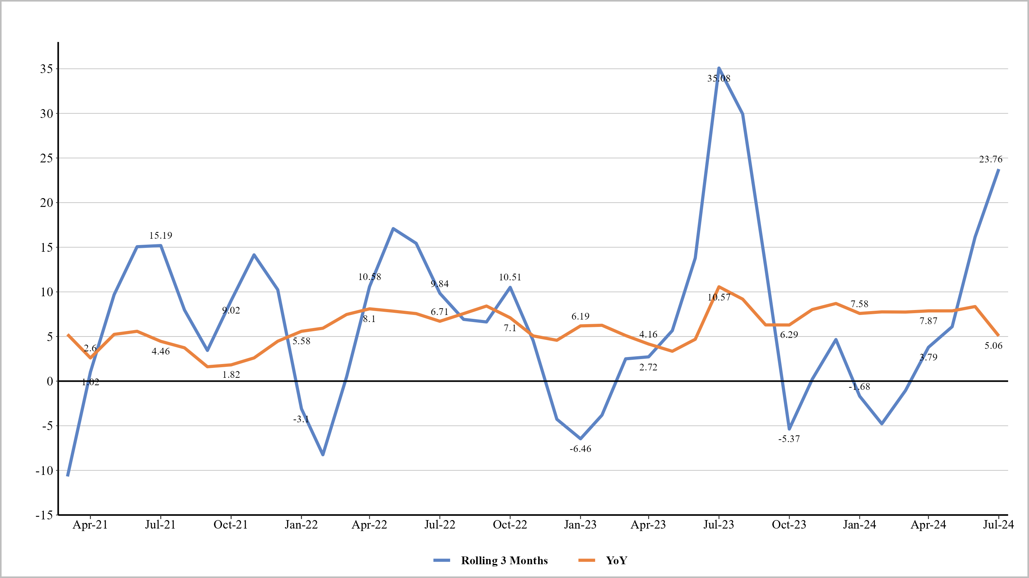
Food and Beverages YoY vs. Rolling 3 Months
Source: Thurro, MoSPI

Slide 14
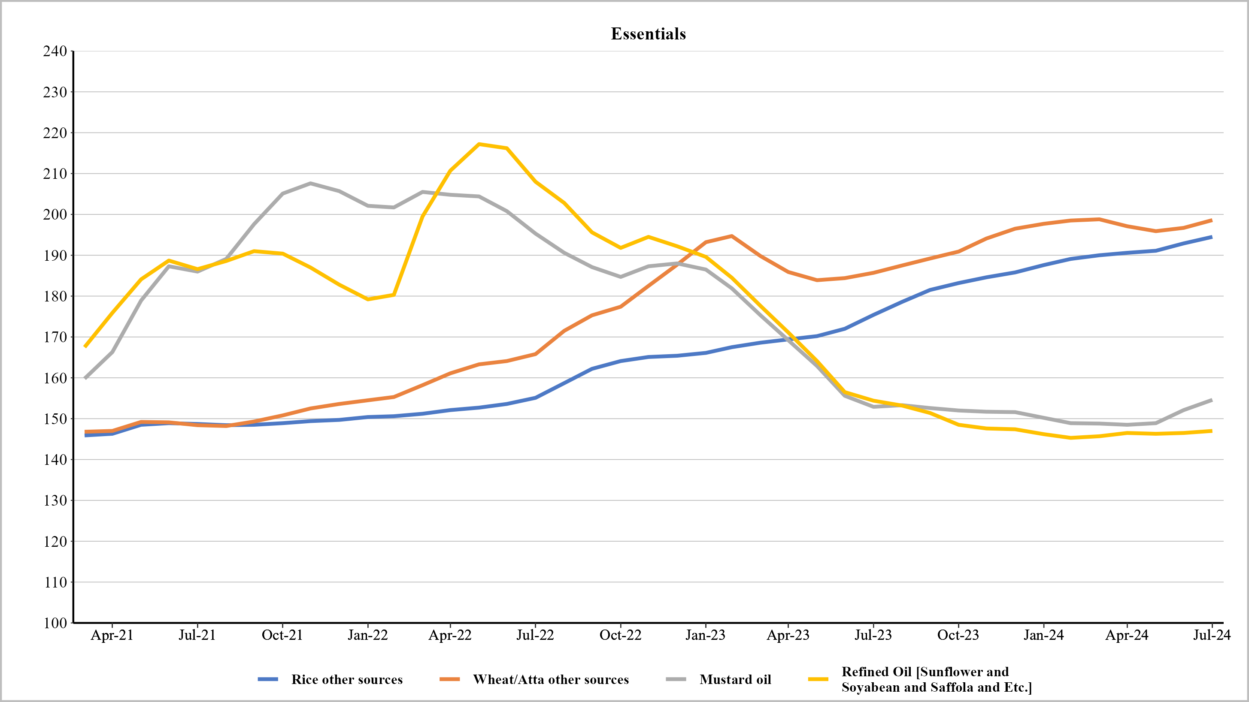
Food and Beverages : Essentials
Source: Thurro, MOSPI

Slide 15
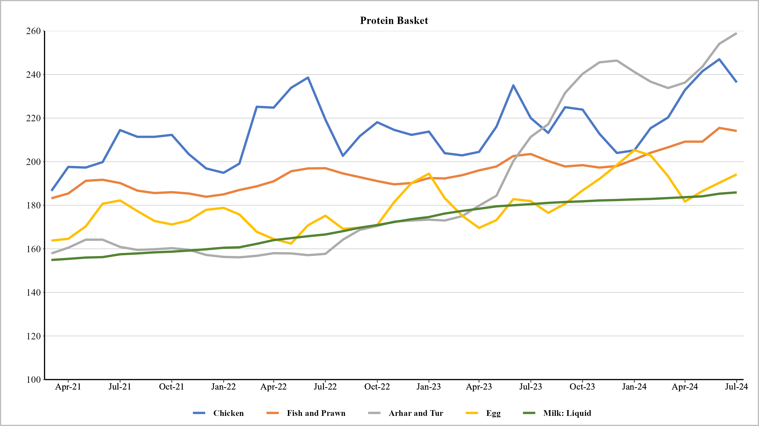
Food and Beverages : Protein Basket
Source: Thurro, MOSPI

Slide 16
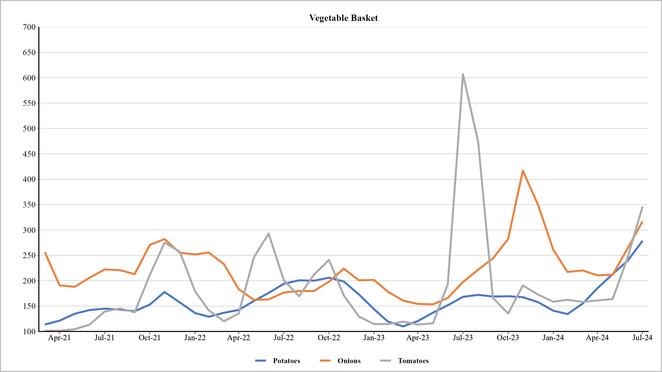
Food and Beverages : Vegetable Basket
Source: Thurro, MOSPI

Slide 17
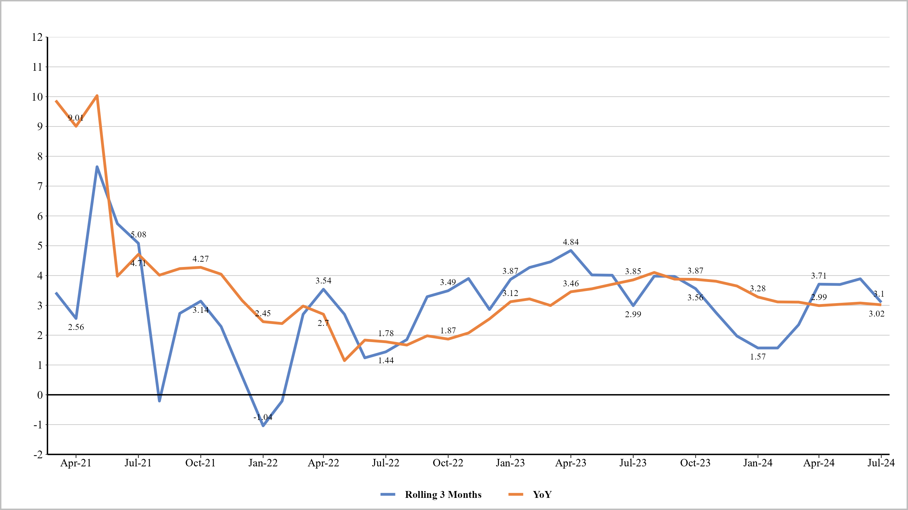
Pan, Tobacco and Intoxicants
Source: Thurro, MoSPI

Slide 18
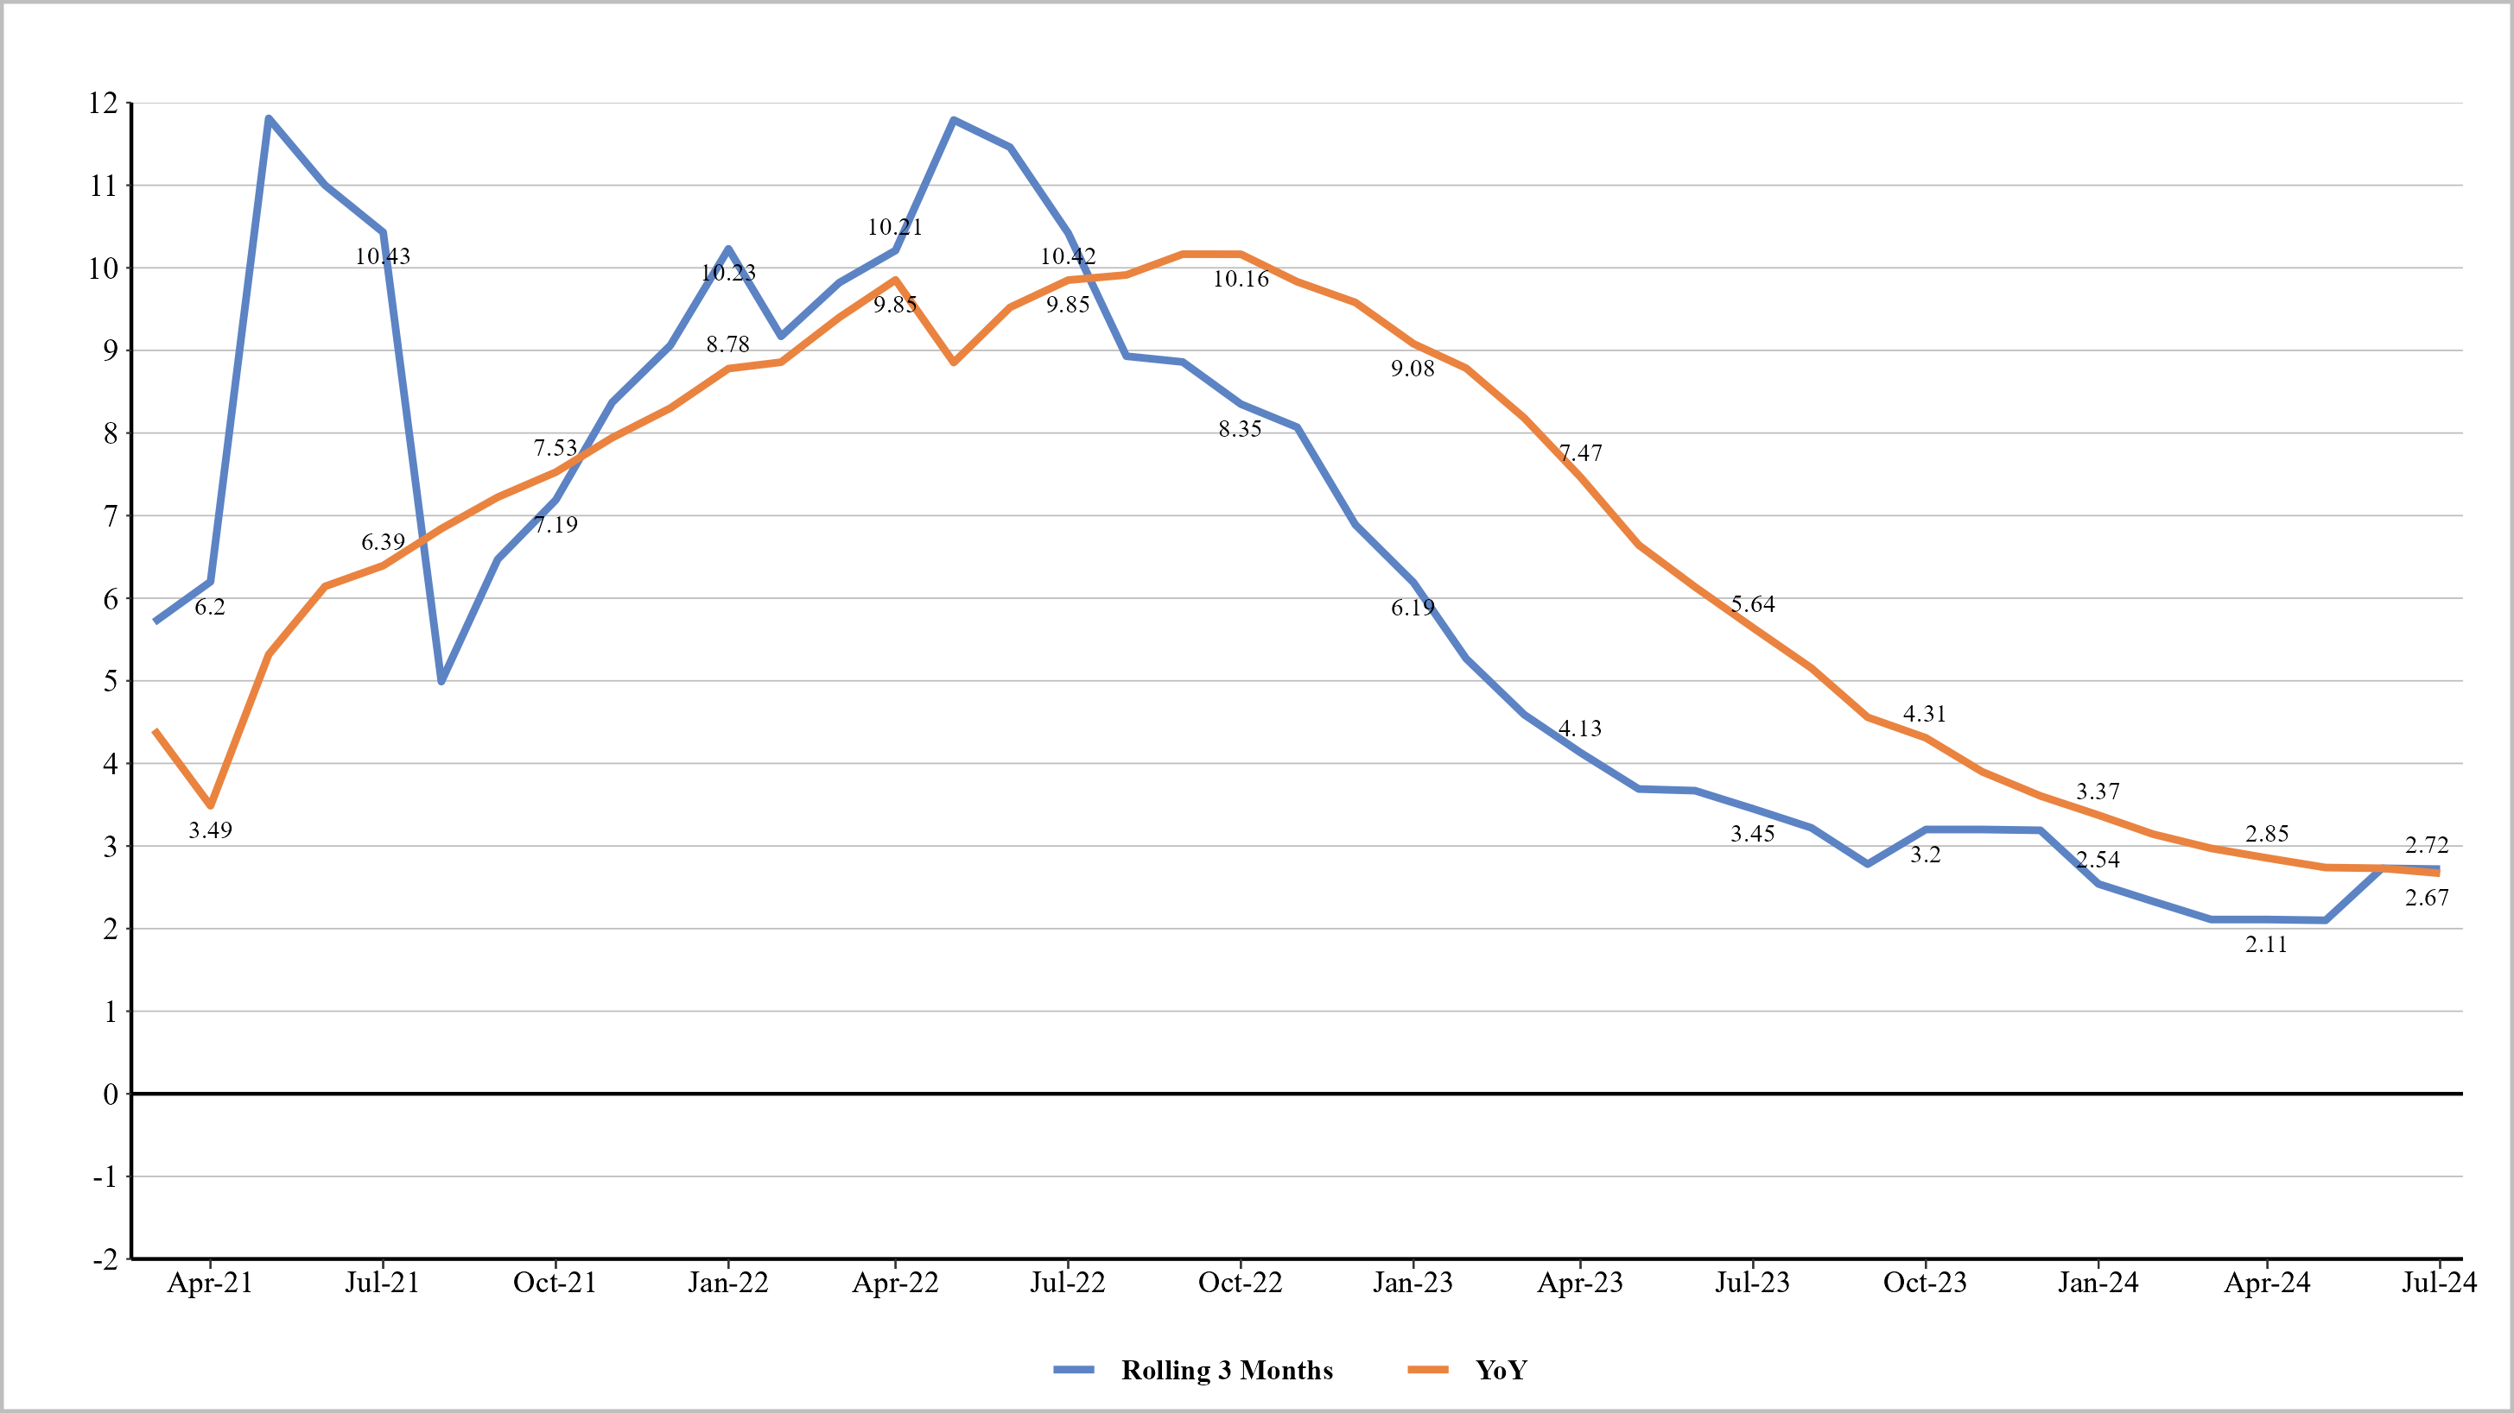
Clothing and Footwear
Source: Thurro, MoSPI

Slide 19
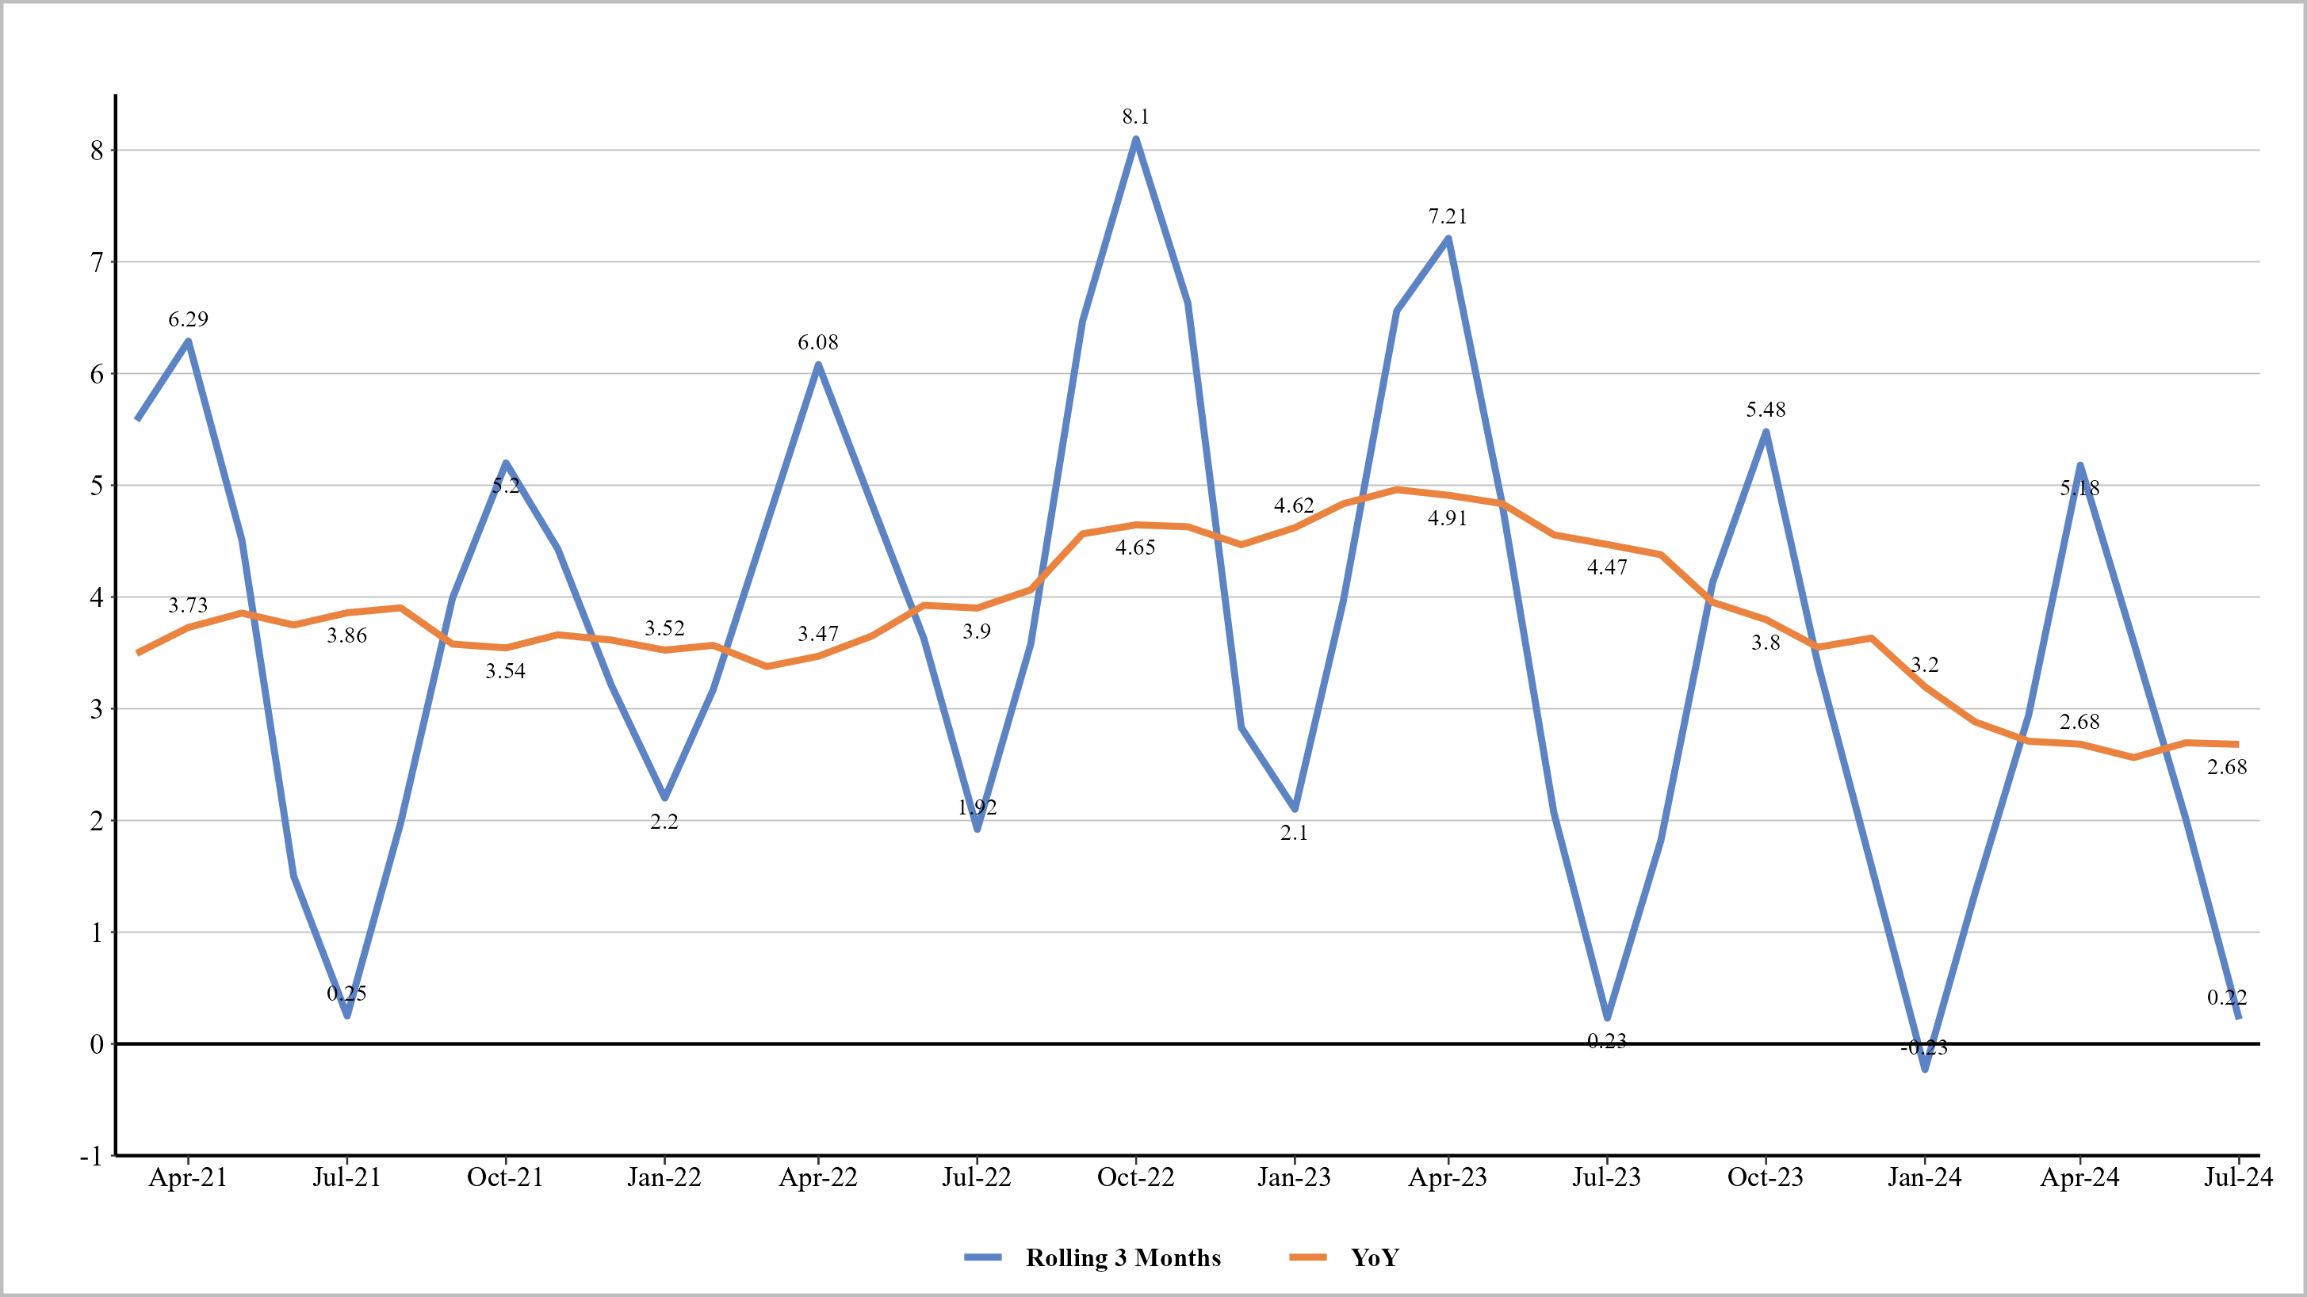
Housing
Source: Thurro, MoSPI

Slide 20
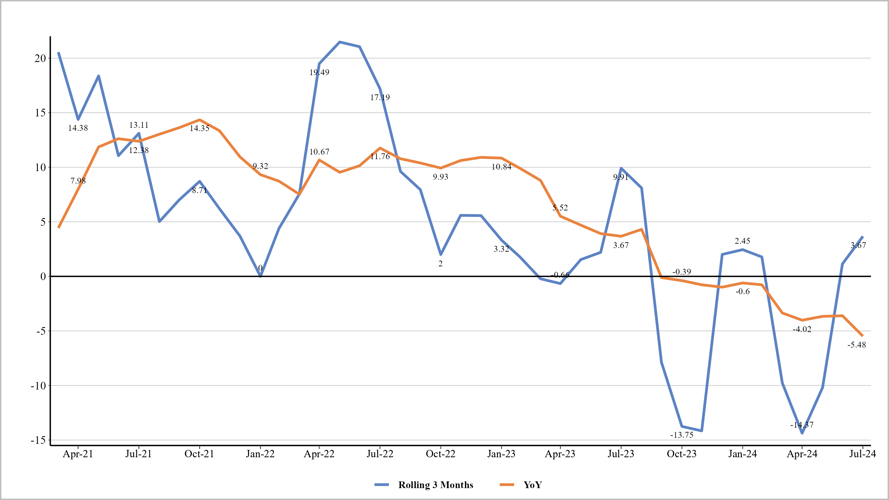
Fuel and Light
Source: Thurro, MoSPI

Slide 21
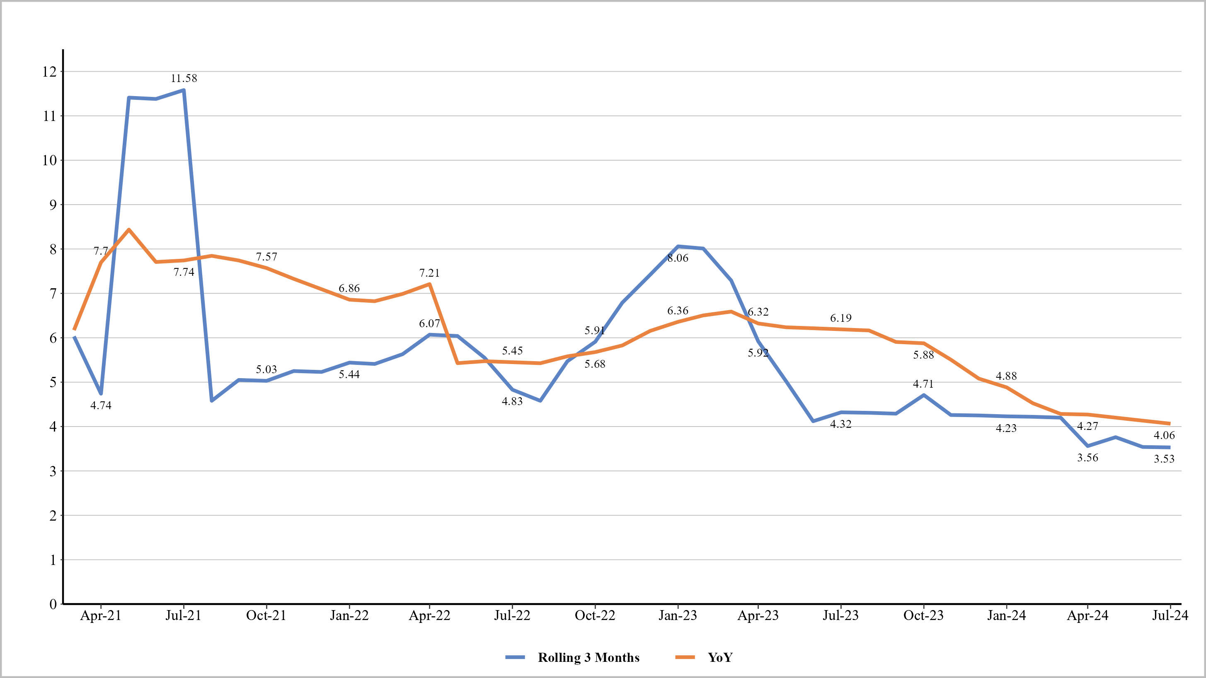
Health
Source: Thurro, MoSPI

Slide 22
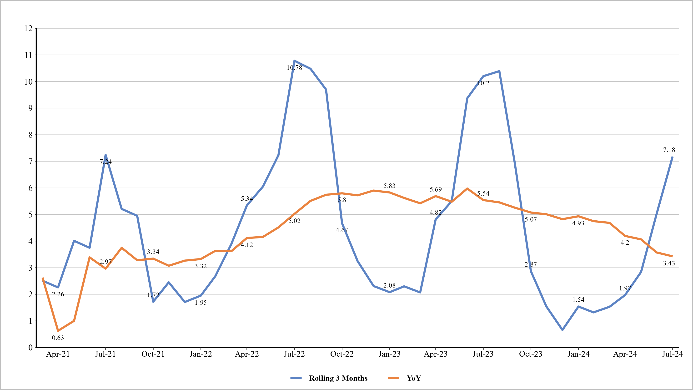
Education
Source: Thurro, MoSPI

Slide 23
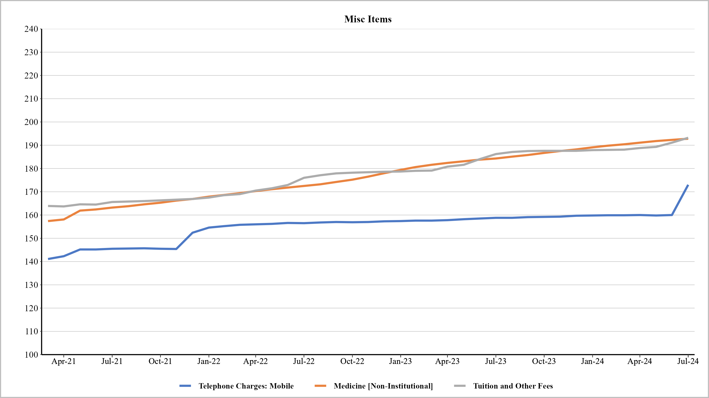
Other - Component wise
Source: Thurro, MOSPI

Slide 24
Top 10 Inflators and deflators (Weight adjusted)
Items | Jun - 24 YoY | Items | Jul - 24 YoY | Items | Jun - 24 MoM | Items | Jul - 24 MoM
potato | 0.567% | potato | 0.646% | tomato | 0.282% | tomato | 0.241%
rice_other sources | 0.532% | rice_other sources | 0.477% | onion | 0.156% | potato | 0.164%
onion | 0.377% | onion | 0.390% | potato | 0.119% | telephone charges: mobile | 0.149%
house rent; garage rent | 0.246% | house rent; garage rent | 0.250% | brinjal | 0.062% | onion | 0.132%
garlic (gm) | 0.242% | gold | 0.225% | palak/other leafy vegetables | 0.051% | cauliflower | 0.060%
arhar; tur | 0.214% | milk: liquid (litre) | 0.192% | other vegetables | 0.044% | house rent; garage rent | 0.053%
gold | 0.212% | medicine [non-institutional] | 0.185% | milk: liquid (litre) | 0.042% | brinjal | 0.045%
electricity (std. unit) | 0.198% | arhar; tur | 0.179% | rice_other sources | 0.041% | rice_other sources | 0.036%
milk: liquid (litre) | 0.189% | wheat/atta_other sources | 0.178% | cauliflower | 0.041% | peas [Vegetables] | 0.034%
medicine [non-institutional] | 0.186% | garlic (gm) | 0.170% | green chillies | 0.040% | cabbage | 0.033%
LPG [excl. conveyance] | -0.319% | LPG [excl. conveyance] | -0.318% | house rent; garage rent | -0.064% | chicken | -0.053%
refined oil [sunflower; soyabe | -0.081% | tomato | -0.247% | mango | -0.035% | mango | -0.017%
petrol for vehicle | -0.044% | jeera (gm) | -0.069% | kerosene â€“ PDS (litre) | -0.012% | kerosene â€“ PDS (litre) | -0.015%
mustard oil | -0.030% | refined oil [sunflower; soyabe | -0.061% | lemon (no.) | -0.009% | lemon (no.) | -0.013%
dry chillies (gm) | -0.027% | petrol for vehicle | -0.043% | parwal/patal; kundru | -0.006% | fish; prawn | -0.008%
wheat/atta_PDS | -0.017% | dry chillies (gm) | -0.038% | jeera (gm) | -0.005% | jeera (gm) | -0.005%
jeera (gm) | -0.014% | green chillies | -0.037% | dry chillies (gm) | -0.004% | guava | -0.004%
coconut: copra | -0.008% | apple | -0.024% | gold | -0.003% | dry chillies (gm) | -0.004%
orange; mausami (no.) | -0.004% | ginger (gm) | -0.024% | watermelon | -0.002% | leechi | -0.004%
railway fare | -0.004% | wheat/atta_PDS | -0.017% | kerosene â€“ other sources (li | -0.002% | other fuel | -0.002%
Note : Red - Yellow < 0 < Light Green - Dark Green
Source: Thurro, MOSPI

Slide 25
IIP Growth (YoY)
Description | Weight | Jun 23 | Jul 23 | Aug 23 | Sep 23 | Oct 23 | Nov 23 | Dec 23 | Jan 24 | Feb 24 | Mar 24 | Apr 24 | May 24 | Jun 24
IIP |  | 4.05 | 6.18 | 10.87 | 6.35 | 11.89 | 2.47 | 4.39 | 4.21 | 5.60 | 5.47 | 4.98 | 6.18 | 4.24
IIP Consensus
Mining | 14.37 | 7.56 | 10.68 | 12.35 | 11.50 | 13.14 | 7.01 | 5.20 | 6.02 | 8.13 | 1.30 | 6.77 | 6.56 | 10.30
Manufacturing | 77.63 | 3.51 | 5.26 | 9.98 | 5.13 | 10.58 | 1.31 | 4.62 | 3.64 | 4.94 | 5.90 | 3.89 | 4.96 | 2.61
Electricity | 7.99 | 4.22 | 7.99 | 15.26 | 9.87 | 20.38 | 5.76 | 1.23 | 5.63 | 7.59 | 8.62 | 10.24 | 13.74 | 8.58
Used-Based Classification
Primary goods | 34.05 | 5.31 | 7.67 | 12.36 | 8.02 | 11.36 | 8.45 | 4.76 | 2.94 | 5.93 | 3.03 | 7.03 | 7.34 | 6.34
Capital goods | 8.22 | 2.87 | 5.15 | 13.05 | 8.37 | 21.67 | -1.11 | 3.70 | 3.24 | 1.72 | 6.99 | 2.71 | 2.92 | 2.42
Intermediate goods | 17.22 | 5.18 | 3.22 | 7.37 | 6.13 | 9.53 | 3.42 | 3.70 | 5.27 | 8.61 | 6.15 | 3.22 | 3.89 | 3.11
Infrastructure/ construction goods | 12.34 | 13.33 | 12.56 | 15.71 | 10.13 | 12.61 | 1.55 | 5.50 | 5.48 | 8.33 | 7.43 | 8.01 | 6.29 | 4.39
Consumer durables | 12.84 | -6.78 | -3.62 | 6.02 | 0.97 | 15.93 | -4.83 | 5.24 | 11.58 | 12.56 | 9.53 | 9.99 | 12.63 | 8.65
Consumer non-durables | 15.33 | 0.55 | 8.33 | 9.93 | 2.66 | 9.29 | -3.38 | 3.04 | 0.30 | -3.17 | 5.22 | -2.46 | 2.54 | -1.43
Note : Red - Yellow < 0 < Light Green - Dark Green
Source: Thurro, MOSPI

Slide 26
IIP Growth Attributes
Description | Weight | Jun 23 | Jul 23 | Aug 23 | Sep 23 | Oct 23 | Nov 23 | Dec 23 | Jan 24 | Feb 24 | Mar 24 | Apr 24 | May 24 | Jun 24
IIP |  | 4.05 | 6.18 | 10.87 | 6.35 | 11.89 | 2.47 | 4.39 | 4.21 | 5.60 | 5.47 | 4.98 | 6.18 | 4.24
IIP Consensus
Mining | 14.37 | 0.58 | 0.89 | 1.56 | 0.91 | 1.71 | 0.35 | 0.63 | 0.60 | 0.80 | 0.79 | 0.71 | 0.89 | 0.61
Manufacturing | 77.63 | 3.14 | 4.79 | 8.44 | 4.93 | 9.23 | 1.92 | 3.41 | 3.27 | 4.35 | 4.25 | 3.86 | 4.80 | 3.29
Electricity | 7.99 | 0.32 | 0.49 | 0.87 | 0.51 | 0.95 | 0.20 | 0.35 | 0.34 | 0.45 | 0.44 | 0.40 | 0.49 | 0.34
Used-Based Classification
Primary goods | 34.05 | 1.38 | 2.10 | 3.70 | 2.16 | 4.05 | 0.84 | 1.49 | 1.43 | 1.91 | 1.86 | 1.69 | 2.10 | 1.44
Capital goods | 8.22 | 0.33 | 0.51 | 0.89 | 0.52 | 0.98 | 0.20 | 0.36 | 0.35 | 0.46 | 0.45 | 0.41 | 0.51 | 0.35
Intermediate goods | 17.22 | 0.70 | 1.06 | 1.87 | 1.09 | 2.05 | 0.43 | 0.76 | 0.72 | 0.96 | 0.94 | 0.86 | 1.06 | 0.73
Infrastructure/ construction goods | 12.34 | 0.50 | 0.76 | 1.34 | 0.78 | 1.47 | 0.30 | 0.54 | 0.52 | 0.69 | 0.68 | 0.61 | 0.76 | 0.52
Consumer durables | 12.84 | 0.52 | 0.79 | 1.40 | 0.82 | 1.53 | 0.32 | 0.56 | 0.54 | 0.72 | 0.70 | 0.64 | 0.79 | 0.54
Consumer non-durables | 15.33 | 0.62 | 0.95 | 1.67 | 0.97 | 1.82 | 0.38 | 0.67 | 0.64 | 0.86 | 0.84 | 0.76 | 0.95 | 0.65
Note : Red - Yellow < 0 < Light Green - Dark Green
Source: Thurro, MOSPI

Slide 27
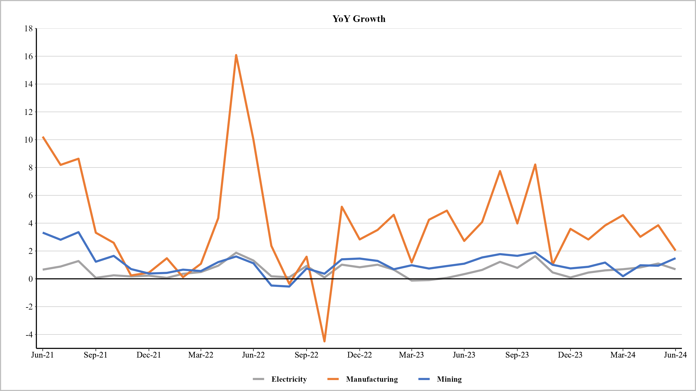
IIP Sector-Wise Growth
Source: Thurro, MOSPI

Slide 28
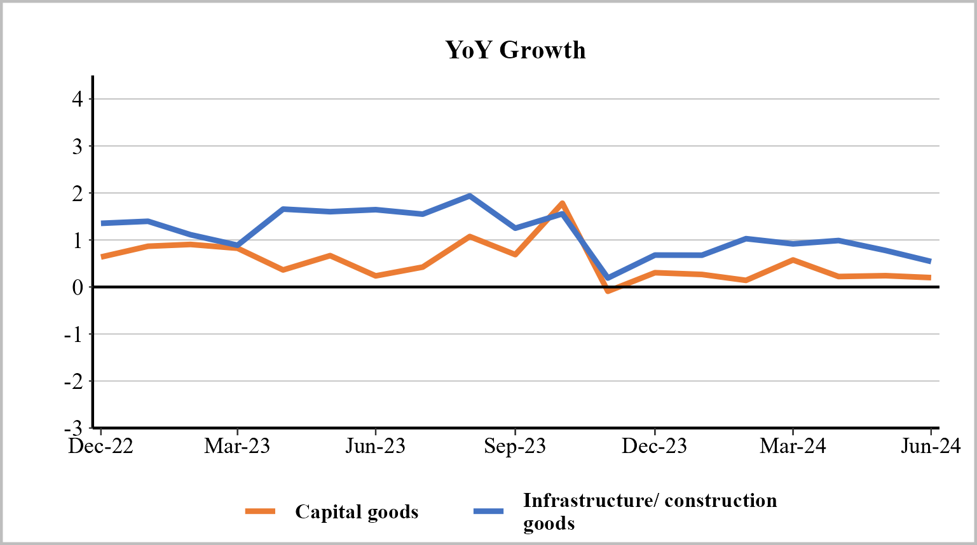
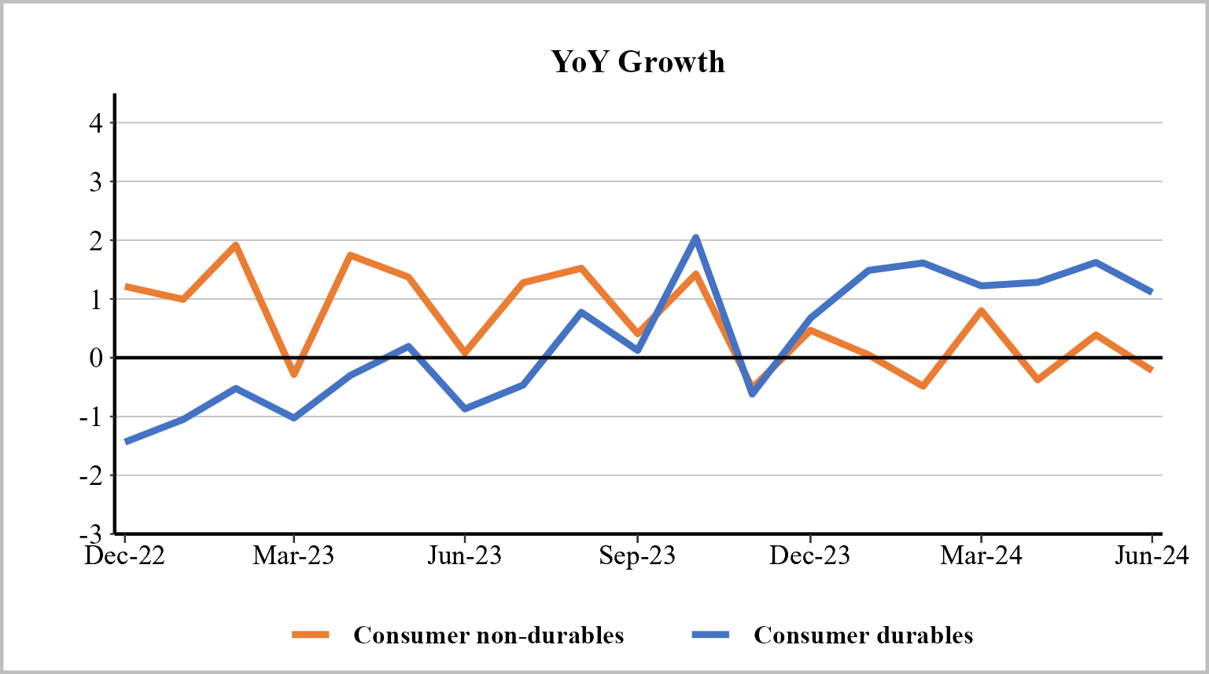
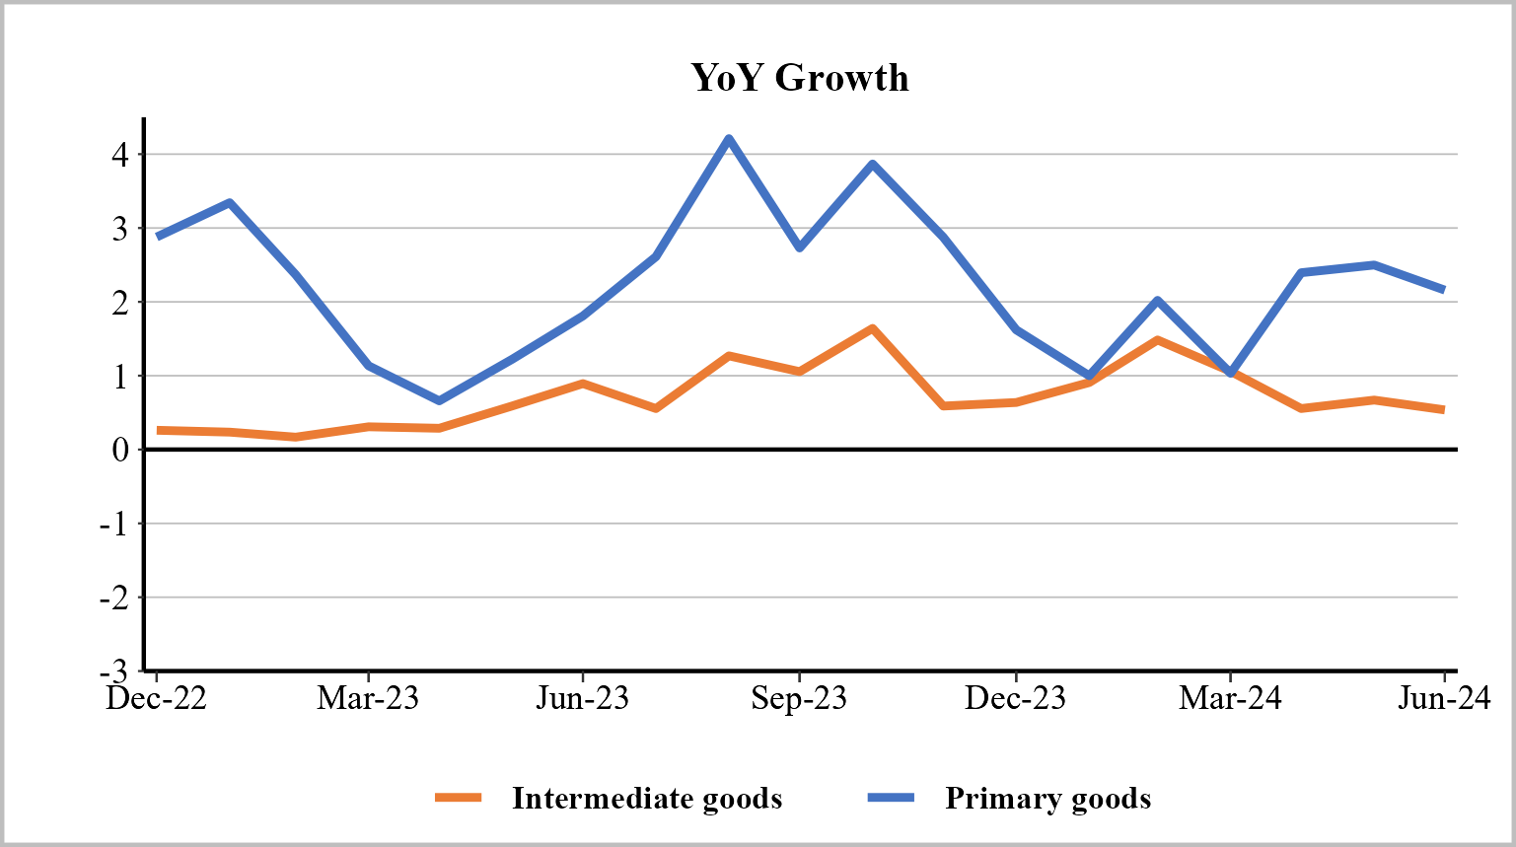
IIP Use-Based Growth
Source: Thurro, MOSPI

