Slide 1
Monthly Data Overview
Feb '24 NEW DELHI

Slide 2
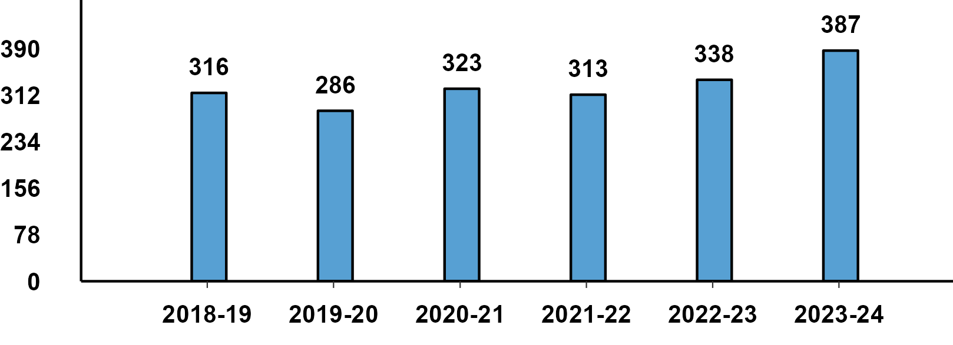
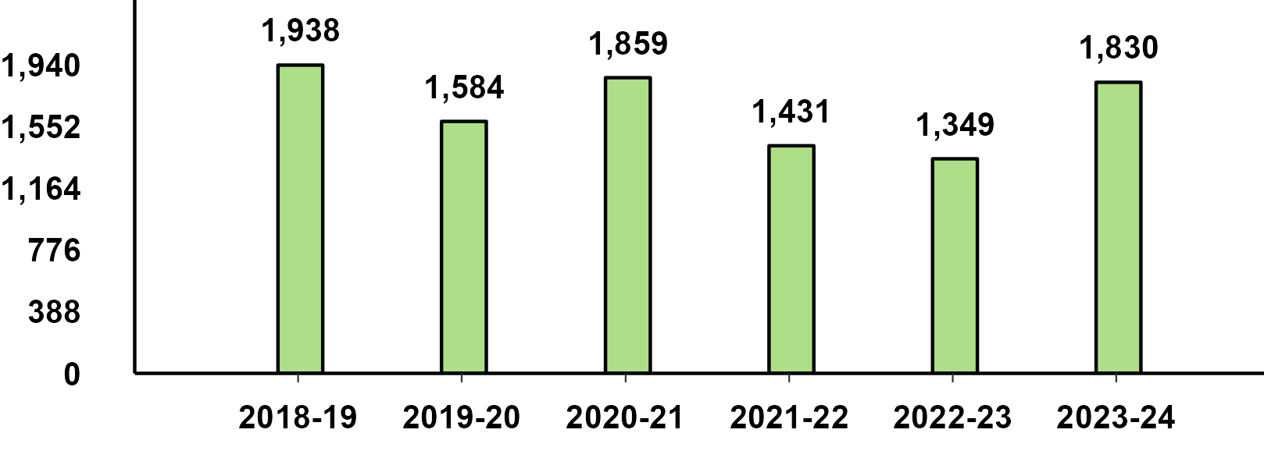
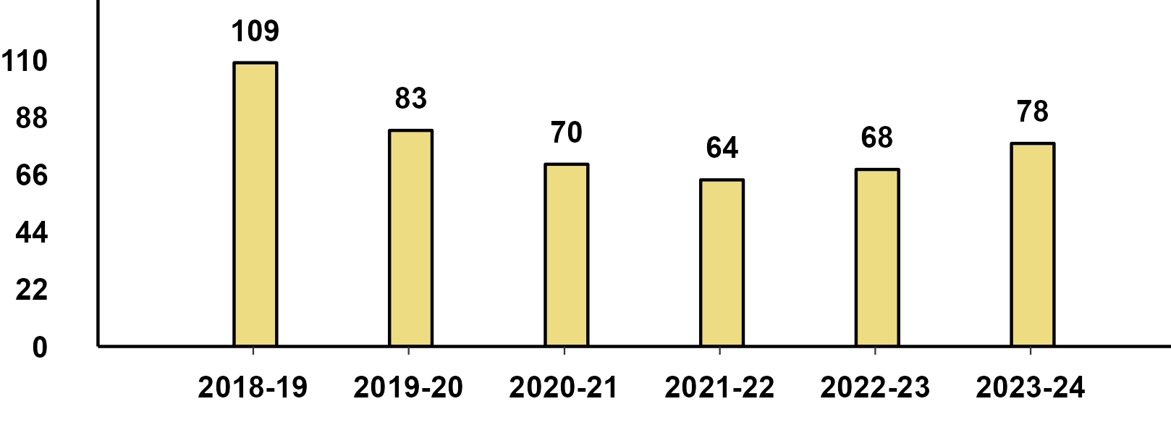
Monthly Production -Feb '24
Passenger Vehicle
Two-Wheeler
Three-Wheeler

Slide 3
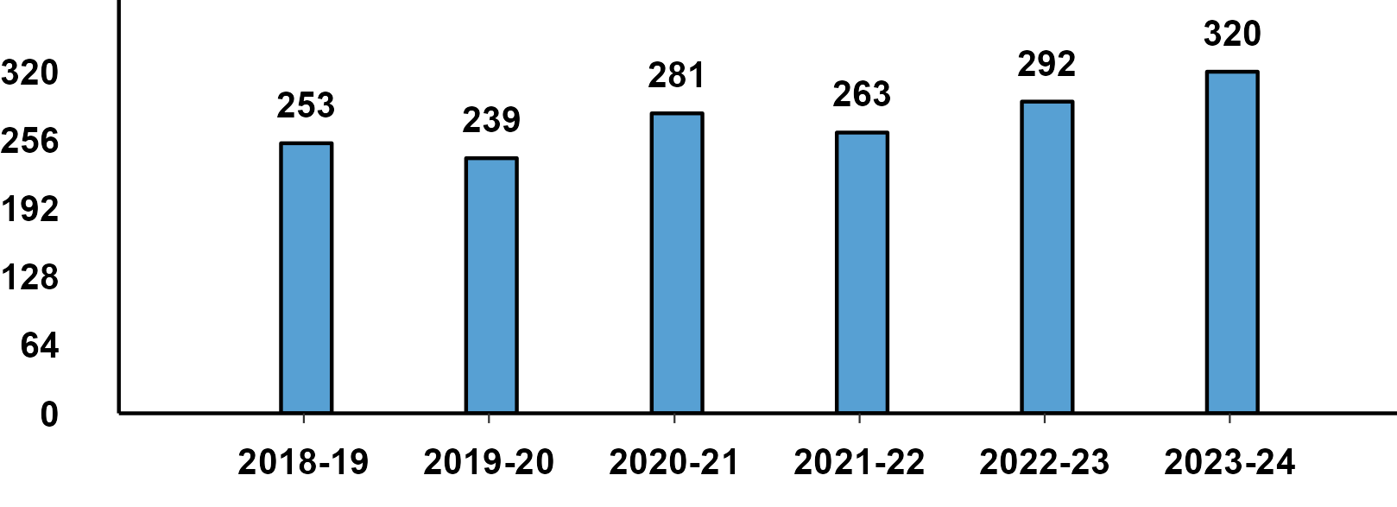
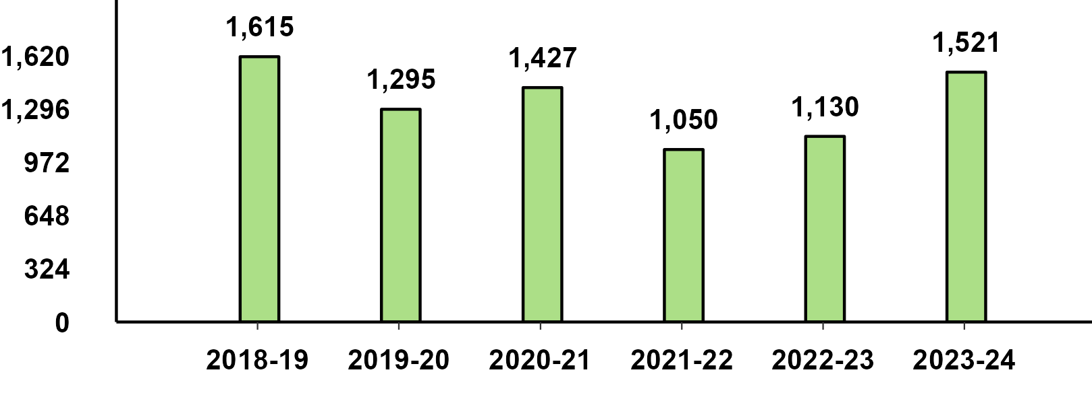
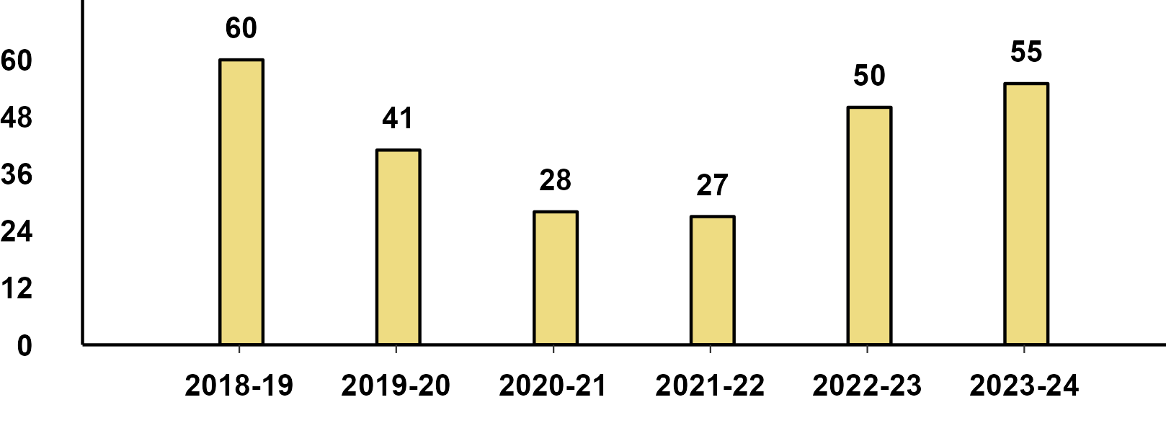
Monthly Domestic Sales -Feb '24
Passenger Vehicle
Two-Wheeler
Three-Wheeler

Slide 4
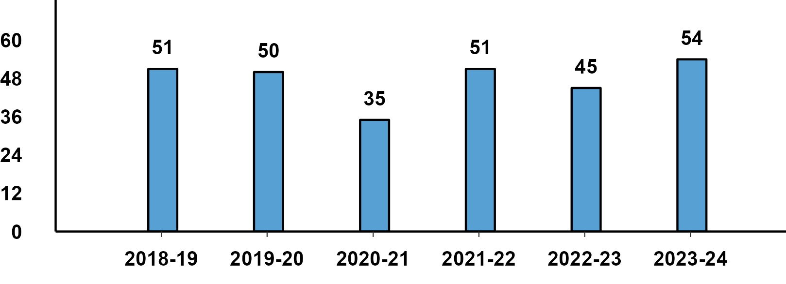
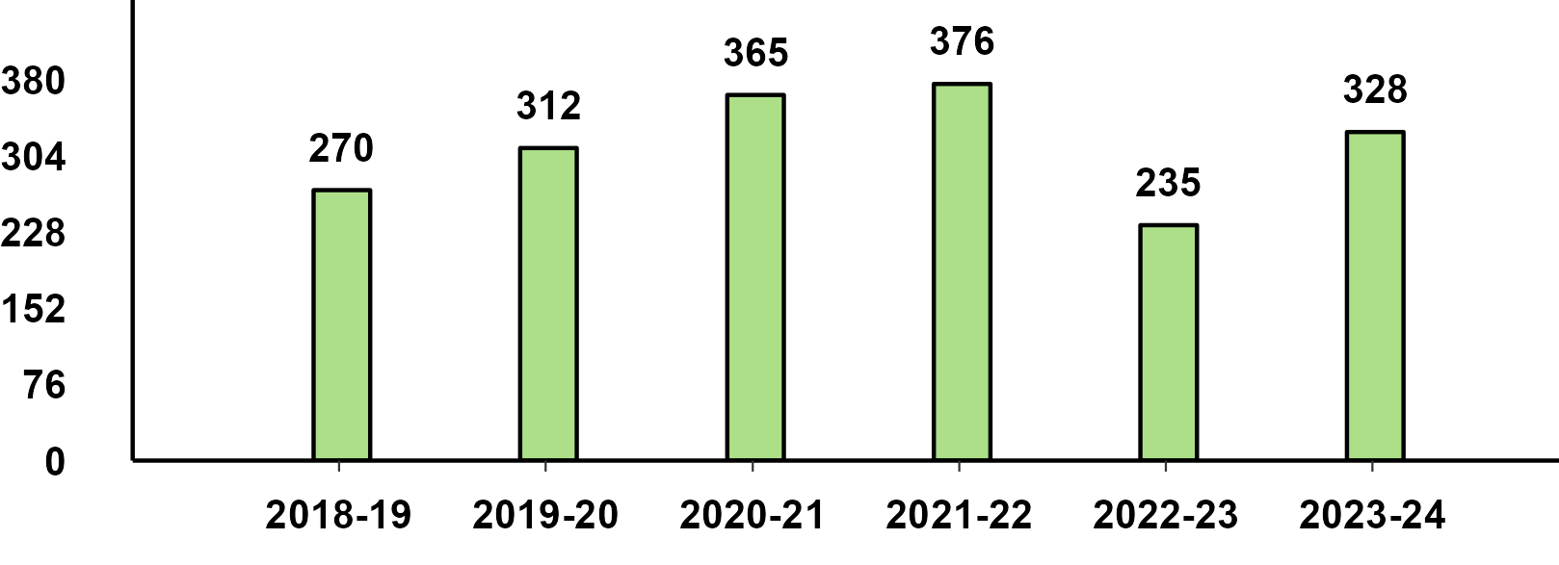
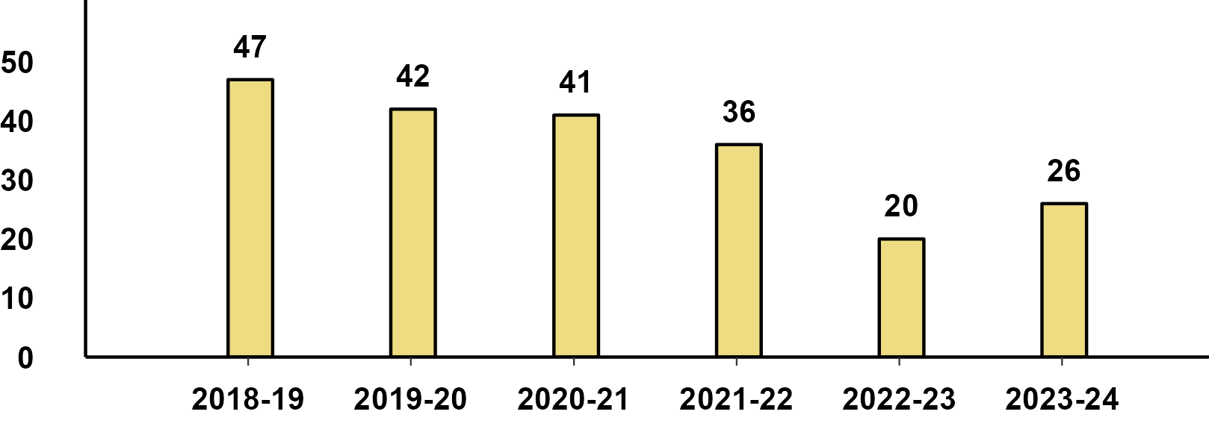
Monthly Exports -Feb '24
Passenger Vehicle
Two-Wheeler
Three-Wheeler

Slide 5
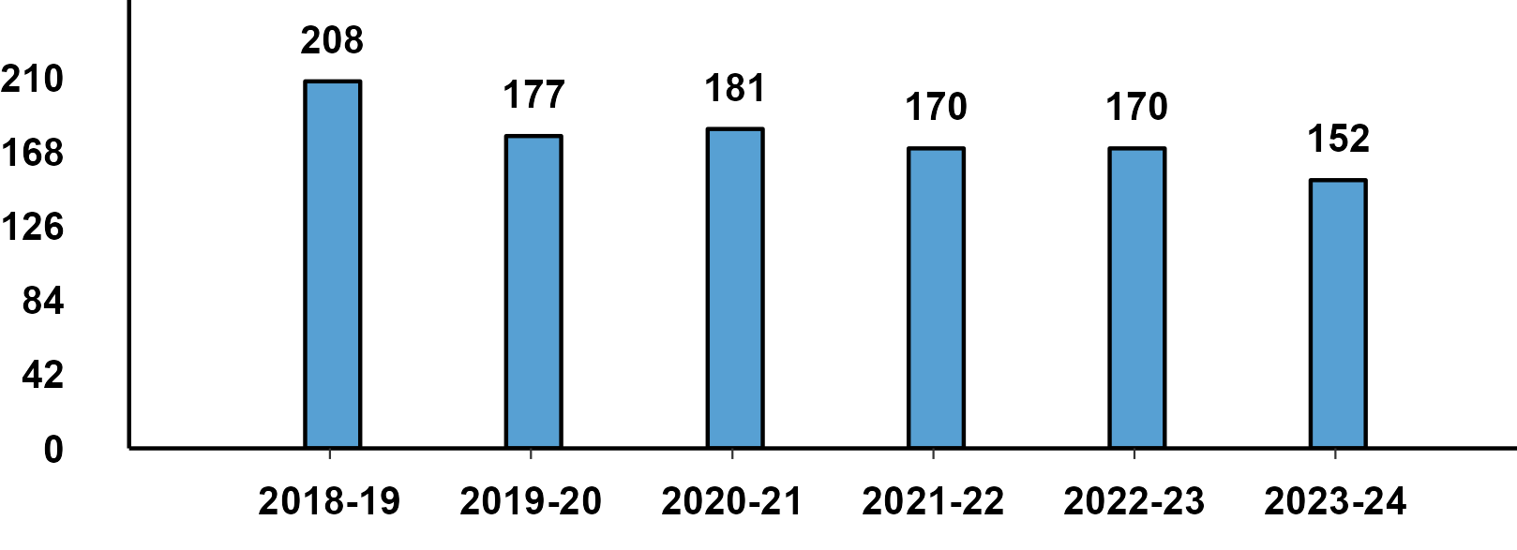
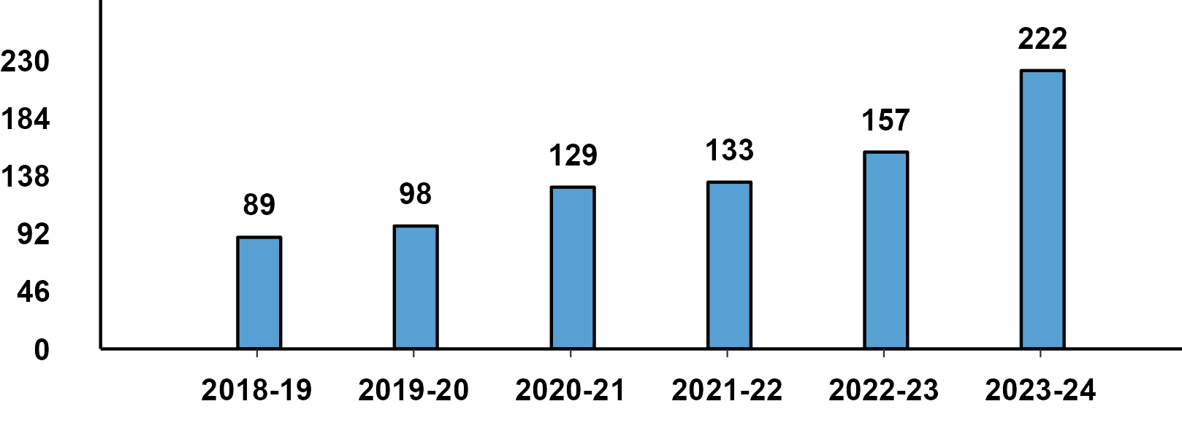
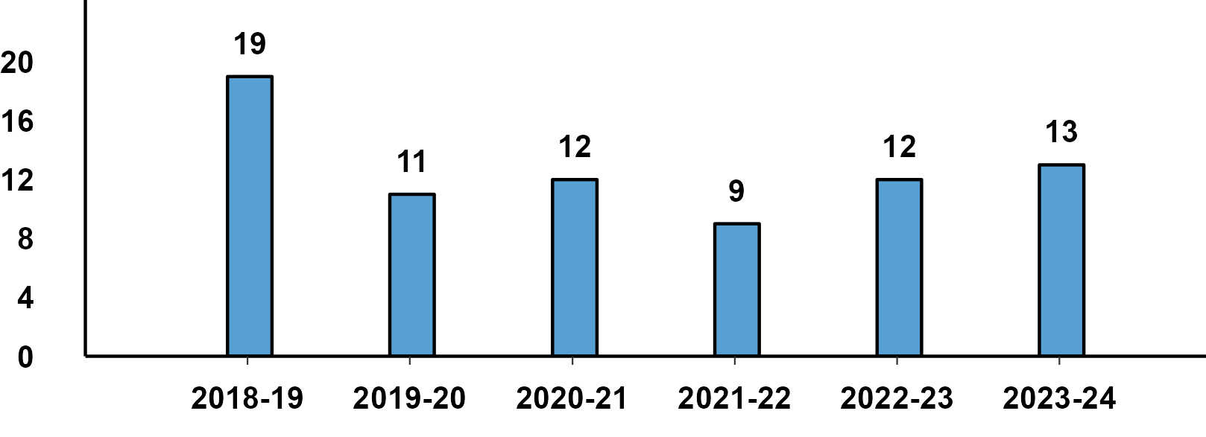
Monthly Production - PV (Sub Categories) -Feb '24
Passenger Cars
Utility Vehicles/SUVs
Vans

Slide 6
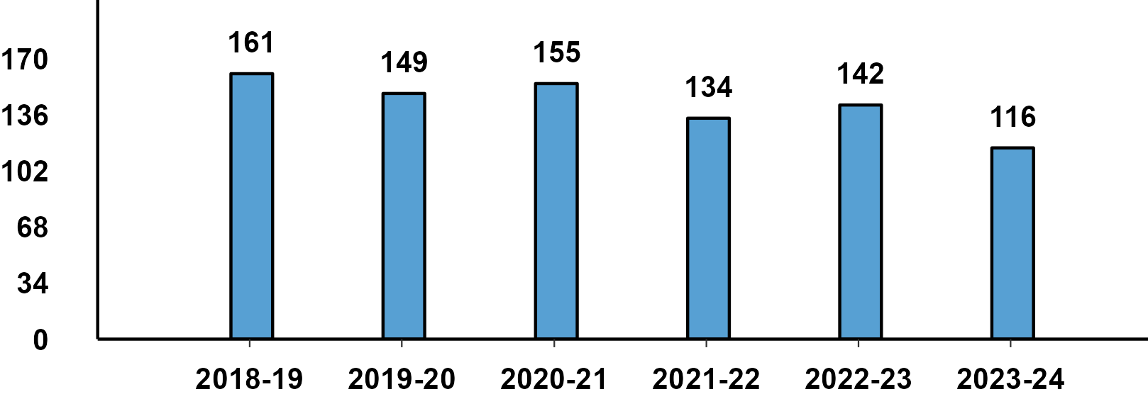
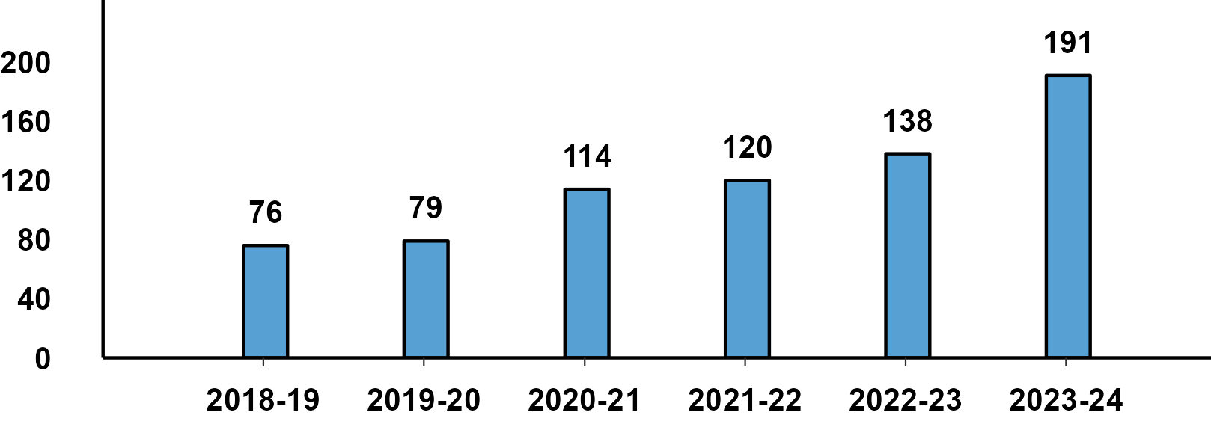
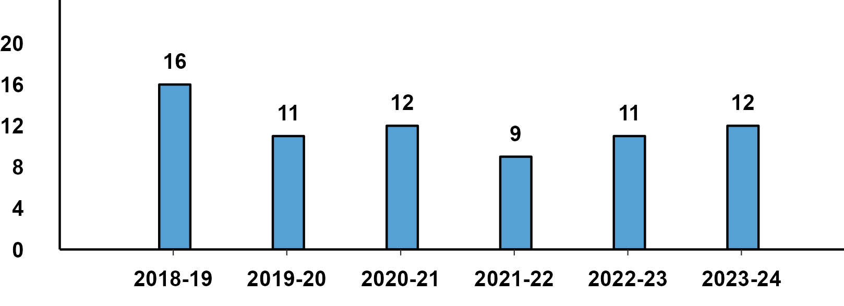
Monthly Domestic Sales - PV (Sub-Categories) - Feb '24
Passenger Cars
Utility Vehicles/SUVs
Vans

Slide 7
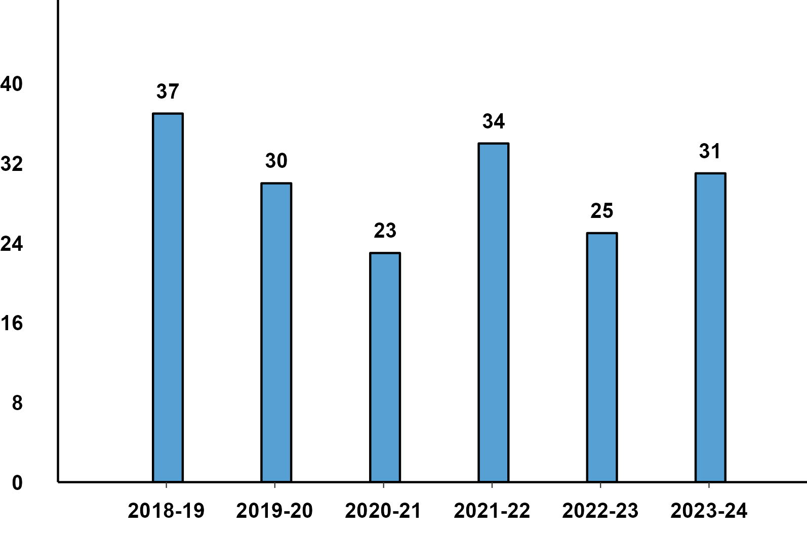
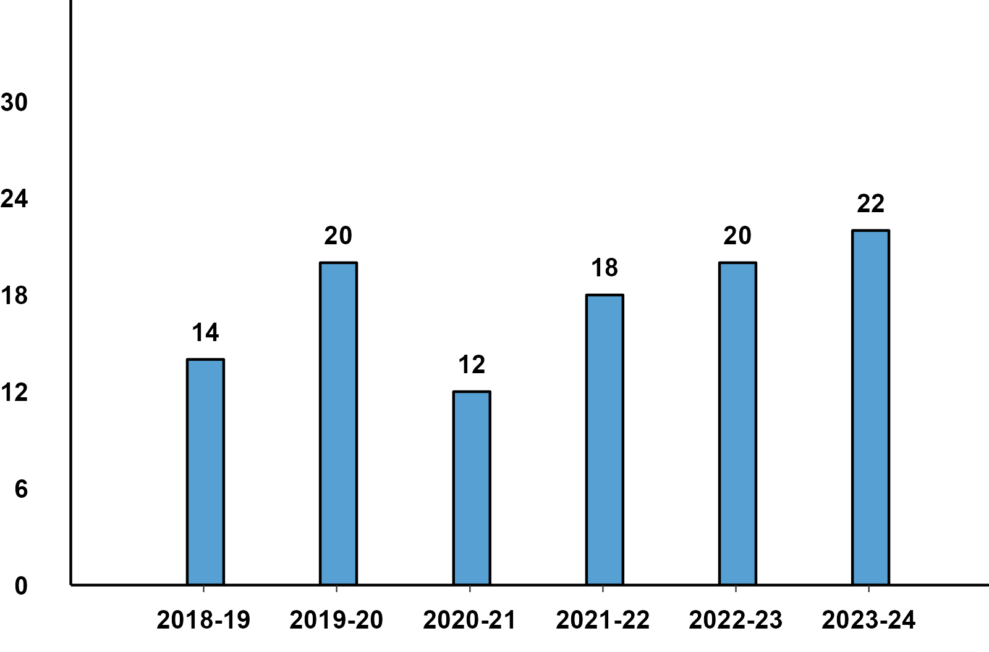
Monthly Exports - PV (Sub-Categories) - Feb '24
Passenger Cars
Utility Vehicles/SUVs

Slide 8
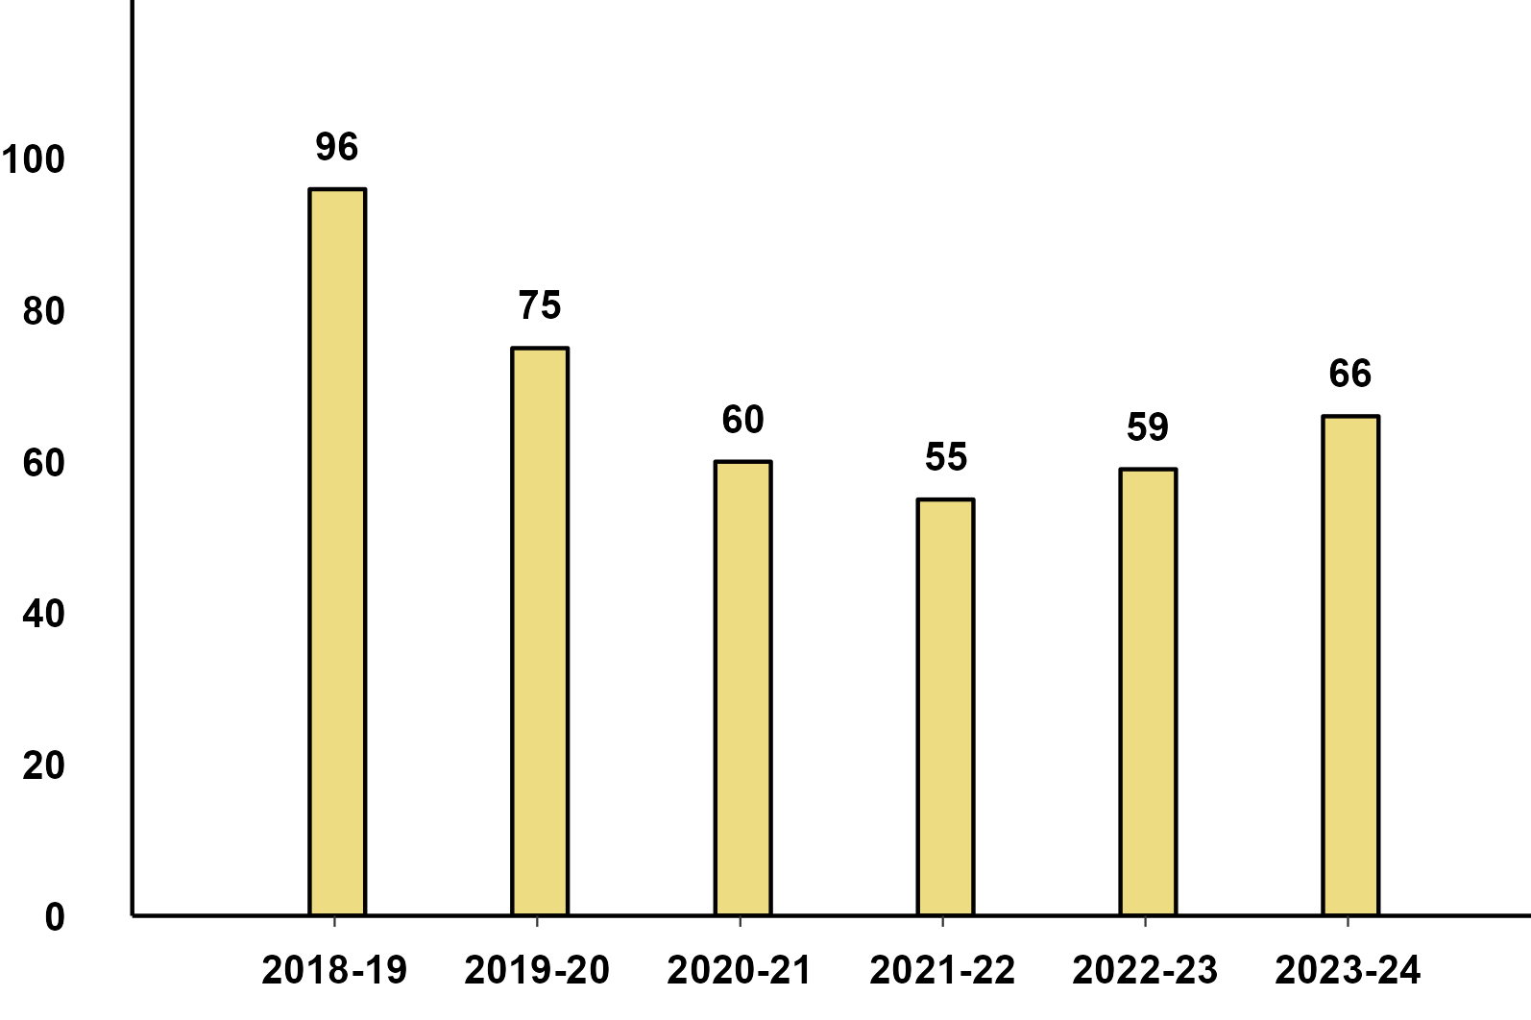
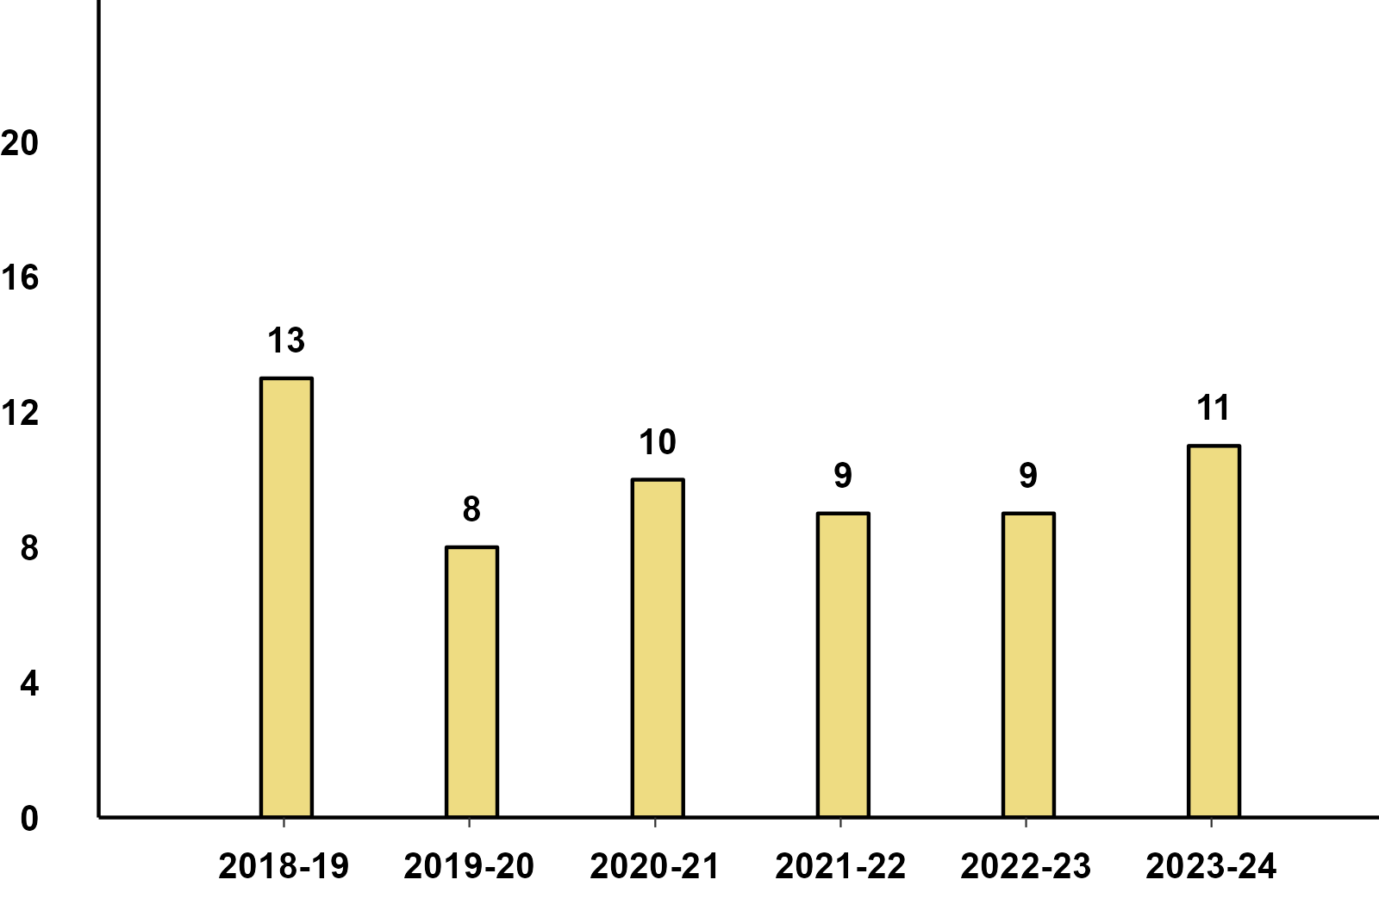
Monthly Production - 3W (Sub-Categories) -Feb '24
Passenger Carrier
Goods Carrier

Slide 9
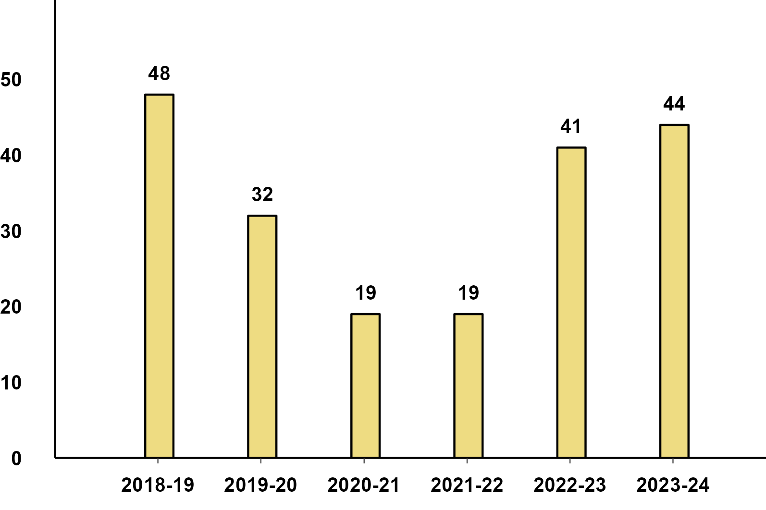
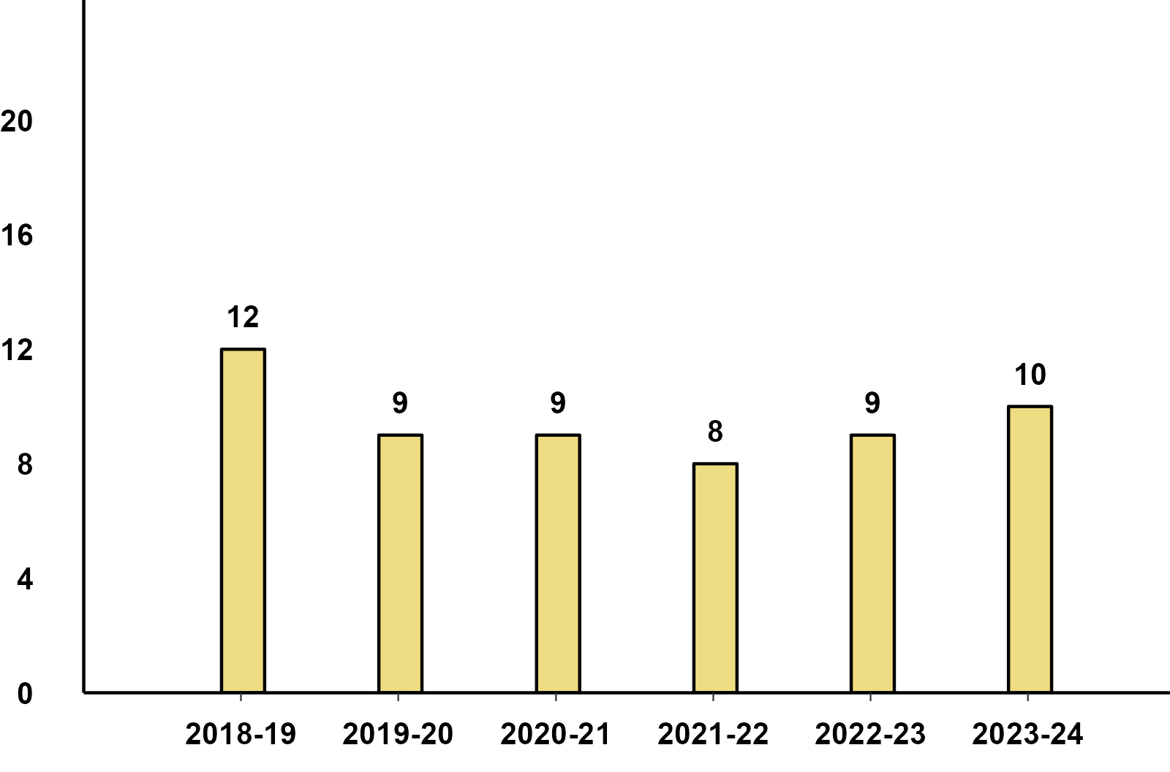
Monthly Domestic Sales - 3W (Sub-Categories) -Feb '24
Passenger Carrier
Goods Carrier

Slide 10
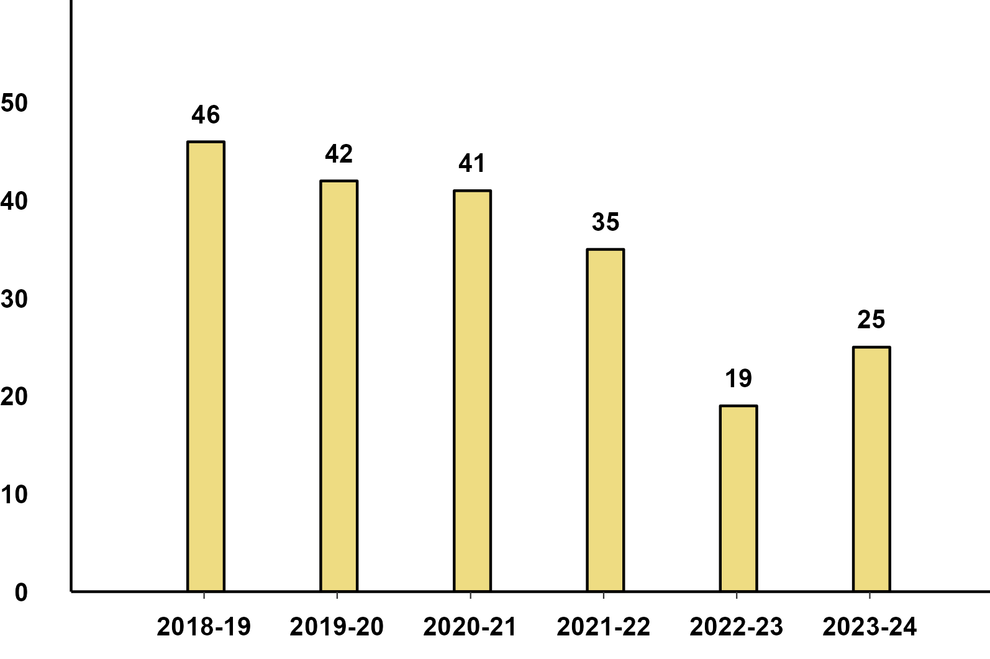
Monthly Exports - 3W (Sub-Categories) -Feb '24
Passenger Carrier

Slide 11
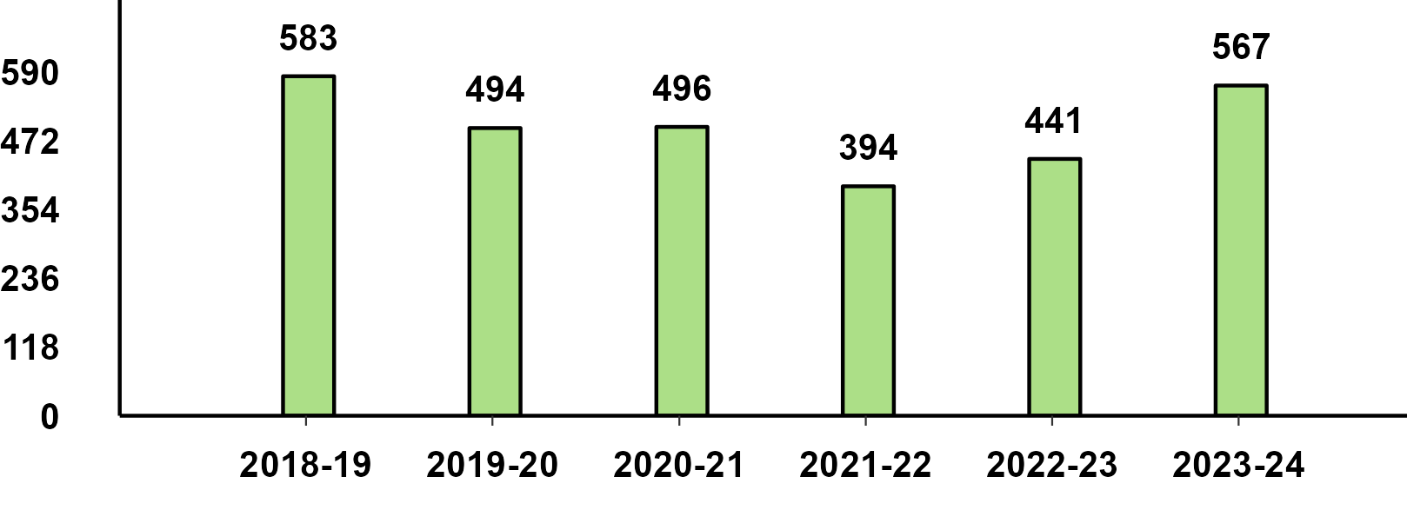
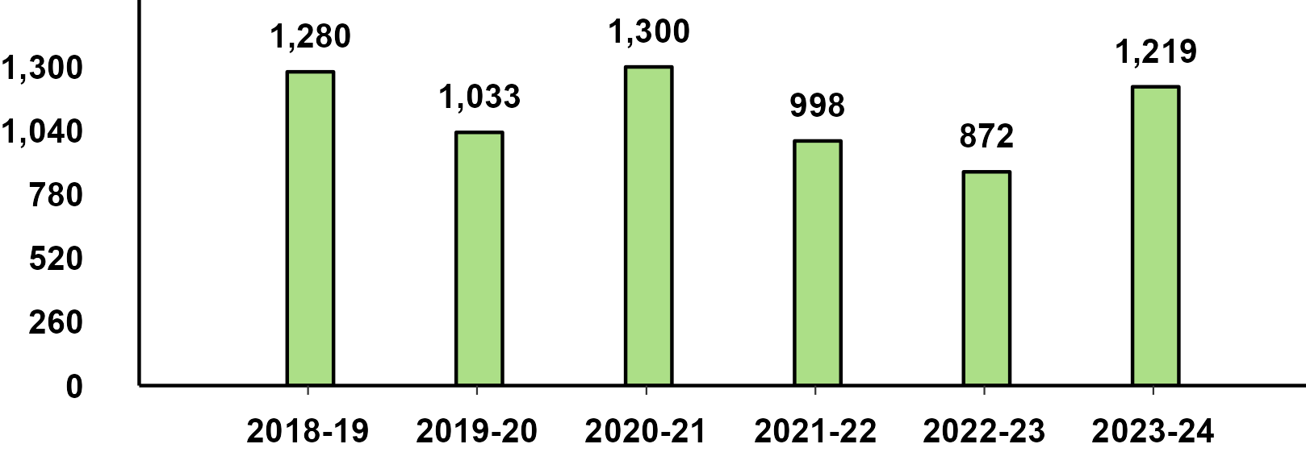
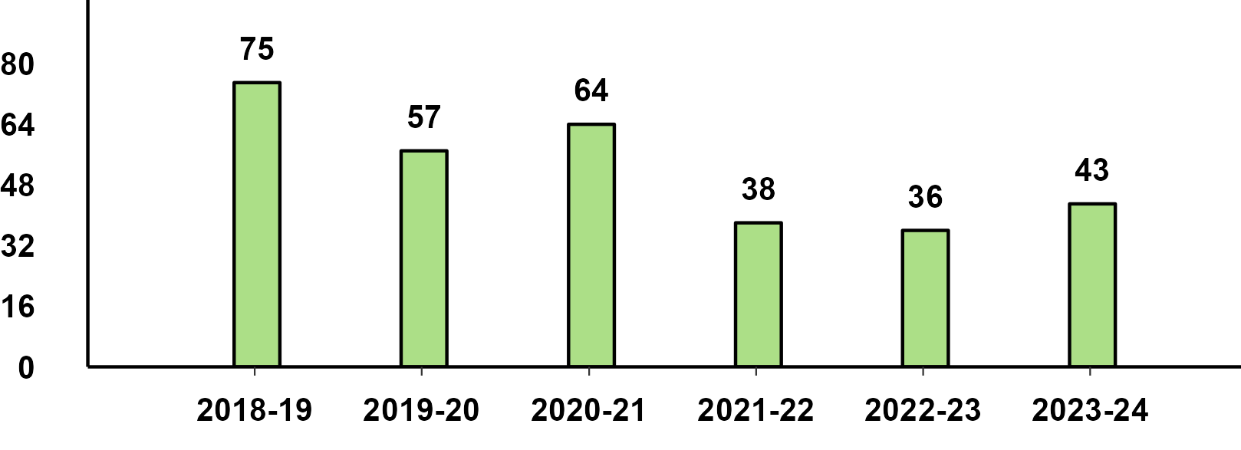
Monthly Production - 2W (Sub-Categories) - Feb '24
Scooters
Motorcycles
Mopeds

Slide 12
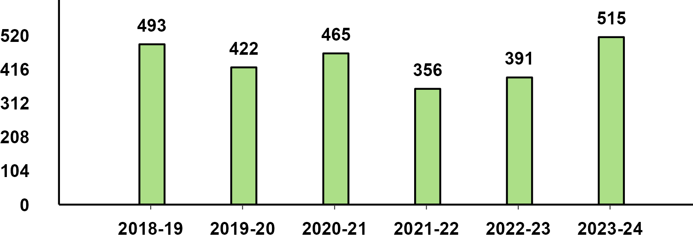
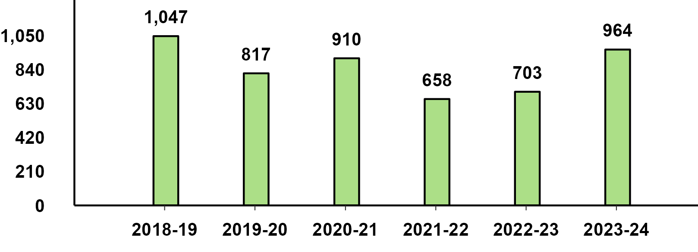
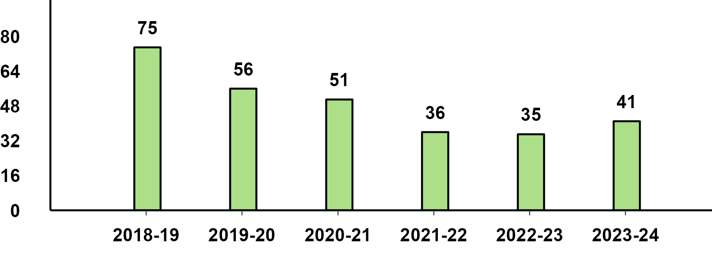
Monthly Domestic Sales - 2W (Sub-Categories) - Feb '24
Scooters
Motorcycles
Mopeds

Slide 13
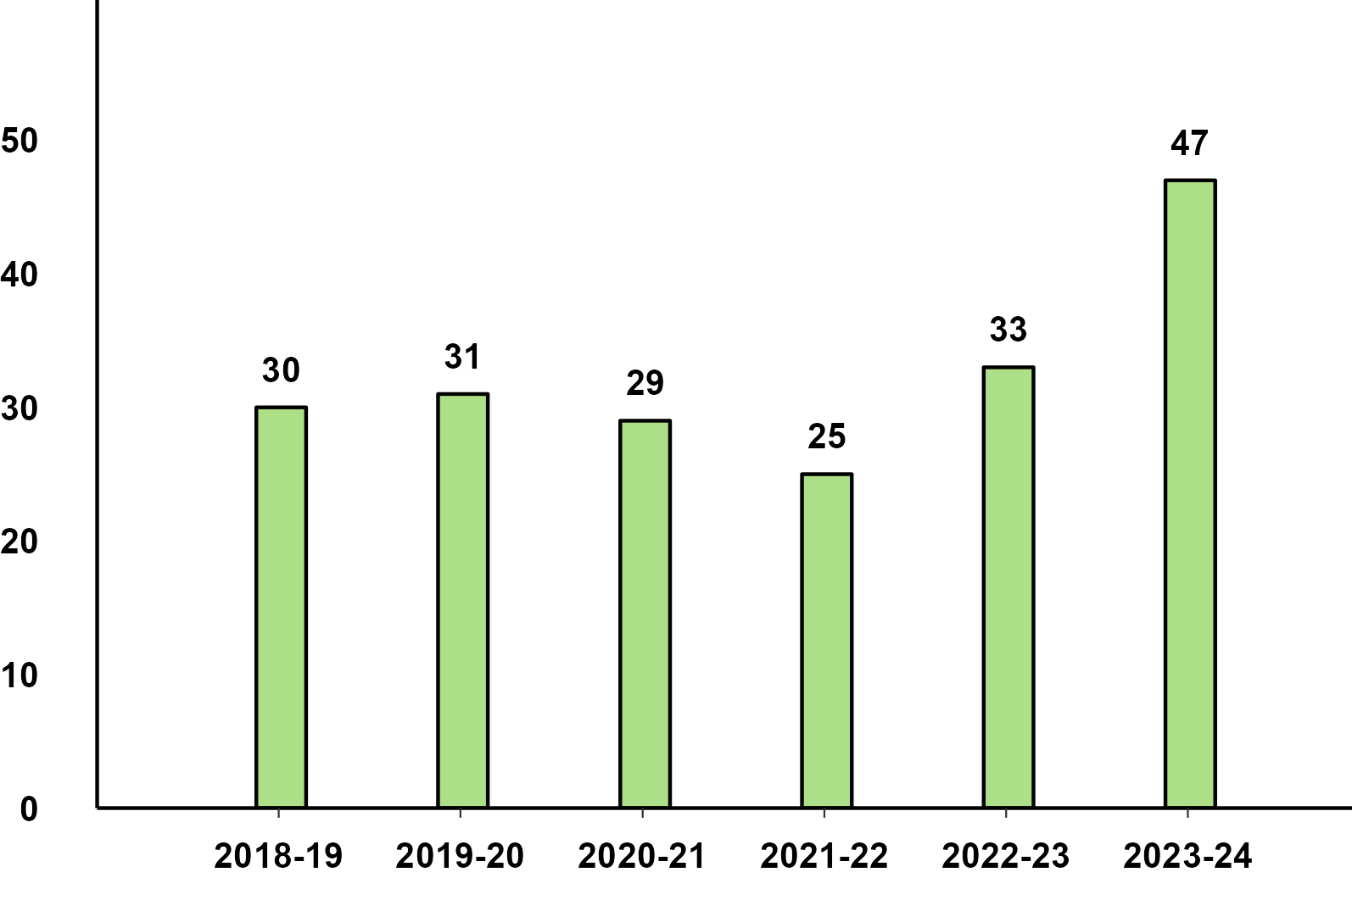
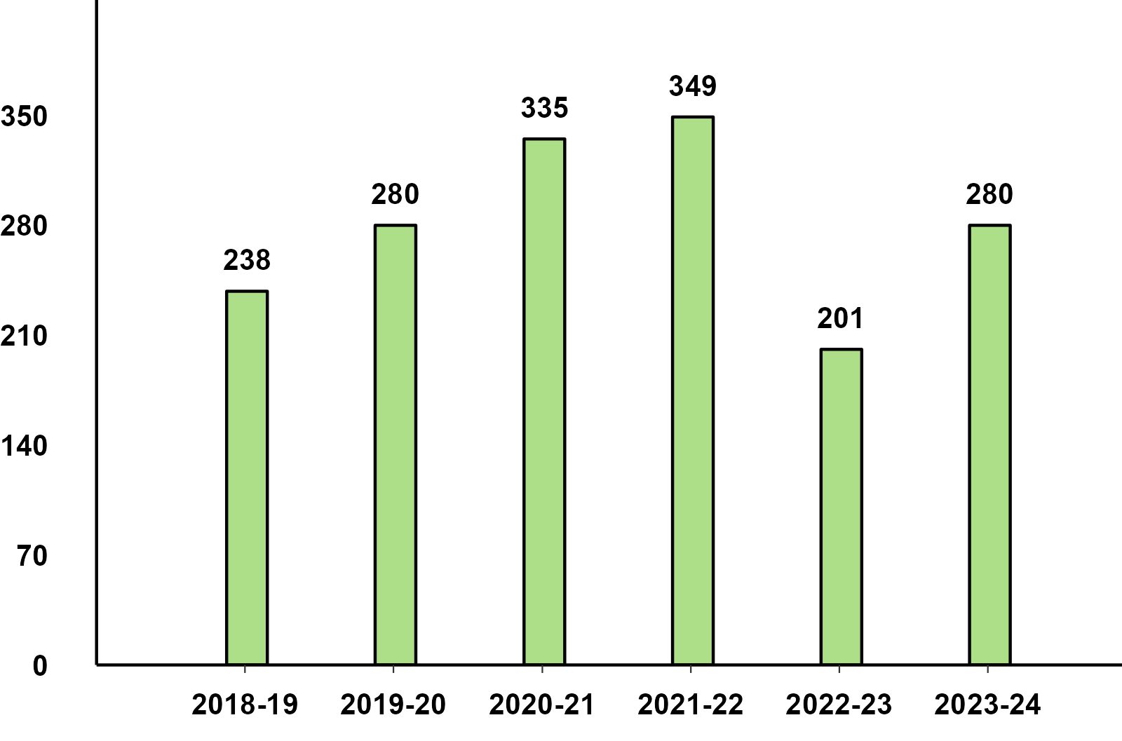
Monthly Exports - 2W (Sub-Categories) - Feb '24
Scooters
Motorcycles

Slide 14
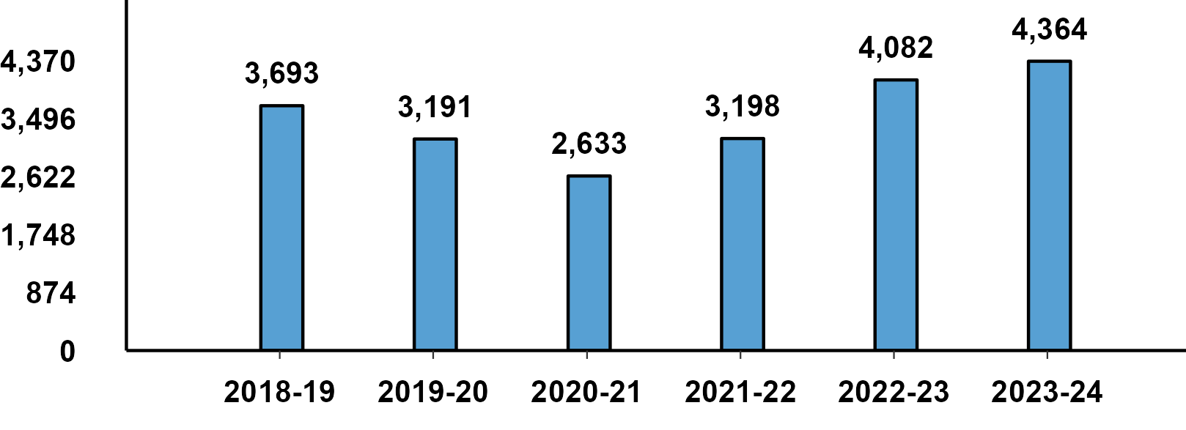
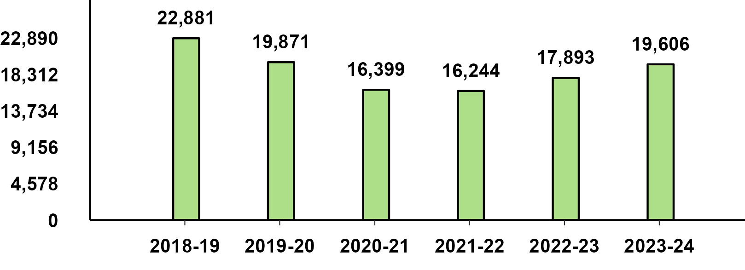
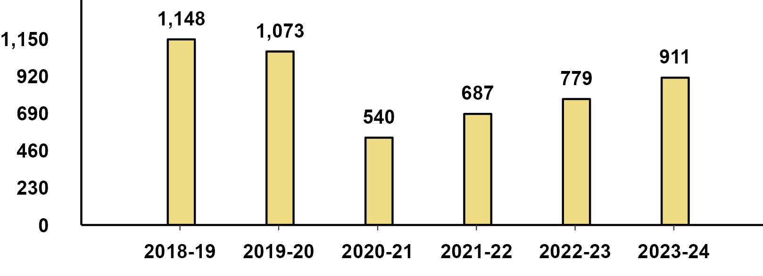
Monthly Production Cumulative - Feb '24
Passenger Vehicle
Two-Wheeler
Three-Wheeler

Slide 15
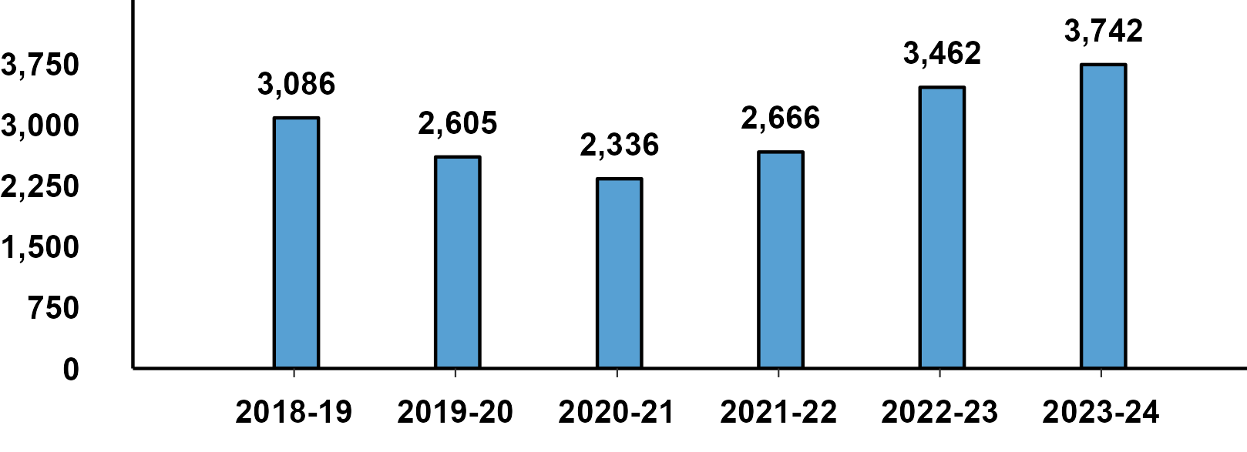
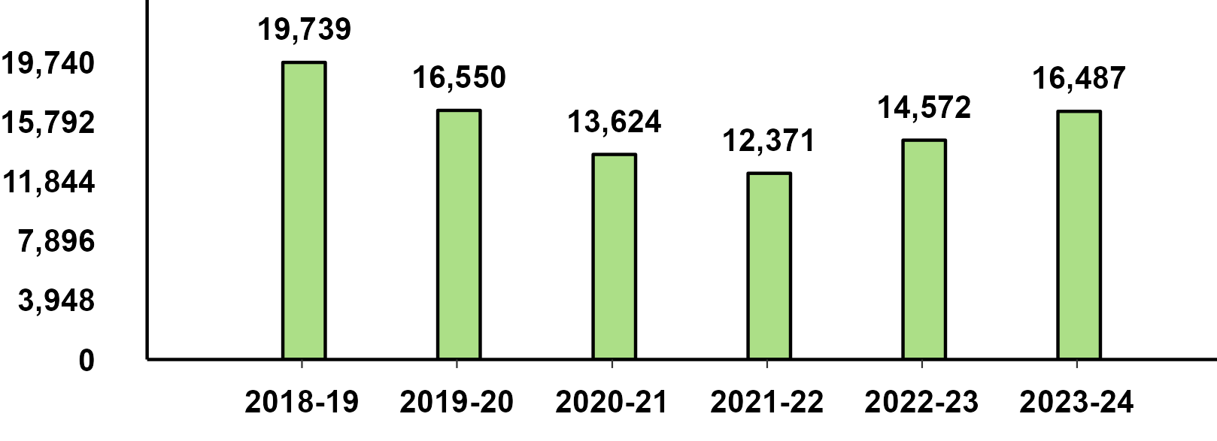
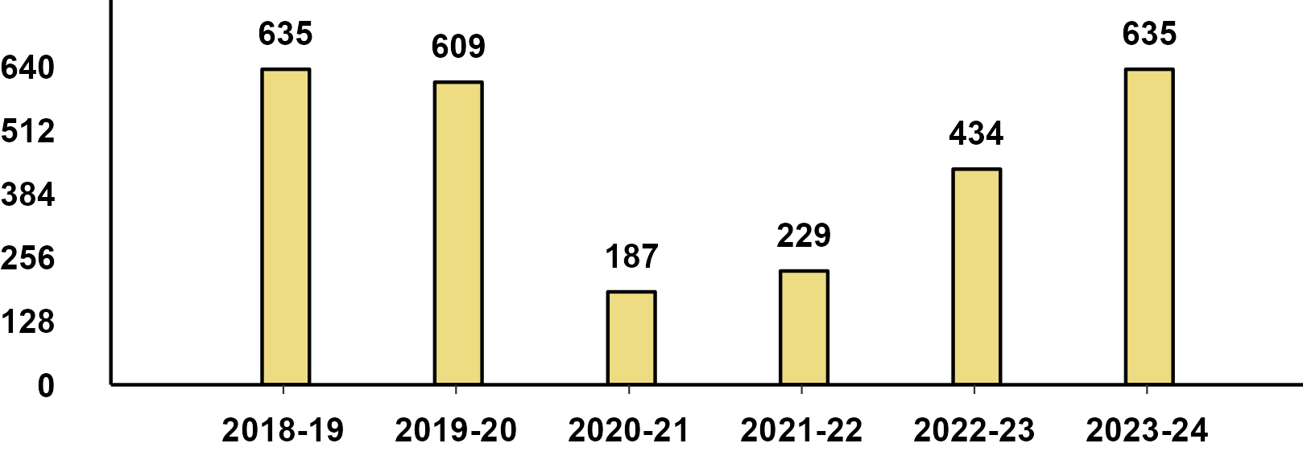
Monthly Domestic Sales Cumulative - Feb '24
Passenger Vehicle
Two-Wheeler
Three-Wheeler

Slide 16
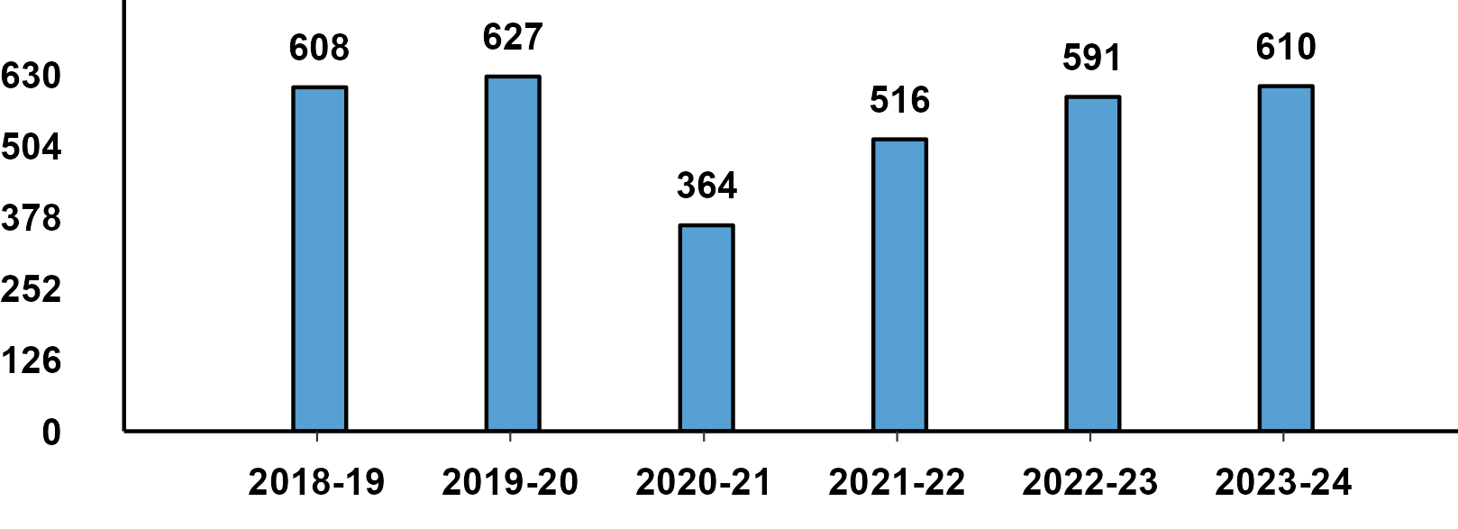
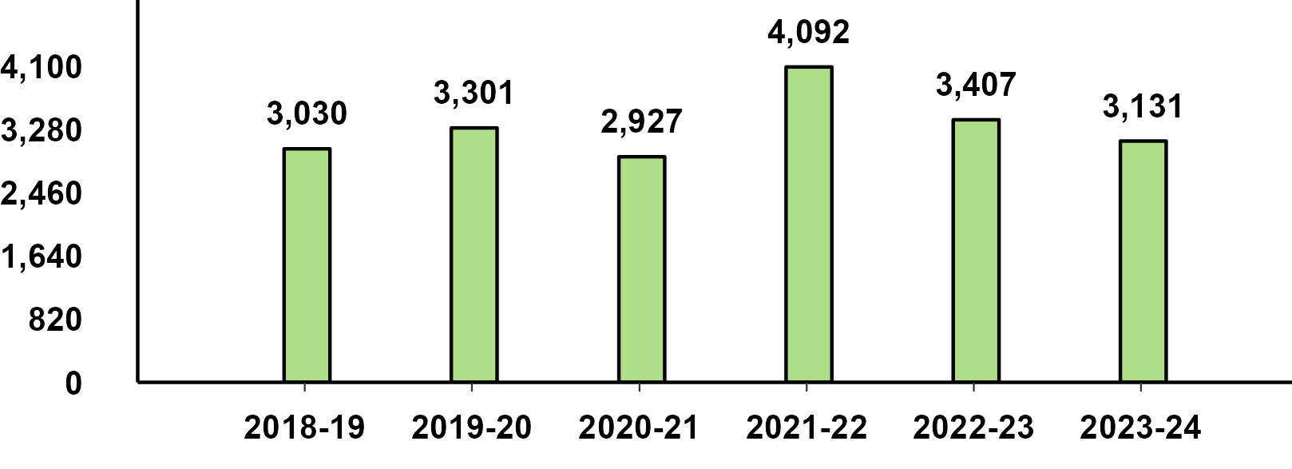
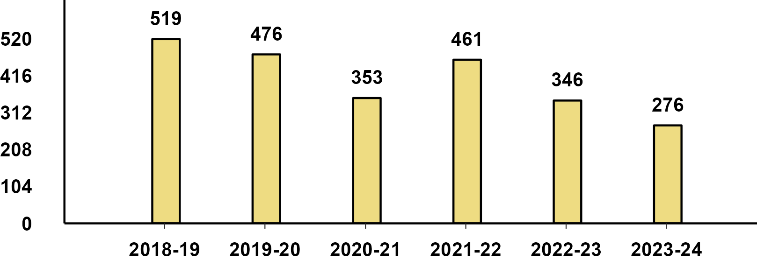
Monthly Exports Cumulative - Feb '24
Passenger Vehicle
Two-Wheeler
Three-Wheeler

