Slide 1
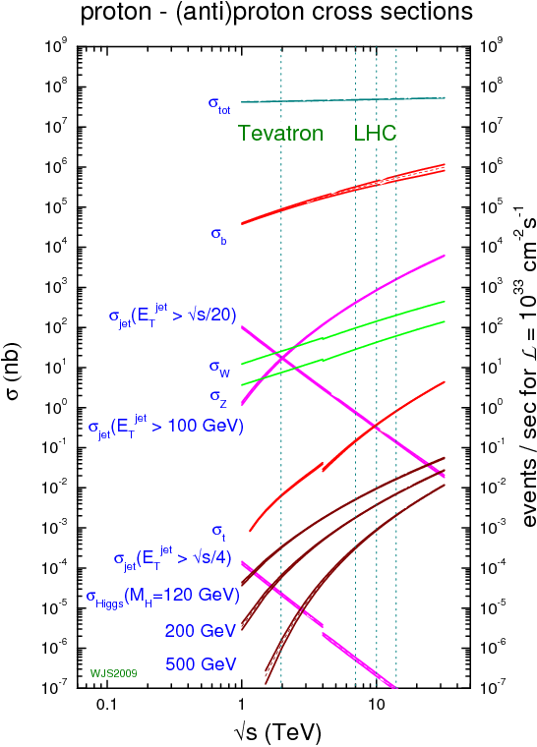
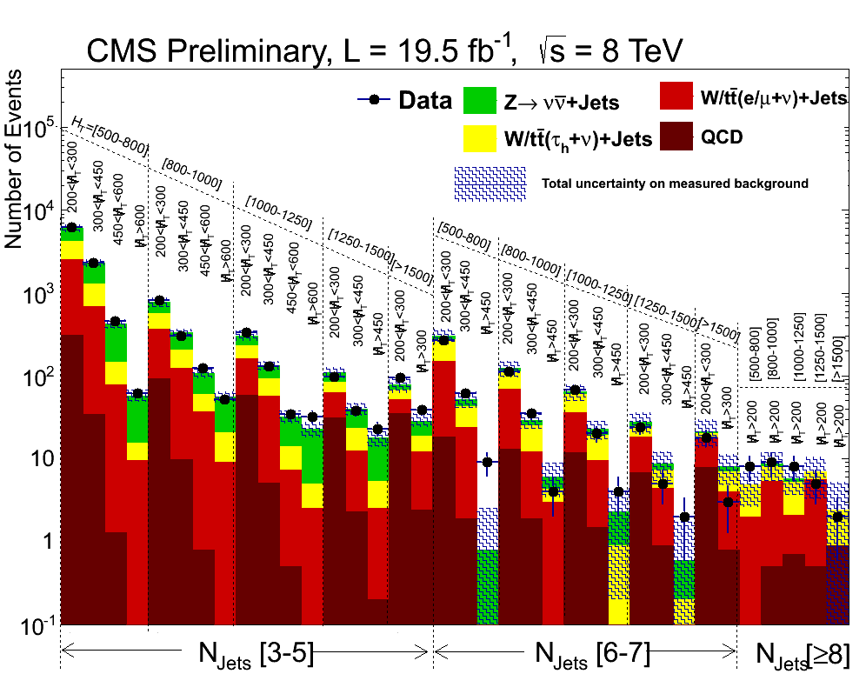
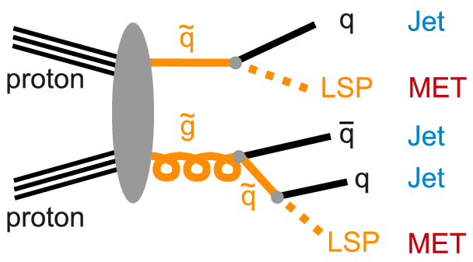
Search for New Physics with Jets + MET
Matthias Schröder (DESY)
Altan Cakir (DESY)
The search for new physics is one of the primary goals of the LHC physics programme
In this exercise, we will follow the recently published SUS-13-012 and
  Perform a search for new-physics in events with jets and missing transverse momentum
  Focus on the prediction of the expected Standard-Model backgrounds from data
  Compare our background predictions to the latest 8-TeV data from CMS

