Slide 1
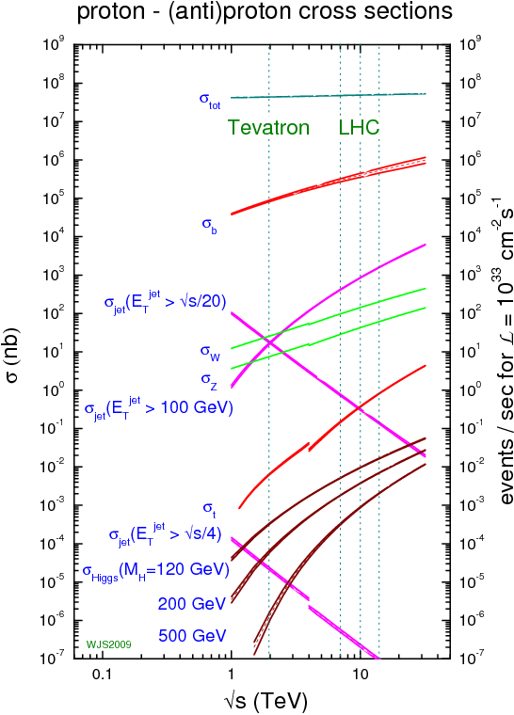
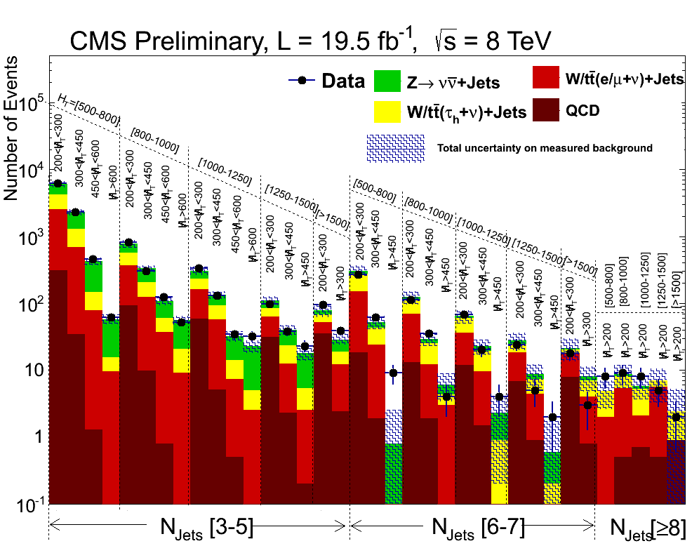
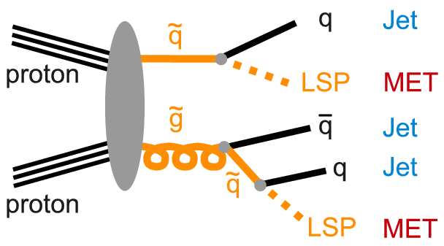
Search for New Physics with Jets + MET Matthias Schröder (DESY) Altan Cakir (DESY)
The search for new physics is one of the primary goals of the LHC physics programme
In this exercise, we will follow the recently published SUS-13-012 and
Perform a search for new-physics in events with jets and missing transverse momentum
Focus on the prediction of the expected Standard-Model backgrounds from data
Compare our background predictions to the latest 8-TeV data from CMS

