Slide 1
Sales Insights Project

Slide 2
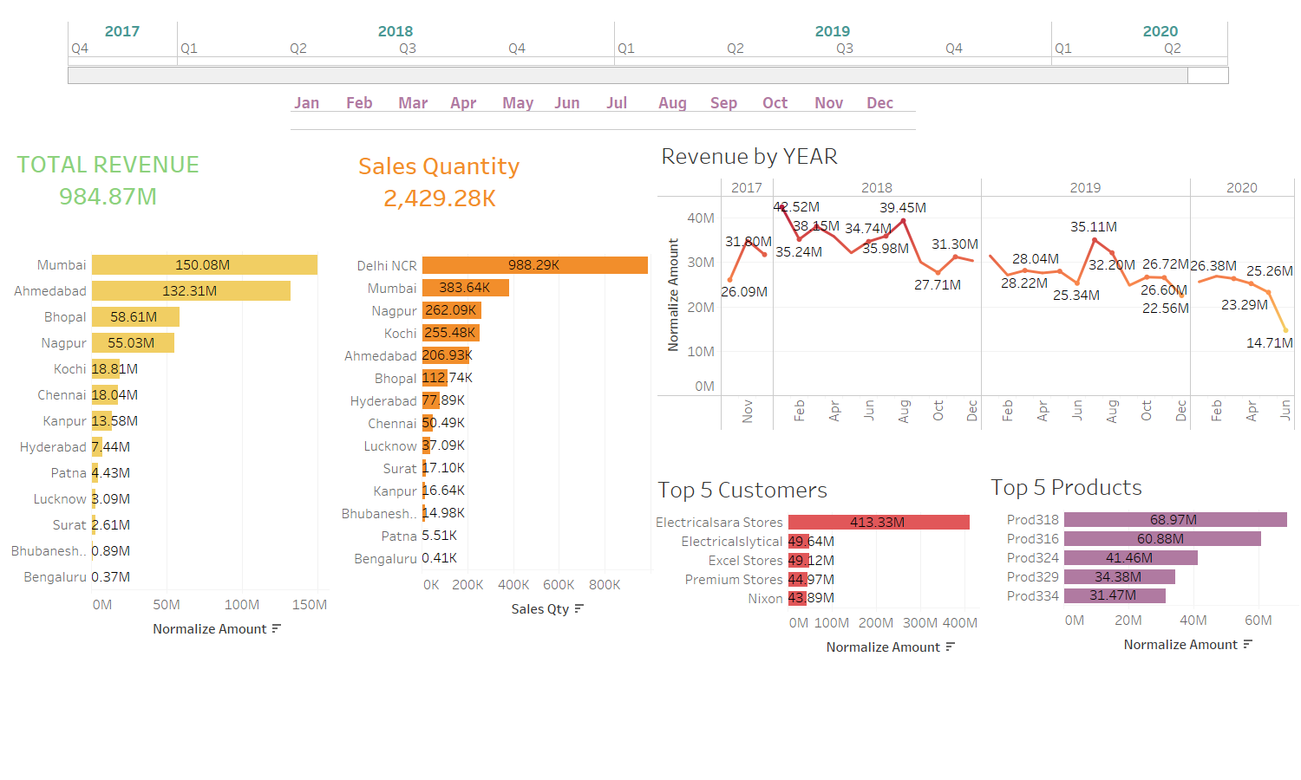

Slide 3
