Slide 1

GitHub Copilot Hackathon
Team Name- Beginners
Team Leader Name- Adreeja Mahato
Team Leader Email Address-adreejamahato@gmail.com

Slide 2

Brief Summary of Project:
The personal finance tracker is a web-based application that allows users to track their income and expenses. It is built using JavaScript, HTML, and CSS, and incorporates features for adding, editing, and deleting transactions. The application provides a user-friendly interface where users can input transaction details such as description, amount, and type (income or expense). The transactions are then displayed in a list, showing the description, amount, and a delete button for each entry. The application also calculates and displays the current balance based on the entered transactions. It leverages Microsoft Cloud Technologies for hosting, database storage, and authentication, while utilizing GitHub Copilot for code completion and suggestions. The project aims to provide users with a convenient and efficient tool for managing their personal finances in a secure and organized manner.

Slide 3
Business Challenge /Use Cases
The personal finance tracker can address various business challenges and cater to a range of use cases. Some of the key business challenges it can help overcome and use cases it can support include:
Budgeting and Expense Tracking: The finance tracker enables individuals to set and manage budgets effectively. Users can track their expenses, categorize them, and monitor their spending habits over time. This helps in identifying areas where adjustments can be made to achieve financial goals.
Financial Goal Setting: The application allows users to set specific financial goals, such as saving for a vacation or paying off debts. By tracking income and expenses, users can monitor their progress towards these goals and make informed decisions to stay on track.
Investment Portfolio Monitoring: For investors, the finance tracker can serve as a tool to monitor their investment portfolios. Users can track their investment transactions, analyze performance, and calculate returns to make informed investment decisions.
Tax Planning: By maintaining accurate records of income and expenses, users can simplify the process of tax planning and preparation. The finance tracker provides a consolidated view of financial transactions, making it easier to gather necessary information during tax filing.
Small Business Expense Tracking: The application can be used by small business owners to track their business expenses separately from personal finances. This helps in maintaining proper financial records, managing cash flow, and simplifying tax reporting for the business.
Family Budgeting: The finance tracker can support family budgeting by allowing multiple users to input their income and expenses. This enables families to have a centralized view of their financial situation, promote transparency, and collaborate on financial decisions.
Financial Education: The finance tracker can be used as an educational tool to teach individuals about budgeting, expense tracking, and personal finance management. It provides a practical way for users to learn and improve their financial literacy.
Overall, the personal finance tracker addresses the need for better financial management, empowers users to make informed financial decisions, and supports various business and personal use cases related to budgeting, expense tracking, goal setting, and financial planning

Slide 4
Proposed Solution
The proposed technology stack for the personal finance tracker project includes:
Front-End:
HTML: Used for creating the structure and content of the web pages.
CSS: Used for styling the user interface and providing visual enhancements.
JavaScript: Used for implementing the interactive features, handling user input, and performing calculations.
Back-End (not mentioned in the code provided):
Server-Side Language (e.g., Node.js, Python, PHP): Used for server-side logic and handling data operations.
Database (e.g., MySQL, MongoDB): Used for storing and managing transaction data.
Integration with Microsoft Cloud Technologies (mentioned in previous responses):
Azure: Used for hosting the application and deploying it to the cloud.
Azure SQL Database: Used for storing and managing transaction data securely.
Azure Active Directory: Used for authentication and user management.
GitHub Copilot (mentioned in previous responses):
AI-powered code completion tool that assists in generating code snippets and completing code lines based on context.
It's important to note that the code provided in previous responses focused on the front-end implementation using HTML, CSS, and JavaScript. For a complete solution, we would need to incorporate a back-end implementation and integrate it with a database for data storage and retrieval. Additionally, integrating with Microsoft Cloud Technologies and GitHub Copilot can enhance the functionality and deployment options of the application.

Slide 5
Technology/Tool Stack Used:
The technology or tool stack used in the frontend of the personal finance tracker application includes:
HTML (Hypertext Markup Language): Used for creating the structure and content of the web pages.
CSS (Cascading Style Sheets): Used for styling the user interface, including layout, colors, fonts, and visual enhancements.
JavaScript: Used for implementing the interactive features, handling user input, and performing calculations on the client-side.
GitHub Copilot (AI-powered code completion tool): Assists in generating code snippets and completing code lines based on context, providing guidance during development.
Responsive Design: The application is designed to be responsive, meaning it adapts and provides an optimal user experience across different screen sizes and devices.

Slide 6
Mention of usage of Github Copilot
GitHub Copilot can be used during the development process of the personal finance tracker application to assist with generating code snippets and completing code lines. It utilizes AI-powered code completion to provide suggestions based on the context and patterns observed in the codebase.
Here are some ways GitHub Copilot can be useful in the development of the application:
1. Code Suggestions: GitHub Copilot can provide intelligent suggestions for completing code lines or generating code snippets based on the current context. It can save time and effort by offering relevant code snippets for common programming tasks.
2. Function and Method Suggestions: When working with JavaScript, GitHub Copilot can assist in suggesting appropriate functions or methods for specific operations. For example, it can provide suggestions for calculating balances, validating inputs, or formatting dates.
3. Error Handling: GitHub Copilot can help in handling errors by suggesting common error handling patterns or providing suggestions for exception handling code.
4. Syntax and API Guidance: It can assist in writing correct syntax by providing suggestions for JavaScript language constructs or methods from relevant libraries or frameworks.
5. Refactoring Assistance: GitHub Copilot can offer suggestions for refactoring code snippets to improve code readability, performance, or maintainability. It can help identify areas of code that can be optimized or simplified.
6. Documentation Assistance: It can provide suggestions for code comments or generate method/function documentation based on the code context, making it easier to maintain code documentation.
While GitHub Copilot can be a valuable tool during development, it's important to review and validate the suggestions provided by Copilot to ensure they align with your project requirements and adhere to best practices. It should be used as a productivity tool and not as a substitute for understanding and writing code independently.

Slide 7
Source code in zip file / Github link :
https://adreeja06.github.io/github-copilot-hackathon/
https://github.com/adreeja06/github-copilot-hackathon

Slide 8
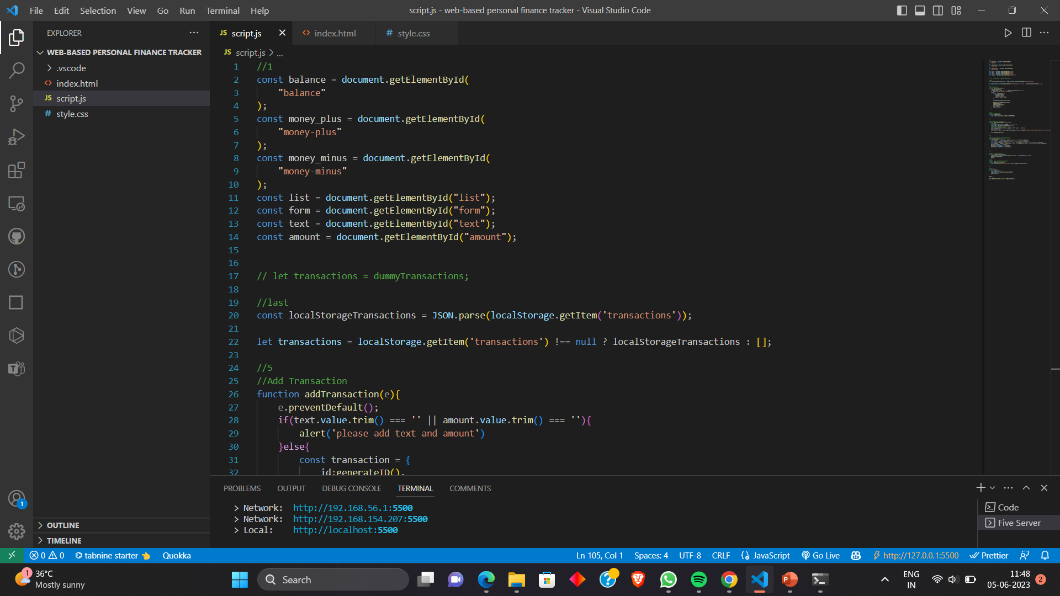
Execution Demo(Video/Screenshots) showing usage of the GitHub Copilot Platform :

Slide 9
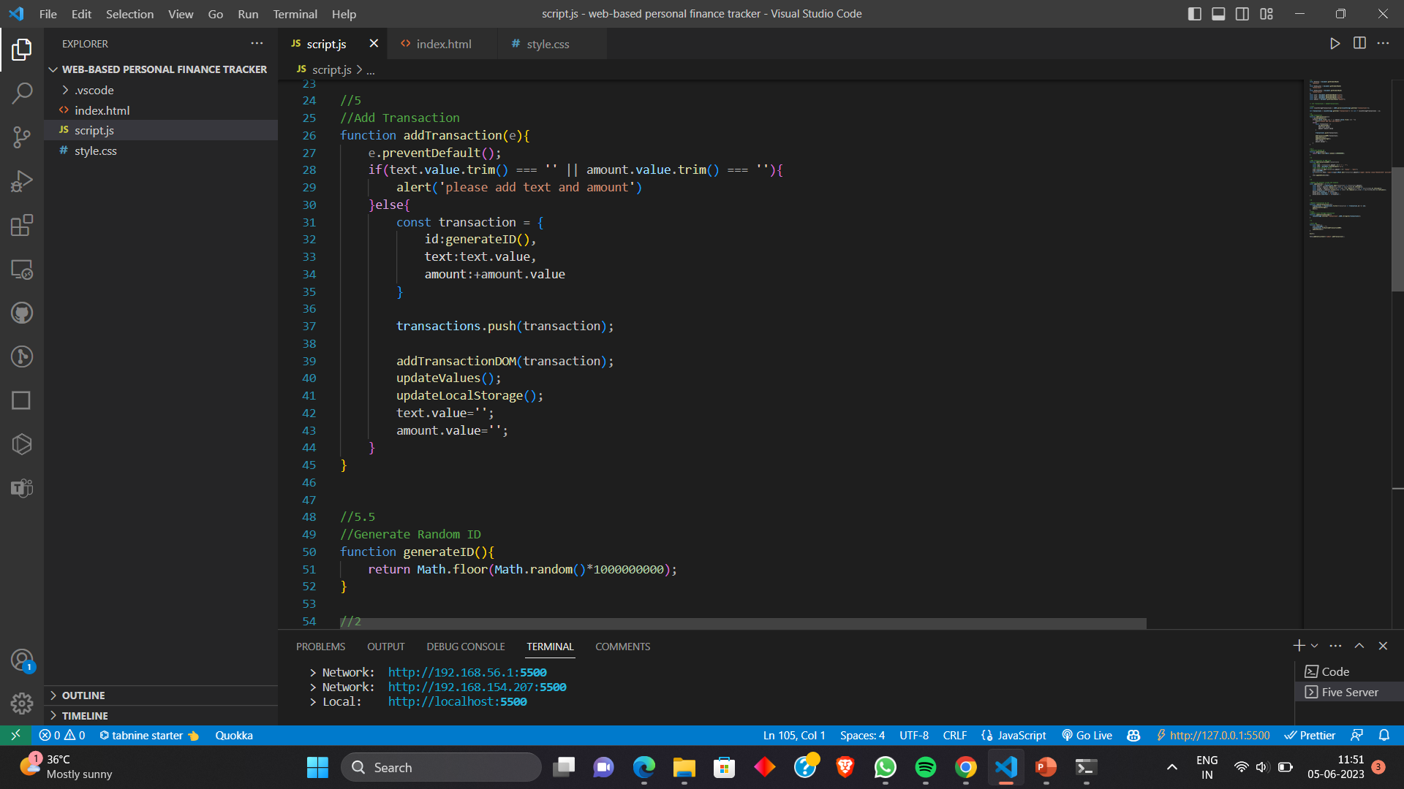
Execution Demo(Video/Screenshots) showing usage of the GitHub Copilot Platform :

Slide 10
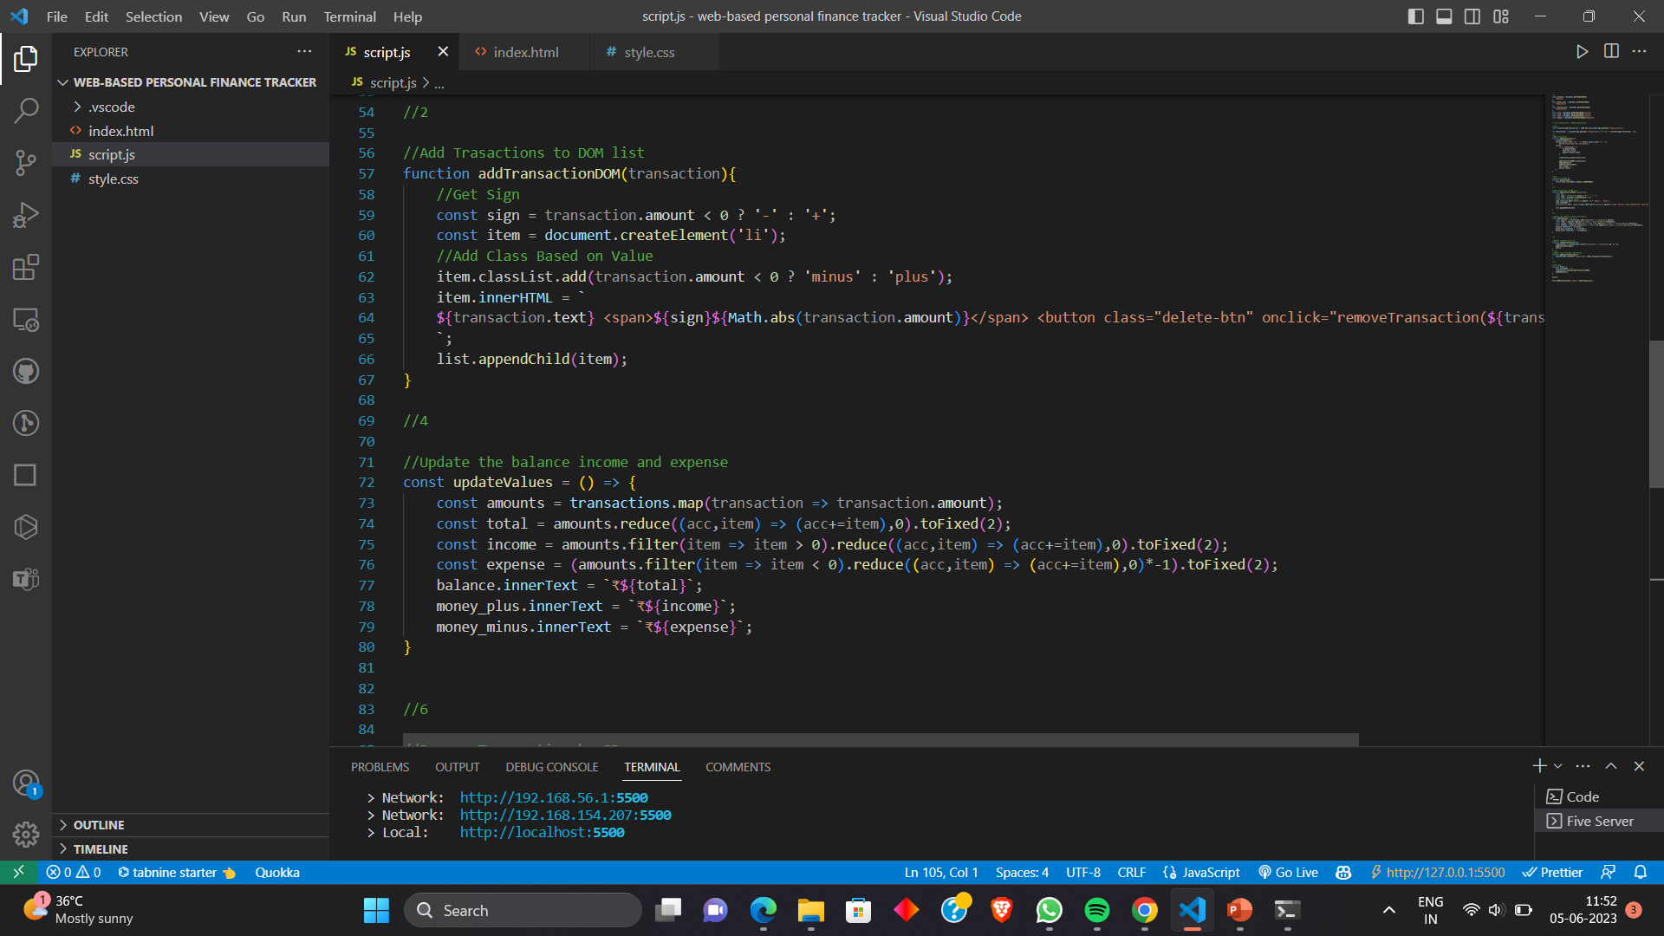
Execution Demo(Video/Screenshots) showing usage of the GitHub Copilot Platform :

Slide 11
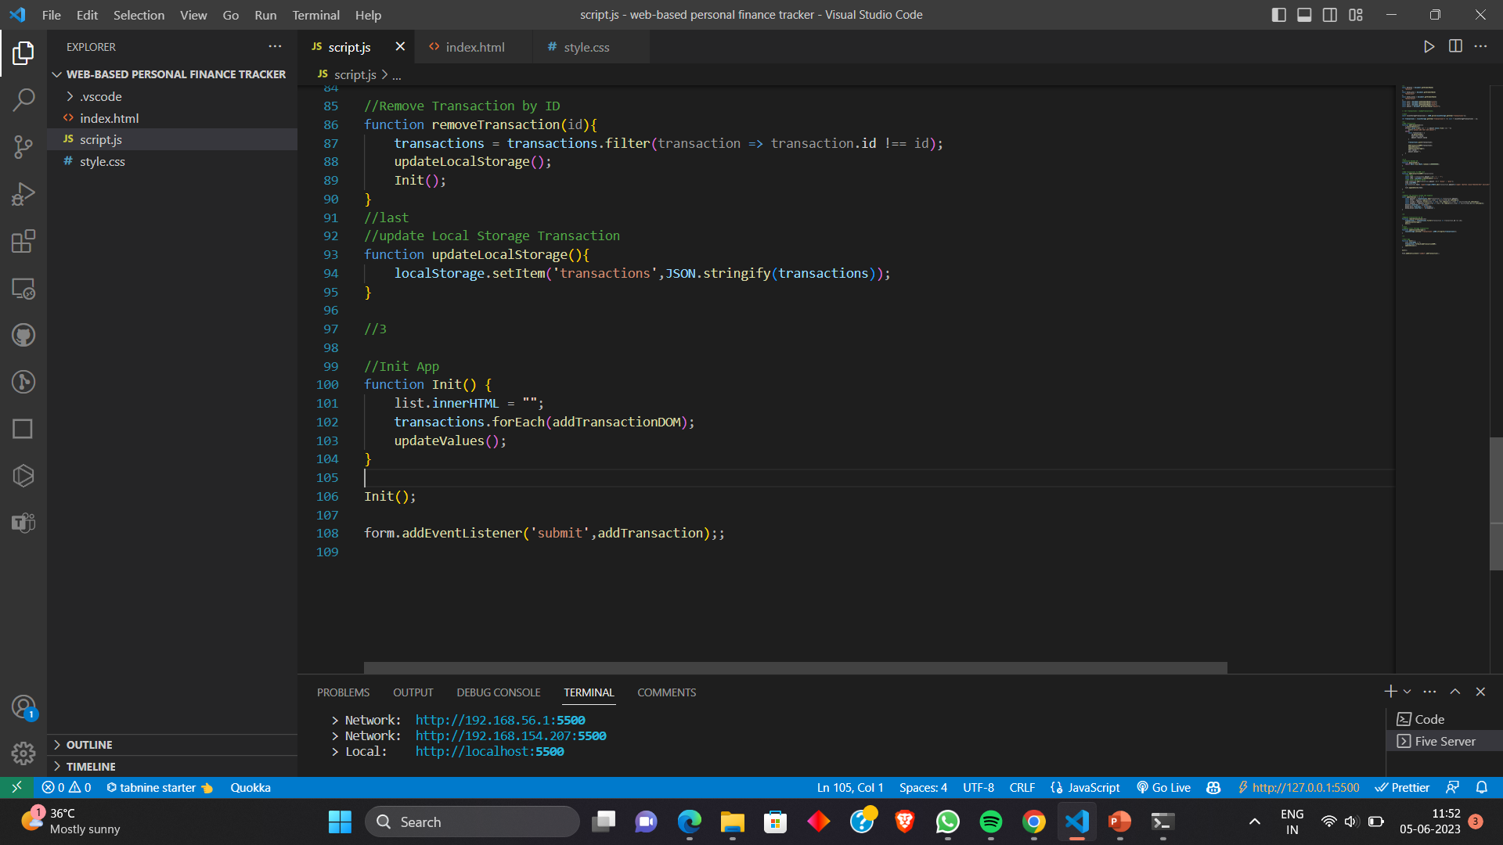
Execution Demo(Video/Screenshots) showing usage of the GitHub Copilot Platform :

Slide 12
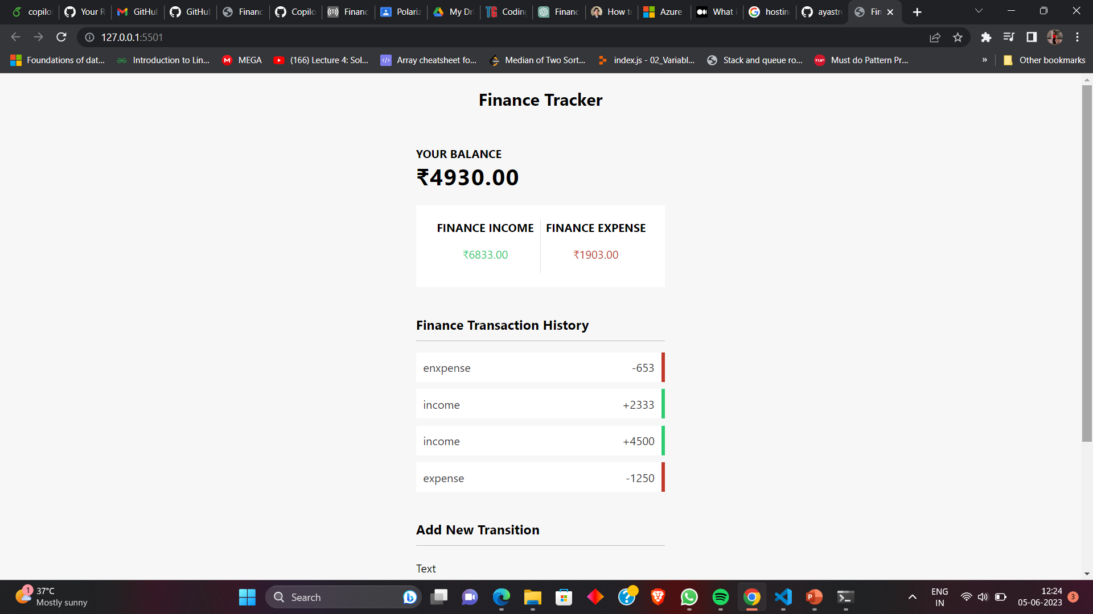
Execution Demo(Video/Screenshots) showing usage of the GitHub Copilot Platform :

Slide 13
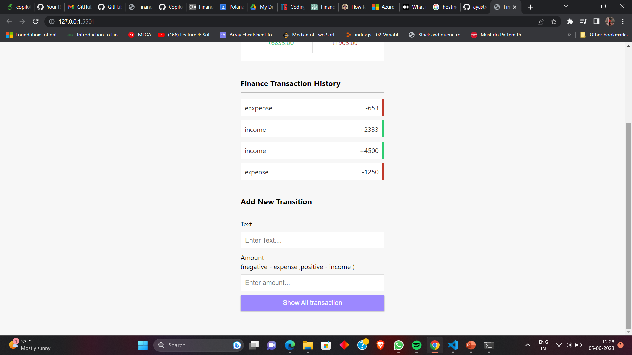
Execution Demo(Video/Screenshots) showing usage of the GitHub Copilot Platform :

Slide 14
Additional comments (optional):
The personal finance tracker application is a valuable tool for individuals to manage their finances effectively. By integrating technologies like Microsoft Cloud Technologies and utilizing GitHub Copilot, you can enhance the functionality, scalability, and user experience of the application.
Microsoft Cloud Technologies, such as Azure, provide a robust and reliable infrastructure for hosting, data storage, and authentication. Leveraging Azure services like Azure Web App, Azure SQL Database, and Azure Active Directory can ensure secure data storage, seamless deployment, and streamlined user management.
GitHub Copilot, powered by AI, can assist in speeding up the development process by providing intelligent code suggestions and completions. It can help you write code faster and more efficiently, reducing the time spent on repetitive tasks and allowing you to focus on higher-level logic and functionality.
However, it's important to remember that while GitHub Copilot can provide useful suggestions, it's still important to review and validate the generated code to ensure correctness, adherence to coding standards, and alignment with project requirements. It should be used as a tool to aid in development, but not as a complete replacement for human understanding and decision-making.
Overall, by leveraging the power of Microsoft Cloud Technologies and utilizing tools like GitHub Copilot, you can create a robust and user-friendly personal finance tracker application that empowers individuals to effectively manage their finances and make informed financial decisions.

Slide 15
THANK YOU

