Slide 1
Test Cases
Testing SemanticRoleMiner

Slide 2
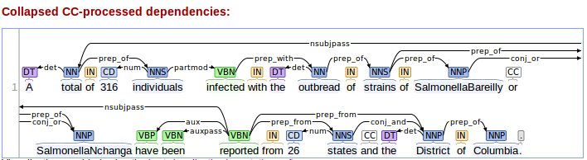
Test Case 1
Sentence :
  A total of 316 individuals infected with the outbreak strains of SalmonellaBareilly or SalmonellaNchanga have been reported from 26 states and the District of Columbia.
  Satnford dependencies presentation:

Slide 3
Raw Stanford Output
det (total-2 , A-1 )
nsubjpass (reported-21 , total-2 )
amod (individuals-5 , 316-4 )
prep_of (total-2 , individuals-5 )
partmod (individuals-5 , infected-6 )
det (strains-10 , the-8 )
nn (strains-10 , outbreak-9 )
prep_with (infected-6 , strains-10 )
nn (Bareilly-15 , _-12 )
nn (Bareilly-15 , Salmonella-13 )
nn (Bareilly-15 , _-14 )
prep_of (strains-10 , Bareilly-15 )
nn (Salmonella_Nchanga-18 , _-17 )
prep_of (strains-10 , Salmonella_Nchanga-18 )
conj_or (Bareilly-15 , Salmonella_Nchanga-18 )
aux (reported-21 , have-19 )
auxpass (reported-21 , been-20 )
root (ROOT-0 , reported-21 )
num (states-24 , 26-23 )
prep_from (reported-21 , states-24 )
det (District-27 , the-26 )
prep_from (reported-21 , District-27 )
conj_and (states-24 , District-27 )
prep_of (District-27 , Columbia-29 )

Slide 4
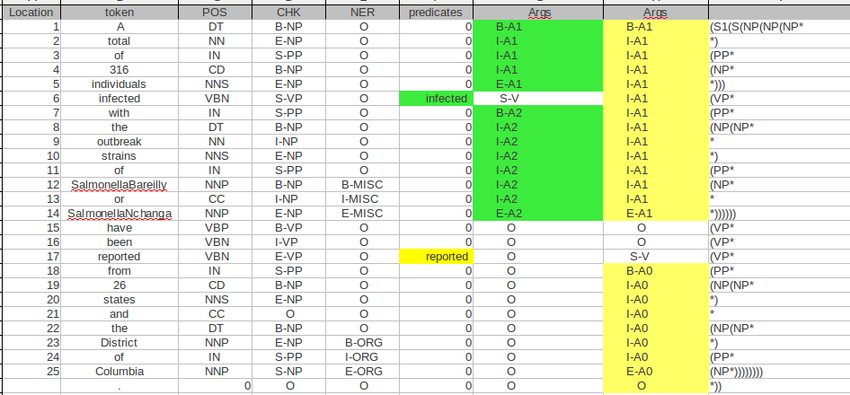
Raw Senna Output
There are 2 predicates in this table, related columns are highlighted.
1
2
3
4
5
6

Slide 5
Mining Some Info
1- Processing Senna raw output
    makeSenna()
2- Finding all predicates with label “Args=S-V”
    findPreds() → Output : Verb-location , targetColumn
      [ ['infected - 6'], '5' ]
      [ ['reported - 17'], '6' ]
3- Finding the domain for each predicate (location) :
    findDomain() → Output : label [ start , end ]
      reported
      {'A1-reported': ['1', '14'], 'V-reported': ['17', '17'], 'A0-reported': ['18', '25']}
      infected
      { 'A1-infected': ['1', '5'], 'V-infected': ['6', '6'] ,'A2-infected': ['7', '14']}

Slide 6
Mining Some Info
4- Gathering all tokens covered by each label:
    FindArgs()
      reported
      'A1-reported': ['A-1' ], ['total-2' ], ['of-3' ], ['316-4' ], ['individuals-5' ], ['infected-6' ], ['with-7' ], ['the-8' ], ['outbreak-9' ], ['strains-10' ], ['of-11' ], ['SalmonellaBareilly-12' ], ['or-13' ], ['SalmonellaNchanga-14' ]
      'V-reported': ['reported-17' ]
      'A0-reported': ['from-18' ], ['26-19' ], ['states-20' ], ['and-21' ], ['the-22' ], ['District-23' ], ['of-24' ], ['Columbia-25' ]
      Infected
      'V-infected': ['infected-6']
      'A1-infected': ['A-1'], ['total-2'], ['of-3'], ['316-4'], ['individuals-5']
      'A2-infected': ['with-7'], ['the-8'], ['outbreak-9'], ['strains-10'], ['of-11'], ['SalmonellaBareilly-12'], ['or-13'], ['SalmonellaNchanga-14']

Slide 7
Mining some Info
5- including dependency relations from stanford with senna
  MixedArgs() → Output :label (dependency [token1, token2])
    reported
A1-reported
A0-reported
Link-reported

Slide 8
Mining Some Info
Continuing 5
Reported
  0: {'A1-reported': {'det': (['total-2'], ['A-1'])}},
  2: {'A1-reported': {'amod': (['individuals-5'], ['316-4'])}},
  3: {'A1-reported': {'prep_of': (['total-2'], ['individuals-5'])}},
  4: {'A1-reported': {'partmod': (['individuals-5'], ['infected-6'])}},
  5: {'A1-reported': {'det': (['strains-10'], ['the-8'])}},
  6: {'A1-reported': {'nn': (['strains-10'], ['outbreak-9'])}},
  7: {'A1-reported': {'prep_with': (['infected-6'], ['strains-10'])}},
  8: {'A1-reported': {'prep_of': (['strains-10'], ['SalmonellaBareilly-12'])}},
  9: {'A1-reported': {'prep_of': (['strains-10'], ['SalmonellaNchanga-14'])}},
  10: {'A1-reported': {'conj_or': (['SalmonellaBareilly-12'], ['SalmonellaNchanga-14'])}}
  11: {'A0-reported': {'num': (['states-20'], ['26-19'])}},
  13: {'A0-reported': {'det': (['District-23'], ['the-22'])}},
  15: {'A0-reported': {'conj_and': (['states-20'], ['District-23'])}},
  16: {'A0-reported': {'prep_of': (['District-23'], ['Columbia-25'])}}}
  1: {'Link-reported': {'nsubjpass': (['reported-17'], ['total-2'])}}
  12: {'Link-reported': {'prep_from': (['reported-17'], ['states-20'])}},
  14: {'Link-reported': {'prep_from': (['reported-17'], ['District-23'])}},

Slide 9
Mining Some Info
Continuing 5
Reported
  0: {'A1-reported': {'det': (['total-2'], ['A-1'])}},
  2: {'A1-reported': {'amod': (['individuals-5'], ['316-4'])}},
  3: {'A1-reported': {'prep_of': (['total-2'], ['individuals-5'])}},
  4: {'A1-reported': {'partmod': (['individuals-5'], ['infected-6'])}},
  5: {'A1-reported': {'det': (['strains-10'], ['the-8'])}},
  6: {'A1-reported': {'nn': (['strains-10'], ['outbreak-9'])}},
  7: {'A1-reported': {'prep_with': (['infected-6'], ['strains-10'])}},
  8: {'A1-reported': {'prep_of': (['strains-10'], ['SalmonellaBareilly-12'])}},
  9: {'A1-reported': {'prep_of': (['strains-10'], ['SalmonellaNchanga-14'])}},
  10: {'A1-reported': {'conj_or': (['SalmonellaBareilly-12'], ['SalmonellaNchanga-14'])}}
  11: {'A0-reported': {'num': (['states-20'], ['26-19'])}},
  13: {'A0-reported': {'det': (['District-23'], ['the-22'])}},
  15: {'A0-reported': {'conj_and': (['states-20'], ['District-23'])}},
  16: {'A0-reported': {'prep_of': (['District-23'], ['Columbia-25'])}}}
  1: {'Link-reported': {'nsubjpass': (['reported-17'], ['total-2'])}}
  12: {'Link-reported': {'prep_from': (['reported-17'], ['states-20'])}},
  14: {'Link-reported': {'prep_from': (['reported-17'], ['District-23'])}},

Slide 10
Mining some Info
Continuing 5
Infected
A2-infected
A1-infected
Link-infected

Slide 11
Mining some Info
Continuing 5
Infected
  0: {'A1-infected': {'det': (['total-2'], ['A-1'])}},
  1: {'A1-infected': {'amod': (['individuals-5'], ['316-4'])}},
  2: {'A1-infected': {'prep_of': (['total-2'], ['individuals-5'])}},
  4: {'A2-infected': {'det': (['strains-10'], ['the-8'])}},
  5: {'A2-infected': {'nn': (['strains-10'], ['outbreak-9'])}},
  7: {'A2-infected': {'prep_of': (['strains-10'], ['SalmonellaBareilly-12'])}},
  8: {'A2-infected': {'prep_of': (['strains-10'], ['SalmonellaNchanga-14'])}},
  9: {'A2-infected': {'conj_or': (['SalmonellaBareilly-12'], ['SalmonellaNchanga-14'])}}}
  6: {'Link-infected': {'prep_with': (['infected-6'], ['strains-10'])}},
  3: {'Link-infected': {'partmod': (['individuals-5'], ['infected-6'])}},

Slide 12
Statements
'100': 'St0-reported-17 A1 A1-reported-17',
'101': 'A1-reported-17 nsubjpass total-2',
'102': 'St0-reported-17 A0 A0-reported-17',
'103': 'A0-reported-17 prep_from states-20',
'104': 'A0-reported-17 prep_from District-23',
'105': 'St0-infected-6 A1 A1-infected-6'
'106': 'A1-infected-6 partmod individuals-5',
'107': 'St0-infected-6 A2 A2-infected-6',
'108': 'A2-infected-6 prep_with strains-10',
'109': 'total-2 det A-1',
'110': 'individuals-5 amod 316-4', '111': 'total-2 prep_of individuals-5',
'112': 'strains-10 det the-8'
'113': 'strains-10 nn outbreak-9''
114': 'strains-10 prep_of SalmonellaBareilly-12',
'115': 'strains-10 prep_of SalmonellaNchanga-14',
'116': 'SalmonellaBareilly-12 conj_or SalmonellaNchanga-14',
'117': 'states-20 num 26-19',
'118': 'District-23 det the-22',
'119': 'states-20 conj_and District-23',
'120': 'District-23 prep_of Columbia-25',

Slide 13
'St0-reported-17':
'A0-reported-17 reported-17 A1-reported-17',
prep_from
prep_from
nsubjpass
'115': conj_and
'102':
District-23
'100':
total-2
'107':
prep_of
'St0-infected-6':
'Null infected-6 A1-infected-6',
'101':
states-20',
det
prep_with
partmod
det
num
'105':
A-1
prep_of
'103':
individuals-5
'113':
26-19',
'114':
the-22',
'St10-infected-6':
A2-infected-6',
'116':
Columbia-25
amod
prep_with
'106':
316-4',
'108':
the-8
det
'104':
strains-10
nn
'109':
outbreak-9
prep_of
prep_of
'110':
SalmonellaBareilly-12
112: conj_or
'111':
SalmonellaNchanga-14

Slide 14
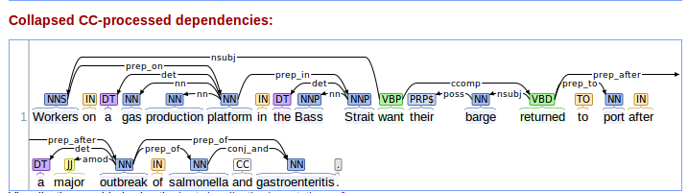
Test Case 2
Sentence :
  Workers on a gas production platform in the Bass Strait want their barge returned to port after a major outbreak of salmonella and gastroenteritis.
  Satnford dependencies presentation:

Slide 15
Raw Stanford Output
nsubj(want-11, Workers-1)
det(platform-6, a-3)
nn(platform-6, gas-4)
nn(platform-6, production-5)
prep_on(Workers-1, platform-6)
det(Strait-10, the-8)
nn(Strait-10, Bass-9)
prep_in(platform-6, Strait-10)
root(ROOT-0, want-11)
poss(barge-13, their-12)
nsubj(returned-14, barge-13)
ccomp(want-11, returned-14)
prep_to(returned-14, port-16)
det(outbreak-20, a-18)
amod(outbreak-20, major-19)
prep_after(returned-14, outbreak-20)
prep_of(outbreak-20, salmonella-22)
prep_of(outbreak-20, gastroenteritis-24)
conj_and(salmonella-22, gastroenteritis-24)

Slide 16
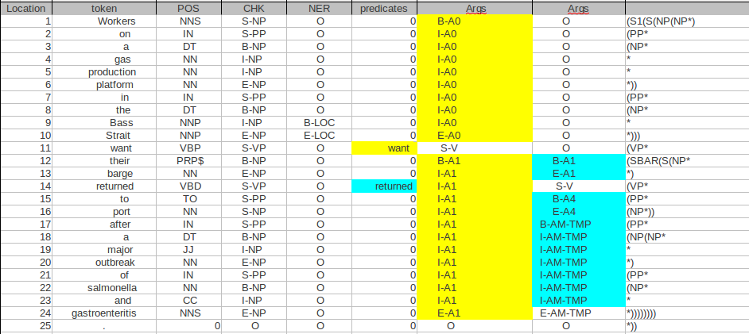
Raw Senna Output

Slide 17
Mining Some Info
1- Processing Senna raw output
    makeSenna()
2- Finding all predicates with label “Args=S-V”
    findPreds() → Output : Verb-location , targetColumn
      [['want-11'], '5']
      [['returned-14'], '6']
3- Finding the domain for each predicate (location) :
    findDomain() → Output : label [ start , end ]
      want
      {'A0-want': ['1', '10'], 'V-want': ['11', '11'], 'A1-want': ['12', '24']}
      returned
      {'V-returned': ['14', '14'], 'AM-returned': ['17', '24'], 'A1-returned': ['12', '13'], 'A4-returned': ['15', '16']}

Slide 18
Mining Some Info
4- Gathering all tokens covered by each label:
    FindArgs()
      want
      'A0-want': [['Workers-1'], ['on-2'], ['a-3'], ['gas-4'], ['production-5'], ['platform-6'], ['in-7'], ['the-8'], ['Bass-9'], ['Strait-10']]
      'V-want': [['want-11']],
      'A1-want': [['their-12'], ['barge-13'], ['returned-14'], ['to-15'], ['port-16'], ['after-17'], ['a-18'], ['major-19'], ['outbreak-20'], ['of-21'], ['salmonella-22'], ['and-23'], ['gastroenteritis-24']]
      returned
      'V-returned': [['returned-14']],
      'AM-returned': [['after-17'], ['a-18'], ['major-19'], ['outbreak-20'], ['of-21'], ['salmonella-22'], ['and-23'], ['gastroenteritis-24']],
      'A1-returned': [['their-12'], ['barge-13']],
      'A4-returned': [['to-15'], ['port-16']]}

Slide 19
Mining some Info
5- including dependency relations from stanford with senna
  MixedArgs() → Output :label (dependency [token1, token2])
    want
A0-want
A1-want
Link-want

Slide 20
Mining Some Info
Continuing 5
want
  1: {'A0-want': {'det': (['platform-6'], ['a-3'])}},
  2: {'A0-want': {'nn': (['platform-6'], ['gas-4'])}},
  3: {'A0-want': {'nn': (['platform-6'], ['production-5'])}},
  4: {'A0-want': {'prep_on': (['Workers-1'], ['platform-6'])}},
  5: {'A0-want': {'det': (['Strait-10'], ['the-8'])}},
  6: {'A0-want': {'nn': (['Strait-10'], ['Bass-9'])}},
  7: {'A0-want': {'prep_in': (['platform-6'], ['Strait-10'])}},
  8: {'A1-want': {'poss': (['barge-13'], ['their-12'])}},
  9: {'A1-want': {'nsubj': (['returned-14'], ['barge-13'])}},
  11: {'A1-want': {'prep_to': (['returned-14'], ['port-16'])}},
  12: {'A1-want': {'det': (['outbreak-20'], ['a-18'])}},
  13: {'A1-want': {'amod': (['outbreak-20'], ['major-19'])}},
  14: {'A1-want': {'prep_after': (['returned-14'], ['outbreak-20'])}},
  15: {'A1-want': {'prep_of': (['outbreak-20'], ['salmonella-22'])}},
  16: {'A1-want': {'prep_of': (['outbreak-20'], ['gastroenteritis-24'])}},
  17: {'A1-want': {'conj_and': (['salmonella-22'], ['gastroenteritis-24'])}}}
  10: {'Link-want': {'ccomp': (['want-11'], ['returned-14'])}},
  0: {'Link-want': {'nsubj': (['want-11'], ['Workers-1'])}},

Slide 21
Mining some Info
MixedArgs() → Output :label (dependency [token1, token2])
    returned
A1-returned
A4-returned
AM-returned
Link-returned

Slide 22
Mining Some Info
Continuing 5
returned
  0: {'A1-returned': {'poss': (['barge-13'], ['their-12'])}},
  3: {'AM-returned': {'det': (['outbreak-20'], ['a-18'])}},
  4: {'AM-returned': {'amod': (['outbreak-20'], ['major-19'])}},
  6: {'AM-returned': {'prep_of': (['outbreak-20'], ['salmonella-22'])}},
  7: {'AM-returned': {'prep_of': (['outbreak-20'], ['gastroenteritis-24'])}},
  8: {'AM-returned': {'conj_and': (['salmonella-22'], ['gastroenteritis-24'])}}
  5: {'Link-returned': {'prep_after': (['returned-14'], ['outbreak-20'])}},
  2: {'Link-returned': {'prep_to': (['returned-14'], ['port-16'])}},
  1: {'Link-returned': {'nsubj': (['returned-14'], ['barge-13'])}},

Slide 23
Statements
'100': 'St0-returned-14 A1 A1-returned-14',
'101': 'A1-returned-14 nsubj barge-13',
'102': 'St0-returned-14 A4 A4-returned-14',
'103': 'A4-returned-14 prep_to port-16',
'104': 'St0-returned-14 AM AM-TMP-returned-14',
'105': 'AM-TMP-returned-14 prep_after outbreak-20',
'106': 'St0-want-11 A0 A0-want-11',
'107': 'A0-want-11 nsubj Workers-1',
'108': 'St0-want-11 A1 A1-want-11',
'109': 'A1-want-11 ccomp St0-returned-14',
'110': 'barge-13 poss their-12',
'111': 'outbreak-20 det a-18',
'112': 'outbreak-20 amod major-19',
'113': 'outbreak-20 prep_of salmonella-22',
'114': 'outbreak-20 prep_of gastroenteritis-24',
'115': 'salmonella-22 conj_and gastroenteritis-24',
'116': 'platform-6 det a-3',
'117': 'platform-6 nn gas-4',
'118': 'platform-6 nn production-5',
'119': 'Workers-1 prep_on platform-6',
'120': 'Strait-10 det the-8',
'121': 'Strait-10 nn Bass-9',
'122': 'platform-6 prep_in Strait-10'}

Slide 24
'St0-want-11':
A0-want-11 want-11 A1-want-11
'103':
Workers-1',
nsubj
prep_on
'114':
platform-6
prep_in
'117':
Strait-10
det
'115':
the-8
nn
nn
104:
ccomp
det
'111':
a-3
nn
'113':
production-5
'116':
Bass-9
'112':
gas-4
'St0-returned-14':
'Null returned-14 A1-returned-14',
prep_to
'St30-returned-14':
A4-returned-14
prep_to
nsubj
prep_after
'101':
port-16
poss
'100':
barge-13
'St40-returned-14':
AM-TMP-returned-14
'105':
their-12'
prep_after
det
'102':
outbreak-20',
prep_of
'109':
gastroenteritis-24
'106':
a-18
amod
prep_of
'107':
major-19
'108':
salmonella-22',
conj_and

Slide 25
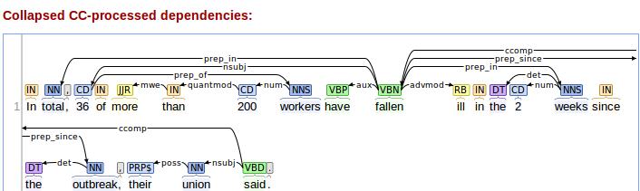
Test Case 3
Sentence :
  In total, 36 of more than 200 workers have fallen ill in the 2 weeks since the outbreak, their union said.
  Satnford dependencies presentation:

Slide 26
Raw Stanford Output
prep_in(fallen-11, total-2)
nsubj(fallen-11, 36-4)
mwe(than-7, more-6)
quantmod(200-8, than-7)
num(workers-9, 200-8)
prep_of(36-4, workers-9)
aux(fallen-11, have-10)
ccomp(said-23, fallen-11)
acomp(fallen-11, ill-12)
det(weeks-16, the-14)
num(weeks-16, 2-15)
prep_in(ill-12, weeks-16) VS. prep_in(fallen,weeks) ← from visual parser
det(outbreak-19, the-18)
prep_since(fallen-11, outbreak-19)
poss(union-22, their-21)
nsubj(said-23, union-22)
root(ROOT-0, said-23)

Slide 27
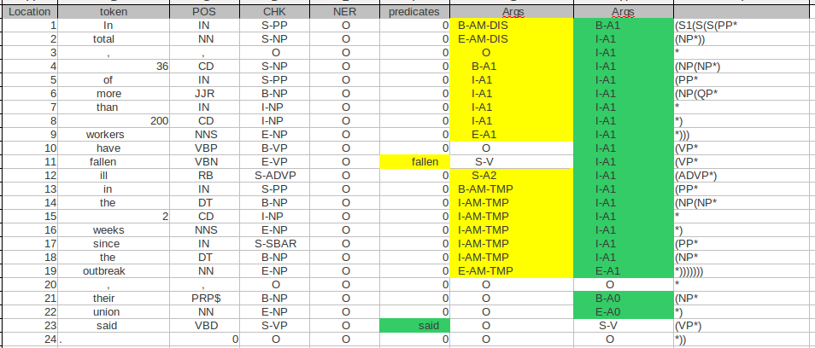
Raw Senna Output

Slide 28
Mining Some Info
4- Gathering all tokens covered by each label:
    FindArgs()
      said
      'V-said': [['said-23']],
      'A0-said': [['their-21'], ['union-22']],
      'A1-said': [['In-1'], ['total-2'], [',-3'], ['36-4'], ['of-5'], ['more-6'], ['than-7'], ['200-8'], ['workers-9'], ['have-10'], ['fallen-11'], ['ill-12'], ['in-13'], ['the-14'], ['2-15'], ['weeks-16'], ['since-17'], ['the-18'], ['outbreak-19']]
      fallen
      'AM-TMP-fallen': [['in-13'], ['the-14'], ['2-15'], ['weeks-16'], ['since-17'], ['the-18'], ['outbreak-19']],
      'AM-DIS-fallen': [['In-1'], ['total-2']],
      'A2-fallen': [['ill-12']],
      'A1-fallen': [['36-4'], ['of-5'], ['more-6'], ['than-7'], ['200-8'], ['workers-9']],
      'V-fallen': [['fallen-11']]}

Slide 29
Mining Some Info
4- Gathering all tokens covered by each label:
    FindArgs()
      said
      'V-said': [['said-23']],
      'A0-said': [['their-21'], ['union-22']],
      'A1-said': [['In-1'], ['total-2'], [',-3'], ['36-4'], ['of-5'], ['more-6'], ['than-7'], ['200-8'], ['workers-9'], ['have-10'], ['fallen-11'], ['ill-12'], ['in-13'], ['the-14'], ['2-15'], ['weeks-16'], ['since-17'], ['the-18'], ['outbreak-19']]
      fallen
      'AM-TMP-fallen': [['in-13'], ['the-14'], ['2-15'], ['weeks-16'], ['since-17'], ['the-18'], ['outbreak-19']],
      'AM-DIS-fallen': [['In-1'], ['total-2']],
      'A2-fallen': [['ill-12']],
      'A1-fallen': [['36-4'], ['of-5'], ['more-6'], ['than-7'], ['200-8'], ['workers-9']],
      'V-fallen': [['fallen-11']]}

Slide 30
Mining Some Info
4- Gathering all tokens covered by each label:
    FindArgs()
      said
      'V-said': [['said-23']],
      'A0-said': [['their-21'], ['union-22']],
      'A1-said': [['In-1'], ['total-2'], [',-3'], ['36-4'], ['of-5'], ['more-6'], ['than-7'], ['200-8'], ['workers-9'], ['have-10'], ['fallen-11'], ['ill-12'], ['in-13'], ['the-14'], ['2-15'], ['weeks-16'], ['since-17'], ['the-18'], ['outbreak-19']]
      fallen
      'AM-TMP-fallen': [['in-13'], ['the-14'], ['2-15'], ['weeks-16'], ['since-17'], ['the-18'], ['outbreak-19']],
      'AM-DIS-fallen': [['In-1'], ['total-2']],
      'A2-fallen': [['ill-12']],
      'A1-fallen': [['36-4'], ['of-5'], ['more-6'], ['than-7'], ['200-8'], ['workers-9']],
      'V-fallen': [['fallen-11']]}

Slide 31
Mining Some Info
1- Processing Senna raw output
    makeSenna()
2- Finding all predicates with label “Args=S-V”
    findPreds() → Output : Verb-location , targetColumn
      [['fallen-11'], '5'],
      [['said-23'], '6']
3- Finding the domain for each predicate (location) :
    findDomain() → Output : label [ start , end ]
      said
      {'V-said': ['23', '23'], 'A0-said': ['21', '22'], 'A1-said': ['1', '19']}
      fallen
      {'AM-TMP-fallen': ['13', '19'], 'AM-DIS-fallen': ['1', '2'], 'A1-fallen': ['4', '9'], 'V-fallen': ['11', '11'], 'A2-fallen': ['12', '12']}

Slide 32
Mining some Info
5- including dependency relations from stanford with senna
  MixedArgs() → Output :label (dependency [token1, token2])
    said
A1-said
A0-said
Link-said

Slide 33
Mining Some Info
Continuing 5
said
  {'A1-said': {'prep_in': (['fallen-10'], ['total-2'])}},
  {'A1-said': {'nsubj': (['fallen-10'], ['36-3'])}},
  {'A1-said': {'mwe': (['than-6'], ['more-5'])}},
  {'A1-said': {'quantmod': (['200-7'], ['than-6'])}},
  {'A1-said': {'num': (['workers-8'], ['200-7'])}},
  {'A1-said': {'prep_of': (['36-3'], ['workers-8'])}},
  {'A1-said': {'aux': (['fallen-10'], ['have-9'])}},
  {'A1-said': {'advmod': (['fallen-10'], ['ill-11'])}},
  {'A1-said': {'det': (['weeks-15'], ['the-13'])}},
  {'A1-said': {'num': (['weeks-15'], ['2-14'])}},
  {'A1-said': {'prep_in': (['fallen-10'], ['weeks-15'])}},
  {'A1-said': {'det': (['outbreak-18'], ['the-17'])}},
  {'A1-said': {'prep_since': (['fallen-10'], ['outbreak-18'])}}
  {'A0-said': {'poss': (['union-20'], ['their-19'])}},
  {'Link-said': {'dobj': (['said-21'], ['outbreak-18'])}},
  {'Link-said': {'nsubj': (['said-21'], ['union-20'])}},
  {'Link-said': {'rcmod': (['outbreak-18'], ['said-21'])}}}

Slide 34
Mining some Info
MixedArgs() → Output :label (dependency [token1, token2])
    fallen
A1-fallen
AM-DIS
AM-TMP-fallen
Link-fallen

Slide 35
Mining Some Info
Continuing 5
fallen
  2: {'A1-fallen': {'mwe': (['than-7'], ['more-6'])}},
  3: {'A1-fallen': {'quantmod': (['200-8'], ['than-7'])}},
  4: {'A1-fallen': {'num': (['workers-9'], ['200-8'])}},
  5: {'A1-fallen': {'prep_of': (['36-4'], ['workers-9'])}},
  7: {'AM-TMP-fallen': {'det': (['weeks-16'], ['the-14'])}},
  8: {'AM-TMP-fallen': {'num': (['weeks-16'], ['2-15'])}},
  9: {'AM-TMP-fallen': {'det': (['outbreak-19'], ['the-18'])}},
  0: {'Link-fallen': {'prep_in': (['fallen-11'], ['total-2'])}},
  1: {'Link-fallen': {'nsubj': (['fallen-11'], ['36-4'])}},
  10: {'Link-fallen': {'prep_since': (['fallen-11'], ['outbreak-19'])}}
  6: {'Link-fallen': {'acomp': (['fallen-11'], ['ill-12'])}},
Exception link from Argi to Argj
-ill belongs to A2
-Weeks belongs to AM-TMP
-prep_in connects them

Slide 36
Fixed the Exception
fallen
2: {'A1-fallen': {'mwe': (['than-7'], ['more-6'])}},
3: {'A1-fallen': {'quantmod': (['200-8'], ['than-7'])}},
4: {'A1-fallen': {'num': (['workers-9'], ['200-8'])}},
5: {'A1-fallen': {'prep_of': (['36-4'], ['workers-9'])}},
7: {'AM-TMP-fallen': {'det': (['weeks-16'], ['the-14'])}},
8: {'AM-TMP-fallen': {'num': (['weeks-16'], ['2-15'])}},
10: {'AM-TMP-fallen': {'det': (['outbreak-19'], ['the-18'])}},
9: {'Link-AM-TMP-fallen-A2-fallen': {'prep_in': (['ill-12'], ['weeks-16'])}},
0: {'Link-fallen': {'prep_in': (['fallen-11'], ['total-2'])}},
1: {'Link-fallen': {'nsubj': (['fallen-11'], ['36-4'])}},
6: {'Link-fallen': {'acomp': (['fallen-11'], ['ill-12'])}}
11: {'Link-fallen': {'prep_since': (['fallen-11'], ['outbreak-19'])}}}

Slide 37
Statements
{'St40-fallen-10': 'St0-fallen-10 prep_in AM-TMP-fallen-10', 'St10-fallen-10': 'St0-fallen-10 advmod A2-fallen-10', 'St0-said-21': 'A0-said-21 said-21 A1-said-21', 'St0-fallen-10': 'Null fallen-10 A1-fallen-10', 'St41-fallen-10': 'St0-fallen-10 prep_since AM-TMP-fallen-10'}
St0-said-21: A0-said-21 said-21 A1-said-21
St0-fallen-10: Null fallen-10 A1-fallen-10
St10-fallen-10: St0-fallen-10 advmod A2-fallen-10
St40-fallen-10: St0-fallen-10 prep_in AM-TMP-fallen-10
St41-fallen-10: St0-fallen-10 prep_since AM-TMP-fallen-10

Slide 38
Statements visually
A0
A1
token
token
dep
dep
dep
dep
dep
A2
AM..
A3
A4
token
token
token
token

Slide 39
Statements
'St0-fallen-11': 'Null fallen-11 A1-fallen-11',
'St0-said-23': 'A0-said-23 said-23 A1-said-23',
'St10-fallen-11': 'St0-fallen-11 acomp A2-fallen-11',
'St40-fallen-11': 'St0-fallen-11 prep_in AM-TMP-fallen-11',
'St41-fallen-11': 'St0-fallen-11 prep_since AM-TMP-fallen-11',
'St50-fallen-11': 'St0-fallen-11 prep_in AM-DIS-fallen-11',
Continue to next slide

Slide 40
Statements
'100': 'St0-said-23 A1 A1-said-23',
'101': 'A1-said-23 ccomp St0-fallen-11',
'102': 'St0-said-23 A0 A0-said-23',
'103': 'A0-said-23 nsubj union-22',
'104': 'St0-fallen-11 AM AM-DIS-fallen-11',
'105': 'AM-DIS-fallen-11 prep_in total-2'
'106': 'St0-fallen-11 A1 A1-fallen-11',
'107': 'A1-fallen-11 nsubj 36-4',
'108': 'St0-fallen-11 A2 A2-fallen-11',
'109': 'A2-fallen-11 acomp ill-12',
'110': 'St0-fallen-11 AM AM-TMP-fallen-11',
'111': 'AM-TMP-fallen-11 prep_since outbreak-19',
'112': 'than-7 mwe more-6',
'113': '200-8 quantmod than-7',
'114': 'workers-9 num 200-8',
'115': '36-4 prep_of workers-9',
'116': 'weeks-16 det the-14',
'117': 'weeks-16 num 2-15',
'118': 'ill-12 prep_in weeks-16',
'119': 'outbreak-19 det the-18',
'120': 'union-22 poss their-21',

Slide 41
'St0-said-23':
'A0-said-23 said-23 A1-said-23'
quantmod
108:
200-8',
mwe
num
106:
more-6'
107:
than-7',
nsubj
109:
workers
'101':
union-22
100
ccomp
prep_of
'103':
36-4',
poss
114:
their-21
'St0-fallen-11':
'Null fallen-11 A1-fallen-11',
nsubj
prep_in
acomp
'St40-fallen-11':
AM-TMP-fallen-11',
St10-fallen-11':
A2-fallen-11',
prep_since
prep_in
acomp
'St41-fallen-11':
AM-TMP-fallen-11',
'St50-fallen-11':
AM-DIS-fallen-11',
'104':
ill-12',
prep_since
prep_in
prep_in
'105':
outbreak-19'
'102':
total-2',
det
'112':
weeks-16'
det
num
113:
the-18',
'110':
the-14'
111':
2-15',

Slide 42
Discussing Args
Arg0 : agent , subject
Arg1 : patient, which is being affected by agent's action
Arg0(giver)—give—Arg1(thing)—to—Arg2(benefactor, instrument, attribute)
  The executives gave the chefs a standing ovation.
    Arg0(executive)—gave—Arg1(standing ovation)—Arg2(chefs)
– She had given the answers to geography classes.
    Arg0(she)—given—Arg1(answers)—Arg2(geo class)
– given the weakness in both the junk bond market and stock market, traders fear that these transactions may be revised yet.
    Arg0()—given—Arg1(weakness in...market)—Arg2(traders)
– John can't keep up with Mary's rapid mood swings.
    Arg0(john)—keep up—Arg1(Mary's...)
St0=Arg0—verb—Arg1
St1=St0—dep—Arg2

Slide 43
Discussing Args
He was drawing diagrams and sketches for his patron.
  St0 :Arg0(He)--drawing--Arg1(diagrams)
  St01:Arg0(He)—drawing--Arg1(sketches)
  St1 :St0—for—Arg2(patron)
  St11:St01—for—Arg2(patron)
The campaign is drawing fire from anti-smoking advocates.
  St0 : Arg0(campaign)--drawing--Arg1(fire)
  St1 : St0—from—Arg2(anti-smoking...)
Douglas Wilder opened his gubernatorial battle with Marshall Coleman with an abortion commercial.
  St0 : Arg0(Marshal..)--opened--Arg1(his guber....)
  St1 : St0—with—Arg2(an abortion commercial)
The Beatles give way to baseball in the Nipponese version.
  St0 :Arg0(Beatles)--give--Arg1(way)
  St1: St0—to—Arg2(traders)
Mary left her daughter-in-law her pearls in her will
  St0: Arg0(Mary)--left--Arg1(her pearls)
  St1: St0—dobj—Arg2(her pearls)

Slide 44
The door opened.
  St0: Arg0()--opened--Arg1(door)
Taking a verb and its list of Args
Creating St0-verb: Arg0-verb—verb—Arg1-verb
  If any of these Arg do not exist , No-Arg
If Arg2 !=Null:
  Creating St1-verb: St0-verb—dep—Arg2

