Slide 1
Test Cases
Testing SemanticRoleMiner

Slide 2
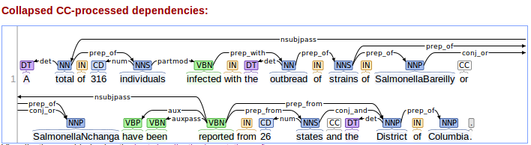
Test Case 1
Sentence :
A total of 316 individuals infected with the outbreak strains of SalmonellaBareilly or SalmonellaNchanga have been reported from 26 states and the District of Columbia.
Satnford dependencies presentation:

Slide 3
Raw Stanford Output
det (total-2 , A-1 )
nsubjpass (reported-21 , total-2 )
amod (individuals-5 , 316-4 )
prep_of (total-2 , individuals-5 )
partmod (individuals-5 , infected-6 )
det (strains-10 , the-8 )
nn (strains-10 , outbreak-9 )
prep_with (infected-6 , strains-10 )
nn (Bareilly-15 , _-12 )
nn (Bareilly-15 , Salmonella-13 )
nn (Bareilly-15 , _-14 )
prep_of (strains-10 , Bareilly-15 )
nn (Salmonella_Nchanga-18 , _-17 )
prep_of (strains-10 , Salmonella_Nchanga-18 )
conj_or (Bareilly-15 , Salmonella_Nchanga-18 )
aux (reported-21 , have-19 )
auxpass (reported-21 , been-20 )
root (ROOT-0 , reported-21 )
num (states-24 , 26-23 )
prep_from (reported-21 , states-24 )
det (District-27 , the-26 )
prep_from (reported-21 , District-27 )
conj_and (states-24 , District-27 )
prep_of (District-27 , Columbia-29 )

Slide 4
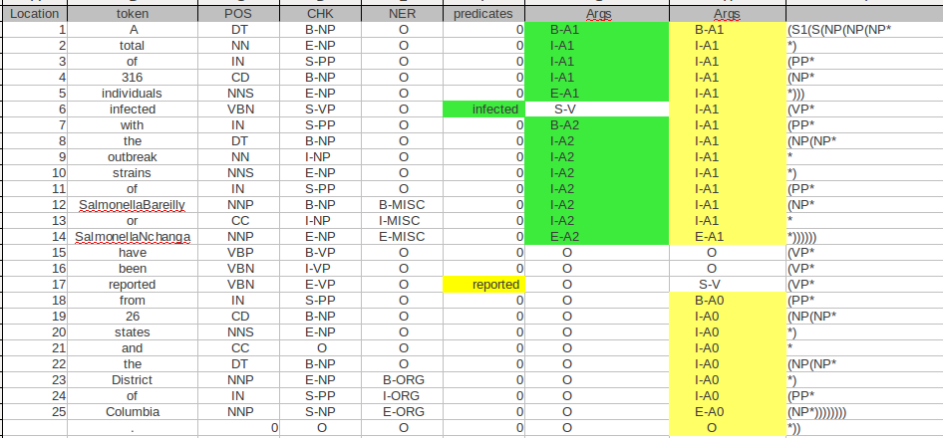
Raw Senna Output
There are 2 predicates in this table, related columns are highlighted.
1
2
3
4
5
6

Slide 5
Mining Some Info
1- Processing Senna raw output
makeSenna()
2- Finding all predicates with label “Args=S-V”
findPreds() → Output : Verb-location , targetColumn
[ ['infected - 6'], '5' ]
[ ['reported - 17'], '6' ]
3- Finding the domain for each predicate (location) :
findDomain() → Output : label [ start , end ]
reported
{'A1-reported': ['1', '14'], 'V-reported': ['17', '17'], 'A0-reported': ['18', '25']}
infected
{ 'A1-infected': ['1', '5'], 'V-infected': ['6', '6'] ,'A2-infected': ['7', '14']}

Slide 6
Mining Some Info
4- Gathering all tokens covered by each label:
FindArgs()
reported
'A1-reported': ['A-1' ], ['total-2' ], ['of-3' ], ['316-4' ], ['individuals-5' ], ['infected-6' ], ['with-7' ], ['the-8' ], ['outbreak-9' ], ['strains-10' ], ['of-11' ], ['SalmonellaBareilly-12' ], ['or-13' ], ['SalmonellaNchanga-14' ]
'V-reported': ['reported-17' ]
'A0-reported': ['from-18' ], ['26-19' ], ['states-20' ], ['and-21' ], ['the-22' ], ['District-23' ], ['of-24' ], ['Columbia-25' ]
Infected
'V-infected': ['infected-6']
'A1-infected': ['A-1'], ['total-2'], ['of-3'], ['316-4'], ['individuals-5']
'A2-infected': ['with-7'], ['the-8'], ['outbreak-9'], ['strains-10'], ['of-11'], ['SalmonellaBareilly-12'], ['or-13'], ['SalmonellaNchanga-14']

Slide 7
Mining some Info
5- including dependency relations from stanford with senna
MixedArgs() → Output :label (dependency [token1, token2])
reported
A1-reported
A0-reported
Link-reported

Slide 8
Mining Some Info
Continuing 5
Reported
0: {'A1-reported': {'det': (['total-2'], ['A-1'])}},
2: {'A1-reported': {'amod': (['individuals-5'], ['316-4'])}},
3: {'A1-reported': {'prep_of': (['total-2'], ['individuals-5'])}},
4: {'A1-reported': {'partmod': (['individuals-5'], ['infected-6'])}},
5: {'A1-reported': {'det': (['strains-10'], ['the-8'])}},
6: {'A1-reported': {'nn': (['strains-10'], ['outbreak-9'])}},
7: {'A1-reported': {'prep_with': (['infected-6'], ['strains-10'])}},
8: {'A1-reported': {'prep_of': (['strains-10'], ['SalmonellaBareilly-12'])}},
9: {'A1-reported': {'prep_of': (['strains-10'], ['SalmonellaNchanga-14'])}},
10: {'A1-reported': {'conj_or': (['SalmonellaBareilly-12'], ['SalmonellaNchanga-14'])}}
11: {'A0-reported': {'num': (['states-20'], ['26-19'])}},
13: {'A0-reported': {'det': (['District-23'], ['the-22'])}},
15: {'A0-reported': {'conj_and': (['states-20'], ['District-23'])}},
16: {'A0-reported': {'prep_of': (['District-23'], ['Columbia-25'])}}}
1: {'Link-reported': {'nsubjpass': (['reported-17'], ['total-2'])}}
12: {'Link-reported': {'prep_from': (['reported-17'], ['states-20'])}},
14: {'Link-reported': {'prep_from': (['reported-17'], ['District-23'])}},

Slide 9
Mining some Info
Continuing 5
Infected
A2-infected
A1-infected
Link-infected

Slide 10
Mining some Info
Continuing 5
Infected
0: {'A1-infected': {'det': (['total-2'], ['A-1'])}},
1: {'A1-infected': {'amod': (['individuals-5'], ['316-4'])}},
2: {'A1-infected': {'prep_of': (['total-2'], ['individuals-5'])}},
4: {'A2-infected': {'det': (['strains-10'], ['the-8'])}},
5: {'A2-infected': {'nn': (['strains-10'], ['outbreak-9'])}},
7: {'A2-infected': {'prep_of': (['strains-10'], ['SalmonellaBareilly-12'])}},
8: {'A2-infected': {'prep_of': (['strains-10'], ['SalmonellaNchanga-14'])}},
9: {'A2-infected': {'conj_or': (['SalmonellaBareilly-12'], ['SalmonellaNchanga-14'])}}}
6: {'Link-infected': {'prep_with': (['infected-6'], ['strains-10'])}},
3: {'Link-infected': {'partmod': (['individuals-5'], ['infected-6'])}},

Slide 11
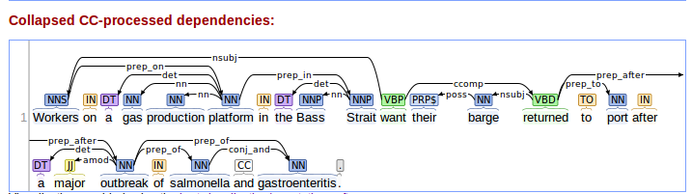
Test Case 2
Sentence :
Workers on a gas production platform in the Bass Strait want their barge returned to port after a major outbreak of salmonella and gastroenteritis.
Satnford dependencies presentation:

Slide 12
Raw Stanford Output
nsubj(want-11, Workers-1)
det(platform-6, a-3)
nn(platform-6, gas-4)
nn(platform-6, production-5)
prep_on(Workers-1, platform-6)
det(Strait-10, the-8)
nn(Strait-10, Bass-9)
prep_in(platform-6, Strait-10)
root(ROOT-0, want-11)
poss(barge-13, their-12)
nsubj(returned-14, barge-13)
ccomp(want-11, returned-14)
prep_to(returned-14, port-16)
det(outbreak-20, a-18)
amod(outbreak-20, major-19)
prep_after(returned-14, outbreak-20)
prep_of(outbreak-20, salmonella-22)
prep_of(outbreak-20, gastroenteritis-24)
conj_and(salmonella-22, gastroenteritis-24)

Slide 13
Raw Senna Output

Slide 14
Mining Some Info
1- Processing Senna raw output
makeSenna()
2- Finding all predicates with label “Args=S-V”
findPreds() → Output : Verb-location , targetColumn
[['want-11'], '5']
[['returned-14'], '6']
3- Finding the domain for each predicate (location) :
findDomain() → Output : label [ start , end ]
want
{'A0-want': ['1', '10'], 'V-want': ['11', '11'], 'A1-want': ['12', '24']}
returned
{'V-returned': ['14', '14'], 'AM-returned': ['17', '24'], 'A1-returned': ['12', '13'], 'A4-returned': ['15', '16']}

Slide 15
Mining Some Info
4- Gathering all tokens covered by each label:
FindArgs()
want
'A0-want': [['Workers-1'], ['on-2'], ['a-3'], ['gas-4'], ['production-5'], ['platform-6'], ['in-7'], ['the-8'], ['Bass-9'], ['Strait-10']]
'V-want': [['want-11']],
'A1-want': [['their-12'], ['barge-13'], ['returned-14'], ['to-15'], ['port-16'], ['after-17'], ['a-18'], ['major-19'], ['outbreak-20'], ['of-21'], ['salmonella-22'], ['and-23'], ['gastroenteritis-24']]
returned
'V-returned': [['returned-14']],
'AM-returned': [['after-17'], ['a-18'], ['major-19'], ['outbreak-20'], ['of-21'], ['salmonella-22'], ['and-23'], ['gastroenteritis-24']],
'A1-returned': [['their-12'], ['barge-13']],
'A4-returned': [['to-15'], ['port-16']]}

Slide 16
Mining some Info
5- including dependency relations from stanford with senna
MixedArgs() → Output :label (dependency [token1, token2])
want
A0-want
A1-want
Link-want

Slide 17
Mining Some Info
Continuing 5
want
1: {'A0-want': {'det': (['platform-6'], ['a-3'])}},
2: {'A0-want': {'nn': (['platform-6'], ['gas-4'])}},
3: {'A0-want': {'nn': (['platform-6'], ['production-5'])}},
4: {'A0-want': {'prep_on': (['Workers-1'], ['platform-6'])}},
5: {'A0-want': {'det': (['Strait-10'], ['the-8'])}},
6: {'A0-want': {'nn': (['Strait-10'], ['Bass-9'])}},
7: {'A0-want': {'prep_in': (['platform-6'], ['Strait-10'])}},
8: {'A1-want': {'poss': (['barge-13'], ['their-12'])}},
9: {'A1-want': {'nsubj': (['returned-14'], ['barge-13'])}},
11: {'A1-want': {'prep_to': (['returned-14'], ['port-16'])}},
12: {'A1-want': {'det': (['outbreak-20'], ['a-18'])}},
13: {'A1-want': {'amod': (['outbreak-20'], ['major-19'])}},
14: {'A1-want': {'prep_after': (['returned-14'], ['outbreak-20'])}},
15: {'A1-want': {'prep_of': (['outbreak-20'], ['salmonella-22'])}},
16: {'A1-want': {'prep_of': (['outbreak-20'], ['gastroenteritis-24'])}},
17: {'A1-want': {'conj_and': (['salmonella-22'], ['gastroenteritis-24'])}}}
10: {'Link-want': {'ccomp': (['want-11'], ['returned-14'])}},
0: {'Link-want': {'nsubj': (['want-11'], ['Workers-1'])}},

Slide 18
Mining some Info
MixedArgs() → Output :label (dependency [token1, token2])
returned
A1-returned
A4-returned
AM-returned
Link-returned

Slide 19
Mining Some Info
Continuing 5
returned
0: {'A1-returned': {'poss': (['barge-13'], ['their-12'])}},
3: {'AM-returned': {'det': (['outbreak-20'], ['a-18'])}},
4: {'AM-returned': {'amod': (['outbreak-20'], ['major-19'])}},
6: {'AM-returned': {'prep_of': (['outbreak-20'], ['salmonella-22'])}},
7: {'AM-returned': {'prep_of': (['outbreak-20'], ['gastroenteritis-24'])}},
8: {'AM-returned': {'conj_and': (['salmonella-22'], ['gastroenteritis-24'])}}
5: {'Link-returned': {'prep_after': (['returned-14'], ['outbreak-20'])}},
2: {'Link-returned': {'prep_to': (['returned-14'], ['port-16'])}},
1: {'Link-returned': {'nsubj': (['returned-14'], ['barge-13'])}},

Slide 20
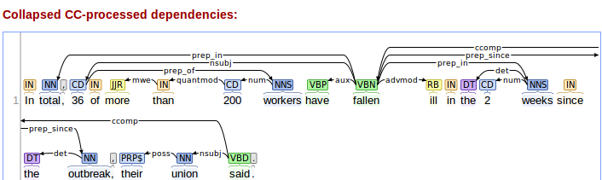
Test Case 3
Sentence :
In total, 36 of more than 200 workers have fallen ill in the 2 weeks since the outbreak, their union said.
Satnford dependencies presentation:

Slide 21
Raw Stanford Output
prep_in(fallen-11, total-2)
nsubj(fallen-11, 36-4)
mwe(than-7, more-6)
quantmod(200-8, than-7)
num(workers-9, 200-8)
prep_of(36-4, workers-9)
aux(fallen-11, have-10)
ccomp(said-23, fallen-11)
acomp(fallen-11, ill-12)
det(weeks-16, the-14)
num(weeks-16, 2-15)
prep_in(ill-12, weeks-16) VS. prep_in(fallen,weeks) ← from visual parser
det(outbreak-19, the-18)
prep_since(fallen-11, outbreak-19)
poss(union-22, their-21)
nsubj(said-23, union-22)
root(ROOT-0, said-23)

Slide 22
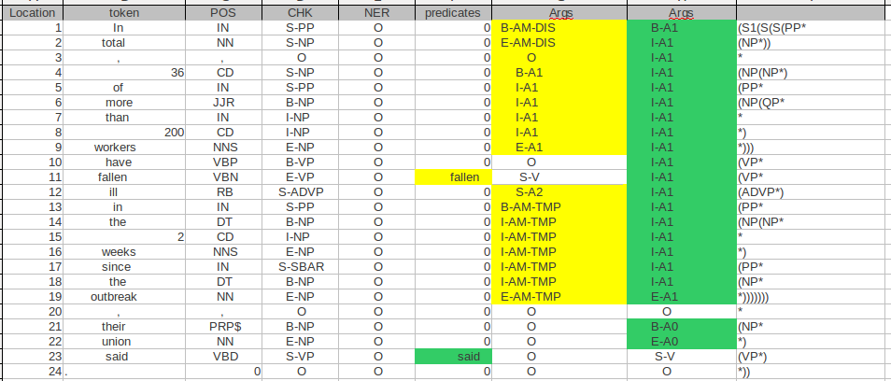
Raw Senna Output

Slide 23
Mining Some Info
4- Gathering all tokens covered by each label:
FindArgs()
said
'V-said': [['said-23']],
'A0-said': [['their-21'], ['union-22']],
'A1-said': [['In-1'], ['total-2'], [',-3'], ['36-4'], ['of-5'], ['more-6'], ['than-7'], ['200-8'], ['workers-9'], ['have-10'], ['fallen-11'], ['ill-12'], ['in-13'], ['the-14'], ['2-15'], ['weeks-16'], ['since-17'], ['the-18'], ['outbreak-19']]
fallen
'AM-TMP-fallen': [['in-13'], ['the-14'], ['2-15'], ['weeks-16'], ['since-17'], ['the-18'], ['outbreak-19']],
'AM-DIS-fallen': [['In-1'], ['total-2']],
'A2-fallen': [['ill-12']],
'A1-fallen': [['36-4'], ['of-5'], ['more-6'], ['than-7'], ['200-8'], ['workers-9']],
'V-fallen': [['fallen-11']]}

Slide 24
Mining Some Info
4- Gathering all tokens covered by each label:
FindArgs()
said
'V-said': [['said-23']],
'A0-said': [['their-21'], ['union-22']],
'A1-said': [['In-1'], ['total-2'], [',-3'], ['36-4'], ['of-5'], ['more-6'], ['than-7'], ['200-8'], ['workers-9'], ['have-10'], ['fallen-11'], ['ill-12'], ['in-13'], ['the-14'], ['2-15'], ['weeks-16'], ['since-17'], ['the-18'], ['outbreak-19']]
fallen
'AM-TMP-fallen': [['in-13'], ['the-14'], ['2-15'], ['weeks-16'], ['since-17'], ['the-18'], ['outbreak-19']],
'AM-DIS-fallen': [['In-1'], ['total-2']],
'A2-fallen': [['ill-12']],
'A1-fallen': [['36-4'], ['of-5'], ['more-6'], ['than-7'], ['200-8'], ['workers-9']],
'V-fallen': [['fallen-11']]}

Slide 25
Mining Some Info
1- Processing Senna raw output
makeSenna()
2- Finding all predicates with label “Args=S-V”
findPreds() → Output : Verb-location , targetColumn
[['fallen-11'], '5'],
[['said-23'], '6']
3- Finding the domain for each predicate (location) :
findDomain() → Output : label [ start , end ]
said
{'V-said': ['23', '23'], 'A0-said': ['21', '22'], 'A1-said': ['1', '19']}
fallen
{'AM-TMP-fallen': ['13', '19'], 'AM-DIS-fallen': ['1', '2'], 'A1-fallen': ['4', '9'], 'V-fallen': ['11', '11'], 'A2-fallen': ['12', '12']}

Slide 26
Mining some Info
5- including dependency relations from stanford with senna
MixedArgs() → Output :label (dependency [token1, token2])
said
A1-said
A0-said
Link-said

Slide 27
Mining Some Info
Continuing 5
Want
'A1-said': {'prep_in': (['fallen-11'], ['total-2'])}},
'A1-said': {'nsubj': (['fallen-11'], ['36-4'])}},
'A1-said': {'mwe': (['than-7'], ['more-6'])}},
'A1-said': {'quantmod': (['200-8'], ['than-7'])},
'A1-said': {'num': (['workers-9'], ['200-8'])}},
'A1-said': {'prep_of': (['36-4'], ['workers-9'])}},
'A1-said': {'aux': (['fallen-11'], ['have-10'])}},
'A1-said': {'acomp': (['fallen-11'], ['ill-12'])}},
'A1-said': {'det': (['weeks-16'], ['the-14'])}},
'A1-said': {'num': (['weeks-16'], ['2-15'])}},
'A1-said': {'prep_in': (['ill-12'], ['weeks-16'])}},
'A1-said': {'det': (['outbreak-19'], ['the-18'])}},
'A1-said': {'prep_since': (['fallen-11'], ['outbreak-19'])}},
'A0-said': {'poss': (['union-22'], ['their-21'])}},
'Link-said': {'ccomp': (['said-23'], ['fallen-11'])}},
'Link-said': {'nsubj': (['said-23'], ['union-22'])}}}

Slide 28
Mining some Info
MixedArgs() → Output :label (dependency [token1, token2])
fallen
A1-fallen
AM-DIS
AM-TMP-fallen
Link-fallen

Slide 29
Mining Some Info
Continuing 5
fallen
2: {'A1-fallen': {'mwe': (['than-7'], ['more-6'])}},
3: {'A1-fallen': {'quantmod': (['200-8'], ['than-7'])}},
4: {'A1-fallen': {'num': (['workers-9'], ['200-8'])}},
5: {'A1-fallen': {'prep_of': (['36-4'], ['workers-9'])}},
7: {'AM-TMP-fallen': {'det': (['weeks-16'], ['the-14'])}},
8: {'AM-TMP-fallen': {'num': (['weeks-16'], ['2-15'])}},
9: {'AM-TMP-fallen': {'det': (['outbreak-19'], ['the-18'])}},
0: {'Link-fallen': {'prep_in': (['fallen-11'], ['total-2'])}},
1: {'Link-fallen': {'nsubj': (['fallen-11'], ['36-4'])}},
10: {'Link-fallen': {'prep_since': (['fallen-11'], ['outbreak-19'])}}
6: {'Link-fallen': {'acomp': (['fallen-11'], ['ill-12'])}},
Exception link from Argi to Argj
-ill belongs to A2
-Weeks belongs to AM-TMP
-prep_in connects them

Slide 30
Fixed the Exception
fallen
2: {'A1-fallen': {'mwe': (['than-7'], ['more-6'])}},
3: {'A1-fallen': {'quantmod': (['200-8'], ['than-7'])}},
4: {'A1-fallen': {'num': (['workers-9'], ['200-8'])}},
5: {'A1-fallen': {'prep_of': (['36-4'], ['workers-9'])}},
7: {'AM-TMP-fallen': {'det': (['weeks-16'], ['the-14'])}},
8: {'AM-TMP-fallen': {'num': (['weeks-16'], ['2-15'])}},
10: {'AM-TMP-fallen': {'det': (['outbreak-19'], ['the-18'])}},
9: {'Link-AM-TMP-fallen-A2-fallen': {'prep_in': (['ill-12'], ['weeks-16'])}},
0: {'Link-fallen': {'prep_in': (['fallen-11'], ['total-2'])}},
1: {'Link-fallen': {'nsubj': (['fallen-11'], ['36-4'])}},
6: {'Link-fallen': {'acomp': (['fallen-11'], ['ill-12'])}}
11: {'Link-fallen': {'prep_since': (['fallen-11'], ['outbreak-19'])}}}

Slide 31
a--b

