Slide 1







Under the supervision of:
Mr. Dhrubojyoti Sarkar
Mr. Soumyajit Das
x
Email Spam Detection with Python
The Internship Project Report
Submitted By:
Adreeraj Das (Roll No: 25)
Reg No: D232431501
ORGANISATION: CMC COMPUTER EDUCATION, SINGUR
Institute: Technique Polytechnic Institute, Hooghly – 712102
Session: 2025–26
Notes:
1

Slide 2
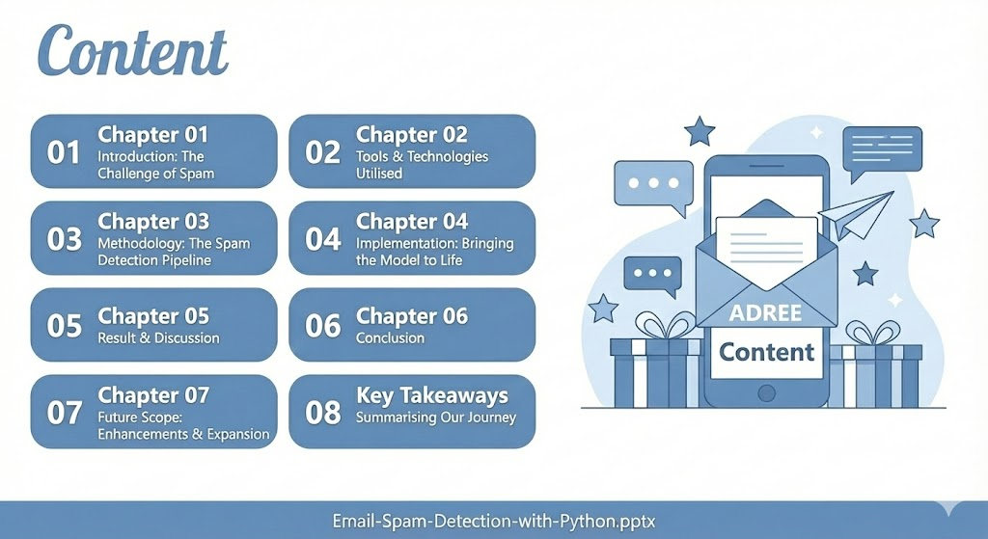

Slide 3


Chapter 1
Introduction: The Challenge of Spam
In the modern digital landscape, email remains a cornerstone of communication, serving as a primary channel for personal, professional, and commercial interactions.
However, its ubiquity has made it a prime target for malicious activities.
The Problem
The Solution
Increasing volumes of unsolicited bulk emails (spam)
Development of robust spam detection systems
Sophisticated phishing attempts
Critical for maintaining email integrity and user trust
Distribution of malware and viruses
Objective: Accurately classify messages as Spam or Ham (legitimate email)
Notes:
2

Slide 4





Chapter 2
Tools & Technologies Utilised
My project leveraged a suite of powerful, open-source tools and libraries, enabling efficient development, robust model training, and seamless deployment.
Python
Nextjs & Flask
Render
Pandas – used To load, clean, and handle the dataset efficiently and also manage data.
scikit-learn (sklearn) – Used to build and train machine learning models we used:
CountVectorizer → Converts text data into numeric features using the Bag of Words model.
train_test_split → Splits the dataset into training and testing sets for model evaluation.
A lightweight web framework for building the user interface and serving model predictions.
Platform used for hosting the web application, providing live accessibility.
Gemini
Used Gemmini Pro 2.5 API
The SMS Spam Collection dataset was instrumental for training and evaluating our model.
Notes:
3

Slide 5


Chapter 3
Methodology: The Spam Detection Pipeline
My approach followed a structured machine learning pipeline, from raw data to a fully deployed model, ensuring accuracy and efficiency in spam classification.
01
02
Data Collection
Preprocessing
Gathering the raw SMS Spam Collection dataset, comprising both legitimate and spam messages.
Cleaning the text data: removing stop words, punctuation, and converting to lowercase for consistency.
03
04
Feature Extraction
Model Training
Transforming text into numerical features using the Bag-of-Words (BoW) model with `CountVectorizer`.
Applying the Multinomial Naive Bayes algorithm to learn patterns from the processed data and check it.
05
06
Evaluation
Deployment
Assessing model performance using metrics: Accuracy, Precision, and Recall.
Integrating the trained model into a Flask web application and hosting it on Render for live access.
Notes:
4

Slide 6
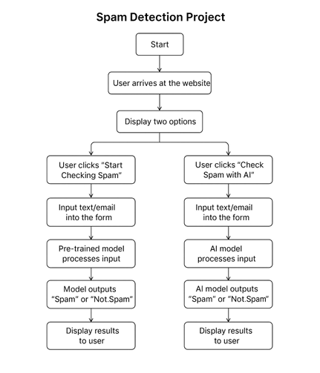

Chapter 3
Methodology: The Spam Detection Flow chart
For the Website
Notes:
4

Slide 7

Chapter 4
Implementation: Bringing the Model to Life
My project culminates in a functional, user-friendly web application that demonstrates the practical application of our spam detection model.
Developed a web application using Python and Next.
Users can input messages into a text field.
Features a Typescript and Tailwind Css interface for user interaction.
The backend model processes the input and predicts whether it's "Spam" or "Ham".
Successfully achieved a classification accuracy of over 95% on the test dataset.
Notes:
5

Slide 8
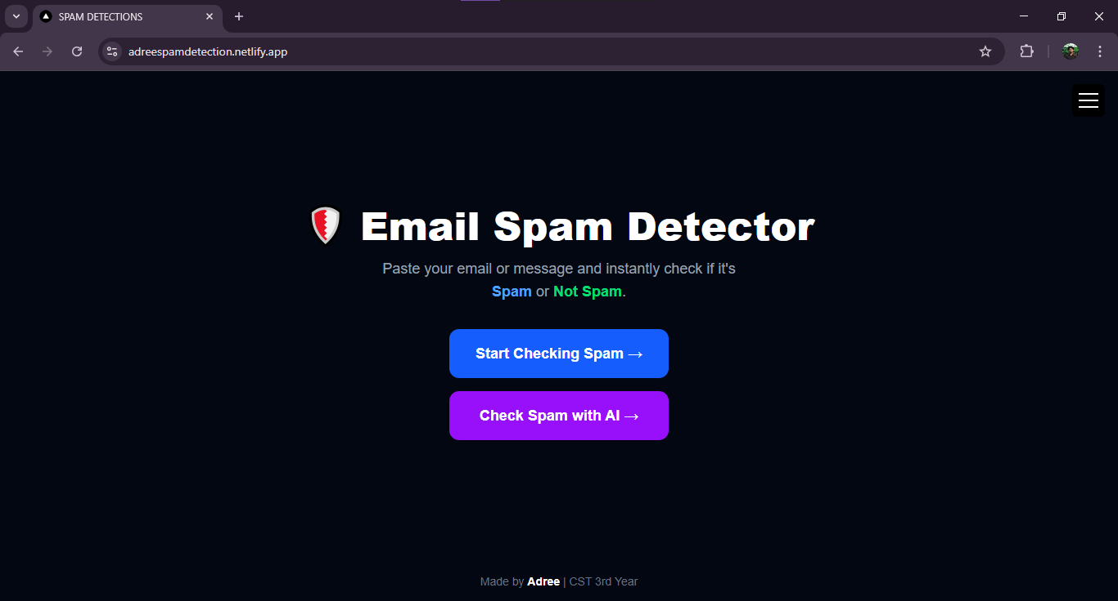
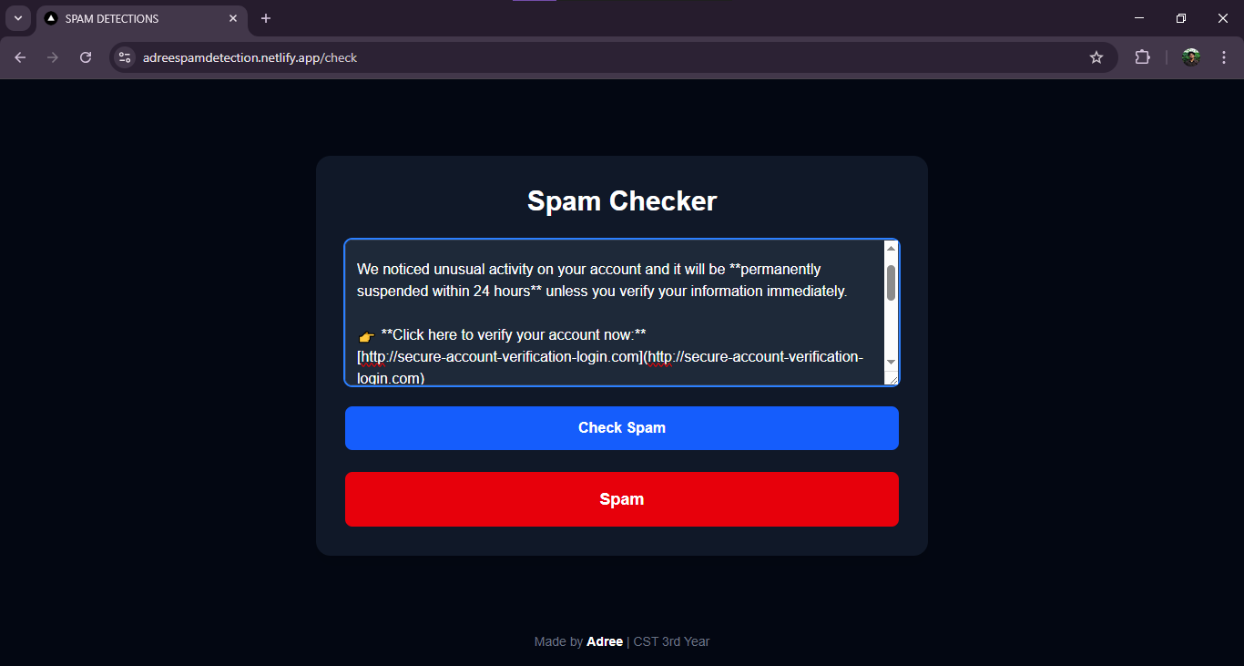
Chapter 4
Implementation: Bringing the Model to Life
visit - https://adreespamdetection.netlify.app
Output
Notes:
5

Slide 9
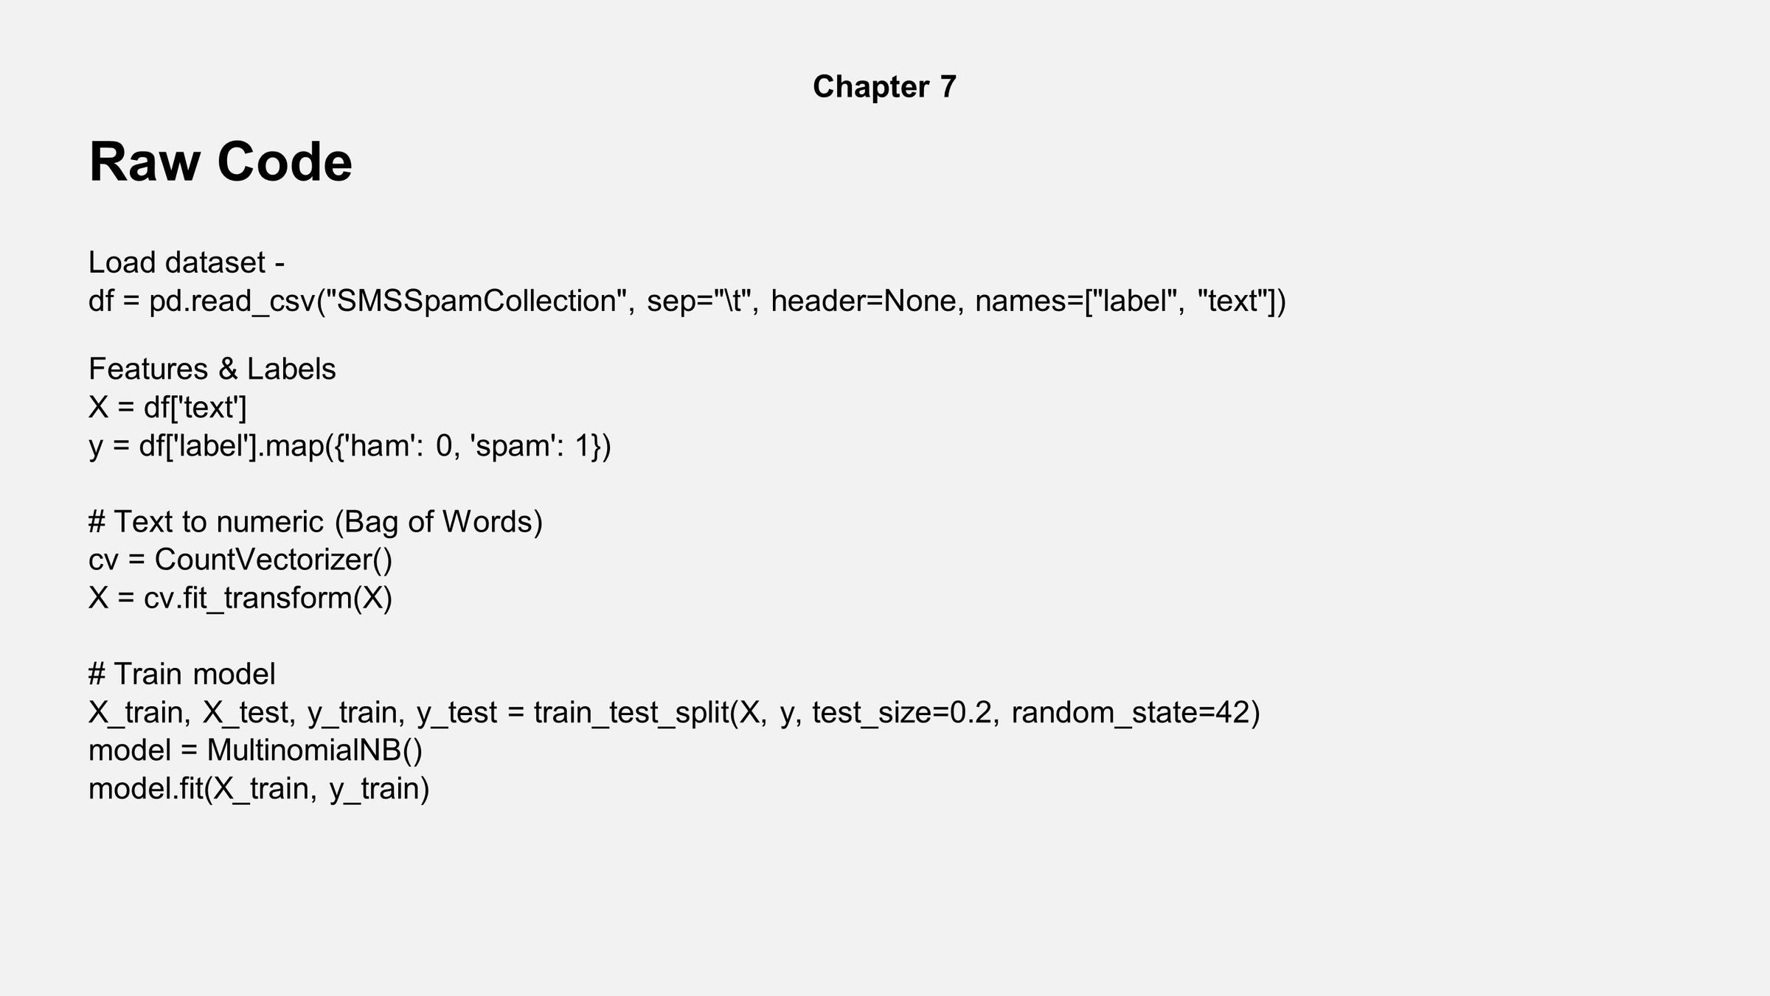
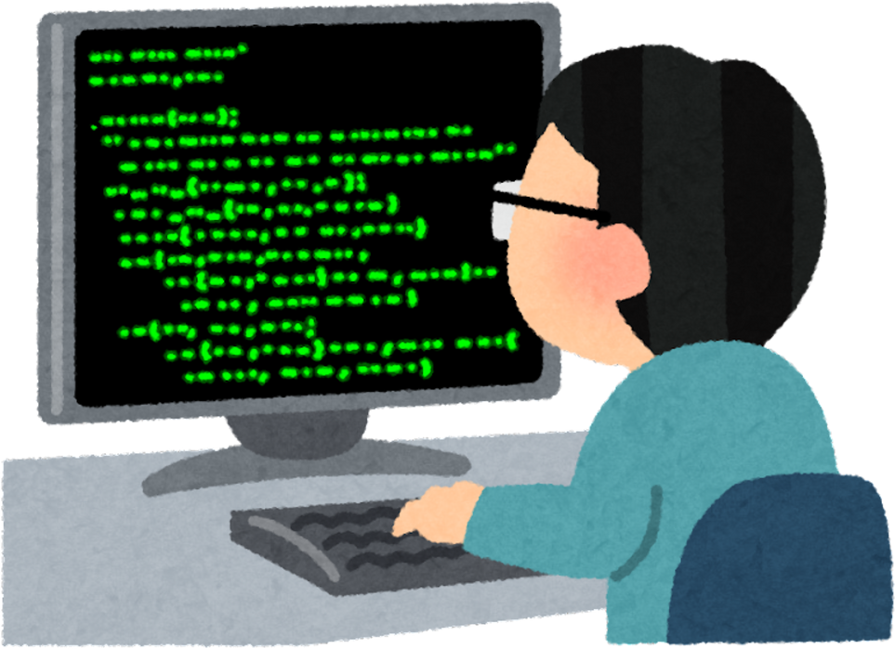
Chapter 4
Notes:
5

Slide 10
Chapter 5
Results & Discussion
The performance metrics underscore the effectiveness of our chosen methodology and the model's reliability in distinguishing between spam and legitimate messages.
>95%
Strong
Strong
Accuracy
Precision
Recall
Overall correct classification rate, indicating strong performance.
High rate of correctly identified spam messages, minimising false positives.
Excellent ability to detect actual spam messages, minimising false negatives.
The Multinomial Naive Bayes classifier proved exceptionally effective for text classification tasks, particularly given its probabilistic nature and suitability for discrete features like word counts.
The model is not only accurate but also lightweight and fast, making it suitable for real-time spam detection without significant computational overhead.
Notes:
6

Slide 11

Chapter 6
Conclusion
We successfully developed and implemented an email spam detection system capable of accurately classifying messages with high efficacy.
This project provided invaluable experience in machine learning pipeline development, web application deployment, and practical problem-solving.
Notes:
7

Slide 12



Chapter 7
Future Scope: Enhancements & Expansion
While the current system performs commendably, there are several avenues for future enhancement to further improve its capabilities and applicability.
Advanced Feature Engineering
Deep Learning Models
Real-World Integration
Implement LSTM (Long Short-Term Memory) or Transformer networks for more complex pattern recognition in sequential data.
Develop APIs or plugins for direct integration with popular email platforms (e.g., Gmail, Outlook) for live spam filtering.
Explore TF-IDF (Term Frequency-Inverse Document Frequency) for weighting word importance, or Word Embeddings (e.g., Word2Vec, GloVe) for capturing semantic relationships.
Notes:
8

Slide 13
Key Takeaways
Summarising Our Journey
Our project successfully demonstrated the power of machine learning in addressing real-world cybersecurity challenges.
Effective Classification
1
Achieved high accuracy in distinguishing spam from ham messages using classical ML.
Practical Application
2
Developed a deployable web application demonstrating immediate utility.
Foundational Learning
3
Gained hands-on experience in data science, web development, and cloud deployment.
Next Steps
We are committed to exploring advanced techniques and real-world deployment scenarios to enhance this project further.
Notes:
9

Slide 14

Thank You
For your time and attention.
Hopefully im open to any questions.
Adreeraj Das
Session: 2025–26
Technique Polytechnic Institute
https://github.com/adreerajdas/Adree-Spam-Detection
Notes:
10

