Slide 1
Soaring With The Eagles Site Map
HOME
PAGE
SAILPLANE
TYPES
THERMALS
LAUNCHING
OBTAIN
LICENSE
PURCHASE
ANATOMY
INSTRU-MENTS
ORDER
FORM
OPTIONS

Slide 2
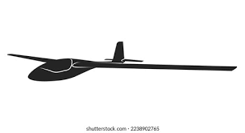

Soaring With The Eagles
Learn About the Sport of Soaring
Home
Sailplane
Types
Thermals
Launching
Obtain a License
Parts of a Sailplane
Purchase a Sailplane

Slide 3

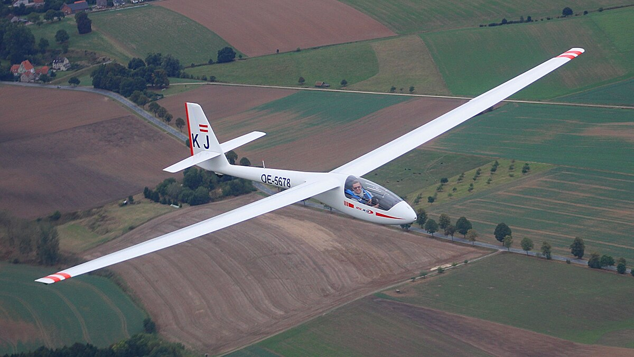
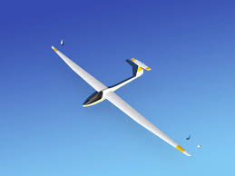

Sailplane Types
Home
Sailplane
Types
Thermals
Launching
Obtain a License
Parts of a Sailplane
Purchase a Sailplane
What is a Sailplane?
One definition from Embry-Riddle University is that a sailplane is a high-performance glider that can stay aloft almost indefinitely only using the updrafts found in the atmosphere.
Competition Class Designations (FAI)
World Class (13.5-meter)
Club Class (older ships; no water ballast allowed)
Standard Class 15-meters
18-Meter Class (max mass of 600kg)
20-Meter Class (max mass of 750kg)
Open Class (longer than 15-meters)
o0

Slide 4
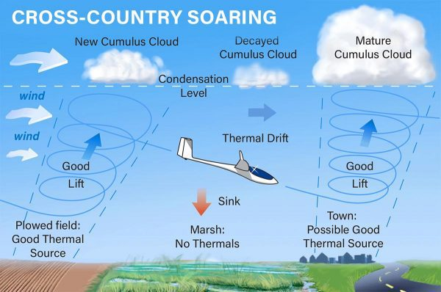
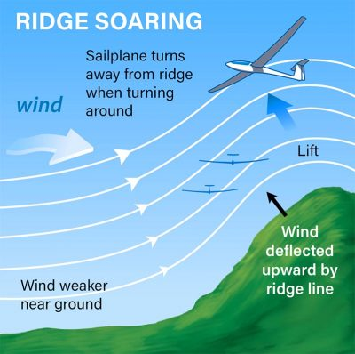
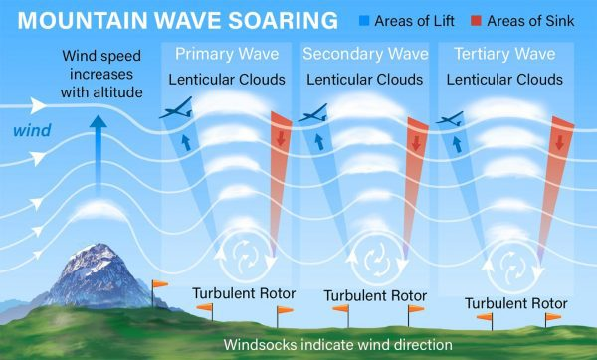
Thermals
Home
Sailplane
Types
Thermals
Launching
Obtain a License
Parts of a Sailplane
Purchase a Sailplane
Types of Rising Air
Sailplane pilots generally seek three types of rising air: thermals, ridge lift, and mountain wave.
Thermals: Generated by hot air on the surface rising into the atmosphere. Thermals can rise thousands of feet into the air.
Ridge Lift: Wind can blow against a mountain or ridge line and the air flow is deflected upward. Sailplanes can fly back and forth on the upwind side of the ridge.
Mountain Wave: A weather phenomenon used by sailplane pilots to keep aloft is to surf on ‘mountain waves’. Strong winds crossing a mountain range will make standing waves in the air.

Slide 5

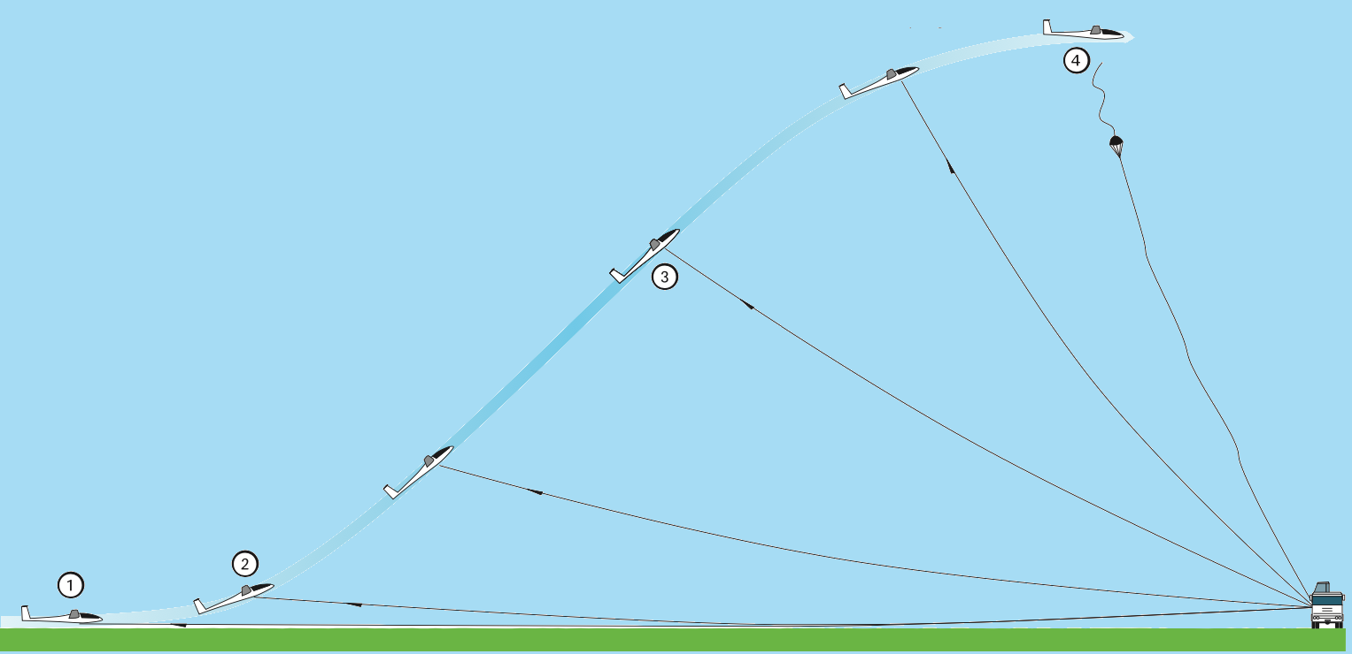
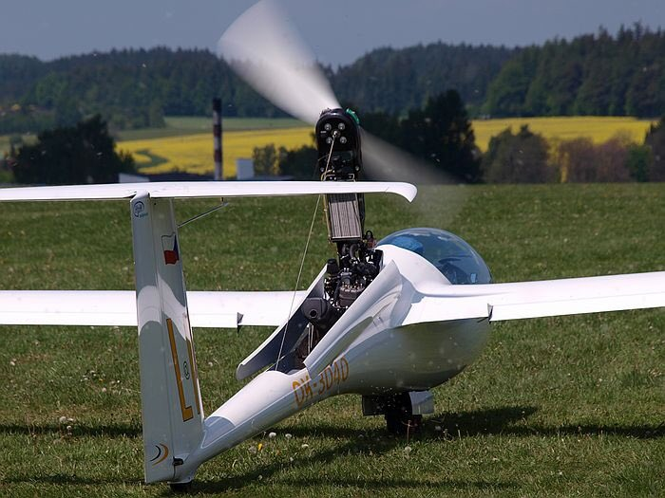
Launching
Getting Into The Air
Tow Plane: The most common means of getting aloft in the USA is to get towed by a powered aircraft up to a predetermined release altitude (generally 1,000-2,000 feet).
Winch Launch: This technique is far more popular in Europe and Asia. In this case, the sailplane is connected via cable to a motorized winch at the far end of the runway. The pilot releases the cable when directly over the winch.
Self-Launch: Some much more expensive sailplanes have built-in engines that are powerful enough to self-launch the sailplane. Once aloft, the engines are either “feathered” or collapsed into the body of the ship.
Home
Sailplane
Types
Thermals
Launching
Obtain a License
Parts of a Sailplane
Purchase a Sailplane

Slide 6
Obtaining A Pilot’s License
Home
Sailplane
Types
Thermals
Launching
Obtain a License
Parts of a Sailplane
Purchase a Sailplane
Sailplane Certificate Eligibility Requirements
In the United States, licensing of aircraft pilots is handled under the authority of the FAA (https://www.faa.gov). Additional sailplane training information may be found on the SSA web site (https://www.ssa.org).
These are the requirements for flying a sailplane solo:
An individual must be at least 14 years old.
A student must demonstrate satisfactory aeronautical knowledge on a test developed by an instructor.
A student must also have received and logged ground and flight training for the maneuvers and procedures in 14 CFR part 61 that are appropriate to the make and model of aircraft to be flown.
A student pilot must demonstrate satisfactory proficiency and safety
To be eligible for a private pilot certificate with a glider rating:
An individual must be at least 16 years of age.
A student must complete the training and flight time requirements described in 14 CFR part 61.
A student pass a knowledge test.
A student must successfully complete a practical test.
Locate a qualified sailplane ground school via http://www.ssa.org.

Slide 7
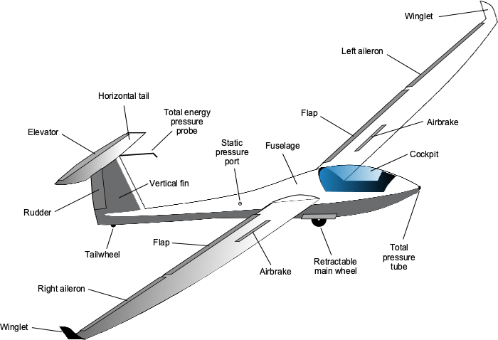
Parts of a Sailplane (1)
Home
Sailplane
Types
Thermals
Launching
Obtain a License
Parts of a Sailplane
Purchase a Sailplane
Anatomy of a Sailplane

Slide 8
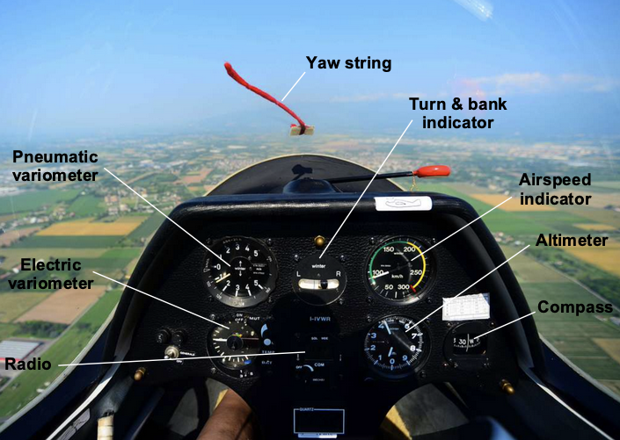
Parts of a Sailplane (2)
Home
Sailplane
Types
Thermals
Launching
Obtain a License
Parts of a Sailplane
Purchase a Sailplane
A Typical Instrument Panel Cluster

Slide 9
Parts of a Sailplane (3)
Mouse Over Displays Photo
Home
Sailplane
Types
Thermals
Launching
Obtain a License
Parts of a Sailplane
Purchase a Sailplane
Optional Equipment:
Item | Description | Photo
Parachute | Used to safely eject from aircraft.
5-Point Harness | Pilot Restraint. Safer than standard 3-point.
Emergency Transmitter (ELT) | Sends emergency beacon in case of crash.
Battery Monitor | Provides visual status of onboard power supply.
Battery, High Perf | Provides much longer lasting power supply.
GPS, Aviation | GPS specifically geared towards aviation.
UHF/VHF Radio | Provides UHF/VHF radio communications.
Variometer, Electric | Provides audio/visual status of rising/falling air.
Oxygen, On-Demand | Provides oxygen to pilot on-demand above 13k feet.

Slide 10
Purchase a Sailplane
Home
Sailplane
Types
Thermals
Launching
Obtain a License
Parts of a Sailplane
Purchase a Sailplane
Type: World Class 15-M 18-M 20-M Club
Make: Grob GlasFlugal Jonker Pilatus
Model: Model-A Model-B Model-C
Seats: 1-Seat 2-Seats
Option-1:
Option-2:
Option-3:
Option-4:
Pull Down Menu
Pull Down Menu
Pull Down Menu
Pull Down Menu
SUBMIT ORDER

