Slide 1
Arimoclomol for BUB1B-MVA
Conditional preclinical repurposing proposal
Can this candidate restore
functional BubR1?
adriamasnou
MVA Hackathon 2026
No drug rescue experiment
has been performed.
Track 2 report / PMID 20516114
1/6
Notes:
For a child with mosaic variegated aneuploidy, a plausible medicine is only a starting point. We propose arimoclomol for laboratory testing, with explicit rules for deciding whether it deserves to advance. We have not demonstrated drug rescue or treated this child. Our contribution is a testable proposal, supported by working tools that others can use.
Evidence: Track 2 report · PMID 20516114
submissions/adriamasnou_track2_report.md
Research proposal. No demonstrated therapeutic rescue or clinical eligibility result.

Slide 2
Variant abundance and function
Phase is inferred. N1002K function remains unmeasured.
Protein amount
Protein function
Expression, turnover
and localisation
Full-length WT and variant
compared at matched abundance
Possible outcomes: abundance-limited, function-limited, mixed or indeterminate
PMIDs 20516114 / 22698286 / 33207204
2/6
Notes:
The two identified variants affect the gene that makes Bub R one, a protein involved in chromosome separation. Their phase is inferred. The exact protein consequences remain unmeasured. The missense variant could reduce abundance, impair function, do both, or remain indeterminate. The proposed experiment compares full-length normal and altered protein at matched abundance. An isolated fragment's melting curve cannot settle that question.
Evidence: PMIDs 20516114 · 22698286 · 33207204
submissions/adriamasnou_track2_report.md
Research proposal. No demonstrated therapeutic rescue or clinical eligibility result.

Slide 3
Four experimental gates
A
Establish the variant's effect
Full-length protein at matched abundance
B
Validate measurement and response
Qualified controls and measured exposure
C
Measure segregation and cell fate
Separate division, death, arrest and selection
D
Apply the prespecified decision rules
Confidence bounds separate advance, reject and inconclusive
Failed controls: indeterminate. Threshold-touching intervals: inconclusive.
Functional rescue plan, gates A-D / proposed experiments
3/6
Notes:
The protocol has four gates. Gate A establishes the variant's effect using full-length protein at matched abundance. Gate B qualifies measurement, pathway response and exposure. Gate C measures chromosome segregation while separately tracking division and cell fate. Gate D applies prespecified confidence bounds. More protein alone cannot pass. Neither can apparent improvement from stopping division or selectively losing abnormal cells. Failed controls are indeterminate. An interval touching the worthwhile-benefit threshold is inconclusive. Only an interval entirely below that threshold rules out the programme's worthwhile benefit at that exposure. These are proposed research rules, not clinical thresholds.
Evidence: Functional rescue plan, gates A-D / proposed experiments
submissions/functional-rescue-plan.md
submissions/rescue-decision-validation.md
Research proposal. No demonstrated therapeutic rescue or clinical eligibility result.

Slide 4
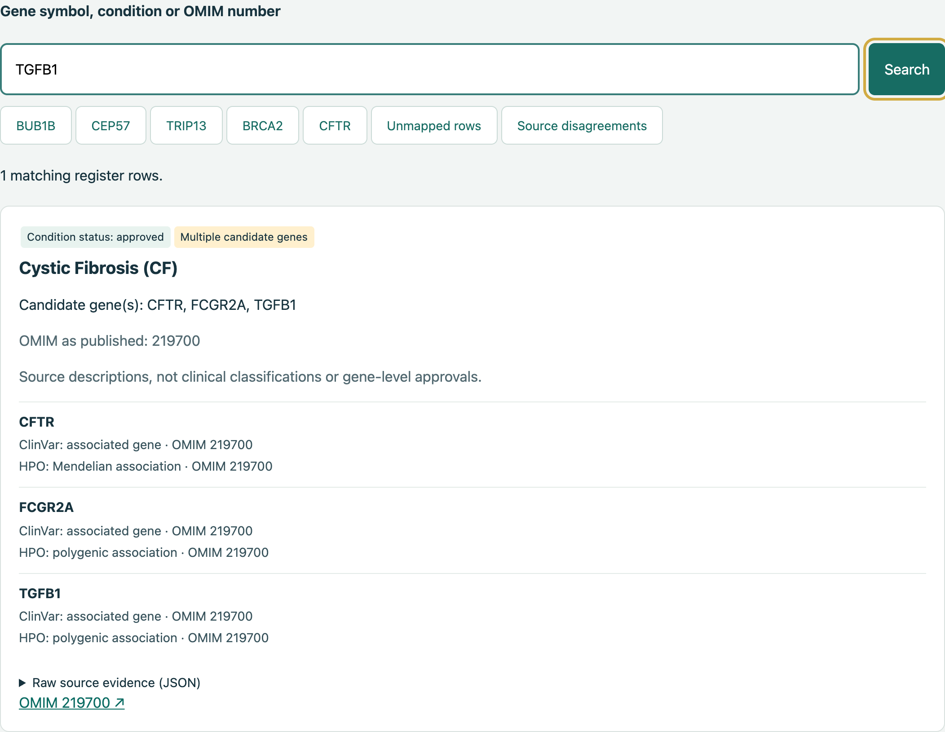
Gene-to-condition navigator
28 queries
47 returned gene-row
associations reviewed
Source roles visible
Shared-source audit
Clinical validity untested
Expanded frozen query audit / HFEA register 2026-08-05
4/6
Notes:
The offline navigator links genes to candidate conditions and shows each source's association role. Twenty-eight selected queries passed, with complete review of every returned source association: forty-seven gene and register-row pairs. This was a developer evaluation using the same source snapshots, not independent clinical validation. All register rows remain visible, including unmapped entries. A match does not establish eligibility. Queries stay on the device.
Evidence: Expanded frozen query audit / HFEA register 2026-08-05
submissions/pgtm-expanded-validation.json
submissions/pgtm-expanded-validation.md
submissions/pgtm-navigator.html
Research proposal. No demonstrated therapeutic rescue or clinical eligibility result.

Slide 5
Rules that reject misleading hits
Implemented rescue-decision prototype
40
frozen synthetic cases
matched expected decisions
Also: 6 real SpliceAI controls passed
9 injected checker faults rejected
Software verification. Biological rescue remains unmeasured.
Rescue-decision validation / SpliceAI measured controls and checker
5/6
Notes:
We implemented these rescue-decision rules as a research software prototype. All forty frozen synthetic cases matched their expected decisions, including protein-only signals, selective killing, missing data and confidence-boundary cases. This verifies software behaviour, not biological rescue. Separately, real Splice A I inference passes six controls. Its checker rejects nine injected failures. Laboratory function, exposure and independent replication remain unmeasured.
Evidence: Rescue-decision validation / SpliceAI measured controls and checker
submissions/rescue-decision-validation.json
submissions/rescue-decision-validation.md
canary/measured-results-2026-10-23.txt
canary/README.md
Research proposal. No demonstrated therapeutic rescue or clinical eligibility result.

Slide 6
The next experiment
Does N1002K retain function
that arimoclomol can rescue?
Delivered now
Evidence still needed
Code, source trail and
a proposed laboratory protocol
Independent functional rescue
at relevant exposure
adriamasnou / MVA Hackathon 2026
6/6
Notes:
The next step is a laboratory test of full-length variant function and exposure-limited rescue. The proposal says what would advance the candidate and what would stop it. The reusable tools, source trail and plain-language explanation are delivered now. Clinical benefit remains to be earned. That is the standard we want this work judged against.
Evidence: adriamasnou · MVA Hackathon 2026
submissions/adriamasnou_track2_report.md
Research proposal. No demonstrated therapeutic rescue or clinical eligibility result.

