Slide 1
Automated Alumni
Mentorship Platform
DevOps Deployment Project
Spring Boot · Jenkins · Docker · Ansible
Repository: github.com/adrian-25/Automated-Alumni-Mentorship-Platform-Deployment
Final-year CSE project

Slide 2
Problem and stakeholders
A focused platform for structured alumni mentorship requests
Students need a clear way to request guidance. Alumni need a simple workflow to review and respond. Administrators need visibility of requests and status.
Platform users
Students
Submit mentorship requests
Alumni
Review and update requests
Administrators
See platform activity
Automated Alumni Mentorship Platform Deployment
02

Slide 3
MVP scope and request workflow
The project deliberately limits scope to a demonstrable mentorship workflow
01
02
03
04
05
Student and alumni records
Search and browse
Mentorship request
Role-aware status change
Summary dashboard
Excluded from the MVP: SSO, production persistence, scheduling, notifications, and observability.
Automated Alumni Mentorship Platform Deployment
03

Slide 4
Architecture and technology choices
A WAR-capable Spring Boot application supports both local testing and Tomcat deployment
Web UI
Thymeleaf MVC pages and dashboard
Application
Java 17, Spring Boot 3, request transition policy
Data
Spring Data JPA with H2 for the MVP
Delivery
Maven, Jenkins, Docker, Tomcat, Ansible
Automated Alumni Mentorship Platform Deployment
04

Slide 5
Git collaboration and traceability
The repository keeps code, configuration, task notes, and evidence together
Feature pull requests #1 and #2 were reviewed and merged.
The repository records a resolved merge conflict and a v1.0.0 baseline tag.
GitHub issue templates produced issue #4 for a defect and issue #5 for a feature request.
Each task directory documents reproducible commands and captured evidence.
Traceability
Commit → build → evidence
Automated Alumni Mentorship Platform Deployment
05

Slide 6
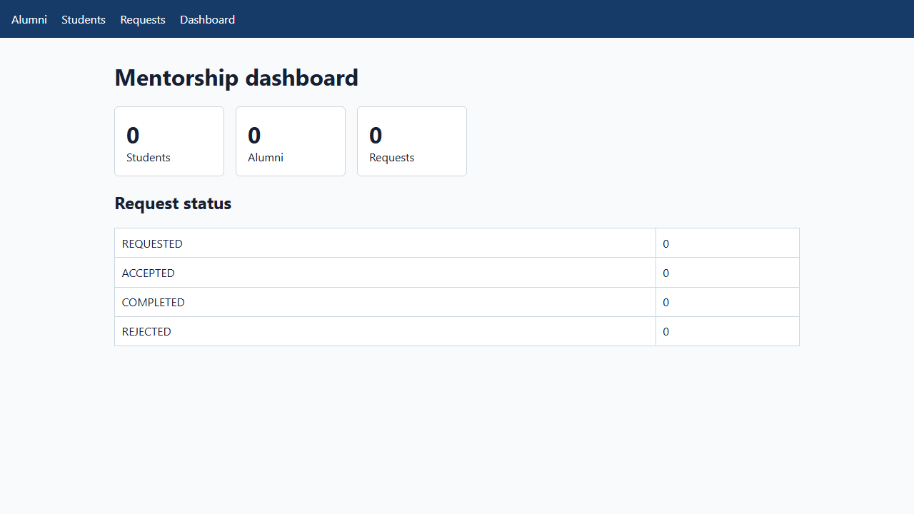
Application demonstration
The running Tomcat container served the mentorship dashboard on localhost:8081
Verified user functions
Record management
Mentor discovery
Request workflow
Dashboard summary
Automated Alumni Mentorship Platform Deployment
06

Slide 7
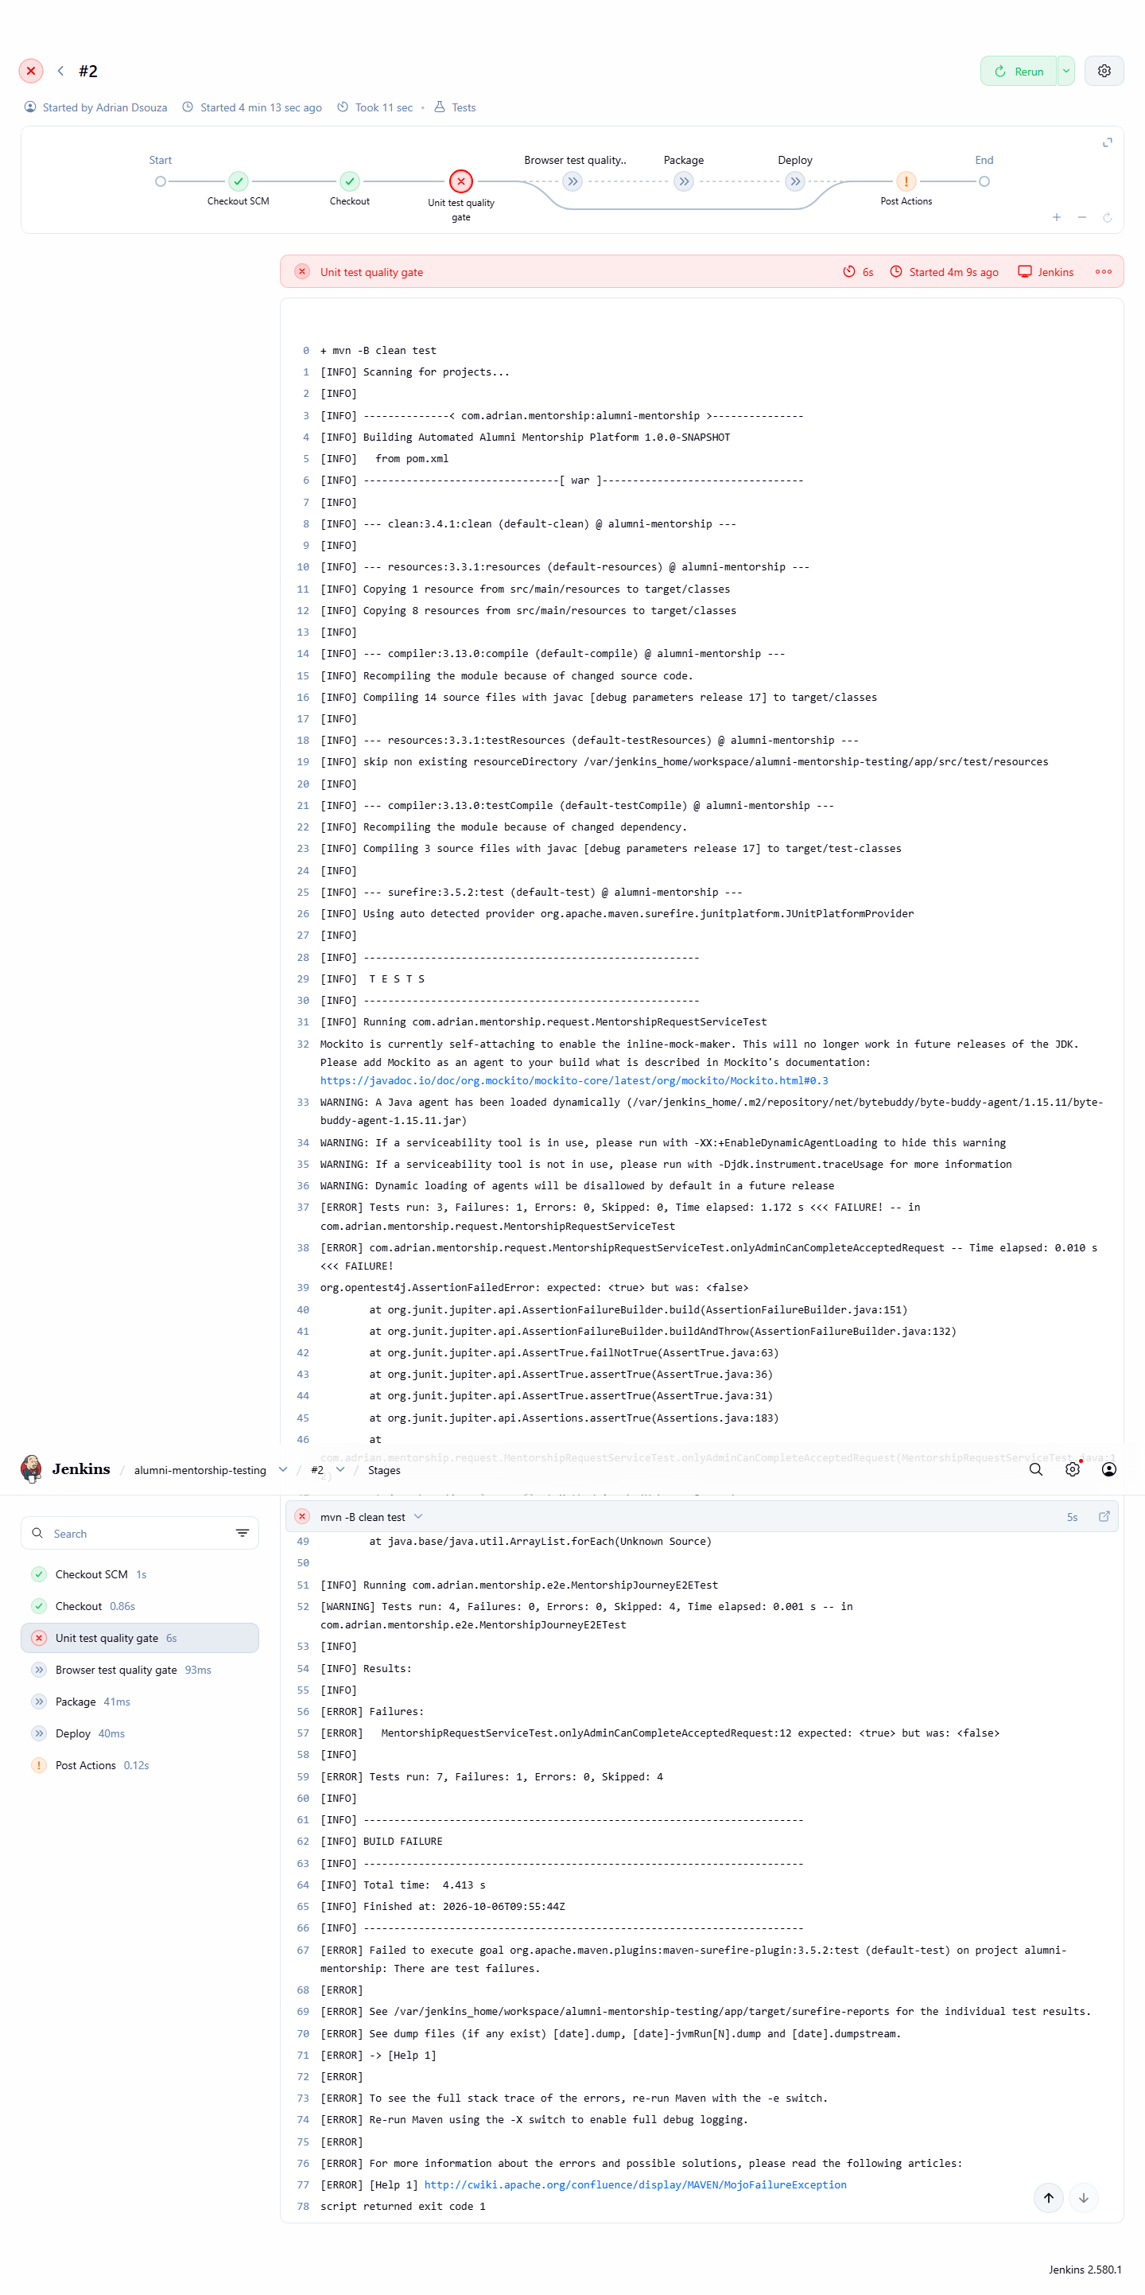
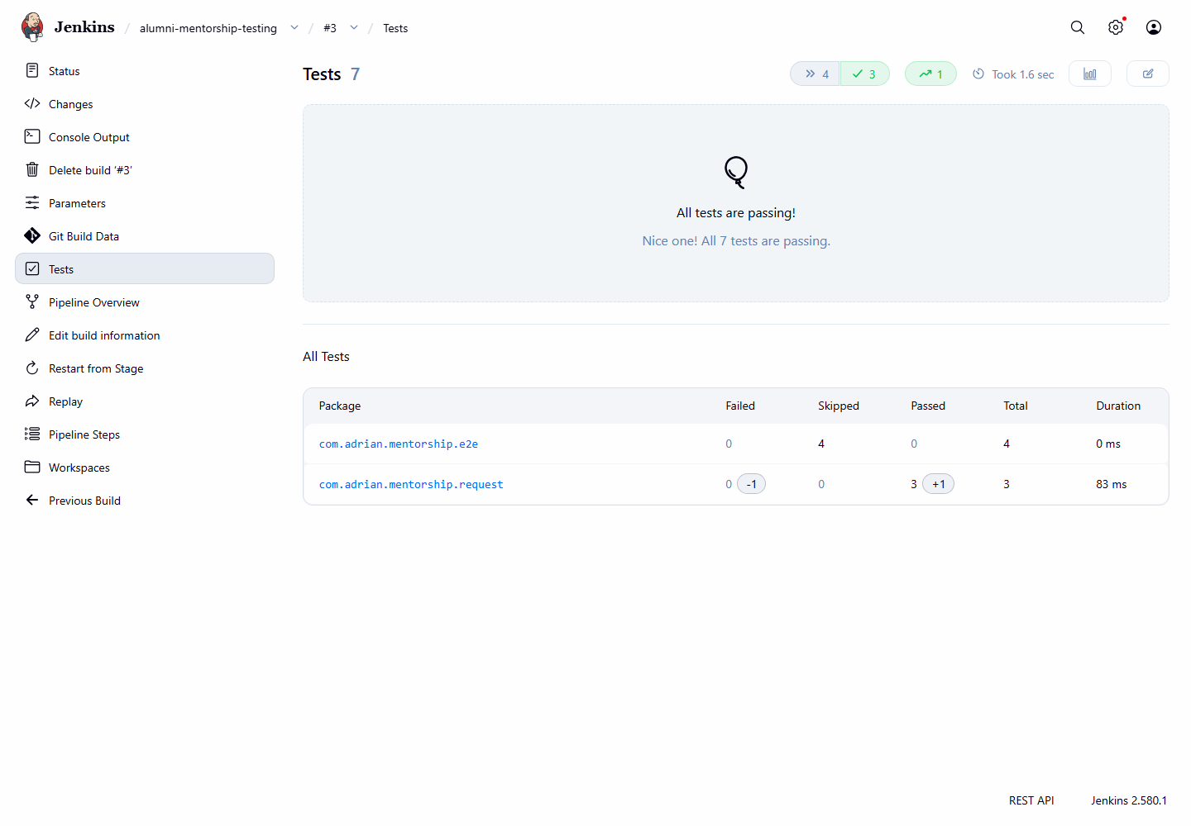
Continuous testing evidence
Maven unit checks and Selenium browser journeys protect the workflow
Defect build: a controlled test failure produced visible Jenkins evidence.
Fixed build: the corrected code produced successful Jenkins test results.
Automated Alumni Mentorship Platform Deployment
07

Slide 8
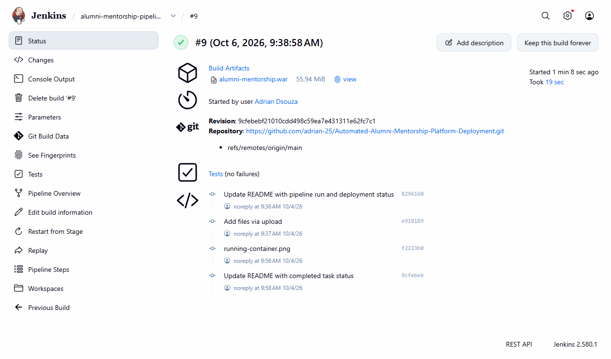
CI/CD pipeline and container deployment
The pipeline tests, builds a versioned image, deploys a fresh container, then checks health
Jenkins runs the Maven quality gate.
Docker builds the Tomcat image from the WAR.
The deployment waits for the health endpoint.
Docker Hub publication is in progress. The live registry run belongs here once it completes.
Automated Alumni Mentorship Platform Deployment
08

Slide 9
Ansible provisioning and reliability
The playbook configures a clean Linux target and verifies the container health endpoint
01
Install Docker prerequisites
02
Create the service account and app directory
03
Pull an immutable image and start the container
04
Check HTTP health, repeat for idempotency, then validate rollback
Pending live evidence: first apply, changed=0 on the second apply, health response, and rollback on the VM.
Automated Alumni Mentorship Platform Deployment
09

Slide 10
Results, limitations, and final demonstration
Verified local results are separate from the VM and registry evidence still being captured
Verified
Final live evidence
Native Maven verification
Published Docker Hub tag
Jenkins CI and Selenium evidence
Jenkins registry deployment
Docker container and browser view
VM apply and second idempotency run
Ansible syntax validation
Rollback and final recorded demo
Next: complete the Docker Hub push, then run Task 13 and Task 14 against the Ubuntu VM using the immutable image tag.
Automated Alumni Mentorship Platform Deployment
10

