Slide 1
Data Mining
Association Rules: Advanced Concepts and Algorithms
Lecture Notes for Chapter 7
Introduction to Data Mining
by
Tan, Steinbach, Kumar
© Tan,Steinbach, Kumar Introduction to Data Mining 4/18/2004 <number>

Slide 2
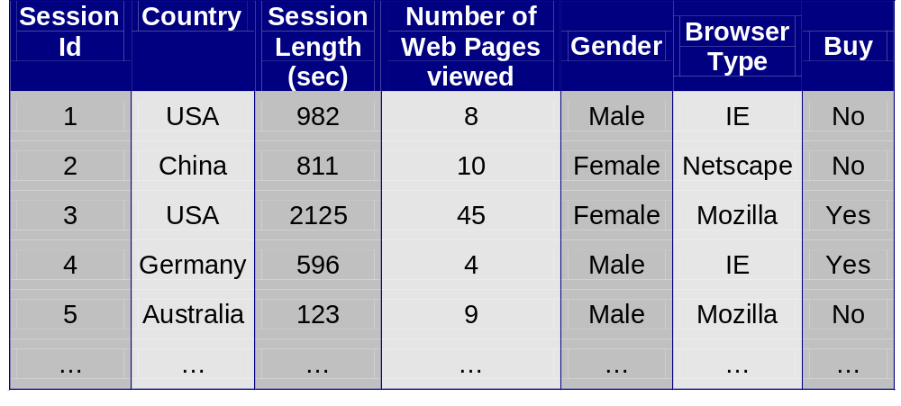
Continuous and Categorical Attributes
How to apply association analysis formulation to non-asymmetric binary variables?
Example of Association Rule:
{Number of Pages ∈[5,10) ∧ (Browser=Mozilla)} → {Buy = No}

Slide 3
Handling Categorical Attributes
Transform categorical attribute into asymmetric binary variables
Introduce a new “item” for each distinct attribute-value pair
  Example: replace Browser Type attribute with
    Browser Type = Internet Explorer
    Browser Type = Mozilla
    Browser Type = Mozilla

Slide 4
Handling Categorical Attributes
Potential Issues
  What if attribute has many possible values
    Example: attribute country has more than 200 possible values
    Many of the attribute values may have very low support
      Potential solution: Aggregate the low-support attribute values
  What if distribution of attribute values is highly skewed
    Example: 95% of the visitors have Buy = No
    Most of the items will be associated with (Buy=No) item
      Potential solution: drop the highly frequent items

Slide 5
Handling Continuous Attributes
Different kinds of rules:
  Age∈[21,35) ∧ Salary∈[70k,120k) → Buy
  Salary∈[70k,120k) ∧ Buy → Age: μ=28, σ=4
Different methods:
  Discretization-based
  Statistics-based
  Non-discretization based
    minApriori

Slide 6
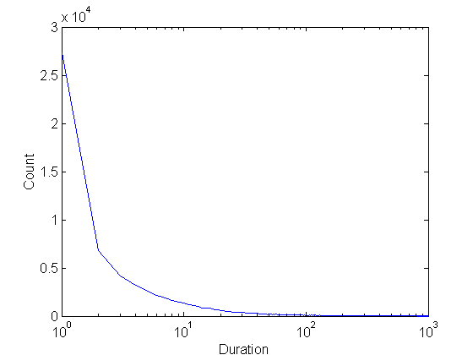
Handling Continuous Attributes
Use discretization
Unsupervised:
  Equal-width binning
  Equal-depth binning
  Clustering
Supervised:
Attribute values, v
Class | v₁ | v₂ | v₃ | v₄ | v₅ | v₆ | v₇ | v₈ | v₉
Anomalous | 0 | 0 | 20 | 10 | 20 | 0 | 0 | 0 | 0
Normal | 150 | 100 | 0 | 0 | 0 | 100 | 100 | 150 | 100
bin₁
bin₂
bin₃

Slide 7
Discretization Issues
Size of the discretized intervals affect support & confidence
  If intervals too small
    may not have enough support
  If intervals too large
    may not have enough confidence
Potential solution: use all possible intervals
{Refund = No, (Income = $51,250)} → {Cheat = No}
{Refund = No, (60K ≤ Income ≤ 80K)} → {Cheat = No}
{Refund = No, (0K ≤ Income ≤ 1B)} → {Cheat = No}

Slide 8
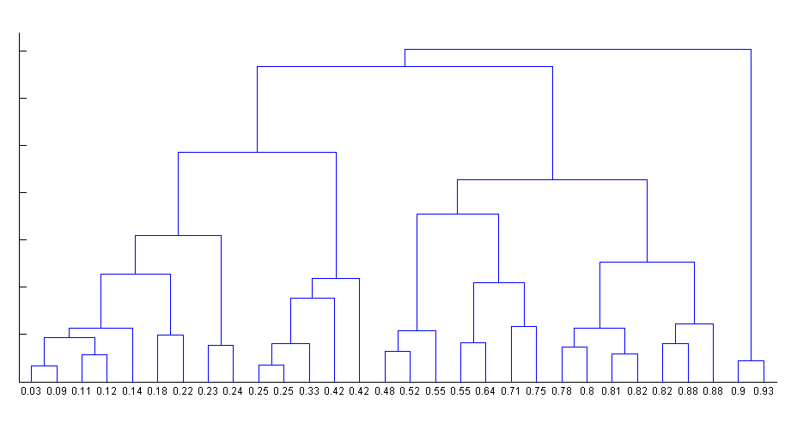
Discretization Issues
Execution time
  If intervals contain n values, there are on average O(n²) possible ranges
Too many rules
{Refund = No, (Income = $51,250)} → {Cheat = No}
{Refund = No, (51K ≤ Income ≤ 52K)} → {Cheat = No}
{Refund = No, (50K ≤ Income ≤ 60K)} → {Cheat = No}

Slide 9
Approach by Srikant & Agrawal
Preprocess the data
  Discretize attribute using equi-depth partitioning
    Use partial completeness measure to determine number of partitions
    Merge adjacent intervals as long as support is less than max-support
Apply existing association rule mining algorithms
Determine interesting rules in the output

Slide 10
Approach by Srikant & Agrawal
Discretization will lose information
  Use partial completeness measure to determine how much information is lost
C: frequent itemsets obtained by considering all ranges of attribute values
P: frequent itemsets obtained by considering all ranges over the partitions
P is K-complete w.r.t C if P ⊆ C,and ∀X ∈ C, ∃ X’ ∈ P such that:
1. X’ is a generalization of X and support (X’) ≤ K × support(X) (K ≥ 1)
2. ∀Y ⊆ X, ∃ Y’ ⊆ X’ such that support (Y’) ≤ K × support(Y)
Given K (partial completeness level), can determine number of intervals (N)
Approximated X
X

Slide 11
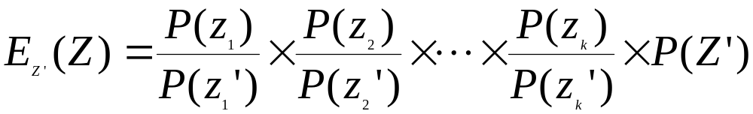
Interestingness Measure
{Refund = No, (Income = $51,250)} → {Cheat = No}
{Refund = No, (51K ≤ Income ≤ 52K)} → {Cheat = No}
{Refund = No, (50K ≤ Income ≤ 60K)} → {Cheat = No}
Given an itemset: Z = {z₁, z₂, …, z_{k}} and its generalization Z’ = {z₁’, z₂’, …, z_{k}’}
P(Z): support of Z
E_{Z’}(Z): expected support of Z based on Z’
  Z is R-interesting w.r.t. Z’ if P(Z) ≥ R × E_{Z’}(Z)

Slide 12
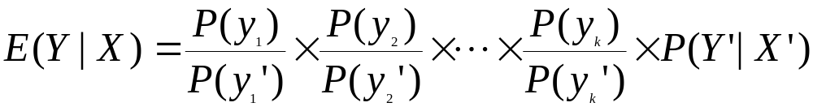
Interestingness Measure
For S: X → Y, and its generalization S’: X’ → Y’
P(Y|X): confidence of X → Y
P(Y’|X’): confidence of X’ → Y’
E_{S’}(Y|X): expected support of Z based on Z’
Rule S is R-interesting w.r.t its ancestor rule S’ if
  Support, P(S) ≥ R × E_{S’}(S) or
  Confidence, P(Y|X) ≥ R × E_{S’}(Y|X)

Slide 13
Statistics-based Methods
Example:
  Browser=Mozilla ∧ Buy=Yes → Age: μ=23
Rule consequent consists of a continuous variable, characterized by their statistics
  mean, median, standard deviation, etc.
Approach:
  Withhold the target variable from the rest of the data
  Apply existing frequent itemset generation on the rest of the data
  For each frequent itemset, compute the descriptive statistics for the corresponding target variable
    Frequent itemset becomes a rule by introducing the target variable as rule consequent
  Apply statistical test to determine interestingness of the rule

Slide 14
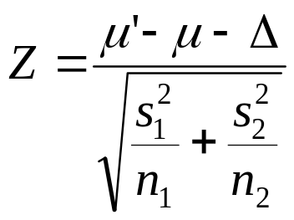
Statistics-based Methods
How to determine whether an association rule interesting?
  Compare the statistics for segment of population covered by the rule vs segment of population not covered by the rule:
    A ⇒ B: μ versus A ⇒ B: μ’
  Statistical hypothesis testing:
    Null hypothesis: H0: μ’ = μ + Δ
    Alternative hypothesis: H1: μ’ > μ + Δ
    Z has zero mean and variance 1 under null hypothesis

Slide 15
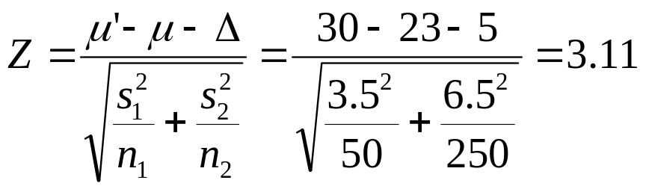
Statistics-based Methods
Example:
  r: Browser=Mozilla ∧ Buy=Yes → Age: μ=23
  Rule is interesting if difference between μ and μ’ is greater than 5 years (i.e., Δ = 5)
  For r, suppose n1 = 50, s1 = 3.5
  For r’ (complement): n2 = 250, s2 = 6.5
  For 1-sided test at 95% confidence level, critical Z-value for rejecting null hypothesis is 1.64.
  Since Z is greater than 1.64, r is an interesting rule

Slide 16
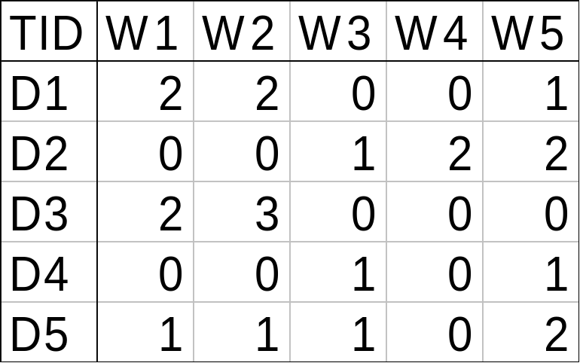
Min-Apriori (Han et al)
Document-term matrix:
Example:
W1 and W2 tends to appear together in the same document

Slide 17
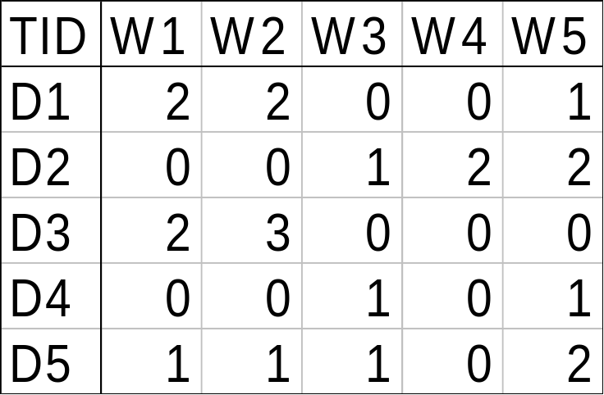
Min-Apriori
Data contains only continuous attributes of the same “type”
  e.g., frequency of words in a document
Potential solution:
  Convert into 0/1 matrix and then apply existing algorithms
    lose word frequency information
  Discretization does not apply as users want association among words not ranges of words

Slide 18
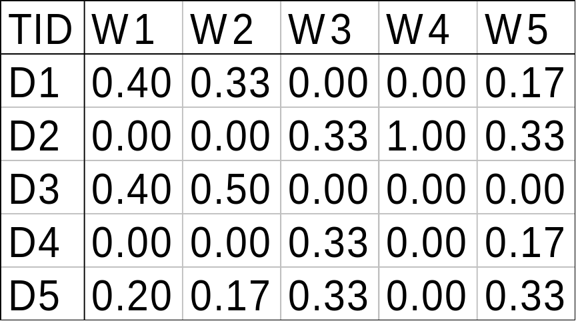
Min-Apriori
How to determine the support of a word?
  If we simply sum up its frequency, support count will be greater than total number of documents!
    Normalize the word vectors – e.g., using L₁ norm
    Each word has a support equals to 1.0
Normalize

Slide 19
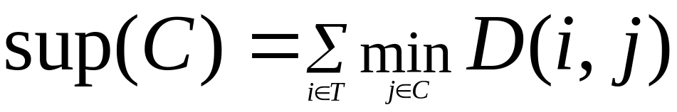
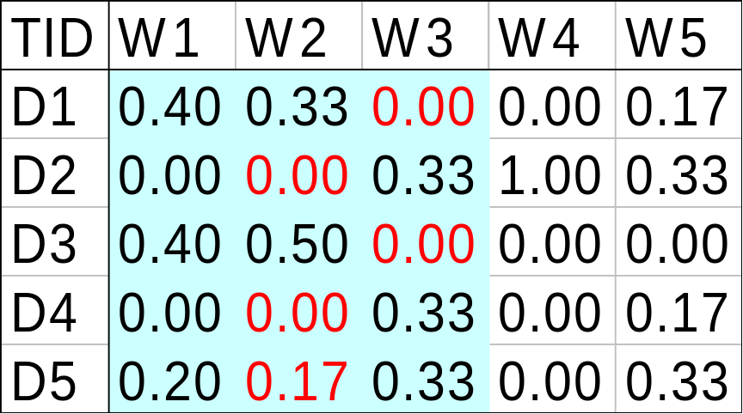
Min-Apriori
New definition of support:
Example:
Sup(W1,W2,W3)
= 0 + 0 + 0 + 0 + 0.17
= 0.17

Slide 20
Anti-monotone property of Support
Example:
Sup(W1) = 0.4 + 0 + 0.4 + 0 + 0.2 = 1
Sup(W1, W2) = 0.33 + 0 + 0.4 + 0 + 0.17 = 0.9
Sup(W1, W2, W3) = 0 + 0 + 0 + 0 + 0.17 = 0.17

Slide 21
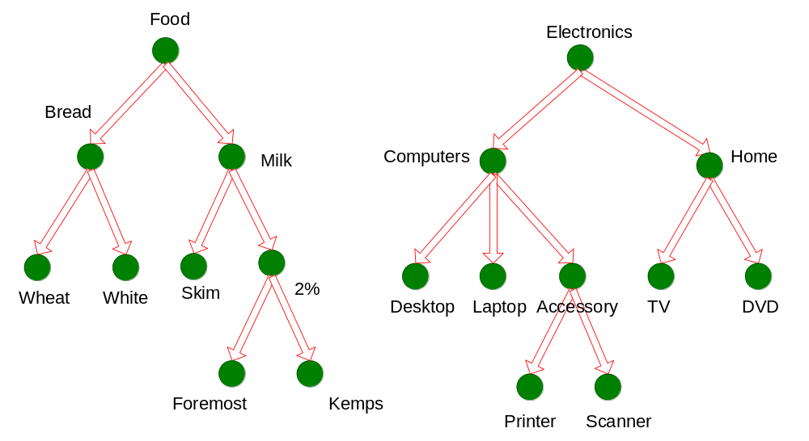
Multi-level Association Rules

Slide 22
Multi-level Association Rules
Why should we incorporate concept hierarchy?
  Rules at lower levels may not have enough support to appear in any frequent itemsets
  Rules at lower levels of the hierarchy are overly specific
    e.g., skim milk → white bread, 2% milk → wheat bread,
    skim milk → wheat bread, etc.
    are indicative of association between milk and bread

Slide 23
Multi-level Association Rules
How do support and confidence vary as we traverse the concept hierarchy?
  If X is the parent item for both X1 and X2, then
  σ(X) ≤ σ(X1) + σ(X2)
  If σ(X1 ∪ Y1) ≥ minsup,
  and X is parent of X1, Y is parent of Y1
  then σ(X ∪ Y1) ≥ minsup, σ(X1 ∪ Y) ≥ minsup
  σ(X ∪ Y) ≥ minsup
  If conf(X1 ⇒ Y1) ≥ minconf,
  then conf(X1 ⇒ Y) ≥ minconf

Slide 24
Multi-level Association Rules
Approach 1:
  Extend current association rule formulation by augmenting each transaction with higher level items
  Original Transaction: {skim milk, wheat bread}
  Augmented Transaction:
  {skim milk, wheat bread, milk, bread, food}
Issues:
  Items that reside at higher levels have much higher support counts
    if support threshold is low, too many frequent patterns involving items from the higher levels
  Increased dimensionality of the data

Slide 25
Multi-level Association Rules
Approach 2:
  Generate frequent patterns at highest level first
  Then, generate frequent patterns at the next highest level, and so on
Issues:
  I/O requirements will increase dramatically because we need to perform more passes over the data
  May miss some potentially interesting cross-level association patterns

Slide 26
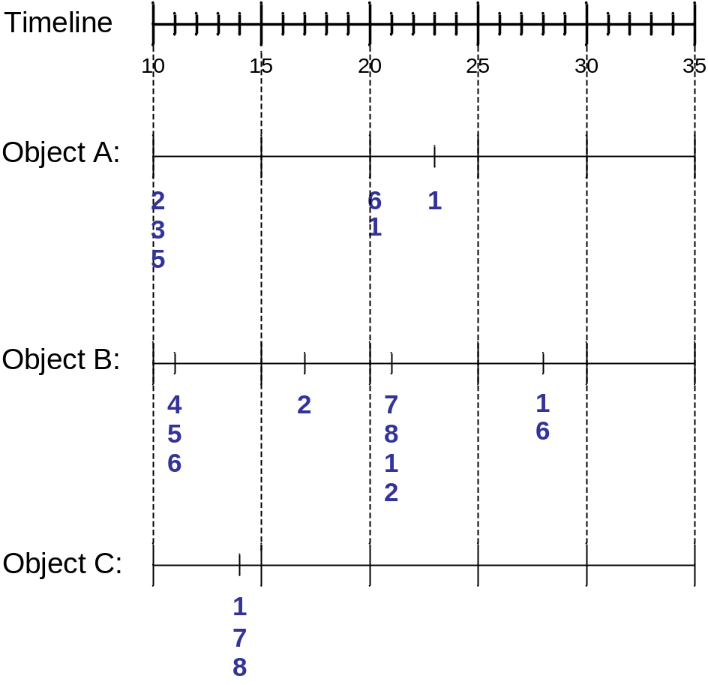
Sequence Data
Sequence Database:
Object
Timestamp
Events
A
10
2, 3, 5
A
20
6, 1
A
23
1
B
11
4, 5, 6
B
17
2
B
21
7, 8, 1, 2
B
28
1, 6
C
14
1, 8, 7

Slide 27
Examples of Sequence Data
Sequence Database | Sequence | Element (Transaction) | Event (Item)
Customer | Purchase history of a given customer | A set of items bought by a customer at time t | Books, diary products, CDs, etc
Web Data | Browsing activity of a particular Web visitor | A collection of files viewed by a Web visitor after a single mouse click | Home page, index page, contact info, etc
Event data | History of events generated by a given sensor | Events triggered by a sensor at time t | Types of alarms generated by sensors
Genome sequences | DNA sequence of a particular species | An element of the DNA sequence | Bases A,T,G,C
Element (Transaction)
Event
(Item)
E1
E2
E1
E3
E2
E2
E3
E4
Sequence

Slide 28
Formal Definition of a Sequence
A sequence is an ordered list of elements (transactions)
  s = < e₁ e₂ e₃ … >
  Each element contains a collection of events (items)
  e_{i} = {i₁, i₂, …, i_{k}}
  Each element is attributed to a specific time or location
Length of a sequence, |s|, is given by the number of elements of the sequence
A k-sequence is a sequence that contains k events (items)

Slide 29
Examples of Sequence
Web sequence:
  < {Homepage} {Electronics} {Digital Cameras} {Canon Digital Camera} {Shopping Cart} {Order Confirmation} {Return to Shopping} >
Sequence of initiating events causing the nuclear accident at 3-mile Island:
(http://stellar-one.com/nuclear/staff_reports/summary_SOE_the_initiating_event.htm)
  < {clogged resin} {outlet valve closure} {loss of feedwater}
  {condenser polisher outlet valve shut} {booster pumps trip}
  {main waterpump trips} {main turbine trips} {reactor pressure increases}>
Sequence of books checked out at a library:
  <{Fellowship of the Ring} {The Two Towers} {Return of the King}>

Slide 30
Formal Definition of a Subsequence
A sequence <a₁ a₂ … a_{n}> is contained in another sequence <b₁ b₂ … b_{m}> (m ≥ n) if there exist integers
i₁ < i₂ < … < i_{n} such that a₁ ⊆ b_{i1} , a₂ ⊆ b_{i1}, …, a_{n} ⊆ b_{in}
The support of a subsequence w is defined as the fraction of data sequences that contain w
A sequential pattern is a frequent subsequence (i.e., a subsequence whose support is ≥ minsup)
Data sequence | Subsequence | Contain?
< {2,4} {3,5,6} {8} > | < {2} {3,5} > | Yes
< {1,2} {3,4} > | < {1} {2} > | No
< {2,4} {2,4} {2,5} > | < {2} {4} > | Yes

Slide 31
Sequential Pattern Mining: Definition
Given:
  a database of sequences
  a user-specified minimum support threshold, minsup
Task:
  Find all subsequences with support ≥ minsup

Slide 32
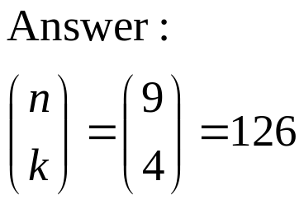
Sequential Pattern Mining: Challenge
Given a sequence: <{a b} {c d e} {f} {g h i}>
  Examples of subsequences:
    <{a} {c d} {f} {g} >, < {c d e} >, < {b} {g} >, etc.
How many k-subsequences can be extracted from a given n-sequence?
<{a b} {c d e} {f} {g h i}> n = 9
k=4: Y _ _ Y Y _ _ _ Y
<{a} {d e} {i}>

Slide 33
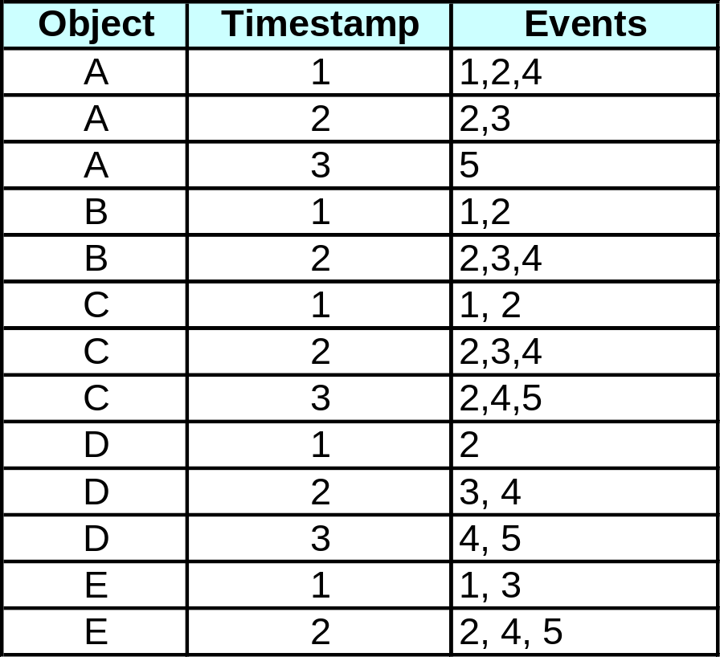
Sequential Pattern Mining: Example
Minsup = 50%
Examples of Frequent Subsequences:
< {1,2} > s=60%
< {2,3} > s=60%
< {2,4}> s=80%
< {3} {5}> s=80%
< {1} {2} > s=80%
< {2} {2} > s=60%
< {1} {2,3} > s=60%
< {2} {2,3} > s=60%
< {1,2} {2,3} > s=60%

Slide 34
Extracting Sequential Patterns
Given n events: i₁, i₂, i₃, …, i_{n}
Candidate 1-subsequences:
    <{i₁}>, <{i₂}>, <{i₃}>, …, <{i_{n}}>
Candidate 2-subsequences:
    <{i₁, i₂}>, <{i₁, i₃}>, …, <{i₁} {i₁}>, <{i₁} {i₂}>, …, <{i_{n-1}} {i_{n}}>
Candidate 3-subsequences:
    <{i₁, i₂ , i₃}>, <{i₁, i₂ , i₄}>, …, <{i₁, i₂} {i₁}>, <{i₁, i₂} {i₂}>, …,
    <{i₁} {i₁ , i₂}>, <{i₁} {i₁ , i₃}>, …, <{i₁} {i₁} {i₁}>, <{i₁} {i₁} {i₂}>, …

Slide 35
Generalized Sequential Pattern (GSP)
Step 1:
  Make the first pass over the sequence database D to yield all the 1-element frequent sequences
Step 2:
Repeat until no new frequent sequences are found
  Candidate Generation:
    Merge pairs of frequent subsequences found in the (k-1)th pass to generate candidate sequences that contain k items
  Candidate Pruning:
    Prune candidate k-sequences that contain infrequent (k-1)-subsequences
  Support Counting:
    Make a new pass over the sequence database D to find the support for these candidate sequences
  Candidate Elimination:
    Eliminate candidate k-sequences whose actual support is less than minsup

Slide 36
Candidate Generation
Base case (k=2):
  Merging two frequent 1-sequences <{i₁}> and <{i₂}> will produce two candidate 2-sequences: <{i₁} {i₂}> and <{i₁ i₂}>
General case (k>2):
  A frequent (k-1)-sequence w₁ is merged with another frequent
  (k-1)-sequence w₂ to produce a candidate k-sequence if the subsequence obtained by removing the first event in w₁ is the same as the subsequence obtained by removing the last event in w₂
    The resulting candidate after merging is given by the sequence w₁ extended with the last event of w₂.
      If the last two events in w₂ belong to the same element, then the last event in w₂ becomes part of the last element in w₁
      Otherwise, the last event in w₂ becomes a separate element appended to the end of w₁

Slide 37
Candidate Generation Examples
Merging the sequences
w₁=<{1} {2 3} {4}> and w₂ =<{2 3} {4 5}>
will produce the candidate sequence < {1} {2 3} {4 5}> because the last two events in w₂ (4 and 5) belong to the same element
Merging the sequences
w₁=<{1} {2 3} {4}> and w₂ =<{2 3} {4} {5}>
will produce the candidate sequence < {1} {2 3} {4} {5}> because the last two events in w₂ (4 and 5) do not belong to the same element
We do not have to merge the sequences
w₁ =<{1} {2 6} {4}> and w₂ =<{1} {2} {4 5}>
to produce the candidate < {1} {2 6} {4 5}> because if the latter is a viable candidate, then it can be obtained by merging w₁ with
< {1} {2 6} {5}>

Slide 38
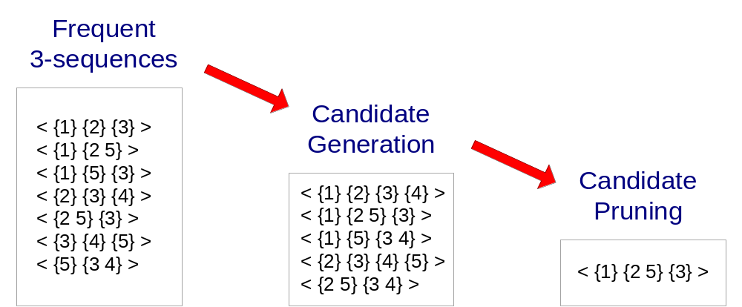
GSP Example

Slide 39
Timing Constraints (I)
{A B} {C} {D E}
x_{g}: max-gap
n_{g}: min-gap
m_{s}: maximum span
<= x_{g}
>n_{g}
<= m_{s}
x_{g} = 2, n_{g} = 0, m_{s}= 4
Data sequence | Subsequence | Contain?
< {2,4} {3,5,6} {4,7} {4,5} {8} > | < {6} {5} > | Yes
< {1} {2} {3} {4} {5}> | < {1} {4} > | No
< {1} {2,3} {3,4} {4,5}> | < {2} {3} {5} > | Yes
< {1,2} {3} {2,3} {3,4} {2,4} {4,5}> | < {1,2} {5} > | No

Slide 40
Mining Sequential Patterns with Timing Constraints
Approach 1:
  Mine sequential patterns without timing constraints
  Postprocess the discovered patterns
Approach 2:
  Modify GSP to directly prune candidates that violate timing constraints
  Question:
    Does Apriori principle still hold?

Slide 41
Apriori Principle for Sequence Data
Suppose:
x_{g} = 1 (max-gap)
n_{g} = 0 (min-gap)
m_{s} = 5 (maximum span)
minsup = 60%
<{2} {5}> support = 40%
but
<{2} {3} {5}> support = 60%
Problem exists because of max-gap constraint
No such problem if max-gap is infinite

Slide 42
Contiguous Subsequences
s is a contiguous subsequence of
w = <e₁>< e₂>…< e_{k}>
if any of the following conditions hold:
  s is obtained from w by deleting an item from either e₁ or e_{k}
  s is obtained from w by deleting an item from any element e_{i} that contains more than 2 items
  s is a contiguous subsequence of s’ and s’ is a contiguous subsequence of w (recursive definition)
Examples: s = < {1} {2} >
  is a contiguous subsequence of
  < {1} {2 3}>, < {1 2} {2} {3}>, and < {3 4} {1 2} {2 3} {4} >
  is not a contiguous subsequence of
  < {1} {3} {2}> and < {2} {1} {3} {2}>

Slide 43
Modified Candidate Pruning Step
Without maxgap constraint:
  A candidate k-sequence is pruned if at least one of its (k-1)-subsequences is infrequent
With maxgap constraint:
  A candidate k-sequence is pruned if at least one of its contiguous (k-1)-subsequences is infrequent

Slide 44
Timing Constraints (II)
x_{g}: max-gap
n_{g}: min-gap
ws: window size
m_{s}: maximum span
{A B} {C} {D E}
<= x_{g}
>n_{g}
<= ws
<= m_{s}
x_{g} = 2, n_{g} = 0, ws = 1, m_{s}= 5
Data sequence | Subsequence | Contain?
< {2,4} {3,5,6} {4,7} {4,6} {8} > | < {3} {5} > | No
< {1} {2} {3} {4} {5}> | < {1,2} {3} > | Yes
< {1,2} {2,3} {3,4} {4,5}> | < {1,2} {3,4} > | Yes

Slide 45
Modified Support Counting Step
Given a candidate pattern: <{a, c}>
  Any data sequences that contain
  <… {a c} … >,
  <… {a} … {c}…> ( where time({c}) – time({a}) ≤ ws)
  <…{c} … {a} …> (where time({a}) – time({c}) ≤ ws)
  will contribute to the support count of candidate pattern

Slide 46
Other Formulation
In some domains, we may have only one very long time series
  Example:
    monitoring network traffic events for attacks
    monitoring telecommunication alarm signals
Goal is to find frequent sequences of events in the time series
  This problem is also known as frequent episode mining
E1
E2
E3
E4
E1
E2
E1
E2
E2 E4
E3 E5
E1
E2
E2
E3 E5
E1
E2
E3 E4
E3 E1
Pattern: <E1> <E3>

Slide 47
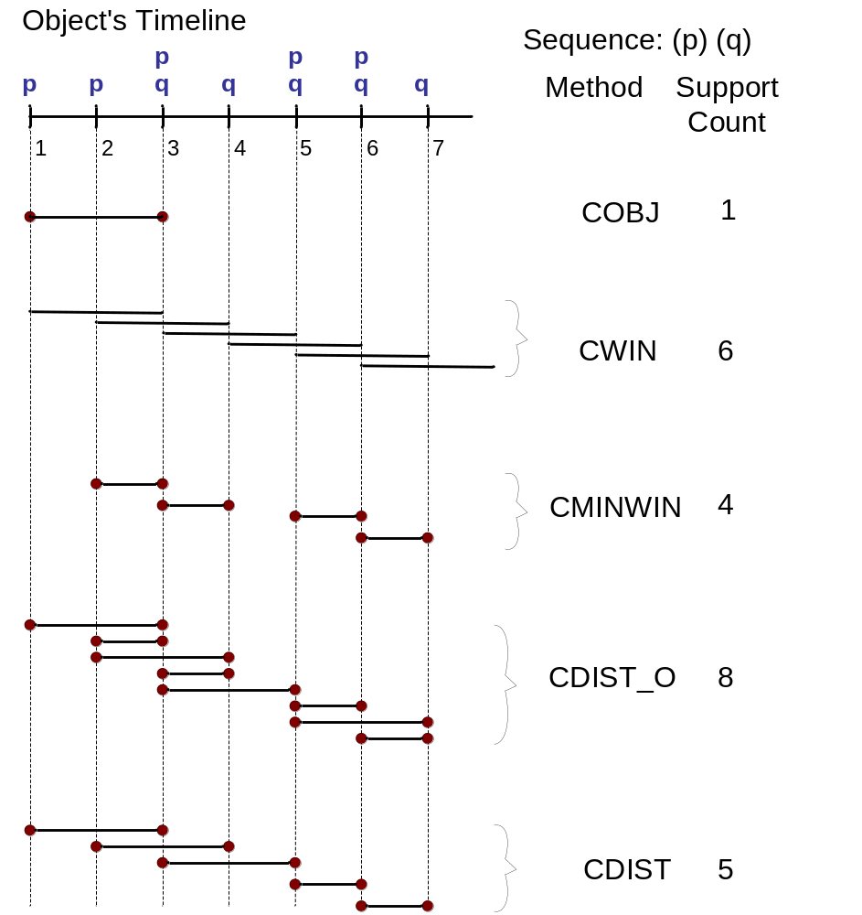
General Support Counting Schemes
Assume:
x_{g} = 2 (max-gap)
n_{g} = 0 (min-gap)
ws = 0 (window size)
m_{s} = 2 (maximum span)

Slide 48
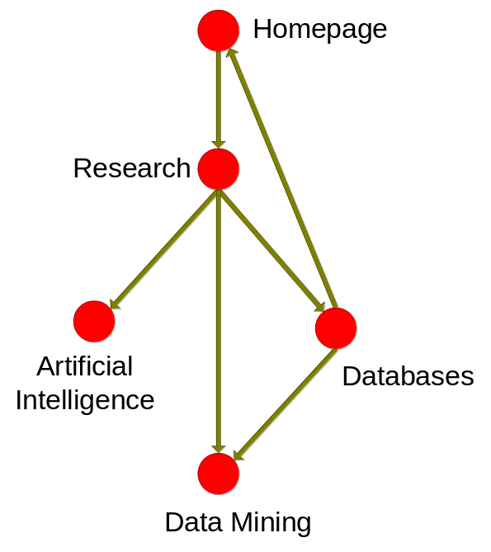
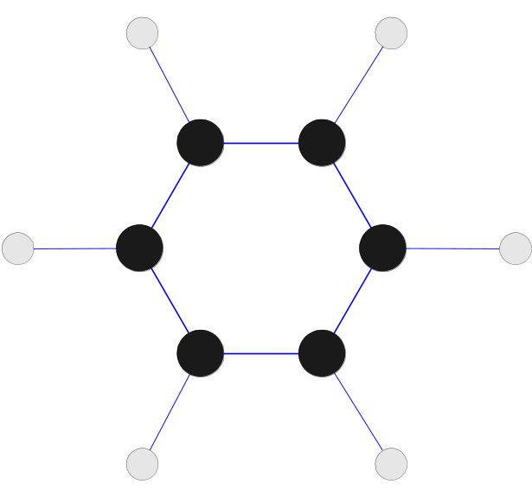
Frequent Subgraph Mining
Extend association rule mining to finding frequent subgraphs
Useful for Web Mining, computational chemistry, bioinformatics, spatial data sets, etc

Slide 49
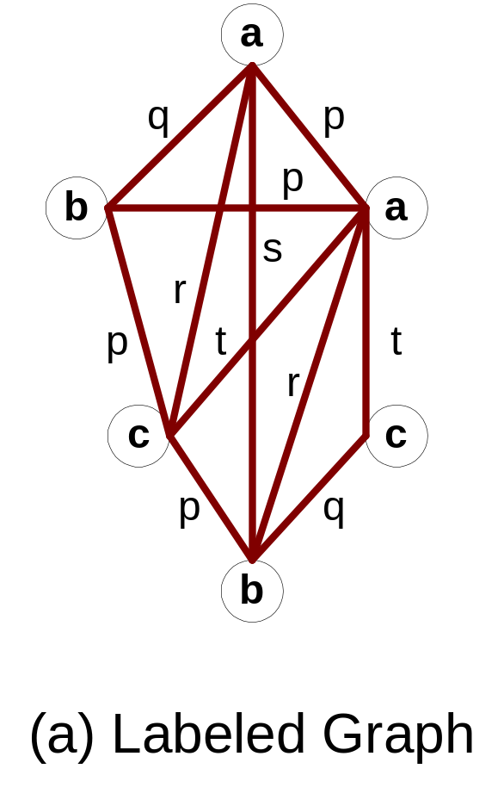
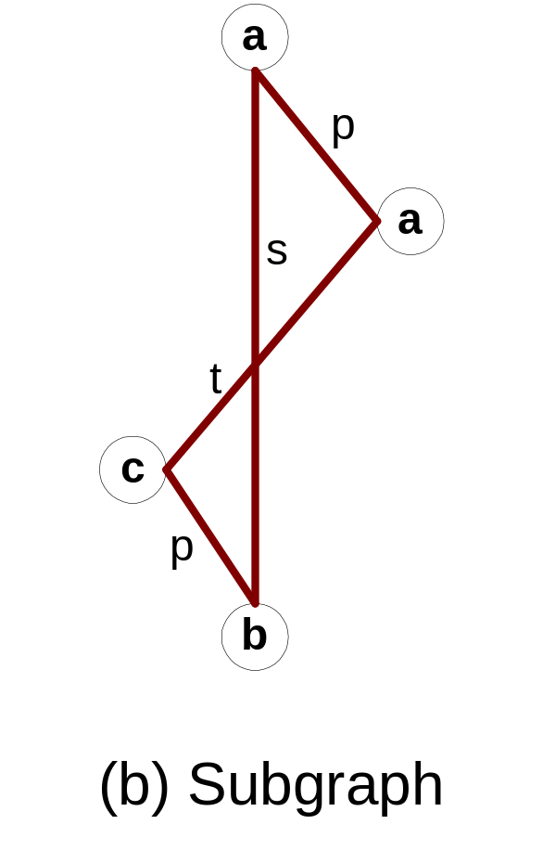
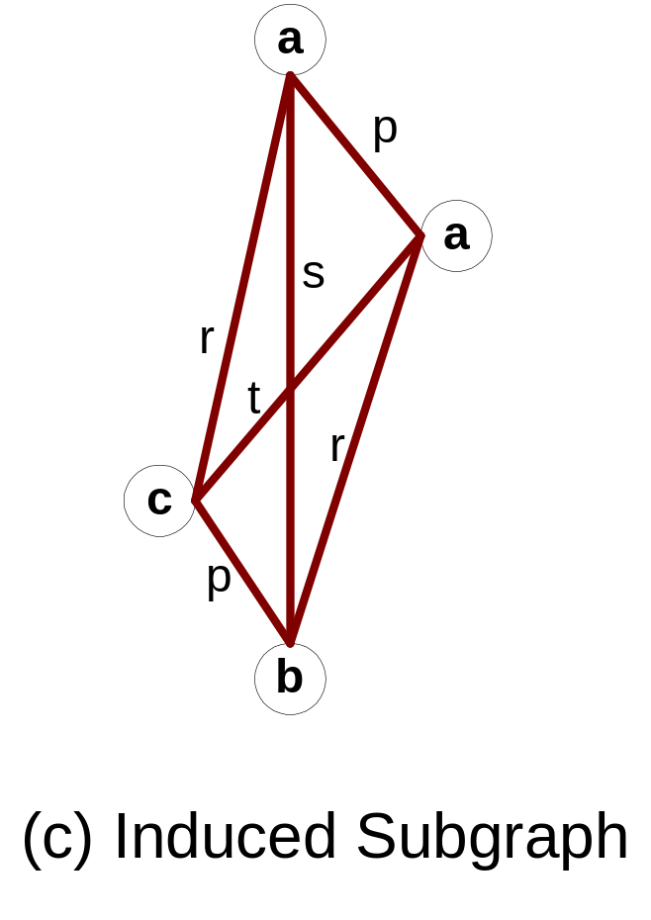
Graph Definitions

Slide 50
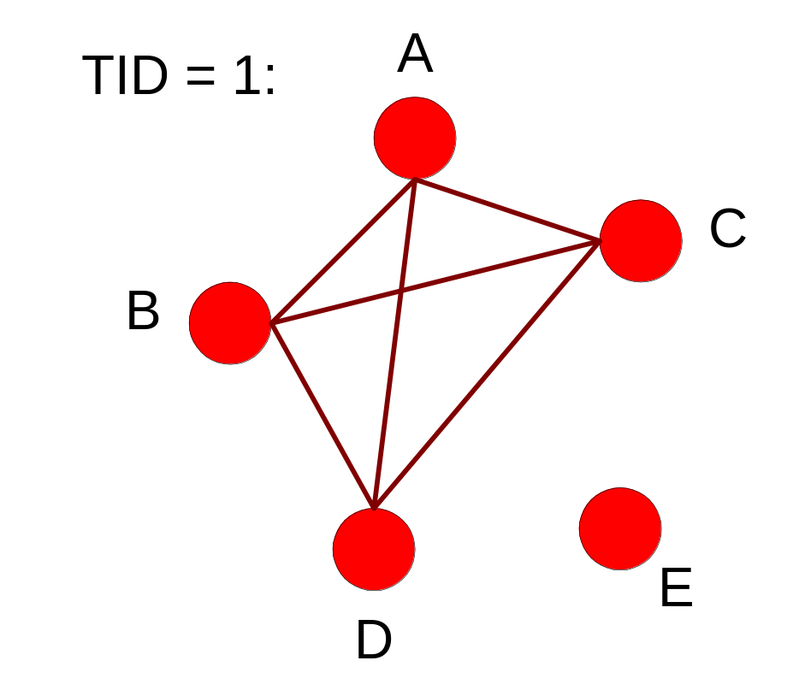
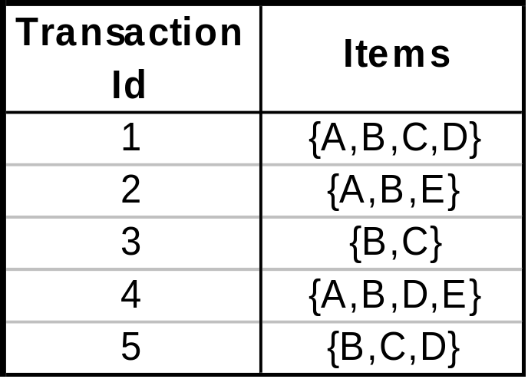
Representing Transactions as Graphs
Each transaction is a clique of items

Slide 51
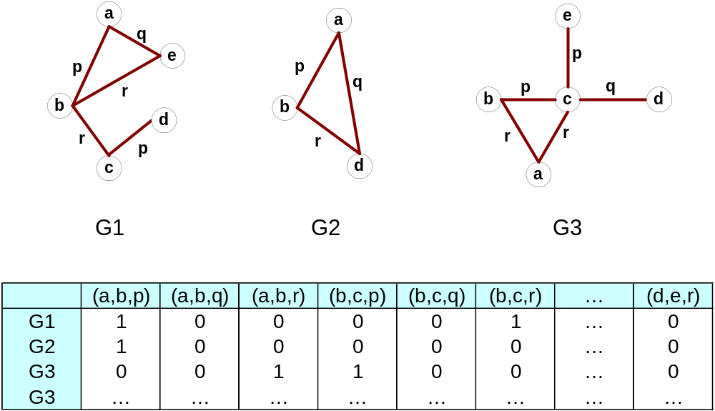
Representing Graphs as Transactions

Slide 52
Challenges
Node may contain duplicate labels
Support and confidence
  How to define them?
Additional constraints imposed by pattern structure
  Support and confidence are not the only constraints
  Assumption: frequent subgraphs must be connected
Apriori-like approach:
  Use frequent k-subgraphs to generate frequent (k+1) subgraphs
    What is k?

Slide 53
Challenges…
Support:
  number of graphs that contain a particular subgraph
Apriori principle still holds
Level-wise (Apriori-like) approach:
  Vertex growing:
    k is the number of vertices
  Edge growing:
    k is the number of edges

Slide 54
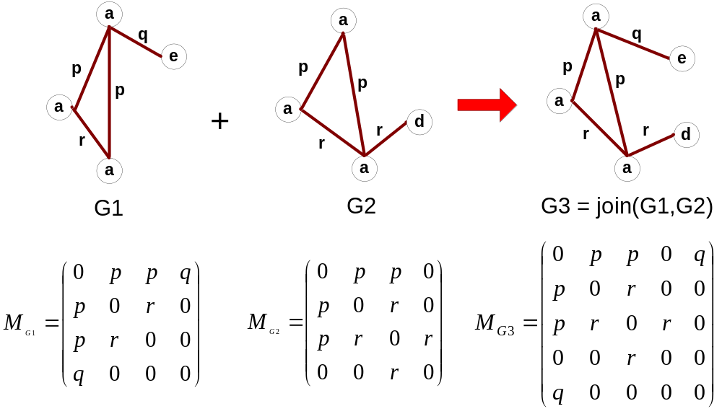
Vertex Growing

Slide 55
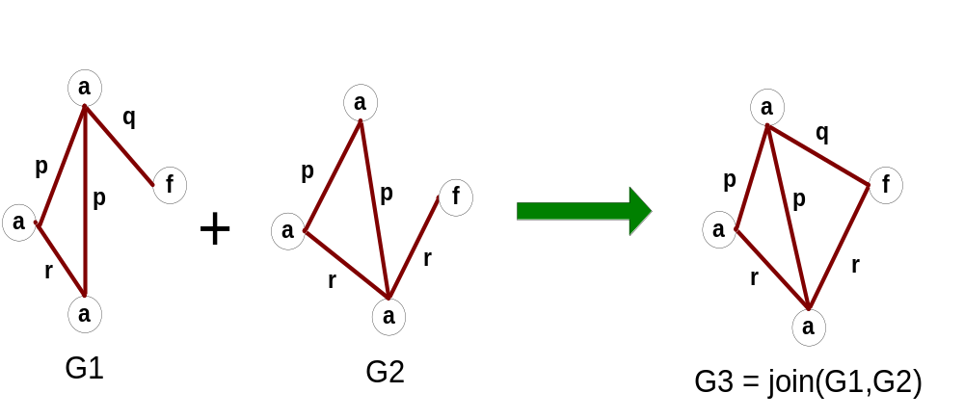
Edge Growing

Slide 56
Apriori-like Algorithm
Find frequent 1-subgraphs
Repeat
  Candidate generation
    Use frequent (k-1)-subgraphs to generate candidate k-subgraph
  Candidate pruning
    Prune candidate subgraphs that contain infrequent
    (k-1)-subgraphs
  Support counting
    Count the support of each remaining candidate
  Eliminate candidate k-subgraphs that are infrequent
In practice, it is not as easy. There are many other issues

Slide 57
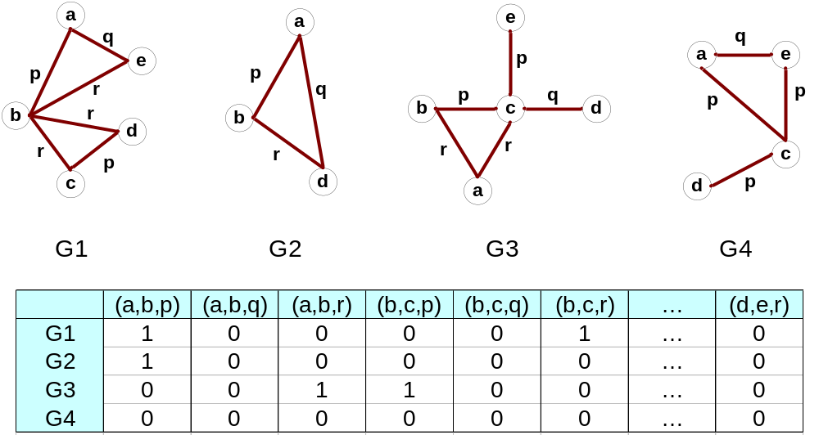
Example: Dataset

Slide 58
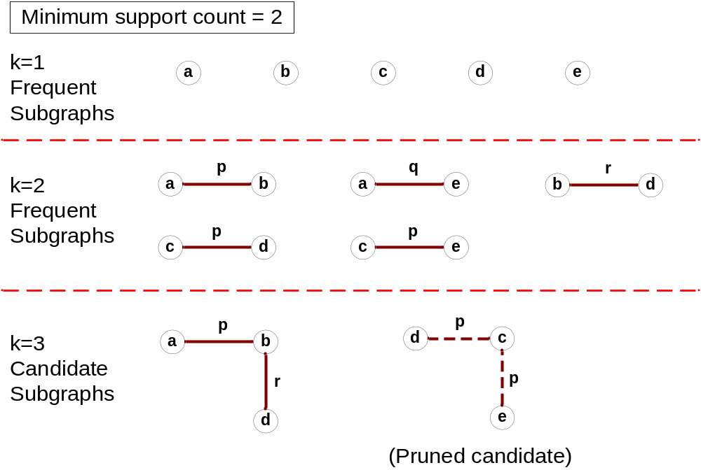
Example

Slide 59
Candidate Generation
In Apriori:
  Merging two frequent k-itemsets will produce a candidate (k+1)-itemset
In frequent subgraph mining (vertex/edge growing)
  Merging two frequent k-subgraphs may produce more than one candidate (k+1)-subgraph

Slide 60
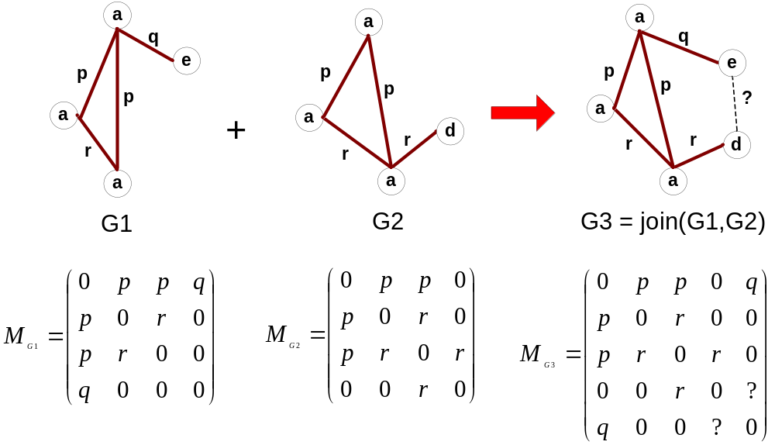
Multiplicity of Candidates (Vertex Growing)

Slide 61
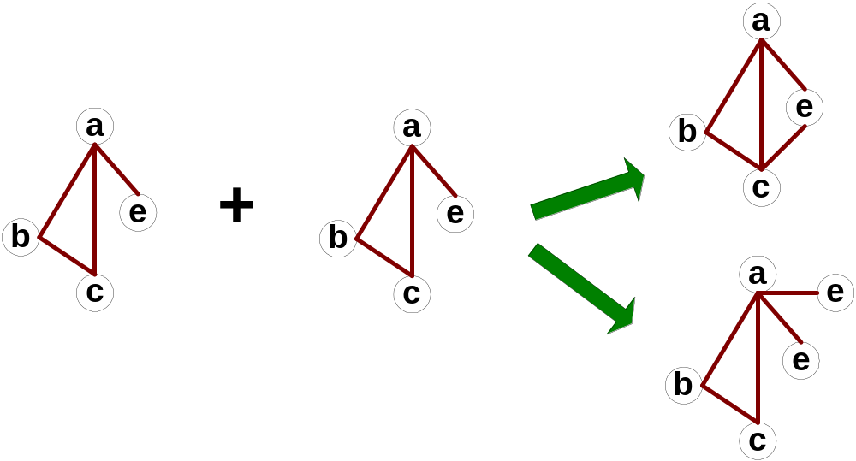
Multiplicity of Candidates (Edge growing)
Case 1: identical vertex labels

Slide 62
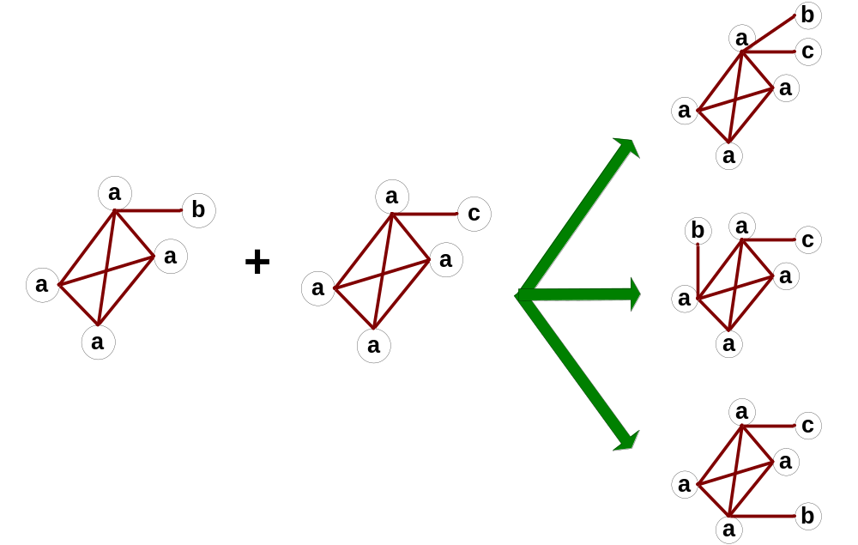
Multiplicity of Candidates (Edge growing)
Case 2: Core contains identical labels
Core: The (k-1) subgraph that is common
between the joint graphs

Slide 63
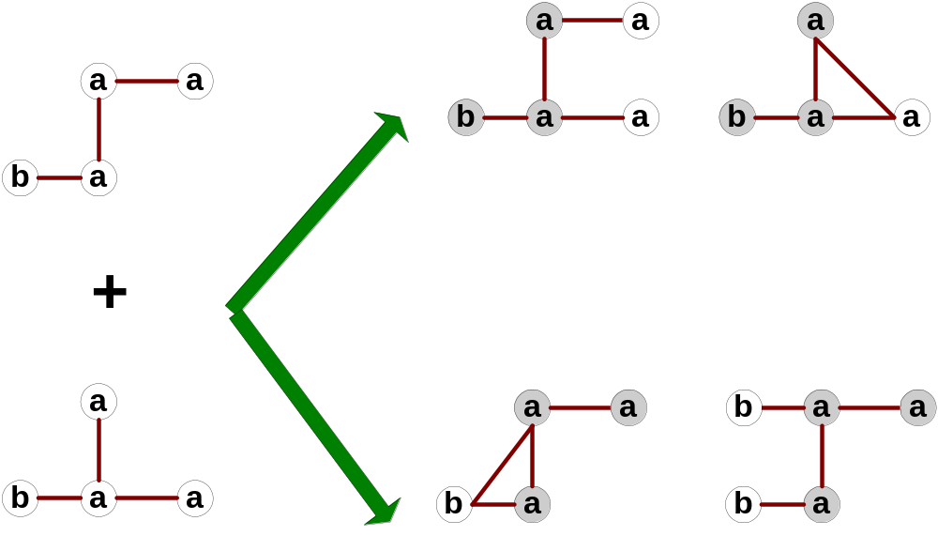
Multiplicity of Candidates (Edge growing)
Case 3: Core multiplicity

Slide 64
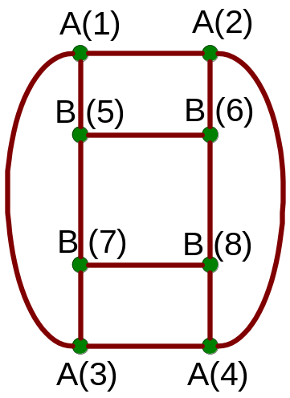
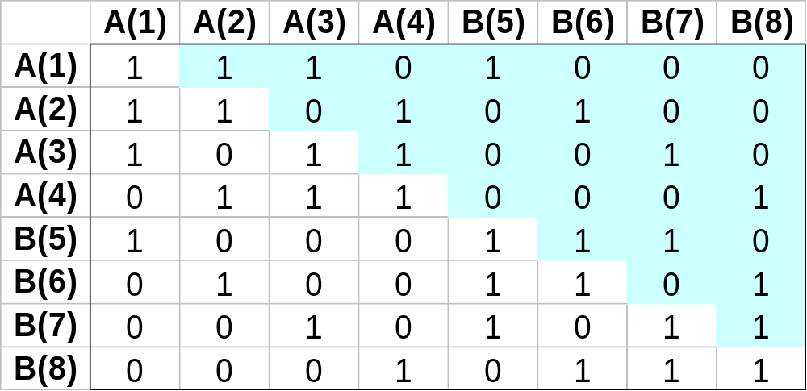
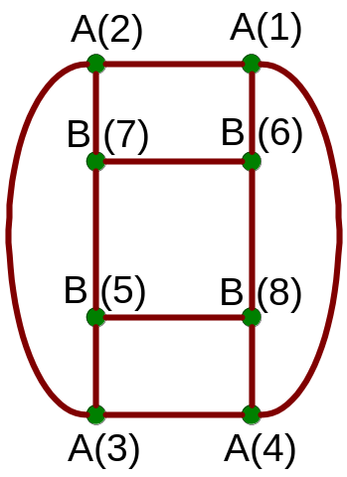
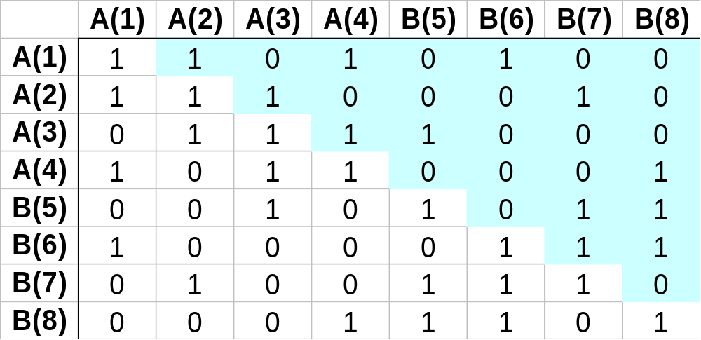
Adjacency Matrix Representation
The same graph can be represented in many ways

Slide 65
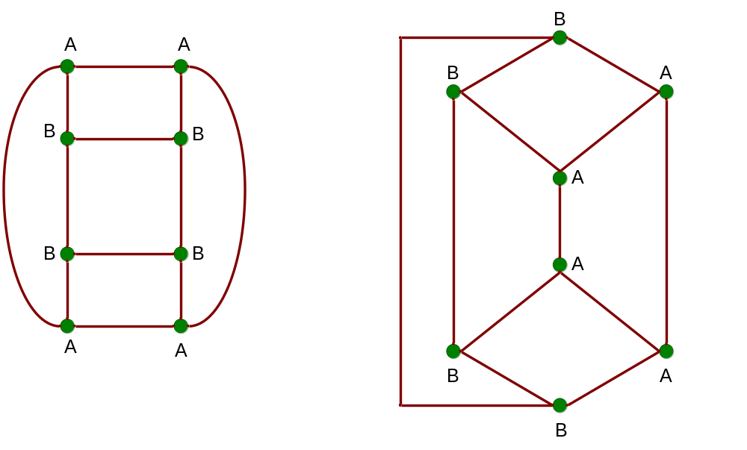
Graph Isomorphism
A graph is isomorphic if it is topologically equivalent to another graph

Slide 66
Graph Isomorphism
Test for graph isomorphism is needed:
  During candidate generation step, to determine whether a candidate has been generated
  During candidate pruning step, to check whether its
  (k-1)-subgraphs are frequent
  During candidate counting, to check whether a candidate is contained within another graph

Slide 67
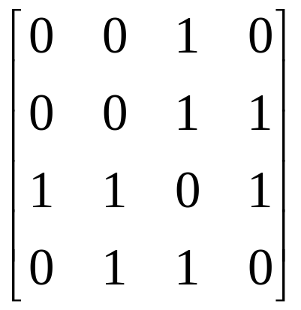
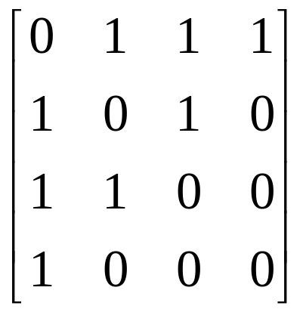
Graph Isomorphism
Use canonical labeling to handle isomorphism
  Map each graph into an ordered string representation (known as its code) such that two isomorphic graphs will be mapped to the same canonical encoding
  Example:
    Lexicographically largest adjacency matrix
String: 0010001111010110
Canonical: 0111101011001000

