Slide 1
Working with Data Data Summarization

Slide 2
Learning Objectives
Why do we need to preprocess data?
Descriptive data summarization

Slide 3
Learning Objectives
Understand motivations for cleaning the data
Understand how to summarize the data

Slide 4
Why Data Preprocessing?
Data mining aims at discovering relationships and other forms of knowledge from data in the real world.
Data map entities in the application domain to symbolic representation through a measurement function.
Data in the real world is dirty
incomplete: missing data, lacking attribute values, lacking certain attributes of interest, or containing only aggregate data
noisy: containing errors, such as measurement errors, or outliers
inconsistent: containing discrepancies in codes or names
distorted: sampling distortion
No quality data, no quality mining results! (GIGO)
Quality decisions must be based on quality data
Data warehouse needs consistent integration of quality data

Slide 5
Multi-Dimensional Measure of Data Quality
Data quality is multidimensional:
Accuracy
Preciseness (=reliability)
Completeness
Consistency
Timeliness
Believability (=validity)
Value added
Interpretability
Accessibility
Broad categories:
intrinsic, contextual, representational, and accessibility.

Slide 6
Major Tasks in Data Preprocessing
Data cleaning
Fill in missing values, smooth noisy data, identify or remove outliers, and resolve inconsistencies and errors
Data integration
Integration of multiple databases, data cubes, or files
Data transformation
Normalization and aggregation
Data reduction
Obtains reduced representation in volume but produces the same or similar analytical results
Data discretization
Part of data reduction but with particular importance, especially for numerical data

Slide 7
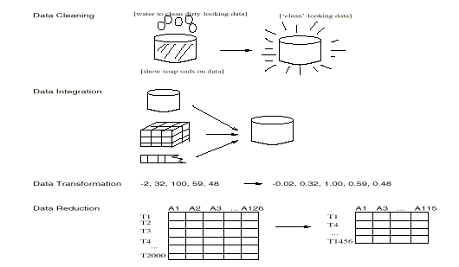
Forms of data preprocessing
from Han & Kamber

Slide 8
Learning Objectives
Understand motivations for cleaning the data
Understand how to summarize the data

Slide 9
Mining Data Descriptive Characteristics
Motivation
To better understand the data: central tendency, variation and spread
Data dispersion characteristics
median, max, min, quantiles, outliers, variance, etc.
Numerical dimensions correspond to sorted intervals
Data dispersion: analyzed with multiple granularities of precision
Boxplot or quantile analysis on sorted intervals
Dispersion analysis on computed measures
Folding measures into numerical dimensions
Boxplot or quantile analysis on the transformed cube

Slide 10
Measuring the Central Tendency
Mean (algebraic measure) (sample vs. population):
Weighted arithmetic mean:
Trimmed mean: chopping extreme values
Median: A holistic measure
Middle value if odd number of values, or average of the middle two values otherwise
Estimated by interpolation (for grouped data):
Mode
Value that occurs most frequently in the data
Unimodal, bimodal, trimodal
Empirical formula:

Slide 11
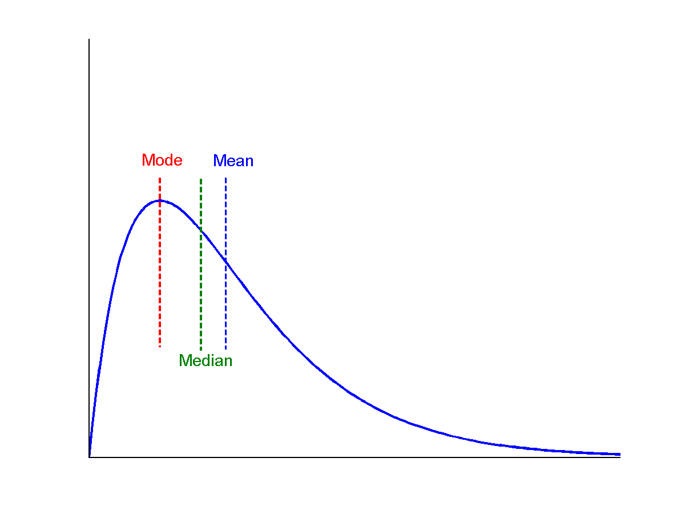
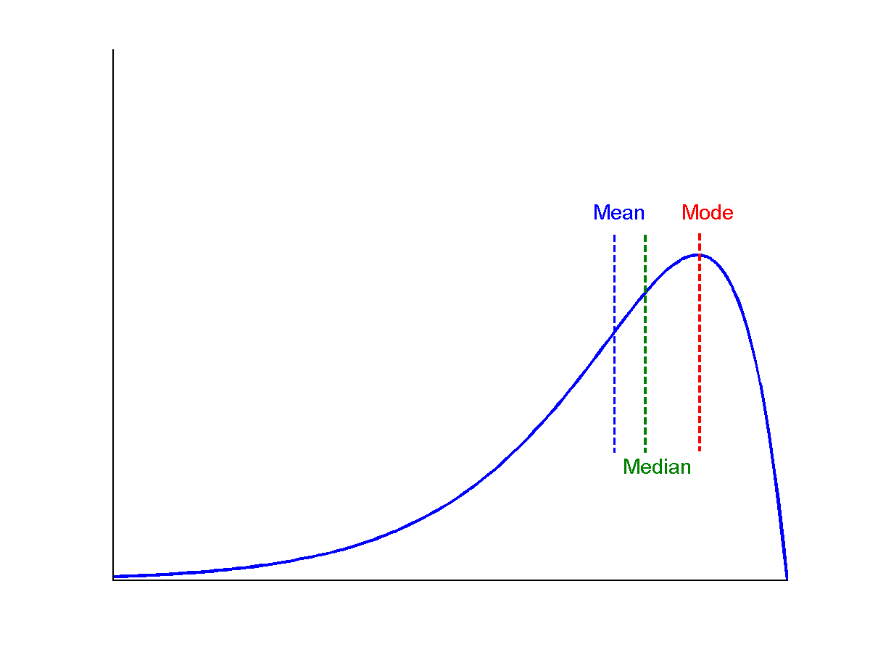
Symmetric vs. Skewed Data
Median, mean and mode of symmetric, positively and negatively skewed data
symmetric
positively skewed
negatively skewed
from Han & Kamber

Slide 12
Measuring the Dispersion of Data
Quartiles, outliers and boxplots
Quartiles: Q₁ (25th percentile), Q₃ (75th percentile)
Inter-quartile range: IQR = Q₃ – Q₁
Five number summary: min, Q₁, M, Q₃, max
Boxplot: ends of the box are the quartiles, median is marked, whiskers, and plot outlier individually
Outlier: usually, a value higher/lower than 1.5 x IQR
Variance and standard deviation (sample: s, population: σ)
Variance: (algebraic, scalable computation)
Standard deviation s (or σ) is the square root of variance s² ⁽or σ²⁾

Slide 13
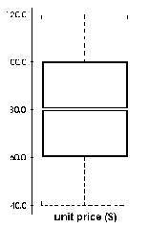
Boxplot Analysis
Five-number summary of a distribution:
Minimum, Q1, M, Q3, Maximum
Boxplot
Data is represented with a box
The ends of the box are at the first and third quartiles, i.e., the height of the box is IQR
The median is marked by a line within the box
Whiskers: two lines outside the box extend to Minimum and Maximum

Slide 14
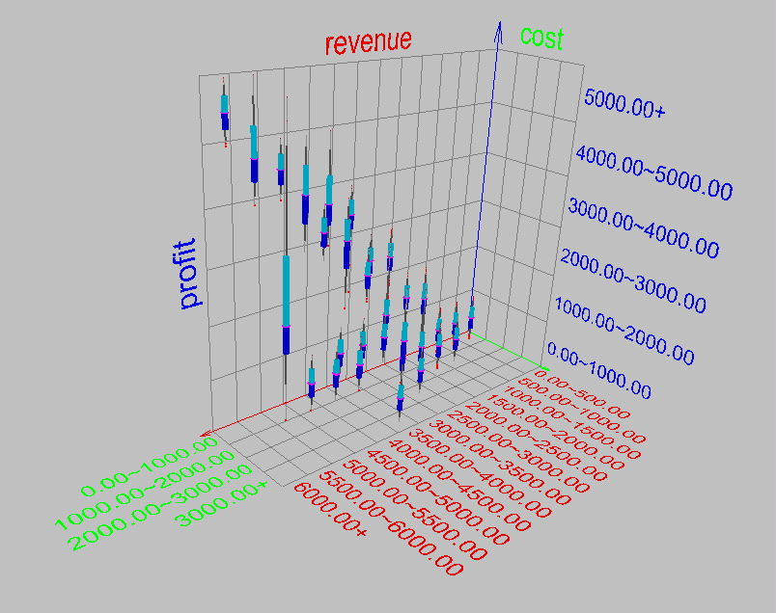
Visualization of Data Dispersion: 3-D Boxplots

Slide 15
Properties of Normal Distribution Curve
The normal (distribution) curve
From μ–σ to μ+σ: contains about 68% of the measurements (μ: mean, σ: standard deviation)
From μ–2σ to μ+2σ: contains about 95% of it
From μ–3σ to μ+3σ: contains about 99.7% of it

Slide 16
Graphic Displays of Basic Statistical Descriptions
Boxplot: graphic display of five-number summary
Histogram: x-axis are values, y-axis repres. frequencies
Quantile plot: each value x_{i} is paired with f_{i} indicating that approximately 100 f_{i} % of data are ≤ x_{i}
Quantile-quantile (q-q) plot: graphs the quantiles of one univariant distribution against the corresponding quantiles of another
Scatter plot: each pair of values is a pair of coordinates and plotted as points in the plane
Loess (local regression) curve: add a smooth curve to a scatter plot to provide better perception of the pattern of dependence

Slide 17
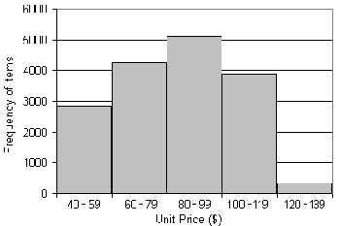
Histogram Analysis
Graph displays of basic statistical class descriptions
Frequency histograms
A univariate graphical method
Consists of a set of rectangles that reflect the counts or frequencies of the classes present in the given data

Slide 18
Histograms Often Tells More than Boxplots
The two histograms shown in the left may have the same boxplot representation
The same values for: min, Q1, median, Q3, max
But they have rather different data distributions

Slide 19
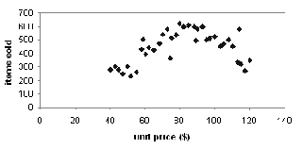
Scatter plot
Provides a first look at bivariate data to see clusters of points, outliers, etc
Each pair of values is treated as a pair of coordinates and plotted as points in the plane

Slide 20
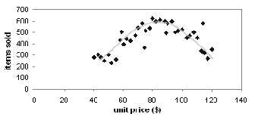
Loess Curve
Adds a smooth curve to a scatter plot in order to provide better perception of the pattern of dependence
Loess curve is fitted by setting two parameters: a smoothing parameter, and the degree of the polynomials that are fitted by the regression

Slide 21
Positively and Negatively Correlated Data
The left half fragment is positively correlated
The right half is negative correlated

Slide 22
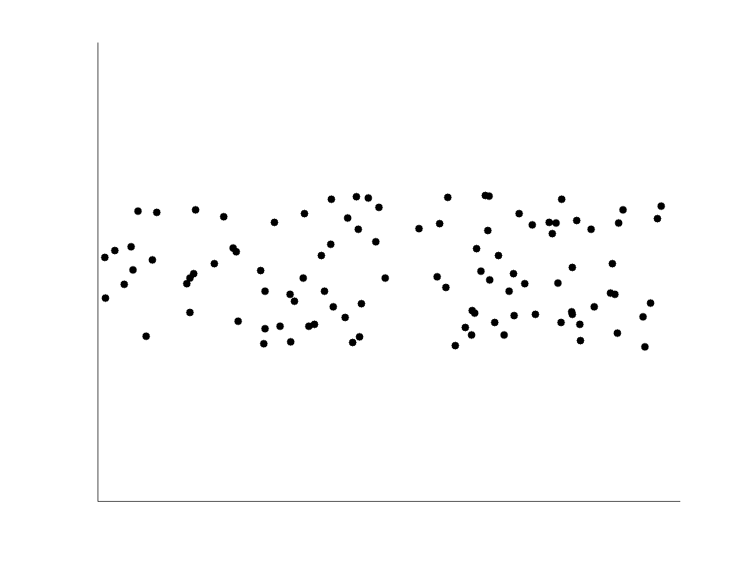
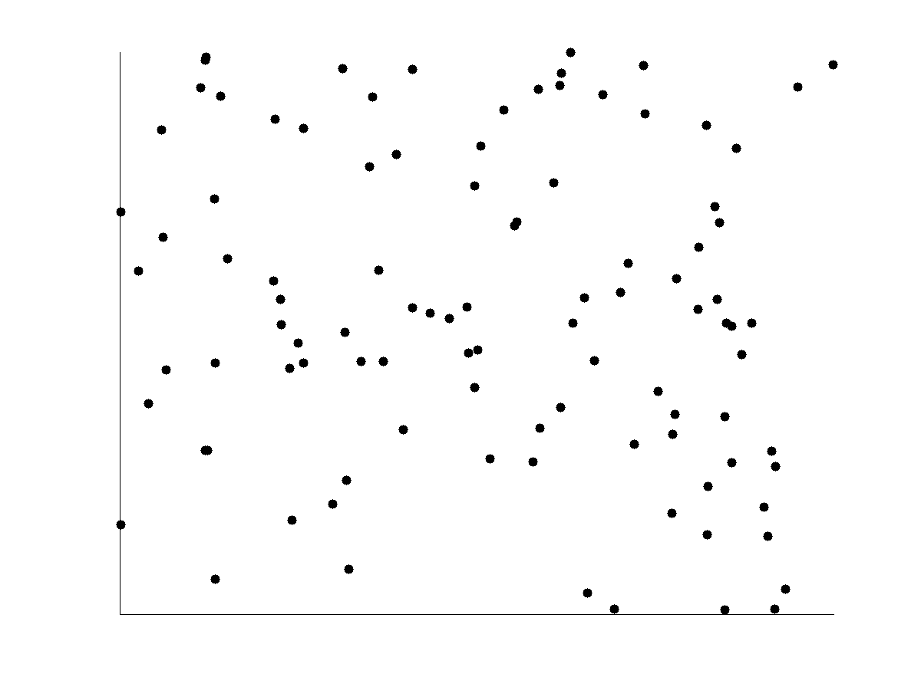
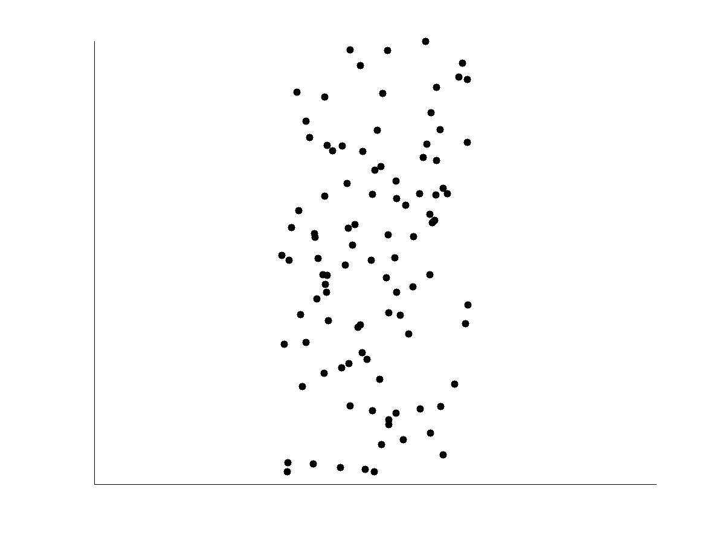
Not Correlated Data

Slide 23
Data Visualization and Its Methods
Why data visualization?
Gain insight into an information space by mapping data onto graphical primitives
Provide qualitative overview of large data sets
Search for patterns, trends, structure, irregularities, relationships among data
Help find interesting regions and suitable parameters for further quantitative analysis
Provide a visual proof of computer representations derived
Typical visualization methods:
Geometric techniques
Icon-based techniques
Hierarchical techniques

Slide 24
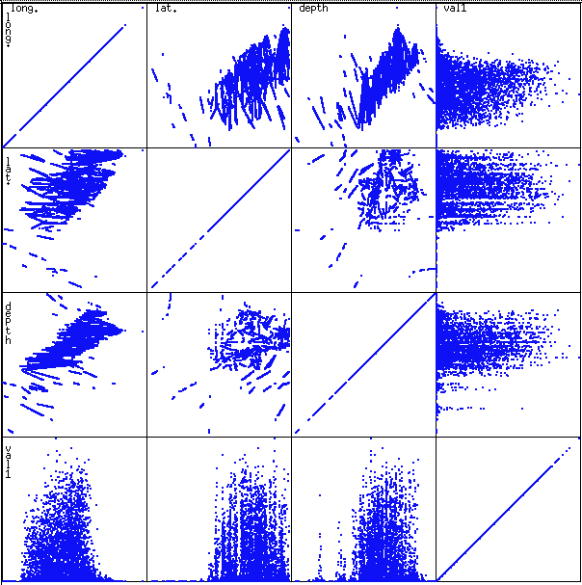
Scatterplot Matrices
Used by ermission of M. Ward, Worcester Polytechnic Institute
Matrix of scatterplots (x-y-diagrams) of the k-dim. data [total of (k2/2-k) scatterplots]

Slide 25
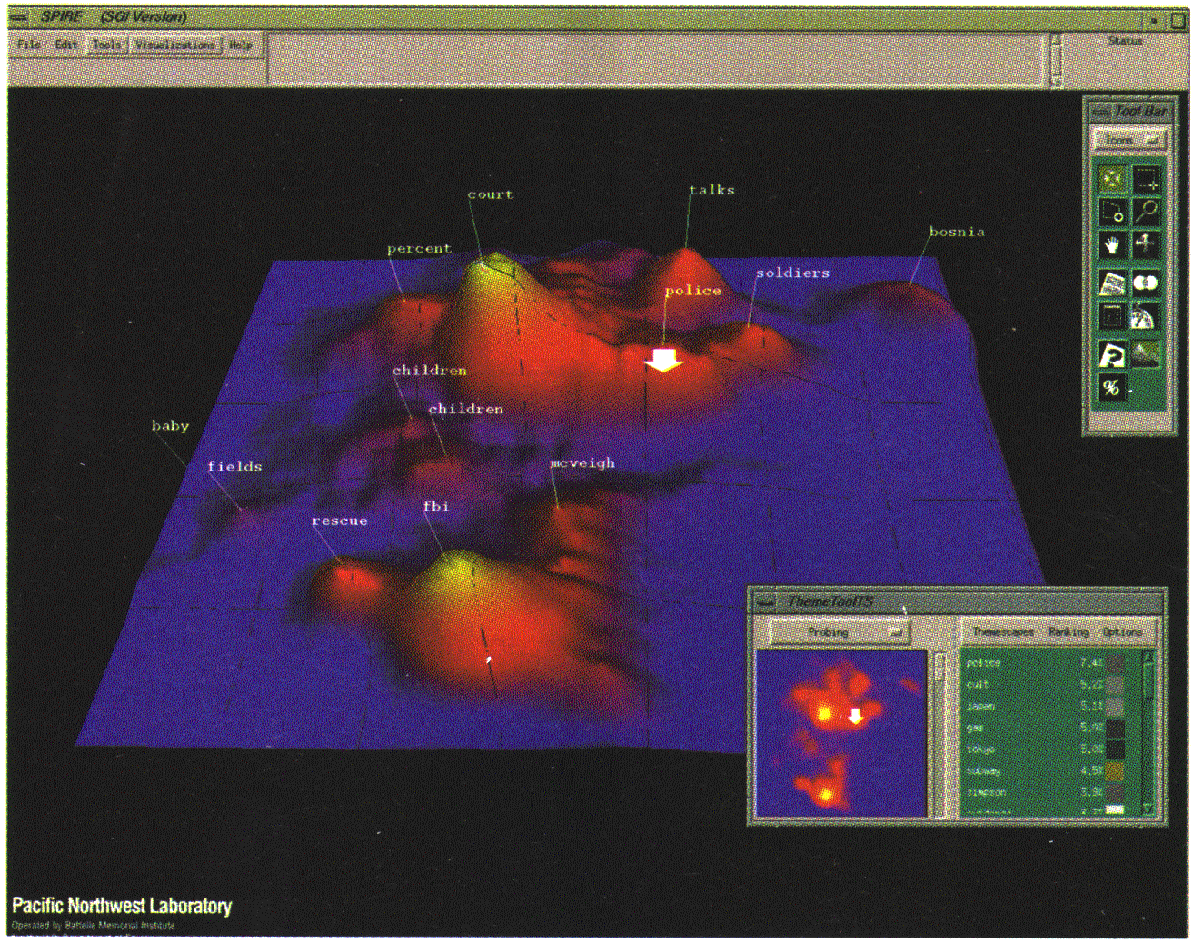
Landscapes
news articles visualized as a landscape
Used by permission of B. Wright, Visible Decisions Inc.
Visualization of the data as perspective landscape
The data needs to be transformed into a (possibly artificial) 2D spatial representation which preserves the characteristics of the data

Slide 26
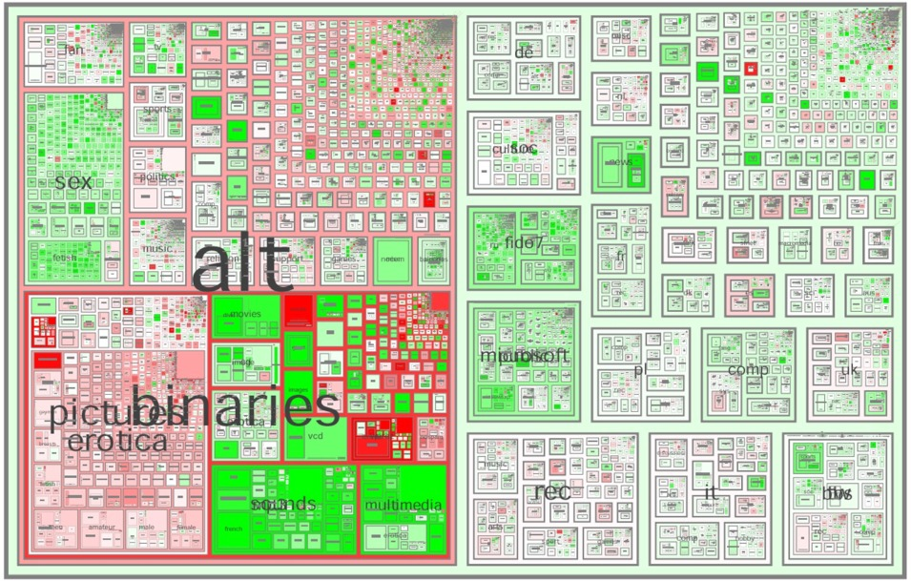
Tree-Map
Screen-filling method which uses a hierarchical partitioning of the screen into regions depending on the attribute values
The x- and y-dimension of the screen are partitioned alternately according to the attribute values (classes)
MSR Netscan Image
from Han & Kamber
Notes:
Picture: http://www.cs.umd.edu/hcil/treemap-history/all102001.jpg

Slide 27
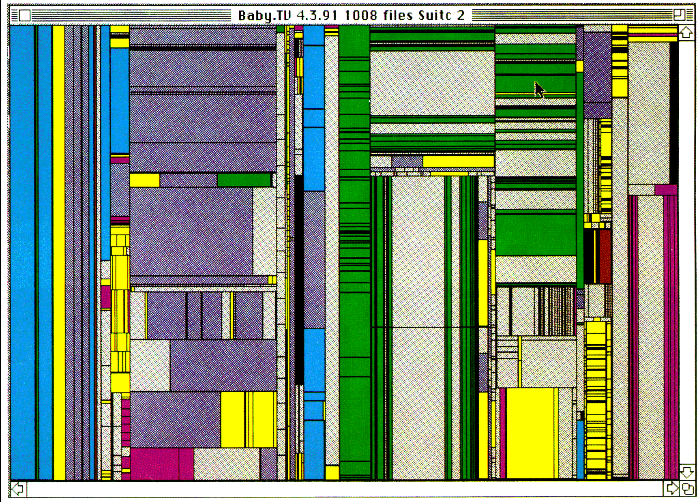
Tree-Map of a File System (Schneiderman)

Slide 28
Summary
Data preparation/preprocessing: A big issue for data analysis and data mining
Data description, data exploration, and summarization set the base for quality data preprocessing
Data preparation includes
Data cleaning
Data integration and data transformation
Data reduction (dimensionality and numerosity reduction)
A lot a methods have been developed but data preprocessing still an active area of research

