Slide 1
Assessing Normality and Data Transformations

Slide 2
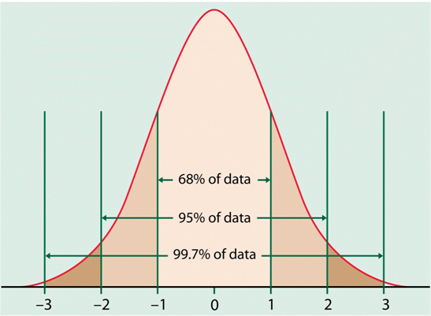
Role of Normality
Many statistical methods require that the numeric variables we are working with have an approximate normal distribution.
For example, t-tests, F-tests, and regression analyses all require in some sense that the numeric variables are approximately normally distributed.
Standardized normal distribution with empirical rule percentages.

Slide 3
Tools for Assessing Normality
Histogram and Boxplot
Normal Quantile Plot
(also called Normal Probability Plot)
Goodness of Fit Tests
Shapiro-Wilk Test (JMP)
Kolmogorov-Smirnov Test (SPSS)
Anderson-Darling Test (MINITAB)

Slide 4
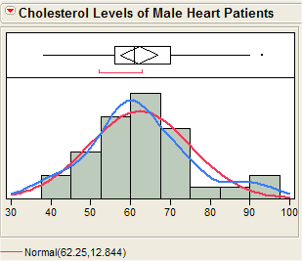
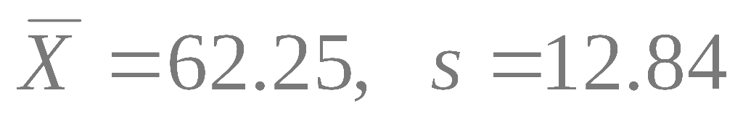
Histograms and Boxplots
The cholesterol levels of the patients appear to be approximately normal, although there is some evidence of right skewness as the mean is larger than the median.
The red curve represents a normal distribution fit to these data and the blue curve the density estimate for these data, these curves should agree if our data is normally distributed.

Slide 5
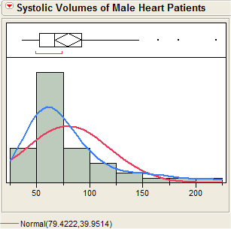
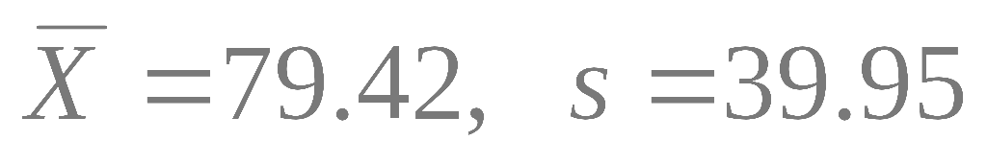
Histograms and Boxplots
The systolic volumes of the male heart patients in this study suggest that they come from a right skewed population distribution.
The red curve represents a normal distribution fit to these data and the blue is the estimated density from the data which does not agree with the imposed normal.
Outliers are not consistent with normality.

Slide 6
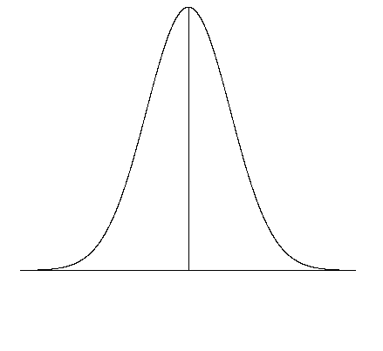
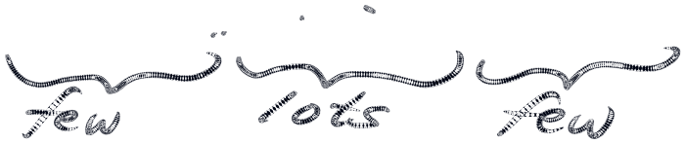
Normal Quantile Plot
Basically compares the spacing of our data to what we would expect to see in terms of spacing if our data were approximately normal.
If our data is approximately normally distributed we should spacing similar to what I attempted to show on the normal curve on the right. Very few observations in both tails and increasingly more observations as we move towards the mean from either side. Also remember the spacing must be symmetric about the mean.

Slide 7
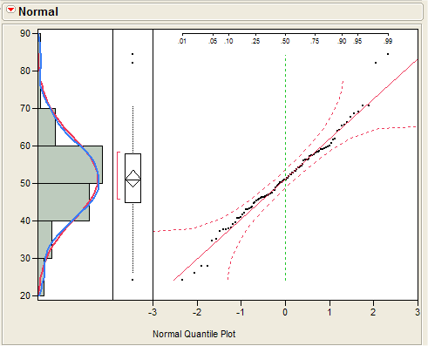
Normal Quantile Plot
THE IDEAL PLOT:
Here is an example where the data is perfectly normal. The plot on right is a normal quantile plot with the data on the vertical axis and the expected z-scores if our data was normal on the horizontal axis.
When our data is approximately normal the spacing of the two will agree resulting in a plot with observations lying on the reference line in the normal quantile plot. The points should lie within the dashed lines.

Slide 8
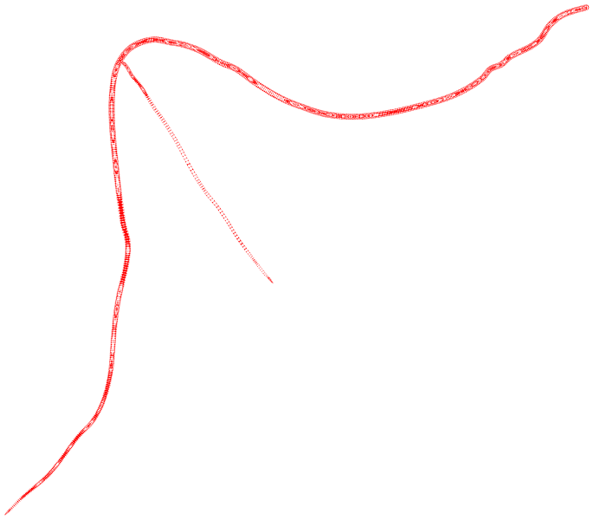
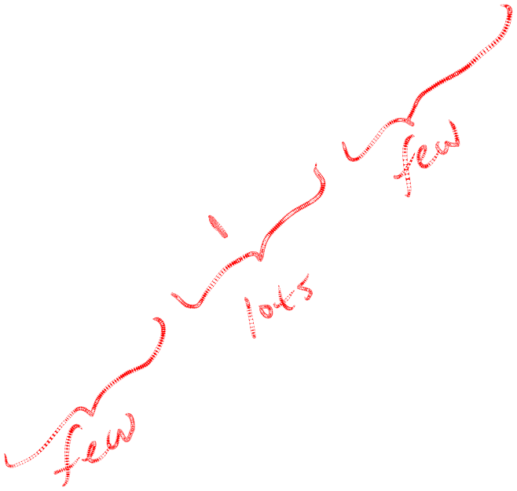
Normal Quantile Plot
THE IDEAL PLOT:
Here is an example where the data is perfectly normal. The plot on right is a normal quantile plot with the data on the vertical axis and the expected z-scores if our data was normal on the horizontal axis.
When our data is approximately normal the spacing of the two will agree resulting in a plot with observations lying on the reference line in the normal quantile plot. The points should lie within the dashed lines.

Slide 9
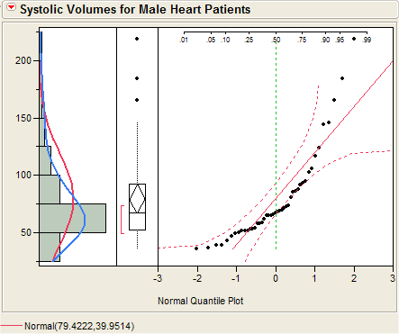
Normal Quantile Plot
(right skewness)
The systolic volumes of the male heart patients are clearly right skewed.
When the data is plotted vs. the expected z-scores the normal quantile plot shows right skewness by a upward bending curve.

Slide 10
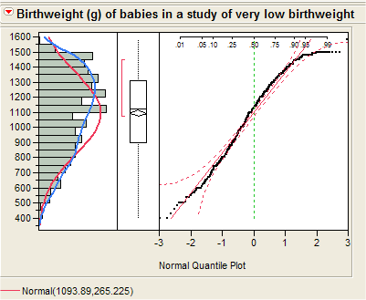
Normal Quantile Plot
(left skewness)
The distribution of birthweights from this study of very low birthweight infants is skewed left.
When the data is plotted vs. the expected z-scores the normal quantile plot shows left skewness by a downward bending curve.

Slide 11
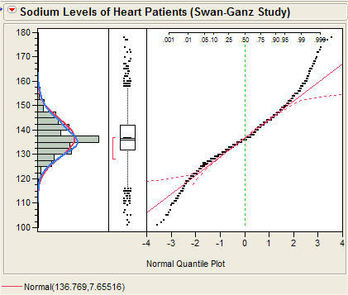
Normal Quantile Plot
(leptokurtosis)
The distribution of sodium levels of patients in this right heart catheterization study has heavier tails than a normal distribution (i.e, leptokurtosis).
When the data is plotted vs. the expected z-scores the normal quantile plot there is an “S-shape” which indicates kurtosis.

Slide 12
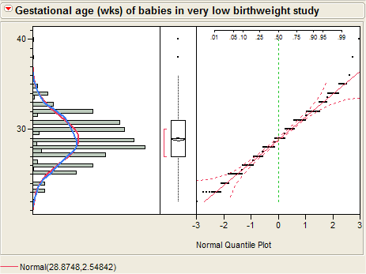
Normal Quantile Plot
(discrete data)
Although the distribution of the gestational age data of infants in the very low birthweight study is approx. normal there is a “staircase” appearance in normal quantile plot.
This is due to the discrete coding of the gestational age which was recorded to the nearest week or half week.

Slide 13
Normal Quantile Plots
IMPORTANT NOTE:
If you plot DATA vs. NORMAL as on the previous slides then:
downward bend = left skew
upward bend = right skew
If you plot NORMAL vs. DATA then: downward bend = right skew
upward bend = left skew

Slide 14
Tests of Normality
There are several different tests that can be used to test the following hypotheses:
H_{o}: The distribution is normal
H_{A}: The distribution is NOT normal
Common tests of normality include:
Shapiro-Wilk Kolmogorov-Smirnov
Anderson-Darling Lillefor’s
Problem: THEY DON’T ALWAYS AGREE!!

Slide 15
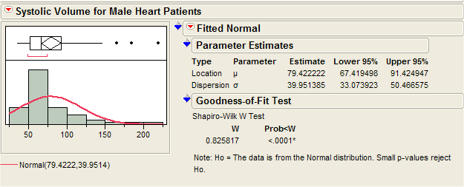
Tests of Normality
H_{o}: The distribution of systolic volume
is normal
H_{A}: The distribution of systolic volume
is NOT normal
Because p < .0001 we have strong evidence against normality for the systolic volume population distribution using the Shapiro-Wilk test.

Slide 16
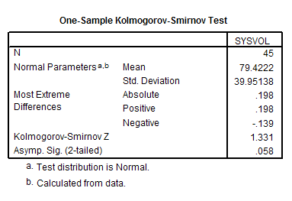
Tests of Normality
H_{o}: The distribution of systolic volume
is normal
H_{A}: The distribution of systolic volume
is NOT normal
We do not have evidence at the α = .05 level against the normality of the population systolic volume distribution when using the Kolmogorov-Smirnov test from SPSS.

Slide 17
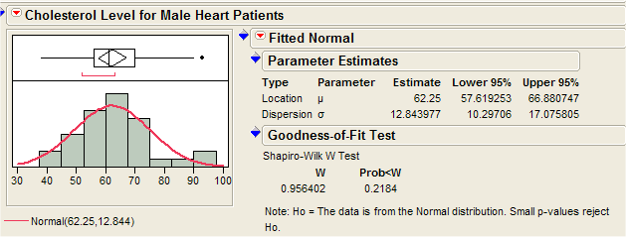
Tests of Normality
H_{o}: The distribution of cholesterol level
is normal
H_{A}: The distribution of cholesterol level
is NOT normal
We have no evidence against the normality of the population distribution of cholesterol levels for male heart patients (p = .2184).

Slide 18
Transformations to Improve Normality (removing skewness)
Many statistical methods require that the numeric variables you are working with have an approximately normal distribution.
Reality is that this is often times not the case. One of the most common departures from normality is skewness, in particular, right skewness.

Slide 19

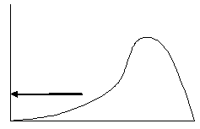




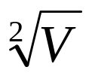


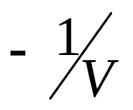
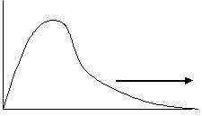
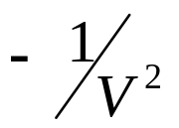
Tukey’s Ladder of Powers
UP
Here V represents our variable of interest. We are going to consider this variable raised to a power λ, i.e. V^{λ}
. . . .
Left skewed
Bigger
Impact
We go up the ladder to remove left skewness and down the ladder to remove right skewness.
Middle rung:
No transformation
(λ = 1)
Bigger
Impact
DOWN
Right skewed
. . . .
Notes:
Because so many transformations available, need some way to organize – Tukey’s ladder.
Upper rungs -- squares, cubes, … that is, power > 1.
Lower rungs:
Roots – that is, 0 < power < 1.
Inverses – that is, power < 0.
Why multiply inverse transformations by -1?
Then, pop in the log:
What is a log? Ask them?
Log of number is power to which you raise a “base” to obtain the number itself:
Log₁₀100 = 2, ‘cos 100 = 10².Log₁₀1000 = 3, ‘cos 100 = 10³, etc.
What’s the log of 10?
What’s the log of 1?
What’s the log of 1/10?
What’s the log of 0?
What are logs to base 2? What are logs to base e?
Generally, further “up” or “down” the ladder you go, more dramatic the impact.
But, the question is:
How do you decide whether to go up or down?
How do you decide how far to go?
How do you decide whether to transform the outcome or the predictor?

Slide 20
Tukey’s Ladder of Powers
To remove right skewness we typically take the square root, cube root, logarithm, or reciprocal of a the variable etc., i.e. V ^{.5}, V ^{.333}, log₁₀(V) (think of V⁰) ,
V ⁻¹, etc.
To remove left skewness we raise the variable to a power greater than 1, such as squaring or cubing the values, i.e. V ², V ^{3,} etc.

Slide 21
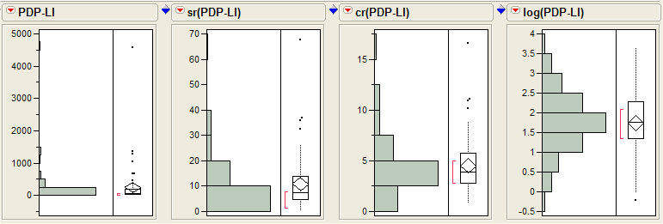

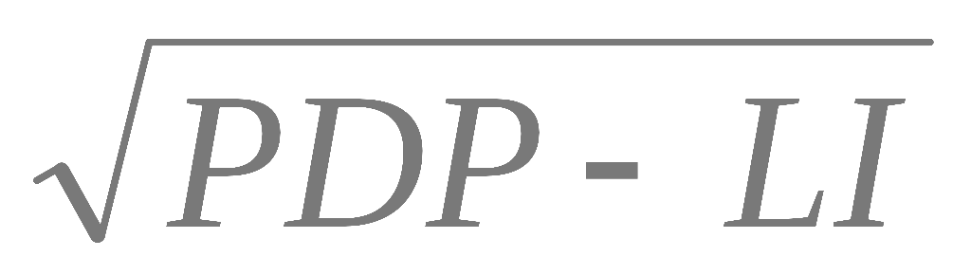
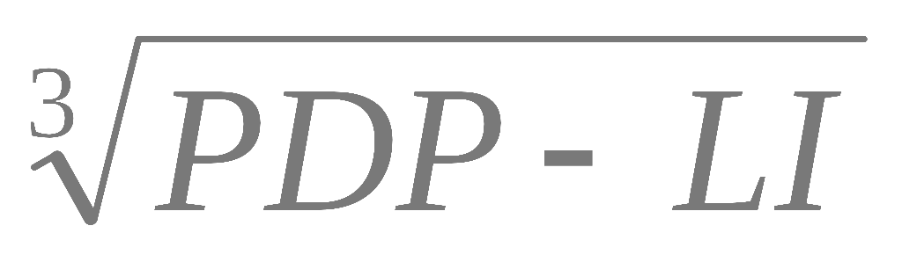

Removing Right Skewness
Example 1: PDP-LI levels for cancer patients
In the log base 10 scale the PDP-LI values are approximately normally distributed.

Slide 22
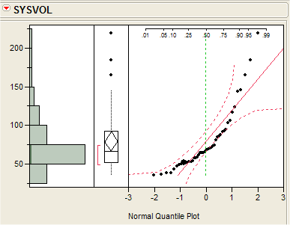
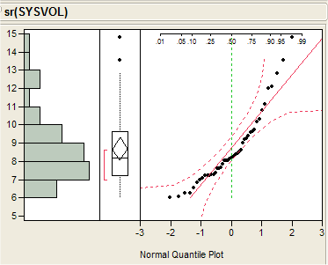
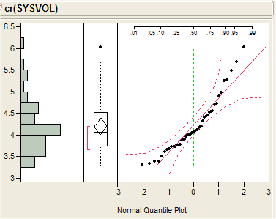
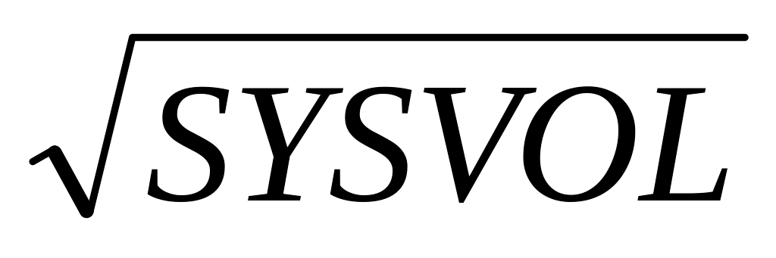
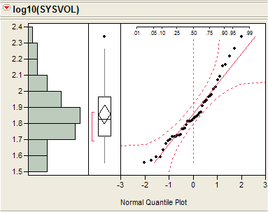
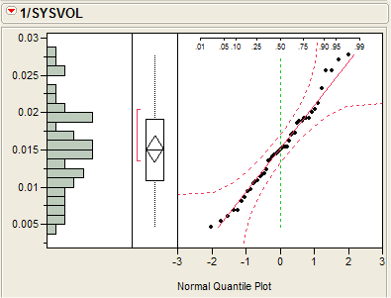
Removing Right Skewness
Example 2: Systolic Volume for Male Heart Patients
sysvol
sysvol ^{.5}
sysvol ^{.333}
log₁₀(sysvol)
1/sysvol

Slide 23
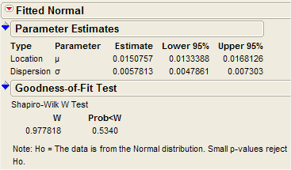
Removing Right Skewness
Example 2: Systolic Volume for Male Heart Patients
1/sysvol
The reciprocal of systolic volume is approximately normally distributed and the Shapiro-Wilk test provides no evidence against normality (p = .5340).
CAUTION: The use of the reciprocal transformation reorders the data in the sense that the largest value becomes the smallest and the smallest becomes the largest after transformation. The units after transformation may or may not make sense, e.g. if the original units are mg/ml then after transformation they would be ml/mg.

