Slide 1
Machine Learning,
Data Mining, and
Knowledge Discovery:
An Introduction
Gregory Piatetsky-Shapiro
KDnuggets

Slide 2
Course Outline
Machine Learning
  input, representation, decision trees
Weka
  machine learning workbench
Data Mining
  associations, deviation detection, clustering, visualization
Case Studies
  targeted marketing, genomic microarrays
  Data Mining, Privacy and Security
Final Project: Microarray Data Mining Competition

Slide 3
Lesson Outline
Introduction: Data Flood
Data Mining Application Examples
Data Mining & Knowledge Discovery
Data Mining Tasks

Slide 4

Trends leading to Data Flood
More data is generated:
  Bank, telecom, other business transactions ...
  Scientific data: astronomy, biology, etc
  Web, text, and e-commerce

Slide 5
Big Data Examples
Europe's Very Long Baseline Interferometry (VLBI) has 16 telescopes, each of which produces 1 Gigabit/second of astronomical data over a 25-day observation session
  storage and analysis a big problem
AT&T handles billions of calls per day
  so much data, it cannot be all stored -- analysis has to be done “on the fly”, on streaming data

Slide 6
Largest databases in 2003
Commercial databases:
  Winter Corp. 2003 Survey: France Telecom has largest decision-support DB, ~30TB; AT&T ~ 26 TB
Web
  Alexa internet archive: 7 years of data, 500 TB
  Google searches 4+ Billion pages, many hundreds TB
  IBM WebFountain, 160 TB (2003)
  Internet Archive (www.archive.org),~ 300 TB

Slide 7
From terabytes to exabytes to …
UC Berkeley 2003 estimate: 5 exabytes (5 million terabytes) of new data was created in 2002.
www.sims.berkeley.edu/research/projects/how-much-info-2003/
US produces ~40% of new stored data worldwide
2006 estimate: 161 exabytes (IDC study)
  www.usatoday.com/tech/news/2007-03-05-data_N.htm
2010 projection: 988 exabytes

Slide 8
Largest Databases in 2005
Winter Corp. 2005 Commercial Database Survey:
  Max Planck Inst. for Meteorology , 222 TB
  Yahoo ~ 100 TB (Largest Data Warehouse)
  AT&T ~ 94 TB
www.wintercorp.com/VLDB/2005_TopTen_Survey/TopTenWinners_2005.asp

Slide 9
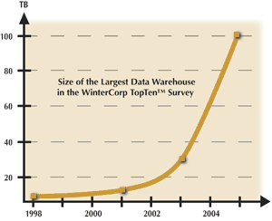
Data Growth
In 2 years, the size of the largest database TRIPLED!

Slide 10
Data Growth Rate
Twice as much information was created in 2002 as in 1999 (~30% growth rate)
Other growth rate estimates even higher
Very little data will ever be looked at by a human
Knowledge Discovery is NEEDED to make sense and use of data.

Slide 11
Lesson Outline
Introduction: Data Flood
Data Mining Application Examples
Data Mining & Knowledge Discovery
Data Mining Tasks

Slide 12
Machine Learning / Data Mining
Application areas
Science
  astronomy, bioinformatics, drug discovery, …
Business
  CRM (Customer Relationship management), fraud detection, e-commerce, manufacturing, sports/entertainment, telecom, targeted marketing, health care, …
Web:
  search engines, advertising, web and text mining, …
Government
  surveillance (?|), crime detection, profiling tax cheaters, …

Slide 13
Application Areas
What do you think are some of the most important and widespread business applications of Data Mining?

Slide 14
Data Mining for Customer Modeling
Customer Tasks:
  attrition prediction
  targeted marketing:
    cross-sell, customer acquisition
  credit-risk
  fraud detection
Industries
  banking, telecom, retail sales, …

Slide 15
Customer Attrition: Case Study
Situation: Attrition rate at for mobile phone customers is around 25-30% a year!
With this in mind, what is our task?
  Assume we have customer information for the past N months.

Slide 16
Customer Attrition: Case Study
Task:
Predict who is likely to attrite next month.
Estimate customer value and what is the cost-effective offer to be made to this customer.

Slide 17
Customer Attrition Results
Verizon Wireless built a customer data warehouse
Identified potential attriters
Developed multiple, regional models
Targeted customers with high propensity to accept the offer
Reduced attrition rate from over 2%/month to under 1.5%/month (huge impact, with >30 M subscribers)
(Reported in 2003)

Slide 18
Assessing Credit Risk: Case Study
Situation: Person applies for a loan
Task: Should a bank approve the loan?
Note: People who have the best credit don’t need the loans, and people with worst credit are not likely to repay. Bank’s best customers are in the middle

Slide 19
Credit Risk - Results
Banks develop credit models using variety of machine learning methods.
Mortgage and credit card proliferation are the results of being able to successfully predict if a person is likely to default on a loan
Widely deployed in many countries

Slide 20
e-commerce
A person buys a book (product) at Amazon.com
What is the task?

Slide 21
Successful e-commerce – Case Study
Task: Recommend other books (products) this person is likely to buy
Amazon does clustering based on books bought:
  customers who bought “Advances in Knowledge Discovery and Data Mining”, also bought “Data Mining: Practical Machine Learning Tools and Techniques with Java Implementations”
Recommendation program is quite successful

Slide 22
Unsuccessful e-commerce case study (KDD-Cup 2000)
Data: clickstream and purchase data from Gazelle.com, legwear and legcare e-tailer
Q: Characterize visitors who spend more than $12 on an average order at the site
Dataset of 3,465 purchases, 1,831 customers
Very interesting analysis by Cup participants
  thousands of hours - $X,000,000 (Millions) of consulting
Total sales -- $Y,000
Obituary: Gazelle.com out of business, Aug 2000

Slide 23
Genomic Microarrays – Case Study
Given microarray data for a number of samples (patients), can we
Accurately diagnose the disease?
Predict outcome for given treatment?
Recommend best treatment?

Slide 24
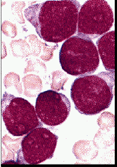


Example: ALL/AML data
38 training cases, 34 test, ~ 7,000 genes
2 Classes: Acute Lymphoblastic Leukemia (ALL) vs Acute Myeloid Leukemia (AML)
Use train data to build diagnostic model
ALL
AML
  Results on test data:
  33/34 correct, 1 error may be mislabeled

Slide 25

Security and Fraud Detection - Case Study
Credit Card Fraud Detection
Detection of Money laundering
  FAIS (US Treasury)
Securities Fraud
  NASDAQ KDD system
Phone fraud
  AT&T, Bell Atlantic, British Telecom/MCI
Bio-terrorism detection at Salt Lake Olympics 2002

Slide 26
Data Mining and Privacy
in 2006, NSA (National Security Agency) was reported to be mining years of call info, to identify terrorism networks
Social network analysis has a potential to find networks
Invasion of privacy – do you mind if your call information is in a gov database?
What if NSA program finds one real suspect for 1,000 false leads ? 1,000,000 false leads?

Slide 27
Problems Suitable for Data-Mining
require knowledge-based decisions
have a changing environment
have sub-optimal current methods
have accessible, sufficient, and relevant data
provides high payoff for the right decisions!
Privacy considerations important if personal data is involved

Slide 28
Lesson Outline
Introduction: Data Flood
Data Mining Application Examples
Data Mining & Knowledge Discovery
Data Mining Tasks

Slide 29
Knowledge Discovery Definition
Knowledge Discovery in Data is the
non-trivial process of identifying
  valid
  novel
  potentially useful
  and ultimately understandable patterns in data.
from Advances in Knowledge Discovery and Data Mining, Fayyad, Piatetsky-Shapiro, Smyth, and Uthurusamy, (Chapter 1), AAAI/MIT Press 1996

Slide 30
Related Fields
Machine
Learning
Visualization
Data Mining and
Knowledge Discovery
Statistics
Databases

Slide 31
Statistics, Machine Learning and
Data Mining
Statistics:
  more theory-based
  more focused on testing hypotheses
Machine learning
  more heuristic
  focused on improving performance of a learning agent
  also looks at real-time learning and robotics – areas not part of data mining
Data Mining and Knowledge Discovery
  integrates theory and heuristics
  focus on the entire process of knowledge discovery, including data cleaning, learning, and integration and visualization of results
Distinctions are fuzzy
witten&eibe

Slide 32
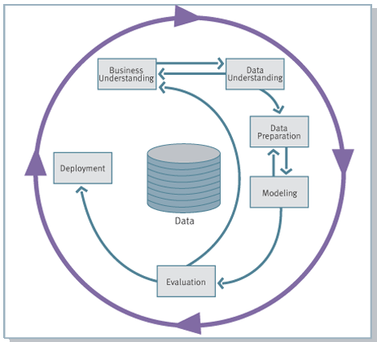
Knowledge Discovery Process flow, according to CRISP-DM
see
www.crisp-dm.org
for more
information
Monitoring

Slide 33

Historical Note:
Many Names of Data Mining
Data Fishing, Data Dredging: 1960-
  used by Statistician (as bad name)
Data Mining :1990 --
  used DB, business
  in 2003 – bad image because of TIA
Knowledge Discovery in Databases (1989-)
  used by AI, Machine Learning Community
also Data Archaeology, Information Harvesting, Information Discovery, Knowledge Extraction, ...
Currently: Data Mining and Knowledge Discovery
are used interchangeably

Slide 34
Lesson Outline
Introduction: Data Flood
Data Mining Application Examples
Data Mining & Knowledge Discovery
Data Mining Tasks

Slide 35
Major Data Mining Tasks
Classification: predicting an item class
Clustering: finding clusters in data
Associations: e.g. A & B & C occur frequently
Visualization: to facilitate human discovery
Summarization: describing a group
Deviation Detection: finding changes
Estimation: predicting a continuous value
Link Analysis: finding relationships
…

Slide 36
Data Mining Tasks: Classification
Learn a method for predicting the instance class from pre-labeled (classified) instances
Many approaches: Statistics,
Decision Trees, Neural Networks,
...

Slide 37
Data Mining Tasks: Clustering
Find “natural” grouping of instances given un-labeled data

Slide 38
Summary:
Technology trends lead to data flood
  data mining is needed to make sense of data
Data Mining has many applications, successful and not
Knowledge Discovery Process
Data Mining Tasks
  classification, clustering, …

Slide 39
More on Data Mining and Knowledge Discovery
KDnuggets.com
News, Publications
Software, Solutions
Courses, Meetings, Education
Publications, Websites, Datasets
Companies, Jobs
…

Slide 40
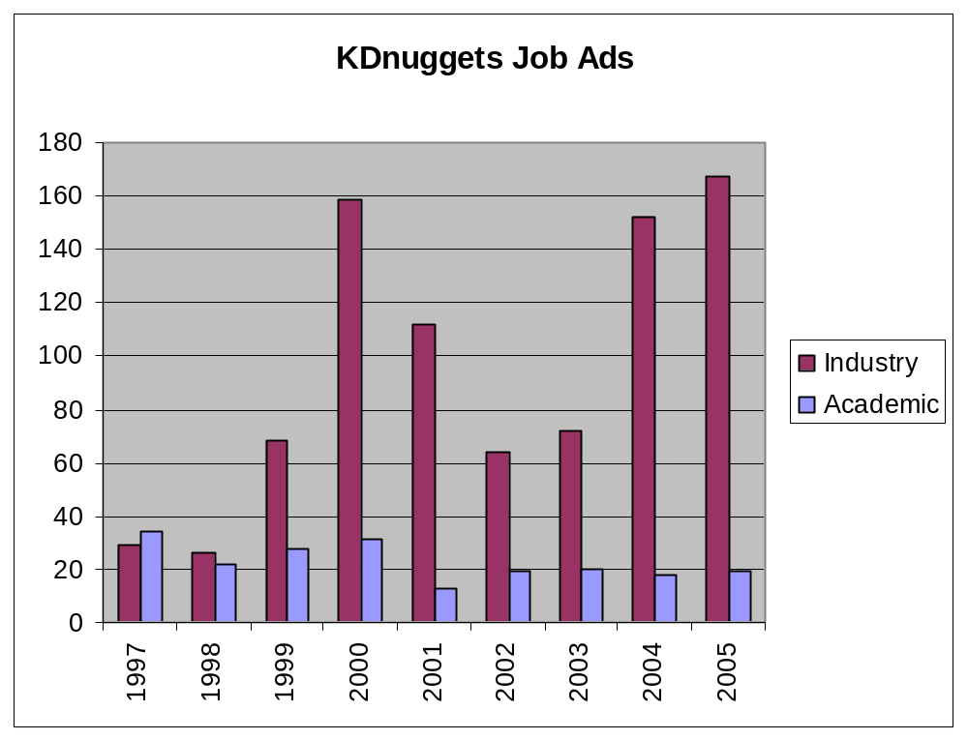
Data Mining Jobs in KDnuggets

