Slide 1
Data Preparation
(Data pre-processing)

Slide 2
Data Preparation
Introduction to Data Preparation
Types of Data
Discretization of Continuous Variables
Outliers
Data Transformation
Missing Data
Handling Redundancy
Sampling and Unbalanced Datasets
2

Slide 3
INTRODUCTION TO DATA PREPARATION
2

Slide 4
Why Prepare Data?
Some data preparation is needed for all mining tools
The purpose of preparation is to transform data sets so that their information content is best exposed to the mining tool
Error prediction rate should be lower (or the same) after the preparation as before it
2

Slide 5
Why Prepare Data?
Preparing data also prepares the miner so that when using prepared data the miner produces better models, faster
GIGO - good data is a prerequisite for producing effective models of any type
2

Slide 6
Why Prepare Data?
Data need to be formatted for a given software tool
Data need to be made adequate for a given method
Data in the real world is dirty
incomplete: lacking attribute values, lacking certain attributes of interest, or containing only aggregate data
e.g., occupation=“”
noisy: containing errors or outliers
e.g., Salary=“-10”, Age=“222”
inconsistent: containing discrepancies in codes or names
e.g., Age=“42” Birthday=“03/07/1997”
e.g., Was rating “1,2,3”, now rating “A, B, C”
e.g., discrepancy between duplicate records
e.g., Endereço: travessa da Igreja de Nevogilde Freguesia: Paranhos
2

Slide 7
Major Tasks in Data Preparation
Data discretization
Part of data reduction but with particular importance, especially for numerical data
Data cleaning
Fill in missing values, smooth noisy data, identify or remove outliers, and resolve inconsistencies
Data integration
Integration of multiple databases, data cubes, or files
Data transformation
Normalization and aggregation
Data reduction
Obtains reduced representation in volume but produces the same or similar analytical results
2

Slide 8

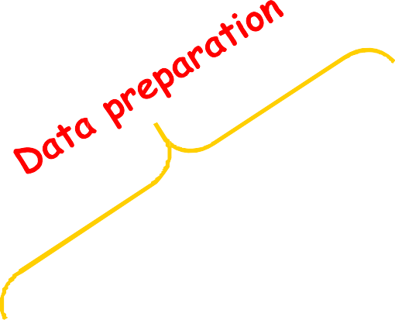
Data Preparation as a step in the Knowledge Discovery Process
Knowledge
Evaluation and Presentation
Data Mining
Selection and Transformation
Cleaning and Integration
DW
DB
2

Slide 9
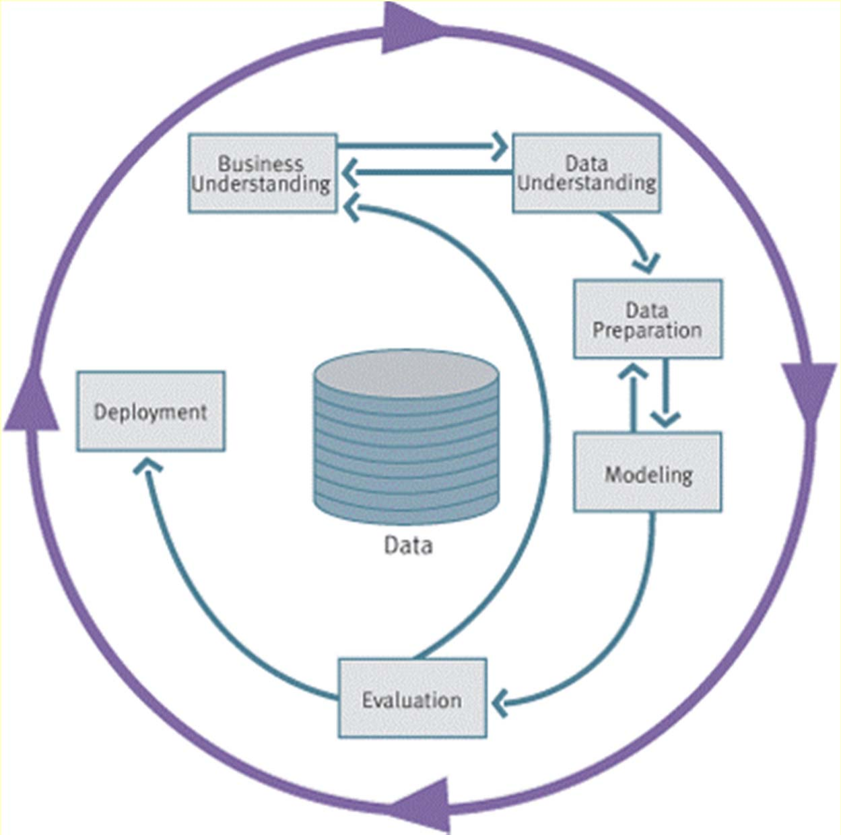
CRISP-DM
CRISP-DM is a
comprehensive data mining methodology and process model that provides anyone—from novices to data mining experts—with a complete blueprint for conducting a data mining project.
A methodology enumerates the steps to reproduce success
2

Slide 10
CRISP-DM Phases and Tasks
Business Understanding
Data Understanding
Data Preparation
Modelling
Evaluation
Deployment
Determine Business Objectives
Collect Initial Data
Select Data
Select Modeling Technique
Evaluate Results
Plan Deployment
Assess Situation
Describe Data
Clean Data
Generate Test Design
Review Process
Plan Monitoring & Maintenance
Determine Data Mining Goals
Explore Data
Construct Data
Build Model
Determine Next Steps
Produce Final Report
Produce Project Plan
Verify Data Quality
Integrate Data
Assess Model
Review Project
Format Data
10

Slide 11
CRISP-DM Phases and Tasks
Business Understanding
Data Understanding
Data Preparation
Modelling
Evaluation
Deployment
Collect Initial Data
Determine Select
Business Modeling ^{Evaluate Plan}
Objectives Technique ^{Results Deployment}
Generate Plan
^{Assess} Test ^{Review} Monitoring &
^{Situation} Design ^{Process} Maintenance
Determine _{Build Determine} Produce
Data Mining _{Model Next Steps} Final Goals Report
^{Produce} Assess Review
^{Project} Model Project
Plan
11
Select Data
Describe Data
Clean Data
Explore Data
Construct Data
Verify Data Quality
Integrate Data
Format Data

Slide 12
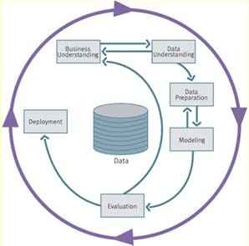
CRISP-DM: Data Understanding
Collect data
List the datasets acquired (locations, methods used to acquire, problems encountered and solutions achieved).
Describe data
Check data volume and examine its gross properties.
Accessibility and availability of attributes. Attribute types, range, correlations, the identities.
Understand the meaning of each attribute and attribute value in business terms.
For each attribute, compute basic statistics (e.g., distribution, average, max, min, standard deviation, variance, mode, skewness).
13

Slide 13
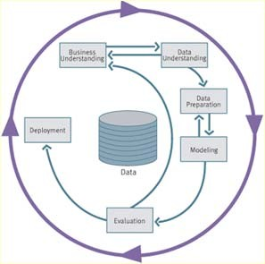
CRISP-DM: Data Understanding
Explore data
Analyze properties of interesting attributes in detail.
Distribution, relations between pairs or small numbers of attributes, properties of significant sub-populations, simple statistical analyses.
Verify data quality
Identify special values and catalogue their meaning.
Does it cover all the cases required? Does it contain errors and how common are they?
Identify missing attributes and blank fields. Meaning of missing data.
Do the meanings of attributes and contained values fit together?
Check spelling of values (e.g., same value but sometime beginning with a lower case letter, sometimes with an upper case letter).
Check for plausibility of values, e.g. all fields have the same or nearly the same values.
13

Slide 14
CRISP-DM: Data Preparation
Select data
Reconsider data selection criteria.
Decide which dataset will be used.
Collect appropriate additional data (internal or external).
Consider use of sampling techniques.
Explain why certain data was included or excluded.
Clean data
Correct, remove or ignore noise.
Decide how to deal with special values and their meaning (99 for marital status).
Aggregation level, missing values, etc.
Outliers?
13

Slide 15
CRISP-DM: Data Preparation
Construct data
Derived attributes.
Background knowledge.
How can missing attributes be constructed or imputed?
Integrate data
Integrate sources and store result (new tables and records).
Format Data
Rearranging attributes (Some tools have requirements on the order of the attributes, e.g. first field being a unique identifier for each record or last field being the outcome field the model is to predict).
Reordering records (Perhaps the modelling tool requires that the records be sorted according to the value of the outcome attribute).
Reformatted within-value (These are purely syntactic changes made to satisfy the requirements of the specific modelling tool, remove illegal characters,
uppercase lowercase).
15

Slide 16
TYPES OF DATA
18

Slide 17
Types of Measurements
Nominal scale
Categorical scale
Ordinal scale
Interval scale
Ratio scale
More information content
Qualitative
Quantitative
Discrete
or Continuous
18

Slide 18
Types of Measurements: Examples
Nominal:
ID numbers, Names of people
Categorical:
eye color, zip codes
Ordinal:
rankings (e.g., taste of potato chips on a scale from 1-10), grades, height in {tall, medium, short}
Interval:
calendar dates, temperatures in Celsius or Fahrenheit, GRE (Graduate Record Examination) and IQ scores
Ratio:
temperature in Kelvin, length, time, counts
18

Slide 19
Types of Measurements: Examples
Day | Outlook | Temperature | Humidity | Wind | PlayTennis?
1 | Sunny | 85 | 85 | Light | No
2 | Sunny | 80 | 90 | Strong | No
3 | Overcast | 83 | 86 | Light | Yes
4 | Rain | 70 | 96 | Light | Yes
5
6
Rain Rain
68
80 Lig
h
t Ye
PlayTennis?
Day Outlook
Temperature
Humidity ^{s}
Wind
1
65
Sunny
70 Str
o
ng N
o
Hot
High
Light
No
7
8
Overcast
2
64
Sunny
65 Str
o
ng Ye
Hot
High
^{s} Strong
No
Sunny Sunny
72
95 Lig
h
t N
o
3 | Overcast | Hot | High Light Yes
4 | Rain | Mild | High ^{s} Light Yes
5 | Rain | Cool | Normal ^{s} Light Yes
6 | Rain | Cool | Normal ^{s} Strong No
7 | Overcast | Cool | Normal ^{s} Strong Yes
8 | Sunny | Mild | High | ^{s} Light | No
9 | Sunny | Cool | Normal | Light | Yes
10 | Rain | Mild | Normal | Light | Yes
11 | Sunny | Mild | Normal | Strong | Yes
12 | Overcast | Mild | High | Strong | Yes
13 | Overcast | Hot | Normal | Light | Yes
14 | Rain | Mild | High | Strong | No | 19
9
10
69
70 Lig
h
t Ye
Rain Sunny
75
80 Lig
h
t Ye
11
Overcast
Overcast 14
75
70 Str
o
ng Ye
72
90 Str
o
ng Ye
81
75 Lig
h
t Ye
Rain
71
91 Str
o
ng N
o

Slide 20
Data Conversion
Some tools can deal with nominal values but other need fields to be numeric
Convert ordinal fields to numeric to be able to use “>” and “<“ comparisons on such fields.
A → 4.0
A- → 3.7
B+ → 3.3
B → 3.0
Multi-valued, unordered attributes with small no. of values
e.g. Color=Red, Orange, Yellow, …, Violet
for each value v create a binary “flag” variable C_v , which is 1 if Color=v, 0 otherwise
20

Slide 21
Conversion: Nominal, Many Values
Examples:
US State Code (50 values)
Profession Code (7,000 values, but only few frequent)
Ignore ID-like fields whose values are unique for each record
For other fields, group values “naturally”:
e.g. 50 US States → 3 or 5 regions
Profession – select most frequent ones, group the rest
Create binary flag-fields for selected values

Slide 22
DISCRETIZATION OF CONTINUOUS VARIABLES

Slide 23
Discretization
Divide the range of a continuous attribute into intervals
Some methods require discrete values, e.g. most versions of Naïve Bayes, CHAID
Reduce data size by discretization
Prepare for further analysis
Discretization is very useful for generating a summary of data
Also called “binning”

Slide 24
Equal-width Binning
It divides the range into N intervals of equal size (range): uniform grid
If A and B are the lowest and highest values of the attribute, the width of intervals will be: W = (B -A)/N.
Temperature values:
64 65 68 69 70 71 72 72 75 75 80 81 83 85
Count
4
2 2 2 0 2 2
[64,67) [67,70) [70,73) [73,76) [76,79) [79,82) [82,85]
Equal Width, bins Low <= value < High

Slide 25
Equal-width Binning
Count
1
[0 – 200,000) … ….
[1,800,000 –
2,000,000]
Salary in a corporation
Disadvantage
Unsupervised
Where does N come from?
Sensitive to outliers
Advantage
simple and easy to implement
produce a reasonable abstraction of data
25

Slide 26
Equal-depth (or height) Binning
It divides the range into N intervals, each containing
approximately the same number of samples
Generally preferred because avoids clumping
In practice, “almost-equal” height binning is used to give more intuitive breakpoints
Additional considerations:
don’t split frequent values across bins
create separate bins for special values (e.g. 0)
readable breakpoints (e.g. round breakpoints

Slide 27
Equal-depth (or height) Binning
Temperature values:
64 65 68 69 70 71 72 72 75 75 80 81 83 85
Count
4
4
4
2
[64 .. .. .. .. 69]
[70 .. 72]
[73 .. .. .. .. .. .. .. .. 81]
[83 .. 85]
Equal Height = 4, except for the last bin

Slide 28
Discretization considerations
Class-independent methods
Equal Width is simpler, good for many classes
can fail miserably for unequal distributions
Equal Height gives better results
Class-dependent methods can be better for classification
Decision tree methods build discretization on the fly
Naïve Bayes requires initial discretization
Many other methods exist …

Slide 29
Method 1R
Developed by Holte (1993).
It is a supervised discretization method using binning.
After sorting the data, the range of continuous values is divided into a number of disjoint intervals and the boundaries of those intervals are adjusted based on the class labels associated with the values of the feature.
Each interval should contain a given minimum of instances ( 6 by default) with the exception of the last one.
The adjustment of the boundary continues until the next values belongs to a class different to the majority class in the adjacent interval.

Slide 30
1R Example
Interval contains at leas 6 elements
Adjustment of the boundary continues until the next values belongs to a class different to the majority class in the adjacent interval.
 | 1 2 3 4 5 6 |  |  |  |  |  | 1 2 3 4 5 6 7 |  |  |  |  |  |  | 1 2 3 4 5 6 7 |  |  |  |  |  |  | 1 2 3 4 5 6 7 |  |  |  |  |  |  | 1 2 3 4
Var | 65 | 78 | 79 | 79 | 81 | 81 | 82 | 82 | 82 | 82 | 82 | 82 | 83 | 83 | 83 | 83 | 83 | 84 | 84 | 84 | 84 | 84 | 84 | 84 | 84 | 84 | 85 | 85 | 85 | 85 | 85
Class | 2 | 1 | 2 | 2 | 2 | 1 | 1 | 2 | 1 | 2 | 2 | 2 | 2 | 1 | 2 | 2 | 2 | 1 | 2 | 2 | 1 | 1 | 2 | 2 | 1 | 1 | 1 | 2 | 2 | 2 | 2
majority |  |  |  |  |  | 2 |  |  |  |  |  | 2 |  |  |  |  |  |  | 2 |  |  |  |  |  |  | 1
new class | 1 1 1 1 1 1 1 1 1 1 1 1 1 1 1 1 1 1 1 1 |  |  |  |  |  |  |  |  |  |  |  |  |  |  |  |  |  |  |  | 2 2 2 2 2 2 2 |  |  |  |  |  |  | 3 3 3 3
Comment: The original method description does not mention the criterion of making sure that the same value for Var is kept is the same interval (although that seems reasonable).
The results above are given by the method available in the R package Dprep. See the following papers for more detail:
Very Simple Classification Rules Perform Well on Most Commonly Used Datasets by Robert C. Holte
The Development of Holte’s 1R Classifier by Craig Nevill-Manning, Geoffrey Holmes and Ian H. Witten

Slide 31
Exercise
Discretize the following values using EW and ED binning
13, 15, 16, 16, 19, 20, 21, 22, 22, 25, 30, 33, 35, 35, 36, 40, 45

Slide 32
Entropy Based Discretization
Class dependent (classification)
Sort examples in increasing order
Each value forms an interval (‘m’ intervals)
Calculate the entropy measure of this discretization
Find the binary split boundary that minimizes the entropy function over all possible boundaries. The split is selected as a binary discretization.
|
S S
| | |
E (S ,T ) =
Ent (
S S
1
) +
2
Ent ( )
|S | |S |
1
2
5. Apply the process recursively until some stopping criterion is met, e.g.,
Ent (S ) − E (T ,S ) > δ

Slide 33
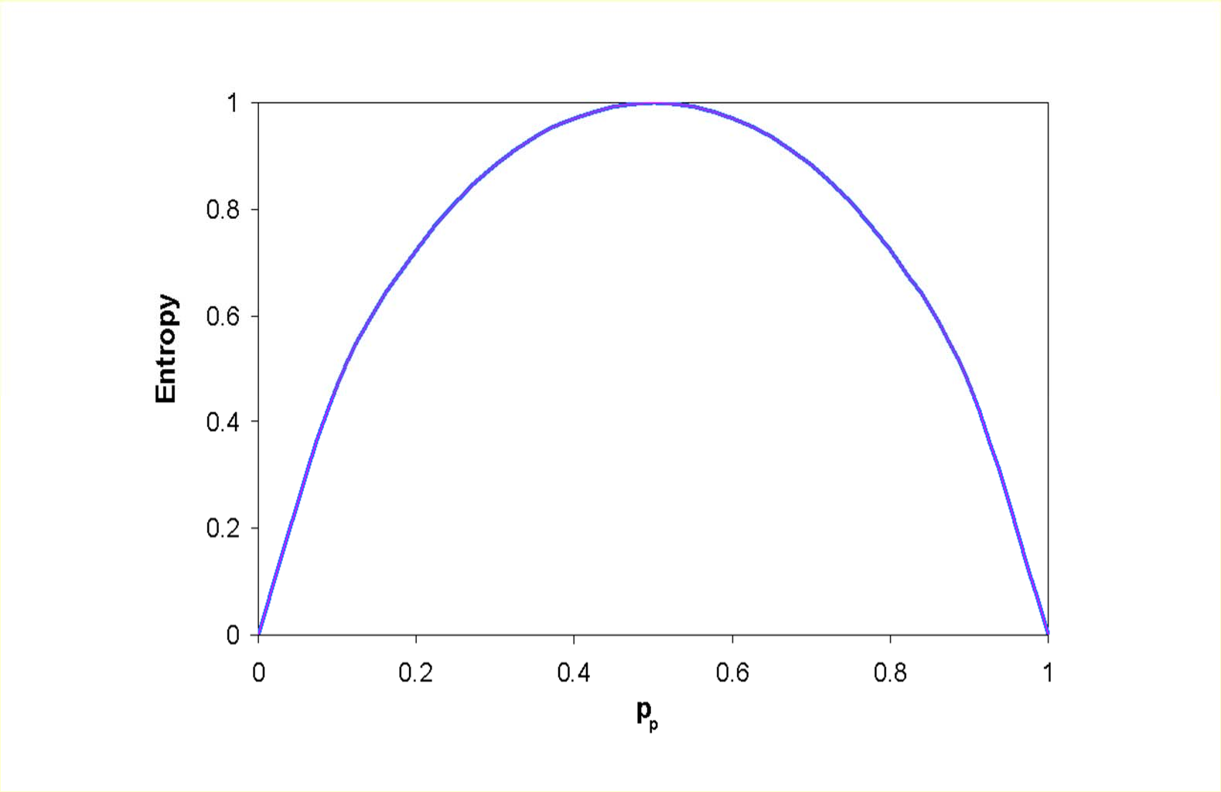
Entropy
p | 1-p | Ent
0.2 | 0.8 | 0.72
0.4 | 0.6 | 0.97
0.5 | 0.5 | 1
0.6 | 0.4 | 0.97
0.8 | 0.2 | 0.72
log₂(2)
p1 | p2 | p3 | Ent
0.1 | 0.1 | 0.8 | 0.92
0.2 | 0.2 | 0.6 | 1.37
0.1 | 0.45 | 0.45 | 1.37
0.2 | 0.4 | 0.4 | 1.52
0.3 | 0.3 | 0.4 | 1.57
0.33 | 0.33 | 0.33 | 1.58
N
Ent = −∑ p_{c} ⋅ log₂ p_{c}
log₂(3)
c =1

Slide 34
Entropy/Impurity
S - training set, C₁,...,C_{N} classes
Entropy E(S) - measure of the impurity in a group of examples
p_{c} - proportion of C_{c} in S
N
Impurity(S ) = −∑ p_{c} ⋅log₂ p_{c}
c =1

Slide 35
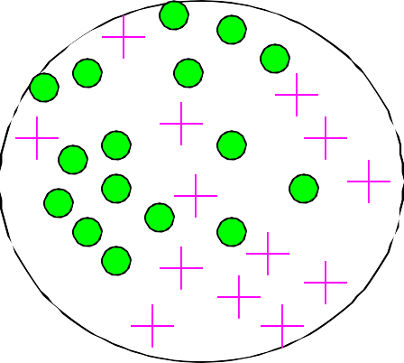
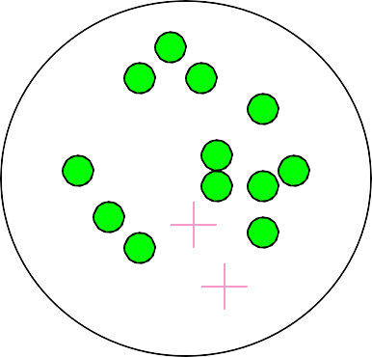
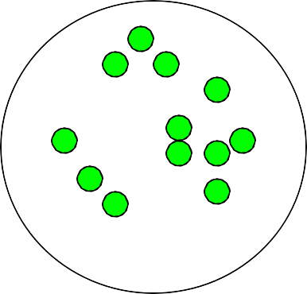
Impurity
Very impure group
Less impure
Minimum impurity
high entropy
null entropy

Slide 36
An example of entropy disc.
Test split temp < 71.5
 | yes | no
< 71.5 | 4 | 2
> 71.5 | 5 | 3
Temp.
Play?
64
Yes
65
No
Ent(split 71.5) = ⁶ ⋅^{⎛ 4} log ⁴ + ² log ^{2 ⎞}
₆ ⎟
68
Yes
(4 yes, 2 no)
14 ⎜ 6 6 6
⎝
⎠
69
Yes
8 ⎛ 5 5
3 3 ⎞
70
Yes
+
⋅⎜ log + log ⎟ = 0.939
71
No
14 ⎝ 8
8 8 8 ⎠
72
No
72
Yes
 | yes | no
< 77 | 7 | 3
> 77 | 2 | 2
75
Yes
75
Yes
80
No
(5 yes, 3 no)
81
Yes
Ent(split 77) = ¹⁰ ⋅^{⎛ 7} log ⁷ + ³ log ^{3 ⎞}
⎜ ⎟
83
Yes
14 ⎝ 10 10 10 10 ⎠
85
No
4 ⎛ 2 2 2 2 ⎞
+
⋅⎜ log + log ⎟ = 0.915
14 ⎝ 4
4 4 4 ⎠
36

Slide 37
An example (cont.)
Temp.
Play?
The method tests all split
64
Yes
6th split
possibilities and chooses the split with smallest entropy.
In the first iteration a split at 84 is chosen.
The two resulting branches are processed recursively.
65
No
68
Yes
69
Yes
70
Yes
5th split
4th split 3rd split
71
No
72
No
72
Yes
75
Yes
75
Yes
80
No
81
Yes
2nd split
The fact that recursion only occurs in the first interval in this example is an artifact. In general both intervals have to be split.
83
Yes
85
No
1st split

Slide 38
The stopping criterion
Previous slide did not take into account the stopping criterion.
Ent(S) − E(T , S) > δ
∂ > log(N − 1) ₊ Δ(T , S)
N N
Δ(T , S) = log (3^{c} − 2) −[cEnt(S) − c Ent(S ) −c Ent(S )]
2 1 1 2 2
c is the number of classes in S c₁ is the number of classes in S₁ c₂ is the number of classes in S₂.
This is called the Minimum Description Length Principle (MDLP)

Slide 39
Exercise
Compute the gain of splitting this data in half
Humidity play
65 Yes
70 No
70 Yes
70 Yes
75 Yes
80 Yes
80 Yes
85
86
90
90
91
95
96
No Yes No Yes No No Yes
39

Slide 40
OUTLIERS

Slide 41
Outliers
Outliers are values thought to be out of range.
“An outlier is an observation that deviates so much from other observations as to arouse suspicion that it was generated by a different mechanism”
Can be detected by standardizing observations and label the standardized values outside a predetermined bound as outliers
Outlier detection can be used for fraud detection or data cleaning
Approaches:
do nothing
enforce upper and lower bounds
let binning handle the problem

Slide 42
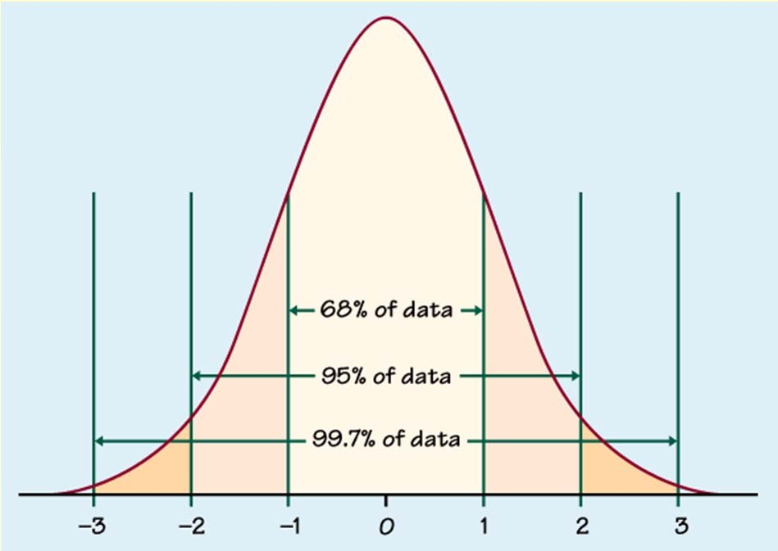
Outlier detection
Univariate
Compute mean and std. deviation. For k=2 or 3, x is an outlier if outside limits (normal distribution assumed)
(x − ks, x + ks)

Slide 43
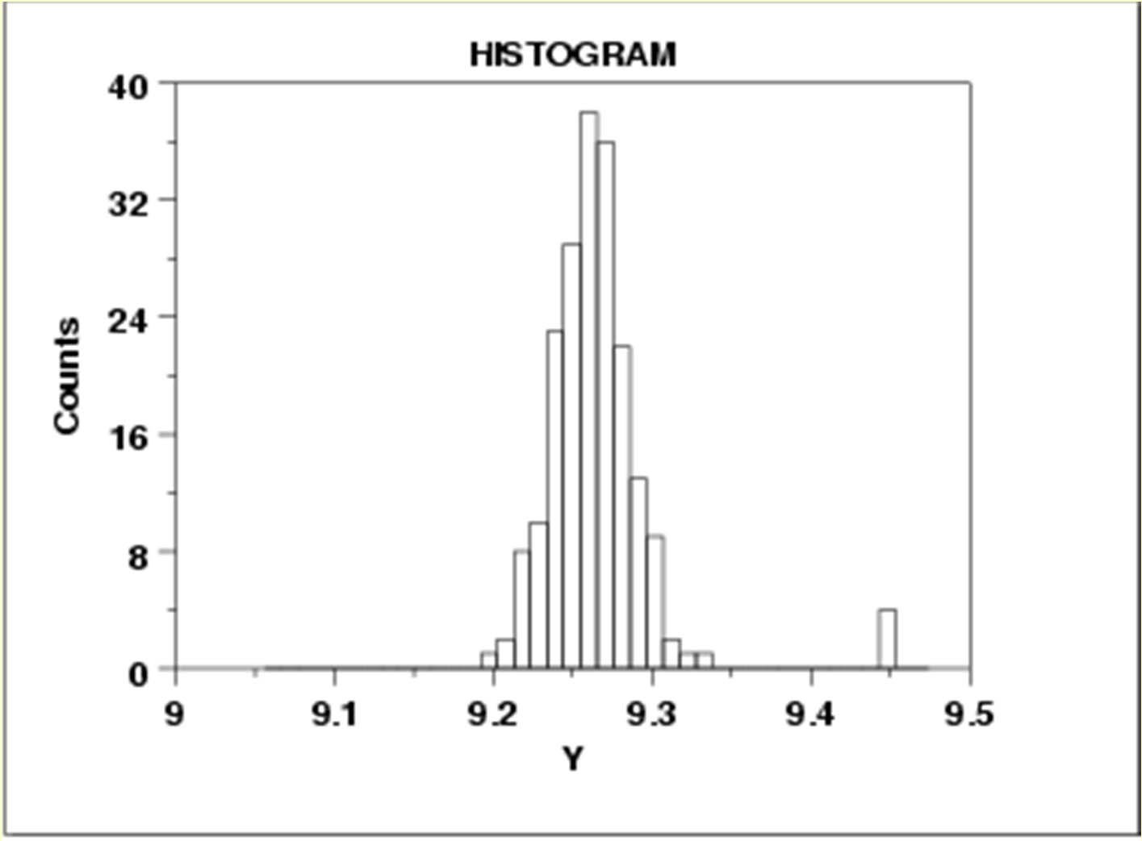

Slide 44
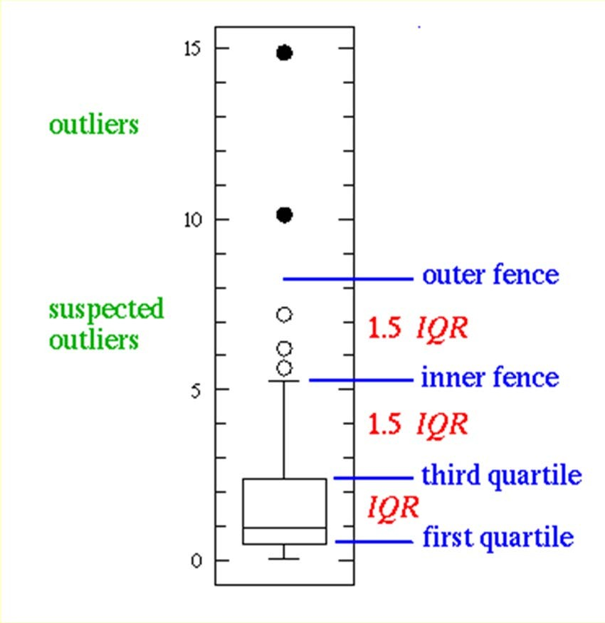
Outlier detection
Univariate
Boxplot: An observation is an extreme outlier if
(Q1-3×IQR, Q3+3×IQR), where IQR=Q3-Q1
(IQR = Inter Quartile Range)
and declared a mild outlier if it lies outside of the interval
(Q1-1.5×IQR, Q3+1.5×IQR).
http://www.physics.csbsju.edu/stats/box2.html
44

Slide 45
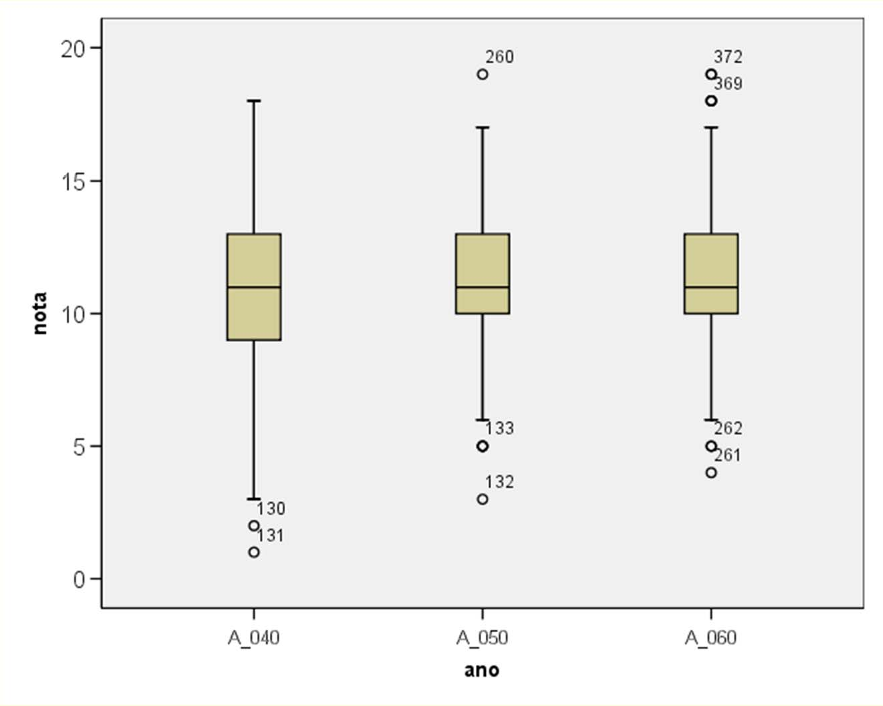
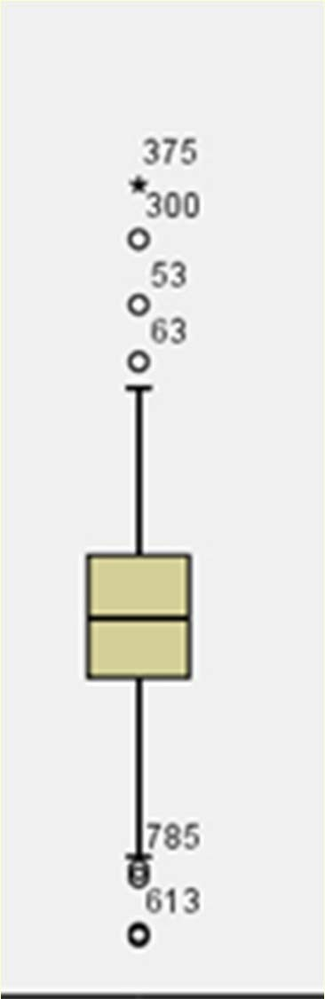
> 3 L
> 1.5 L
L

Slide 46
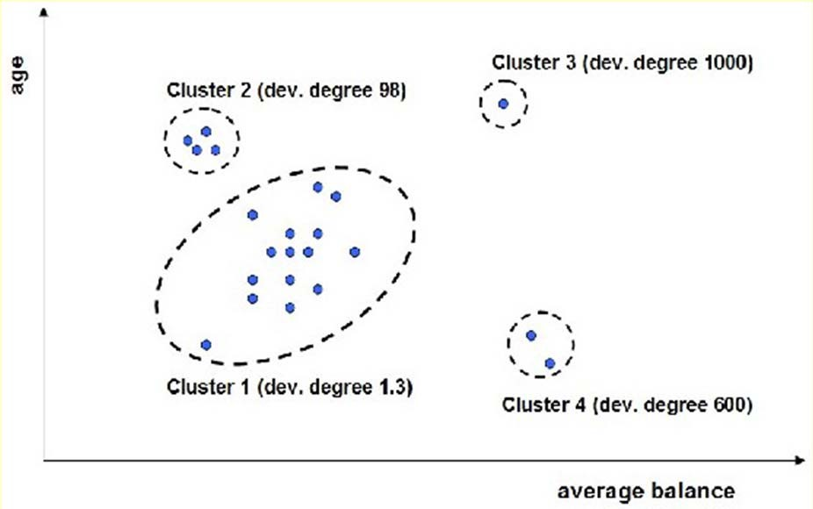
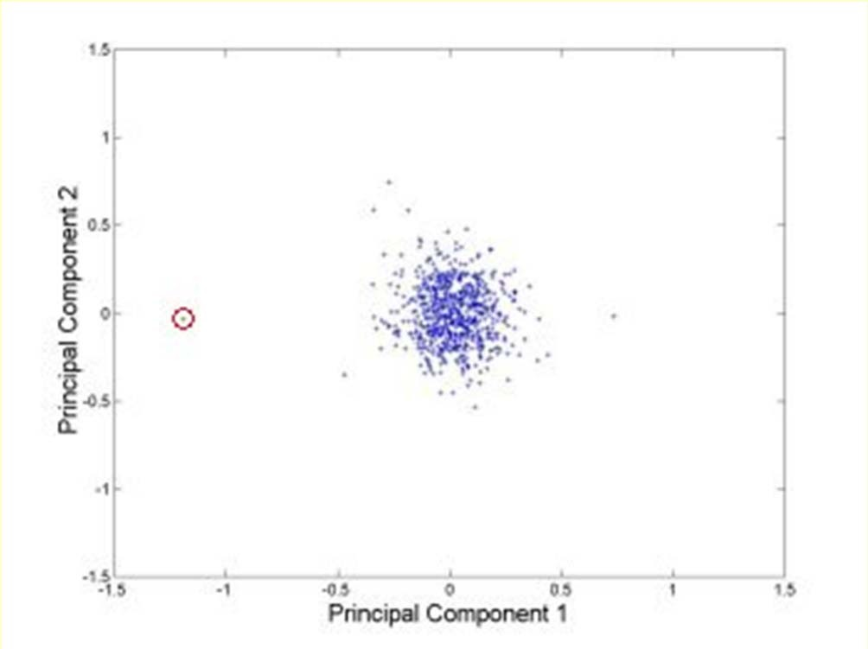
Outlier detection
Multivariate
Clustering
Very small clusters are outliers
http://www.ibm.com/developerworks/data/li brary/techarticle/dm-0811wurst/

Slide 47
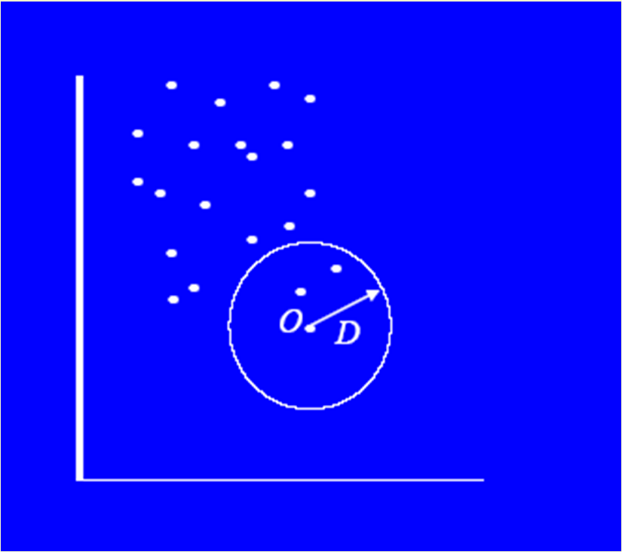
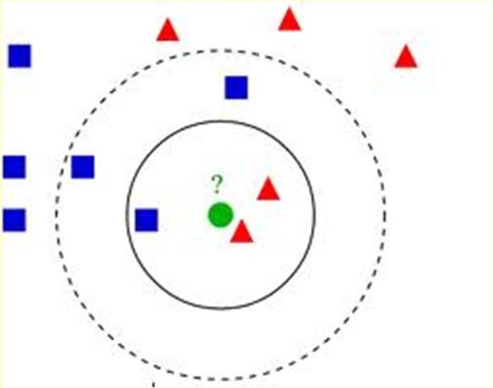
Outlier detection
Multivariate
Distance based
An instance with very few neighbors within D is regarded as an outlier
Knn algorithm

Slide 48
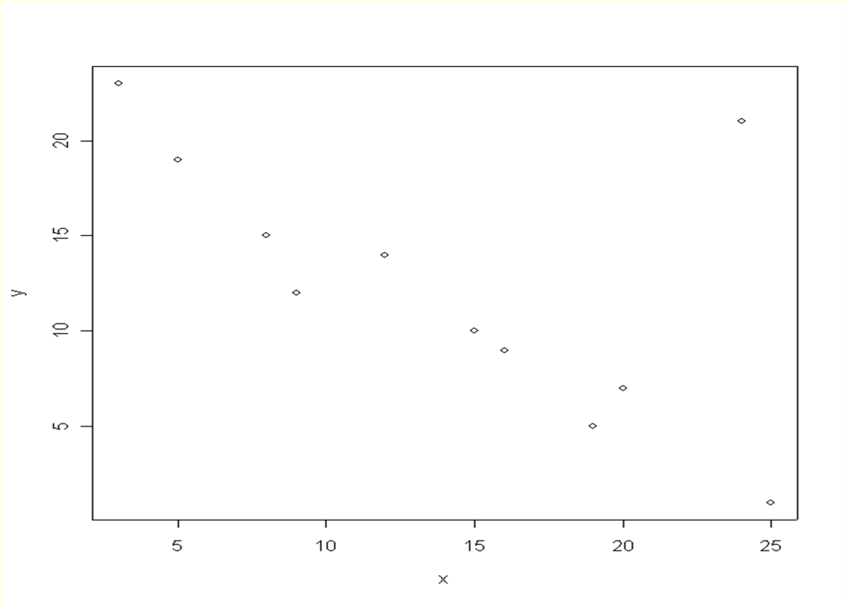
A bi-dimensional outlier that is not an outlier in either of its projections.

Slide 49

Recommended reading
Only with hard work and a favorable context you will have the chance to become an outlier!!!

Slide 50
DATA TRANSFORMATION

Slide 51
Normalization
For distance-based methods, normalization helps to prevent that attributes with large ranges out-weight attributes with small ranges
min-max normalization
z-score normalization
normalization by decimal scaling

Slide 52
Normalization
min-max normalization
v ' =
v − min v
(new _ max v − new_min )
v + new_minv
max v − min v
z-score normalization
_{v ' =} v − v
does not eliminate outliers
σ _{v}
normalization by decimal scaling
v
10 ^{j}
Where j is the smallest integer such that Max(| v' |)<1
range: -986 to 917 => j=3 -986 -> -0.986 917 -> 0.917
v' =

Slide 53
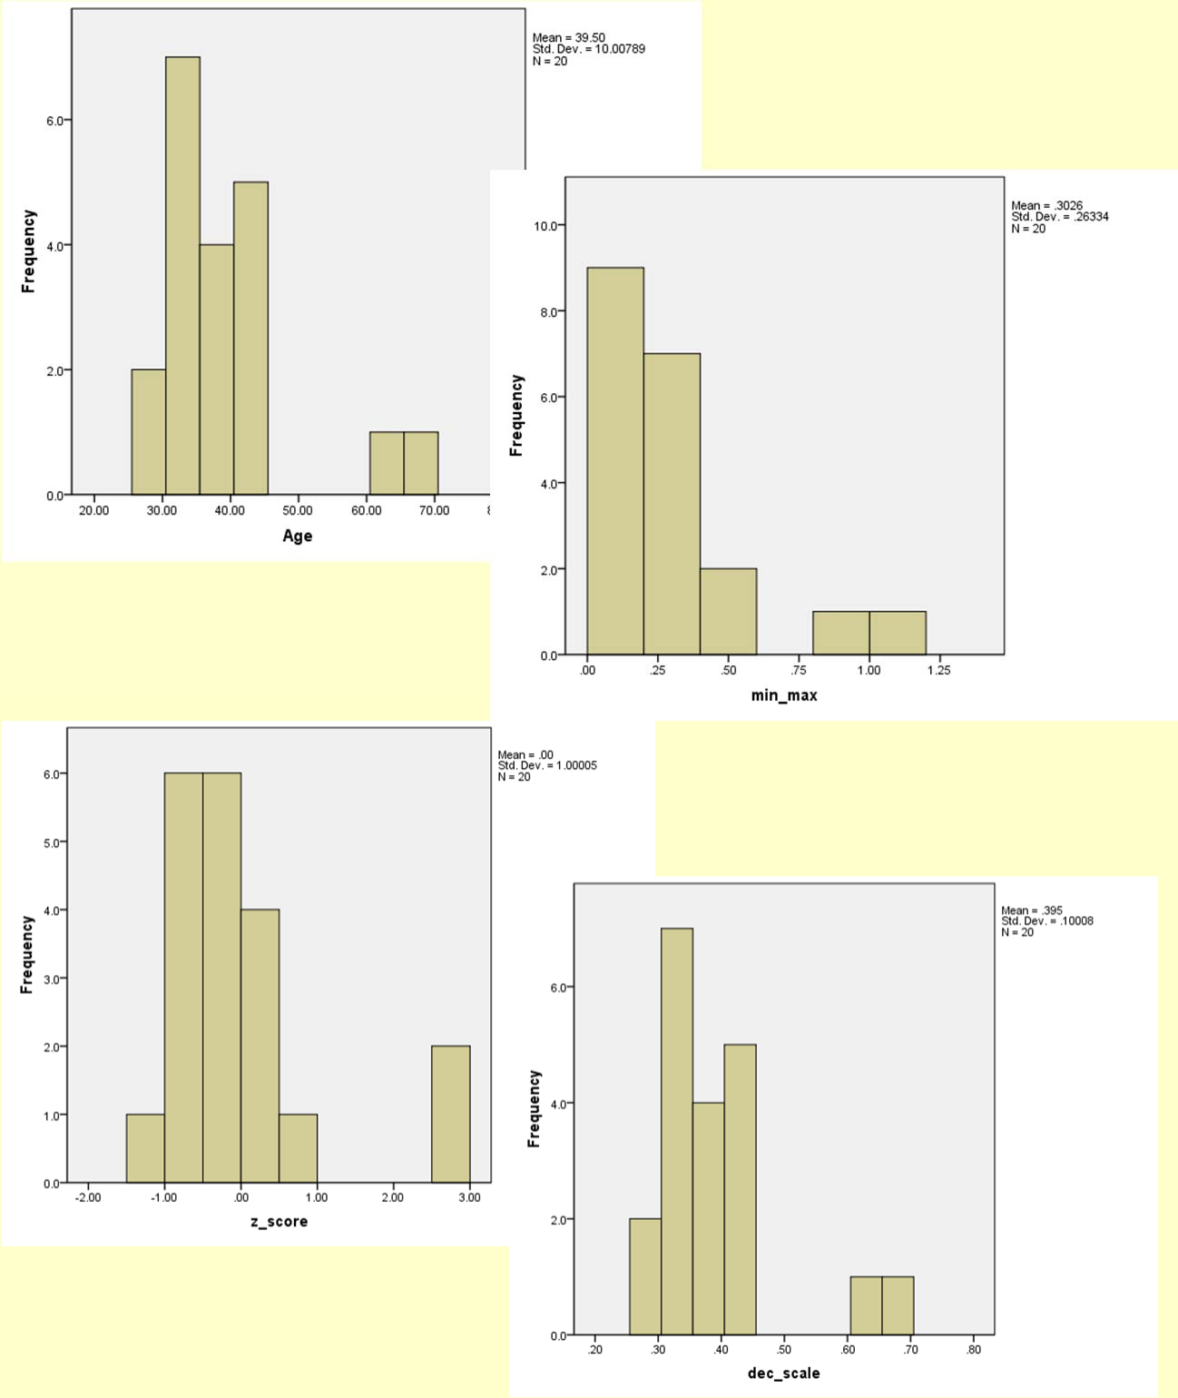
Age | min‐max (0‐1) z‐score |  | dec. scaling
44 | 0.421 0.450 |  | 0.44
35 | 0.184 ‐0.450 |  | 0.35
34 | 0.158 ‐0.550 |  | 0.34
34 | 0.158 ‐0.550 |  | 0.34
39 | 0.289 ‐0.050 |  | 0.39
41 | 0.342 0.150 |  | 0.41
42 | 0.368 0.250 |  | 0.42
31 | 0.079 ‐0.849 |  | 0.31
28 | 0.000 ‐1.149 |  | 0.28
30 | 0.053 ‐0.949 |  | 0.3
38 | 0.263 ‐0.150 |  | 0.38
36 | 0.211 ‐0.350 |  | 0.36
42 | 0.368 0.250 |  | 0.42
35 | 0.184 ‐0.450 |  | 0.35
33 | 0.132 ‐0.649 |  | 0.33
45 | 0.447 0.550 |  | 0.45
34 | 0.158 ‐0.550 |  | 0.34
65 | 0.974 2.548 |  | 0.65
66 | 1.000 2.648 |  | 0.66
38 | 0.263 ‐0.150 |  | 0.38
28 | minimun
66 | maximum
39.50 | avgerage
10.01 | standard deviation
53

Slide 54
MISSING DATA

Slide 55
Missing Data
Data is not always available
E.g., many tuples have no recorded value for several attributes, such as customer income in sales data
Missing data may be due to
equipment malfunction
inconsistent with other recorded data and thus deleted
data not entered due to misunderstanding
certain data may not be considered important at the time of entry
not register history or changes of the data
Missing data may need to be inferred.
Missing values may carry some information content: e.g. a credit application may carry information by noting which field the applicant did not complete

Slide 56
Missing Values
There are always MVs in a real dataset
MVs may have an impact on modelling, in fact, they can destroy it!
Some tools ignore missing values, others use some metric to fill in replacements
The modeller should avoid default automated replacement techniques
Difficult to know limitations, problems and introduced bias
Replacing missing values without elsewhere capturing that information removes information from the dataset

Slide 57
How to Handle Missing Data?
Ignore records (use only cases with all values)
Usually done when class label is missing as most prediction methods do not handle missing data well
Not effective when the percentage of missing values per attribute varies considerably as it can lead to insufficient and/or biased sample sizes
Ignore attributes with missing values
Use only features (attributes) with all values (may leave out important features)
Fill in the missing value manually
tedious + infeasible?

Slide 58
How to Handle Missing Data?
Use a global constant to fill in the missing value
e.g., “unknown”. (May create a new class!)
Use the attribute mean to fill in the missing value
It will do the least harm to the mean of existing data
If the mean is to be unbiased
What if the standard deviation is to be unbiased?
Use the attribute mean for all samples belonging to the same class to fill in the missing value

Slide 59
How to Handle Missing Data?
Use the most probable value to fill in the missing value
Inference-based such as Bayesian formula or decision tree
Identify relationships among variables
Linear regression, Multiple linear regression, Nonlinear regression
Nearest-Neighbour estimator
Finding the k neighbours nearest to the point and fill in the most frequent value or the average value
Finding neighbours in a large dataset may be slow

Slide 60
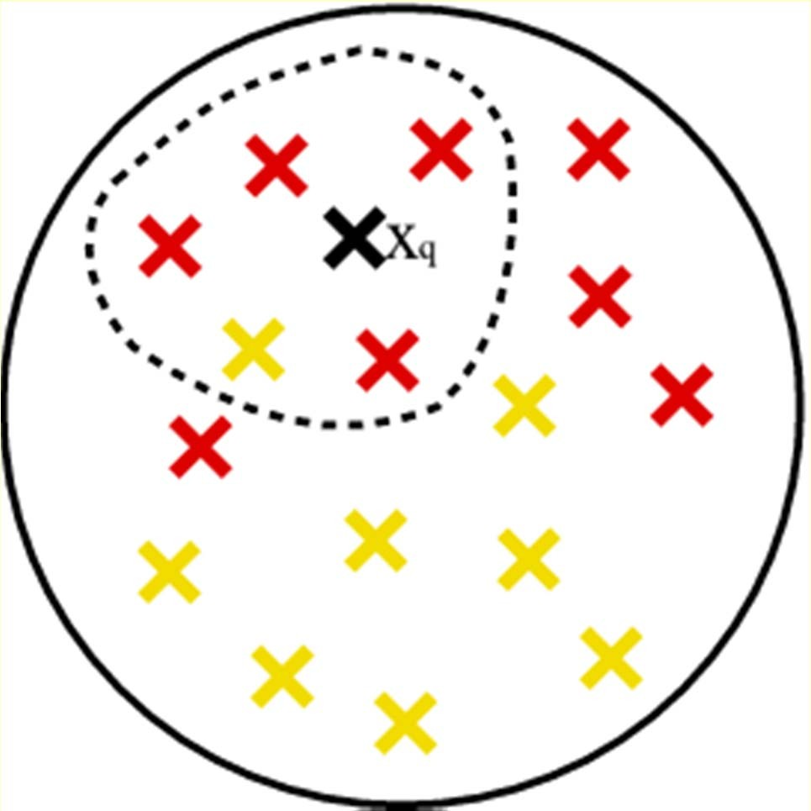
Nearest-Neighbour

Slide 61
How to Handle Missing Data?
Note that, it is as important to avoid adding bias and distortion to the data as it is to make the information available.
bias is added when a wrong value is filled-in
No matter what techniques you use to conquer the problem, it comes at a price. The more guessing you have to do, the further away from the real data the database becomes. Thus, in turn, it can affect the accuracy and validation of the mining results.

Slide 62
HANDLING REDUNDANCY

Slide 63
Handling Redundancy in Data Integration
Redundant data occur often when integrating databases
The same attribute may have different names in different databases
False predictors are fields correlated to target behavior, which describe events that happen at the same time or after the target behavior
Example: Service cancellation date is a leaker when predicting attriters
One attribute may be a “derived” attribute in another table, e.g., annual revenue
For numerical attributes, redundancy may be detected by correlation analysis
N
¹ ⋅∑(x − x )⋅ (y − y )
r =
N −1 _{n=1}
n n
(−1 ≤ r ≤ 1)
XY
1
N −1
N
1
N −1
N
XY
⋅ (x − x ) ⋅
⋅ (y
y )
∑ n
n=1
2
∑ n
n=1
2

Slide 64
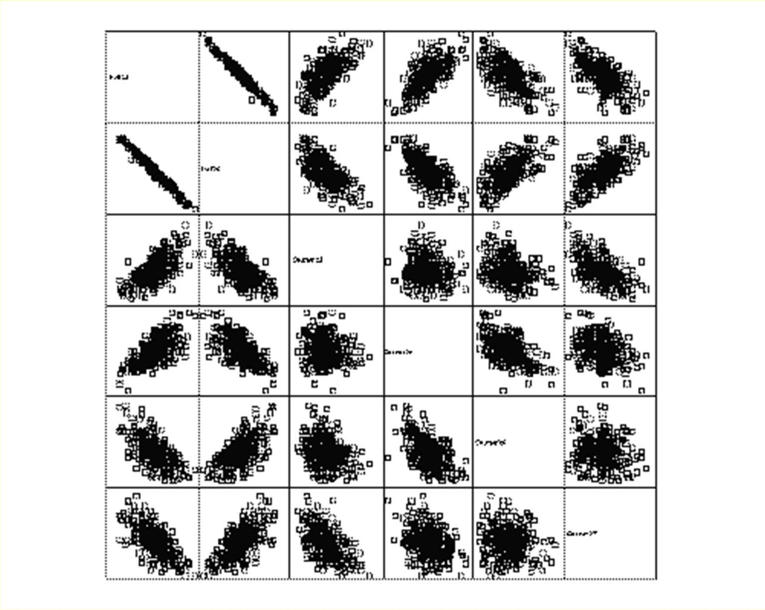
Scatter Matrix

Slide 65
SAMPLING AND UNBALANCED DATASETS

Slide 66
Sampling
The cost of sampling is proportional to the sample size and not to the original dataset size, therefore, a mining algorithm’s complexity is potentially sub-linear to the size of the data
Choose a representative subset of the data
Simple random sampling (SRS) (with or without reposition)
Stratified sampling:
Approximate the percentage of each class (or subpopulation of interest) in the overall database
Used in conjunction with skewed data

Slide 67
Unbalanced Target Distribution
Sometimes, classes have very unequal frequency
Attrition prediction: 97% stay, 3% attrite (in a month)
medical diagnosis: 90% healthy, 10% disease
eCommerce: 99% don’t buy, 1% buy
Security: >99.99% of Americans are not terrorists
Similar situation with multiple classes
Majority class classifier can be 97% correct, but useless

Slide 68
Handling Unbalanced Data
With two classes: let positive targets be a minority
Separate raw held-aside set (e.g. 30% of data) and raw train
put aside raw held-aside and don’t use it till the final model
Select remaining positive targets (e.g. 70% of all targets) from raw train
Join with equal number of negative targets from raw train, and randomly sort it
Separate randomized balanced set into balanced train and balanced test

Slide 69





Building Balanced Train Sets
Same % of Y and N
Targets
Y
..
.. N
Balanced set
Non‐Targets
N N N
.. Y N
..
SRS
70/30
Balanced Train
Balanced Test
Raw Held
SRS
Raw set for estimating accuracy of final model

Slide 70
Summary
Every real world data set needs some kind of data pre-processing
Deal with missing values
Correct erroneous values
Select relevant attributes
Adapt data set format to the software tool to be used
In general, data pre-processing consumes more than 60% of a data mining project effort

Slide 71
References
‘Data preparation for data mining’, Dorian Pyle, 1999
‘Data Mining: Concepts and Techniques’, Jiawei Han and Micheline Kamber, 2000
‘Data Mining: Practical Machine Learning Tools and Techniques with Java Implementations’, Ian H. Witten and Eibe Frank, 1999
‘Data Mining: Practical Machine Learning Tools and Techniques second edition’, Ian H. Witten and Eibe Frank, 2005
DM: Introduction: Machine Learning and Data Mining, Gregory Piatetsky-Shapiro and Gary Parker
(http://www.kdnuggets.com/data_mining_course/dm1-introduction-ml-data-mining.ppt)
ESMA 6835 Mineria de Datos (http://math.uprm.edu/~edgar/dm8.ppt)

