Slide 1


MTCS-MRMC5
Self-Learning Systems
Campaign-Level Detection of Low-and-Slow Password Spraying at API Login Endpoints Using a Temporal Convolutional Network
Name : CHIA U-MENG ADRIAN (XIE YOUMING)
Notes:
Good morning, everyone. My name is Adrian Chia. My thesis asks a simple question: can we catch a password attack that is designed to stay quiet? In the next eighteen minutes I will show you why the usual defences miss it, how looking at the whole crowd of login traffic makes it visible, and what a small neural network, a Temporal Convolutional Network, can and cannot do with that view.
[Target time 0:30]

Slide 2
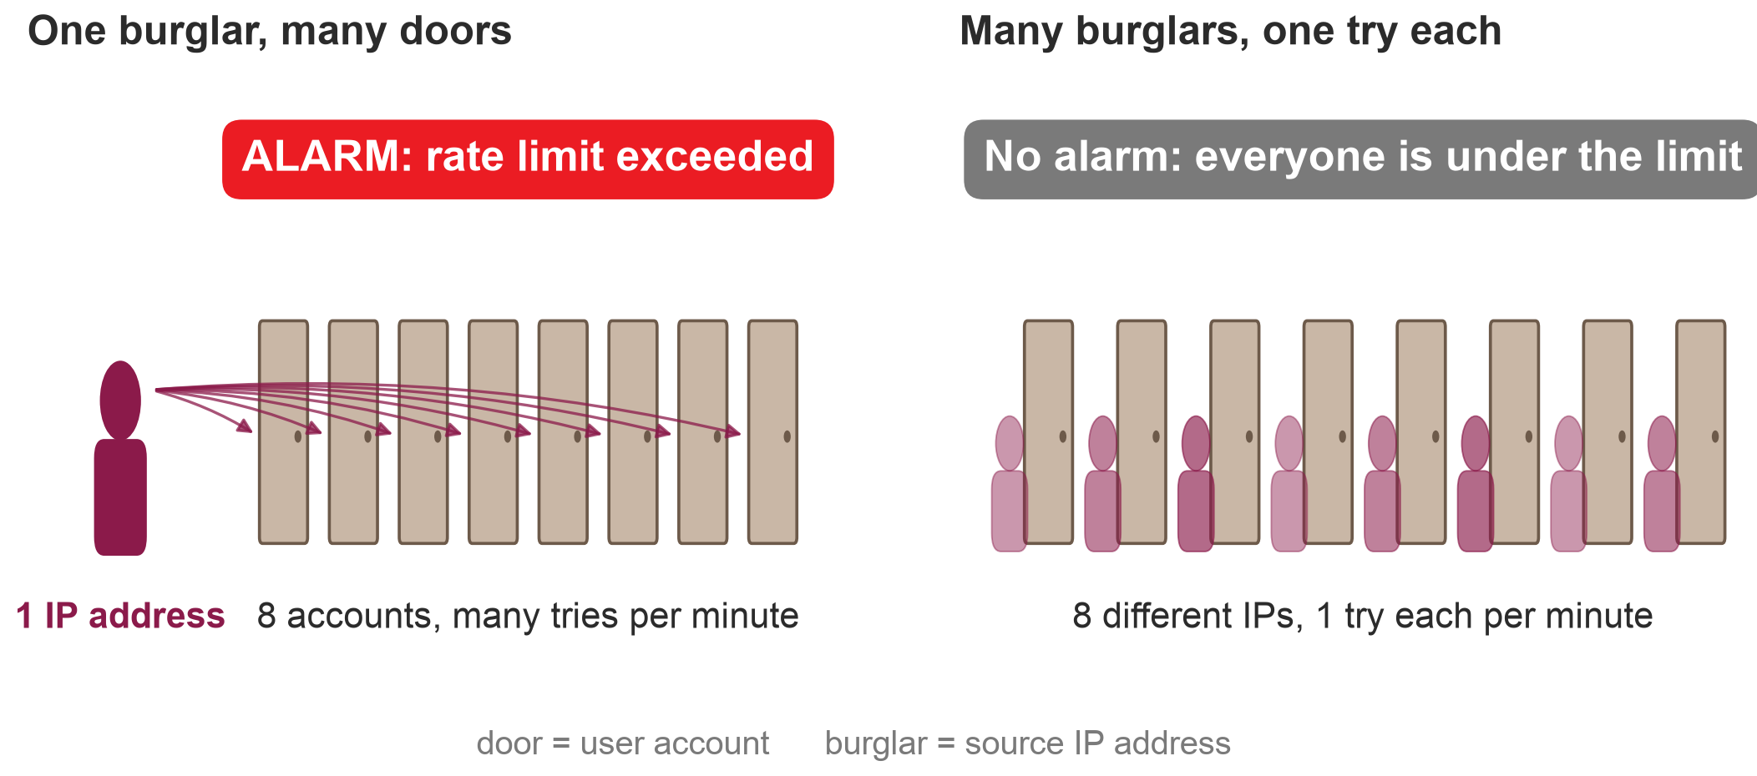
The quiet burglar
the quiet burglar
Would your alarm go off?
Low-and-slow password spraying: every IP and every account stays under every limit
2
Notes:
Let me start with a burglar. On the left, one burglar walks down a corridor and tries every door, again and again. That is easy to catch: one person, many attempts, and the alarm rings. On the right, the gang has learned. Each burglar tries one door, once, and walks away. Nobody tries twice, so nobody looks suspicious. [PAUSE] Quick question for the room: would your alarm go off on the right? [PAUSE] Most alarms would not. In my world, the door is a user account and the burglar is an IP address. Attackers spread their login attempts across hundreds of different IP addresses every minute and keep each one slow. This is called low-and-slow password spraying, and it is the attack this thesis is about.
[Target time 1:00]

Slide 3
Why this matters
Credential attacks are common, and this one is built to stay quiet
22%
39%
+113%
of breaches examined: stolen credentials were the way in (2025 DBIR research)
of breaches involve credential abuse at some stage (2026 DBIR)
daily API attacks per enterprise in one year (Akamai, 121 → 258)
Official names for this attack
MITRE ATT&CK T1110.003 Password Spraying · OWASP OAT-007 Credential Cracking
MITRE: adversaries may deliberately throttle spraying attempts to avoid triggering alerts.
Sources: Verizon 2025 DBIR research [8]; Verizon 2026 DBIR, p. 16 [9]; Akamai 2026 [10]; MITRE ATT&CK T1110.003 [1]; OWASP OAT-007 [14]
3
Notes:
This is not a theoretical problem. Research published by Verizon alongside the 2025 Data Breach Investigations Report found that stolen credentials were the way in for 22 per cent of the breaches examined. In the 2026 report, credential abuse still appears at some stage in 39 per cent of breaches. Akamai reports that daily API attacks per enterprise rose by 113 per cent in a year. And the technique has official names: MITRE ATT&CK calls it password spraying, T1110.003, and OWASP lists it under credential cracking, OAT-007. MITRE even notes that attackers deliberately slow spraying down to avoid alerts. So the attack is common, and it is built to be quiet.
[Target time 1:00]

Slide 4
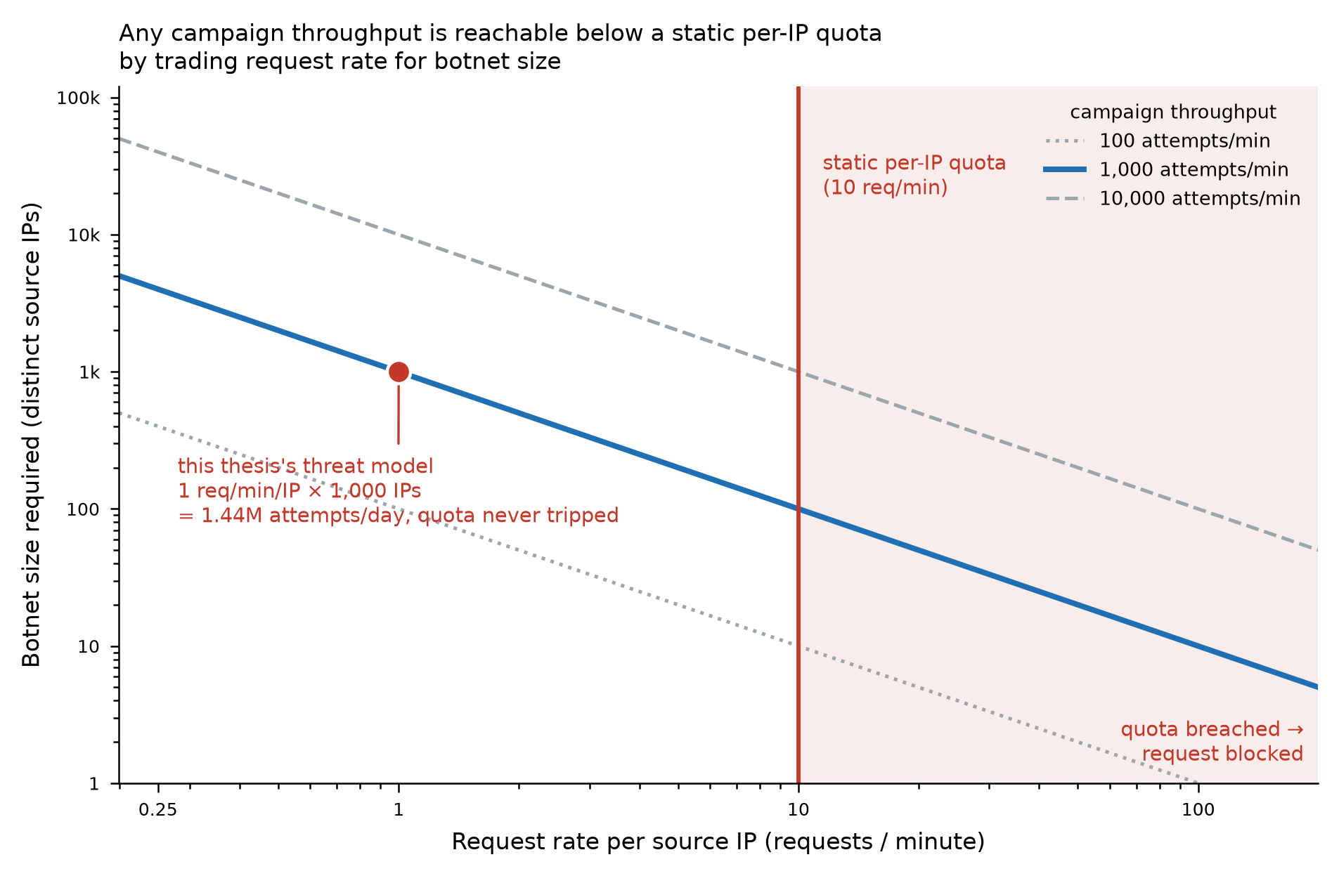
Why rate limits miss it
A per-IP limit caps each address, never the number of addresses
Total attack speed = requests per IP × number of IPs
The limit (red) fixes only the first factor.
More speed? Add IP addresses
Each address stays under the quota.
Account lockout fails too
Spraying touches each account only occasionally.
OWASP's own warning
IP-based blocking is easy to circumvent; do not rely on it alone.
Figure 1 of the thesis (ch.1.1); OWASP Credential Stuffing Prevention Cheat Sheet [4]
4
Notes:
So why do current defences miss it? The standard defence at an API Gateway is a rate limit: each client, usually each IP address, may send only so many requests per minute. This chart shows the problem. The horizontal axis is how fast each IP sends requests; the vertical axis is how many IPs the attacker uses. The curves show total attack speed. A per-IP limit is the red line. It caps how far to the right you can go, but says nothing about how far up. An attacker who wants more speed simply adds IP addresses and stays under the line. Account lockout has the same weakness from the other side: password spraying tries each account only occasionally, so no account reaches its lockout limit. OWASP itself warns that IP blocking should not be the main defence, because it is easy to get around.
[Target time 1:15]

Slide 5
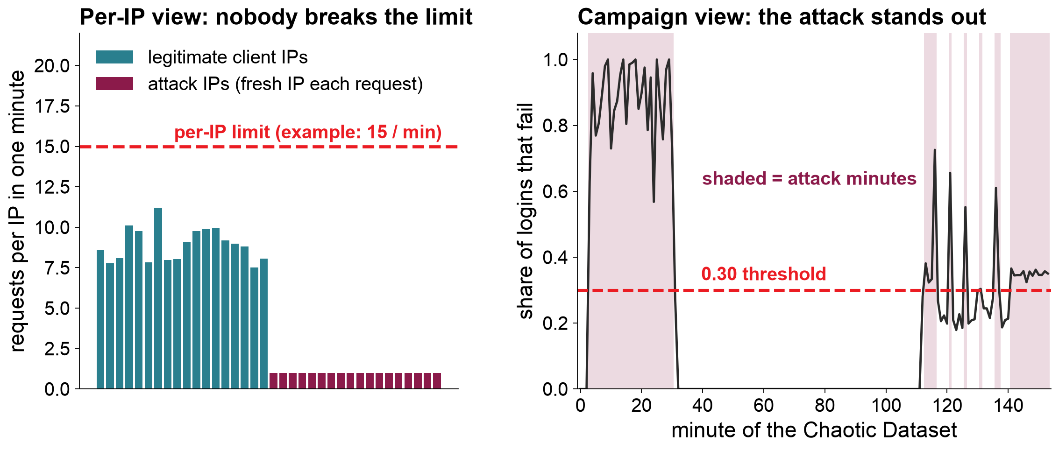
The idea: watch the crowd, not the person
the quiet burglar
Add up every login in each minute and ask one question: what share failed?
Left: illustration from the testbed configuration (Table 1). Right: the Chaotic Dataset, real minute-level data.
5
Notes:
So what would catch it? The idea of my thesis is to stop watching individuals and watch the crowd. On the left is the per-IP view of a minute in my testbed. Real users, in teal, each make about nine logins a minute. The attack addresses, in maroon, make one request each, because the bots use a fresh address every time. Against a per-IP limit, the attackers actually look quieter than real users. [CLICK] On the right is the campaign view. I add up every login in each minute, from every IP, and ask one question: what share of them failed? Now the attack is obvious. The shaded minutes are attack minutes, and the failure rate rises above the dashed line at 0.30.
[Target time 1:00]

Slide 6
Research question and two claims
Thesis statement (short form)
Per-client rate limits cannot bound a low-and-slow, IP-rotating spray. One-minute campaign-level aggregates make it visible, and a compact TCN learns the campaign-level boundary, carries it to independent traffic and costs almost nothing to run.
Claim 1: fidelity and transfer
The TCN reproduces the campaign labels on two independent test datasets, including one where the attack–IP relationship is reversed.
Claim 2: cost
One forward pass is far shorter than the one-minute window on an ordinary CPU, so the gateway overhead is negligible.
RQ1 Does it transfer? (ch.4.3–4.5)
RQ2 How fast does it alarm, and where does it fail? (ch.4.7–4.9)
RQ3 What does it cost? (ch.4.6)
6
Notes:
That leads to my thesis statement. Per-client rate limits cannot stop this attack, but one-minute, campaign-level summaries make it visible. I test two claims. Claim one, fidelity and transfer: a compact Temporal Convolutional Network learns the campaign rule and carries it to traffic it has never seen, even when that traffic behaves differently from training. Claim two, cost: running the model is cheap enough to sit next to an API Gateway. Three research questions follow: does it transfer, how quickly does it alarm and where does it fail, and what does it cost?
[Target time 0:45]

Slide 7
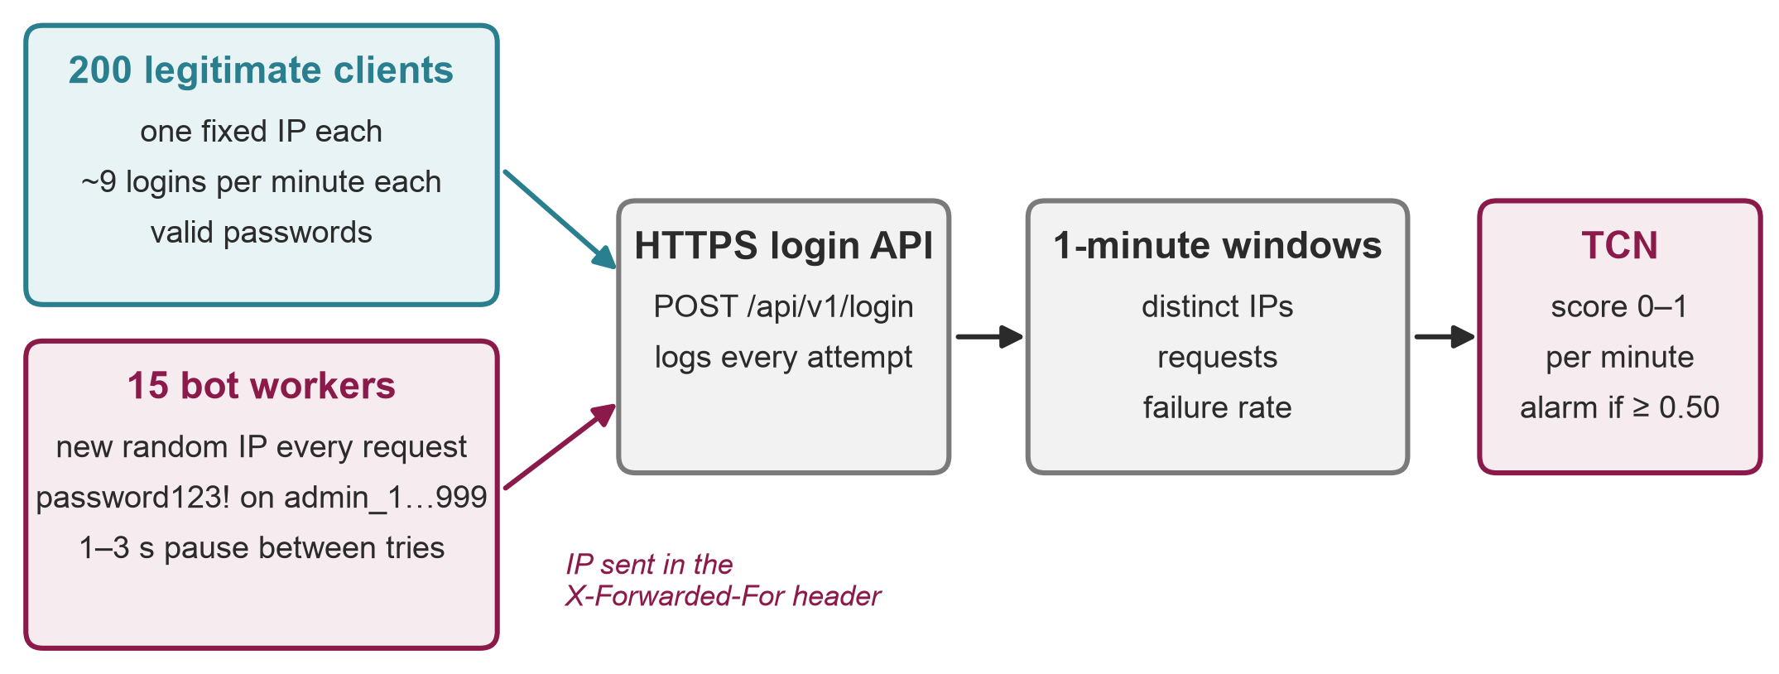
The testbed
Simulated login traffic against a real HTTPS endpoint
Honest caveat: lab-generated traffic, controlled but not production traffic
Table 1 of the thesis (ch.3.1); values taken from the traffic generator's source code
7
Notes:
To test this I built a testbed. At the top left, 200 legitimate clients, each with one fixed IP address, log in with valid passwords about nine times a minute each, around 30 requests per second in total. Below them, 15 bot workers run the attack. Each bot tries the same password, password123!, against the accounts admin_1 to admin_999, waits one to three seconds, and sends every request from a brand-new random IP address, written into the X-Forwarded-For header. Everything goes to an HTTPS login endpoint that records each attempt. The records are grouped into one-minute windows, and the TCN gives each minute a score between zero and one; a score of 0.50 or more raises an alarm. One honest point now, because it matters later: this traffic is simulated in a lab. That makes the experiment controlled, but it is not real enterprise traffic.
[Target time 1:15]

Slide 8
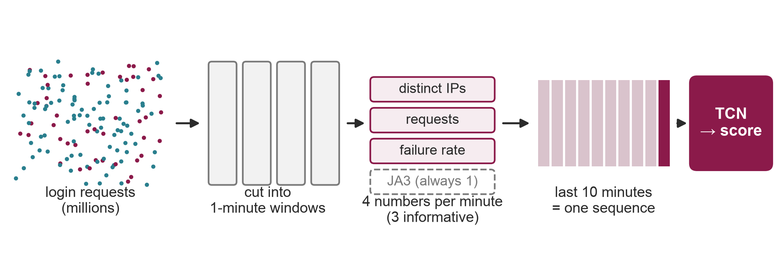
From requests to features
Millions of requests become a 10 × 3 table per decision
1 minute
3
10
1
window length
informative numbers per minute
minutes per sequence
score per minute
ch.3.2; JA3 was exactly 1 in all 17,198 windows of all datasets
8
Notes:
Here is how millions of login requests become something a model can read. Every request goes into its one-minute window. For each minute I compute four numbers: the number of distinct IP addresses, the number of requests, the share that failed, and the number of distinct TLS fingerprints, called JA3. That last one turned out to be exactly one in every window, so in practice the model works with three numbers per minute. The model looks at the last ten minutes as one sequence and scores the newest minute. So its whole view of the world is a small table: ten rows and three useful columns. That is why it can be so fast.
[Target time 1:00]

Slide 9
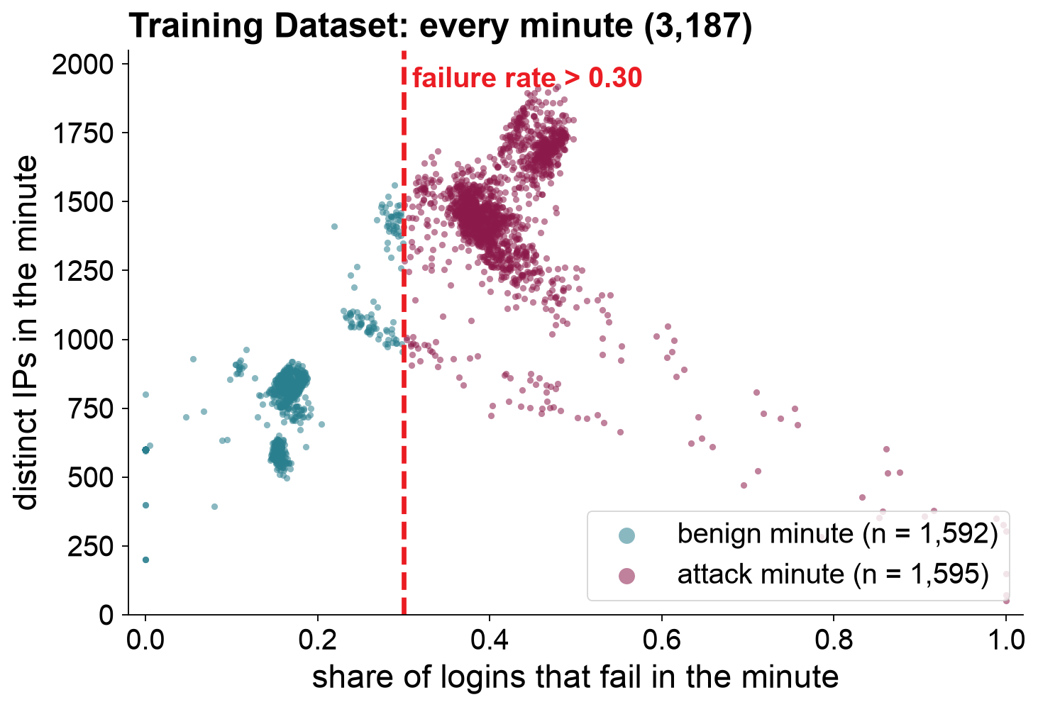
How an attack minute is labelled
The campaign rule
attack if failure rate > 0.30
and distinct IPs > 5
In practice the IP condition almost never matters: the label is a failure-rate threshold
(agreement 100%, 100% and 99.99% across the three datasets)
What this means
The label is computed from the model's own inputs. The model therefore learns a rule; it is not discovering unknown attacks. The results measure how faithfully it learns and transfers that rule.
ch.3.3, Proposition 1 and Table 2; limitation L1
9
Notes:
To train and test a model you need ground truth: which minutes are attacks? I use a campaign rule. A minute is labelled attack if more than 30 per cent of its logins fail and it has more than five distinct IP addresses. Each dot is one minute of the Training Dataset, 3,187 minutes in all, and the dashed line is the 0.30 rule. In practice the IP condition almost never matters, so the label is essentially a failure-rate threshold. I want to be upfront about what this means. Because the label is computed from the same numbers the model sees, the model is learning a rule, not discovering unknown attacks. My results show how faithfully a small network learns that rule and carries it to new data. I state this formally in chapter 3.3, and it shapes every claim I make.
[Target time 1:00]

Slide 10
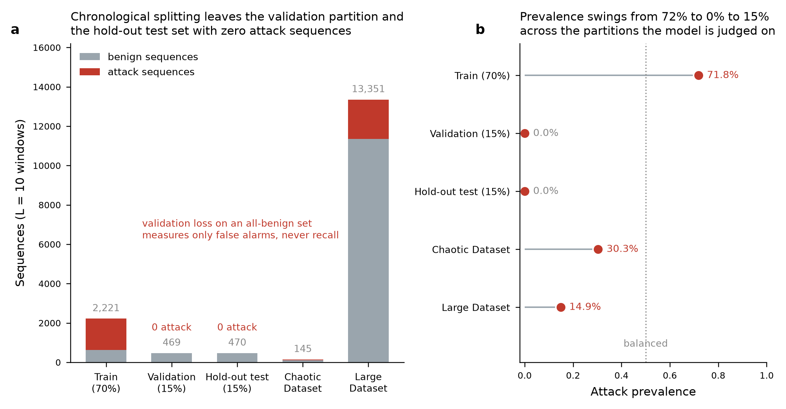
Three datasets
Chronological split; two independent test datasets the model never saw
Training Dataset
53.1 h · 8.1 M requests · 3,187 minutes
70 / 15 / 15 split in time order; validation and hold-out test set contain no attacks
Chaotic Dataset
154 min · stop-start attacks
bursts of 1–4 min, plus 28- and 13-min attacks · 145 sequences
Large Dataset
233.4 h · 33.7 M requests
four long attack blocks · 13,351 sequences
Table 3 and Figure 2 of the thesis (ch.3.4)
10
Notes:
I used three datasets. The Training Dataset is 53.1 hours of traffic, about 8.1 million requests, split in time order: the first 70 per cent for training, then 15 per cent for validation and 15 per cent as a hold-out test set. Because the attacks happened early in the recording, the validation set and the hold-out test set contain only normal traffic, as the chart shows, so the hold-out test set measures false alarms only. The real test comes from two independent test datasets that the model never saw. The Chaotic Dataset is 154 minutes of stop-start attacks, with bursts as short as one minute. The Large Dataset is a 233.4-hour run with 33.7 million requests.
[Target time 1:00]

Slide 11
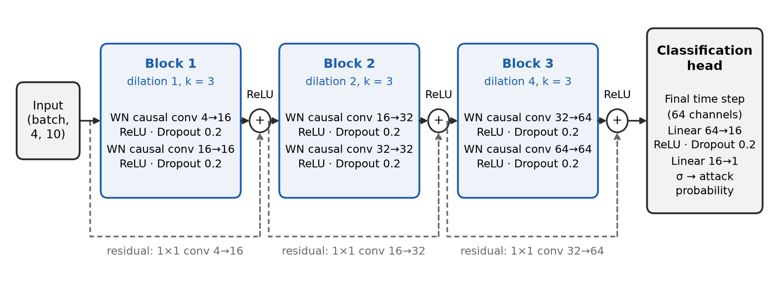
The model: a Temporal Convolutional Network
causal
dilations 1 · 2 · 4
28,241
looks only backwards in time, so it can run live
covers the whole 10-minute window (receptive field 29)
parameters, about 113 KB of weights
Figure 4 and Table 5 of the thesis (ch.3.5); architecture verified against the trained weights
11
Notes:
The model is a Temporal Convolutional Network, or TCN. Think of it as a small pattern detector that slides along the ten-minute timeline. It is causal: it only looks backwards in time, never at the future, so it can run live. It uses dilated convolutions: the first block compares neighbouring minutes, the second compares minutes two apart, the third four apart. Stacking them lets it cover the whole ten-minute window cheaply. The dashed shortcut connections help it train smoothly. At the end, a small classifier turns the last time step into an attack probability. The whole network has 28,241 parameters, about 113 kilobytes of weights. I checked this architecture against the trained weights file itself, and it loads exactly.
[Target time 1:15]

Slide 12
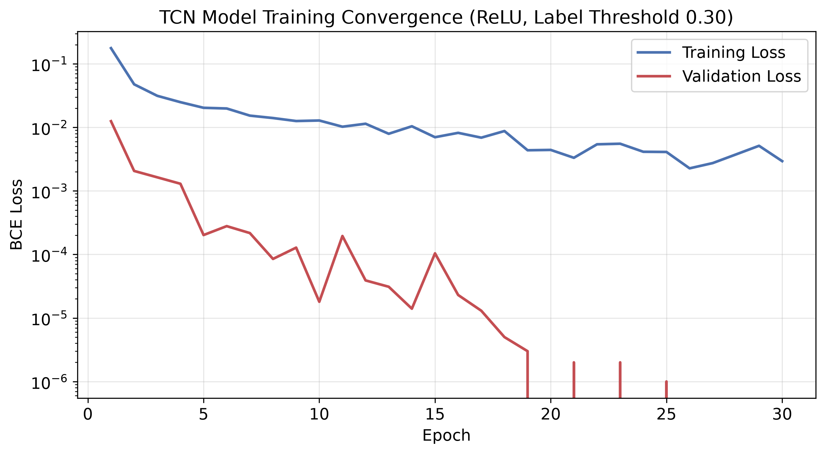
Training
30 epochs; checkpoint from epoch 27 (lowest validation loss)
Why is validation loss almost zero?
The validation set contains only normal traffic.
It measures false alarms, not whether attacks are caught.
Recall is measured on the independent test datasets.
Figure 5 of the thesis (ch.4.1); Table 6
12
Notes:
Training ran for 30 epochs. Training loss, in blue, falls steadily, and I kept the checkpoint from epoch 27, which had the lowest validation loss. The red validation curve falls almost to zero. That looks too good, and there is a reason: the validation set contains only normal traffic, so it only tells us that the model does not raise false alarms. It says nothing about whether attacks are caught. That is why the two independent test datasets matter: they are where recall is measured.
[Target time 0:45 · SKIP IF SHORT OF TIME]

Slide 13
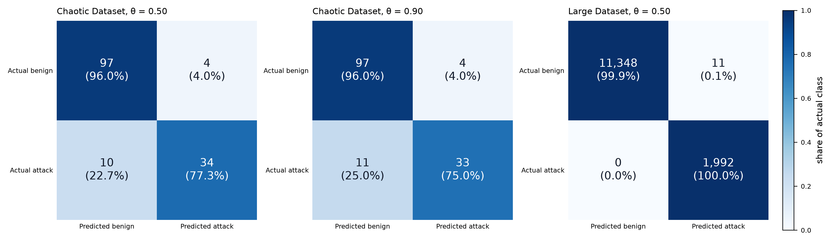
Results: the headline
Frozen model, independent test datasets, threshold 0.50
1,992 / 1,992
11
0.9972
≈ 1.4 / day
Large Dataset attack sequences found (recall 1.0)
false alarms in 11,359 normal sequences
F1 on the Large Dataset (precision 0.9945)
false alerts on the Large Dataset
Chaotic Dataset
F1 0.83
precision 0.89 · recall 0.77
Hold-out test set
0 false alarms
in 470 normal sequences
Tables 7 and 8, Figure 7 of the thesis (ch.4.2–4.3)
13
Notes:
So, does it work? On the Large Dataset, 233 hours that the model had never seen, there were 1,992 attack sequences. The model found every one of them: a recall of 1.0. Out of 11,359 normal sequences it raised only 11 false alarms. That gives a precision of 0.9945 and an F1 score of 0.9972, or about 1.4 false alerts per day. On the hold-out test set, 470 normal sequences, it raised no false alarms at all. [PAUSE] The Chaotic Dataset is harder by design: short bursts that start and stop. There the F1 score is 0.83, with precision 0.89 and recall 0.77. It missed 10 of 44 attack sequences, and in a moment I will show you exactly where. The confusion matrices give the counts.
[Target time 1:30]

Slide 14
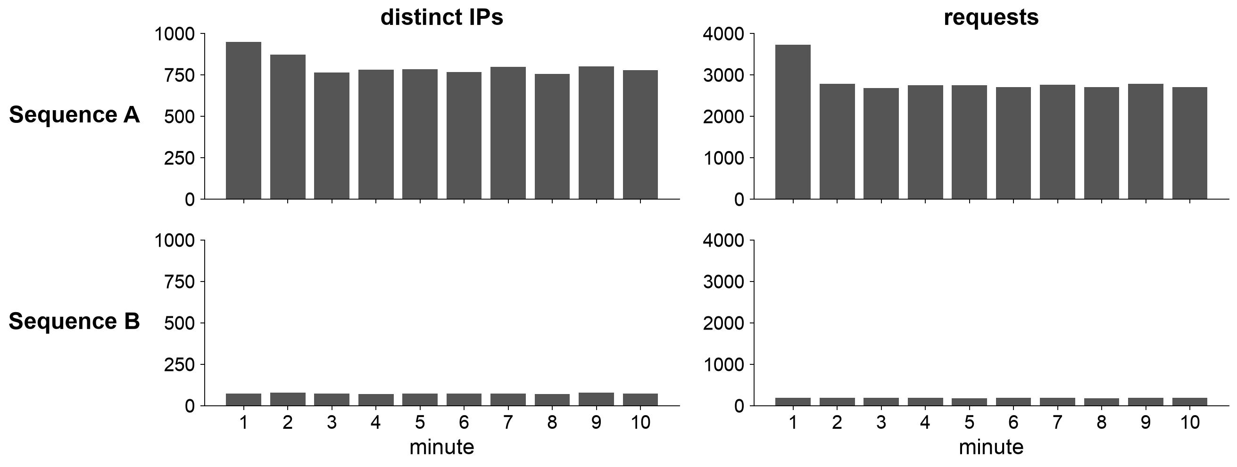
Spot the attack
the quiet burglar
Two 10-minute sequences from the Large Dataset. One is an attack. A or B?
A
or
B ?
14
Notes:
Now a quick game. Here are two ten-minute sequences from the Large Dataset. I am showing only two of the numbers the model receives: distinct IP addresses and requests per minute. One of them is an attack. Hands up if you think it is A. [PAUSE] And who thinks B? [PAUSE] Most people choose A: lots of IP addresses and lots of traffic. That looks like a botnet.
[Target time 0:40 · SKIP IF SHORT OF TIME]

Slide 15
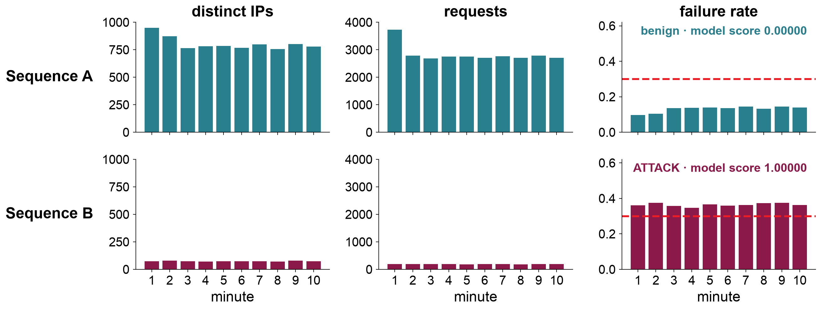
Spot the attack: the answer is B
the quiet burglar
Few IPs, little traffic, but more than a third of its logins fail
Large Dataset sequences ending at window 2,854 (A) and window 1,188 (B); scores from the trained model
15
Notes:
The answer is B. A is normal traffic: around 800 IP addresses and 2,800 requests a minute. B is the attack: only about 74 IP addresses and fewer than 200 requests a minute, but more than a third of its logins fail. The model scored A at essentially zero and B at essentially one.
[Target time 0:25 · SKIP IF SHORT OF TIME]

Slide 16
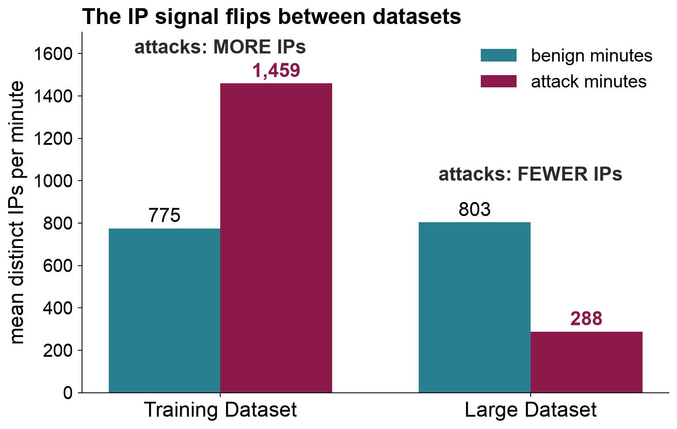
The plot twist
the quiet burglar
The IP signal flips between datasets, and the model still works
Earlier exploratory model
recall 0.26 on the Large Dataset: it followed the IP count
Final model
recall 1.00 on the Large Dataset
What its scores follow
failure rate: +0.71 (Spearman)
distinct IPs: −0.39
Tables 4, 9 and 10 of the thesis (ch.3.4, 4.4, 4.5)
16
Notes:
And that is the plot twist of this thesis. In the Training Dataset, attack minutes had more IP addresses than normal minutes: 1,459 against 775 on average. In the Large Dataset it is the opposite: 288 against 803. A model that had simply learned 'many IPs means attack' would fail badly here. In fact I have such a model: an earlier exploratory version, trained on a smaller dataset with a different label threshold, found only about a quarter of the attacks on this dataset. The final model found all of them, and its scores follow the failure rate, with a rank correlation of plus 0.71, while moving against the IP count. It learned the campaign signal, not the shortcut.
[Target time 0:55]

Slide 17
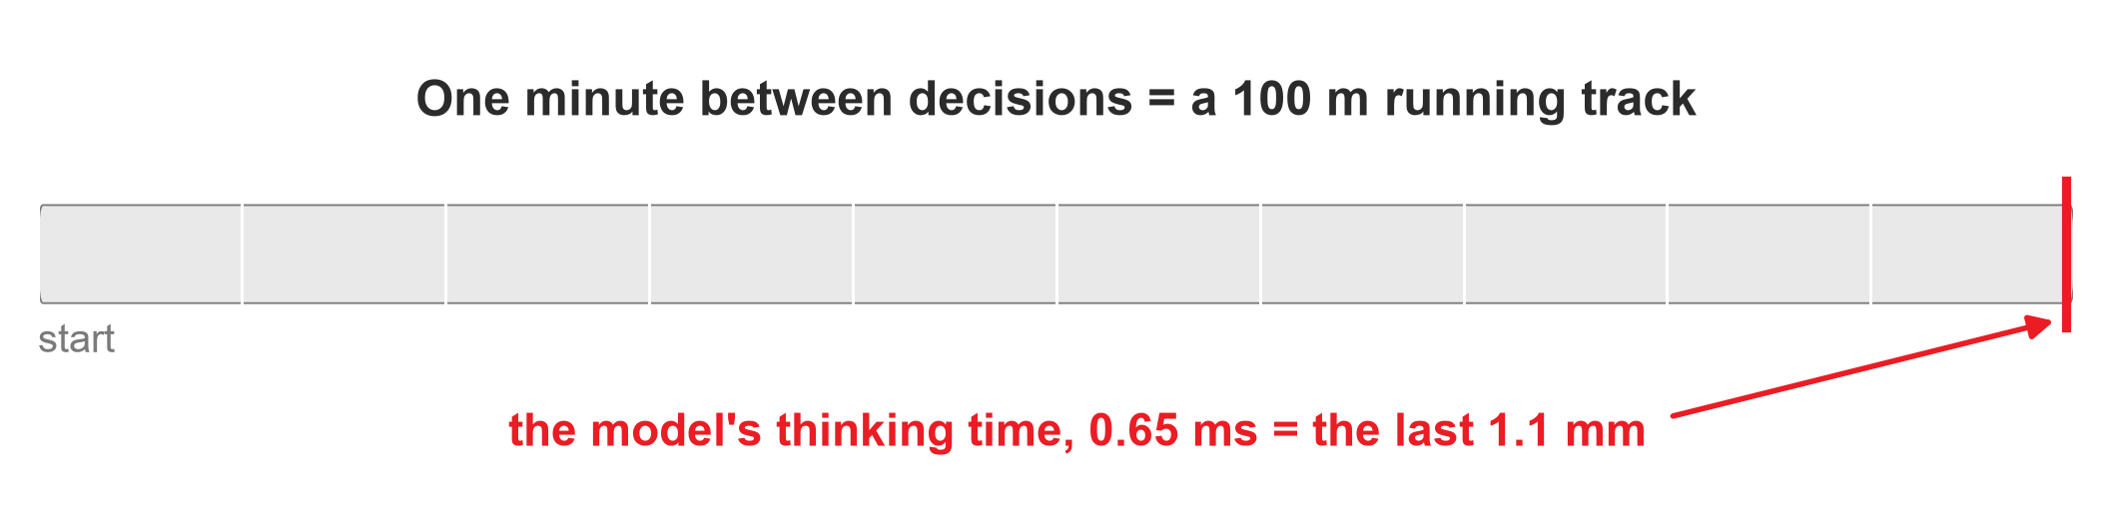
Fast enough for a gateway
Claim 2: one decision per minute, measured on an ordinary CPU
0.65 ms
1.64 ms
≈ 0.001%
same cost
mean time per decision
99th percentile
of one CPU core
at 10 or 10,000 requests per second
Not measured: the cost of computing the per-minute aggregates.
Table 11 of the thesis (ch.4.6): 500 timed forward passes, batch size 1, 6 CPU threads
17
Notes:
Claim two: cost. One forward pass of the model takes 0.65 milliseconds on average on an ordinary CPU, and 1.64 milliseconds at the 99th percentile. The model runs once per minute. If one minute were a 100-metre running track, the model's thinking time would be the last 1.1 millimetres. That is about 0.001 per cent of one CPU core. Because the model reads one summary per minute, the cost is the same whether the gateway handles ten requests a second or ten thousand. One caveat: computing the per-minute summaries also costs something, and I did not benchmark that part.
[Target time 0:45]

Slide 18
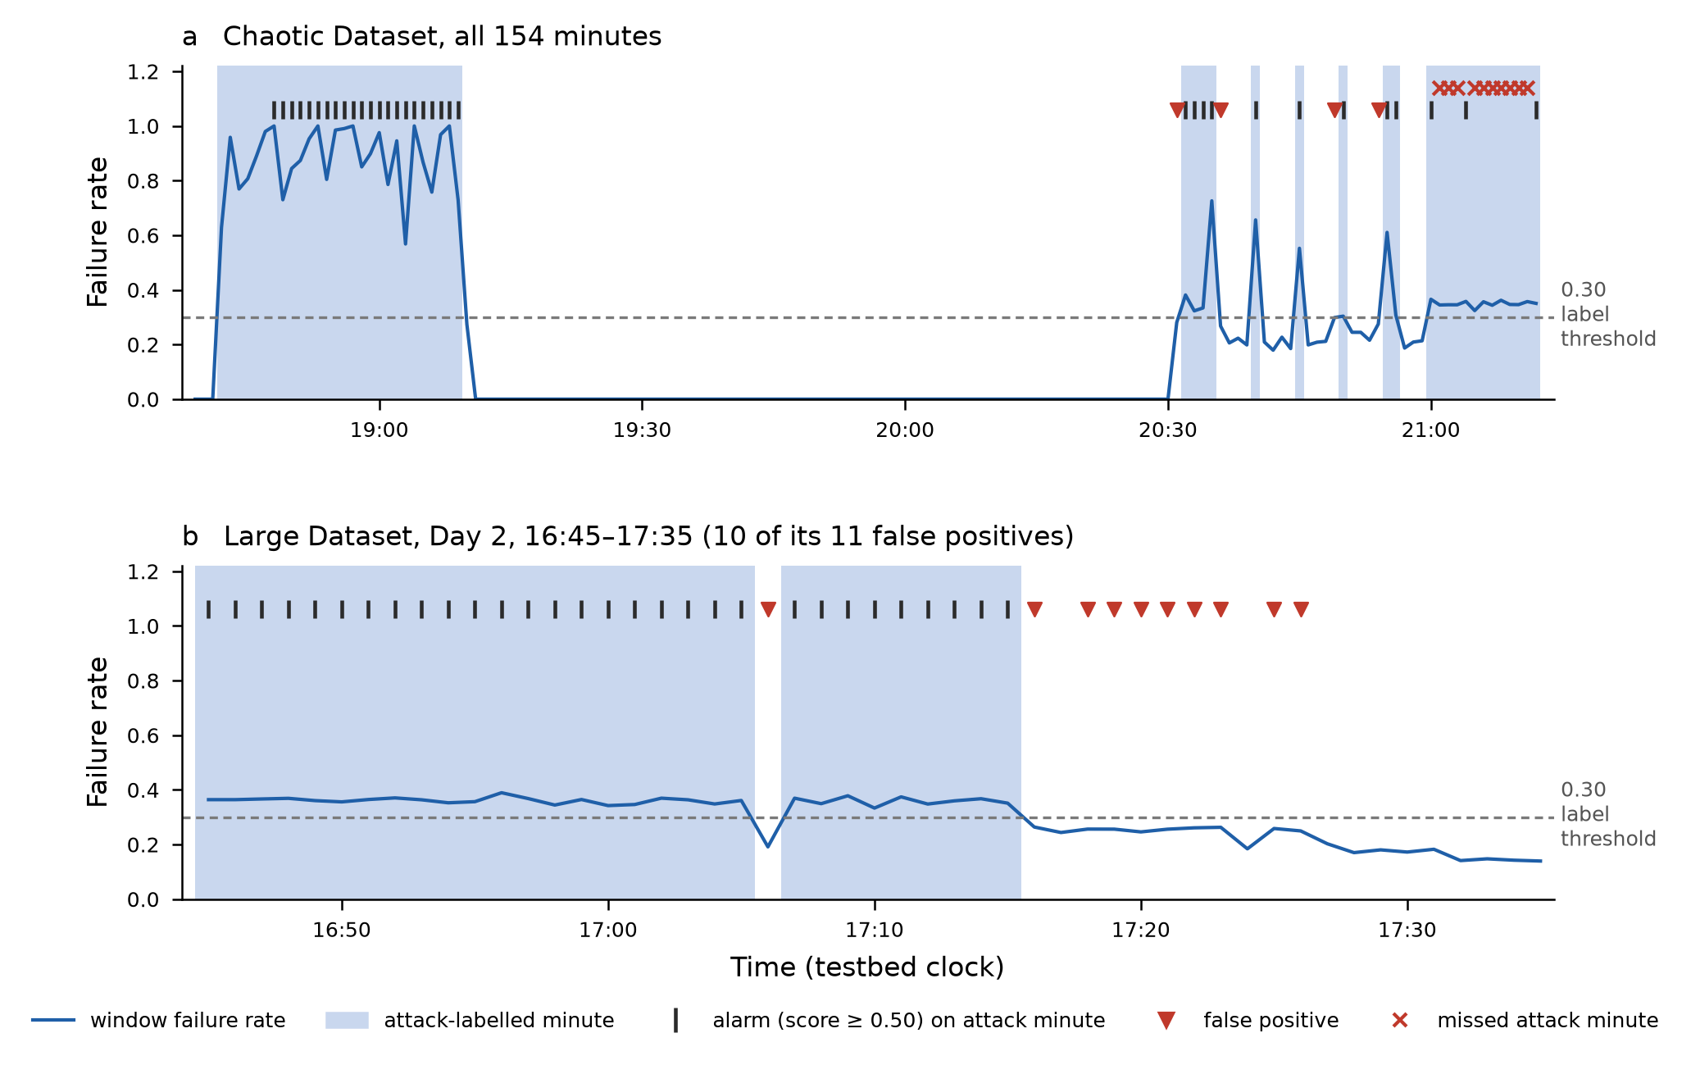
When it fires and where it errs
First minute
alarm in the first scorable minute of every attack episode
15 false alarms
all within 15 min of an attack; failure rate 0.19–0.30
10 misses
all in the last Chaotic attack; failure rate 0.32–0.36
0 false alarms
in more than 11,000 normal minutes far from any attack
Figure 10 and Tables 12–13 of the thesis (ch.4.7–4.8); threshold 0.50
18
Notes:
Two practical questions: how quickly does it alarm, and where does it go wrong? The top panel is the whole Chaotic Dataset; the bottom panel is a 50-minute stretch of the Large Dataset. Shaded minutes are attack minutes and the black ticks are alarms. For every attack episode whose first minute could be scored, the model alarmed in that very first minute, including one-minute bursts. All 15 false alarms, the red triangles, happen within 15 minutes of an attack, at its edges, with failure rates between 0.19 and 0.30, just under the line. Across more than 11,000 normal minutes far from any attack there were no false alarms at all. The 10 misses, the crosses, are all in the last Chaotic attack, where the failure rate hovers just above the line, at 0.32 to 0.36. So the errors sit exactly where the rule itself is borderline.
[Target time 1:15]

Slide 19
Limitations, honestly
What this thesis does not show
1
Simulated traffic
200 synthetic users, one browser profile, no daily cycles (L6)
2
Labels come from a rule
a failure-rate threshold reproduces them exactly; the model learns the rule (L1)
3
TLS and header features untested
JA3 was constant; no header features were extracted (L5)
4
Minutes, not IPs
no per-client attribution; the throttling mechanism was not built (L7)
5
Single run
no fixed random seed; overlapping sequences make the intervals optimistic (L4)
6
Evasion
≈ 2.3 successful logins per failure keeps the rate at 0.30 (L3, not tested)
ch.5.2 (L1–L7) and Table 15 of the thesis
19
Notes:
I want to be clear about what this work does not show. First, the data are simulated: 200 synthetic users with one browser profile, no daily cycles and no real user mistakes. Second, the labels come from a rule over the model's own inputs, and a simple failure-rate threshold reproduces them exactly. So the model learns a rule; this does not show that it finds attacks the rule would miss. Third, the TLS fingerprint was constant and I extracted no header features, so TLS and header analysis are not tested here. Fourth, the model flags minutes, not IP addresses, and I did not build the throttling mechanism itself. Fifth, each result comes from a single training run without a fixed random seed. And an attacker who knows the 0.30 boundary could hide by adding about 2.3 successful logins for every failed one.
[Target time 1:15]

Slide 20
Take-home messages
1
2
3
Look at the campaign, not the client
A small TCN learns and carries the rule
It costs almost nothing
Per-client limits cannot see a low-and-slow attack that rotates IPs. One-minute aggregates can.
28,241 parameters; F1 0.9972 on 233 unseen hours, even when the IP pattern flips.
0.65 ms once a minute, about 0.001% of one CPU core.
Within the limits stated, both claims of the thesis hold.
20
Notes:
Three messages to take home. One: per-client rate limits cannot see a low-and-slow attack that rotates IP addresses; you have to look at the campaign, the whole minute. Two: a small TCN, about 28 thousand parameters, learns that campaign rule and carries it to new traffic, even when the IP pattern flips. Three: it costs almost nothing to run, well under a millisecond once a minute. Within the limits I described, both claims of the thesis hold.
[Target time 0:45]

Slide 21
Thank you
the quiet burglar
Questions?
Campaign-level detection of low-and-slow password spraying at API login endpoints
Chia U-Meng Adrian (Xie Youming) · MTCS-MRMC5
21
Notes:
Thank you for listening. I am happy to take your questions.
[Target time 0:15]

Slide 22
Backup slides
Shown only when a question needs them
B1 the labelling rule is recoverable from the inputs
B6 scores near the 0.30 boundary
B2 hold-out test set (false-positive benchmark)
B7 latency distribution
B3 an earlier model that did not transfer
B8 threats to validity
B4 false alerts per day against threshold
B9 where this sits in the literature
B5 95% confidence intervals
B10 feature distributions in the Training Dataset
22
Notes:
Divider: everything after this slide is backup material. Jump here from any question with the slide number (type the number and press Enter in slide show).

Slide 23
Backup: the labelling rule is recoverable from the inputs
Proposition 1: a threshold on the standardised final window reproduces every label
Dataset | Windows with failure rate > 0.30 | Windows labelled attack | Agreement with failure-rate threshold alone
Training | 1,595 | 1,595 | 100%
Chaotic Dataset | 50 | 50 | 100%
Large Dataset | 2,001 | 2,000 | 99.99% (1 window with ≤ 5 IPs)
ℓ(W) = 1[failure rate > 0.30] · 1[distinct IPs > 5]
Consequence: the evaluation measures fidelity and transfer of a campaign rule, not discovery of attacks outside the rule (L1). A zero-parameter threshold reproduces the labels exactly; the contribution is that a compact network learns this boundary from data and keeps it under a distribution shift.
ch.3.3, Table 2; Kaufman et al. on leakage [59]
23
Notes:
Show if asked about circularity, target leakage or 'is the model just learning a threshold?'. Key line: yes, by design; the claim is fidelity and transfer (ch.3.3, L1).

Slide 24
Backup: hold-out test set (false-positive benchmark)
470
0
0.000000146
benign sequences (8.0 h, last 15% of the Training Dataset)
false positives at every threshold from 0.50 to 0.90
highest score given to any sequence
All attack-labelled windows fall in the first 70% of the recording, so the chronological validation set and hold-out test set are benign only. They serve as a false-positive benchmark; recall is measured on the independent test datasets.
ch.4.2; Table 3
24
Notes:
Show if asked why the hold-out test set has no attacks. 470 benign sequences, 0 false positives at every threshold 0.50–0.90, maximum score 1.46e-7 (ch.4.2).

Slide 25
Backup: an earlier model that did not transfer
Earlier model: 497 windows (8.3 h), labels at failure rate > 0.40, GELU; same three-block topology
Model / dataset | Precision | Recall | F1 | ROC-AUC | TN / FP / FN / TP
Earlier · Chaotic | 1.0000 | 0.7500 | 0.8571 | 0.9802 | 101 / 0 / 11 / 33
Final · Chaotic | 0.8947 | 0.7727 | 0.8293 | 0.9876 | 97 / 4 / 10 / 34
Earlier · Large | 1.0000 | 0.2575 | 0.4096 | 0.3576 | 11,359 / 0 / 1,479 / 513
Final · Large | 0.9945 | 1.0000 | 0.9972 | 0.999983 | 11,348 / 11 / 0 / 1,992
Chaotic Dataset: no significant difference (Fisher p = 1.00 for recall, p = 0.12 for false alarms). Large Dataset: the earlier model's scores rise with IP count (Spearman +0.401). The models differ in data, label threshold and activation at once, so the cause of the failure is not isolated.
ch.4.5, Table 10; Fisher's exact test on the Chaotic Dataset
25
Notes:
Show if asked whether transfer is automatic. Earlier model: 497 windows, 0.40 labels, GELU; three differences at once, so the comparison does not isolate the cause (ch.4.5).

Slide 26
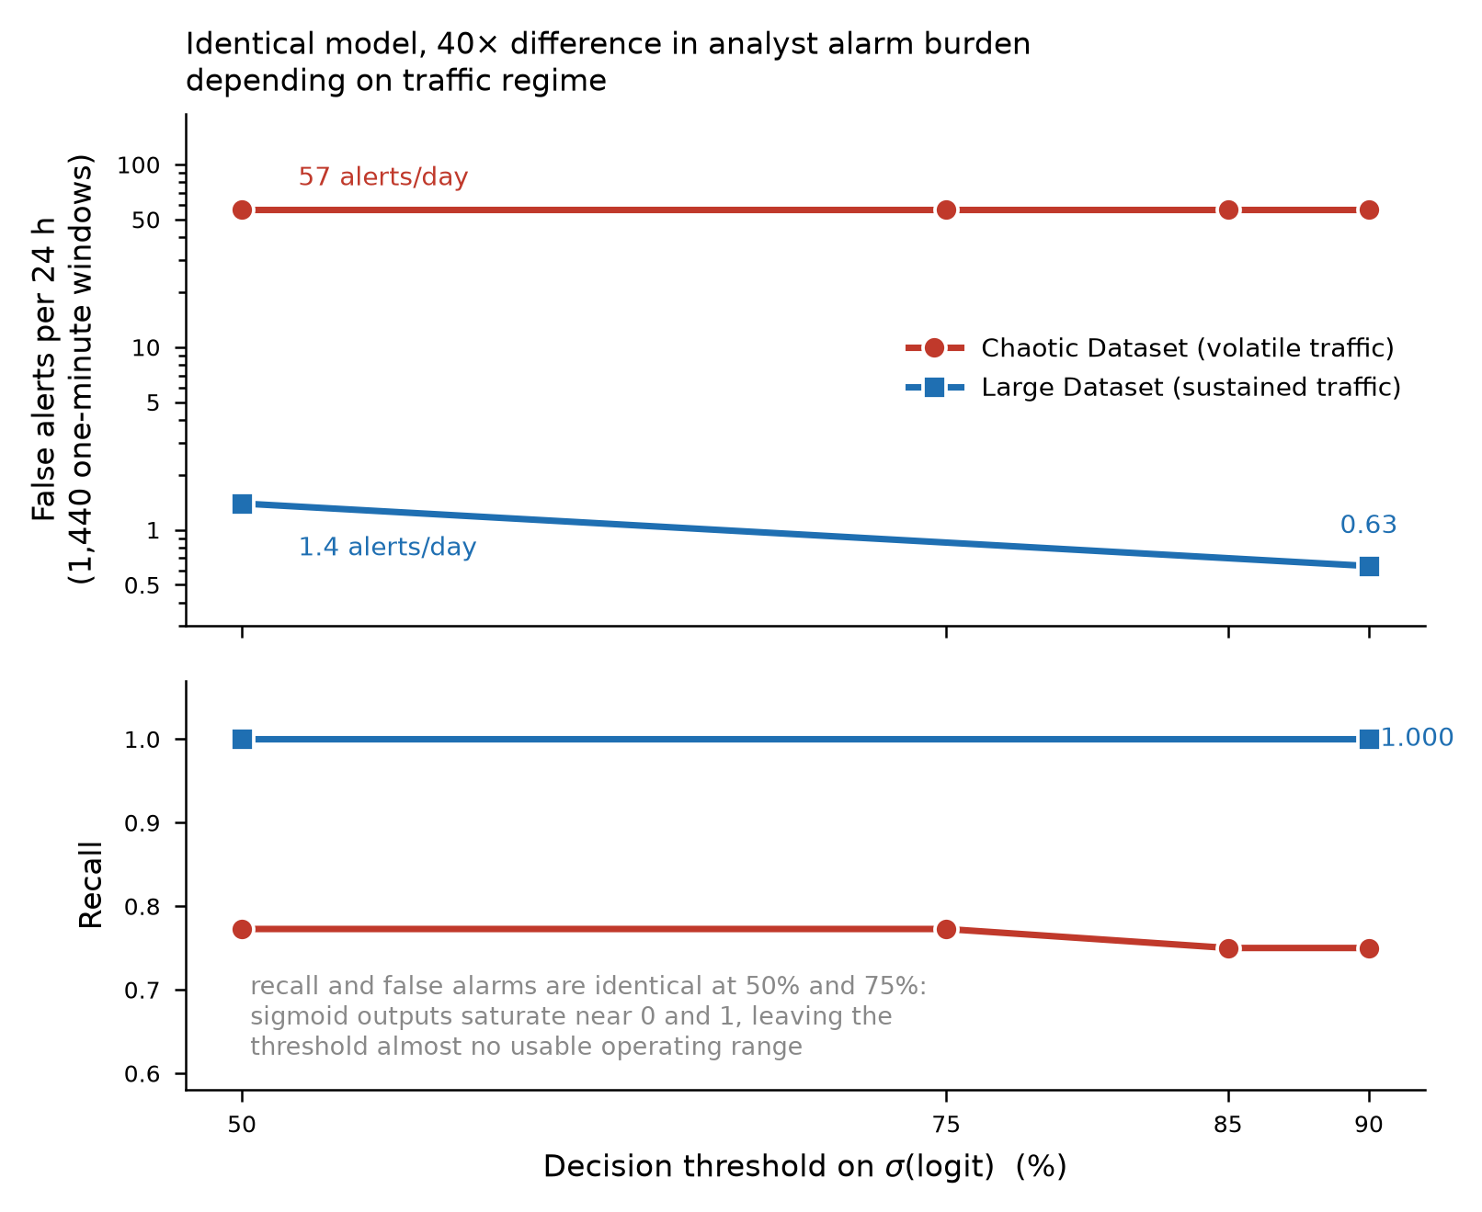
Backup: false alerts per day against threshold
Dataset (θ) | FPR | False alerts / day
Chaotic (0.50) | 0.0396 | 57.0
Large (0.50) | 0.00097 | 1.39
Large (0.90) | 0.00044 | 0.63
Scores are strongly bimodal (99.9% of Large Dataset scores below 0.01 or above 0.99), so moving the threshold from 0.50 to 0.90 changes few decisions.
Figure 8 and Table 8 of the thesis (ch.4.3); alerts/day = 1,440 × FPR
26
Notes:
Show if asked about threshold choice or alarm fatigue. 57 false alerts/day on the Chaotic Dataset vs 1.39 on the Large Dataset at 0.50 (Figure 8, Table 8).

Slide 27
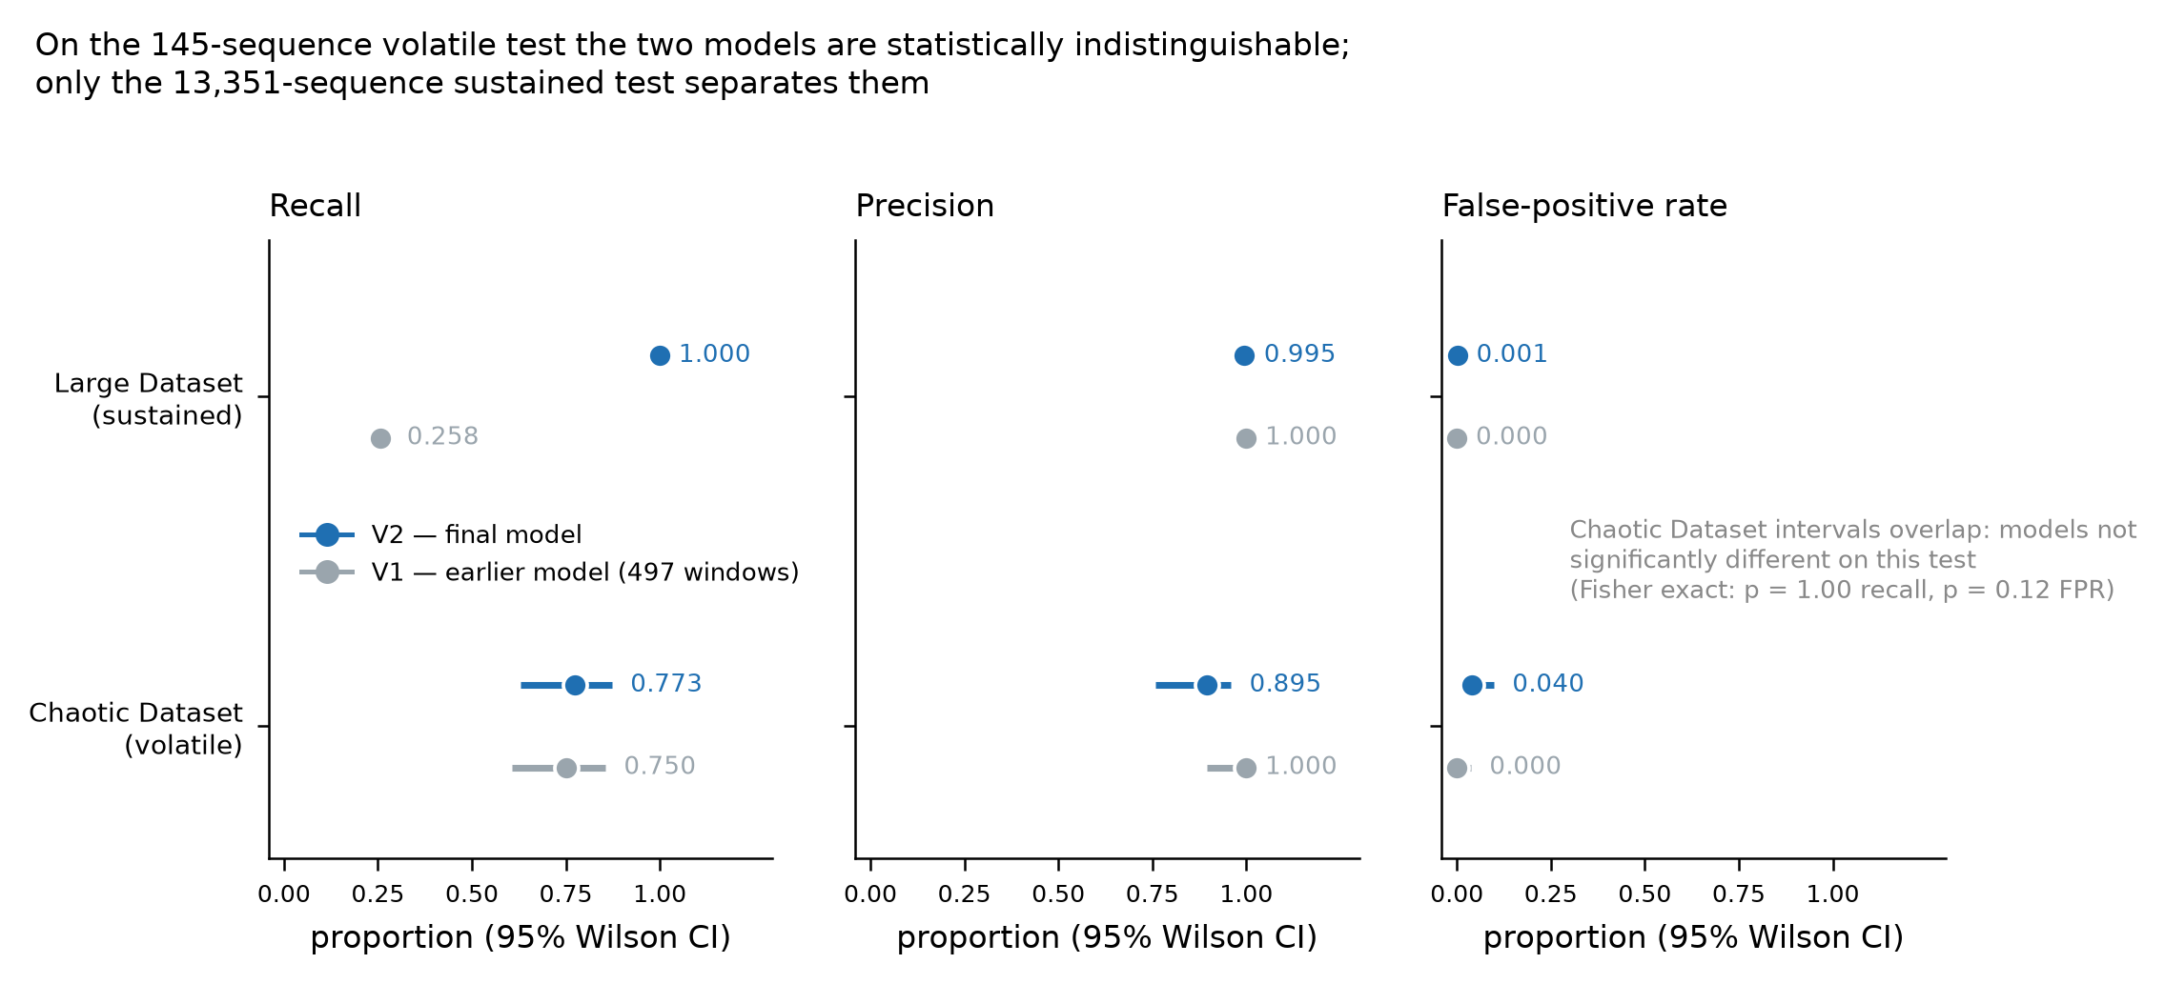
Backup: 95% confidence intervals
Intervals treat overlapping sequences as independent (90% overlap), so they are anti-conservative: about 1,335 and 15 independent observations, not 13,351 and 145 (L4).
Figure 9 and Table 8 of the thesis (legend corrected: earlier model trained on 497 windows); 95% Wilson score intervals
27
Notes:
Show if asked about statistical significance. Wilson intervals; anti-conservative because adjacent sequences overlap by 90% (L4). Fisher p = 1.00 for recall on the Chaotic Dataset.

Slide 28
Backup: scores near the 0.30 boundary
Windows and alarms by failure-rate band of the final window (θ = 0.50)
Failure-rate band | Training: benign / attack | Large benign: flagged / total | Large attack: detected / total | Chaotic benign: flagged / total | Chaotic attack: detected / total
≤ 0.20 | 525 / 0 | 1 / 11,347 | — | 0 / 85 | —
0.20–0.25 | 23 / 0 | 2 / 4 | — | 0 / 11 | —
0.25–0.30 | 87 / 0 | 8 / 8 | — | 4 / 5 | —
0.30–0.35 | 0 / 98 | — | 698 / 698 | — | 4 / 11
0.35–0.40 | 0 / 584 | — | 899 / 899 | — | 4 / 7
> 0.40 | 0 / 913 | — | 395 / 395 | — | 26 / 26
The learned boundary tracks 0.30 to within a few hundredths of failure rate; it errs on the high side in the Large Dataset and the low side in the last Chaotic attack.
Table 14 of the thesis (ch.4.9)
28
Notes:
Show if asked where the learned boundary sits. Table 14: model and rule agree at or below 0.20 and above 0.40, with one exception.

Slide 29
Backup: latency distribution
Statistic | Mean | P50 | P95 | P99 | Min | Max
Latency (ms) | 0.65 | 0.62 | 0.81 | 1.64 | 0.52 | 2.50
Duty cycle: 0.00065 s / 60 s ≈ 0.0000108 ≈ 0.001% of one core
The original host hardware and library versions were not recorded. A later reference run on the research machine gave a mean of 0.437 ms and a P99 of 0.475 ms. The cost that dominates in deployment, computing the window aggregates, was not benchmarked.
Table 11 of the thesis (ch.4.6); 50 warm-up passes, 500 timed passes, eager-mode PyTorch
29
Notes:
Show if asked about hardware or latency variance. Table 11; host hardware and library versions of the original run were not recorded; a later check gave 0.437 ms mean.

Slide 30
Backup: threats to validity
Assessed against the ten pitfalls of Arp et al. [57]
Category | Threat | Status in this thesis
Construct | Labels recoverable from inputs (L1) | Stated formally; claims restricted to fidelity and transfer
Construct | TLS feature constant; no header features (L5) | Thesis statement restricted to the informative features
Internal | Temporal leakage | Controlled: chronological split, training-only scaler, no boundary-crossing sequences
Internal | Checkpoint chosen on benign-only validation (L2) | Stated; hold-out test set reported only as a false-positive benchmark
External | Synthetic, homogeneous benign traffic (L6) | Two separately generated datasets with different structure
Conclusion | Overlapping sequences, single run (L4) | Wilson intervals, Fisher tests and alarms per day; dependence stated
Conclusion | Accuracy at 15% prevalence | PR-AUC, alarms per day and confusion matrices reported
Table 15 of the thesis (ch.5.3)
30
Notes:
Show if asked about validity or Arp et al.'s pitfalls. Table 15 covers six of the ten pitfalls; sampling bias applies fully.

Slide 31
Backup: where this sits in the literature
What each family of defences looks at, and what this thesis adds
Family | Unit it watches | Why it misses low-and-slow spraying | Thesis link
Per-client rate limits (token buckets, HTTP 429) | one client or key | each rotating IP stays under its quota | ch.2.2
Per-account lockout (NIST, OWASP) | one account | spraying touches each account rarely | ch.2.2
Multi-host botnet detection (BotSniffer [28], BotMiner [29], PUBCRAWL [30]) | groups of hosts | built for C&C or crawling, not login telemetry | ch.2.3
Risk-based authentication (Freeman [32], Wiefling [33]) | one login attempt | scores attempts, not campaigns | ch.2.4
Sequence models (Bai et al. TCN [39], Sadique & Sengupta [35]) | time series | not applied to campaign-level login windows | ch.2.5
TLS fingerprinting (JA3 [45], JA4 [46]) | one handshake | per-connection; ambiguous on its own | ch.2.6
Chapter 2 of the thesis; reference numbers as in the thesis
31
Notes:
Show if asked about related work or novelty. Per-client and per-account controls, multi-host detection, risk-based authentication, sequence models, TLS fingerprinting (ch.2).

Slide 32
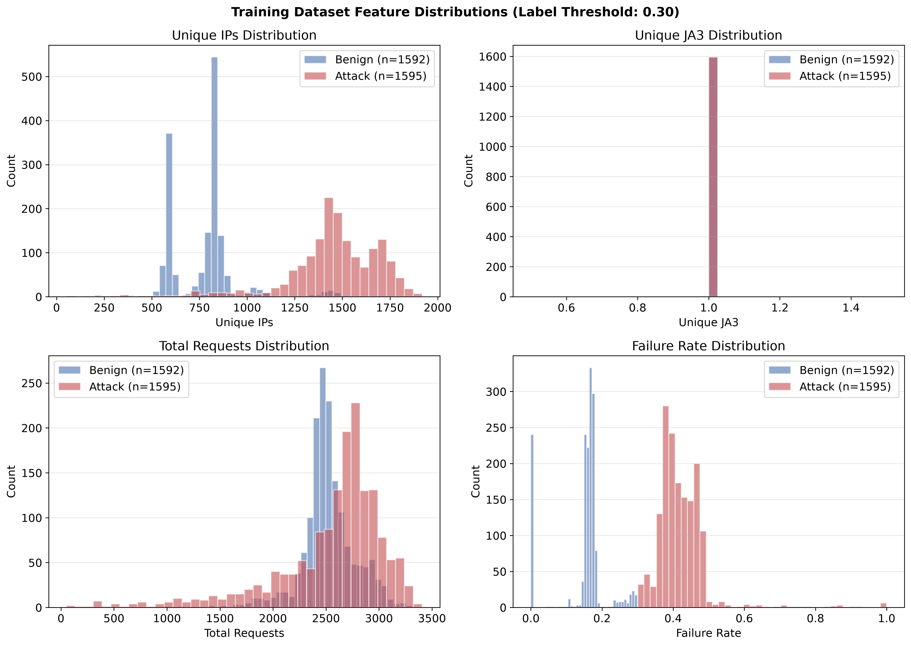
Backup: feature distributions in the Training Dataset
Figure 6 of the thesis (ch.4.1)
32
Notes:
Show if asked about the features. Distinct IPs and failure rate separate the classes; requests overlap; JA3 is constant at 1 (Figure 6).

