Slide 1
Java Workshop _{with Adrian}

Slide 2
Agenda
What is Java?
Java JVM and bytecode
Write, compile and run!
Java Java Java - syntax and symantics
Data types
Class
Class: Inheritance and polymorphism
Interface
Methods
Acces modifier types
Loop control
Exceptions
Collections
Generics
Functions & Lambdas
Streams
Optional
Core Java libraries
Managing multiple Java versions
6. Digging into employees-app
Code structure
Flow analysis
Design decisions (good and bad)
Good practices
Tests
Debugging

Slide 3
What is Java?
Java is a high-level, class-based, object-oriented programming language that is designed to have as few implementation dependencies as possible.
It is a general-purpose programming language intended to let programmers write once, run anywhere (WORA), meaning that compiled Java code can run on all platforms that support Java without the need to recompile.
Source: https://en.wikipedia.org/wiki/Java_(programming_language)

Slide 4
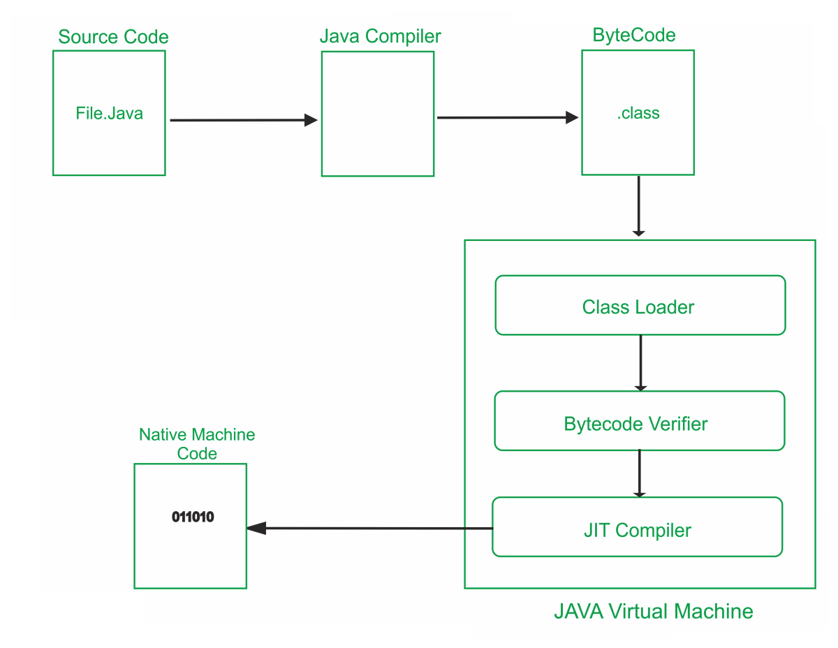
Java JVM and bytecode
Java applications are typically compiled to bytecode that can run on any Java virtual machine (JVM) regardless of the underlying computer architecture.
Source: https://proandroiddev.com/optimize-java-byte-code-d37d9938729e

Slide 5
Write, compile and run!
Main.java
public class Main {
public static void main(String[] args) {
System.out.println("Hello Java World!");
}
}
$ javac Main.java
$ java Main
> Hello Java World!

Slide 6
Datatypes
Primitive data types (predefined by the language and named by a keyword):
byte, short, int, long,
eg. long id = 5
float, double
eg. double multiplier = 1,56
boolean
eg. boolean result = true
char
eg. char prefix = ‘a’
Reference data types (created using defined constructors of the classes), ie.:
String message = “Hello world!”
String error = new String(“Failure”)
LocalDateTime now = LocalDateTime.now()

Slide 7
Class
class Cat { private String breed; private String name; private int age; public Cat(String breed, String name, int age) { this.breed = breed; this.name = name; this.age = age; } public String getName() { return name; } public void setName(String name) { this.name = name; } void bark() { } void sleep() { } }
Cat cat = new Cat(“Ragdoll”, “Kitty”, 5);
cat.bark();
Class – a template/blueprint that describes the behaviour and state that the objects support.
Object – an instance of a class, can have state and behaviour.

Slide 8
Inheritance and polymorphism
abstract class Animal { protected String breed; protected String name; protected int age; protected Animal(String breed, String name, int age) { this.breed = breed; this.name = name; this.age = age; } public String getName() { return name; } public void setName(String name) { this.name = name; } abstract boolean isHungry(); abstract void sleep(); }
class Cat extends Animal { private int satietyLevel; public Cat(String breed, String name, int age) { super(breed, name, age); } public Cat(String breed, String name, int age, int satietyLevel) { super(breed, name, age); this.satietyLevel = satietyLevel; } @Override boolean isHungry() { return satietyLevel < 2; } @Override void sleep() { // TODO: implement cat falling asleep }
void meow() { } }
Animal cat = new Cat("Ragdoll", "Kitty", 3); cat.isHungry();
Cat cat2 = new Cat("Ragdoll", "Catty", 3); boolean isHungry = cat2.isHungry(); cat2.meow();

Slide 9
Interface
An interface is a reference type in Java. It is similar to class. It is a collection of abstract methods. A class implements an interface, thereby inheriting the abstract methods of the interface.
interface Comparable<T> { public int compareTo(T o); }
abstract class Animal implements Comparable<Animal> { // rest of implementation @Override public int compareTo(Animal o) { return this.age - o.age; } }

Slide 10
Method
A method is a block of code which only runs when it is called.
class AnimalFactory { public static String[] supportedSpecies() { return new String[]{"Dog", "Cat", "Cow"}; } public Animal create(String species, String name, String breed, int age){ return null; } public Animal create(String species, String name, String breed) { return null; } }
String[] supportedSpecies = AnimalFactory.supportedSpecies(); AnimalFactory factory = new AnimalFactory(); Animal newCat = factory.create("Cat", "Kitty", "Ragdoll"); Animal newCat2 = factory.create("Cat", "Kitty", "Ragdoll", 5);

Slide 11
Access modifiers
Access modifiers are used to set the accessibility (visibility) of classes, interfaces, variables, methods, constructors, data members, and the setter methods.
Modifier | Description
public | The code is accessible for all classes
private | The code is only accessible within the declared class
default | The code is only accessible in the same package. This is used when you don't specify a modifier.
protected | The code is accessible in the same package and subclasses.
Source: https://www.w3schools.com/java/java_modifiers.asp

Slide 12
Loop control
While loop
For loop
while (condition) {
// code block to be executed
}
for (int i = 0; i < 5; i++) {
System.out.println(i);
}
Do While loop
For-each loop
do {
// code block to be executed
} while (condition);
String[] colors = {”Black", ”Blue", ”Green", ”Red"};
for (String i : colors) {
System.out.println(i);
}

Slide 13
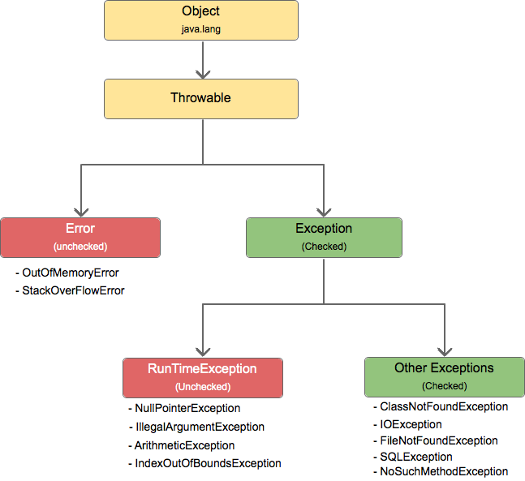
Java Exceptions
Exception - an event that occurs during the execution of a program that disrupts the normal flow of instructions.
Try-catch
try {
// Block of code to try
} catch(Exception e) {
// Block of code to handle errors
}
Try-catch-finally
Source: https://hashcodec.com/java-programming/exception-handling
try {
int[] myNumbers = {1, 2, 3};
System.out.println(myNumbers[10]);
} catch (Exception e) {
System.out.println(”Exception thrown.
} finally {
System.out.println("The 'try catch' is finished.");
}
public class Main {
public static void main(String[ ] args) {
try {
int[] myNumbers = {1, 2, 3};
System.out.println(myNumbers[10]);
} catch (IndexOutOfBoundsException e) {
System.out.println("Something went wrong."); }
}
}
}

Slide 14
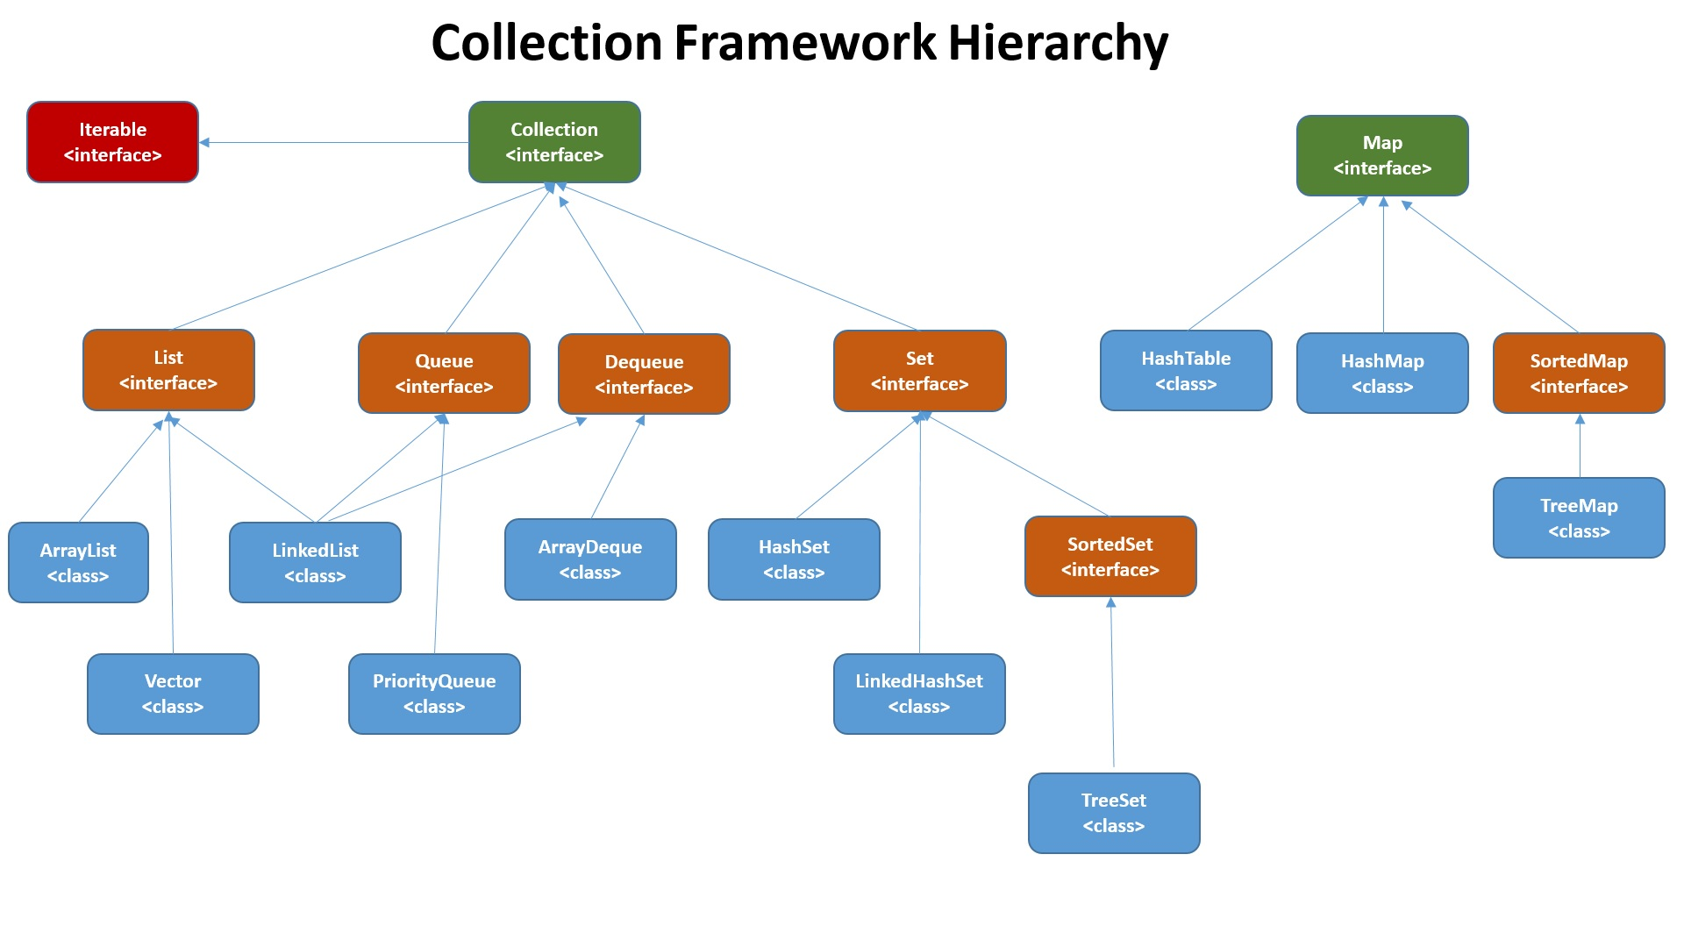
Java Collections
Source: https://facingissuesonit.com/2019/10/15/java-collection-framework-hierarchy/

Slide 15
Java Collections
Map<Integer, String> dayOfWeekNames = new HashMap<>(); dayOfWeekNames.put(0, "Monday"); dayOfWeekNames.put(1, "Tuesday"); var monday = dayOfWeekNames.get(0);
List<String> names = new ArrayList<>(); names.add("John"); names.add("Tony"); var john = names.get(0);

Slide 16
Java Generics
Problem
Solution
List list = new LinkedList();
list.add(new Integer(1));
Integer i = list.iterator().next();
Integer i = (Integer) list.iterator().next();
List<Integer> list = new LinkedList<>();
list.add(new Integer(1));
Integer i = list.iterator().next();
public <T> List<T> fromArrayToList(T[] a) { return Arrays.stream(a)
.collect(Collectors.toList()); }

Slide 17
Java Functions & Lambdas
Any interface with a SAM (Single Abstract Method) is a functional interface, and its implementation may be treated as lambda expressions.
A lambda is an anonymous function.
@FunctionalInterface public interface Function<T, R> { R apply(T t); } @FunctionalInterface public interface Supplier<T> { T get(); } @FunctionalInterface public interface Consumer<T> { void accept(T t); }
Function<String, String> uppercase = s -> s.toUpperCase(); uppercase.apply("string");
Supplier<String> stringSupplier = () -> "String"; String string = stringSupplier.get();
Consumer<Integer> intPrint = i -> System.out.println(i); Consumer<Integer> intPrint = System.out::println; intPrint.accept(i);

Slide 18
Java Stream
Stream - a sequence of elements supporting sequential and parallel aggregate operations.
int sum = widgets.stream() .filter(w -> w.getColor() == RED) .mapToInt(w -> w.getWeight()) .sum();

Slide 19
Java Optional
Optional - a container object which may or may not contain a non-null value. If a value is present, isPresent() will return true and get() will return the value.
Optional<String> stringOptional = Optional.of("String"); if (stringOptional.isPresent()) { // do something } var s1 = stringOptional.orElseGet(() -> "other string"); var s2 = stringOptional.orElseThrow(() -> new RuntimeException()); var s3 = stringOptional.filter(s -> s.startsWith("S")); var s4 = stringOptional.map(s -> s.toLowerCase());

Slide 20
Core Java libraries
java.lang → contains fundamental classes and interfaces closely tied to the language and runtime system.
java.io, java.nio, java.net → I/O and networking API.
java.math → provides mathematical expressions and evaluation, as well as arbitrary-precision decimal and integer number datatypes.
java.util → built-in Collection data structures, and utility classes, for Regular expressions, Concurrency, logging and Data compression.
java.text → deals with text, dates, numbers and messages.
java.security, java.crypto → provide security and encryption services.
java.sql → access to SQL databases.

Slide 21
Managing multiple Java versions
https://sdkman.io/install
$ sdk list java
$ sdk install java
$ sdk install 18-amzn
$ sdk use java 17.0.3-tem
================================================================================
Vendor | Use | Version | Dist | Status | Identifier
--------------------------------------------------------------------------------
Corretto | | 18 | amzn | local only | 18-amzn
| >>> | 18.0.1 | amzn | installed | 18.0.1-amzn
| | 17.0.3.6.1 | amzn | | 17.0.3.6.1-amzn
| | 11.0.15.9.1 | amzn | | 11.0.15.9.1-amzn
| | 8.332.08.1 | amzn | | 8.332.08.1-amzn
GraalVM | | 22.1.0.r17 | grl | | 22.1.0.r17-grl
| | 22.1.0.r11 | grl | | 22.1.0.r11-grl
| | 22.0.0.2.r17 | grl | | 22.0.0.2.r17-grl
| | 22.0.0.2.r11 | grl | | 22.0.0.2.r11-grl
| | 21.3.2.r17 | grl | | 21.3.2.r17-grl
| | 21.3.2.r11 | grl | | 21.3.2.r11-grl
| | 20.3.6.r11 | grl | | 20.3.6.r11-grl
Alternative:
https://www.jenv.be/

