Slide 1
Spring Workshop _{with Adrian}

Slide 2
Agenda
Why to use any framework like Spring?
What is Spring Framework?
What is Spring Boot?
Inversion Of Control & Dependency Injection
Spring Container
Spring Bean
Bootstrapping Spring Boot App
6. Digging into code
Code structure
Gradle + Gradle tasks
@SpringBootApplication
Spring Boot actuator
API endpoint
Spring DevTools
App configuration – application properties
Bean types and creation
Dependency injection
Controller – Service – Repository architecture
Spring Data
Rest Exception Handler
Transactional service
Controller Tests

Slide 3
Why to use any framework like Spring?
Helps us focus on the core task rather than the boilerplate associated with it.
Brings together years of wisdom in the form of design patterns.
Helps us adhere to the industry.
Brings down the total cost of ownership for the application.
Source: https://www.baeldung.com/spring-why-to-choose

Slide 4
What is Spring Framework?
The Spring Framework provides a comprehensive programming and configuration model for modern Java-based enterprise applications - on any kind of deployment platform.
A key element of Spring is infrastructural support at the application level: Spring focuses on the "plumbing" of enterprise applications so that teams can focus on application-level business logic, without unnecessary ties to specific deployment environments.
Features:
Core technologies: dependency injection, events, resources, i18n, validation, data binding, type conversion, SpEL, AOP.
Testing: mock objects, TestContext framework, Spring MVC Test, WebTestClient.
Data Access: transactions, DAO support, JDBC, ORM, Marshalling XML.
Spring MVC and Spring WebFlux web frameworks.
Integration: remoting, JMS, JCA, JMX, email, tasks, scheduling, cache.
Source: https://spring.io/projects/spring-framework

Slide 5
What is Spring Boot?
Spring Boot makes it easy to create stand-alone, production-grade Spring based Applications that you can "just run".
We take an opinionated view of the Spring platform and third-party libraries so you can get started with minimum fuss. Most Spring Boot applications need minimal Spring configuration.
Features:
Create stand-alone Spring applications
Embed Tomcat, Jetty or Undertow directly (no need to deploy WAR files)
Provide opinionated 'starter' dependencies to simplify your build configuration
Automatically configure Spring and 3rd party libraries whenever possible
Provide production-ready features such as metrics, health checks, and externalized configuration
Source: https://spring.io/projects/spring-boot

Slide 6
Inversion of Control & Dependency Injection
IoC
In contrast with traditional programming, in which our custom code makes calls to a library, IoC enables a framework to take control of the flow of a program and make calls to our custom code. To enable this, frameworks use abstractions with additional behaviour built in. If we want to add our own behaviour, we need to extend the classes of the framework or plugin our own classes.
The advantages of this architecture are:
decoupling the execution of a task from its implementation
making it easier to switch between different implementations
greater modularity of a program
greater ease in testing a program by isolating a component or mocking its dependencies, and allowing components to communicate through contracts
DI
Dependency injection is a pattern we can use to implement IoC, where the control being inverted is setting an object's dependencies.
Connecting objects with other objects, or “injecting” objects into other objects, is done by an assembler rather than by the objects themselves.
Without DI
With DI
public class Store { private Item item; public Store() { item = new ItemImpl1(); } }
public class Store { private Item item;
public Store(Item item) { this.item = item; } }

Slide 7
Spring Container
Spring container is at the core of the Spring Framework. The container will:
create the objects,
wire them together,
configure them,
manage their complete life cycle from creation till destruction.
The Spring container uses DI to manage the components that make up an application. These objects are called Spring Beans.

Slide 8
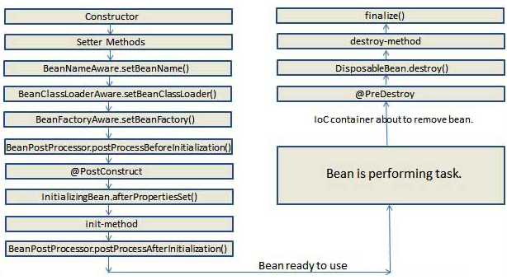
Spring Bean
Beans are objects that form the backbone of the application. A bean is an object that is instantiated, assembled, and otherwise managed by a Spring IoC container.
Bean scopes
singleton | Only one instance per Spring container (default).
prototype | A new instance every time bean is requested.
request | Single instance per HTTP request.
session | Single instance per HTTP session.
global-session | Single instance per global HTTP session.
Bean lifecycle
Source: https://www.concretepage.com/spring/spring-bean-life-cycle-tutorial

Slide 9
Spring Boot Annotations
Source: https://www.jrebel.com/sites/rebel/files/pdfs/cheatsheet-jrebel-spring-annotations.pdf

Slide 10
Bootstrapping Spring Boot App
Spring Boot Initializr
https://start.spring.io
Spring Boot Starters list
https://docs.spring.io/spring-boot/docs/current/reference/htmlsingle/#using.build-systems.starters

