Slide 1
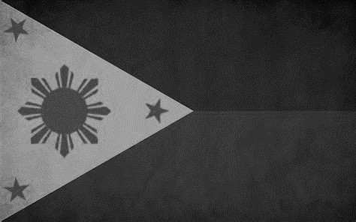
Notes:
Okay, my name is Adrian and I did my movement project on the removal of the Marcos regime in the Philippines.

Slide 2
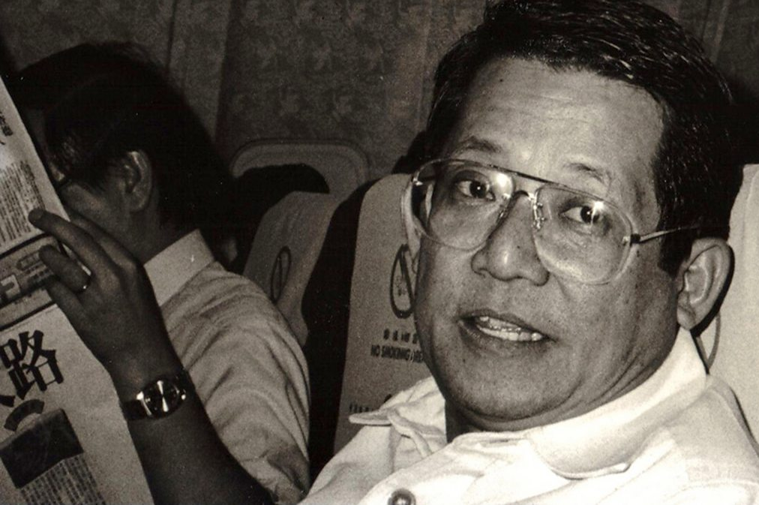
Background
Reason
  Abuse of power by Ferdinand Marcos
Location
  Philippines (Manila), 1965-1986
Key organizations/individuals
  Benigno "Ninoy" Aquino
    Lakas ng Bayan (LABAN)
  Corazon "Cory" Aquino
  Catholic Church
Benigno “Ninoy” Aquino
Notes:
So the reason that this movement came about was because of the abuse of power by the then president Ferdinand Marcos. Marcos had used his power and wealth to rig elections and enforce martial law in order to extend his term indefinitely and keep the country under his thumb. As a way to silence those that opposed, he would assassinate them.
This all took place in the Philippines from 1965 to 1986 which was the duration of Marcos’ reign as ruler, the climax near the end of the movement which is known as the People Power Revolution took place in the capital city of Manila.
The key organizations and individuals involved in the movement were Benigno “Ninoy” Aquino, Corazon “Cory” Aquino, and the Catholic Church.
Ninoy Aquino was a politician who was the front liner for most of the movement. Ninoy and his party Lakas ng Bayan or LABAN were the most vocal about Marcos’ atrocities and fought the hardest to remove him. His assassination is what kickstarted the People Power Revolution.
After his death, Cory Aquino, Ninoy’s wife, was the one to pick up the mantle and remove Marcos from office. She was also the one to succeed Marcos as president.
The catholic church holds a lot of power in the Philippines due to the importance of religion in the country. As such, when they heard the people’s cries, they were to provide food and refuge to the lower class, relay news when Marcos’ took control of the media as well as front line the People Power Revolution alongside Cory Aquino.

Slide 3
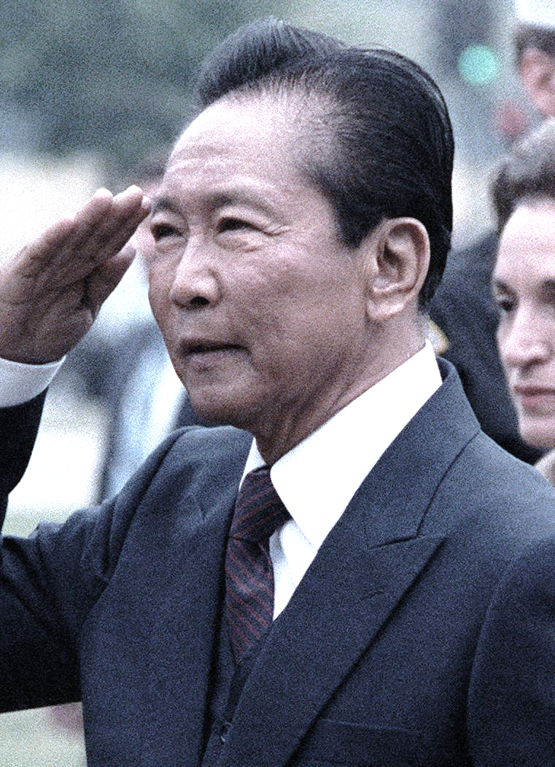
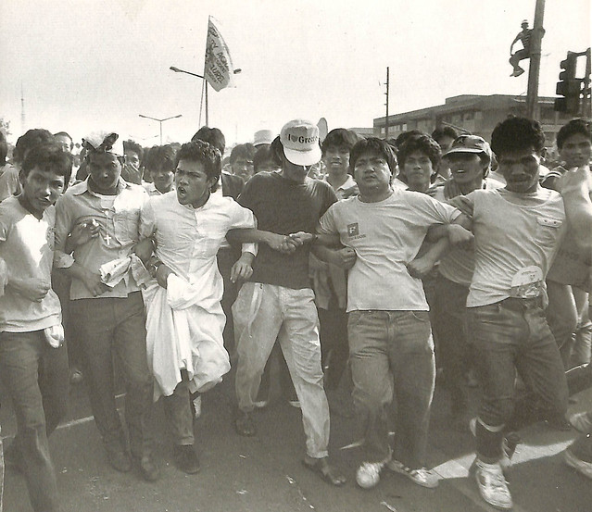
Key Adversaries
Major Tactics
Ferdinand Marcos
The Military
  Intelligence Chief Fabian Ver
Foreign Powers (US)
Violent
  Bombings
  Ramming cars
Non-violent
  Human barricades
  Protest/Mass demonstration
Ferdinand Marcos
Human barricade
Notes:
Okay so biggest adversary was Ferdinand Marcos who was a politician who had become the president of the Philippines. At first, his intentions were pure and wanted the best for the country. However, his greed made him want to keep the position forever which ended up turning him into a dictator.
A major supporter of his was the military under the directive of intelligence chief Fabian Ver. They were the ones who enforced the rules of Marcos and came up with the plan for martial law. Under martial law, the military could control every aspect of the citizens daily life
Another major supporter of Marcos were foreign powers, more specifically the US. The US would give funds to the Philippines if the president followed their orders. The orders were basically to stay democratic and support the US in all its foreign endeavors which included the wars. This was something that Marcos took full advantage of by sending Filipino troops to Vietnam during the Vietnam War, despite the outcry of the people. This also cost the lives of many that went over which garnered Marcos a lot of hate
So the movement actually utilized both violent and nonviolent tactics. The major violent tactics were bombings and ramming cars into buildings, specifically government buildings or buildings that were used as meeting places for Marcos supporters. The non-violent tactics were human barricades, where unarmed citizens would place themselves between armed conflicts to prevent shooting, and protest/mass demonstration, the largest one being over 2 million Filipinos out on the streets of Manila during the People Power Revolution.

Slide 4
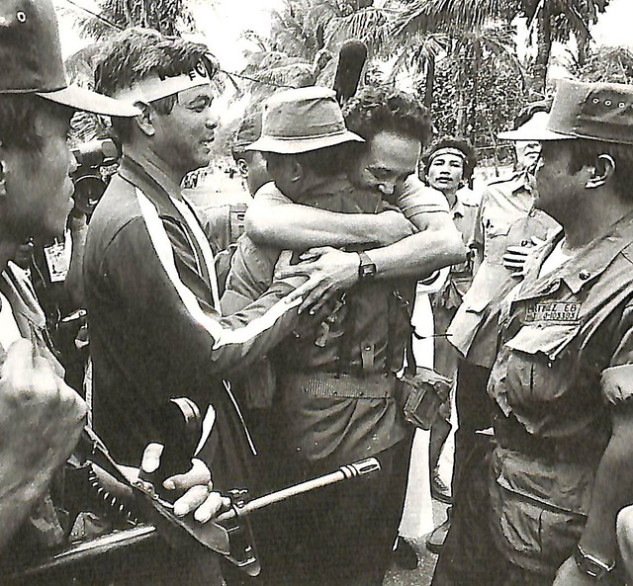
Message Box
Movement
  “...have to place themselves between the soldiers to avoid bloodshed” (BBC)
  “No Filipino really wanted to kill a fellow Filipino, it just wasn’t worth it, Marcos wasn’t worth it” (BBC)
Adversary
  The only one that can save the country
  Doing all of this for the sake of the people, towards a better future
Notes:
Some of the messages of the movement were that they “...have to place themselves between the soldiers to avoid bloodshed”
and “No Filipino really wanted to kill a fellow Filipino, it just wasn’t worth it, Marcos wasn’t worth it” (BBC). These were messages spread after Ninoy Aquino’s death and it showed that nobody wanted anyone to die, as much as they wanted Marcos gone, having someone lose their life was a price that nobody should have to pay. They not only believed in this message but also believed everyone else believed this message, no matter what side you were on, so much so that they were willing to put themselves in the crossfire as a demonstration of faith and comradery.
Some of the ideas of the adversary were that he was only one that can save the country and that he was doing all of this for the sake of the people, towards a better future. This showed Marcos’ arrogance and narcissism. He believed that he was the messiah, someone who would bring greatness to the country. Along with that, he thought that everything he was doing was for the people, that he would bring salvation, even though the opposite was tr

Slide 5
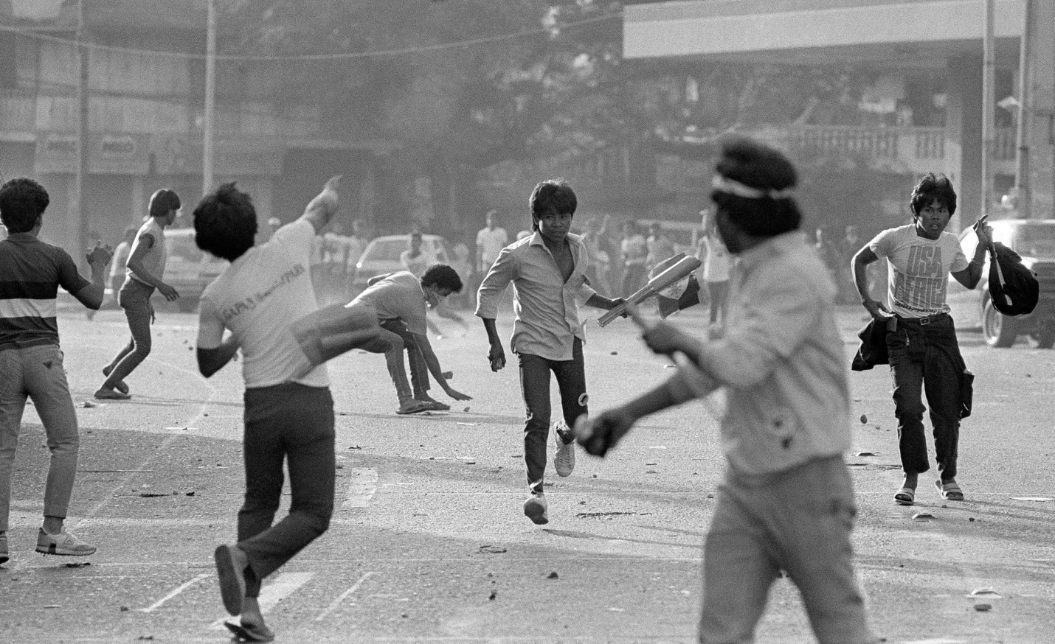
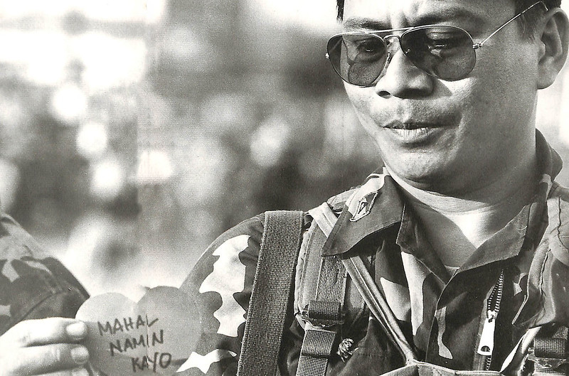
Polarization
Violent
  Intentionally divisive
  No goal of gaining public sentiment
Non-violent
  Show unity
  Strength in numbers
Notes:
Because the movement utilized both violent and nonviolent tactics, there were different takes on polarization. When the movement relied on violent tactics, they were intentionally divisive to draw the line between them and the adversary. However, they didn’t care about gaining public sentiment. Their goal was to show that they are a threat to Marcos and won’t stop until he’s out of power, whether that be willingly or with his death. Public opinion of the violent groups might have been an all-time low, but that didn’t stop them. Eventually, violent tactics created dialogue between Marcos and Aquino
After Aquino’s death, most of the movement switched to nonviolent tactics to avoid more bloodshed. The movement realized that Marcos was not threatened by them. If everyone could share the sentiment then nothing can prevent them from achieving their goals, not even the military pointing its guns at them. This switch showed the values of the people and that really nobody wanted to be divided.

Slide 6
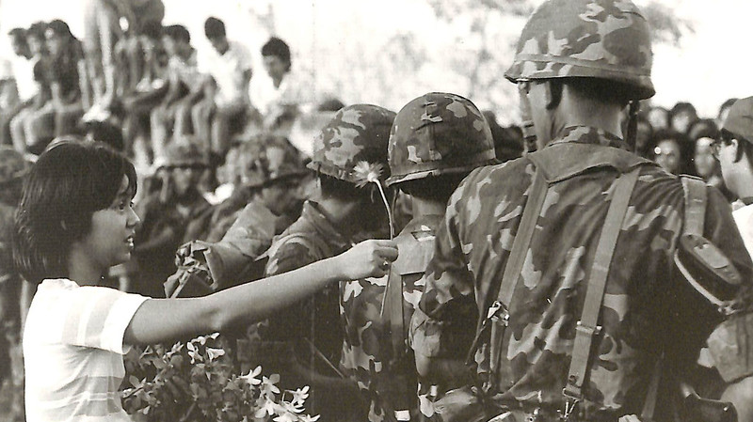
Letter to Great Granddaughter

Slide 7
Works cited
Overholt, William H. “The Rise and Fall of Ferdinand Marcos.” Asian Survey, vol. 26, no. 11, 1986, pp. 1137–63. JSTOR, doi.org/10.2307/2644313.
BBC. How Filipino People Power toppled dictator Marcos. February 17, 2016. www.bbc.com/news/av/magazine-35526200
Ziv, Ilan. People Power. 1989, docuseek2.com.ezproxy.stthomas.edu/if-pow.

Slide 8
Picture credits
Background Photo: https://wallpapercave.com/w/wp2023818
https://www.bbc.co.uk/programmes/b03xl4bb
http://rudebutgood.blogspot.com/2011/11/ferdinand-marcos.html
https://www.flickr.com/photos/govph/16380540630
https://www.flickr.com/photos/govph/16566316881
https://www.flickr.com/photos/govph/16541995946
https://www.flickr.com/photos/govph/16566889482

