Slide 1
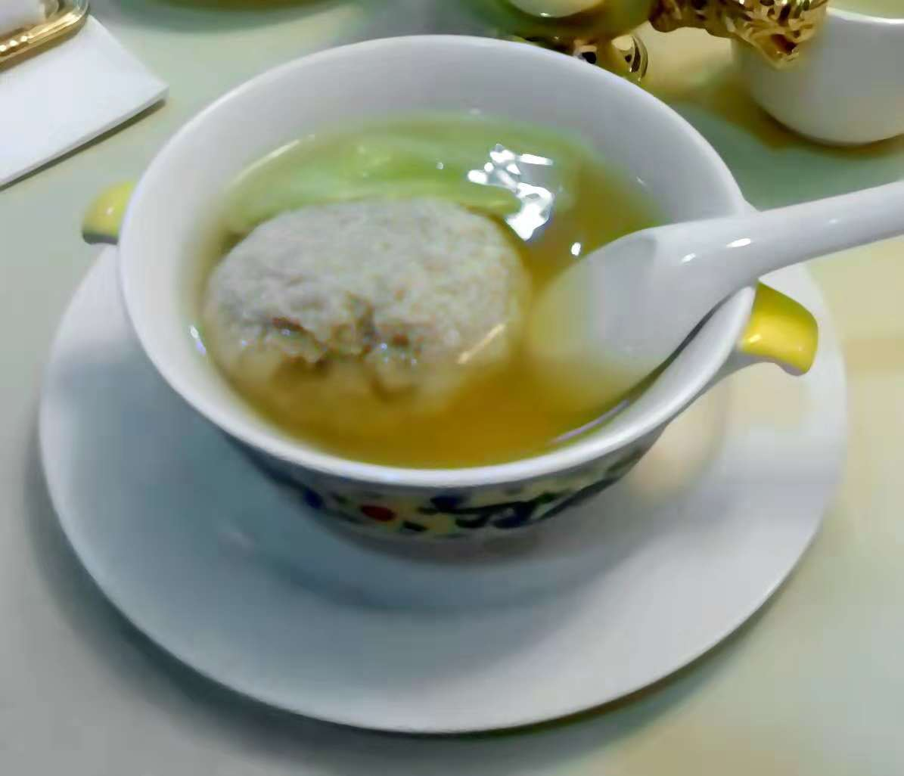
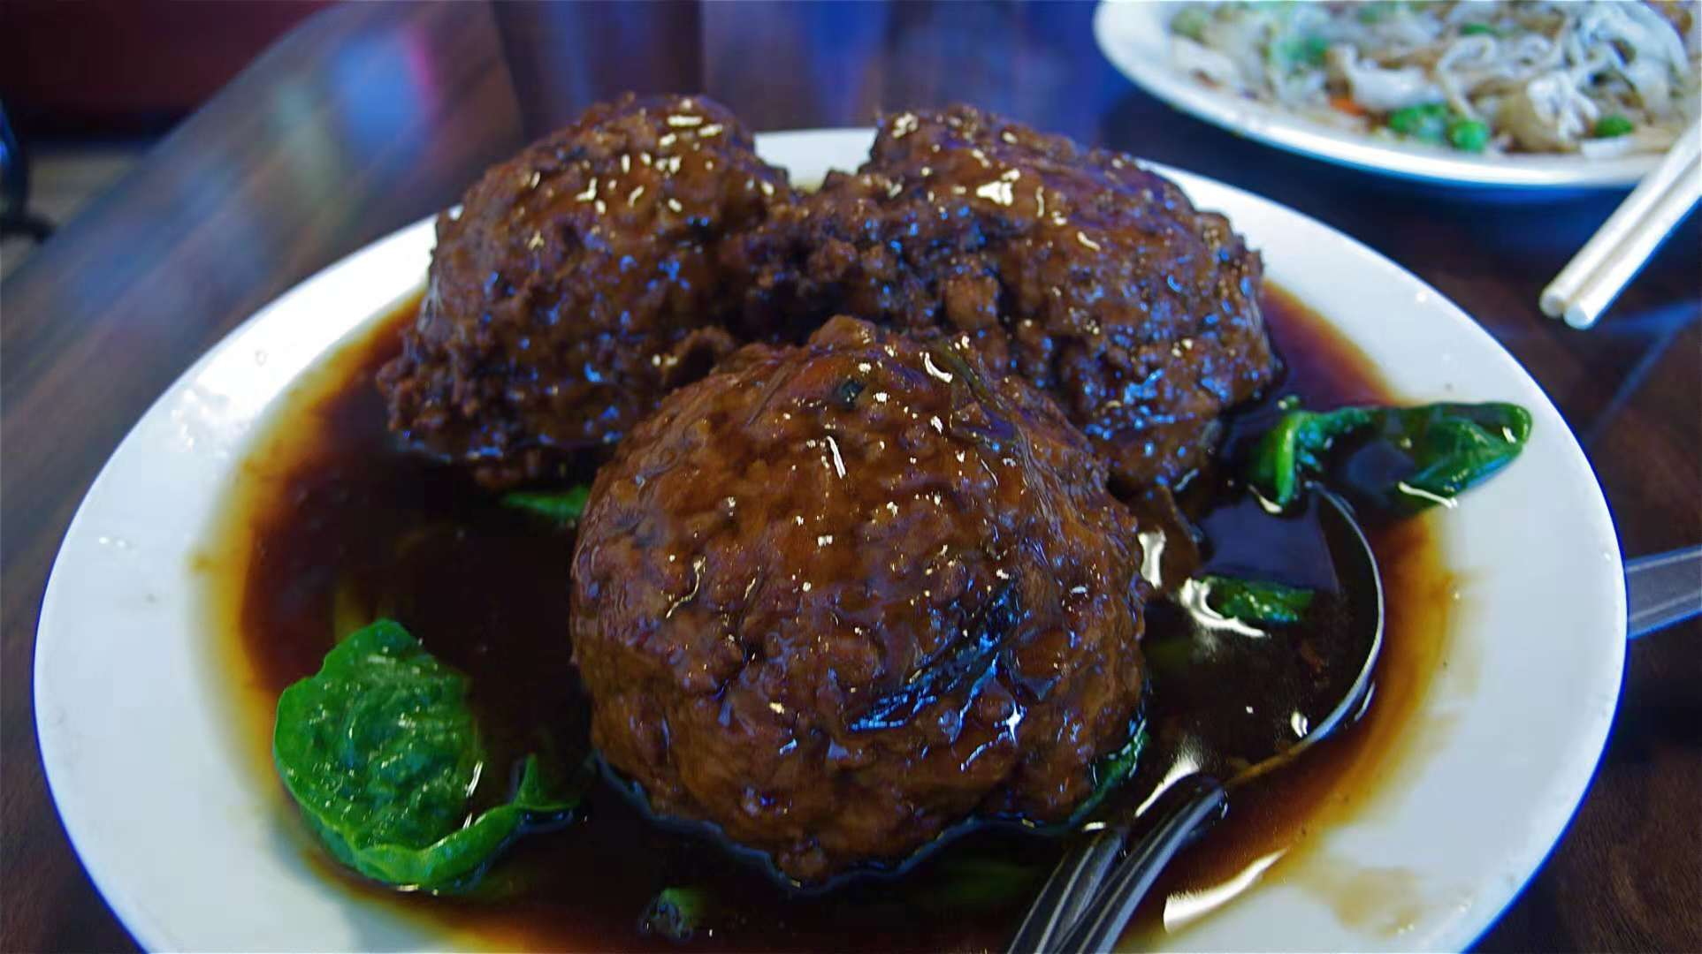
Lion's head

Slide 2
Lion's Head (simplified Chinese: 狮子头; traditional Chinese: 獅子頭; pinyin:
Shīzitóu) or stewed meatball is a dish from the Huaiyang cuisine of eastern China, consisting of large pork meatballs stewed with vegetables. There are two varieties: white (or plain), and red (红烧, cooked with soy sauce). The plain variety is usually stewed or steamed with napa cabbage. The red variety can be stewed with cabbage or cooked with bamboo shoots and tofu derivatives. The minced meat rich in fat is more likely to bring better texture, addition of chopped water chestnut also works.

Slide 3
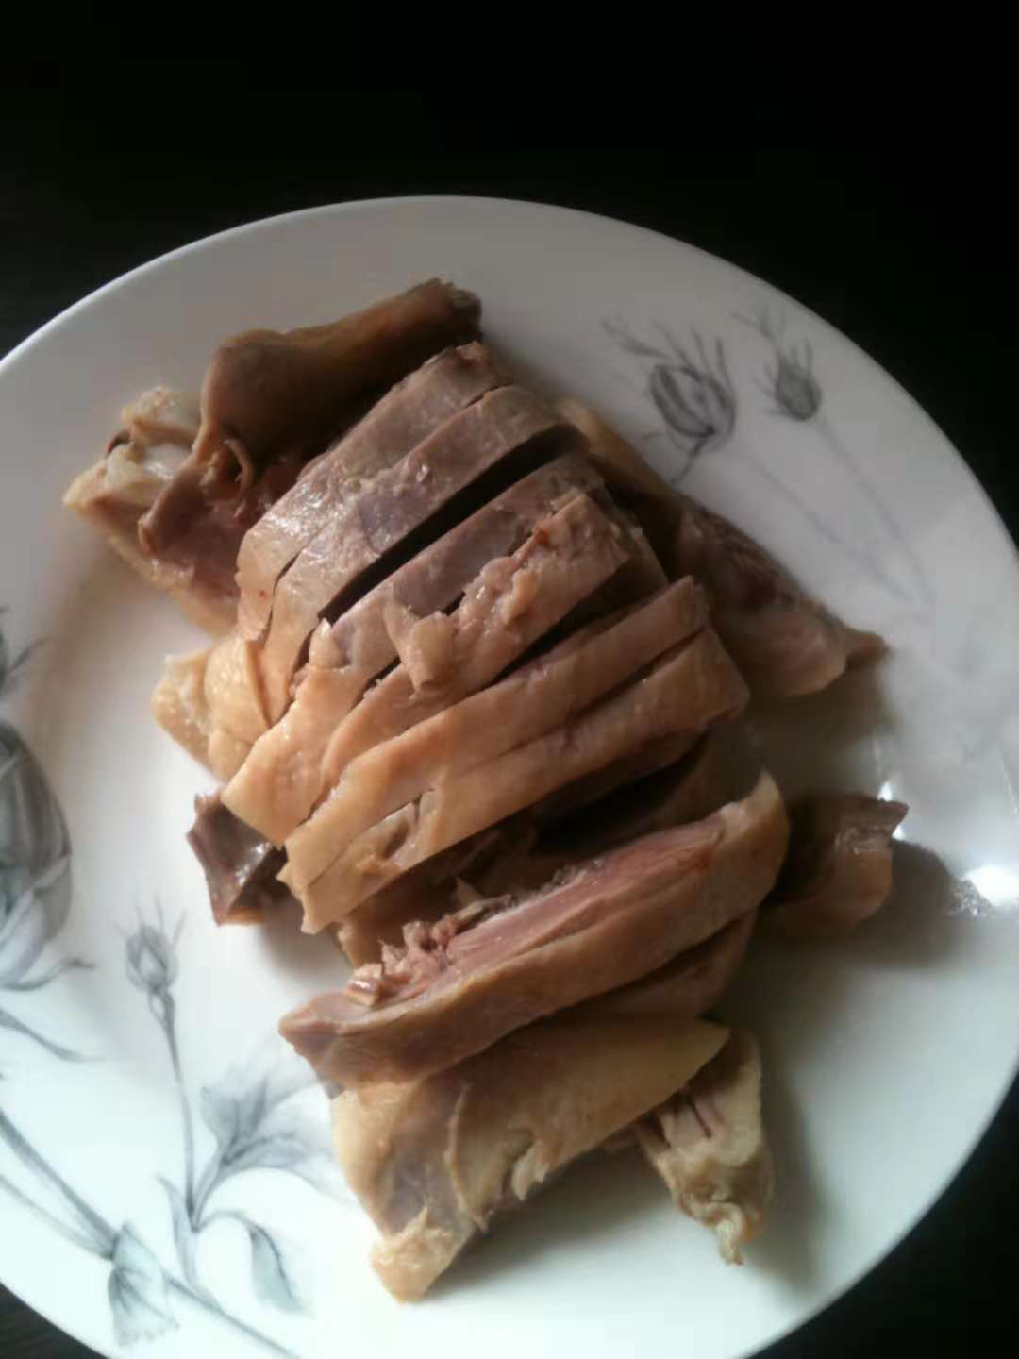
Nanjing salted duck
Nanjing Salted Duck (Chinese: 盐水鸭) is a local duck dish from Nanjing, China. The history of the dish goes back hundreds of years, possibly to the 14th century, but it grew more famous during the Qing Dynasty. The tender white duckmeat has some fat but is not greasy, and in presentation the dish is fragrant and often crispy. Nanjing Salted Duck prepared shortly before or after mid-Autumn is reputed to taste the best, because of duck production during the sweet osmanthus blooming season (osmanthus may be added to the spice mixture particularly in those months). Sometimes the seasonal version of the dish is called Osmanthus Duck

Slide 4
请在此输入您的文本。请在此输入您的文本。请在此输入您的文本。请在此输入您的文本。请在此输入您的文本。请在此输入您的文本。请在此输入您的文本。请在此输入您的文本。请在此输入您的文本。请在此输入您的文本。
请在此输入您的文本。请在此输入您的文本。请在此输入您的文本。请在此输入您的文本。请在此输入您的文本。请在此输入您的文本。请在此输入您的文本。请在此输入您的文本。请在此输入您的文本。请在此输入您的文本。

