Slide 1


Automated KYC System
Streamlining Identity Verification with OCR and Face Recognition
Toma Radu & Ivan Adrian

Slide 2
Problem Statement
Financial institutions and service providers need a secure, efficient way to verify customers' identities (KYC).
Objective: Develop a proof-of-concept web application that automates ID scanning, text extraction, and face verification.
Scope:
OCR of Romanian ID cards to retrieve user data.
Face detection on the ID card to isolate the printed face.
Face verification between the ID’s face and a live/selfie image.

Slide 3
Implementation Architecture and Workflow
User uploads ID image:
PaddleOCR extracts textual information from the ID.
Labels to Exclude and MRZ Pattern Matching parse critical fields.
User uploads selfie image:
Multi-Task Cascaded Convolutional Neural Networks (MTCNN) detects and crops faces from the ID and selfie.
Face Verification:
DeepFace compares the ID face and selfie face.
Results & Visualization:
Extracted ID text fields and face verification result are displayed.

Slide 4
Key Components
Streamlit for user interface.
PaddleOCR for Optical Character Recognition (OCR).
MTCNN for face detection and cropping.
DeepFace for face embedding and similarity comparison.

Slide 5
Key Performance Indicators (KPIs)
OCR Accuracy:
Metrics: Character Error Rate (CER), Word Error Rate (WER).
Target: High accuracy in extracting ID fields.
Face Detection Reliability:
Metrics: Precision, Recall of face detection.
Target: Correct bounding box detection.
Face Verification Accuracy:
Metrics: FAR, FRR, and overall accuracy.
Target: Minimal false positives or negatives.
Processing Time:
Metric: Average time for results.
Target: Near real-time (few seconds).

Slide 6
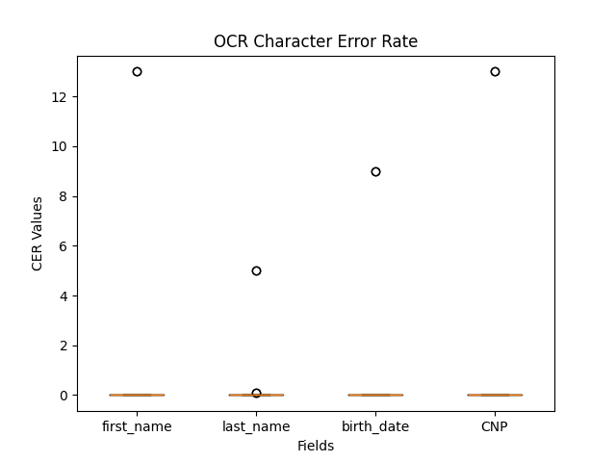
OCR

Slide 7
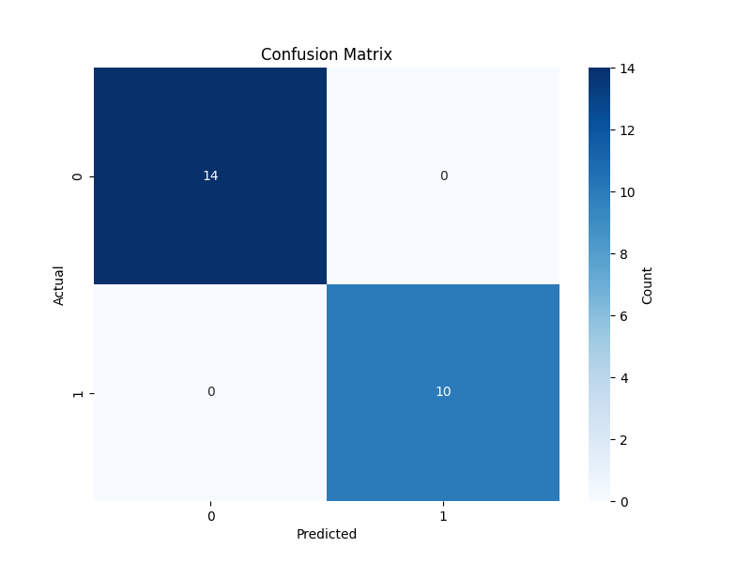
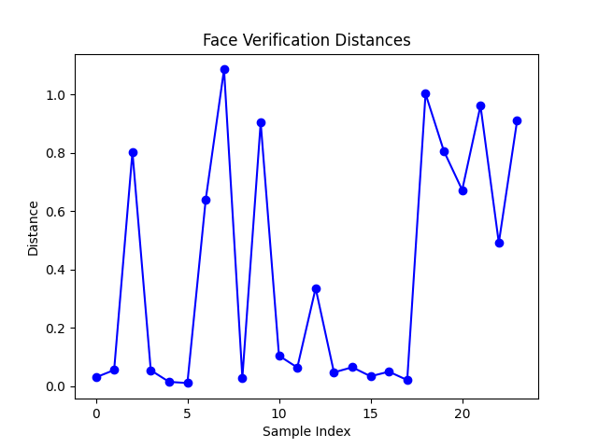
Face Recognition

Slide 8
Results
Successful OCR Data Extraction:
Reliable extraction of CNP, name, and MRZ fields.
Face Cropping and Verification:
High-confidence face detection and cropping using MTCNN.
Real-Time Demonstration:
Deployed via Streamlit for quick testing.
Potential Improvements:
Larger dataset for model fine-tuning.
Enhanced preprocessing for low-quality images.
Tuning DeepFace thresholds for specific risk tolerances.

