Slide 1






Decentralized Identity.
Frictionless, Secure, and Trustworthy.

Slide 2
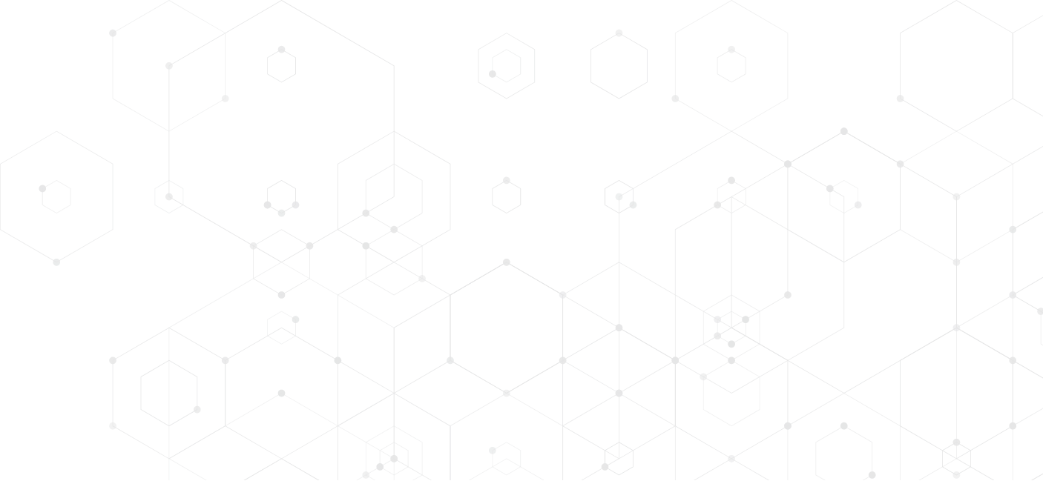



Introduction to EarthID
EarthID is a multi-award-winning decentralized Identity platform that enables organizations to issue and verify digital ID and credentials securely and seamlessly.
EarthID helps organizations prevent identity fraud, reduce costs and foster trust.
Fraud Prevention
Trust in Business
Cost Savings
User Experience
Copyright © 2023 EarthID. All rights reserved.

Slide 3



EarthID Capabilities
Digital Wallets
Verifiable Credentials
Zero Knowledge Proofs (ZKP)
EarthID is SUPERB
Secure
User Centric
Portable
Efficient
Reusable
Borderless
Copyright © 2023 EarthID. All rights reserved.

Slide 4





Key Features and Use Cases
1. Digital ID and Credentials for Citizens and Customers
5. Passwordless Authentication for Fraud Prevention
2. Reusable and Interoperable ID and credentials for Web3 and Metaverse
4. Frictionless Digital Onboarding/ ID verification for Customers and Employees
3. Secure and Tamper-proof Records of Ownership, Compliance and Transactions
Copyright © 2023 EarthID. All rights reserved.

Slide 5
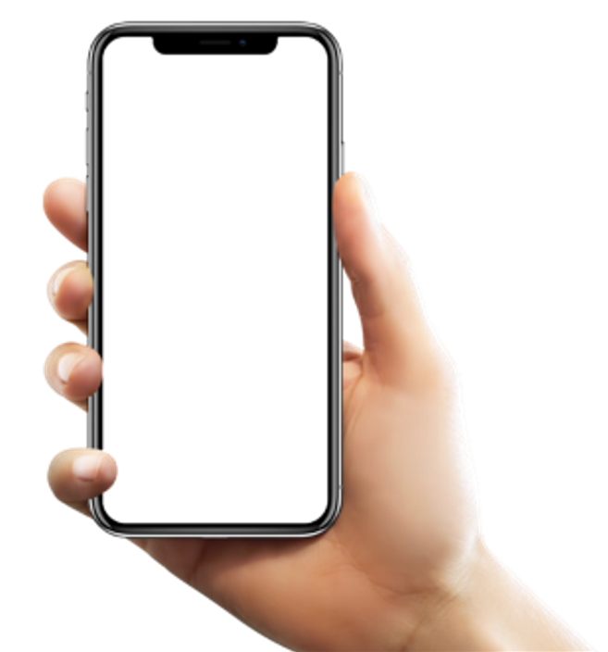
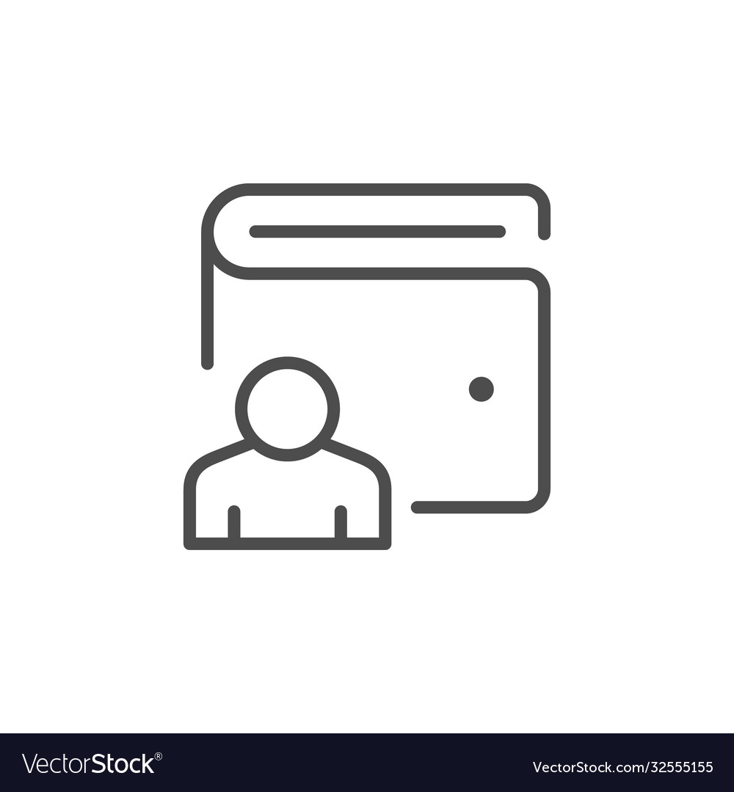
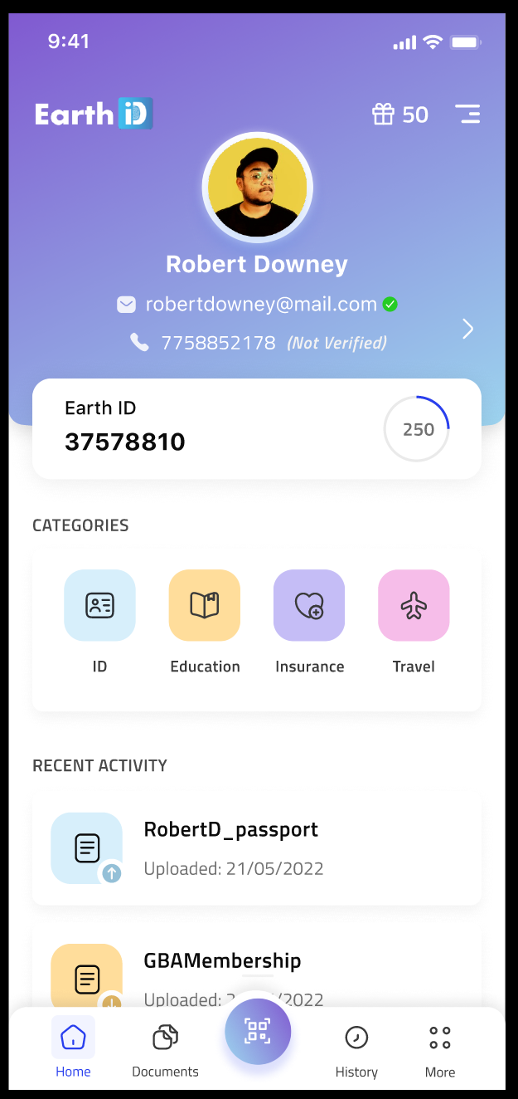





EarthID Solution
Wallet (multi-lingual)
Name: Robert Downey ID Proof: UK DL
Insurance Documents
Account Statements
Eligibility Proof
Ownership Proof
Financial Institution (s)
APIs
Interoperable, Decentralized
Identity Infrastructure
Copyright © 2023 EarthID. All rights reserved.

Slide 6





Globally Recognized and Trusted
Innovate UK Smart Grant Winner
MassChallenge Fintech Cohort 2023
Awarded Blockchain Innovation of the Year 2022
NASSCOM’s DeepTech Club Member
Mayor of London’s International Business Program
25+ Strategic Partnerships
Marquee Partners
Copyright © 2023 EarthID. All rights reserved.

Slide 7



Innovating Collaboratively
MENTOR+
Copyright © 2023 EarthID. All rights reserved.

Slide 8
Why Innovate UK?
Funding for Innovation
Accelerated Growth Opportunities
Validation and Credibility
Networking and Collaboration Opportunities
Enhanced Market Competitiveness
Knowledge and Skills Development
Copyright © 2023 EarthID. All rights reserved.

Slide 9
Purpose of the project?
Device Agnostic Web3 Wallet
Customer Trust and Competitive Edge
Prevent Identity Thefts and Fraud
Space Wallet
Data Ownership and Control
Interoperability and Portability
Remove Digital Divide
Copyright © 2023 EarthID. All rights reserved.

Slide 10
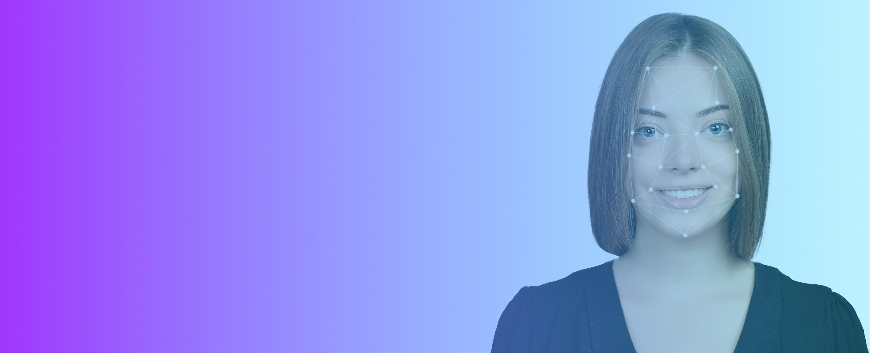


For more information, please visit: https://myearth.id
or email us at: info@myearth.id

