Slide 1


Orion GeoAI
A GIS Expert AI
- Understands Geospatial Data
- Answers Questions
- Does GIS tasks
On-premise AI for geospatial data — 100% Sovereignty, 100% Privacy.

Slide 2



THE PROBLEM
AI is here. Clients are not ready to adopt
Europe moves towards sovereignty
LLMs does not understand location by design
LLMs understand text. They have no concept of spatial relationships.
LLM by itself is not made for Geospatial use cases.
EU AI Act, GDPR, Government Policies and more
⏳ Geospatial Questions Take Weeks
Employee Churn
To answer a simple question business needs to:
Creates a ticket for the GIS team.
Wait 3 – 4 weeks until GIS team has capacity available.
Wait 1 -3 days so that a GIS analyst can deliver.
Total wait time: 4 -5 weeks
GIS expertise exists only in the head of one expert. The expertise is gone when that expert is gone.
Training curve for new employees is 3 - 6 months

Slide 3
THE SOLUTION
Orion: A center of command for all your GIS questions and tasks
"Show me all the Gas pipes that haven’t been inspected in the last quarter."
→ "47 Gas pipes found. That haven’t been inspected in the last quarter. Want me to add them to the chart for pipes to be inspected?"
✓ Save Time
✓ Save Money
✓ Keep your Data
✓ Keep your Knowledge
✓ Keep your Sovereignty
✓ Reliable ,Traceable Answers
- Today: 3–5 weeks per GIS question (specialist queue + analysis)
With Orion: 5 minutes
No Esri License
ArcGIS costs
€30K–150K/year per client
No AI Subscription
No more cost on AI subscription and tokens per user
Businesses make decisions based on data. A single hallucination can be costly. That’s why reliability, consistency, and traceability are at the heart of our design.
Data never leaves the server. Full compliance with Dutch/EU data sovereignty rules.
Knowledge stays in your organization when an expert leaves
- Instant Onboarding for New Staff
Every New Hire Starts with a Senior at Their Side.

Slide 4









PRODUCT
Multi-Agentic Geo RAG Framework
Orion
Data Catalogue
External Data
Geodatabase
Planner
Create Map
Orchestrator
User chats in NL
Generate Report
Sanitizer
Answers Questions
Executer
File System
And many more
Task Board

Slide 5
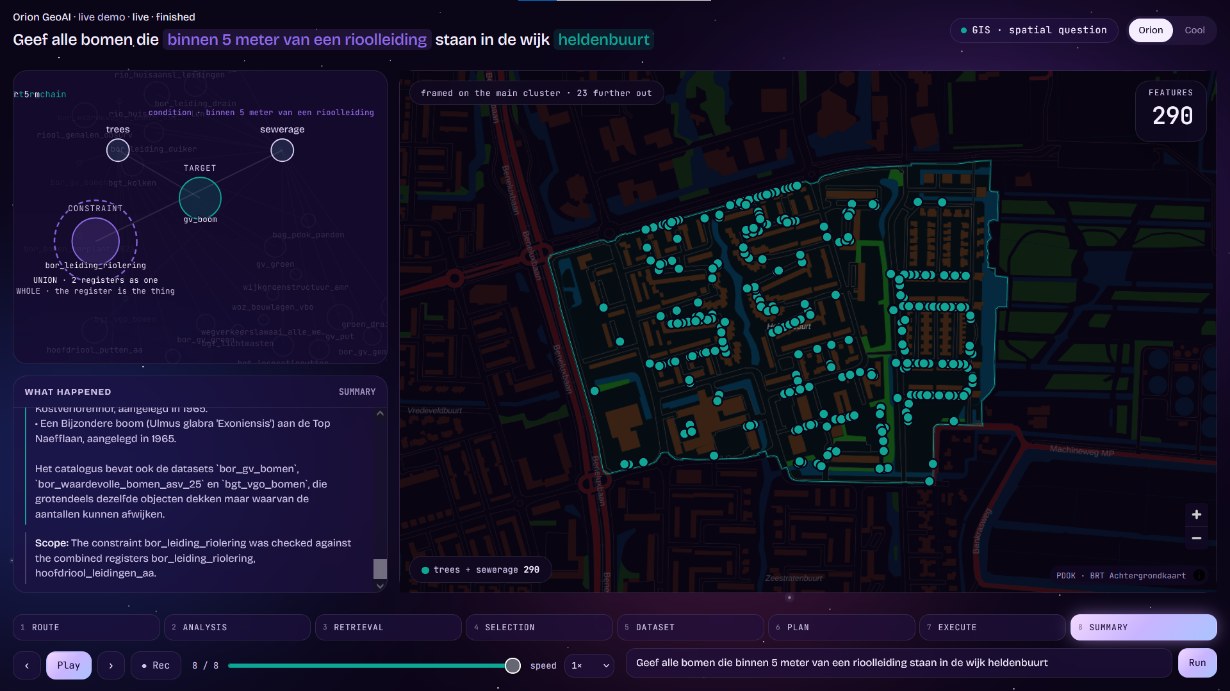
PROOF
Its live!
https://geoai-gisuniverse.westeurope.cloudapp.azure.com/stage/index.html

Slide 6
WHY NOW
Three tailwinds are converging
🤖
🏛️
Policies
Technology Readiness
Market Readiness
New models run on consumer hardware with response times under 3 seconds.
The EU AI Act, GDPR and government policies mandate that sensitive public data stays on-premise.
Digital Sovereignty is demanded
Organizations are actively searching for ways to replace Esri.
Old GIS software is too slow, too expensive and not made for AI
First-mover window: Many claim they are building GeoAI. While what they do is just to connect Claude to a GIS software.
We are building deep tech AI : The infrastructure that makes organizations independent.

Slide 7
MARKET SIZE
Large, defensible, and underserved
€300M
€12M
€3M
SAM — Netherlands
(gemeenten + waterschappen + utilities)
SOM Year 3
(30 organizations via partners)
TAM — EU government and Utility GIS software market
Netherlands
EU Expansion
🏛 342 Gemeenten (municipalities)
💧 21 Waterschappen (water boards)
🛣 1 Rijkswaterstaat (national)
⚡ 50+ Utility companies (Stedin, Alliander…)
Average license: €20K–30K/year
🇩🇪 Germany
🇧🇪 Belgium
🇫🇷 France

Slide 8
BUSINESS MODEL
Open-source + Licensing + OEM distribution
COMMUNITY
CLIENT
PARTNER
Open source
Direct license
OEM license
Limited capabilities
Developer adoption
Lead generation
Annual platform license
Implementation and support
Capability / scale tiers
Partner margin
Deployment rights
Volume and enterprise tiers

Slide 9
GO-TO-MARKET
Distribution through companies we already know and conferences
Target Clients
Consultancy
Engineering
Our first target market is private engineering firms. They make decisions faster, which shortens our sales cycle and delivers a faster return on investment.
Next phase:
government
Utilities
Energy
environment
Longer sales cycles, but larger and more stable contracts.

Slide 10
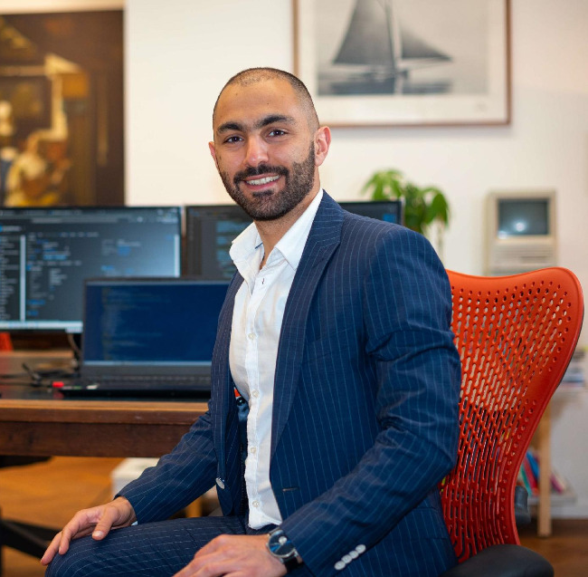
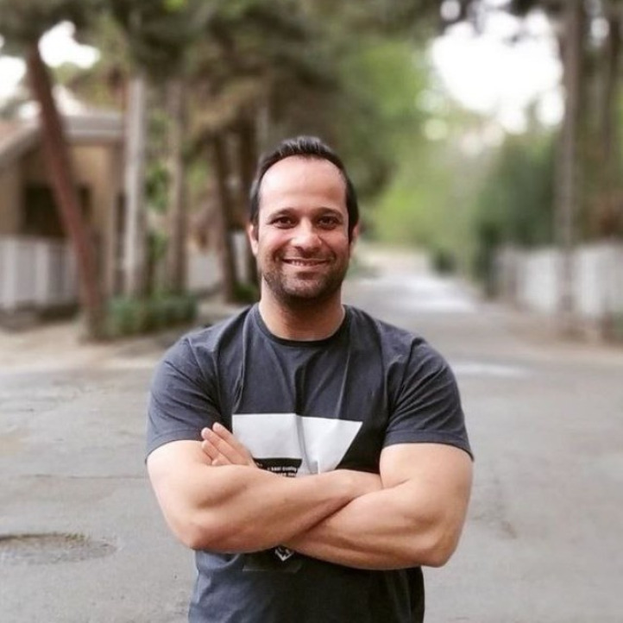
Adrian Akbari
Soheil Setayeshi
TEAM
Founder & CEO
CTO
Domain Experts in
GIS + AI
15 years of experience.
Engineering director of Neshan Maps. A national navigation app with 30 million users.
GIS architect and developer with + 10 years of experience designing enterprise geo-systems and applications
Why Us?
We are the user. We are the market
We designed GIS systems for municipalities, water boards, provinces, ministries, utilities, and consultancy firms. We didn't discover geospatial data from the AI side — we built the workflows our product now automates. We know exactly where analysts lose three hours a day, and why.
- We know the competition from the inside.
We have deployed, extended, and worked around Esri, VertiGIS, QGIS, and every major GIS stack . We know their technical details and their limitations.

Slide 11


THE ASK
We are offering a limited number of founding implementation partnerships
3 Months Pilot → 12 months post pilot license
NO Implementation effort from your side → We will implement it on your system
NO data leaves your organization → 100% safe.
NO commitment from you → NO vendor lock-in
Minimum requirement → Just read access to a geodatabase. Works with any GPU!
Limited Offer: 3 months pilot just for 5K
→ We ask for your feedback

Slide 12
Orion
GIS Organizational Brain that knows your data and processes
Like that senior who is running everything for 15 years
On-premise AI for geospatial data.
Built for Dutch and EU government data sovereignty.
Adrian Akbari · Founder
adrian@gisuniverse.com

