Slide 1
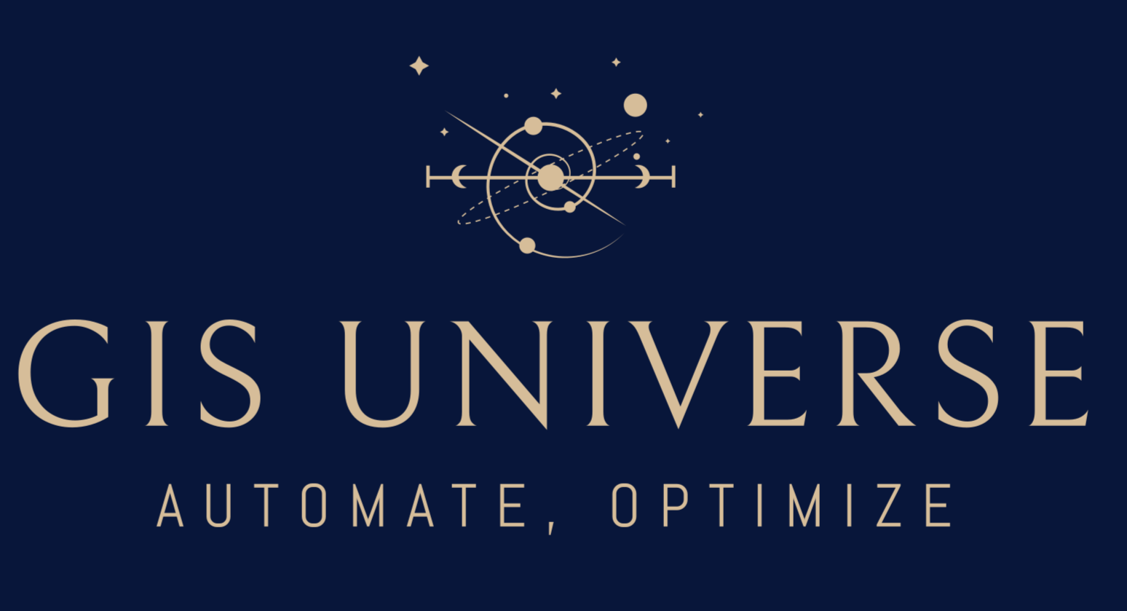
GeoAI
A GIS Expert AI
- Understands Geospatial Data
- Answers Questions
- Does GIS tasks
On-premise AI for geospatial data — 100% Sovereignty, 100% Privacy.

Slide 2
What is GeoAI?
GeoAI: A center of command for all your GIS questions and tasks
"Show me all the Gas pipes that haven’t been inspected in the last quarter."
→ "47 Gas pipes found. That haven’t been inspected in the last quarter. Want me to add them to the chart for pipes to be inspected?"
call to action
CTA scrolls down to the bottom of the page
User gets two options:
1. fill in a contact form
2. directly book a free consultation call

Slide 3
Demo: video of geoai

Slide 4
Why GeoAI
Save Time
✓ Get Answers in Minutes not Weeks
✓ New Employee is immediately onboarded!
To answer a simple question business needs to:
Creates a ticket for the GIS team.
Wait a few weeks until GIS team has capacity available.
Wait a few days so that a GIS analyst can deliver.
Total wait time: 4 -5 weeks
GeoAI can answer this in 5 minutes not 5 weeks.
GeoAI is just like that senior who already knows everything:
- what data we have
- where each data can be found
- what scripts we have
- what each script does

Slide 5
Why GeoAI
Save Money
Esri license
AI tokens license
No token cost. Runs on open-weight models
Calculate how much cost they save per employee by using geoai
Insert chart showing time save
Us vs commercial software

Slide 6
Why GeoAI
Keep your Data
Keep your Knowledge
Keep your Sovereignty
Geoai is 100% on-premise
Built for security
Buit for compliancy with GDPR, AI Act, traceability and government data sovereignty. Data never leaves the server.
GIS expertise often exists only in the head of one expert.
The expertise is gone when that expert is gone.
With GeoAI keep the knowledge in your organization.
When that expert leaves. The knowledge remain in your hands

Slide 7
Why GeoAI
- Automations
Automate any GIS workflow with AI Agents
Call to action

Slide 8
DevOps: Publish a WFS/WMS, ArcGIS Service
Why GeoAI
ETL, Data Engineering
Connect toGIS Servers: OGC API, GeoServer, ArcGIS Server
This in graph form
Second circle pups up on mouse hover
Integrations
Updates the Web Viewer
Web Viewers
Current Features
Understand which data, scripts, web apps, ... is related to the problem.
search history of relevant tickets.
propose a solution pointing to a file, script, app
Roadmap Features
Connects to
Connects to
Geodatabase
Answers Quesations
Connects to
Task Board: Azure ADO, SAP, etc
Connects to
GeoAI
Connects to
Write and Modify
Scripts
Fetch or Create Data
Connects to
External Data Sources:
PDOK, NGR, Kadaster, KNMI,…
Connects to
File System
Extract from satellite images
Answer Questions,
and Run Scripts
Insert call to action
Sensor Data
Understands where is what: Python scripts , FME Scripts, SQL scripts, Documentations,....

Slide 9
Try it out!
Link to the demo page
Tested on +200 most common GIS use cases
Indexed 287+ Layers
Improving the reliability of answers everyday
Call to action

Slide 10
For Who?
Could be a graph
Government
Energy and Utilities
Construction
Environment
Telecom
Real Estate
Municipalities
Gas
Urban Planning
waterschappen
Electricity
Provincies
Water
Ministries
MBZ
RWS
RIVM
How could GeoAI help my organization?
Discover how Orion GeoAI can be tailor made for your unique use cases
Call to action

Slide 11









How it work?
Multi-Agentic Geo RAG Framework
Reliable
Consistent
Secure
Hardware Flexible
GeoAI
External Data
Agents
Geodatabase
Planner
Data Catalogue
Create/Update Map
User chats in NL
Connect agents together
To show collaboration
Orchestrator
Generate Report
And many more
Sanitizer
Answers Questions
Executer
File System
Task Board

Slide 12

The Offer
We are offering a limited number of Pilot Programs
3 Months Pilot → 12 months post pilot license
NO Implementation effort from your side → We will implement it on your system
NO data leaves your organization → 100% safe.
NO commitment from you → NO vendor lock-in. Cancel anytime
Minimum requirement → Just read access to a geodatabase. Works with any GPU!
Call to action

Slide 13
GeoAI
GIS Organizational Brain that knows your data and processes
Like that senior who is running everything for 15 years
On-premise AI for geospatial data.
Built for EU government data sovereignty.
Footer
Call to action

Slide 14


As a separate tab
Adrian Akbari
Soheil Setayeshi
Who are we?
Founder & CEO
CTO
Domain Experts in
GIS + AI
15 years of experience.
Engineering director of Neshan Maps. A national navigation app with 30 million users.
GIS architect and developer with + 10 years of experience designing enterprise geo-systems and applications
Why Us?
We are the user. We are the market
We designed GIS systems for municipalities, water boards, provinces, ministries, utilities, and consultancy firms. We didn't discover geospatial data from the AI side — we built the workflows our product now automates. We know exactly where analysts lose three hours a day, and why.
- We know the competition from the inside.
We have deployed, extended, and worked around Esri, VertiGIS, QGIS, and every major GIS stack . We know their technical details and their limitations.

Slide 15
As a separate tab
Mission Vision
We will make Europe Sovereign
We will make Europe Independent
Keep your Knowledge
Keep your Data
Keep your Sovereignty

