Slide 1
Smart Annotation Platform using Deep Learning
Project Pitch
Team:
Adriana Pinto
Salman Khan
Tayyibah Rasheed
24th July 2021

Slide 2
Motivation
Labelled Images enables ML/DL Models.
1.3 B $ Market with an expected a compound growth rate of 25.6% from 2021 to 2026
Data annotation is a laborious process and is time and cost intensive.
Take up to 40 secs a single object.
Notes:
Data annotation, specifically for image data sets is a challenging task since it requires a rigorous manual training process that is time and cost intensive to ensure standardized outcomes.
The global data collection and labelling market has been estimated as a 1.3B$ market in 2020 with a compound growth rate of 25.6% from 2021 to 2026.
Manually tracing object boundaries is a laborious process, taking up to 40sec per object [2, 9].

Slide 3
Objective
Automate semantic segmentation and annotation of objects of interest in a given image.
Key research question:
Is it possible to standardize and minimize manual annotation errors for outdoor and indoor images?
How much improvement in time can an automated detection and segmentation system provide?
(w.r.t to manual process)
What key metrics should be considered for designing such an automated image labelling systems.
(Whats the loss function within Poly RNN+)
When will such an automated annotation system fail?
(Observations from mis-classification)?

Slide 4
Data
Data used for this task will be ADE20K data set -(https://groups.csail.mit.edu/vision/datasets/ADE20K/ )
Dataset contains:
27,574 images (25,574 for training and 2,000 for testing) spanning 365 different scenes.
707,868 unique objects from 3,688 categories, along with their WordNet definition and hierarchy.
193,238 annotated object parts and parts of parts.
Polygon annotations with attributes, annotation time, depth ordering.
Our scope will be limited to street view data set.

Slide 5
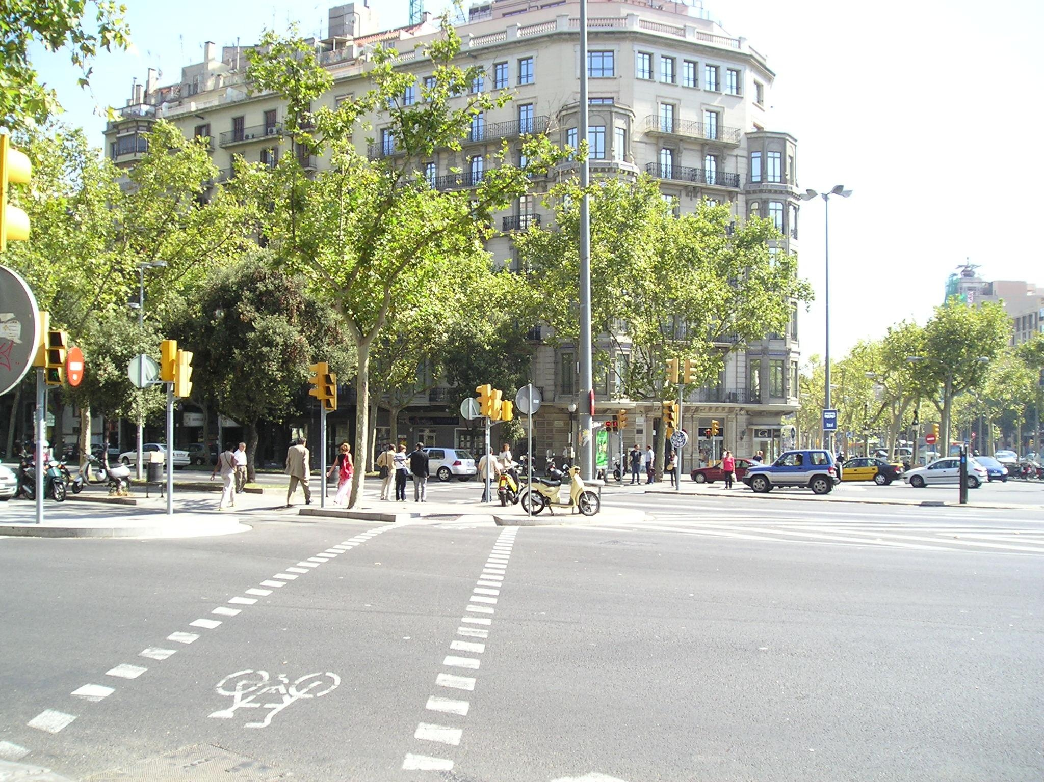
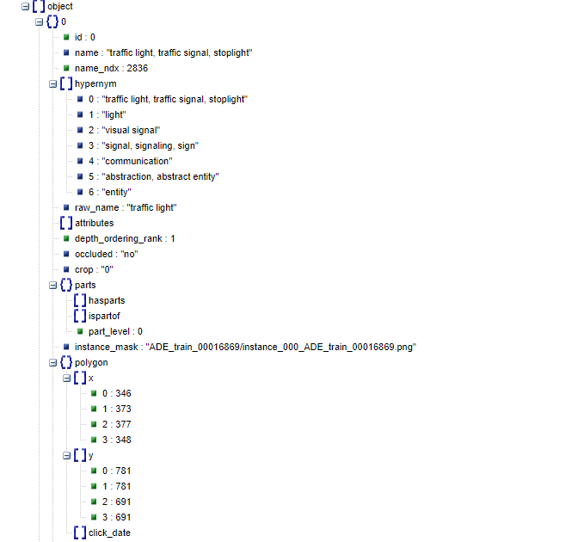
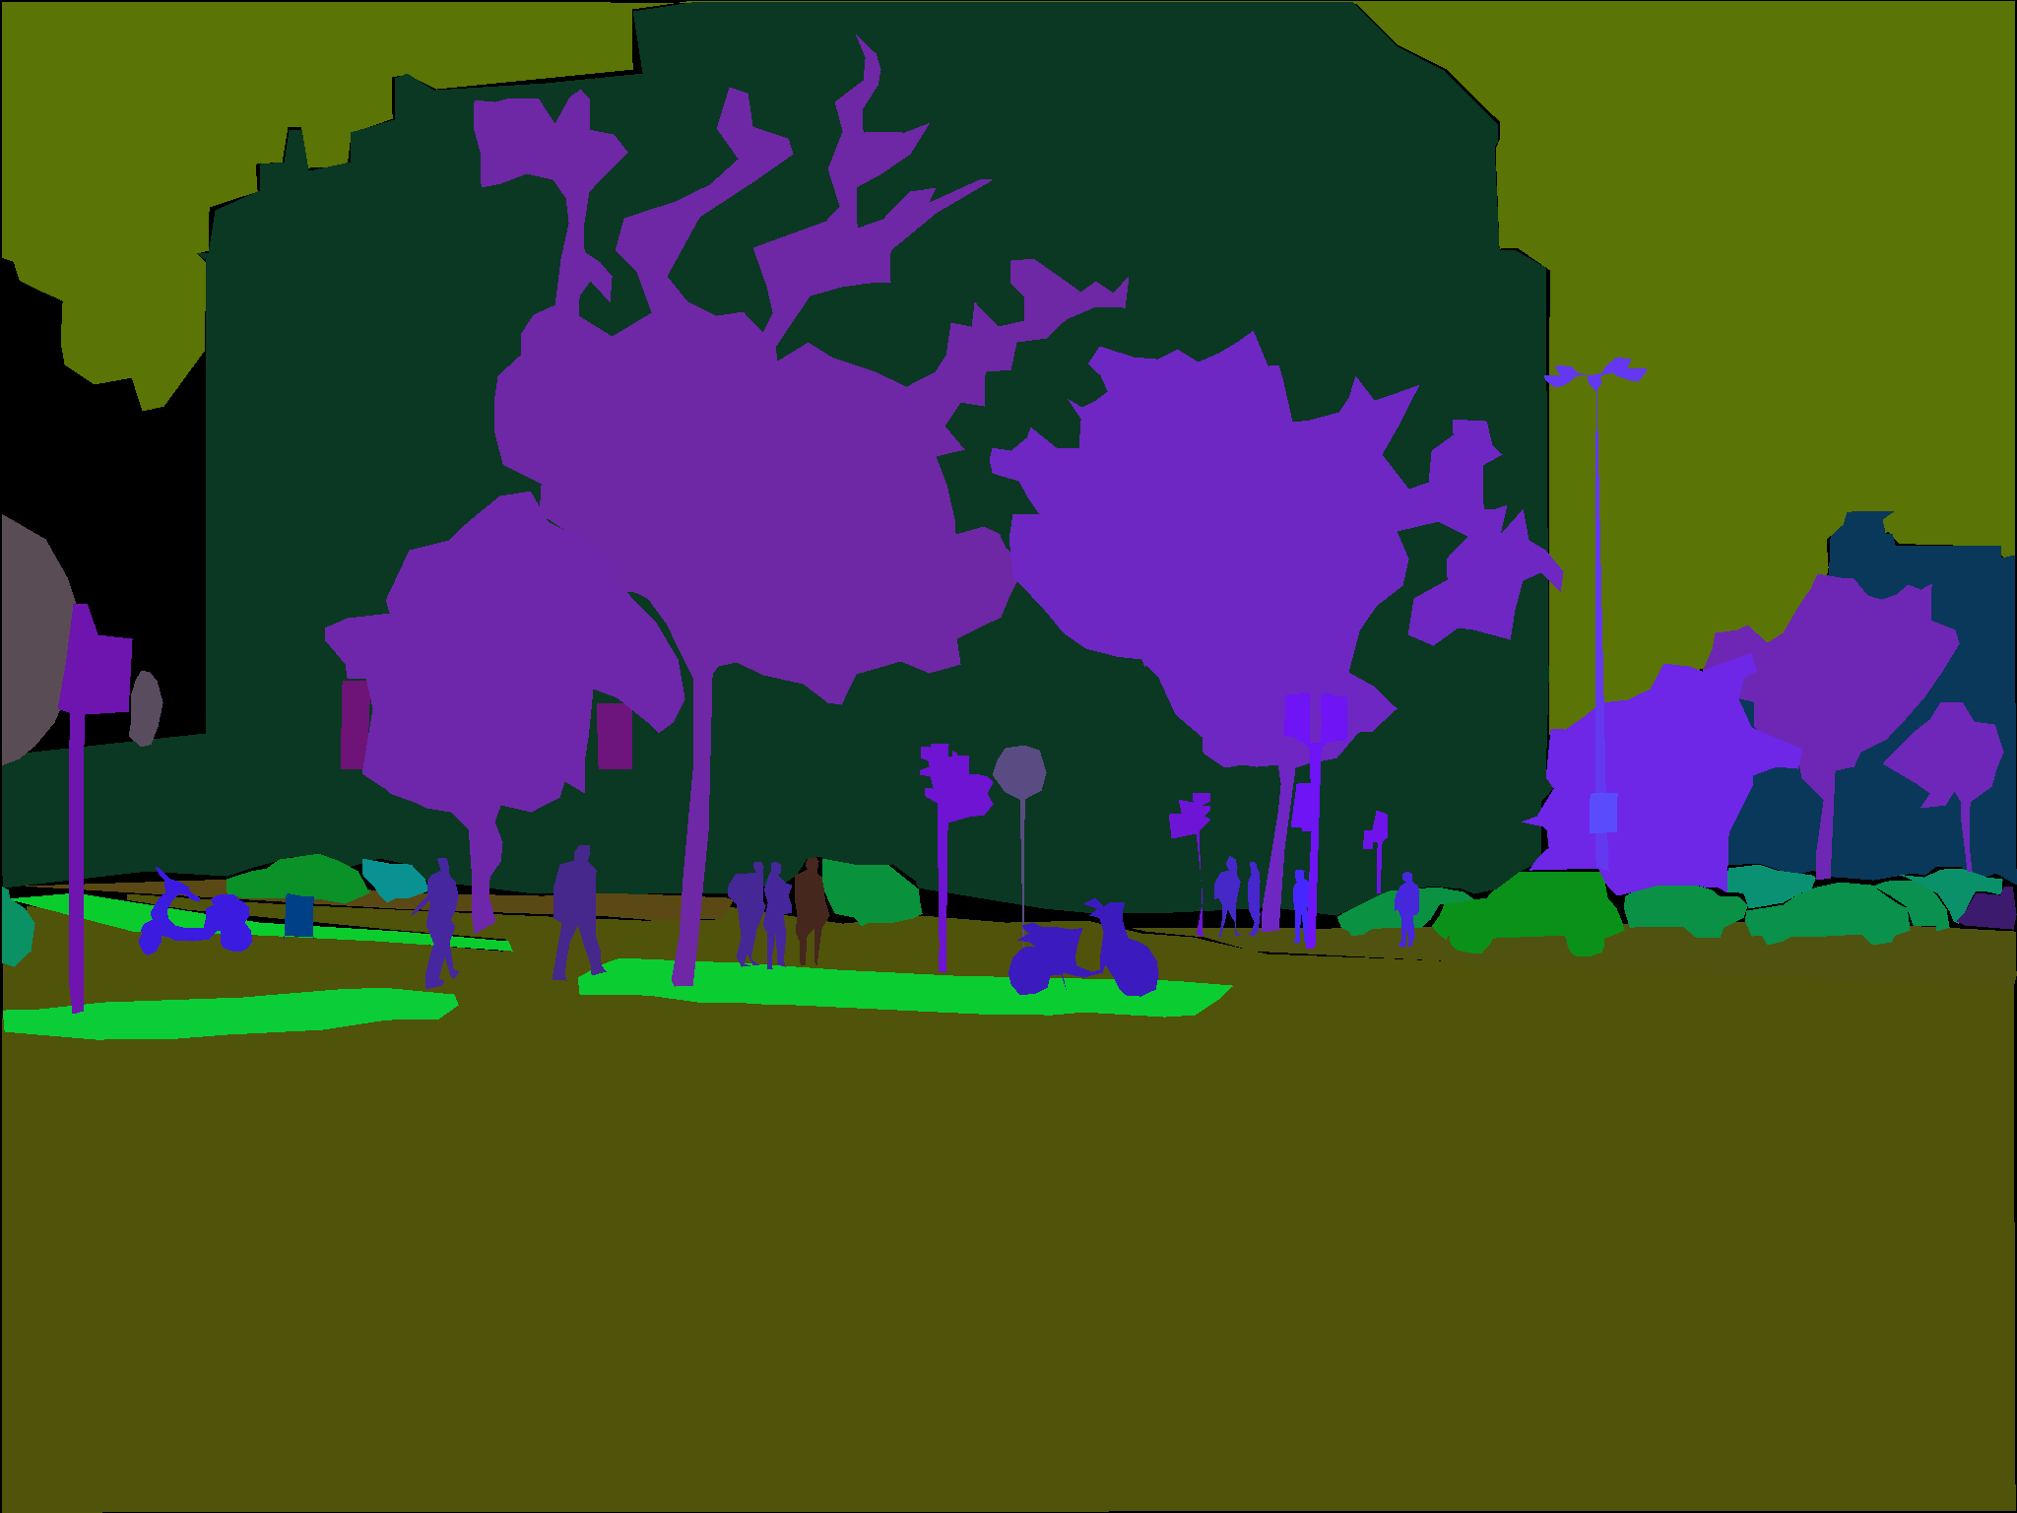
DATA - Example
Notes:
Every image and its annotations are inside a folder_name, that you can find using index_ade20k.pkl. Once you are inside the folder name, for a given image image_name (e.g. ADE_train_00016869) you will find:
image_name.jpg: containing the raw image, with blurred license plates and faces (e.g. ADE_train_00016869.jpg)
image_name_seg.png: with the pixel-wise annotations of objects and instances (e.g. ADE_train_00016869_seg.png). The RGB channels encode the class and instance information. Check out (utils/utils_ade20k.py)[utils/utils_ade20k.py] for an example on how to read those.
image_name_parts_{i}.png: with the annotation of the parts at level i (e.g. ADE_train_00016869_parts_1.png).
image_name: a folder with all the instances in that image, stored as pngs encoding a binary amodal mask (showing occluded objects) (e.g. ADE_train_00016869).
image_name.json: a json file containing information about the time the object was annotated, the polygons annotated, annotation of attributes etc. (e.g ADE_train_00016869.json).

Slide 6
Project PLAN
Literature Review
Analyse Data
Replicate an existing technique (e.g. Polygon-RNN or Polygon-GCN) for our selected domain.
Develop an overall annotation system with the ML/DL modules.
ML web app that enables annotation of outdoor images
Technical report on Data, Process and Outcomes

Slide 7
Questions?

