Slide 1
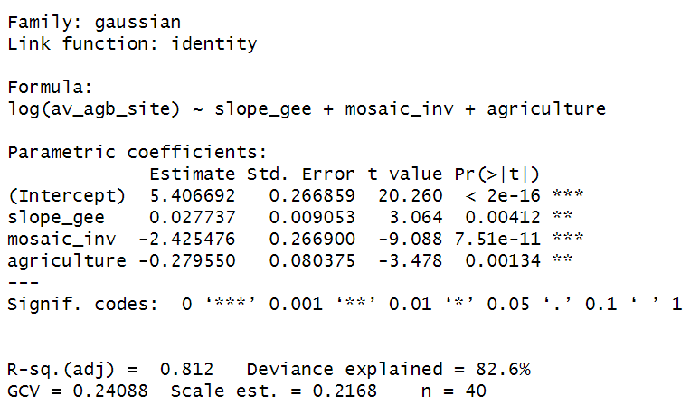
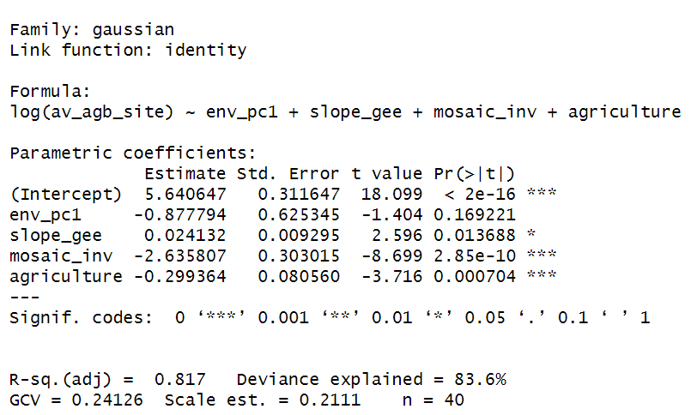
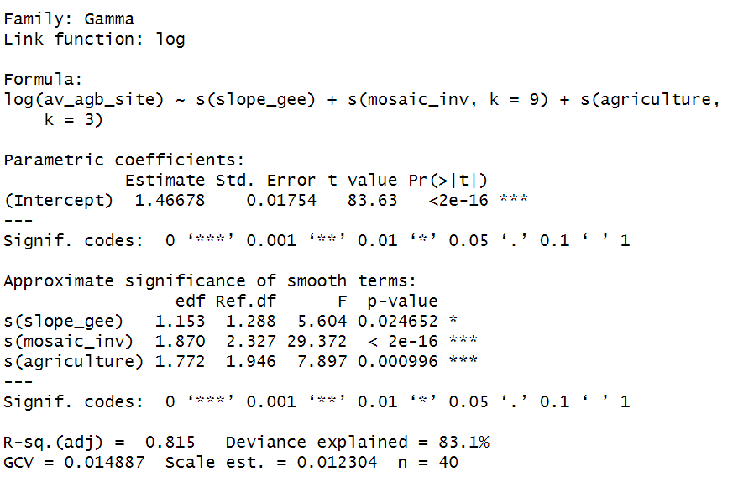
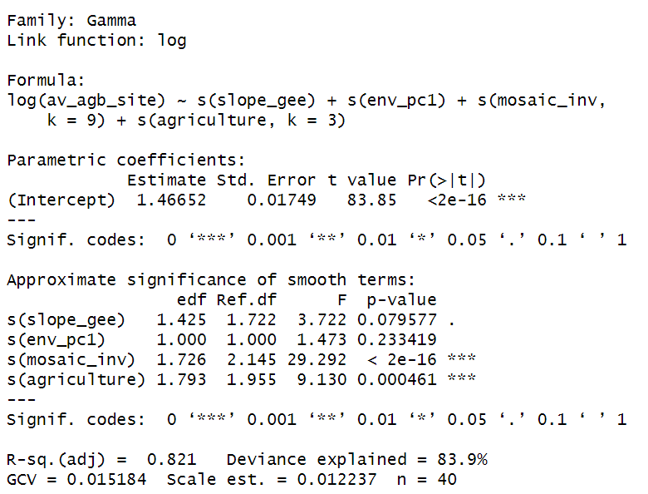
Models
Linear model 1 | Linear model 2
GAM 1 | GAM 2

Slide 2
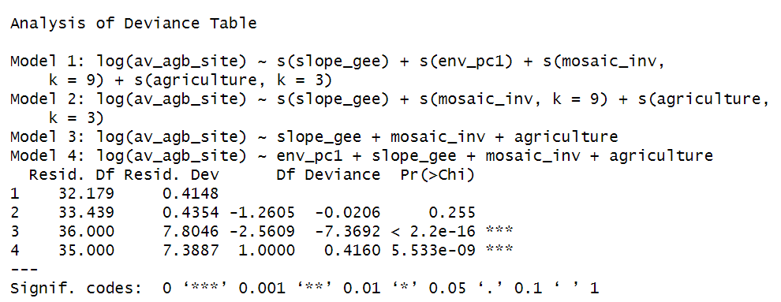
Models
 | AIC | GCV | R2 (adj)
Linear Model 1 | 58.14854 | 0.24088 | 0.812
Linear Model 2 +env | 57.9578 | 0.24126 | 0.817
GAM 1 | 63.57002 | 0.014887 | 0.815
GAM 2 +env | 64.1565 | 0.015184 | 0.821

Slide 3
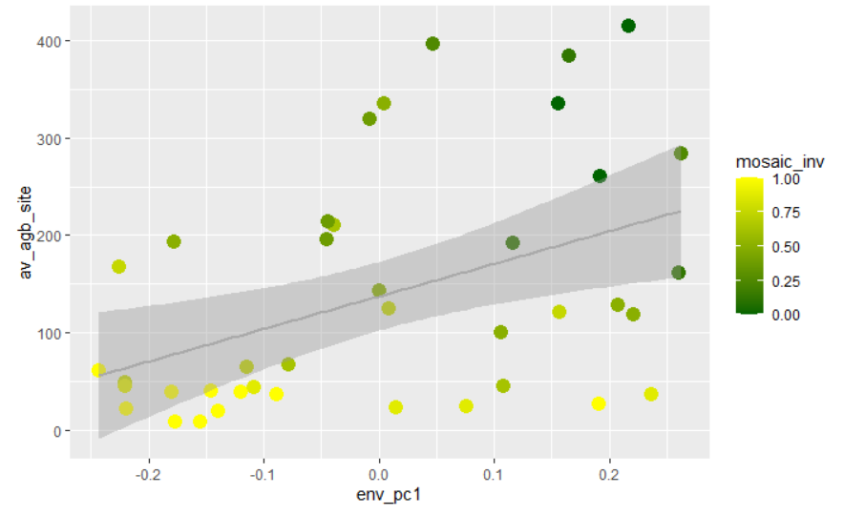
PC1 ~ AGB

Slide 4
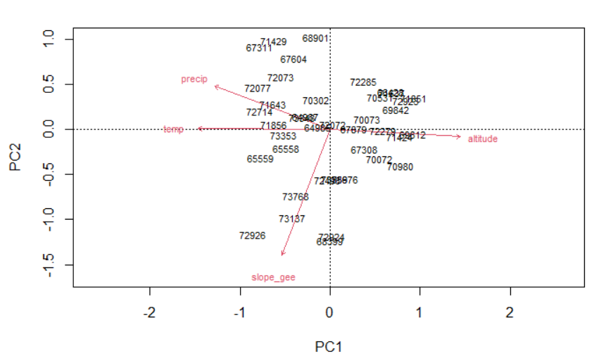
PCA with environmental variables (n=40)

Slide 5
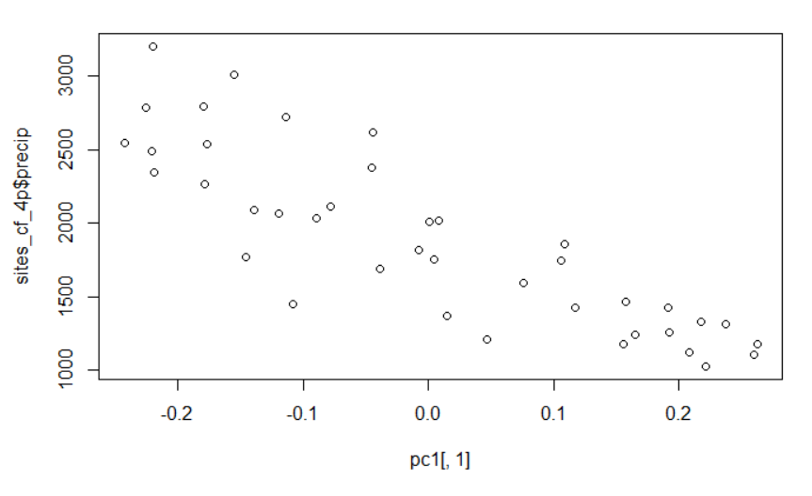
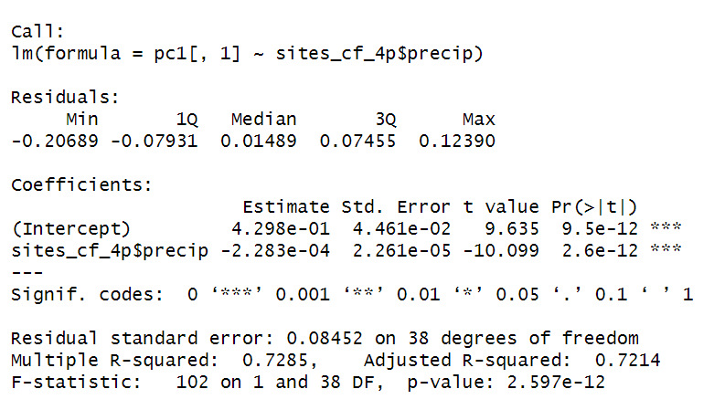
PC1 ~ Precipitation

Slide 6
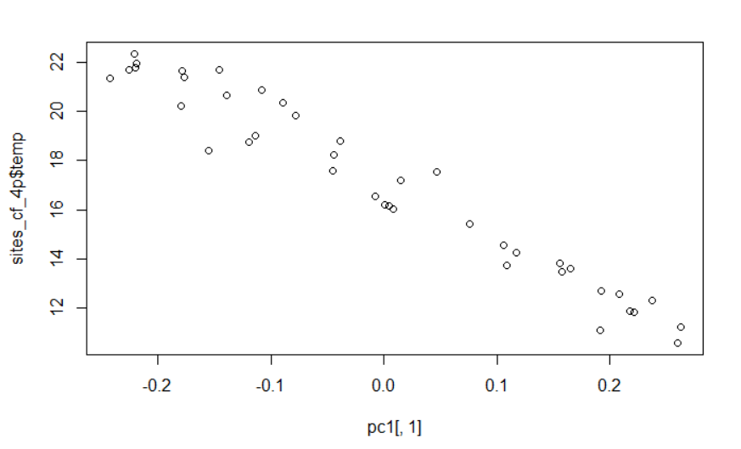
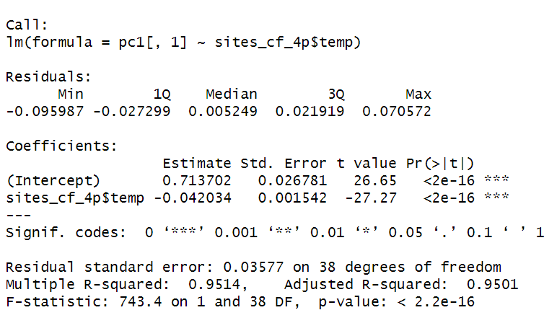
PC1 ~ Temperature

Slide 7
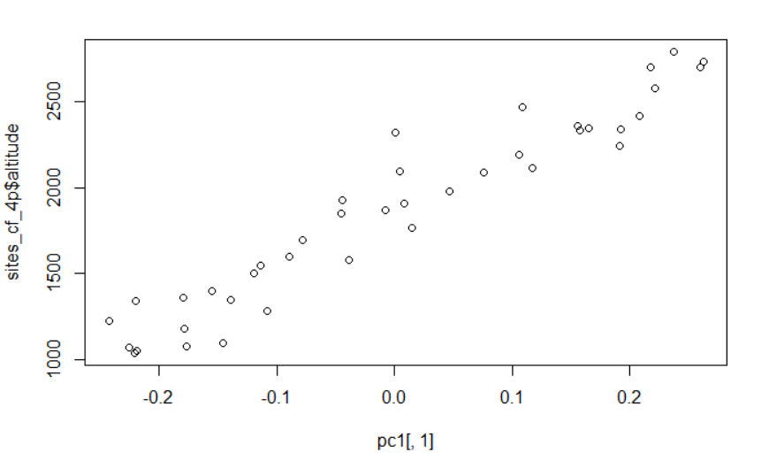
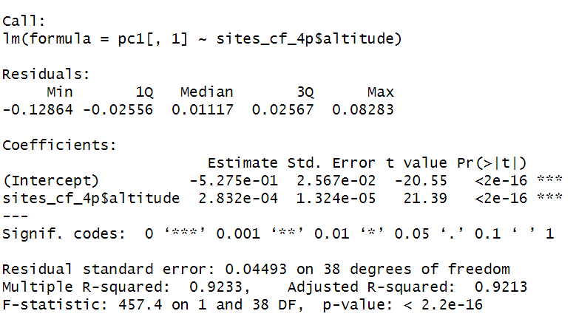
PC1 ~ elevation

