Slide 1
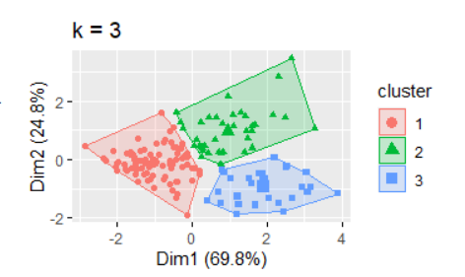
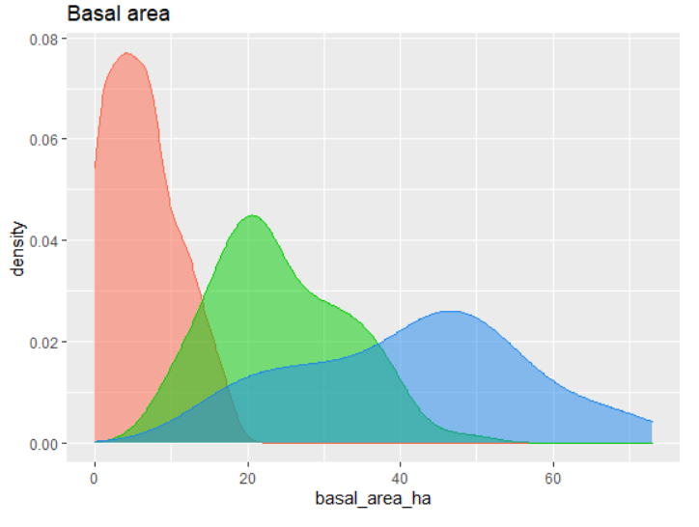
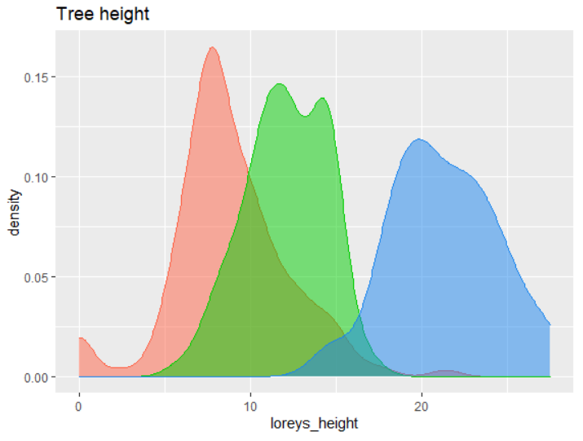
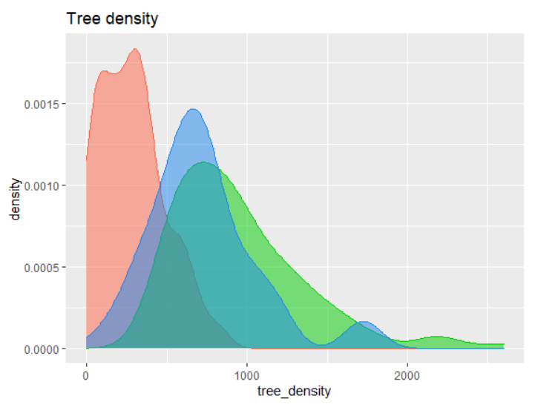
Forest categories. Non-hierarchical analysis (k-means) Based on structural attributes: basal area, Lorey’s height and Tree density Cluster 1: Very Young Forest (red) Cluster 2: Young Forest (green) Cluster 3: Mature forest (blue)

Slide 2











‘mosaic’ value
normalized mosaic = value - min value / max value - min value
Mosaic goes from 0 (all mature forest) to 1 (all very young forest)

Slide 3
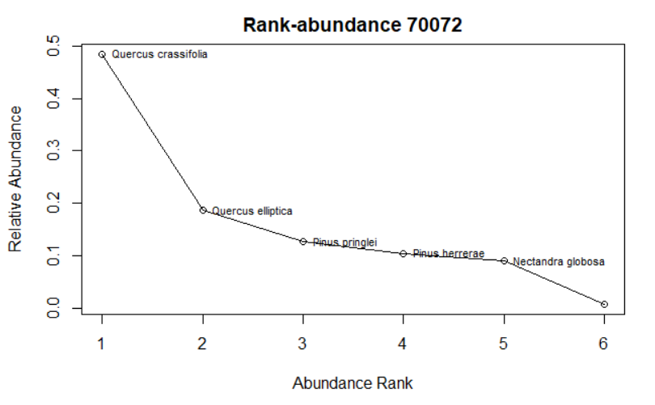
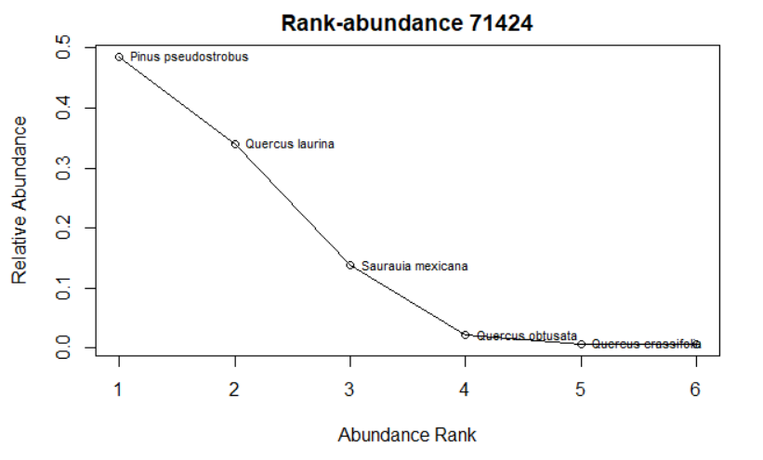
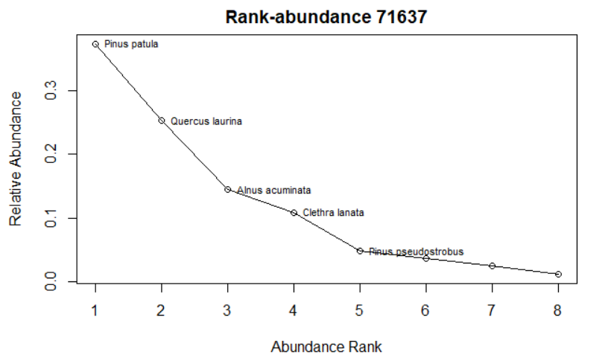
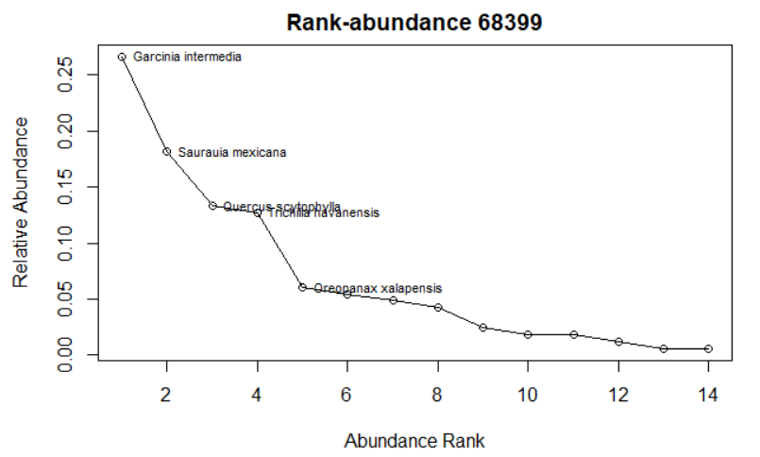
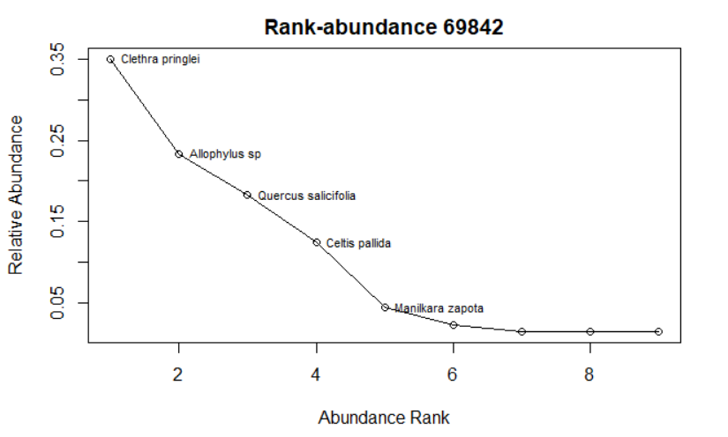
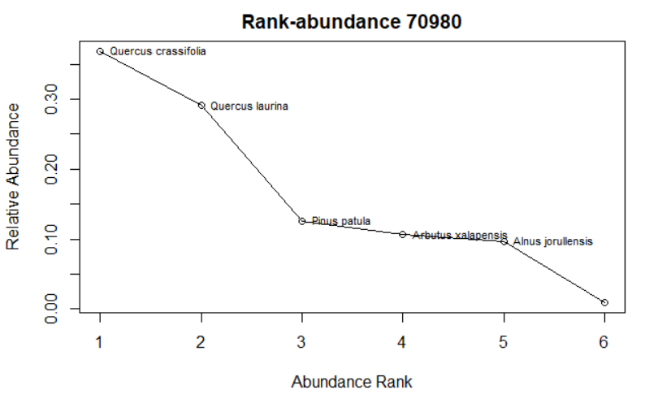
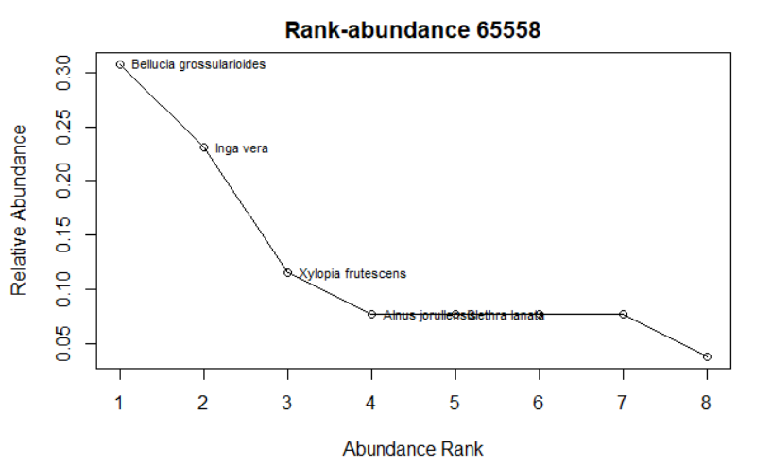
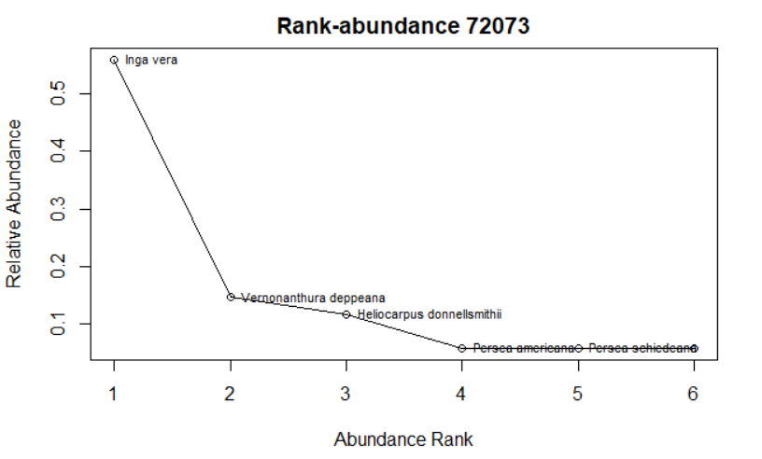
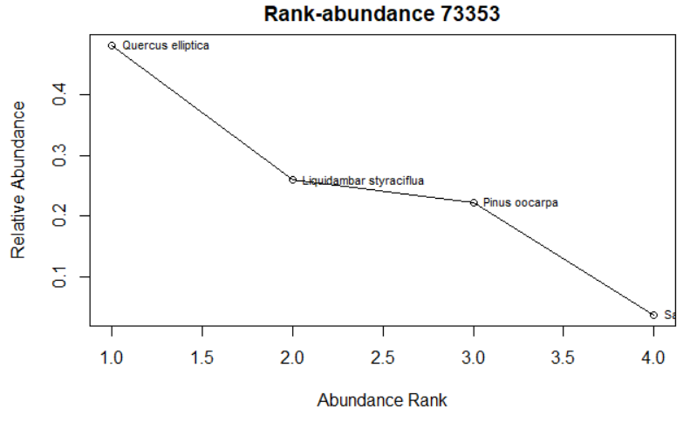
Notes:
Mosaic = 0;
Mosaic = 0.5;
Mosaic = 1;

Slide 4
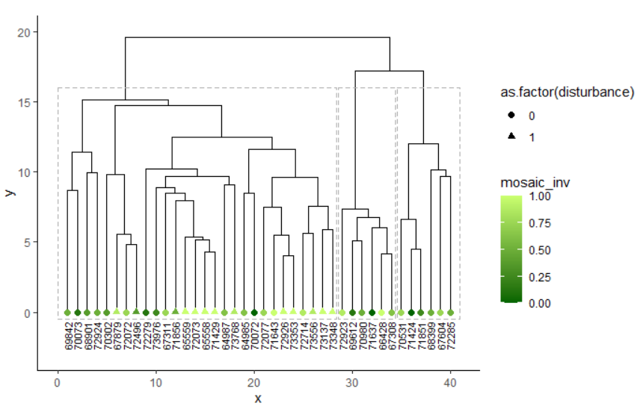
Hierarchical cluster analysis of species community composition

Slide 5
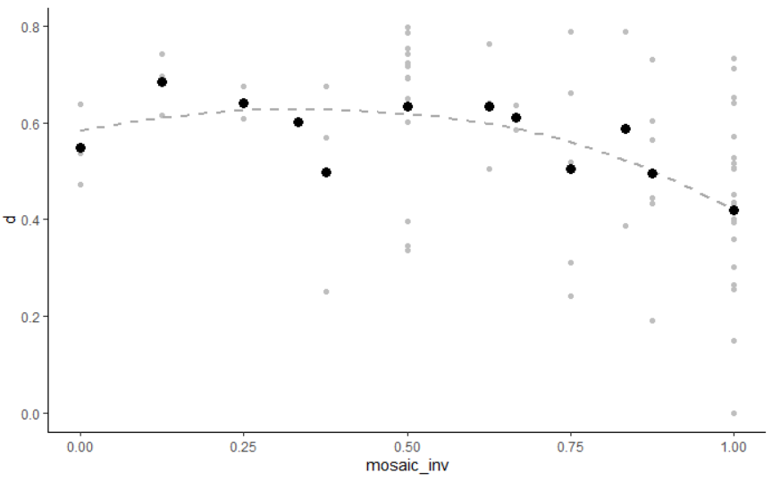
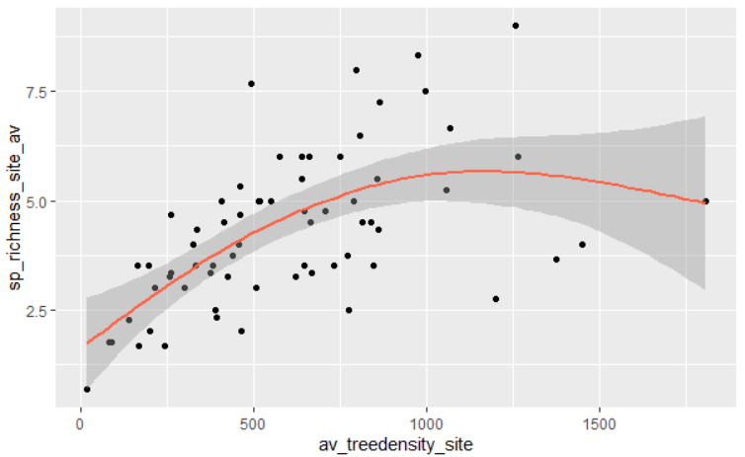
Tree diversity increases (not linear)

