Slide 1
EduHub – Student GradeBook App
Bărăian Adrian-Călin

Slide 2
When first launching the app, make sure you have generated the database using the ddl script provided. Login as admin using these credentials: → username: admin → password: admin123 To test the application correctly, you will have to first add a department, then a teacher and select a department(because the teacher is dependent on the department), then add a course, add a student, class and you can manage the links between student-courses, student-classes, teacher-courses, teacher-classes. Thank you!

Slide 3
Table of contents
01
02
03
Functioning
General Overview & Structure
How the application looks and what’s behind
How the application works, what it can do
The Database
Where the data of the app is stored

Slide 4
01
General Overview & Structure
How the project looks and what’s behind

Slide 5
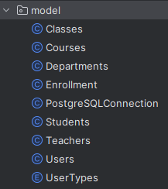
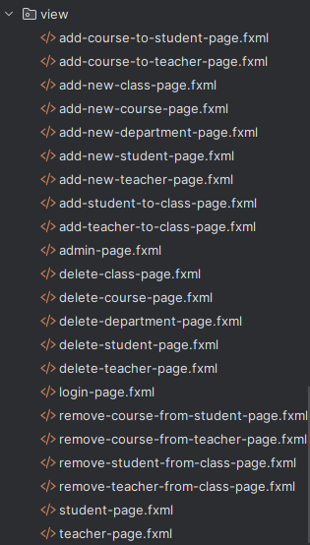
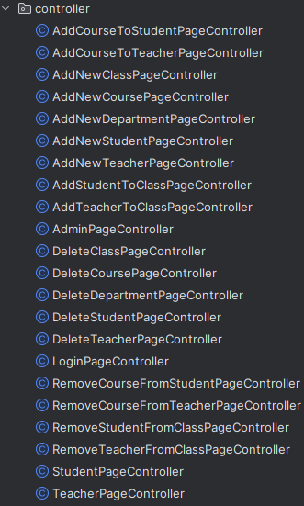
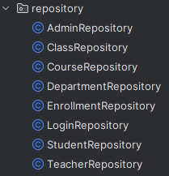
Model
View
Controller
Repository
Usage of enumeration for the user types(student, admin, teacher)

Slide 6
Structure
The structure of the project is based on the MVC architecture, which stands for Model – View – Controller:
→ Model package: Contains the classes that represent the table entities from the database;
→ View package: Contains the .fxml files which describe the visual part of a page(view);
→ Controller package: Contains the classes that describe the internal logic of the page (e.g. what happens when a button is pressed / how the data is collected from a field / how visual objects appear / disappear etc.)
→ Repository: Which contains all the methods used to interact with the database, queries

Slide 7
Main Views
Login View
Admin View
Student View
Teacher View
The view that pops-up when you first launch the application.
Logging-in using the admin account takes you to this view
Inside the admin view we have several more views for the insertion/deletion/management of data in database
Logging-in using a student account takes you to this view.
You can see your grades, members of your class and change your password
Logging-in using a teacher account takes you to this view. You can give grades to your students and change your password

Slide 8
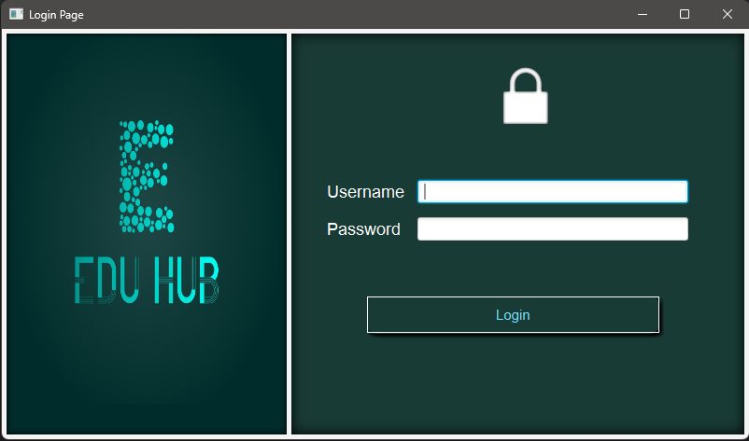
Login View

Slide 9
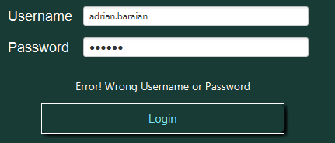
Login View
When launching the application, this is the first view that pops up. Completing the fields with the right credentials takes us to the next view (admin view <- for the admin account or to the student or teacher view, based on the type of user). The identification of the what type of user is logging in is made via PostgreSQL query, because the user type is an attribute of the Users Class (admin/ teacher/ student). If the credentials do not match any account in the database, then, we are notified through a label that something is wrong.

Slide 10
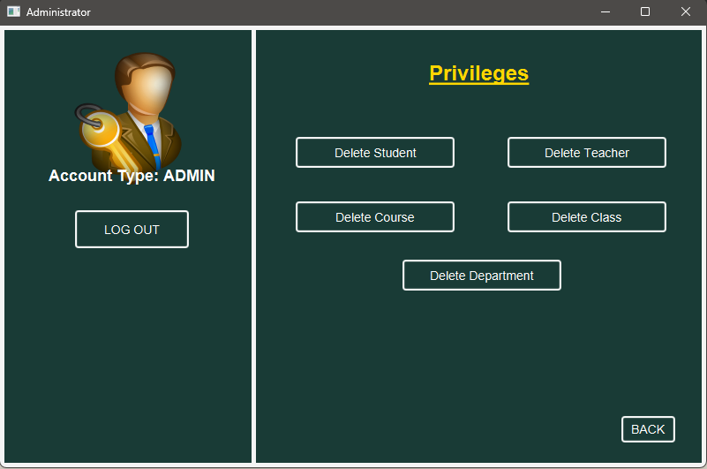
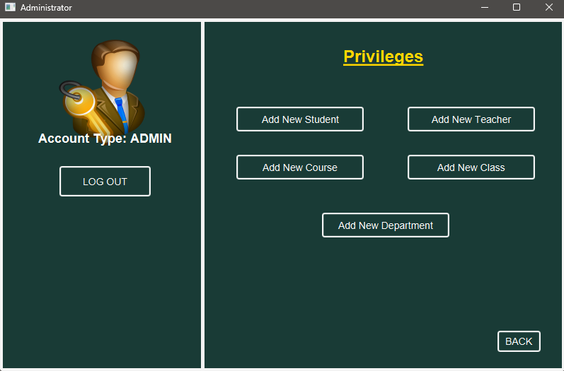
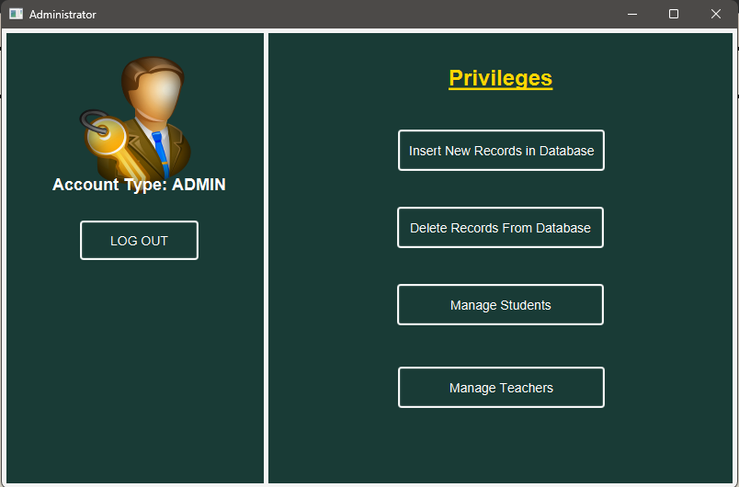
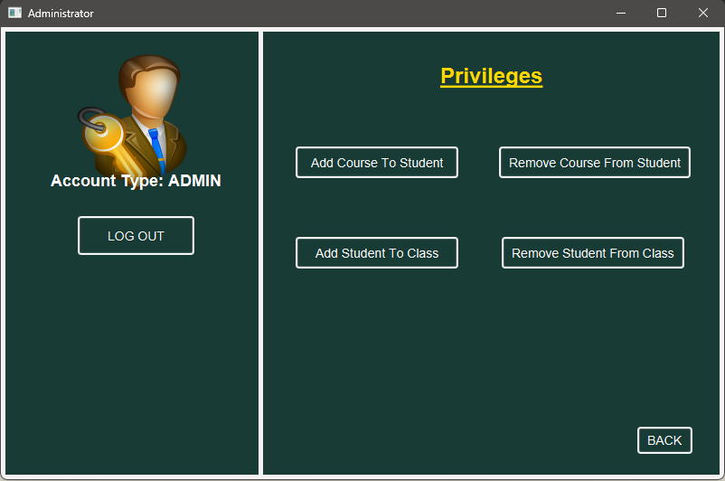
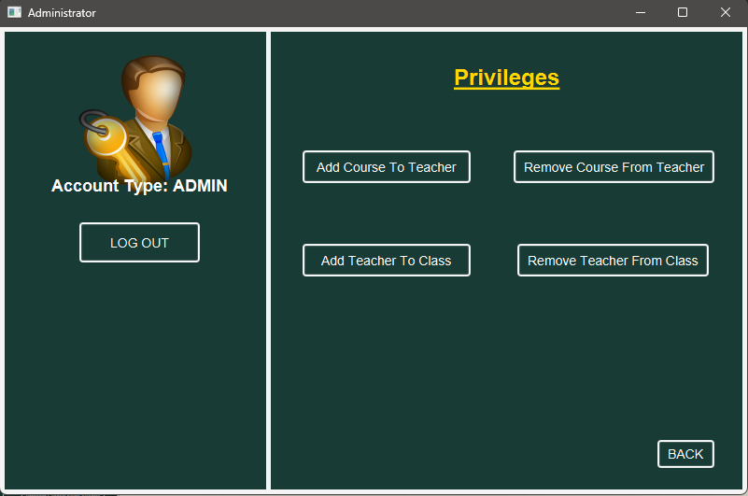
Admin View

Slide 11
Admin View
Being logged-in as admin, we gain certain privileges, such as:
→Inserting new data into the database;
→Deleting data from the database;
→Managing student data (enrolling/removing students to/from courses, adding/removing students to/from classes);
→Managing teacher data(adding/removing teachers to/from courses/classes).
When pressing one of the buttons in the main page of admin-view, the other buttons “hide” and new ones appear(the ones appearing are set visible, and the others are set to be not-visible). Pressing one of these secondary-phase buttons, will open a separate main stage(it will not allow clicks outside the current window) for data management(insertion, deletion, linking etc.).

Slide 12
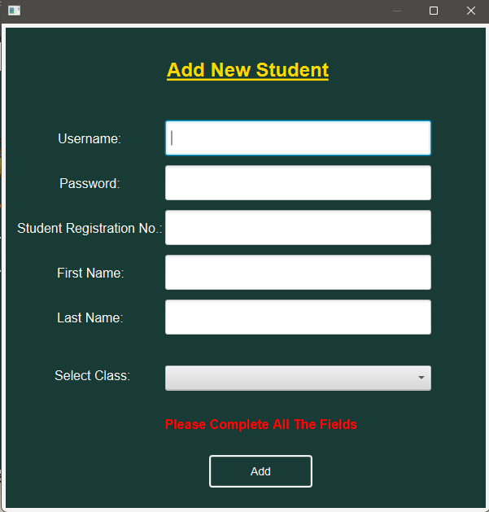
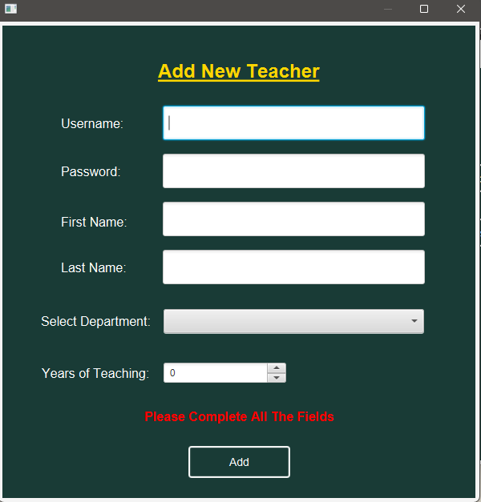
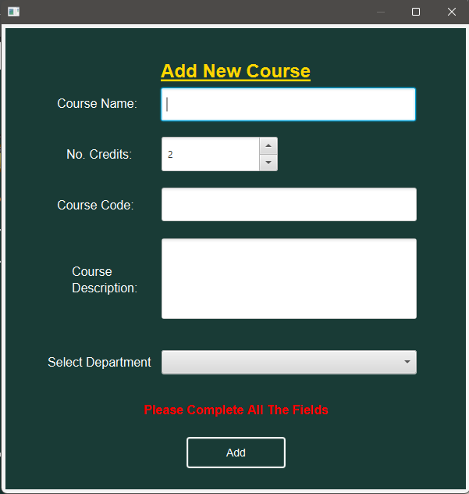
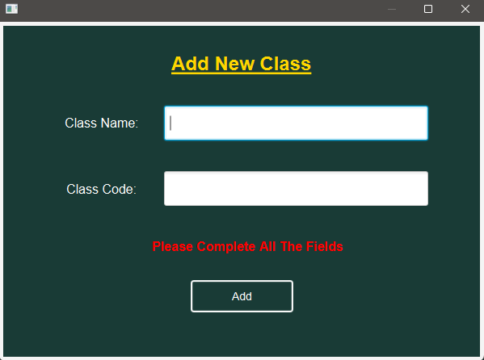
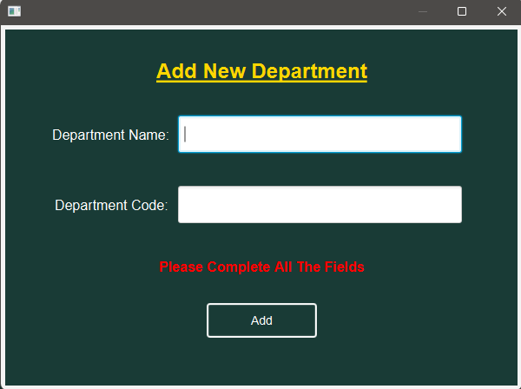
Insert in database - views

Slide 13
Insert in database – cont.
When inserting a record into the database, we first need to fill all the fields (ones with special restrictions) and then press on the “Add” button. If everything is okay, meaning there are no duplicates, and all the fields are filled correctly, the data will be added to the database.

Slide 14
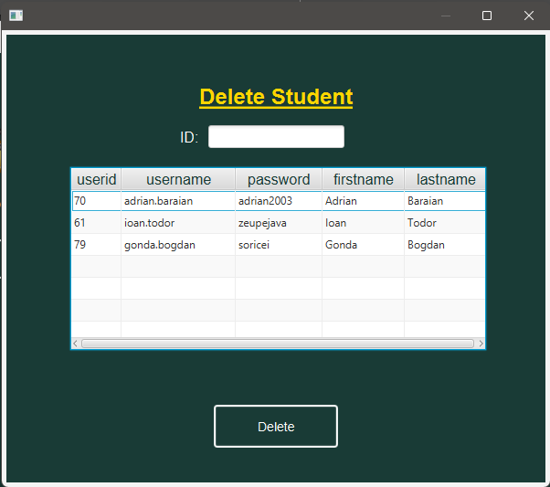
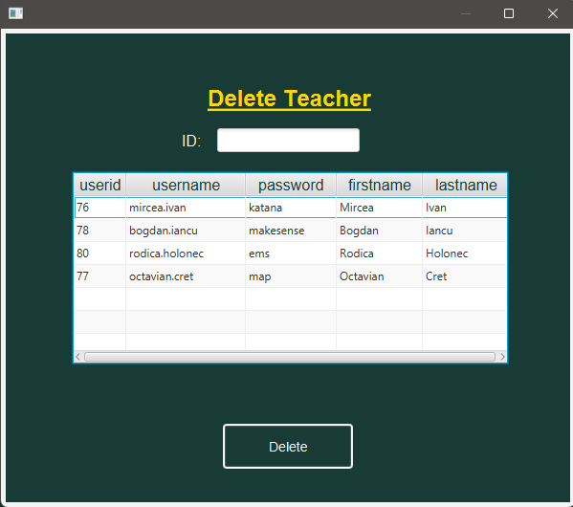
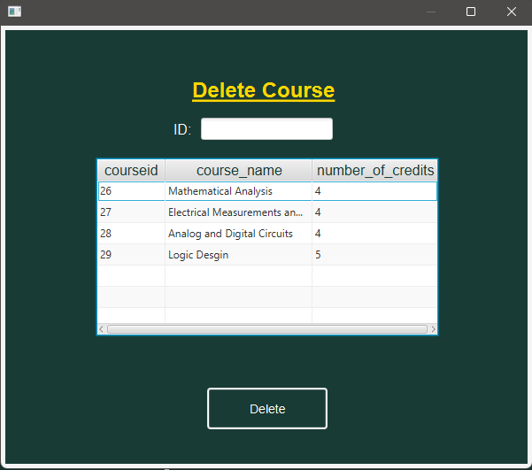
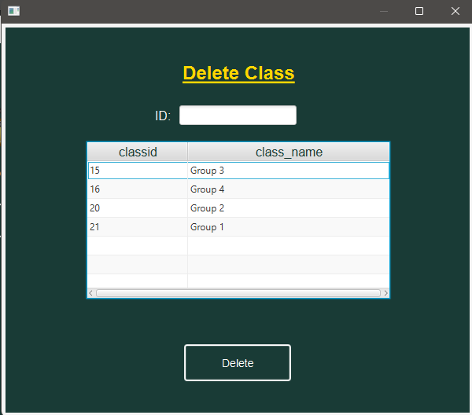
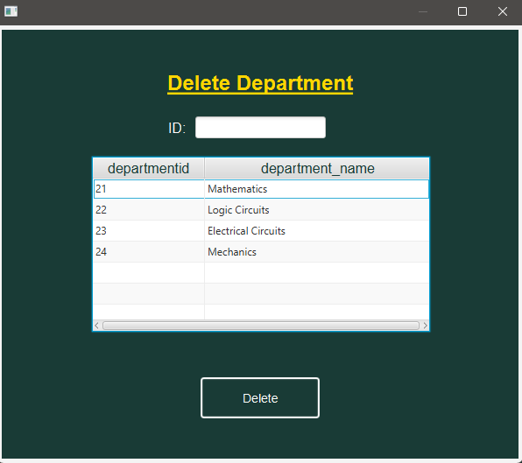
Delete from database - views

Slide 15
Delete from database – cont.
When deleting from database, we just need to select the record we want to delete and then press on the delete button.

Slide 16
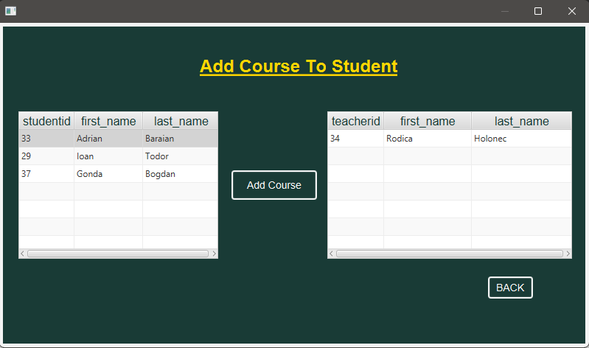
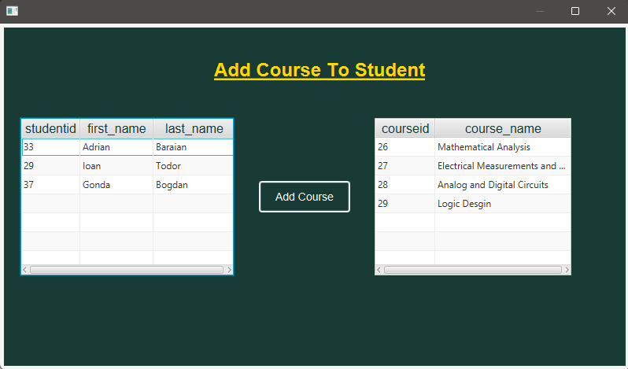
Managing students - views
When adding a course to a student we first select the student, and then we select a course. After selecting a course, we are presented a choice of teachers presenting that course. If no teachers are teaching that course in that moment, we are notified that through a label

Slide 17
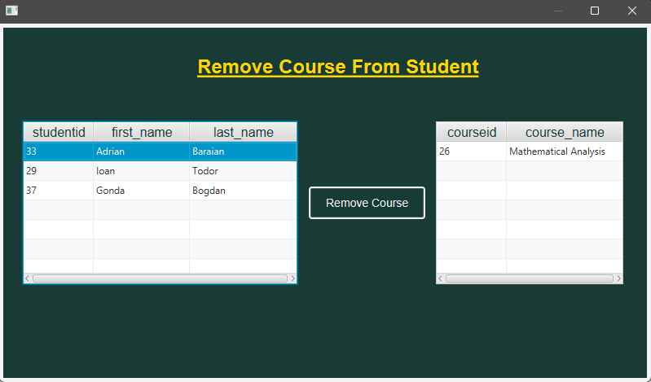
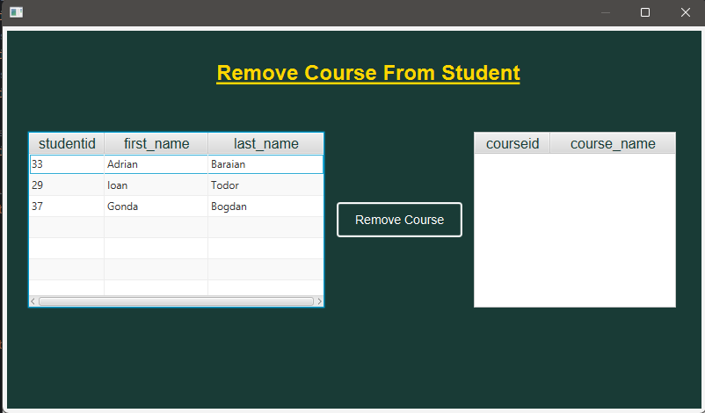
Managing students – views – cont.
When removing a course, we can see that the right table is initially empty. That is because we first have to select a student, then the courses studied by him/her will appear in the courses table.

Slide 18
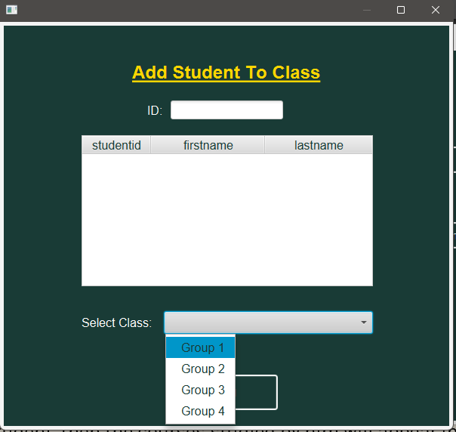
Managing students – views – cont.
When adding a student to a class, in the table we will see only the students that have not been added to a class. The classed is selected through the choice box present on the page.

Slide 19
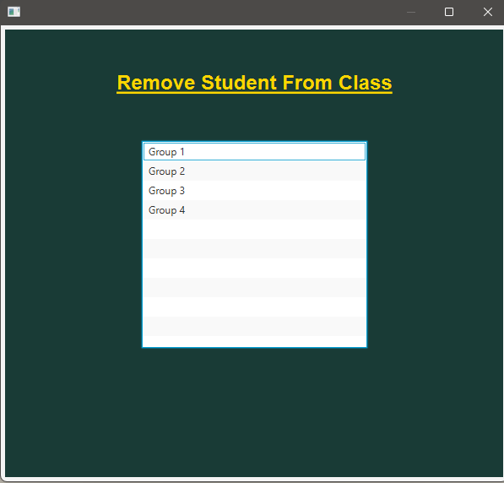
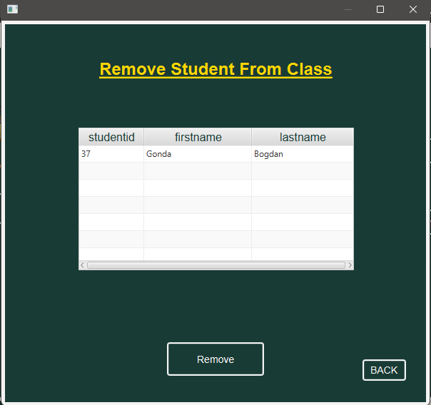
Managing students – views – cont.
When removing a student from a class, we first must select the class from the list and then select the student from that class that we want to remove.

Slide 20
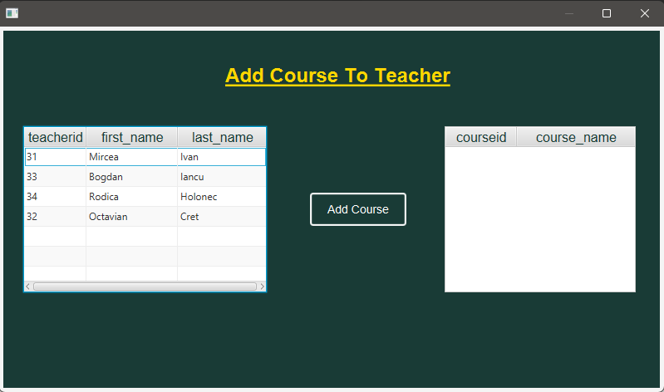
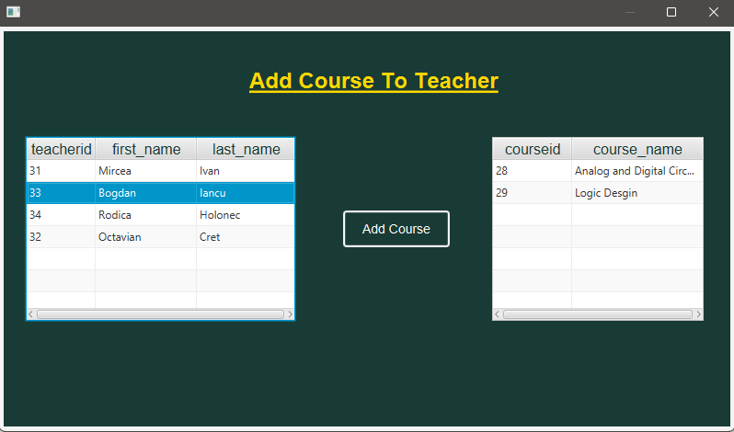
Managing teachers - views
When adding a course to a teacher we first must select from the left table the teacher for who we want to add a course and then, in the right table will appear only the courses which correspond to the department to which the teacher belongs to.

Slide 21
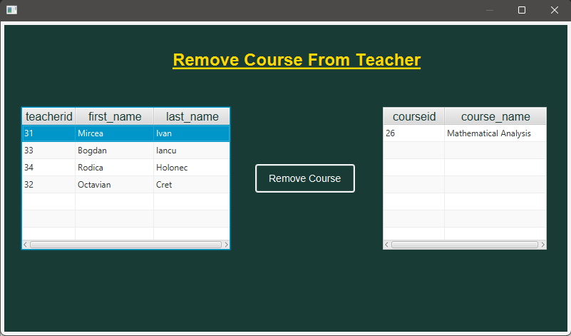
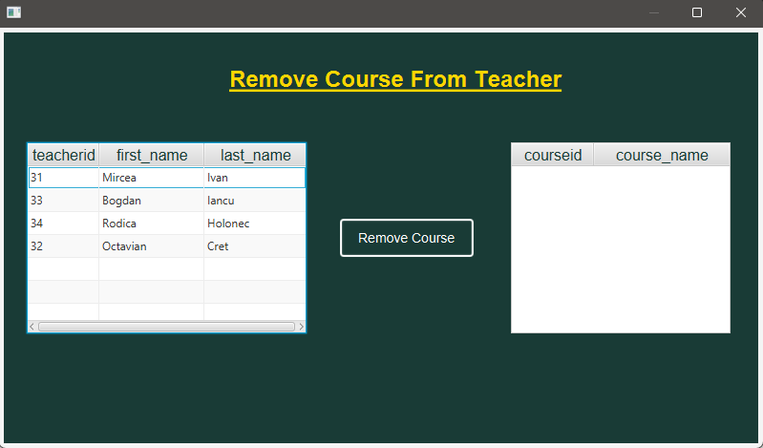
Managing teachers – views – cont.
When removing a course, we can see that the right table is initially empty. That is because we first have to select a teacher, then the courses thought by him/her will appear in the courses table.

Slide 22
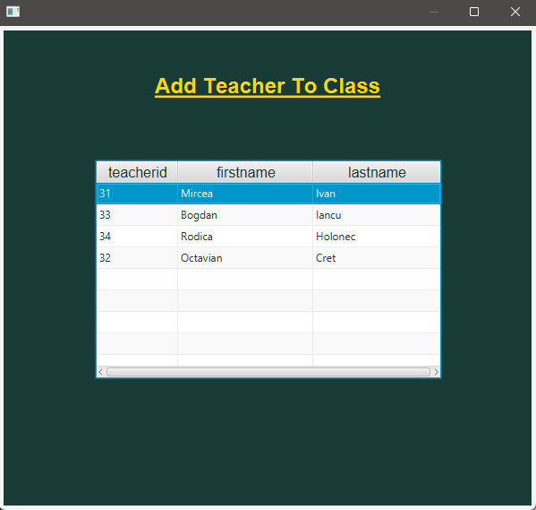
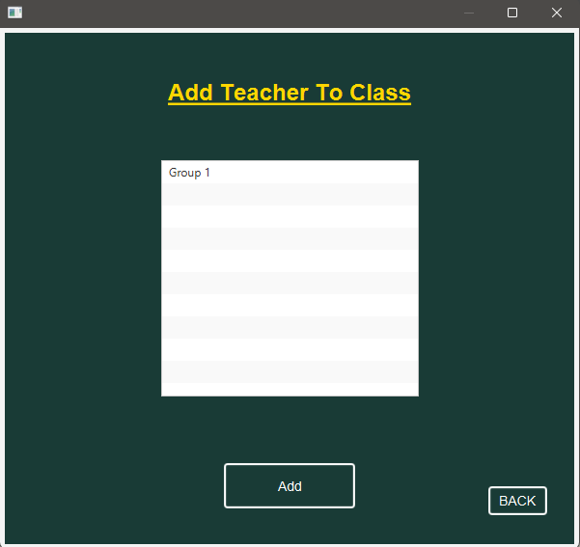
Managing teachers – views – cont.
When adding a teacher to class, we first have to select a teacher, then a list of classes in which he doesn’t belong yet will appear.

Slide 23
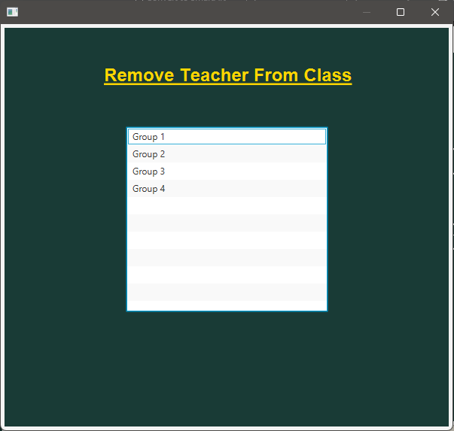
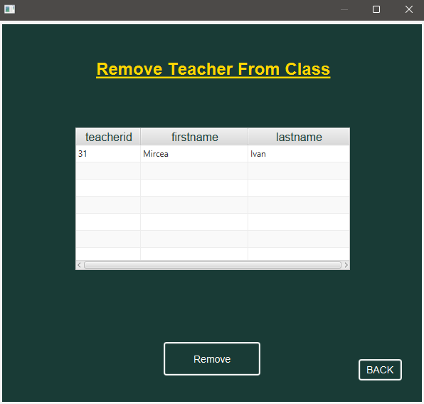
Managing teachers – views – cont.
When removing a teacher from a class, we first select the class then we select which teacher we want to remove from that class.

Slide 24
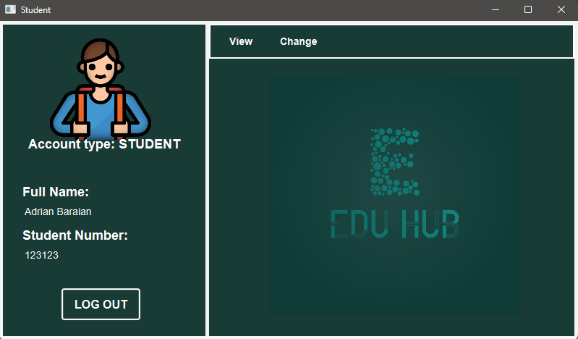
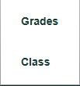

Student View
Full name field unique to the session we are logged in
Student number field unique to the session we are logged in
Menu items for when a menu button is pressed

Slide 25
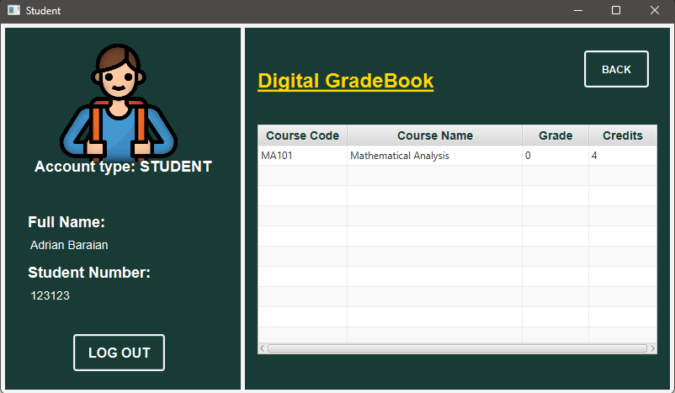
Student View – cont.
When pressing the View → Grades button from the menu-bar, we are presented with a digital grade-book in which the student can the grades acquired at the courses he/she studies. If a grade is 0, that means no grade has yet been given by a teacher (default grade).

Slide 26
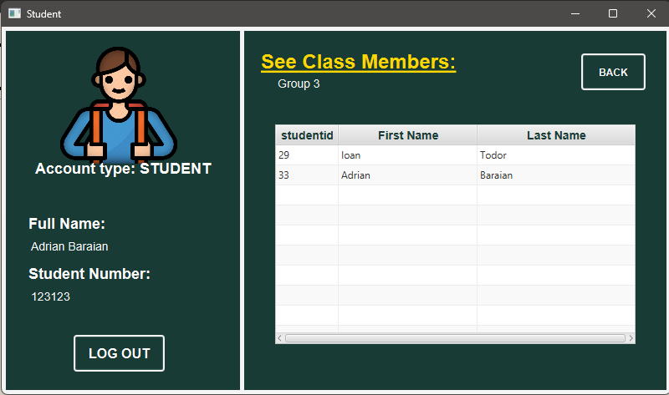
Student View – cont.
When pressing View → Class, we are presented with a table of class members of the current logged-in student
Name of the class of the current logged-in student

Slide 27
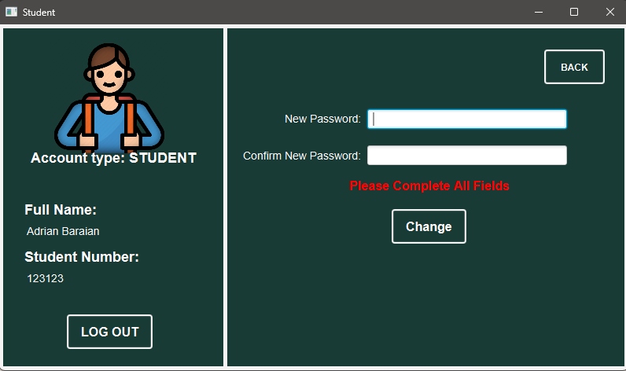
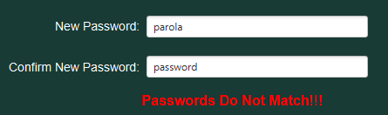
Student View – cont.
When pressing Change → Password button from the menu-bar, we are presented with the fields required to complete in order to change the password.
If the passwords do not match, we are notified through a label

Slide 28
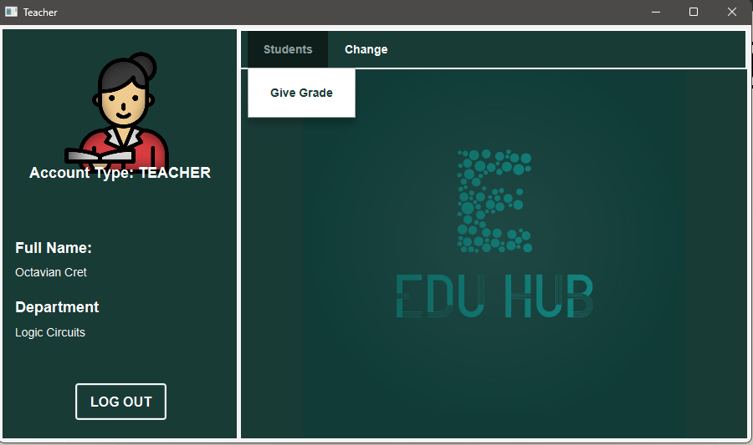

Teacher View
Full name field unique to the session we are logged in
Department field unique to the session we are logged in

Slide 29
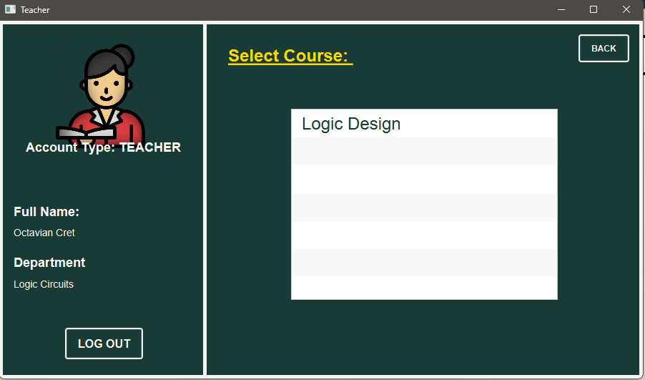
Teacher View – cont.
A teacher can have multiple courses, so when pressing the Give Grades button from the menu-bar, we first have to select the course from a list

Slide 30
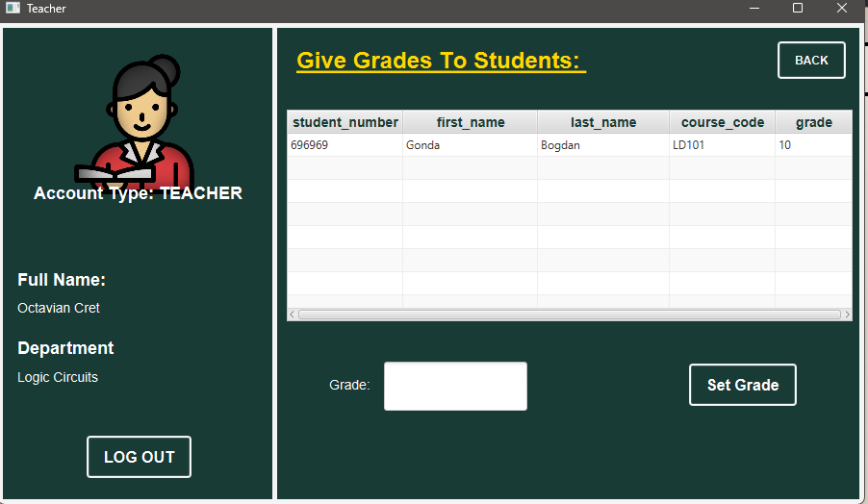
Teacher View – cont.
After the course has been selected, the teacher sees the students from that course and can give grades

Slide 31
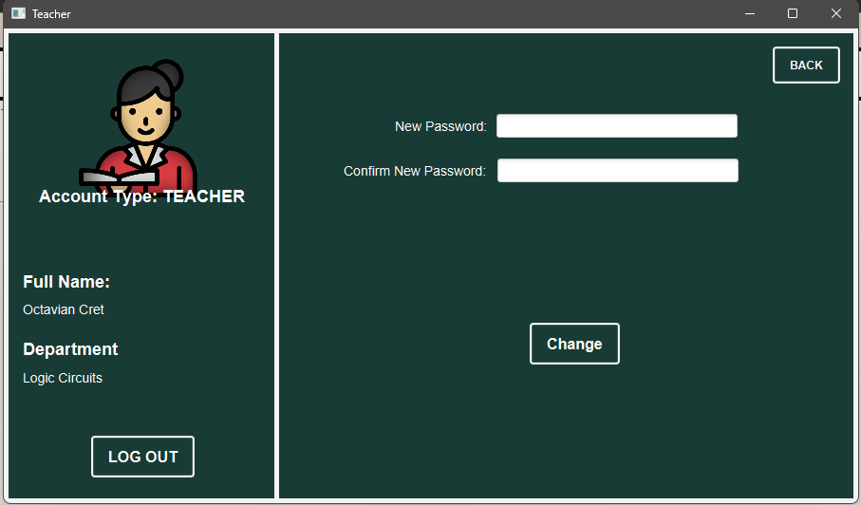
Teacher View – cont.
When pressing Change → Password button from the menu-bar, we are presented with the fields required to complete in order to change the password.
If the passwords do not match, we are notified through a label

Slide 32
02
Functioning
Who does all the stuff behind?

Slide 33
Controller Classes
Each view has its own controller because otherwise, we will only have the visual part of the application, and nothing will work ☺
The Controller Classes contains the code that represents the logic behind the view.
E.g. if we press a button, an action listener is triggered, and a certain method is used that does different actions(like opening a new window)
Data collection from the field happens through the controller and inside the controller the methods used on the database are called.

Slide 34
Controller Classes – cont.
→ The Login Controller assures the login validation and the change of scene based on the user type;
The Admin Controller contains all the logic necessary to open new windows and perform CRUD operations on the database
The Student Controller contains all the logic necessary to modify the layout of the page and for a student to read information about class or grades
The Teacher Controller contains all the logic necessary for a teacher to easily manipulate a student's grades.

Slide 35
03
The Database
Where all the data is stored

Slide 36
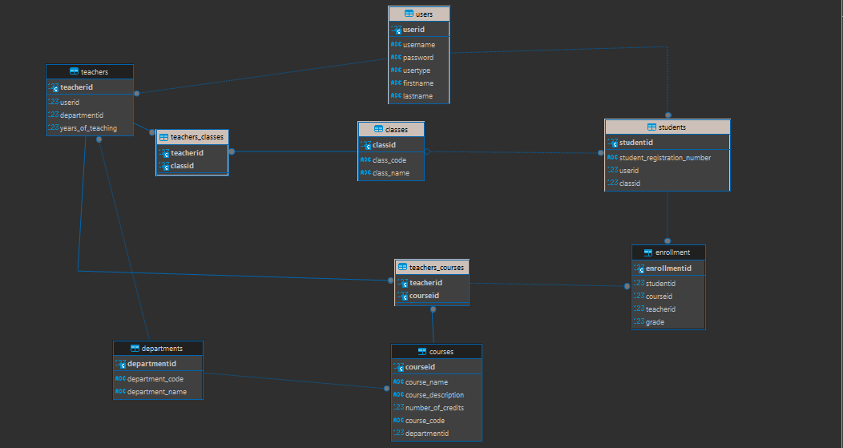
The Database
The database used for the application has been implemented using Dbeaver Software in PostgreSQL language.
ER Diagram of the database

Slide 37
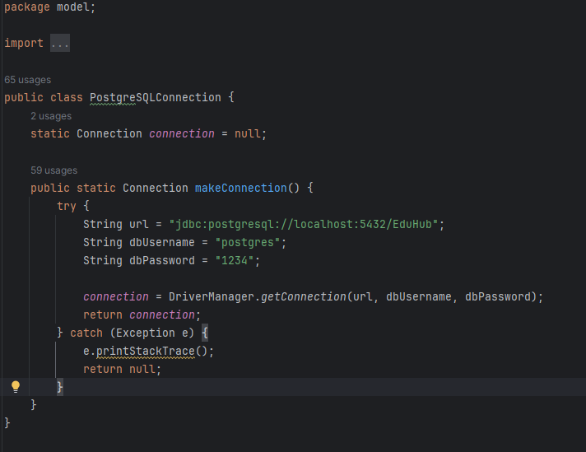
The Database - connection
The connection to the database is made through this static method belonging to the PostgreSQLConnection Class

Slide 38
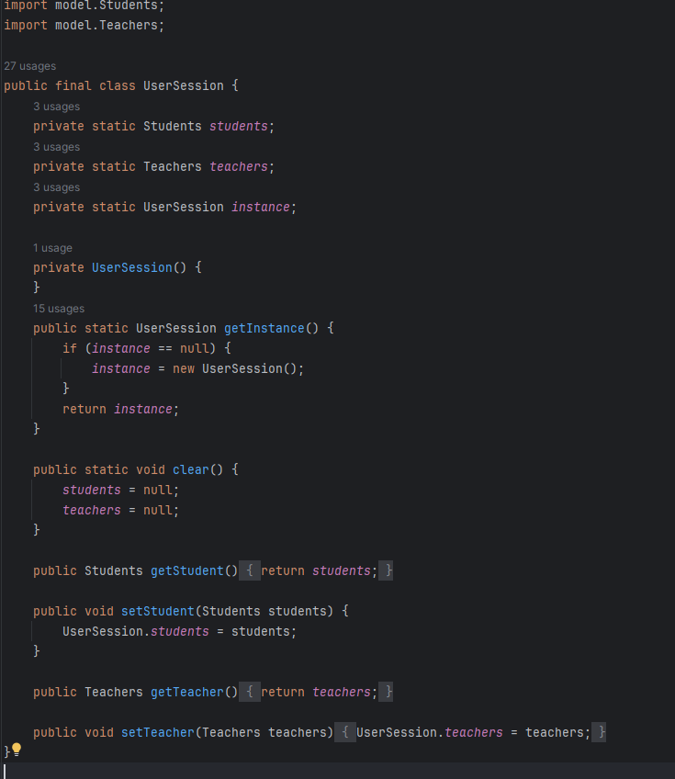
The Database – login session
The data of the current logged-in user is memorized using the UserSession Class that has the static fields students and teachers in which we save data from the database, based on the type of user we login as.

Slide 39
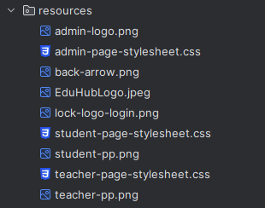
Extra
The resources package in which I have save images or logos plus the fx-css stylesheet used to customize the interface and make it more user-friendly

Slide 40
Final Ideas
The application resembles a School Management System with an implemented grade book.
The application has been developed for educational purposes, as a university - OOP (Object Oriented Programming) project.

Slide 41

Requirements completed
✅
Classes Students and Teachers extend the Users parent class. Override used for the initialize method from the Initializable interface
Enumeration used for the user types
✅
✅
✅
✅
✅
✅
✅
✅
✅
✅
✅

Slide 42
Thanks!
Bărăian Adrian-Călin

