Slide 1

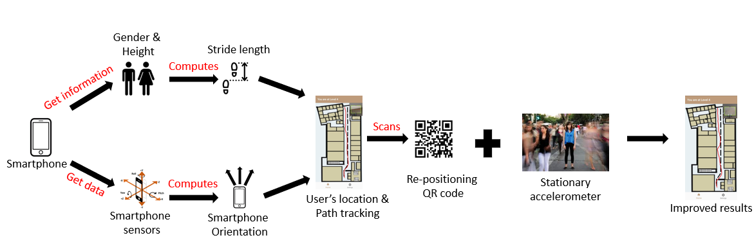
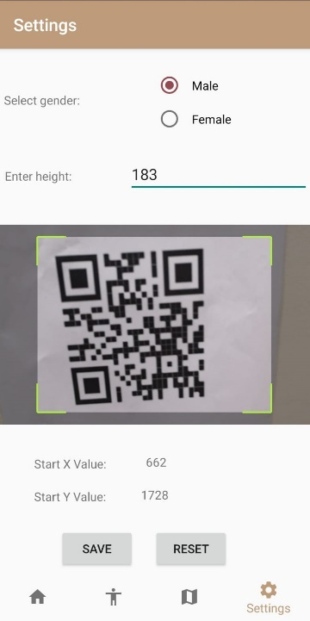
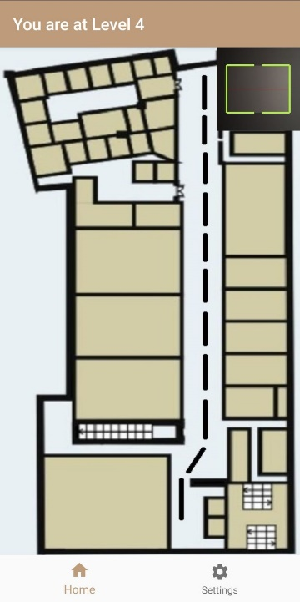
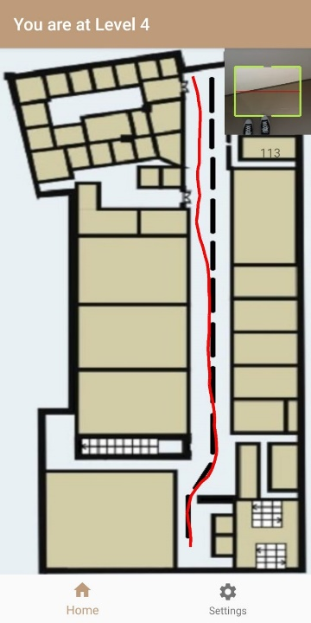
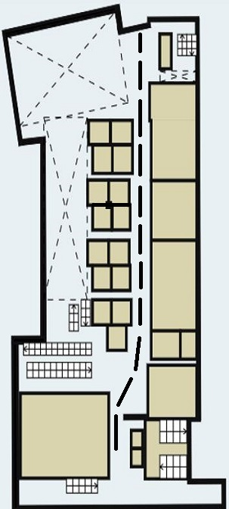
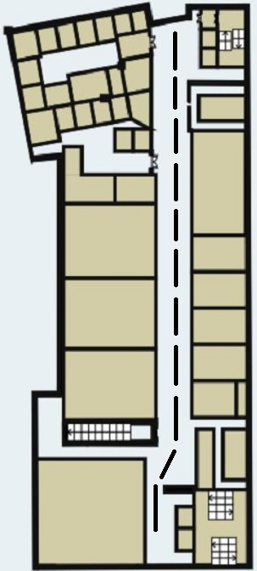
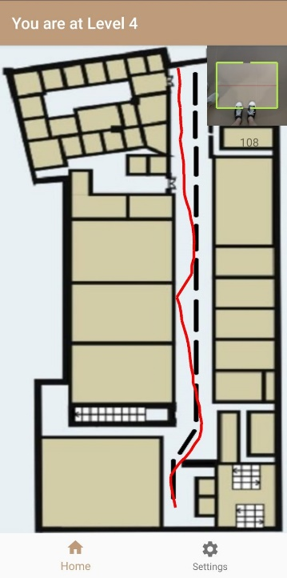
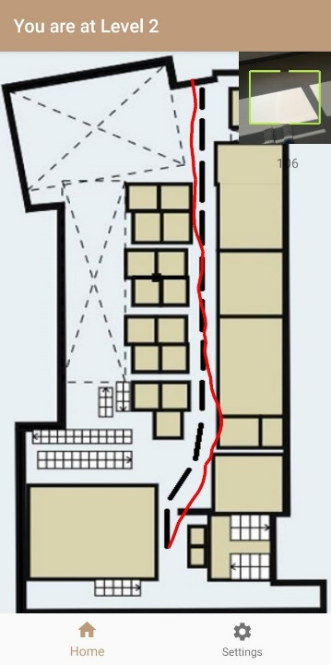

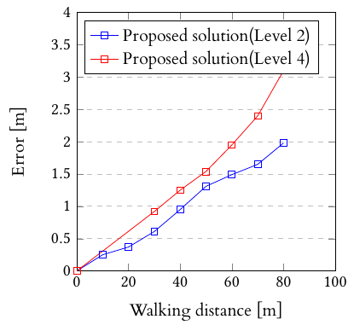
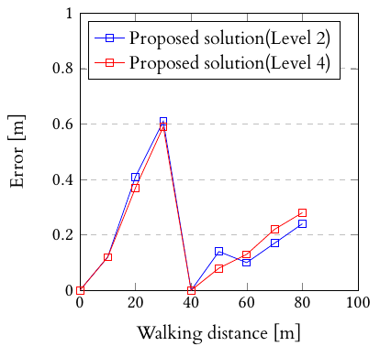
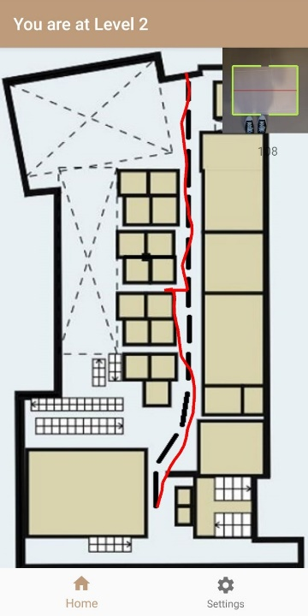
7239
Tan De Hui Adrian
Hybrid Localization with Video Based Positioning Technology
Abstract
This project focuses on using smartphone embedded sensors in conjunction with Quick Response(QR) Code to perform indoor localization on a smartphone.
Technologies that is used in current day solutions requires infrastructures such as Wi-Fi Access Points as well as Bluetooth Low Energy(BLE) Beacons, resulting in an increase in costs for developing an indoor localization application.
This proposed solution provides for an infrastructure-less and low cost solution in the indoor localization field by applying pedestrian dead reckoning using the smartphone’s sensors to track the user’s location and camera to scan the QR Code as well as a stationary accelerometer prompt to allow users to reset the accelerometer.
Technologies/Tools Used
Android Studio
Android Sensor API
Android Graphics API
ZXing Library
Huawei P20 Pro Smartphone
Quick Response Codes
Smartphone embedded sensors such as Accelerometer and Magnetometer provides data to compute the orientation of the smartphone device.
User input such as height and gender is used to compute the stride length of the user.
Stride length and orientation of smartphone device will be used to do the path tracking of the user on the map.
QR Code is scanned to counteract against the drift error suffered by the smartphone embedded sensors.
Stationary accelerometer can be performed to improve accuracy.
System Architecture
Figure 1. Indoor Localization application architecture
Evaluations
Experiments were conducted in SIT@NYP campus level 2 and 4 with no re-positioning(scanning of QR code) and re-positioning in conjunction with stationary accelerometer.
System Flow
Without QR Code Re-positioning
With QR Code Re-positioning + Stationary accelerometer
User directed to main page after providing the necessary information.
User’s location tracked on the map while the user is walking
Figure 2. Flow of system without QR Code for repositioning
User directed to main page after providing the necessary information.
User’s location is tracked while walking and re-positioned(denoted by circle) after scanning QR code.
Figure 4. SIT@NYP level 2 map
Figure 5. SIT@NYP level 4 map
Results
Based off the results, it can be seen that the stationary accelerometer can help to reduce drift error as well as increase the distance between each re-positioning QR code placed.
Figure 3. Flow of system with QR Code for repositioning and Stationary accelerometer
Future Works and URL
Augmented and Virtual reality into Indoor Localization applications.
Enhancing stride length estimation algorithm to obtain more accurate estimation
Integration of GPS and indoor localization for both indoor and outdoor navigation.
Figure 6. No re-positioning QR code
results
Figure 7. Re-positioning QR code and stationary accelerometer results
Supervisors (Singapore): Dr. Chee Kiat (Lawrence) Seow
Supervisor (Glasgow): Dr. Glasgow Prof

