Slide 1



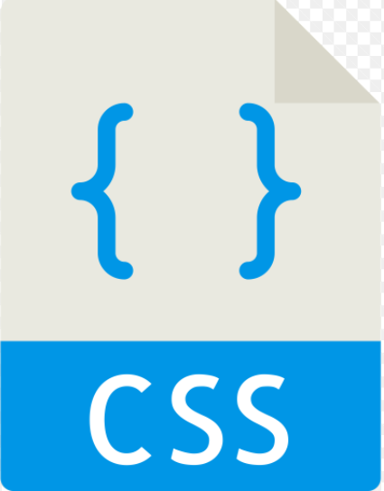
Ethanology’s PubCrawl WebApp
The styles of the elements in the .html files are defined in this file.
All the Jquery, Ajax as well as the javascript functions are all in this file.
Javascript file(function.js)
Cascading style sheet(styles.css)

