Slide 1

Mapping Your Stack
?
Adrian Cockcroft
@adrianco
AWS VP Cloud Architecture Strategy

Slide 2
Technology evolves, and our tech-stack choices need to be discussed, justified and decided.
Start with a few helpful questions…

Slide 3
What problem are you trying to solve?
HINT—Building or installing a framework is the wrong answer…
Something involving new user or business needs is a good answer:
Faster feature delivery?
International launch?
Lower cost?
Improved QoS?

Slide 4

What is the user need?
What problem are you trying to solve?
—
User need

Slide 5

User need
What is the user need?
What does the value chain look like?
What’s your time-to-value?
How is the value chain evolving?
Have you heard of Simon Wardley?

Slide 6
Leverage
Wardley Maps
Visualize evolution and innovate further up the value chain
Notes:
New Needs: IoT, analytics, social media monitoring, scale with number of interactions times number of products shipped, predictive modeling

Slide 7
Let’s look at your
Wardley Map
What’s your position and movement on the map?
Notes:
New Needs: IoT, analytics, social media monitoring, scale with number of interactions times number of products shipped, predictive modeling

Slide 8
A Specific Example:
Travel Search

Slide 9
What problem are you trying to solve?
Users want:
Faster personalized search
Business wants:
Faster feature releases
Lower costs

Slide 10
User need
What is the user need?
What does the value chain look like?
Search Interface
Travel Datastore
Compute and Storage

Slide 11
Example created using
wardleymaps.com

Slide 12
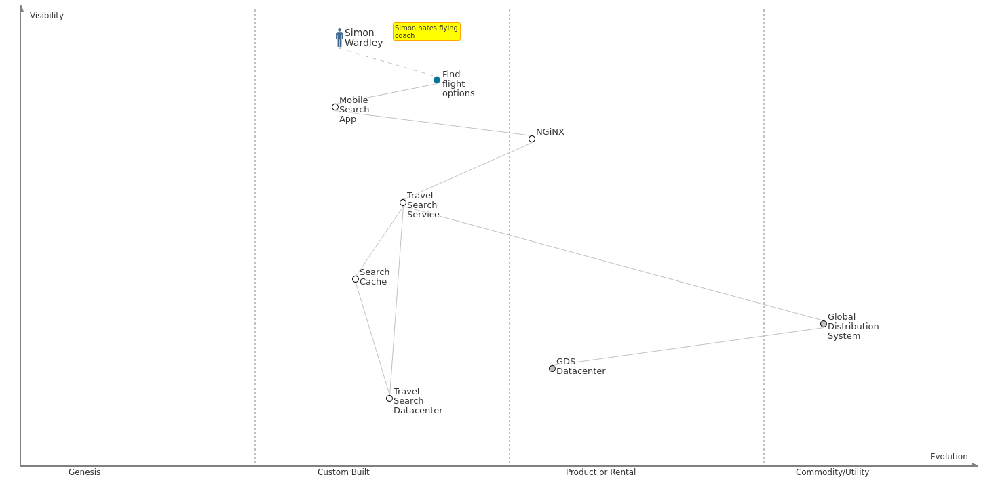
Travel search – starting point
Notes:
New Needs: IoT, analytics, social media monitoring, scale with number of interactions times number of products shipped, predictive modeling

Slide 13
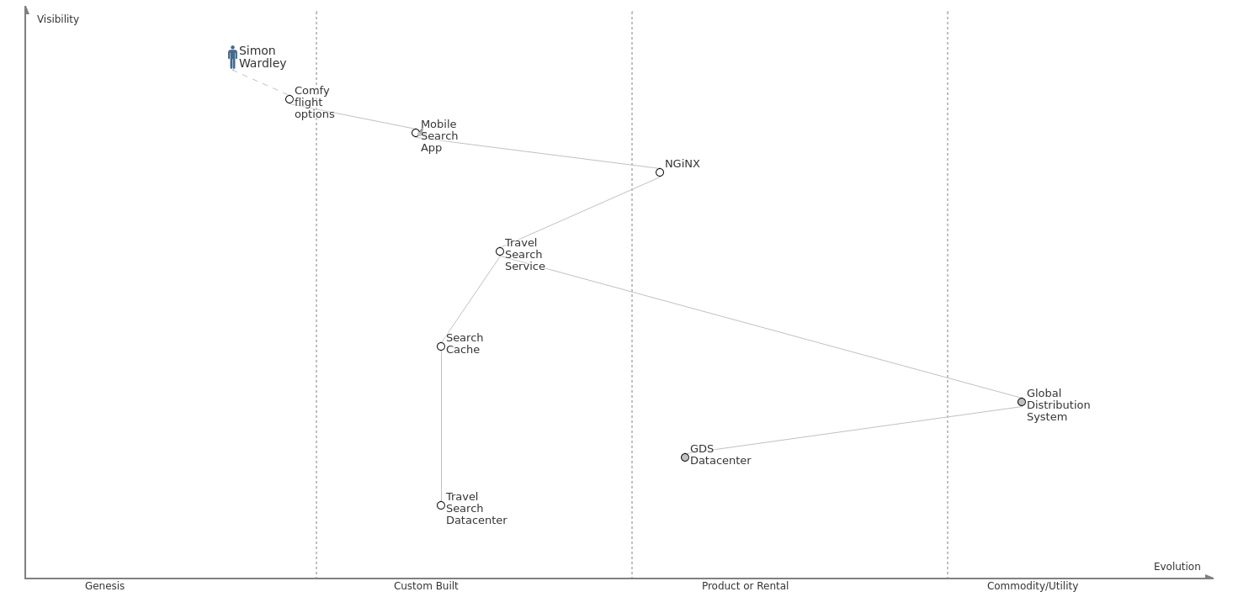
User need – comfy seat search
Notes:
New Needs: IoT, analytics, social media monitoring, scale with number of interactions times number of products shipped, predictive modeling

Slide 14
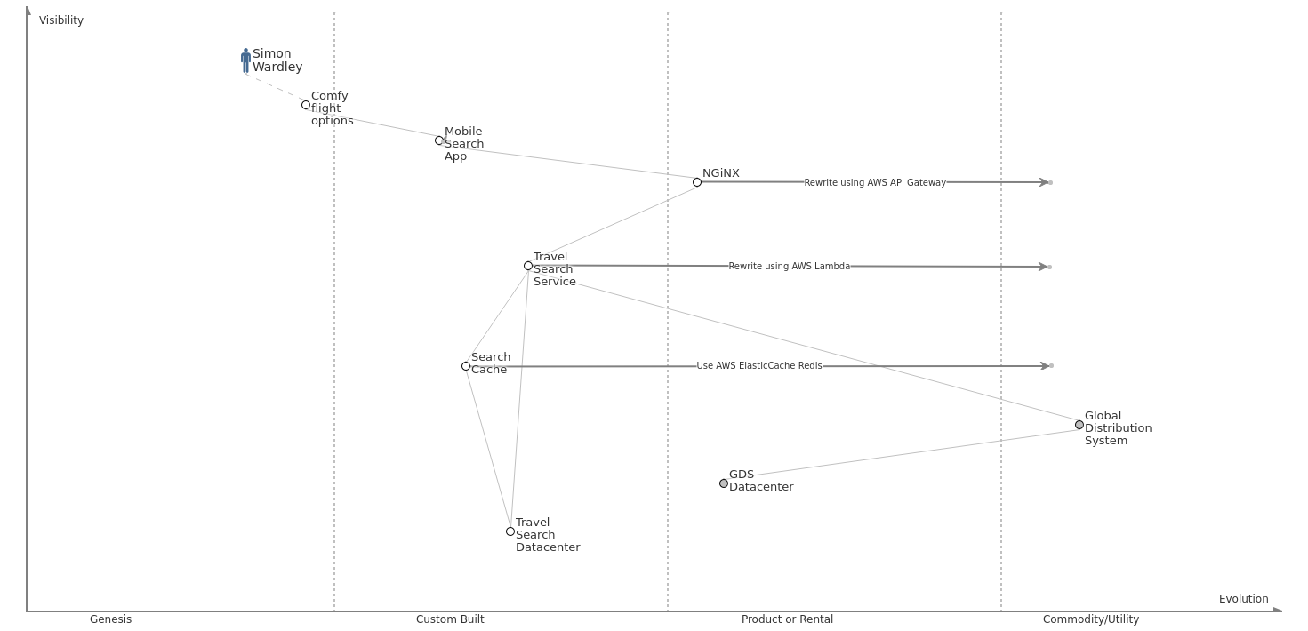
Business goal – reduce search cost
Notes:
New Needs: IoT, analytics, social media monitoring, scale with number of interactions times number of products shipped, predictive modeling

Slide 15
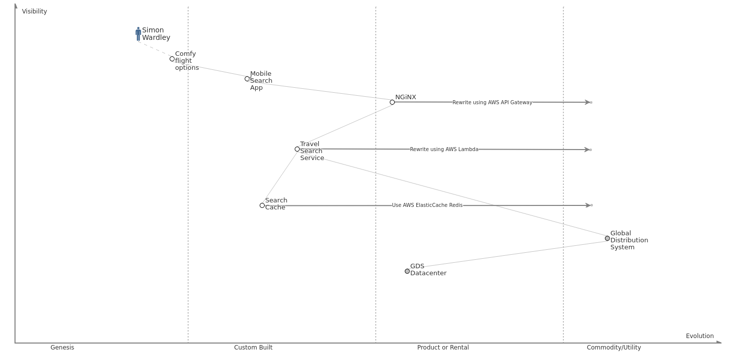
Stack evolution – exit datacenter
Notes:
New Needs: IoT, analytics, social media monitoring, scale with number of interactions times number of products shipped, predictive modeling

Slide 16
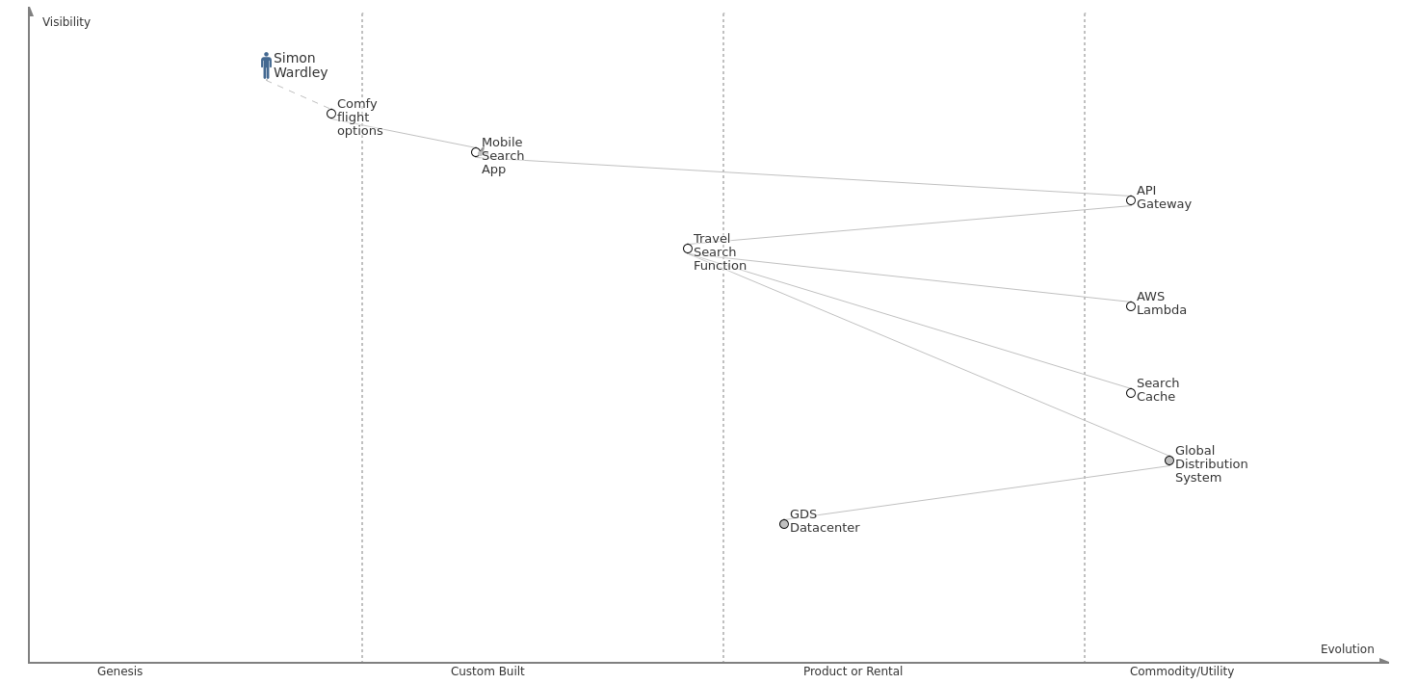
Stack evolution – serverless
Notes:
New Needs: IoT, analytics, social media monitoring, scale with number of interactions times number of products shipped, predictive modeling

Slide 17
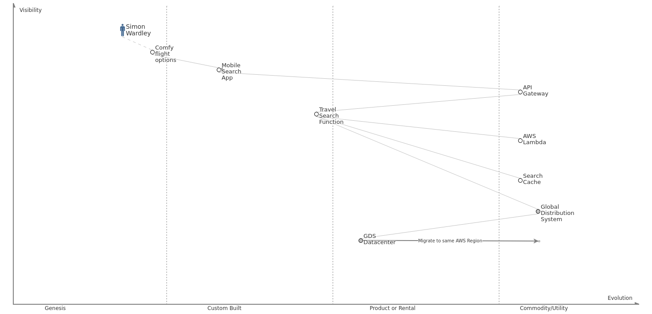
Need faster search – GDS optimized network
Notes:
New Needs: IoT, analytics, social media monitoring, scale with number of interactions times number of products shipped, predictive modeling

Slide 18
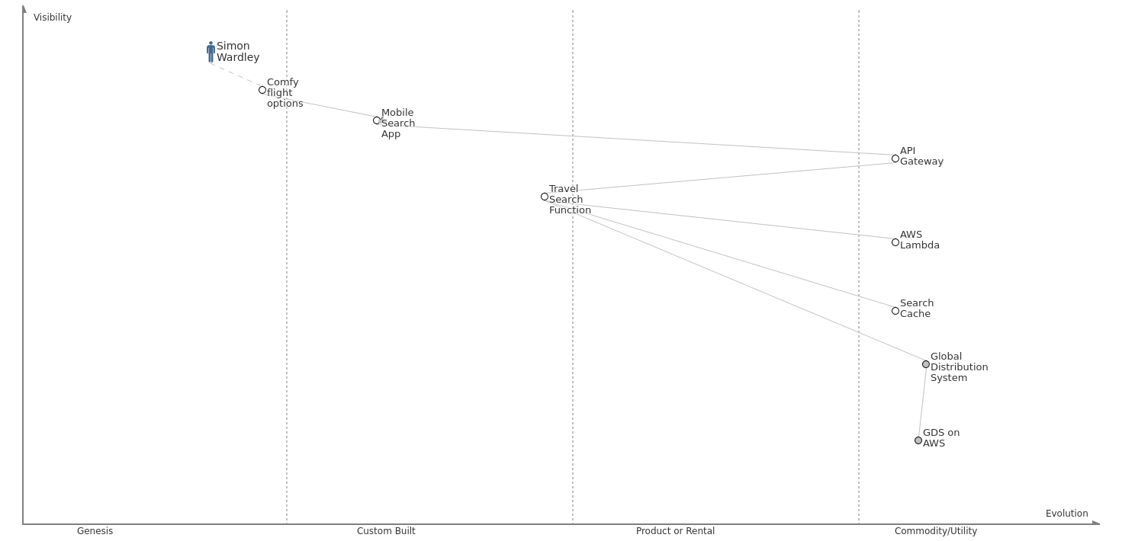
End result – happy Simon, more business value
Notes:
New Needs: IoT, analytics, social media monitoring, scale with number of interactions times number of products shipped, predictive modeling

Slide 19
Map, discuss and plan the evolution of your technology stack.
Follow @swardley and try out wardleymaps.com

Slide 20
Mapping Your Stack
?
Adrian Cockcroft
@adrianco
AWS VP Cloud Architecture Strategy

