Slide 1

Chaos Architecture
?
Adrian Cockcroft
@adrianco
AWS VP Cloud Architecture Strategy

Slide 2
As an architect my role wasn’t to tell other people what the architecture should be.
It was to ask awkward questions…

Slide 3
What should your system do when something fails?
Stop?
Carry on with reduced functionality?

Slide 4
Permissive failure, what’s the real cost of continuing?
What should IT do when something fails?
If a permissions look up fails, should you stop or continue?
See Memories, Guesses, and Apologies by Pat Helland

Slide 5
How often do you failover apps to it?
If a permissions look up fails, should you stop or continue?
Do you have a backup datacenter?
How often do you failover the whole datacenter at once?
“Availability Theater”

Slide 6
A fairy tale…
Once upon a time, in theory, if everything works perfectly, we have a plan to survive the disasters we thought of in advance.
How did that work out?

Slide 7
Forgot to renew domain name…
SaaS vendor
Entertainment site
Didn’t update security certificate and it expired…
Datacenter flooded in hurricane Sandy…
Finance company, Jersey City
Whoops!
YOU, tomorrow

Slide 8
“You can’t legislate against failure, focus on fast detection and response.”
—Chris Pinkham

Slide 9
What is supposed to happen when part of the system fails?
How do you know that your system works at all?
How is it supposed to recover after the failure goes away?

Slide 10

The Network Is Reliable ACM Queue 2014
Bailiss & Kingsbury
@pbailiss @aphyr

Slide 11
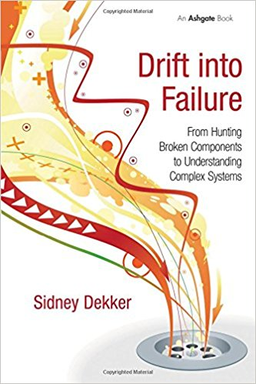
Drift Into Failure
Sydney Dekker

Slide 12
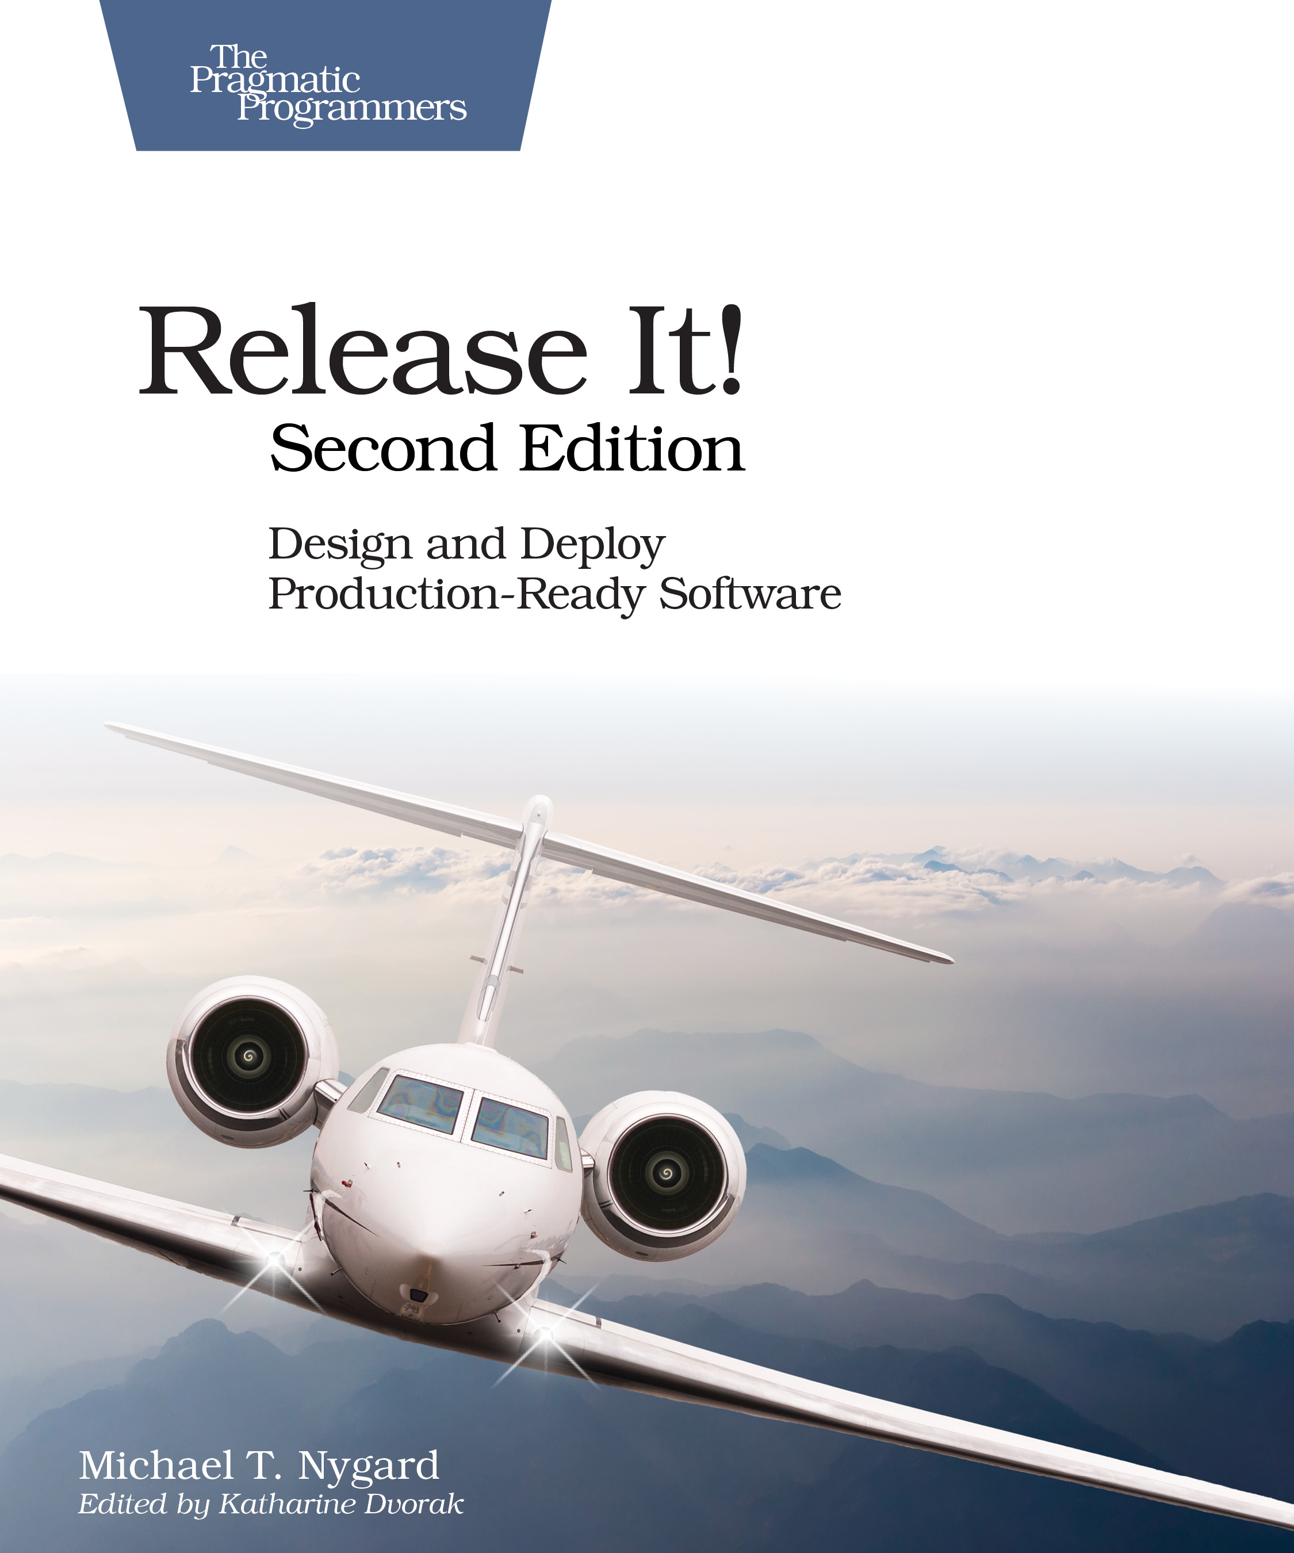
Release It! Second Edition 2017
Michael Nygard

Slide 13
Expensive and custom disaster recovery is being replaced by low cost, portable, automated chaos engineering.

Slide 14
Chaos Architecture Layers
A Cloud Native Availability Model

Slide 15
Chaos Architecture
Four layers
Two teams
An attitude

Slide 17
Infrastructure and Services
No single point of failure

Slide 18
Infrastructure

Slide 20

Switching and Interconnecting
Data replication
Traffic routing
Avoiding issues
Anti-entropy recovery

Slide 21
Switching and Interconnecting
Data replication
Traffic routing
Avoiding issues
Anti-entropy recovery

Slide 22
Switching and Interconnecting
Data replication
Traffic routing
Avoiding issues
Anti-entropy recovery

Slide 23
Switching
Infrastructure

Slide 25
!
Application
Failures
App
Error returns
Slow response
Network partition

Slide 26
Application
Switching
Infrastructure

Slide 28
People
Whoops!
I wonder why it did that?
Let’s reboot it.
Now it’s really hosed
Unexpected application behavior often causes people to intervene and make the situation worse

Slide 29
People Training
!
A fire drill is a boring routine where we make everyone take the stairs and assemble in the parking lot

Slide 30
People Training
Fire drills save lives in the event of a real fire, because people are trained how to react

Slide 31
People
Who runs the “fire drill” for I.T.?
Application
Switching
Infrastructure

Slide 32
People
Application
Chaos Engineering Team
Switching
Infrastructure

Slide 33
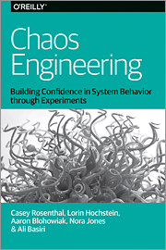
People
Application
Chaos Engineering Team
Switching
Infrastructure

Slide 34
People
Application
Tools
Chaos Engineering Team
Switching
Infrastructure

Slide 35


Tools
Game days
People
Simian Army
Application
chaostoolkit
Chaos Engineering Team
Switching
ChAP
Gremlin
Infrastructure

Slide 36
People
Application
Tools
Chaos Engineering Team
Switching
Security Red Team
Infrastructure

Slide 37
People
Application
Tools
Tools
Chaos Engineering Team
Switching
Security Red Team
Infrastructure

Slide 38
Tools
People
Safestack AVA
Application
Infection
Monkey
Tools
Switching
Chaosslingr
Chaos Engineering Team
Security Red Team
AttackIQ
Infrastructure
SafeBreach

Slide 39
Chaos
Architecture
People
Application
Four layers
Two teams
An attitude— Break it to make it better
Tools
Tools
Chaos Engineering Team
Switching
Security Red Team
Infrastructure

Slide 40
Break it to make it safer
The “New View” of Safety based on:
Todd Conklin’s Pre-accident podcast
John Allspaw’s stella.report

Slide 41

Synoptic Illegibility
If you can’t write down exactly what really happens, you can’t write a synopsis and your system is ad-hoc and messy
The Safety Anarchist Sydney Decker

Slide 42
Failures are a system problem— lack of safety margin
Not something with a root cause of component or human error

Slide 43
Blindfolded on a cliff edge, what would you do?

Slide 44
Hypothesis testing
We think we have safety margin in this dimension, let’s carefully test to be sure
In production
Without causing an issue

Slide 45
Chaos testing ensures that you have:
Experienced Staff
Robust Applications
Dependable Switching Fabric
Redundant Service Foundation

Slide 46
Chaos Architecture
Ask awkward questions
Show you have the margin to absorb key failures
Adrian Cockcroft
@adrianco

