Slide 1


Who Watches the Watchers? Unobservability in the presence of chaos
Adrian Cockcroft
@adrianco
AWS VP Cloud Architecture Strategy

Slide 2
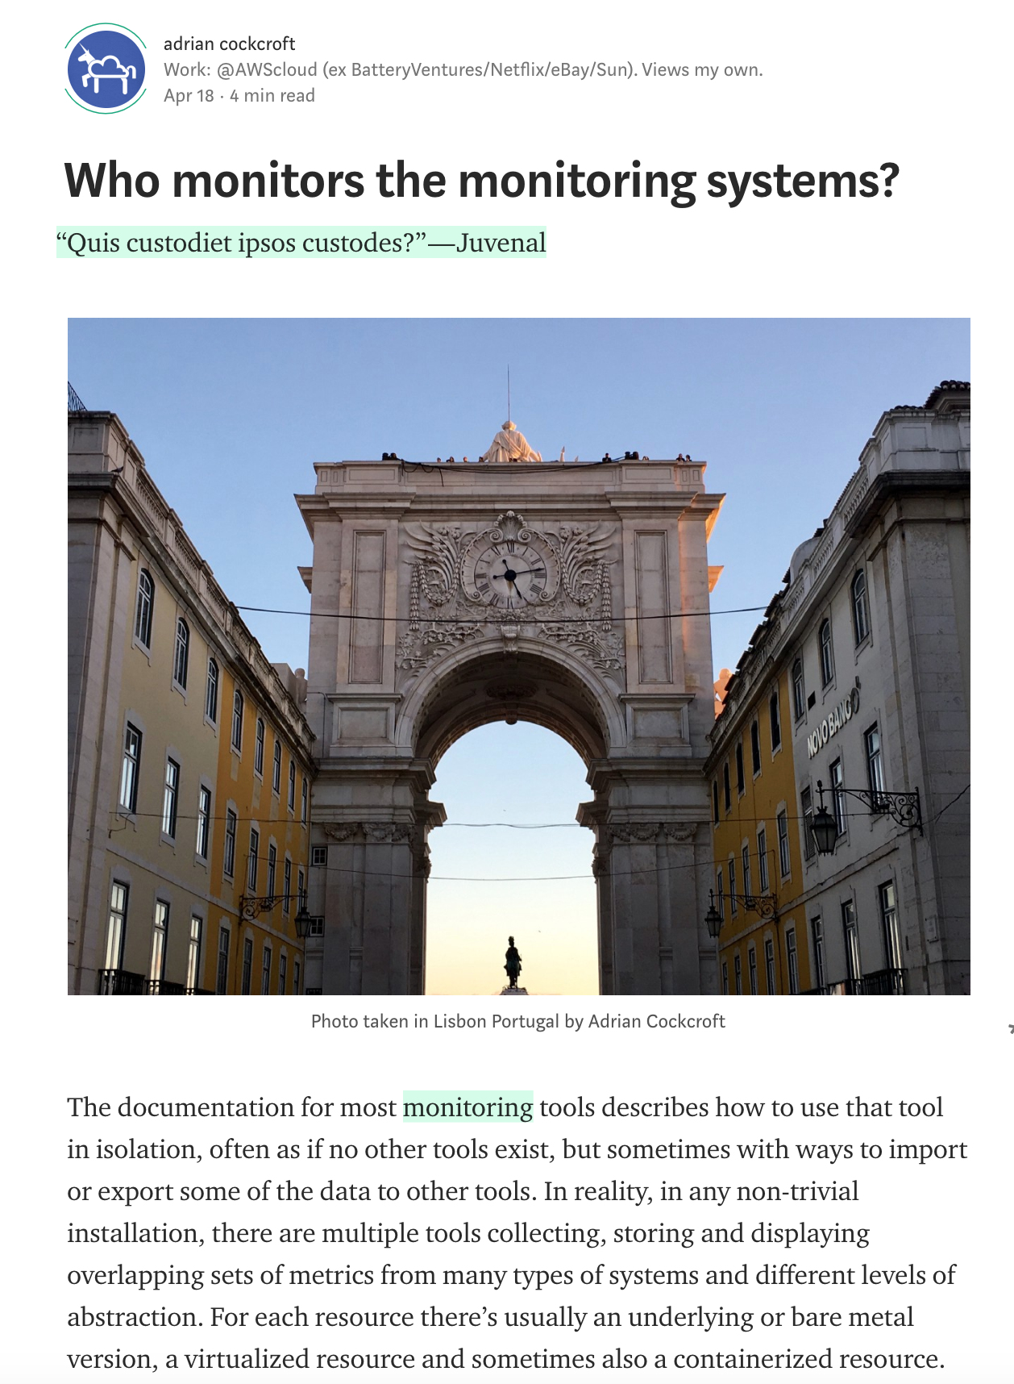
Initial thoughts from April 2018
https://medium.com/@adrianco/who-monitors-the-monitoring-systems-715a333f97fc

Slide 3
What should your system do when something fails?
Stop?
Carry on with reduced functionality?
Collapse horribly?

Slide 4
If a permissions look up fails, should you stop or continue?
Do you have a backup datacenter?
How often do you failover apps to it?
How often do you failover the whole datacenter at once?
What happens to your observability tools when you most need them?

Slide 5
A fairy tale…
Once upon a time, in theory, if everything works perfectly, we have a plan to survive the disasters we thought of in advance.
How did that work out?

Slide 6
Forgot to renew domain name…
SaaS vendor
Entertainment site
Didn’t update security certificate and it expired…
Datacenter flooded in hurricane Sandy…
Finance company, Jersey City
Whoops!
YOU, tomorrow

Slide 7
“You can’t legislate against failure, focus on fast detection and response.”
—Chris Pinkham

Slide 8
Fast detection
This implies that the last thing to fail, should be the monitoring system that makes it observable.

Slide 9

The Network Is Reliable ACM Queue 2014
Bailis & Kingsbury
@pbailis @aphyr
(Spoiler – it isn’t…)

Slide 10

Drift Into Failure
Sydney Dekker
Everyone can do everything right at every step, and you may still get a catastrophic failure as a result…

Slide 11
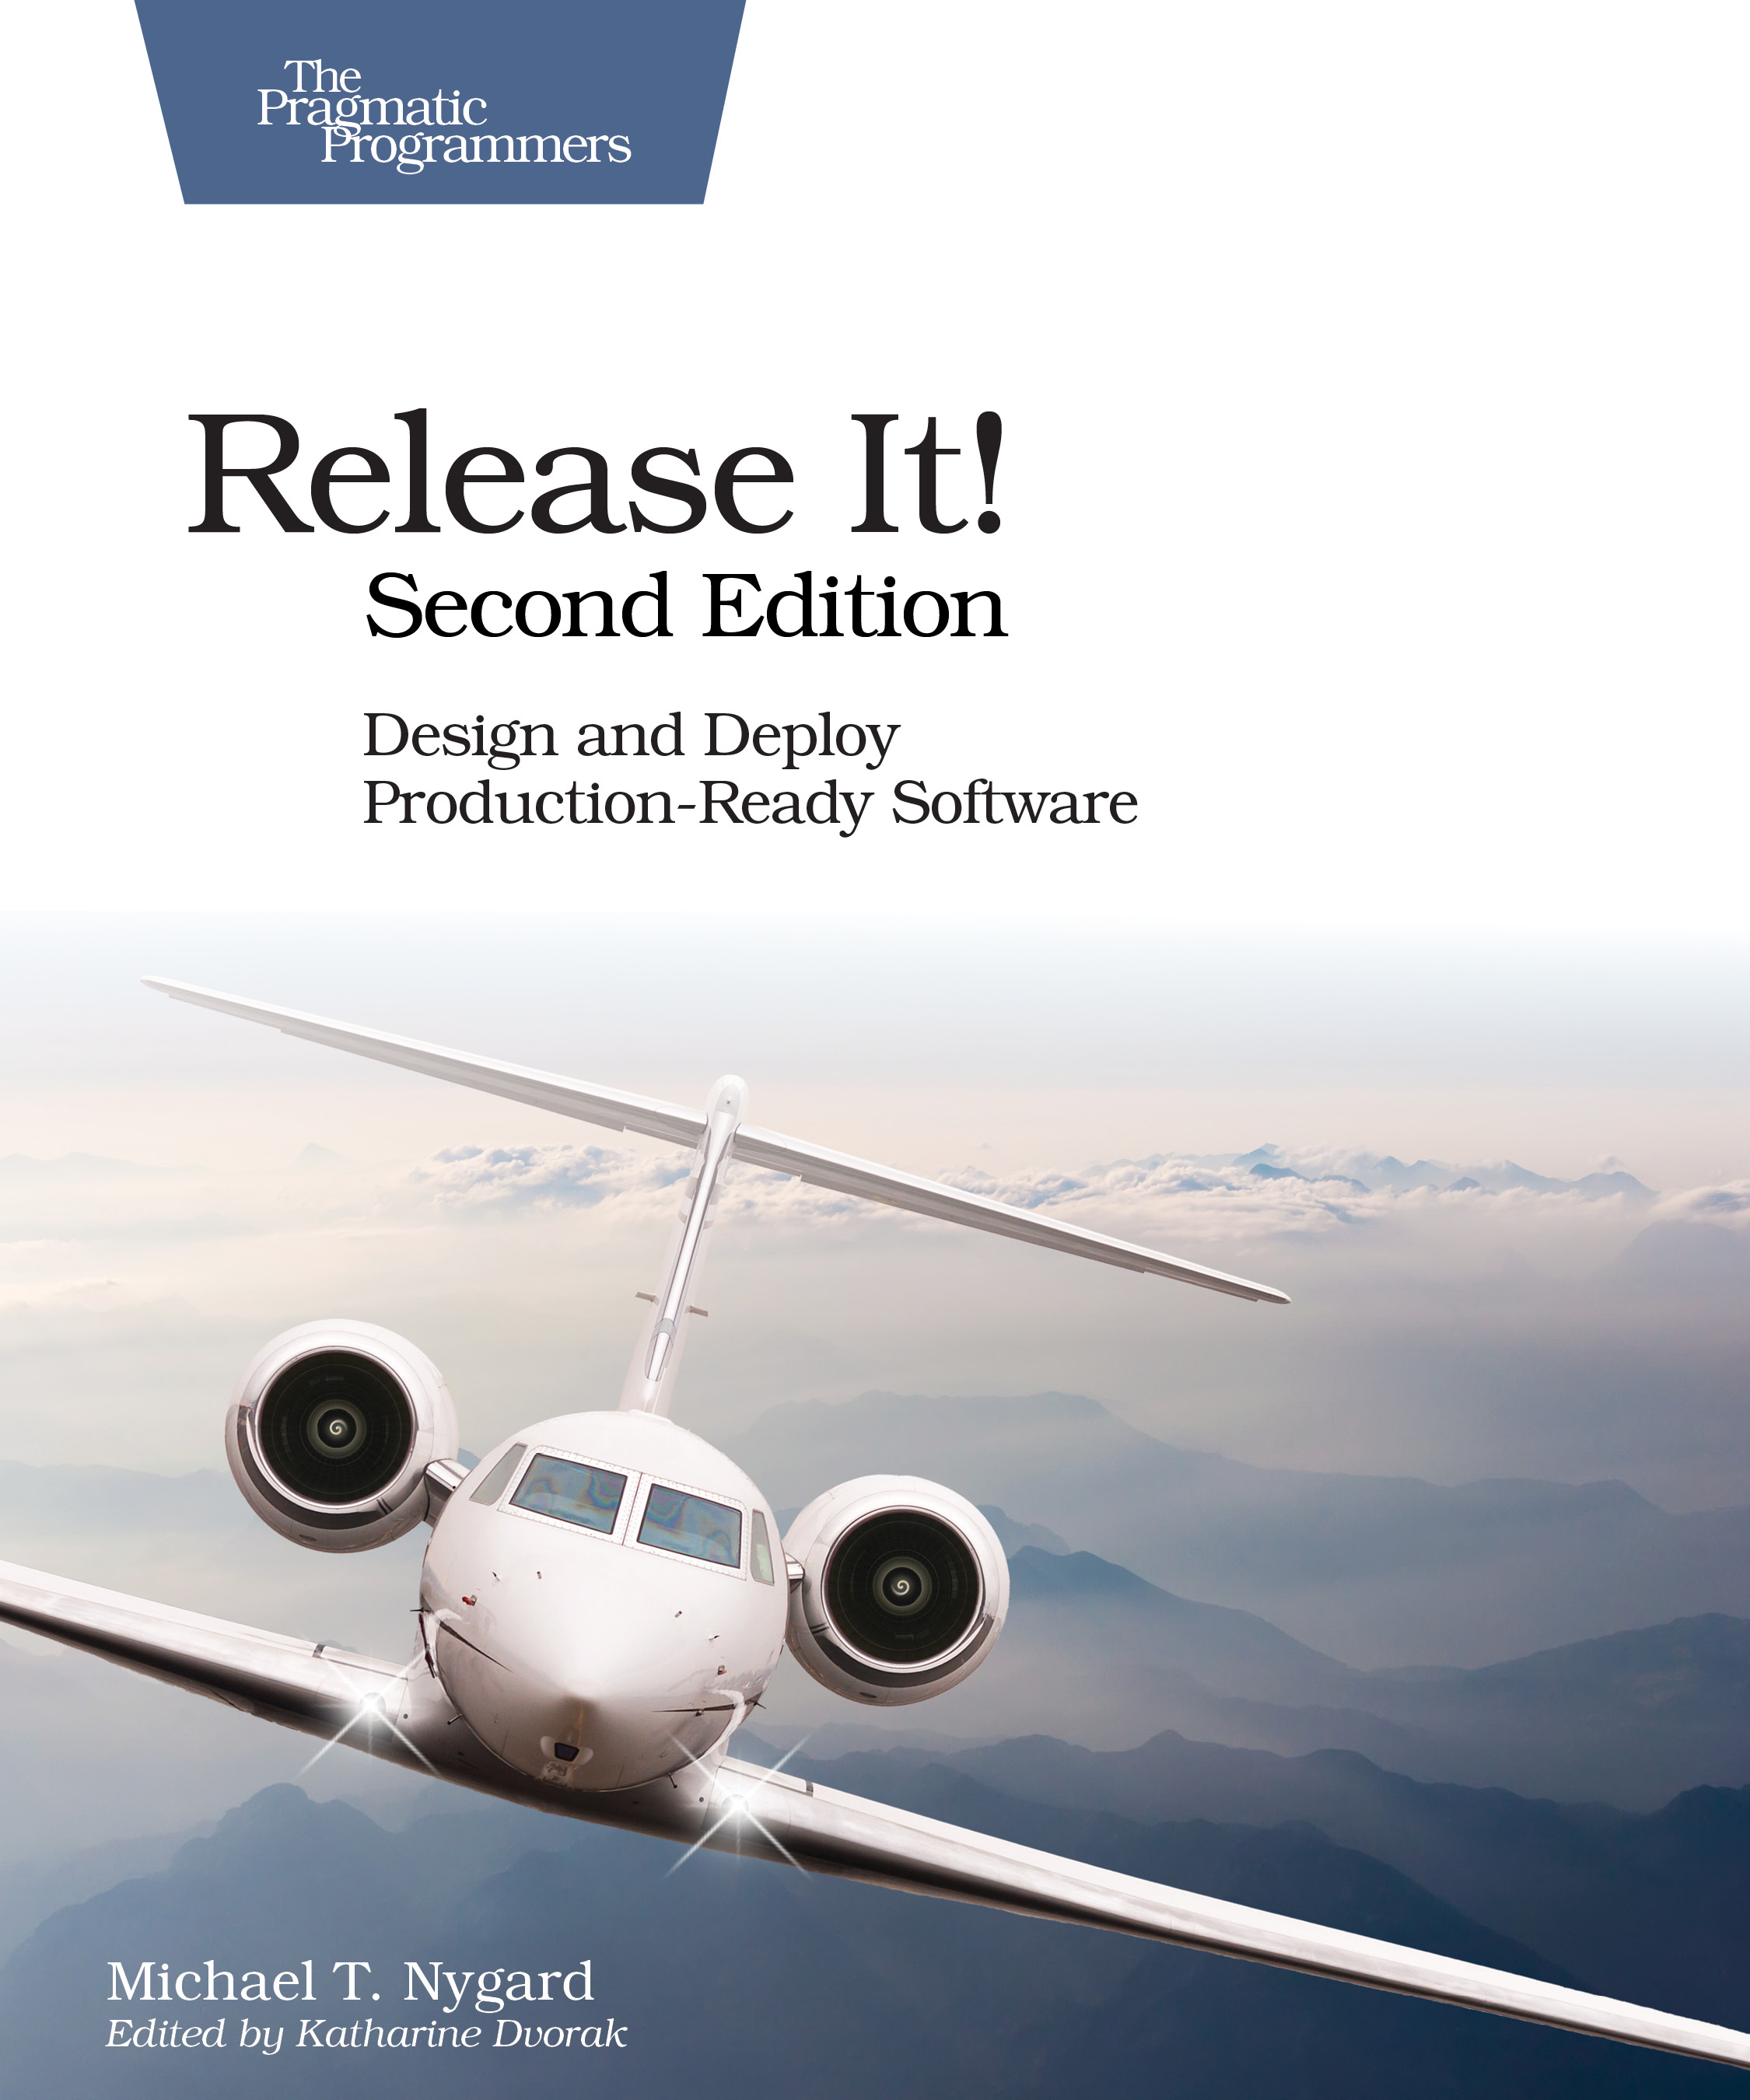
Release It! Second Edition 2017
Michael Nygard
Bulkheads, circuit breakers, and some new ideas…

Slide 12
Chaos engineering is the discipline of experimenting on a distributed system in order to build confidence in the systems capacity to withstand turbulent conditions in production
Principles of Chaos Engineering

Slide 13
Chaos engineering is the discipline of experimenting on a distributed system in order to build confidence in the systems capacity to withstand turbulent conditions in production
experimenting
build confidence
capacity to withstand turbulent conditions
Principles of Chaos Engineering

Slide 14
Experiment
experimenting
to ensure that
build confidence
The impact of failure is mitigated
capacity to withstand turbulent conditions

Slide 15
Failures
What went wrong?
What kind of thing failed

Slide 16
Failures
Impacts
What are the effects of the failure?
What mitigation mechanisms are in place?

Slide 17
You can only be as strong as your weakest link
How can we try to think of everything that might fail?
How can we tell what state everything is really in?

Slide 18
Common language, terminology, and definitions help mitigate communication failure between people working on resiliency.
Taxonomy of failures
Taxonomy
I’m proposing some terminology, try to use common definitions rather than making up your own!
failure layers

Slide 19
Observability
Operations
Taxonomy of failures
Taxonomy
Application
Failure layers
Software stack
Infrastructure
failures

Slide 20
Operations
Application
Software Stack
a
Device failures Disk, power supply, cabling, circuit board, firmware
Taxonomy of failures
Taxonomy
CPU failures Cache corruption, logic bugs
Infrastructure
Datacenter failures Power, connectivity, cooling, fire, flood, wind, quake
failures
Internet failures DNS, ISP, internet routes

Slide 21
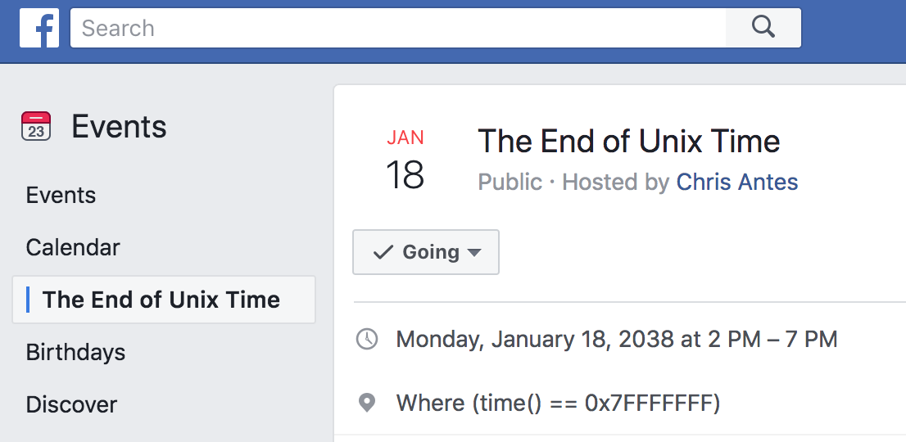
Device failures Disk, power supply, cabling, circuit board, firmware
CPU failures Cache corruption, logic bus
Datacenter failures Power, connectivity, cooling, fire, flood, wind
Routing failures DNS, ISP, internet routes
Taxonomy of failures
Taxonomy
Time bombs Counter wrap round, memory leak
End of Unix Time
Date bombs Leap year, leap second, epoch
infrastructure
Software stack
failures

Slide 22
Time bombs Counter wrap round, memory leak
Date bombs Leap year, leap second, epoch
End of Unix Time
Expiration Certificates timing out
Taxonomy of failures
Taxonomy
Revocation License or account shut down by supplier
Software stack
failures
Exploit Security failures e.g. Heartbleed

Slide 23
Expiration Certificates timing out
Revocation License or account shut down by supplier
Exploit Security failures e.g., Heartbleed
Language bugs Compiler, interpreter
Taxonomy of failures
Taxonomy
Runtime bugs JVM, Docker, Linux, Hypervisor
Software stack
failures
Protocol problems Latency dependent or poor error recovery

Slide 24
Language bugs compiler, interpreter
Runtime bugs JUM, Docker, Linux, Hypervisor
Protocol problems Flaky network protocols
Time bombs (in application code) Counter wrap round, memory leak
Taxonomy of failures
Taxonomy
Date bombs (in application code) Leap year, leap second, epoch, Y2K
software stack
Application
failures
Content bombs Data dependent failures

Slide 25
Time bombs Counter wrap round, memory leak
Date bombs Leap year, leap second, epoch
Content bombs Data dependent failures
A Netflix movie synopsis for a Spanish title contained a cedilla—Ç—encoded as <&#231;>, but was missing the ;.
Taxonomy of failures
Taxonomy
Each time the title was shown, the presentation tier code entered an infinite loop; gradually taking down the site.
software stack
Application
failures
Code for the bug was six years old.

Slide 26
A Netflix movie synopsis for a Spanish title contained a cedilla—Ç—encoded as <&#231;>, but was missing the >.
Each time the title was shown, the presentation tier code entered an infinite loop; gradually taking down the site.
Code for the bug was six years old.
Taxonomy of failures
Configuration Wrong config or bad syntax
Taxonomy
Application
Versioning Incompatible mixes
failures

Slide 27
Configuration Wrong confix or bad syntax
Versioning Incompatible mixes
Cascading failures Error handling bugs
Taxonomy of failures
Taxonomy
Cascading overload Excessive logging, lock contention, hysteresis
Application
Retry Storms Too many retries, work amplification, bad timeout strategy
failures

Slide 28
Cascading failures Error handling bugs
Cascading overload Excessive logging histories, lock contention
Retry Storms Too many retries work amplification, bad timeout strategy
Poor capacity planning
Inadequate incident management
Taxonomy of failures
Taxonomy
Failure to initiate incident
application
Operations
Unable to access monitoring dashboards
failures
Insufficient observability of systems
Incorrect corrective actions

Slide 29
Cascading failures Error handling bugs
Cascading overload Excessive logging histories, lock contention
Retry Storms Too many retries work amplification, bad timeout strategy
Tools go down with the system
Delayed updates prolong incidents
Taxonomy of failures
Taxonomy
Inconsistent data across tools
application
Observability
Disagreements about meaning of metrics
failures
Alert storms, alert fatigue
Overloaded due to scale or rate of change

Slide 30

People
Application
Chaos Engineering Team
Switching
Infrastructure

Slide 31
Hypothesis testing
We think we have safety margin in this dimension, let’s carefully test to be sure
In production
Without causing an issue

Slide 32
Experienced staff
Robust applications
Dependable switching fabric
Redundant service foundation

Slide 33


?
Additional thoughts…
Observability of systems
Epidemic failure modes
Automation and continuous chaos

Slide 34
?
Possible future directions
Observability of systems
Epidemic failure modes
Automation and continuous chaos

Slide 35
Kalman, 1961 paper On the general theory of control systems
A system is observable If the behavior of the entire system can be determined by only looking at its inputs and outputs
Observability
Epidemic failure modes
Automation and continuous chaos
Lesson: Control theory is a thing people should learn about rather than try to reinvent…

Slide 36
DevOps But no one ever talked about observability of computers before?
Cockcroft & Walker, 2001 Capacity Planning For Web Services. Entire chapter on observability which wasn’t controversial at the time
Lesson Control theory is a thing people should learn about rather than reinvent…
Function with no side effects
High
Microservice that does one thing
Medium
Observability
Monolith with tracing and logging
Low
Monolith with logging

Slide 37

Failures can be
Independent Common assumption
Correlated Harder to model and mitigate knock-on effects
Epidemic Everything breaks at once!
examples

Slide 38
Failures can be
Linux Leap—second bug
Memory leak in agent
Cloud zone or region failure
DNS failure
Security configuration syntax error
Epidemic
Independent Common assumption
Correlated Harder to model and mitigate knock-on effects
examples

Slide 39
Linux Leap—second bug
Memory leak in agent
Cloud zone or region failure
DNS failure
Security configuration syntax error
Epidemic
examples
Quarantine needed

Slide 40
Linux Leap—second bug Maintain ability to deploy on Windows
Memory leak in agent Use multiple monitoring tools
Cloud zone or region failure Cross-zone or region replication
DNS failure Multiple domains and providers
Security configuration syntax error Limit the scope of deployments
Epidemic
examples
Quarantine
Diversity needs to be managed to contain an epidemic

Slide 41
Linux Leap—second bug Maintain ability to deploy on Windows
Memory leak in agent Use multiple monitoring tools
Cloud zone or region failure Cross-zone or region replication
DNS failure Multiple domains and providers
Security configuration corruption Limit scope of deployments
Epidemic
examples
Quarantine
Diversity needs to be managed to contain an epidemic

Slide 42
Cloud provides the automation that leads to chaos engineering

Slide 43
As datacenters migrate to cloud, fragile and manual disaster recovery will be replaced by chaos engineering

Slide 44

Testing failure mitigation will move from a scary annual experience to automated continuous chaos
Observability tools need to be more available than the systems they monitor

Slide 45
“A system is observable If the behavior of the entire system can be determined by only looking at its inputs and outputs”
– Kalman 1961
Adrian Cockcroft
@adrianco
AWS VP Cloud Architecture Strategy

