Slide 1
CSE 162 Mobile Computing Lab 3 Location and Map Programming Hua Huang
Lecture: Feb 16 / Feb 18
Demo: Feb 23 / Feb 25
Hard Deadline: Mar 2 / Mar 4
Notes:
Review today, not so fast in future

Slide 2
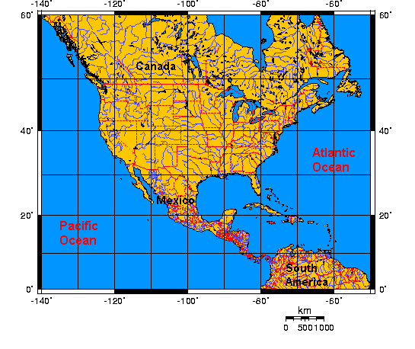
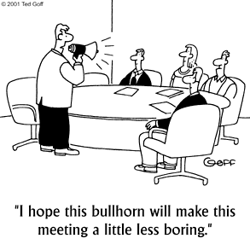

What is localization, aka location?
absolute location
(lat, long)
relative location
context location

Slide 3



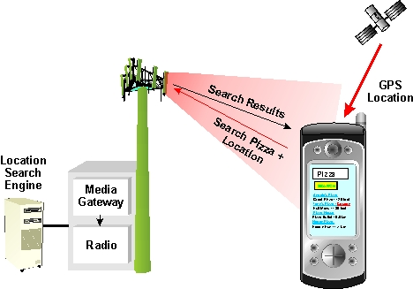

Why should I care about localization?
social application
advertisements
podcasting

Slide 4
Assignments
Creating a google map, display the map
Using Location services, set the map view based on the GPS tracking

Slide 5
Create Project
Create new project: MapsProject
Select google map activity
Go to: google_maps_api.xml

Slide 6
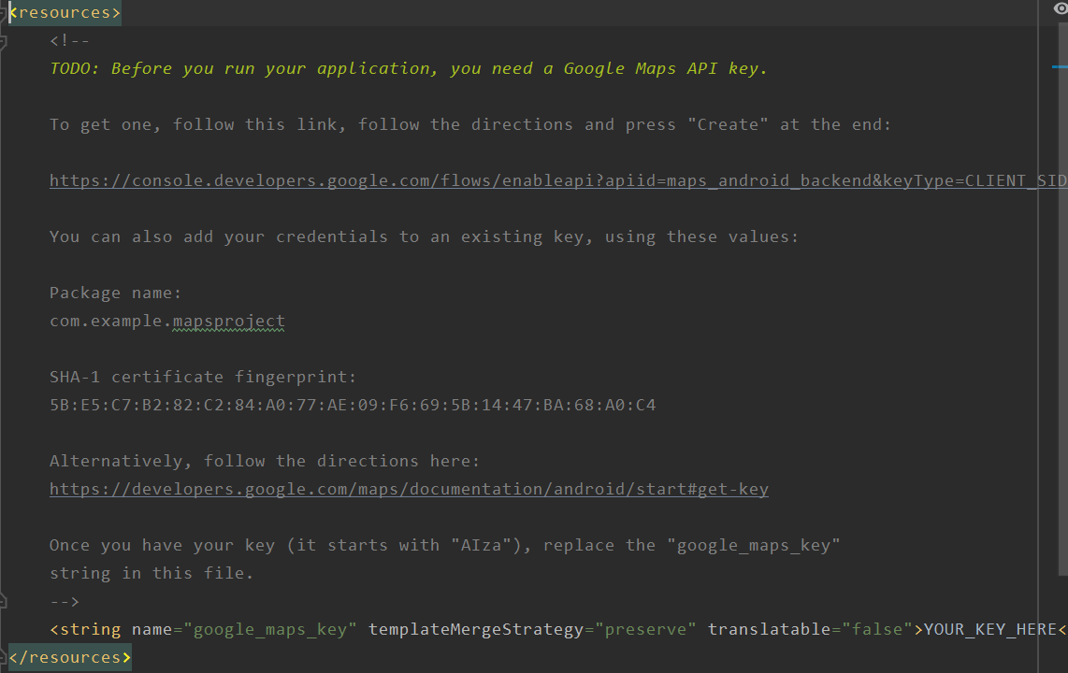

Slide 7
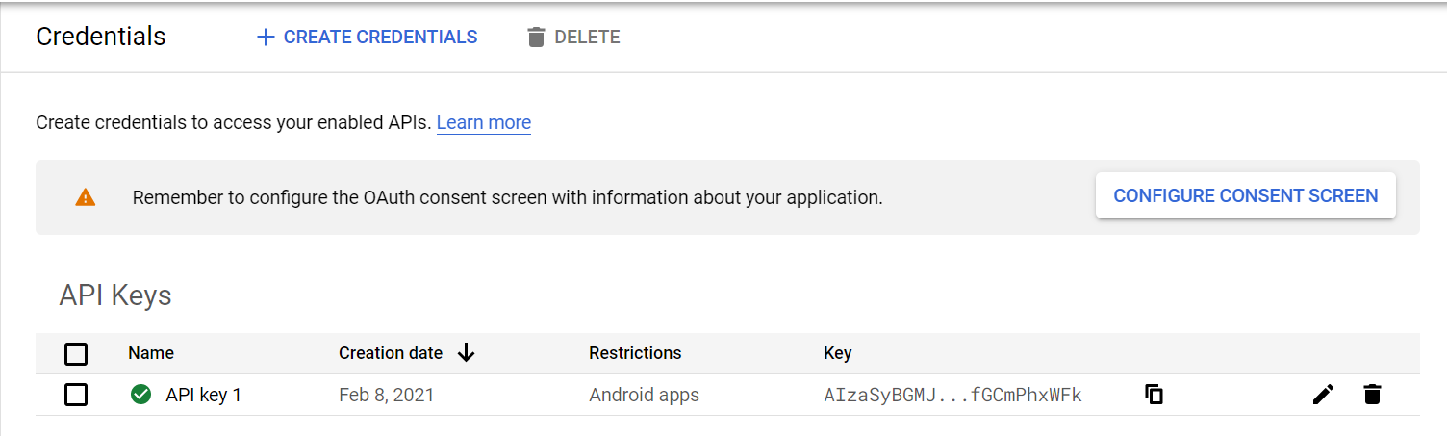

Slide 9
Registering for Location Updates
In order for an object to receive updates from GPS, it must implement the LocationListener interface
// Called when your GPS location changes
@Override
public void onLocationChanged(Location location)
// Called when a provider gets turned off by the user in the settings
@Override
public void onProviderDisabled(String provider)
// Called when a provider is turned on by the user in the settings
@Override
public void onProviderEnabled(String provider)
// Signals a state change in the GPS (e.g. you head through a tunnel and
// it loses its fix on your position)
@Override
public void onStatusChanged(String provider, int status, Bundle extras)

Slide 10
Registering for Location Updates
LocationManager handles registrations for GPS and network location updates
Once the LocationManager is obtained, an object registers for updates by calling requestLocationUpdates , the arguments passed into the requestLocationUpdates method determine the granularity of location changes that will generate an event
send updates that are at least X meters apart
send updates at least this far apart in time
send updates that have this minimum accuracy

Slide 11
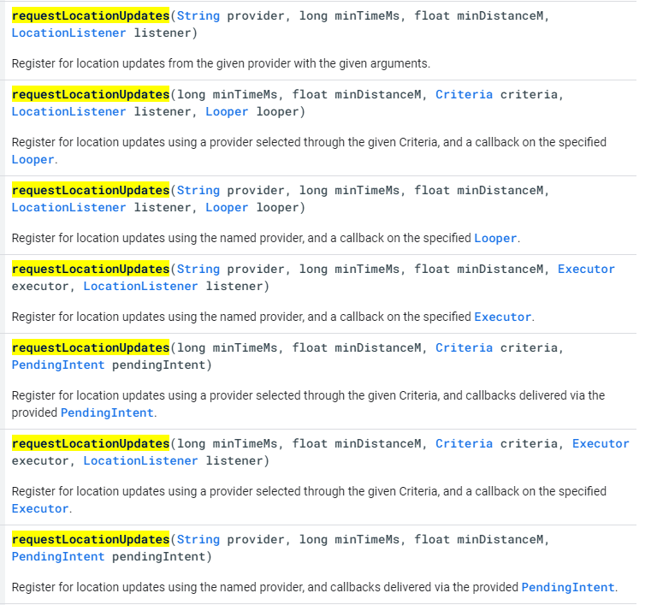

Slide 12
Location Updates
public class MapsActivity extends FragmentActivity implements OnMapReadyCallback, LocationListener {
private GoogleMap mMap;
private LocationManager locationManager;
private double longitude = 151;
private double latitude = -34;
@Override
protected void onCreate(Bundle savedInstanceState) {
super.onCreate(savedInstanceState);
setContentView(R.layout.activity_maps);
// Obtain the SupportMapFragment and get notified when the map is ready to be used.
SupportMapFragment mapFragment = (SupportMapFragment) getSupportFragmentManager().findFragmentById(R.id.map);
mapFragment.getMapAsync(this);
locationManager = (LocationManager) getSystemService(LOCATION_SERVICE);
if (ContextCompat.checkSelfPermission(this, Manifest.permission.ACCESS_COARSE_LOCATION) == PackageManager.PERMISSION_GRANTED)
locationManager.requestLocationUpdates(LocationManager.NETWORK_PROVIDER, 10, Criteria.ACCURACY_COARSE, this);
}
@Override
public void onMapReady(GoogleMap googleMap) {
mMap = googleMap;
}

Slide 13

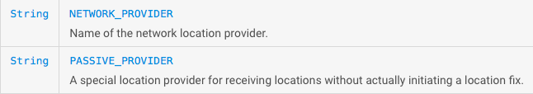
Location Providers
The phone’s location can be determined from multiple providers
GPS location updates consume significantly more power than network location updates but are more accurate
GPS: 25 seconds * 140mA = 1mAh
Network: 2 seconds * 180mA = 0.1mAh
The provider argument determines which method will be used to get a location
You can also register for the PASSIVE_PROVIDER which only updates you if another app is actively using GPS / Network location

Slide 14
Getting Location Info
@Override
public void onLocationChanged(Location location) {
longitude = location.getLongitude();
latitude = location.getLatitude();
AlertDialog alertDialog = new AlertDialog.Builder(MapsActivity.this).create();
alertDialog.setTitle("Location Detected");
alertDialog.setMessage(String.valueOf(latitude) + "," + String.valueOf(longitude));
alertDialog.setButton(AlertDialog.BUTTON_NEUTRAL, "OK",
new DialogInterface.OnClickListener() {
public void onClick(DialogInterface dialog, int which) {
dialog.dismiss();
}
});
alertDialog.show();
LatLng loc = new LatLng(latitude, longitude);
mMap.addMarker(new MarkerOptions().position(loc).title("Marker in at your location"));
mMap.moveCamera(CameraUpdateFactory.newLatLng(loc));
mMap.animateCamera(CameraUpdateFactory.newLatLngZoom(loc, 12.0f));
}

Slide 15
Being a Good Citizen
It is important that you unregister your App when you no longer need updates
For example, you should always unregister your listener when your Activity is paused!
If you unregister when you pause, you must also reregister when you resume
This is true for all sensors!
protected void onPause() {
super.onPause();
try {
locationManager.removeUpdates(this);
} catch (SecurityException e) {
Log.e("Err", "No Location update permission remover");
}
}
protected void onResume() {
super.onResume();
if (ContextCompat.checkSelfPermission(this, Manifest.permission.ACCESS_COARSE_LOCATION) == PackageManager.PERMISSION_GRANTED)
locationManager.requestLocationUpdates(LocationManager.GPS_PROVIDER, 10, Criteria.ACCURACY_COARSE, this);
}

Slide 16
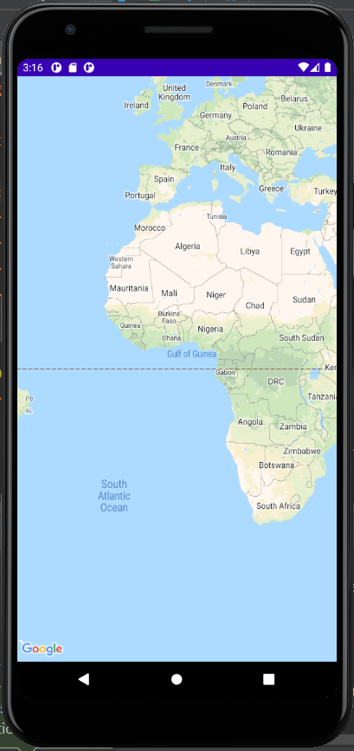
Run the app

Slide 17
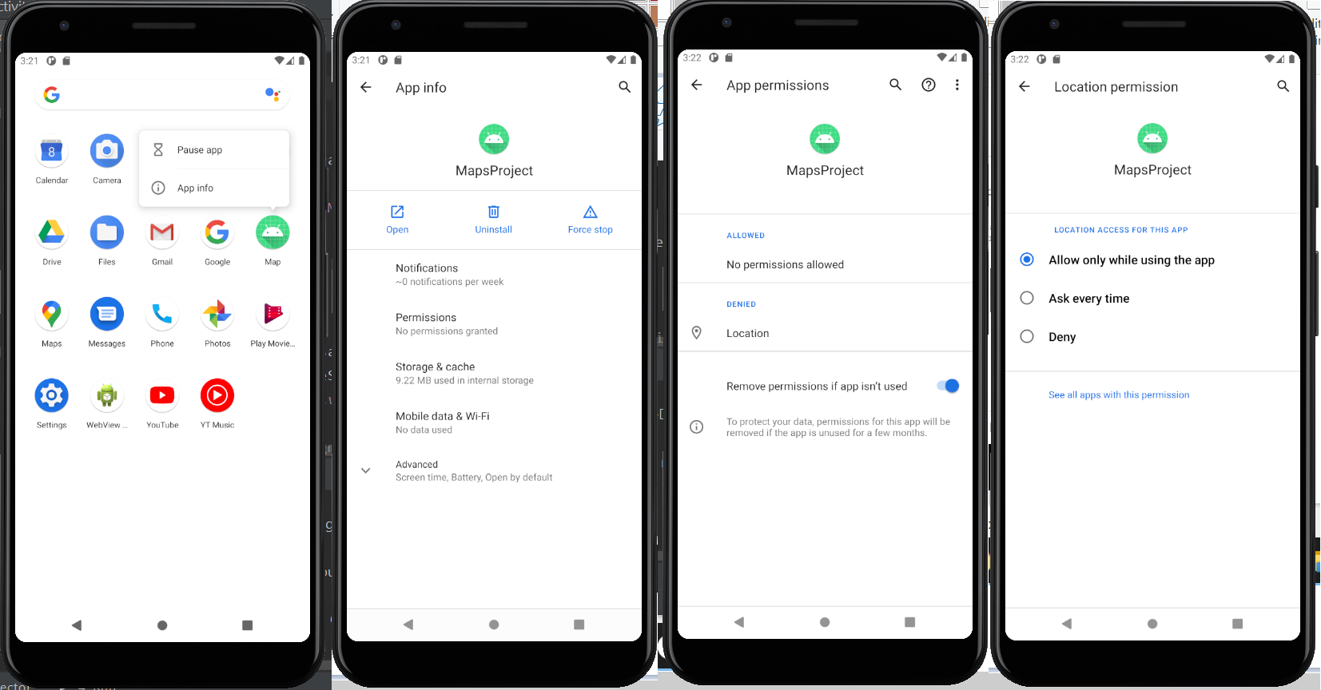

Slide 18
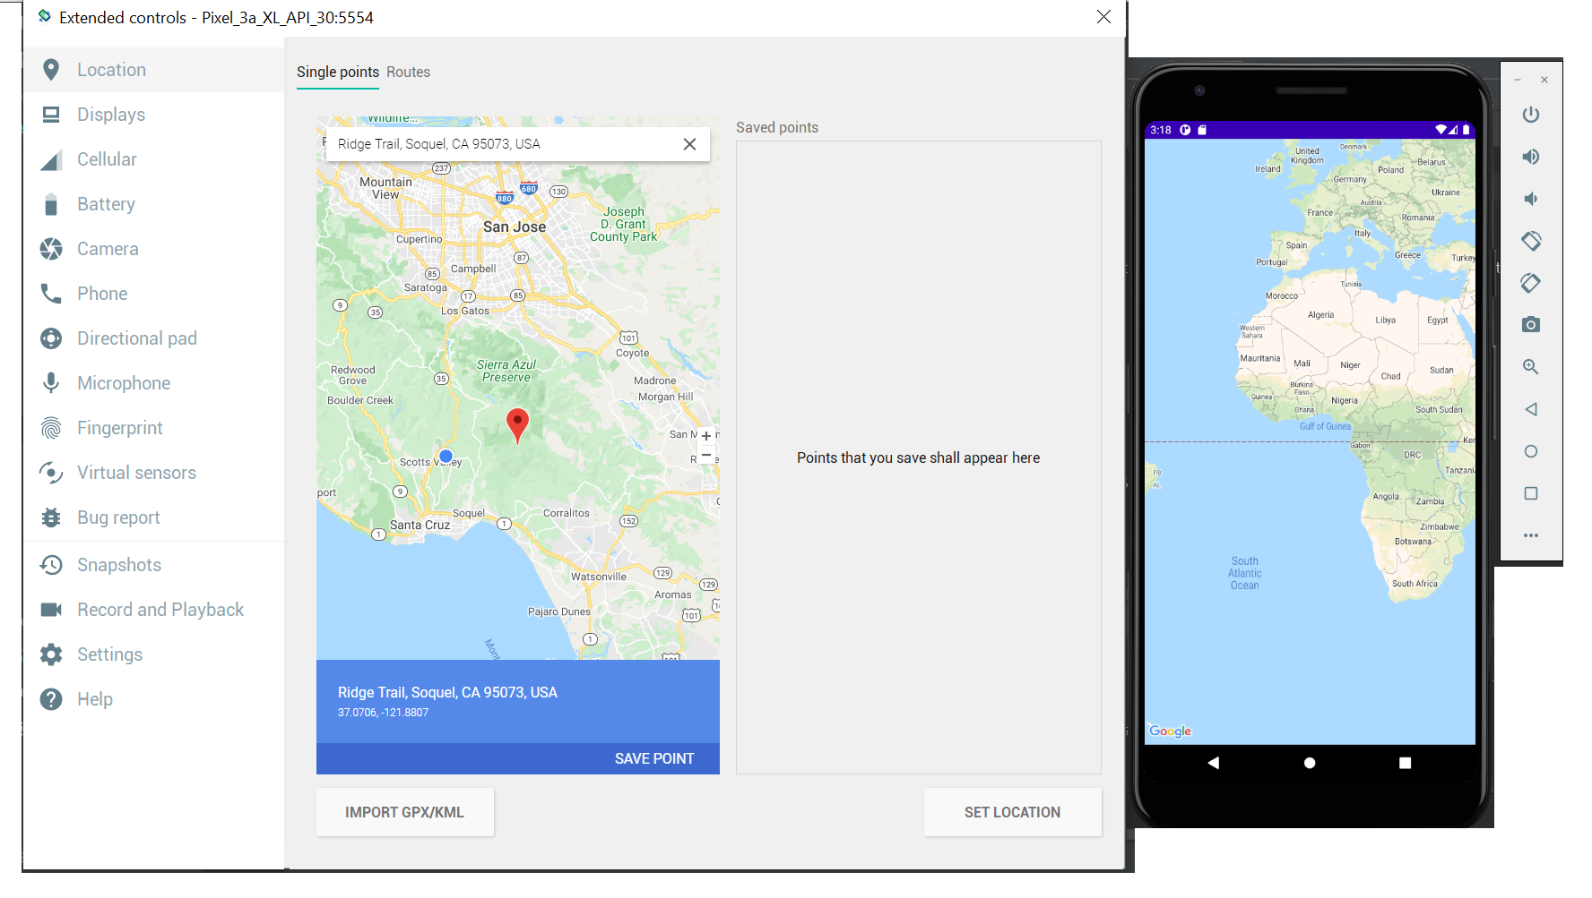

Slide 19
