Slide 1
Math 32, Lecture #3
Prof. Suzanne S. Sindi
ssindi@ucmerced.edu
Prof. Lihong Zhao
lzhao33@ucmerced.edu
Thursday, September 3, 2020

Slide 2
Roadmap
Why this subject is important and awesome!
An experiment with infinitely many outcomes.
What is independence again?
Classic Examples:
Permutations and Combinations
Balls and Urns
Birthday Problem

Slide 3
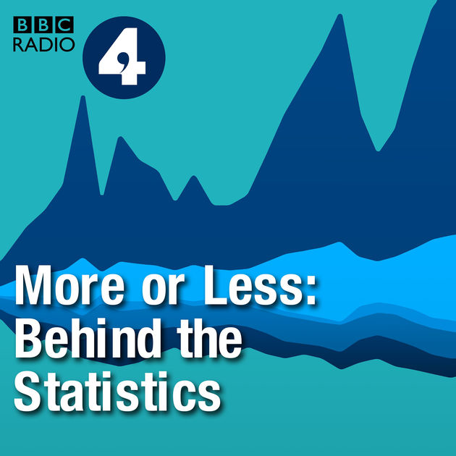

Probability/Statistics Podcasts
Tell who wrote a book based on text analysis!
Does charging for plastic bags decrease their use?
How do you effectively get people to save more?
Is the crime rate rising?
Can sleep deprivation explain differences in disease risk in minority populations?

Slide 4
Question from Lecture 2
Q: If we flip a coin 5 times, what is P(3 H), the probability that we get exactly 3 heads (in any order)?
Answer: First, look at which outcomes involve 3 heads: (H,H,H,T,T), (H,H,T,H,T), (H,H,T,T,H), etc.
It turns out there will be 10 such outcomes.
(5 Choose 3! WHY!!???)
Each has probability 1/32, so the answer is 10/32 or 5/16.

Slide 5
A combination is a grouping of outcomes in which the order does not matter.
A permutation is an arrangement of outcomes in which the order does matter.
Q: Flip a coin 5 times, how many possible outcomes with exactly 3 heads?
A: The order of outcomes is not important, so this situation involves combinations. We need 3 out of 5 flips to be heads, 5 Choose 3, total 10 outcomes with exactly 3 heads.
Check videos 2 in Video List 1 for more examples!

Slide 6
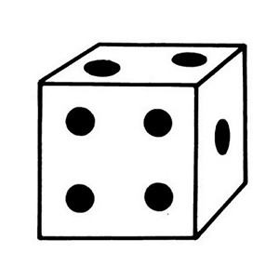
Now, let’s consider another classic problem in probability: rolling a die with six sides, numbered from 1 to 6

Slide 7
Sample Space & Events
Experiment: Rolling a 6 sided die (D6).
1
2
3
4
5
6
(Finite) Outcomes
Sample Space
Ω
Events: Any subset of outcomes
Roll an even number: {2,4,6}
Roll an odd number: {1,3,5}
Empty Set: {} = ∅
With n outcomes 2^{n} possible events.

Slide 8
Set Complement
For any event A we can define the complement of A denoted A^{c}:
A and A^{c} are disjoint sets
Example 1
A: roll an odd number.
A^{c} : roll an even number.
Example 2
A : roll a number greater than 3.
A^{c} : roll a number at most 3.
1
2
3
4
5
6
Sample Space
Ω

Slide 9
De Morgan’s Law
For any 2 events A and B: (A ∪ B)^{c} = A^{c} ∩ B^{c}.
Example:
B
A = Roll a 2 or 3
A^{c} = Roll a 1,4,5 or 6
B = Roll a 2 or 4
B^{c} = Roll a 1,3,5 or 6
A
A ∪ B = Roll a 2,3 or 4
(A ∪ B)^{c} = Roll a 1,5 or 6
A^{c} ∩ B^{c} = Roll a 1,5 or 6

Slide 10
De Morgan’s Law
A
B
A^{C}
B^{C}
(A ∪ B)^{c} =
A^{c} ∩ B^{c}
A ∪ B

Slide 11
P(A) + P(A^{c}) = 1
Law of Total Probability
A
A^{C}

Slide 12
What is the probability of rolling a die (D6) 5 times and seeing: 1,6,4,5,1
P (ω_{1,} ω_{2,} ω_{3,} ω_{4,} ω₅)
= P(ω₁) P(ω₂) P(ω₃) P(ω₄) P(ω₅)
= (1/6)x(1/6)x(1/6)x(1/6)x(1/6)
≈ 0.0001286

Slide 13
Rolling a Die Until you get a 6
What is the probability that I get a 6 for the first time on the 5th roll?
Sample Space?
Same as before, all combinations of 5 rolls of a die.
Total: 6⁵ = 7,776 sequences.
Each throw is independent
First 4 rolls can be 1, 2, 3, 4, or 5,
Prob=5/6 for each roll
Last roll must be a 6, Prob=1/6
P(get 6 for the 1st time on the 5th roll)
= (5/6)⁴(1/6) ≈ 0.08

Slide 14
How many rolls do you need to get your first 6?
Prob(1 roll until 1st 6) = 1/6
Prob(2 rolls until 1st 6) = (5/6)(1/6) = 5/6²
Prob(3 rolls until 1st 6) = (5/6)(5/6)(1/6) = 5²/6³
Prob(N rolls until 1st 6) = …

Slide 15
How many rolls do you need to get your first 6?
Prob(1 roll until 1st 6) = 1/6
Prob(2 rolls until 1st 6) = (5/6)(1/6) = 5/6²
Prob(3 rolls until 1st 6) = (5/6)(5/6)(1/6) = 5²/6³
Prob(N rolls until 1st 6) = 5^{N-1}/6^{N}
What is the state space?
1,2,3,4,….,

Slide 16
Sample Space & Events
Experiment: Number of rolls until the first 6 appears.
1
20
32
14
58
61
100
…
(Infinite) Outcomes
Sample Space
Ω
So we have infinitely many events but they are not equally likely!

Slide 17
Total Probability
Let’s check we have total probability 1.
P(N rolls until 1st 6) = 5^{N-1}/6^{N}
We need to compute the sum over all numbers:

Slide 18
Outcomes/State Space
Outcomes: Finite/Infinite
Later we will see state spaces can be:
discrete {0,1,2,…..}
continuous (0,∞)
But no matter what, the basic laws of probability are obeyed:
P(Ω) = 1
P(∅)=0
P(A ∪ B) = P(A) + P(B) if A and B disjoint

Slide 19
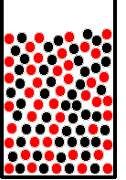
Now, let’s consider another classic problem in probability….
Drawing balls from an urn containing balls with multiple colors.

Slide 20
Balls and Urns
These are classic devices in probability.
Lots of problems can be modeled using such a device.
If we draw a ball at random, we can either:
Keep the balls, a.k.a. sampling without replacement
Put the balls back to the urn, a.k.a. sampling with replacement

Slide 21
Independence
Suppose I have an urn with only 2 balls, 1 black and 1 red.
If I sample with replacement, this is equivalent to flipping a fair coin.
Prob(Black) = ½
Prob(Red) = ½
What about 10 balls, 5 black and 5 red?
The probability is the same!
Sampling with replacement = independence.

Slide 22
Independence
What about 10 balls, 7 black and 3 red.
If I sample with replacement, this is equivalent to flipping a biased coin.
Prob(Black) = 7/10
Prob(Red) = 3/10
What is the probability that sampling with replacement I draw: red, red, black
P(red,red,black) = P(red)xP(red)xP(black) = (3/10)²(7/10) = 63/1000
Sampling with replacement = independence.

Slide 23
Dependence
Now think about sampling without replacement.
I start with 10 balls, 5 red and 5 black.
I draw Ball 1, set it aside. For that ball, P(red) = ½ and P(black) = ½.
I draw Ball 2. For that ball, P(red) and P(black) will depend on color of Ball 1.
Sampling without replacement = dependence.

Slide 24
Balls & Urn
Q: “I start with an urn filled with 5 red and 5 black balls, randomly mixed. I draw three balls from the urn, sampling without replacement. What is the probability that at least one is black?”
How do we do this on our own? Let’s be sneaky.
If A = “Draw at least 1 black”, then A^{C} = “Draw 0 black”.
We know P(A) + P(A^{C}) = 1.
We know A^{C} has only one outcome: red, red, red
P(red,red,red) = (5/10)x(4/9)x(3/8) = 1/12
P(A) = 1 - P(A^{C}) = 1 – 1/12 = 11/12

Slide 25
In Summary
Reviewed important probability terms.
Introduced Set Complement and De Morgan’s Law
Explored infinite state spaces.
Revisited independence and dependence.
Used law of total probability to calculate things.
Explored sampling with and without replacement.

Slide 26
Remember
HW Quiz 1 has been posted this morning and due tomorrow by11:59pm!
Discussion sections next week will be open office hours, no worksheets
HW 2 will be posted tomorrow
Video Quiz 1 will be posted Tuesday, September 8

