Slide 1
Hypothesis Testing & t Tests
Math 32, Fall 2020
Discussion Section #11

Slide 2
Discussion Section #11
In class (and on Homework #12) you have been working on problems in
Hypothesis testing
t-Tests
Today in Lab, you will do computational versions in R of problems like those on Homework #12.

Slide 3
Discussion Section #11
For today, you will receive 2 R scripts (Lab11FollowAlong.R and Lab11.R) and 4 CSV files (1 for each problem).
Lab11FollowAlong.R: Will go through this lecture
Lab11.R: Template for your worksheet
It is important to have all of these in the same directory on your computer and this directory needs to be set as the working directory.
You can set the working directory in R by with the “Session menu” (Session -> Set Working Directory)

Slide 4
R: Programming Environment
Most people use an integrated programming environment (IDE) for R that lets you interact with:
The console: where you tell the computer which R programs/files or commands to run
R Source Code/Files: open/edit any R code you have written. (Typically you write R code in files with a .R suffix.)
Program output: Figures/charts you produce
Prof Sindi uses and recommends RStudio (https://www.rstudio.com/).

Slide 5
Problems #1 and 2: Hypothesis Testing
These next few slides are from Lecture 25 and illustrate hypothesis testing.
You will walk through:
The basics of hypothesis testing
The example you did in class
We will demonstrate in R how to conduct the same hypothesis test.

Slide 6
Hypothesis Testing
You only reject the null hypothesis if there is strong evidence that your outcome would be extremely unlikely.
Steps in a Hypothesis Test:
Formulate the Null and Alternate Hypothesis.
Construct a test statistic and locate the critical region (what you are going to test to decide whether you will reject the null or not).
Determine your “cut-off” level to reject the null hypothesis (significance level, denoted by α).
Decide whether you reject the null hypothesis.

Slide 7
Example: Fair/Biased Coin Flip
Goal: Determine if a coin is fair if we observe 70 out of 100 flips are heads.
Formulate the Hypotheses:
H₀: p = ½ (The coin is fair)
H₁: p > ½ (The coin is biased for heads)
Construct the Test Statistic and Critical Region: Since we observe 70 heads, we will see if ≥ 70 heads is likely under H₀.
Significance Level: We choose α = 0.05
Compute Outcome: P( ≥ 70 Heads | H₀)

Slide 8
Example: Fair/Biased Coin Flip
Compute Outcome: P( ≥ 70 Heads | H₀)
Because the outcome of at least 70 heads occurs with probability 0.00004 < 0.05, we reject the null hypothesis in favor of the alternate.
That is, since the outcome we observe has less than a 5% chance of being true under the null hypothesis, we reject it.

Slide 9
How to Conduct this Same Test in R
In the previous example, we implicitly used a computer to sum values from n = 70 to 100.
Now let’s see how we can use R to do this calculation and obtain important information related to the hypothesis test.
We will use the R function binom.test
? binom.test gives the help information

Slide 10
? binom.test
Syntax

Slide 11
? binom.test
Description of
Arguments
R will compute a confidence interval for p based on your data!

Slide 12
Binomial Hypothesis Test
###############################
# Binomial Hypothesis Testing #
###############################
N = 100;
X = 70;
p0 = 0.50;
hTest = binom.test(X,N,p0,alternative=c('greater'),conf.level=0.95)
print(hTest)
X = number of observed successes (i.e., Heads)
N = total number of trials
p0 = 0.50 is the null hypothesis of a “fair coin”
alternative = c(‘greater’) is our one-sided hypothesis test
conf.level = 0.95 specifies the confidence interval R will report in p based on our data.

Slide 13
binom.test Output
Same value we calculated (See Slide 8)
Since it’s less than 0.05 we reject the null hypothesis
> print(hTest)
Exact binomial test
data: X and N
number of successes = 70, number of trials = 100,
p-value = 3.925e-05
alternative hypothesis: true probability of success is greater than 0.5
95 percent confidence interval:
0.6157794 1.0000000
sample estimates:
probability of success
0.7
Confidence interval on p estimated

Slide 14
What about Normal Distribution
In this case we have a normal distribution with a known variance and want to test the null hypothesis.
These next slides go through another example from Lecture 25.

Slide 15
Example: Body Weight
In the 1970s, 20–29 years old men in the U.S. had a mean μ body weight of 170 pounds with standard deviation σ of 40 pounds. Today, is there is a difference in mean body weight from the 1970’s value?
Null hypothesis H_{0:} μ = 170 (“no difference”)
Let’s consider a two-sided alternative hypothesis can be either H_{1:} μ ≠ 170 (two-sided test)

Slide 16
Example: Body Weight
Suppose we assume that the standard deviation has not changed (σ = 40).
We analyze 64 different individuals and observe an average body weight of 185 (X_{avg} = 185).
We will decide to accept or reject the null hypothesis if our sample average is either much higher or much lower based on the null hypothesis the mean is μ = 170.
We select a significance level of 0.05.
To conduct the hypothesis test we will:
Convert our sample average to a z-statistic.
Determine our two critical values (we have two because it’s a two-sided hypothesis test).
Determine if our z-value lies outside our two critical values.

Slide 17
Example: Body Weight
We first standardize our observation
We look up that
z_{0.025} is equal to 1.96
- z_{0.025} is equal to -1.96
Since z= 3.00 is outside the interval (-1.96,1.96) we reject the null hypothesis.

Slide 18
Example: Body Weight in R
We still need to determine our z-statistic in R, but we can determine the critical values for the normal distribution computationally.
Upper Tail (CDF = 1-0.025)
> qnorm(0.025, mean = 0, sd = 1, lower.tail = FALSE)
[1] 1.959964
Lower Value (CDF = 0.025)
> qnorm(0.025, mean = 0, sd = 1, lower.tail = TRUE)
[1] -1.959964
Note: Since the normal distribution is symmetric, we only needed to compute 1 of these values. But we like learning about R! So we did both ☺

Slide 19
Problems #3 and #4: t-Tests
These next few slides are from Lecture 26 and illustrate the basics of t-Tests.
You will be:
Reminded of the basics of t-Tests.
The different types assumptions of t-Tests.
You will learn how to conduct t-Tests in R using their built-in functions.

Slide 20
The t-test
T-tests are handy hypothesis tests in statistics when you want to compare means
Three types:
One sample t-test --- compares the mean of your sample to some a priori specified value
Two-sample t-test/independent samples t-test --- compare the means of two (statistically independent) samples
Paired samples t-test/dependent samples t-test --- compare the means of two samples in which observations in one sample can be paired with observations in the other sample, e.g., before and after treatments
In Lab #11 and (on Homework #12) you will consider the first two kinds.

Slide 21
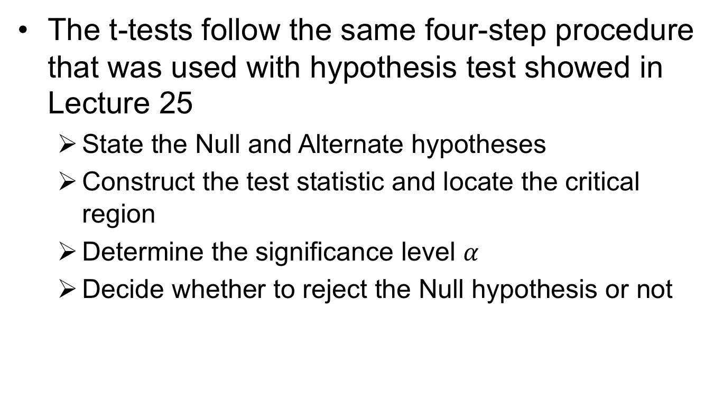
The t-test
The t-tests follow the same four-step procedure that was used with hypothesis test showed in Lecture 25
State the Null and Alternate hypotheses
Construct the test statistic and locate the critical region
Determine the significance level $α$
Decide whether to reject the Null hypothesis or not

Slide 22
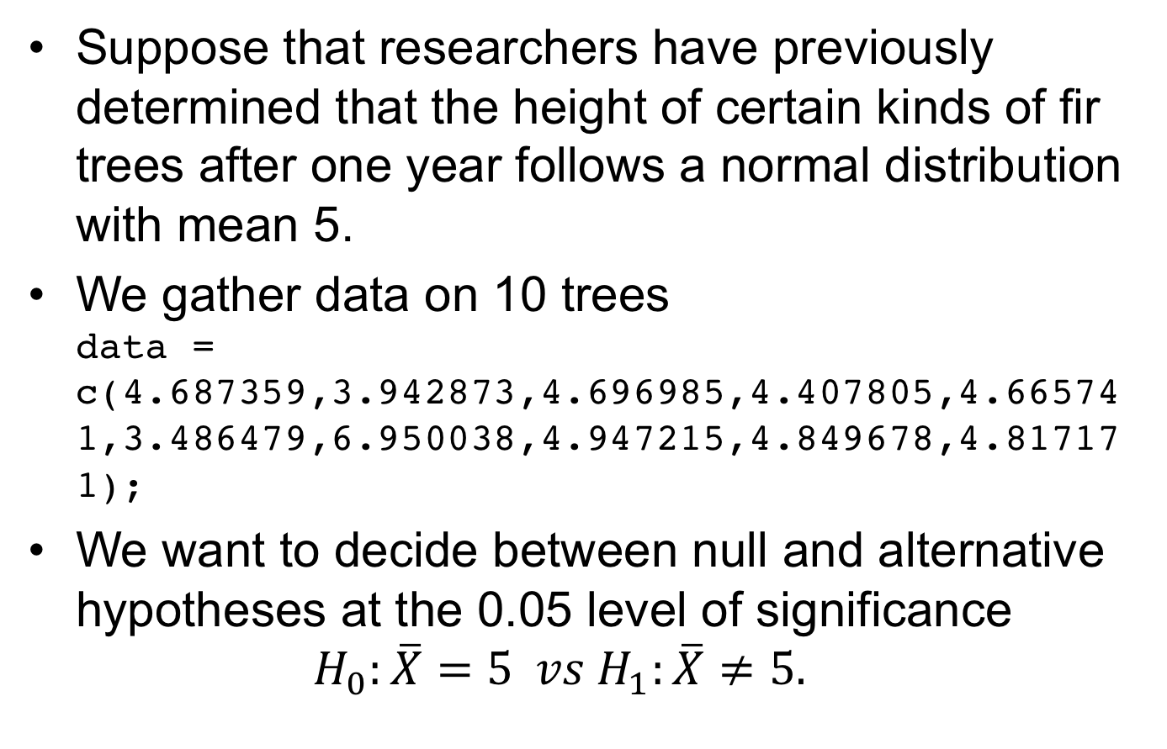
One-Sample t-Test in R
Suppose that researchers have previously determined that the height of certain kinds of fir trees after one year follows a normal distribution with mean 5.
We gather data on 10 trees data = c(4.687359,3.942873,4.696985,4.407805,4.665741,3.486479,6.950038,4.947215,4.849678,4.817171);
We want to decide between null and alternative hypotheses at the 0.05 level of significance $H_{0}:\overline{X}=5 vs H_{1}:\overline{X}≠5.$

Slide 23
One-Sample t-Test in R
In the example we did in class we had to translate things into T statistics, but in R, we have a 1-line command for a two-sided test!!
hTest = t.test(data, mu = mu0)
print(hTest)
One Sample t-test
data: data
t = -0.89661, df = 9, p-value = 0.3933
alternative hypothesis: true mean is not equal to 5
95 percent confidence interval:
4.102102 5.388167
sample estimates:
mean of x
4.745134
In this case we can see our t statistic is -0.89661 and we have 9 degrees of freedom.
Since the p-value of 0.3933 is larger than 0.05 we do not reject H₀.

Slide 24
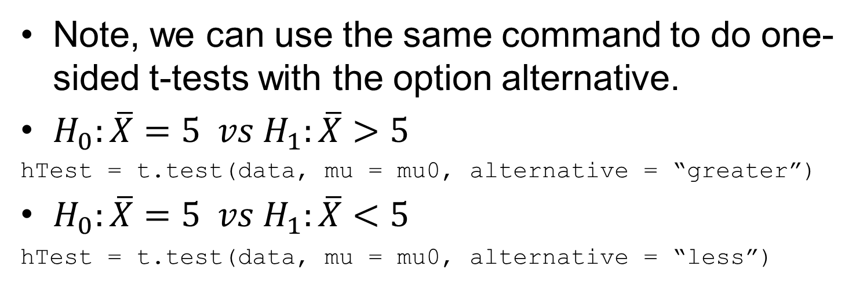
One-Sample t-Test in R
Note, we can use the same command to do one-sided t-tests with the option alternative.
$H_{0}:\overline{X}=5 vs H_{1}:\overline{X}>5$
hTest = t.test(data, mu = mu0, alternative = “greater”)
$H_{0}:\overline{X}=5 vs H_{1}:\overline{X}<5$
hTest = t.test(data, mu = mu0, alternative = “less”)

Slide 25
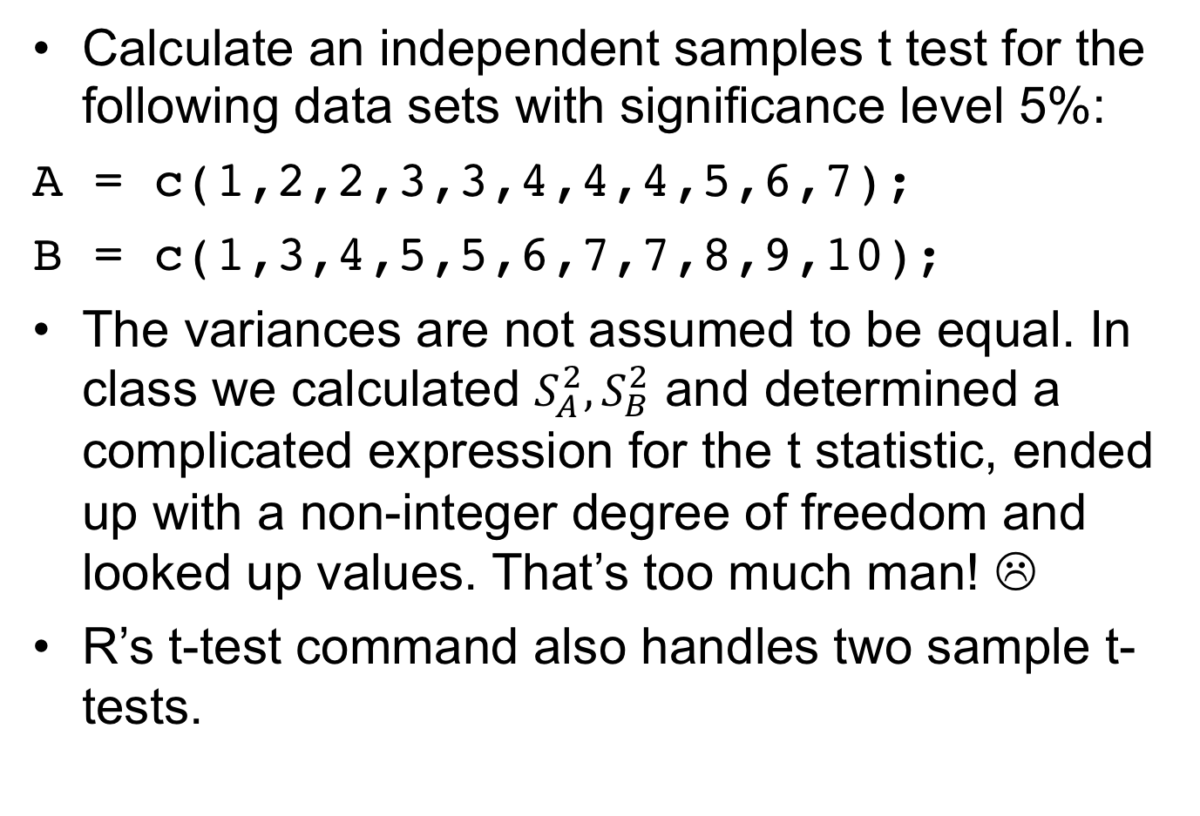
Two Sample t-test in R
Calculate an independent samples t test for the following data sets with significance level 5%:
A = c(1,2,2,3,3,4,4,4,5,6,7);
B = c(1,3,4,5,5,6,7,7,8,9,10);
The variances are not assumed to be equal. In class we calculated $S_{A}^{2}, S_{B}^{2}$ and determined a complicated expression for the t statistic, ended up with a non-integer degree of freedom and looked up values. That’s too much man! ☹
R’s t-test command also handles two sample t-tests.

Slide 26
Two Sample t-test in R
A = c(1,2,2,3,3,4,4,4,5,6,7);
B = c(1,3,4,5,5,6,7,7,8,9,10);
hTest = t.test(A,B)
print(hTest)
Welch Two Sample t-test
data: A and B
t = -2.2537, df = 17.527, p-value = 0.03728
alternative hypothesis: true difference in means is not equal to 0
95 percent confidence interval:
-4.2196357 -0.1440007
sample estimates:
mean of x mean of y
3.727273 5.909091
Since p-value is less than 0.05 we reject the null hypothesis!

Slide 27
Lab #11
Complete the Lab #11 (Lab11.pdf) worksheet.
Note: These problems are very similar to Homework #12 and will (hopefully) help you with this assignment and Homework #12 Quiz.

