Slide 1
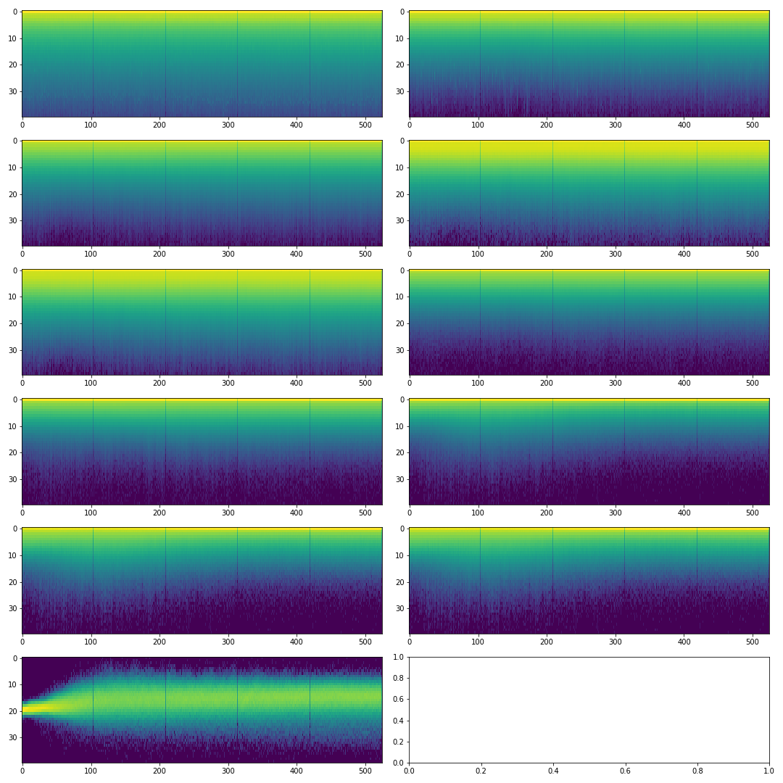
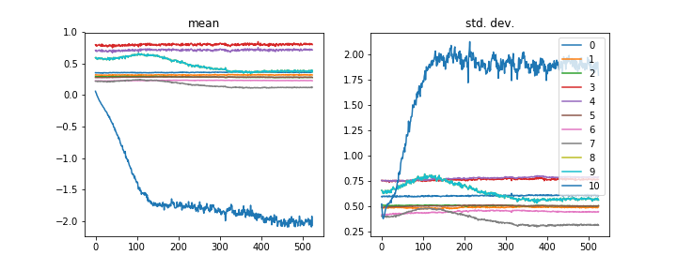
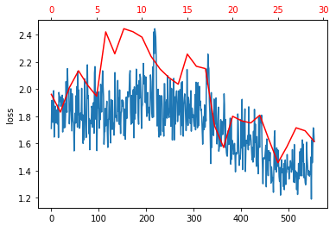
Naive training
– all layers
epoch train_loss train_accuracy valid_loss valid_accuracy time
0 2.852017 0.287686 2.486142 0.387275 00:08
1 2.179299 0.469177 2.641399 0.352697 00:07
2 2.030308 0.531273 2.449481 0.413555 00:07
3 1.731837 0.638368 1.788130 0.615491 00:07
4 1.465440 0.747413 1.599652 0.690180 00:07

Slide 2
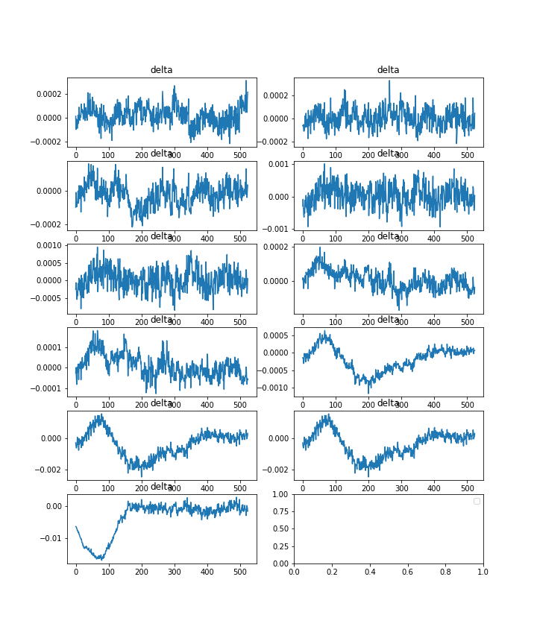
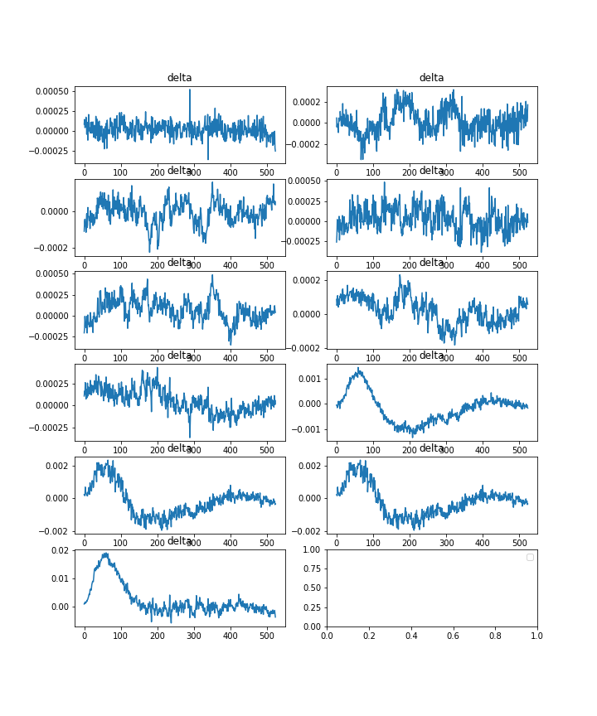
Naive training – all layers
Mean and std. dev deltas between layers
3, 32
32, 64
64, 64
MaxPool
64, 64 Res Block
64, 128 Res Block
128, 256 Res Block
256, 512 Res Block
Avg and MaxPool
Flatten
Linear

Slide 3
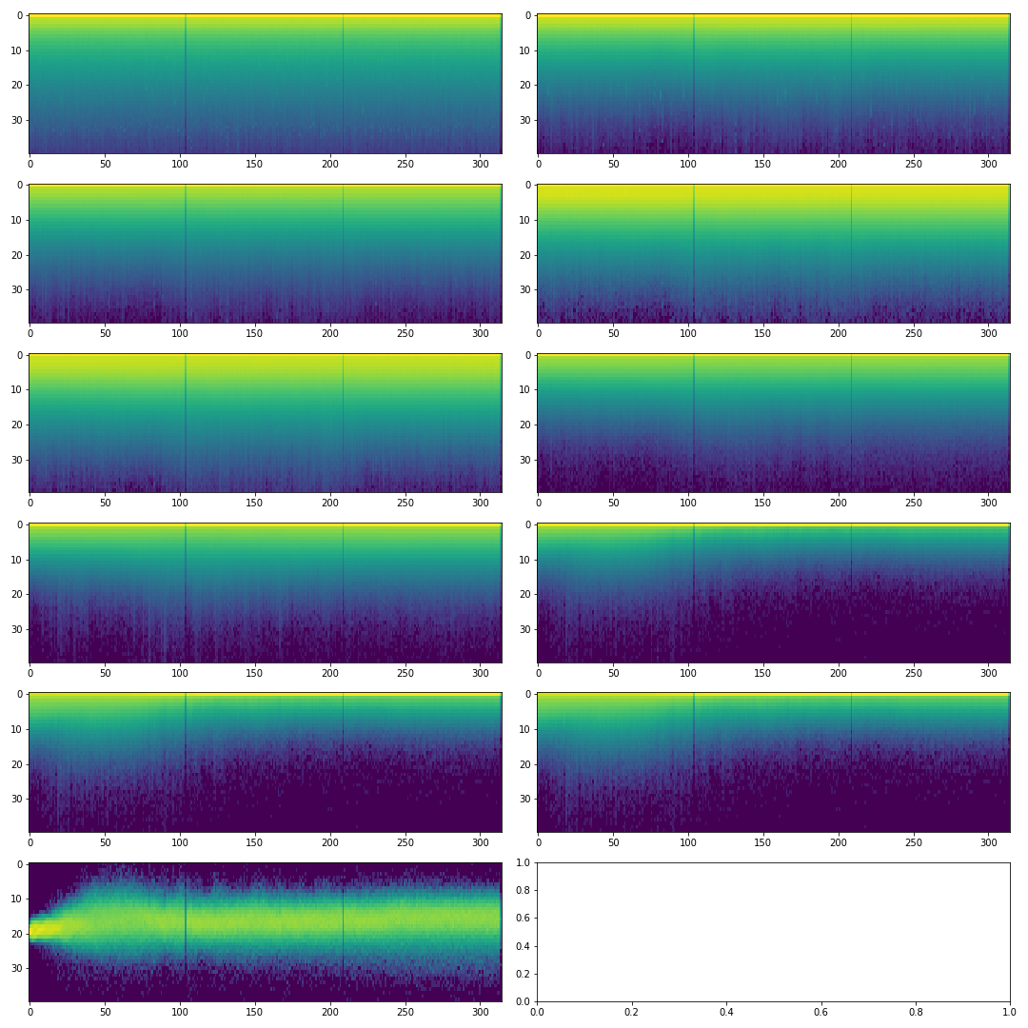
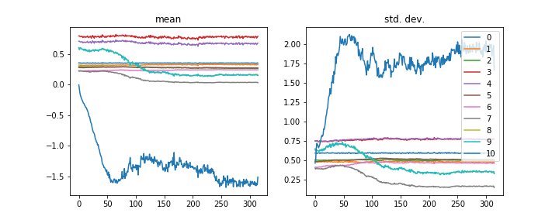
Unfreeze head only, note this is the pre-trained pets model

Slide 4
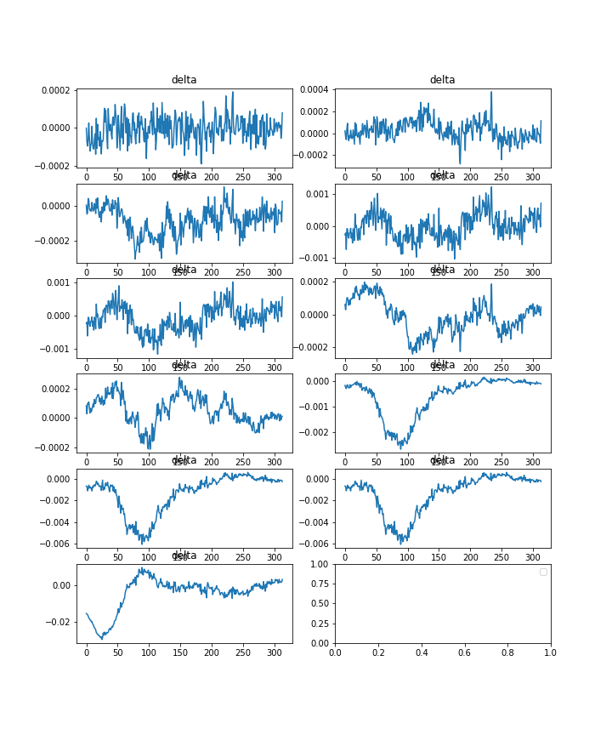
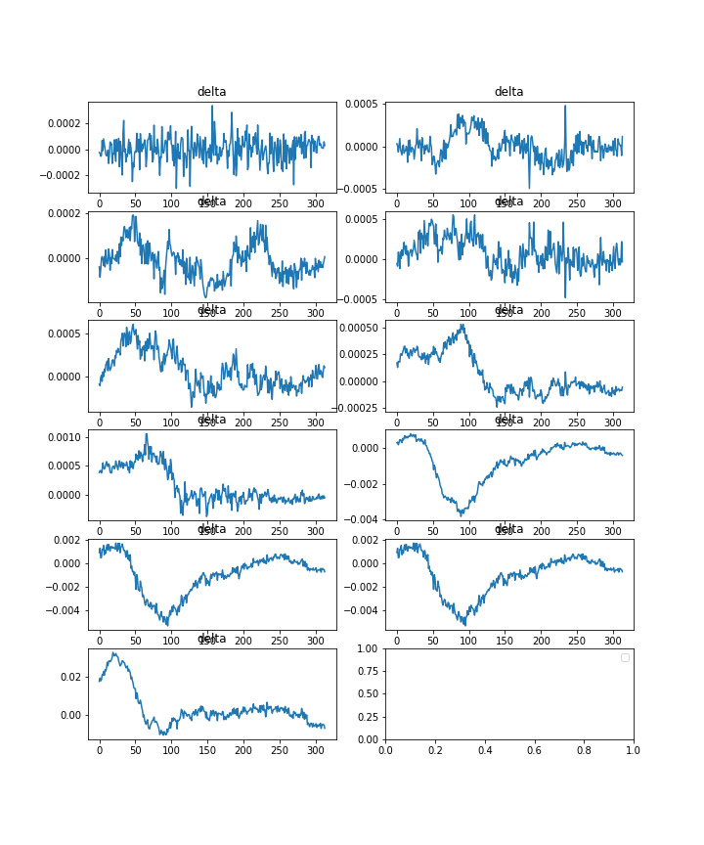
Unfreeze head only

Slide 5
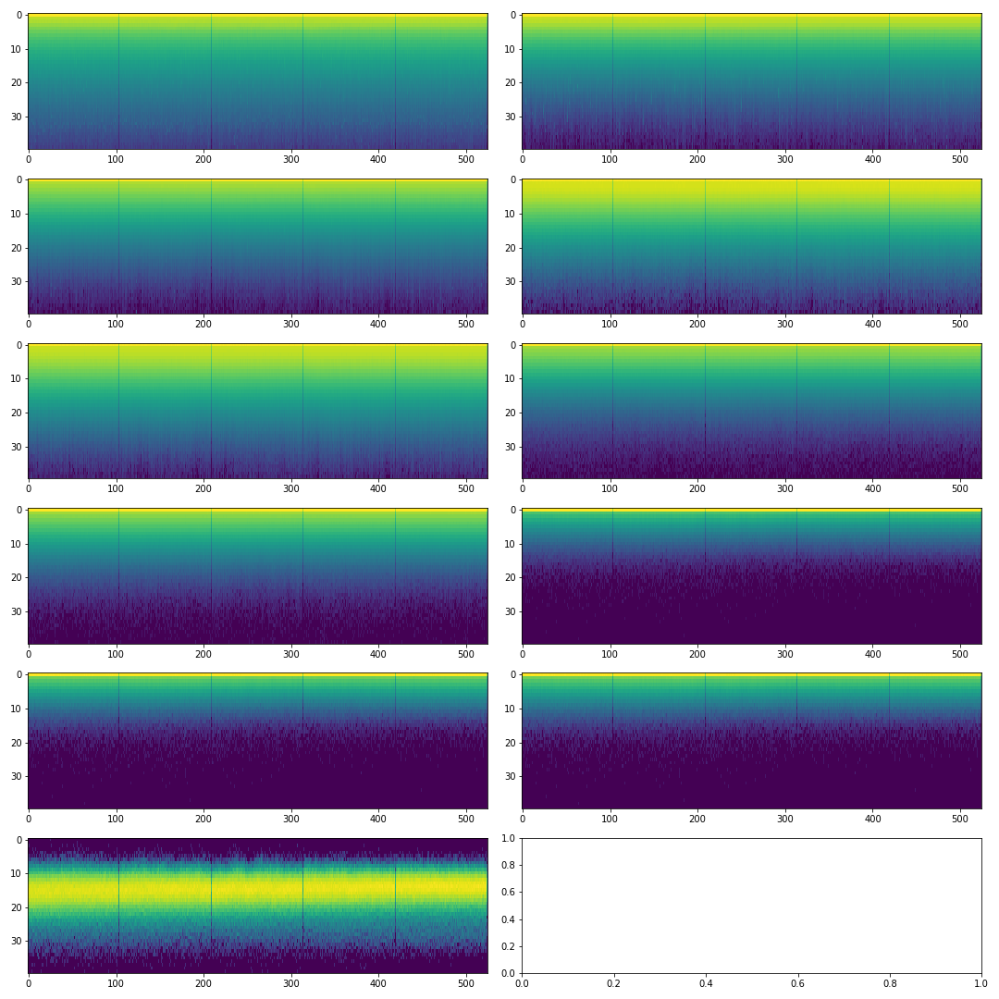
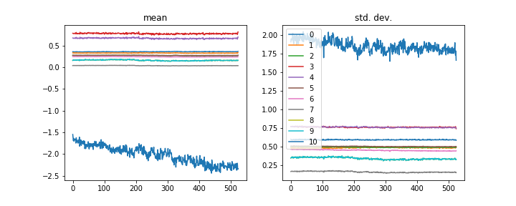
Unfreeze all
epoch train_loss train_accuracy valid_loss valid_accuracy time
0 1.667072 0.665967 1.754682 0.632089 00:34
1 1.664807 0.659517 2.007438 0.542185 00:34
2 1.684244 0.653667 1.889853 0.551867 00:34
3 1.544158 0.706315 1.648641 0.644537 00:34
4 1.361453 0.783411 1.541300 0.688797 00:34

Slide 6
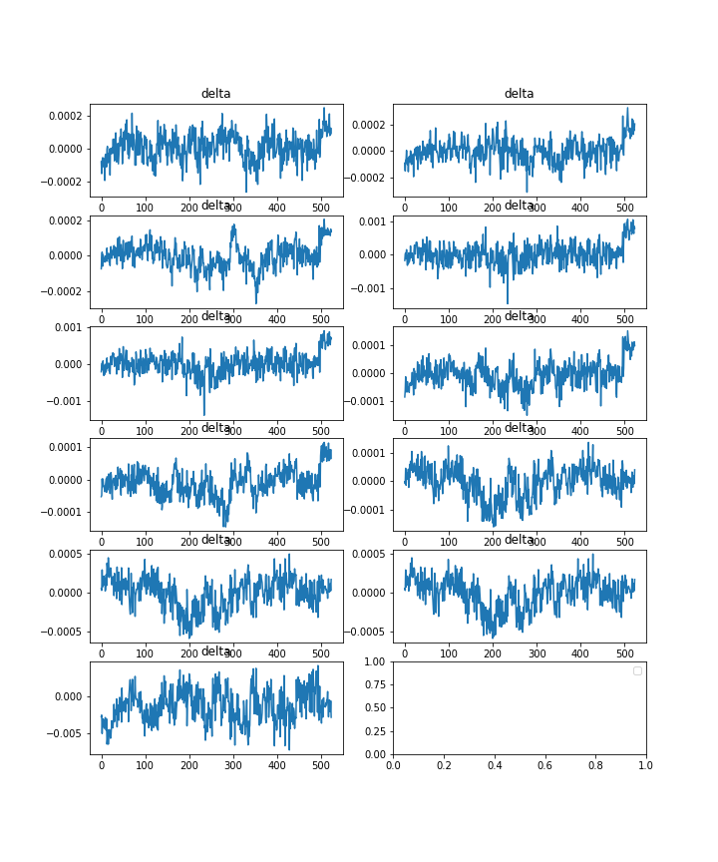
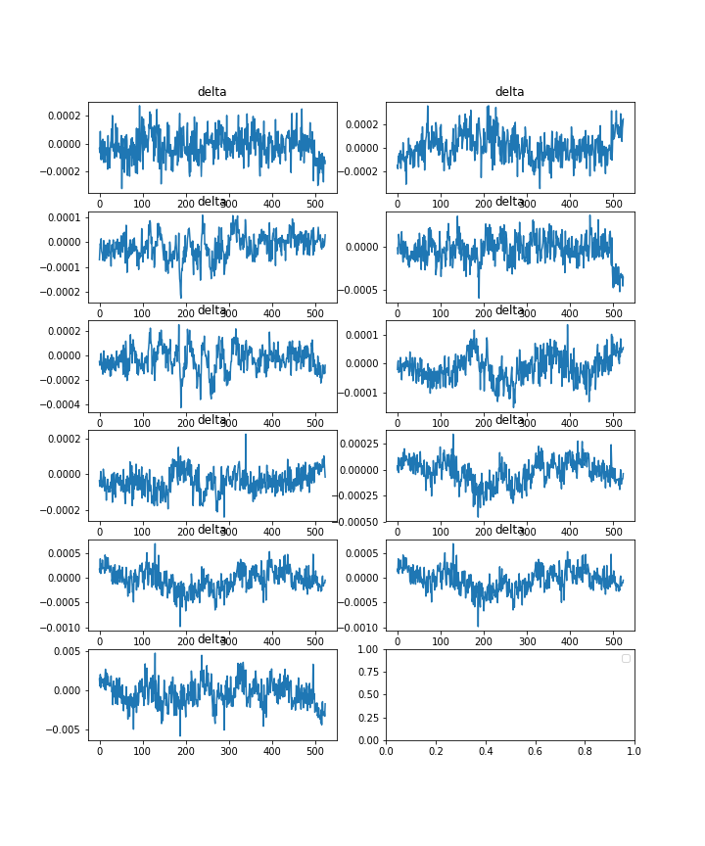
Unfreeze all

Slide 7
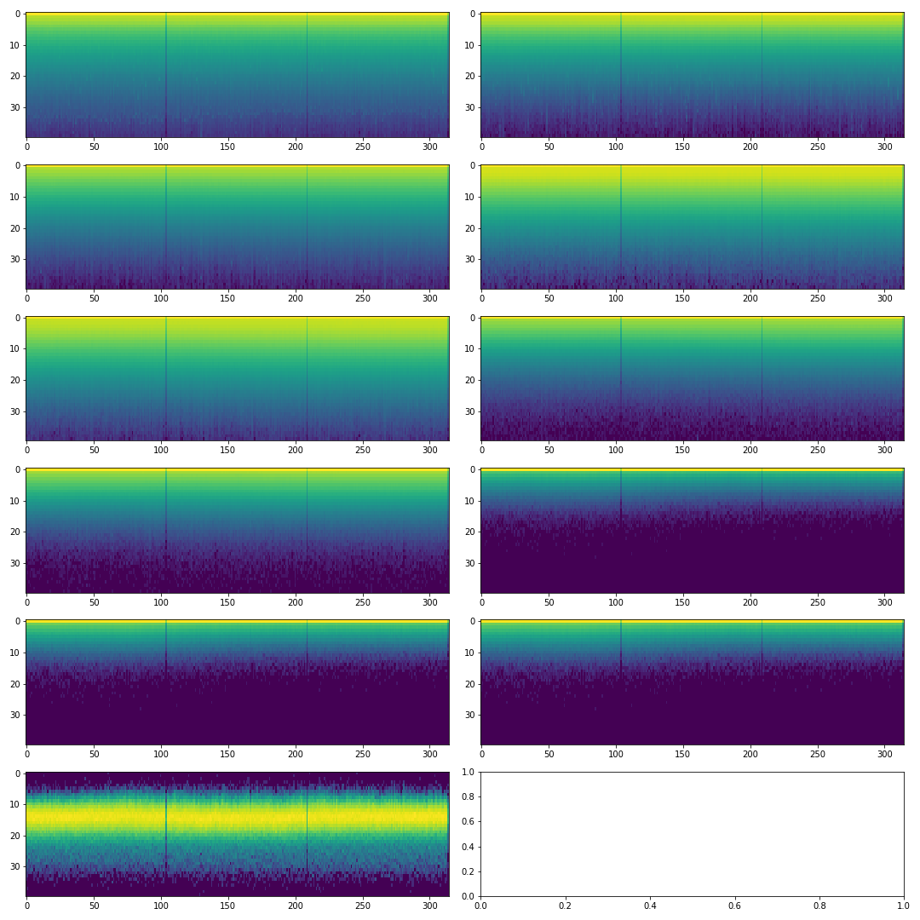
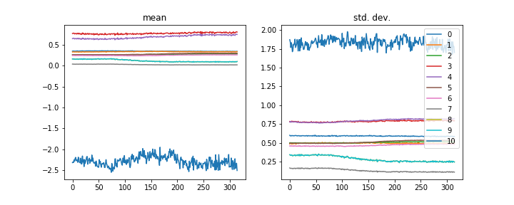
Freeze only non batchnorm layers
(also dont freeze last layer)

Slide 8
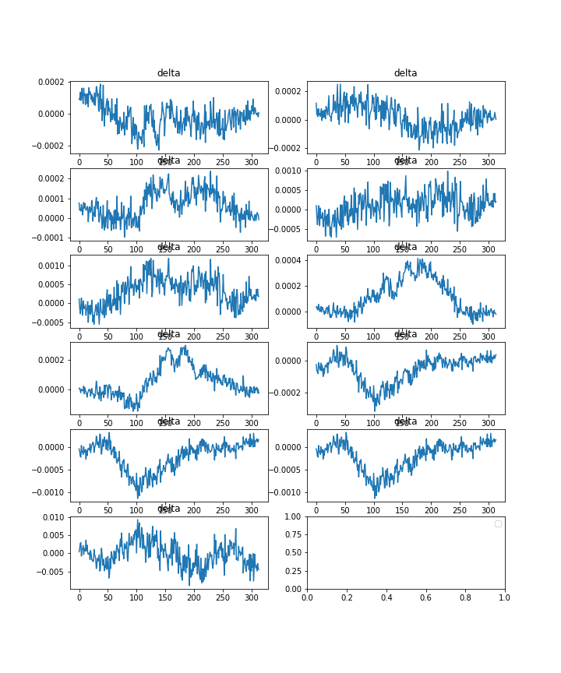
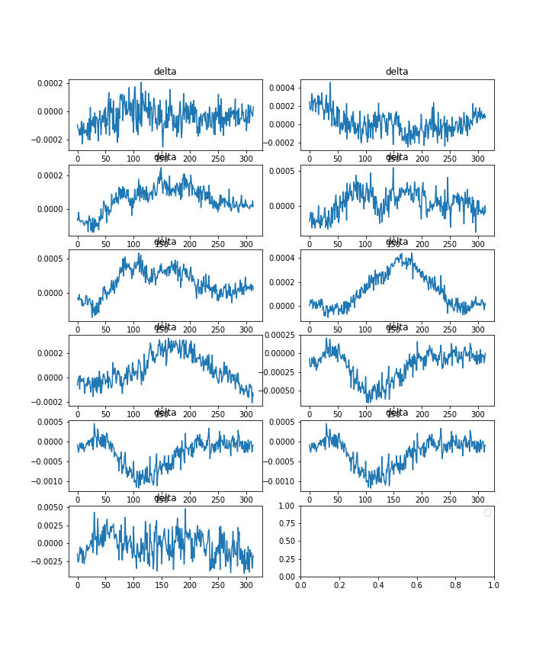
Freeze only non batchnorm layers

Slide 9
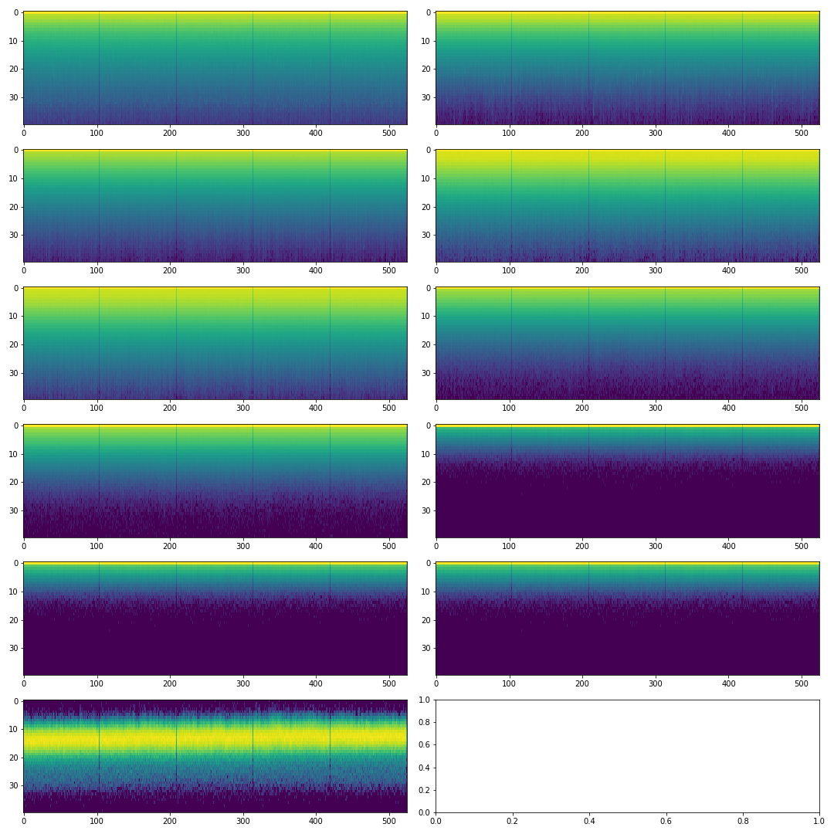
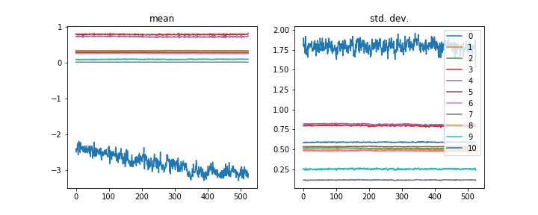
Unfreeze non bn

Slide 10
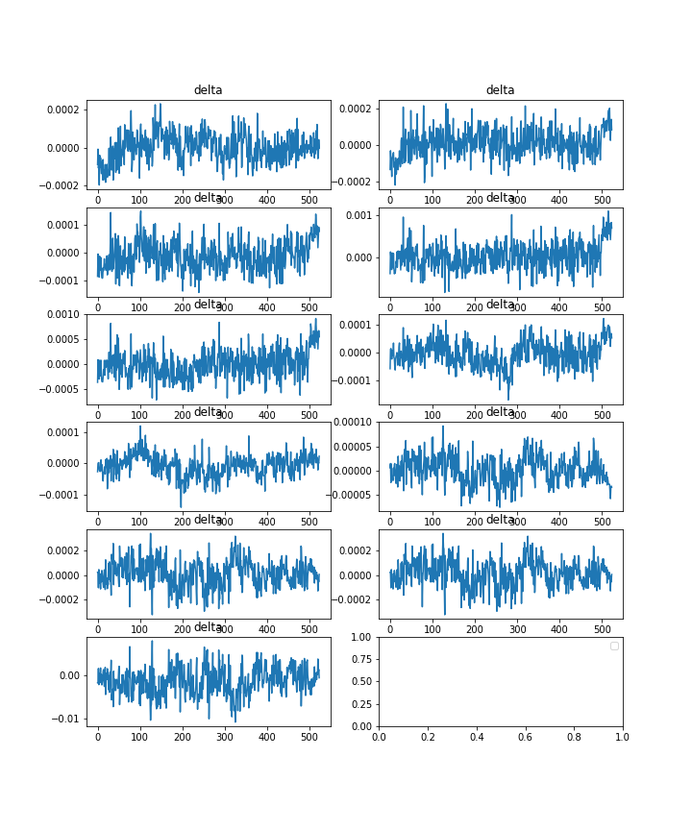
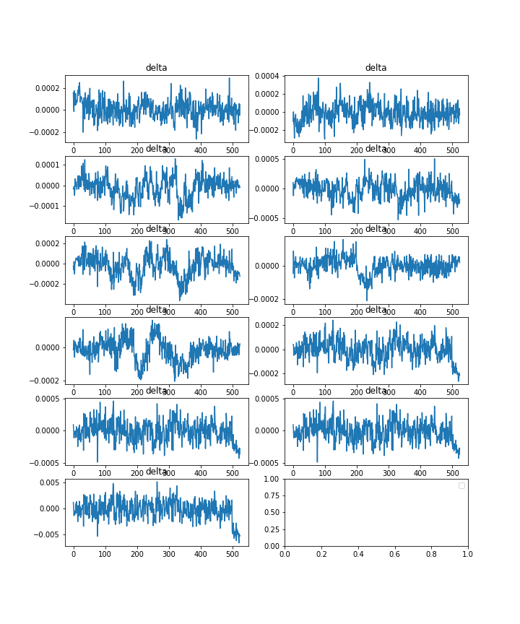
Unfreeze non bn

