Slide 1


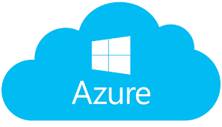

4. Notification Hub sends push notifications to PNS
3. Backend registers device with Notification Hub
5. PNS sends notification to the device
Device requests registration id from platform notification service
Device sends registration id to the App Service backend

