Slide 1
THE MYSTIC
Ramon Llull

Slide 2
Agenda
Ramon Llull
Electoral systems
How Natana was elected abbess
Method for the election of persons
The Art of Elections
Problems within the systems
Llull today
If you have a question at any time, just ask.

Slide 3
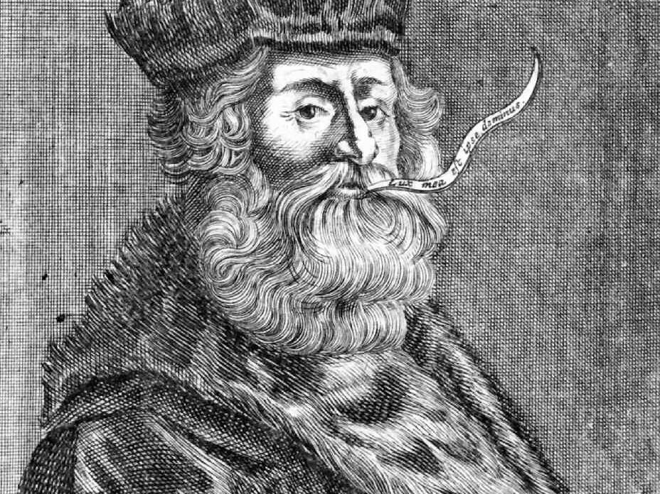

Ramon Llull (1232–1316)
> 200 written works in Catalan, Arabic, and Latin
Three vows:
to accept dying for Christ in converting the unbelievers to His service
to write a book, the best in the world, against unbelievers
to procure the establishment of monasteries, where various languages could be learned.

Slide 4
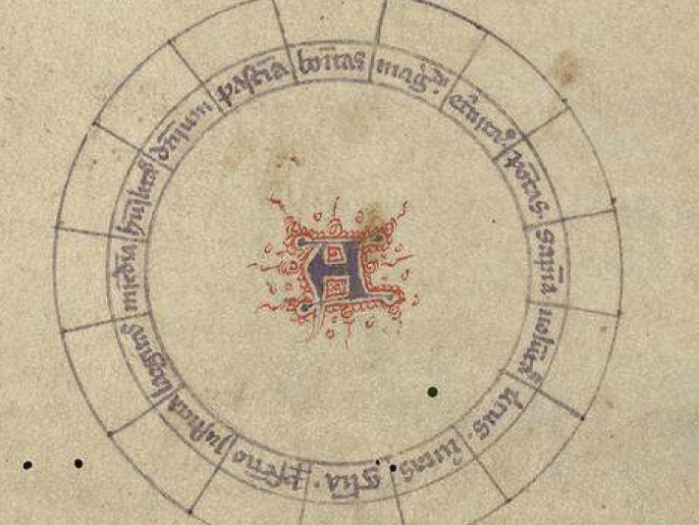
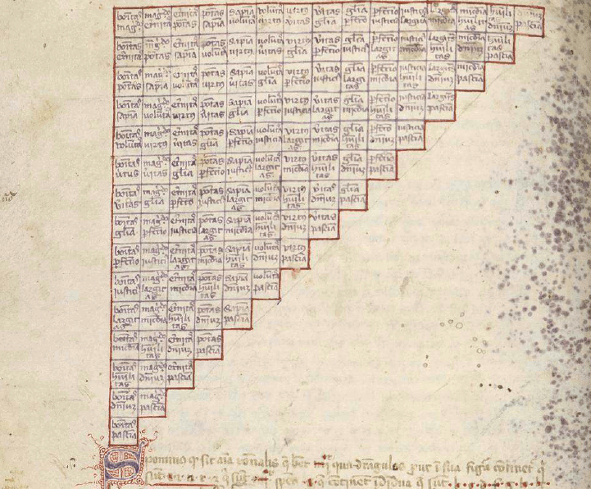
Ars magna - The Great Art
logical system to discover the truth
universal religious law 🡪 overcome the differences between Christianity, Judaism and Islam
Ars as an instrument for an intercultural and interreligious dialogue

Slide 5
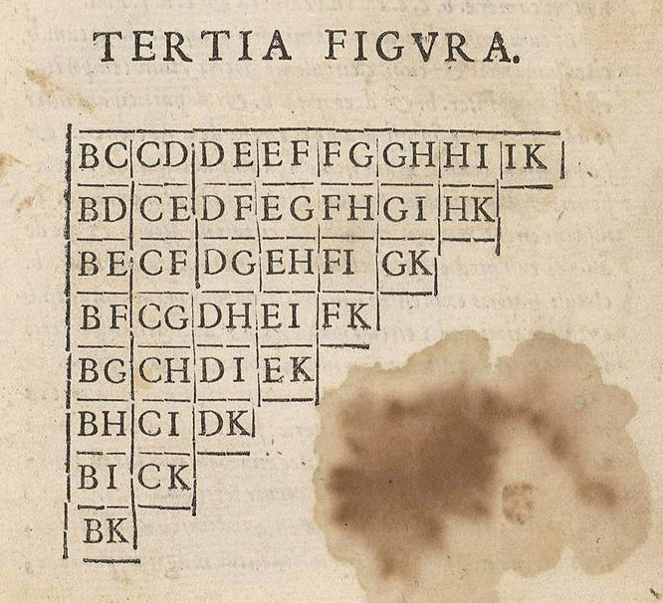
How Natana was elected abbess
Chapter in the book: Libre d’Evast e d’Aloma e de Blanquerna
Two stage system
Number of pairs:
n (n – 1)
2
Example: 9 (9 – 1) = 36
2

Slide 6
What about ties
Two or more sisters win the same number of two-way contests 🡪 vote again
Same number of votes within a contest 🡪 odd number
Ambiguous: “and let her be elected who has the most votes in most cells”
“totaling most votes” VS “winning most comparisons.”

Slide 7
Method for the election of persons
What about ties:
Same number of votes within a contest 🡪 odd number
Both receive a point, both win
Both 0, both 0.5, both 1 point – what‘s the difference?
Two or more sisters win the same number of two-way contests 🡪 vote again
Drawing of a lot
Rankings of the candidates
Time-consuming: election of Natana: two - three hours with only 9 candidates

Slide 8
The Art of Elections
Knockout procedure
candidates enter, single file (A, B, C, D, …, K)
Last one standing
Problem: no ranking
Manipulation (agenda setting): advantageous to be last (K)

Slide 9
Problems within the systems - Rational choice theory
3 Axioms:
1. completeness
xRy or yRx or xIy for all x, y ∈X
2. reflexivity
xRx for all x∈X
3. transitivity
xRy and yRz, then xRz for all x, y, z ∈X
yRx and zRy, then zRx for all x, y, z ∈X
xIy and yIz, then xIz for all x, y, z∈X

Slide 10

Llull today
Llull's 'great art' resembles a modern computer language 🡪 forefather of computer science.
0/1 🡪 binary system
https://www.youtube.com/watch?v=-dbiEY4ClY0

Slide 11
THANK YOU FOR LISTENING
Questions?

