Slide 1
Gun Boo-Boos
By: Luz, Caleb, Mark

Slide 2
Resources
Standard Reports | Gun Violence Archive
https://www.gunviolencearchive.org/reports
CSV files
Accidental Deaths
Accidental Injuries

Slide 3
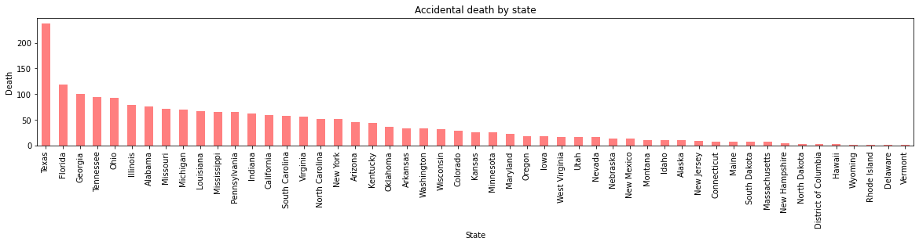

Slide 4
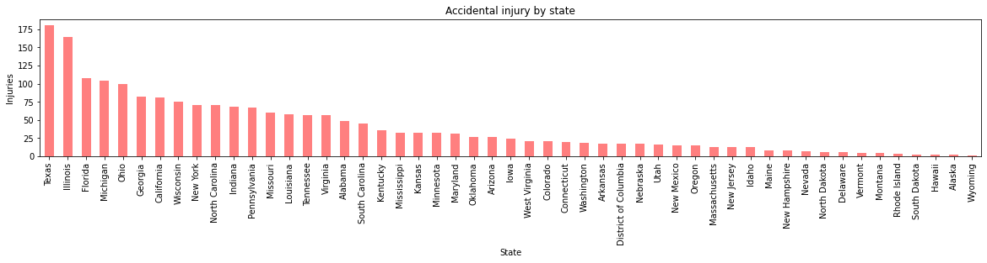

Slide 5
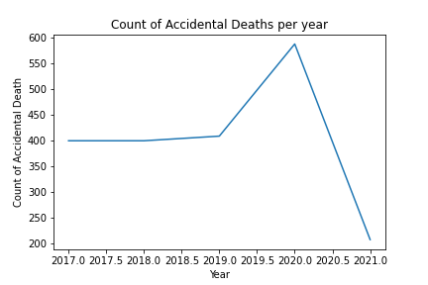

Slide 6
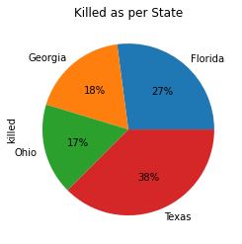
Top 5 States for Gun Deaths in 2020

Slide 7
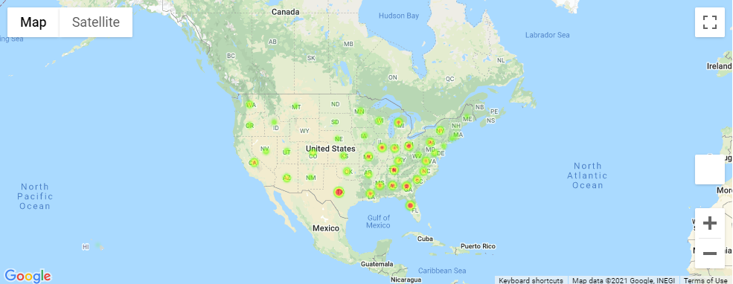
Accidental Deaths

Slide 8
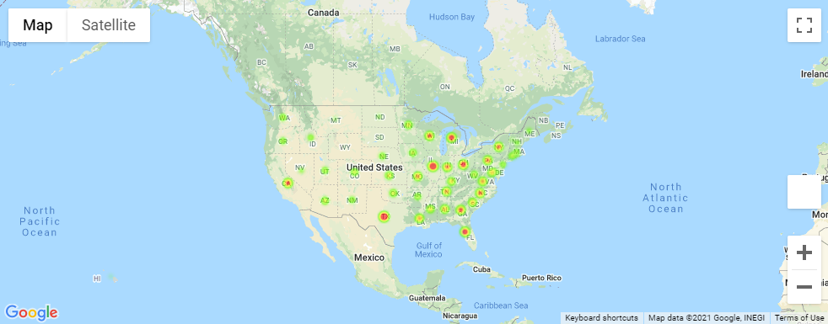
Accidental Injuries

Slide 9
THANK YOU!

