Slide 1
RASPBERRY PI DJ based on user’s mood

Slide 2
Repository
1

Slide 3

GitHub repo
Related files, as well as code can be found on:
http://github.com/adrianl911/MS

Slide 4
User requirements
2

Slide 5
Our project should:
Detect a user’s mood based on two questions asked by Alexa
Detect four moods: happy, sad, angry, neutral while also being open for extension.
Play a song according to your mood
Turn on LEDs according to the song that it is played
Provide a database with a user’s moods

Slide 6
System overview
3

Slide 7
Speech
Audio
Python
Alexa
Arduino

Slide 8
Circuit
4

Slide 9
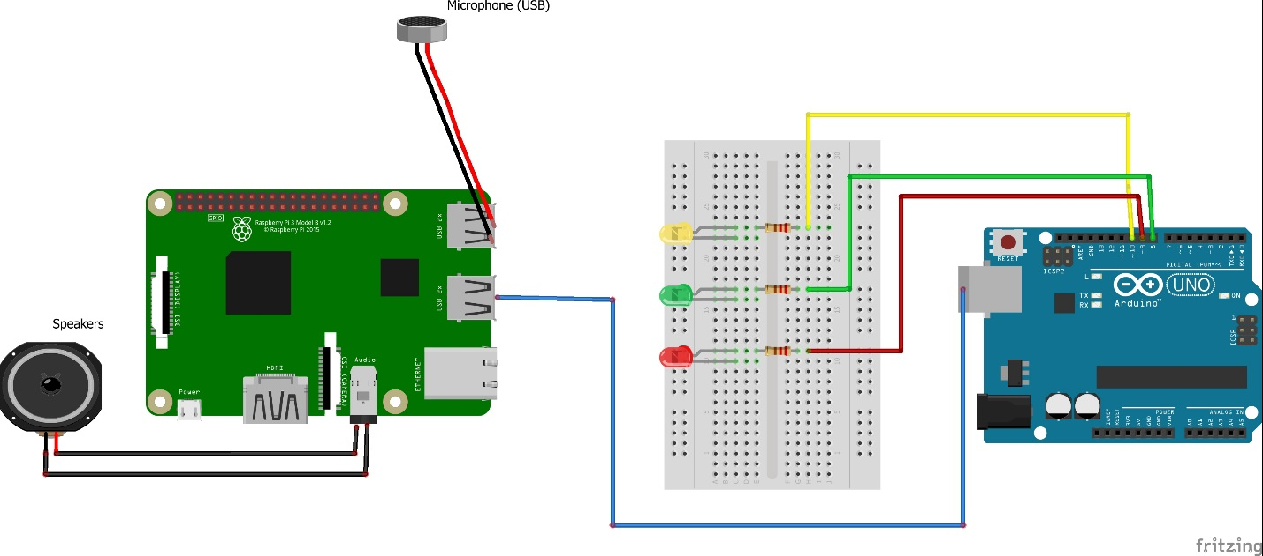
Circuit simulation

Slide 10



What we used:
Raspberry Pi
We turned a Raspberry Pi3 Model B+ into an Alexa Echo using Alexa Skills Kit.
Also, a python server running on Arduino manages the conversation between Alexa and the user.
Arduino
We used Arduino in order to light up some LEDs in synchronization with the song that is being played.

Slide 11
Software design
5

Slide 12
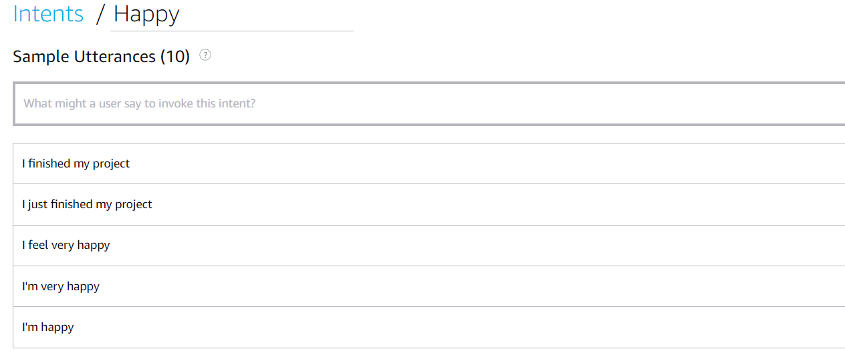
Alexa Skills
We used the skill builder in order to define four states: Happy, Sad, Angry and Neutral. These moods are declared as intents, and every intent has a list of utterances that represent the corresponding mood.

Slide 13
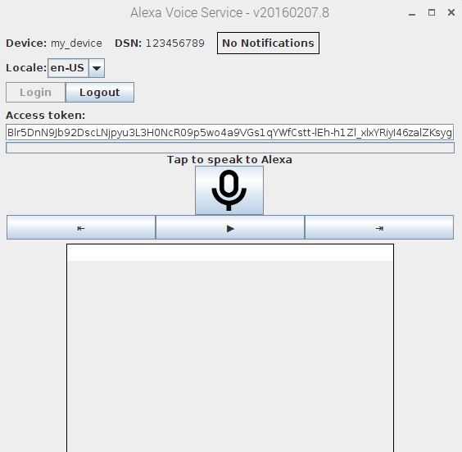
Raspberry configuration
We followed a tutorial to install Alexa Voice Service to our Raspberry, turning it into a sort of homemade Alexa Echo.
After that, we started developing the server that processes the information received from the custom skill.
We used python as programming language and Flask as web framework. Flask is used for managing statements and questions.

Slide 14
Further more
when someone invokes the custom skill, the server intercepts the "Launch" event and returns a welcome message followed by the first question chosen to understand the user's mood: "How are you?"
.
Finally
What the user answers will be classified and the server will handle the event fired from the custom skill. Then, it will calculate the gathered results, it will play a song according to the mood and will send a signal to Arduino, using serial
Next
we followed another tutorial on how to import and use the VLC media player that we will use for playing songs.

Slide 15
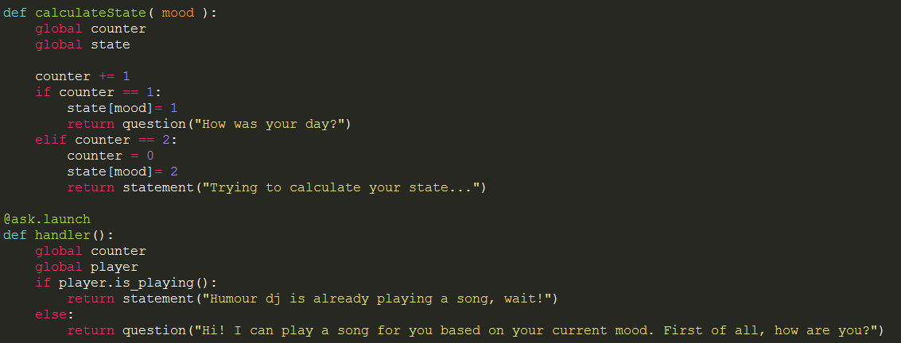
Classifying answers, calculating mood

Slide 16
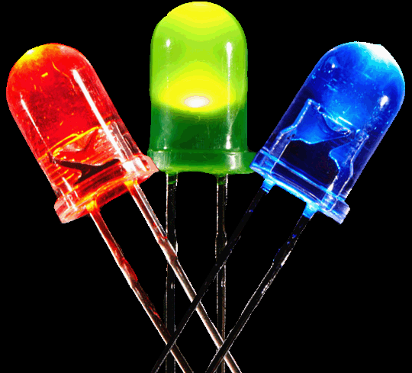
Arduino
The algorithm for the LEDs part uses the Fast Fourier transform of the audio signal from the mp3 to analyze certain frequencies, and lights an LED if certain ranges of frequencies go above the allotted "sensitivity" value.

Slide 17
Results and further work
6

Slide 18
What does the current system do
Calculates mood
Plays different songs based on mood
Light LEDs
Extensions and improvments
Database with user’s mood
More LEDs, maybe using Chainable Leds
Create a playlist for each mood
Send reports via Email

Slide 19
References
https://github.com/alexa/alexa-avs-sample-app/wiki/Raspberry-Pi
http://www.instructables.com/id/How-to-Make-LEDs-Flash-to-Music-with-an-Arduino/
https://blog.computerbacon.com/playing-audio-in-python-with-libvlc.html

