Slide 1
COMP 3340
HKU CS GPU Farm Tutorial

Slide 2

1
Apply for an Account
To use GPU Farm Phase 2, please visit https://intranet.cs.hku.hk/gpufarm_acct_cas/ for application. The username of the account will be the same as your HKU Portal ID. A new password will be set for the account. An email will be sent to you after your account is created.
Application finished
Due to the high utilization of GPU Farm Phase 1, new users are recommended to apply for a Phase 2 account first.
2

Slide 3

1
Apply for an Account
To use GPU Farm Phase 1, please visit https://intranet.cs.hku.hk/gpufarm_acct/ for application. The username and password of the account will be the same as your CS account.
Application finished
3

Slide 4
2
Access the GPU Farm
To access the GPU farm, you need to be connected to the HKU network (e.g., when you are using the wired network in CS laboratories and offices, or connected to CSVPN, HKU Wifi or HKUVPN).
Login with your username and password, e.g.:
ssh -X <your_cs_username>@gpugate1.cs.hku.hk (for Phase 1)
ssh -X <your_portal_id>@gpu2gate1.cs.hku.hk (for Phase 2)
4

Slide 5
3
Use GPUs in Interactive Mode
To have an interactive session, use the gpu-interactive command. An available GPU compute node will be selected and allocated to you, and you will be logged on the node automatically.
The GPU compute nodes are named gpu-comp-x for Phase 1 and gpu2-comp-x for Phase 2.
tmchan@gpugate1:~$ gpu-interactive
tmchan@gpu-comp-1:~$
5

Slide 6
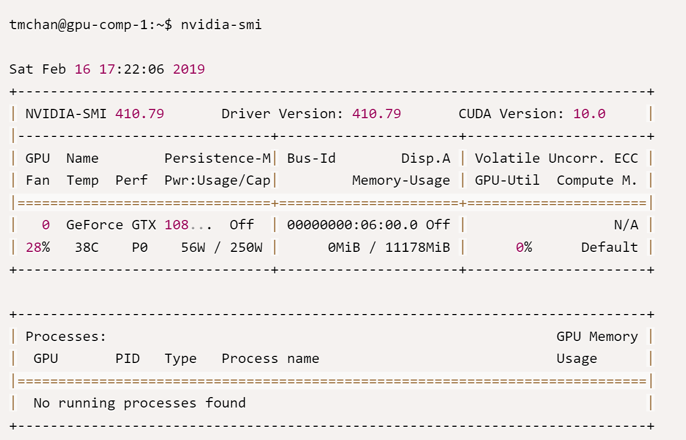
3
Use GPUs in Interactive Mode
You can verify that a GPU is allocated to you with the nvidia-smi command, e.g.:
6

Slide 7
3
Use GPUs in Interactive Mode
You can now install and run software like using a normal Linux server. For example, “pip install numpy”
Note that you do not have sudo privileges. Do not use commands such as 'sudo pip' or 'sudo apt-get' to install software.
The time limits (quotas) for GPU and CPU time start counting once you have logged on to a GPU compute node, until you logout the GPU compute node:
All your processes running on the GPU node will be terminated when you exit from gpu-interactive command.
tmchan@gpu-comp-1:~$ exit
tmchan@gpugate1:~$
7

Slide 8
4
Install Anaconda and pytorch
Install Anaconda
# make sure you are in a GPU compute node (the host name of prompt shows gpu-comp-x) before installing
gpu-interactive
# download installer, check for latest version from www.anaconda.com
wget https://repo.anaconda.com/archive/Anaconda3-2020.11-Linux-x86_64.sh
# run the installer, # and allow the installer to initialize Anaconda3 in your .bashrc
bash Anaconda3-2020.11-Linux-x86_64.sh
# logout and login the GPU node again to activate the change in .bashrc
exit
# run gpu-interactive again when you are back to the gateway node
gpu-interactive
Install pytorch
# Create a conda virtual environment and activate it. (Here, we assume the new environment is called comp3340)
conda create -n comp3340 python=3.7 -y
conda activate comp3340
# Install PyTorch and torchvision following the official instructions,
conda install pytorch=1.7.1 torchvision=0.8.2 torchaudio=0.7.2 cudatoolkit=10.1 -c pytorch
8

Slide 9
5
Running Jupyter Lab on a GPU compute node
Login a GPU compute node from a gateway node with gpu-interactive: gpu-interactive
Install Jupyter Lab:
pip install jupyterlab
Find out the IP address of the GPU compute node, the output will be an IP address 10.XXX.XXX.XXX : hostname -I
Start Jupyter Lab and note the URL displayed at the end of the output: jupyter-lab --no-browser
On your local computer, start another terminal and run SSH with port forwarding to the IP address you obtained: (Change 8888 to the actual port no. you saw in previous step.) ssh -L 8888:localhost:8888 <your_gpu_acct_username>@10.XXX.XXX.XXX
On your local computer, start a web browser. Copy the URL to it.
Remember to shutdown your Jupyter Lab instance and quit your gpu-interacive session after use.
9

Slide 10
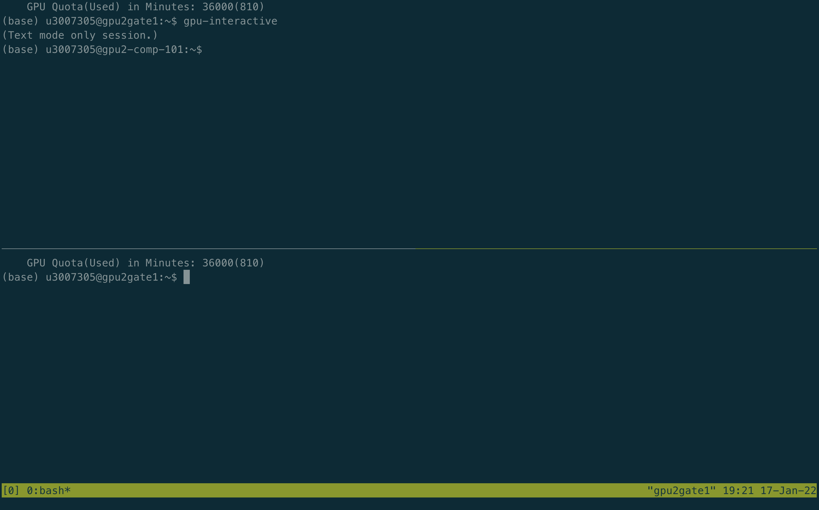
6
Using tmux for Unstable Network Connections
To avoid disconnection due to unstable Wifi or VPN, you may use the tmux command, which can keep a terminal session running even when disconnected, on gpugate1 or gpugate2.
Note that tmux should be run on gpugate1 or gpugate2. Do not run tmux on a GPU node after running gpu-interactive or srun.
After accessing the GPU farm with your username and password, input “tmux” for the first time; Next time you access the GPU farm, input “tmux at” and you will return to the previous terminal session.
10

Slide 11
7
Try python/PyTorch programs on GPU by yourself
Now you can apply for an account and install the software and environments, like PyTorch.
You can then try some examples and tutorials using PyTorch on GPUs.
Some Resources:
https://pytorch.org/get-started/locally/
https://pytorch.org/tutorials/beginner/pytorch_with_examples.html

